Slide 1
GAO Step 6: Obtain the Data
Smart Data Evaluation for Cost Analysis
CEAG Training Working Group
August 12, 2026

Slide 2
Objectives
Overview of GAO Step 6
Identify relevant cost data sources
Data collection plan template
Assess data quality and limitations
Decide what data is usable vs. risky
Document assumptions and data collection decisions
FY27 Training Working Group Efforts

Slide 3
What is included in GAO Step 6
Identify data sources
Collect technical, programmatic, schedule, and cost data
Normalize the data
Check relevance and comparability
Assess data reliability
Document assumptions

Slide 4
Data Quality Dimensions
Relevance
  Does the data match the system and/or the program?
Accuracy
  Is the data correct and verified?
Completeness
  Are important pieces missing?
Timeliness
  Is the data current enough?

Slide 5
Data Collection Plan
Items to consider prior to developing a Data Collection Plan
  Understand the full scope and needs of the estimate
  Understand the estimate structure and boundaries
  Understand the estimating technique
  Understand your data collection needs

Slide 6
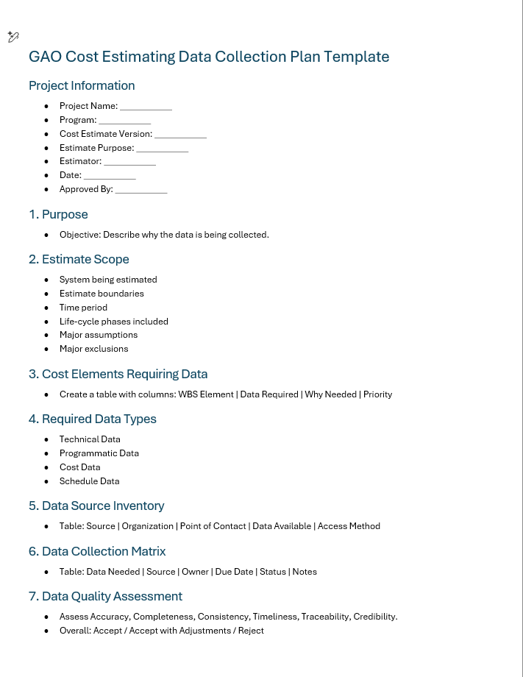
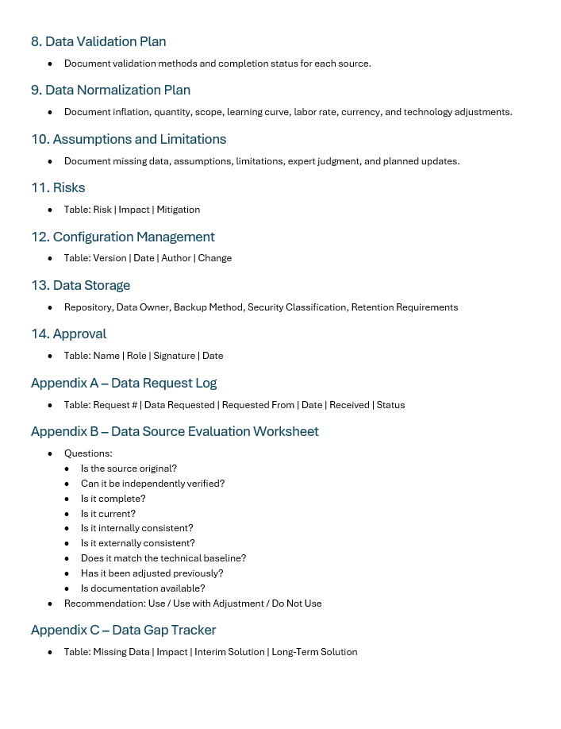
Data Collection Plan Template

Slide 7
Data Normalization – A Brief Overview
Collect historical data
Screen for quality and completeness
Remove non-comparable costs
Convert to common base year (inflation)
Adjust for quantity and production effects
Adjust for technical and performance differences
Validate results
Document all assumptions and normalization factors

Slide 8
Primary vs. Secondary Data Sources
Primary data are obtained from the original source, can usually be traced to an audited document, are considered the best in quality
Secondary data are derived rather than obtained directly from a primary source, can be lower in quality and hard to trace
Data Type | Primary | Secondary
Basic accounting records | ★
Data Collection input forms | ★
Cost reports | ★
Historical databases | ★ | ★
Interviews | ★ | ★
Program briefs | ★ | ★
Subject matter experts | ★ | ★
Technical databases | ★ | ★
Contractor estimates |  | ★
Cost proposals |  | ★
Cost studies |  | ★
Focus groups |  | ★
Research papers |  | ★
Surveys |  | ★

Slide 9
Infrastructure Data Sources-HQ
Data Source Maintainer
Data Source Description
Access
Capital Acquisitions Analytical Toolkit (CAAT)
Office of Enterprise Modeling and Policy (NA-MB-922)
The Capital Acquisitions Analytical Toolkit (CAAT) is a consolidated source of analytical tools and useable capital acquisition data. The CAAT contains PARS, FIMS, Budget Data, ad-hoc data calls, inflation indexes, and capital acquisition model outputs¹. Data updates vary depending on the source.
Application available
to anyone with PIV or Yubi-Key for those awaiting a clearance.
Project Assessment and Reporting System (PARS)
(Included in CAAT)
Office of Project Management (PM-30)
The Department of Energy’s (DOE) Project Assessment and Reporting System (PARS) is DOE’s Project Management Information System (PMIS). This system is used by contractors, Federal Project Directors, Program level oversight, and DOE headquarters independent project analysts². This data is updated monthly.
New users can request a PARS account here.
Facilities Information Management System (FIMS)
(Included in CAAT)
Office of Asset Management (MA-50)
FIMS is DOE's corporate real property database. Real property includes land, and anything permanently affixed to it, such as buildings, fences, bridges, etc. Building fixtures and equipment installed in a building permanently are categorized as real property³. This data is generally updated annually.
Request a FIMS account by Emailing the FIMS helpdesk admins here.
Construction Project Data Sheets (CPDS) Budget Data
(Included in CAAT)
Office of Corporate Budgeting and Performance Integration (NA-MB-55)
Projects over the Minor Construction Threshold must request funds by completing a Construction Project Data Sheet (CPDS). CPDS data collection is an annual, joint effort between NA-MB-55 and NA-MB-80 from the programs as part of the PPBE process⁴.
Raw Historic Presidential Budget Requests are here. Download data into a useable format from CAAT.
Data Calls from Sites
(Partially included in CAAT)
Management and Operating Partners (M&Os) and Program Offices
Individual and ad-hoc data calls between analysts and the seven M&O partners that execute NNSA's missions across eight sites. This data is collected as needed and stored in various locations on the O' drive or an organizational SharePoint⁵.
Download data into a useable format from CAAT.
Programmatic Recapitalization Working Group (PRWG)
(Not included in CAAT)
Office of Enterprise Modeling and Policy (NA-MB-922)
The Programmatic Recapitalization Working Group (PRWG) collects programmatic equipment data above the capital acquisition threshold of $500,000. This data is collected annually via a data call from the sites⁶.
Request access by emailing the PRWG distro list at PRWG@nnsa.doe.gov

Slide 10
Infrastructure Data Sources-HQ
Data Source Maintainer
Data Source Description
Access
G2 Program Management Information System
(Not included in CAAT)
Office of Infrastructure
(NA-90)
G2 integrates scope, schedule, budget, and metric information, creating a single repository of program data. M&O contractors use the G2 system to upload crosswalks of financial data for those program offices’ work breakdown structures⁷. This process allows M&O contractors to report detailed financial data to the program offices monthly.
New users can request a G2 account here.
BUILDER Sustainment Management System (SMS)
(Not included in CAAT)
Office of Infrastructure
(NA-90)
The BUILDER Sustainment Management System (SMS) is a web-based software application that helps DOE/NNSA proactively respond to emerging infrastructure needs by recommending building component repairs and replacements at the most reasonable time, thus ensuring the greatest return on investment⁸.
New users can request BUILDER access here.
Standard Accounting and Reporting System (STARS)
(Not included in CAAT)
Office of Corporate Business Systems (CF-40)
STARS is DOE’s official accounting and reporting system that produces information for DOE’s annual financial statements¹⁰. STARS is generally appropriate for external stakeholders, but lacks the granularity required for many stakeholders. CostEx was developed to meet the need for additional granularity.
A guide for STARS access is available here.
Cost Execution (CostEx)
(Not included in CAAT)
Office of Business Systems and Integration
(NA-MB-1.4 and CF-40)
Cost Execution, or CostEx, is a data source containing expended or costed dollars hours by cost element and work breakdown structure⁹. CostEx data is collected on the 7th of every month. CostEx should reconcile to match STARS values. If submitted values do not reconcile with STARS, the data file will be rejected.
A guide for CostEx access is available here.

Slide 11
Data Source Challenge
Task: Estimate the cost of a new facility that supports the development and production of the Drone Program Beta
Analogous Drone Program Alpha
2006 Budgetary accounting cost report data for the design, production, and operations and sustainment of the drone program
Contractor Estimate
Rough order of Magnitude cost study for the design and construction of a new facility
Commercial Drone Manufacturing Building
Earned Value Data for a nonmilitary manufacturing building complete in 2022
Facility Blueprints
Process Equipment Acquisition Data
Contractor Labor Rates
Technical facility blueprints for manufacturing facilities at
Public Industry OEM database for manufacturing equipment
Forward Pricing Rate Agreement inclusive of direct and overhead burden multipliers
Engineering SME Estimate
Engineering SME estimate with a bill of materials, and projected LOE requirements
Primary
Secondary
Primary
Primary
Primary
Primary
Secondary
Which data would you use?

Slide 12
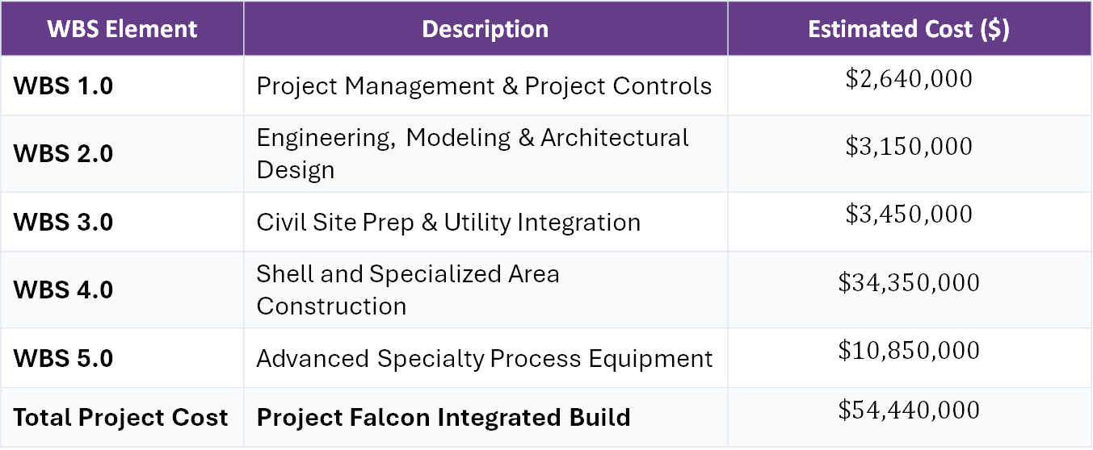
Contractor Proposal- Bad Data
Contractor Falcon submits a proposal for the cost of a new facility with the data below
WBS Element | Description | Estimated Cost ($)
WBS 1.0 | Project Management & Project Controls | $$\$2,640,000$$
WBS 2.0 | Engineering, Modeling & Architectural Design | $$\$3,150,000$$
WBS 3.0 | Civil Site Prep & Utility Integration | $$\$3,450,000$$
WBS 4.0 | Shell and Specialized Area Construction | $$\$34,350,000$$
WBS 5.0 | Advanced Specialty Process Equipment | $$\$10,850,000$$
Total Project Cost | Project Falcon Integrated Build | $$\$54,440,000$$
Technical baseline scope description
Source data classification
Basis of Estimate
Year of Estimate
What errors can you identify?

Slide 13
Contractor Bid Proposal-Good Data
Bidder: Systems & Construction LLC
Project: Program Beta
Base Pricing Structure: Firm-Fixed-Price (FFP) with Time & Materials (T&M) labor rates
Bid Date: June 2022
WBS | Description | Material Cost ($) | Labor Hours | Burdened Hourly Rate ($/hr) | Proposed Labor Cost ($) | Total Element Cost ($) | Contractor's Stated Basis of Estimate (BOE)
1.1.1 | Management and Support | $0.00 | 1,440 hrs | $185 | $266,400 | $266,400 | "Standard historic program allocation." Computed as a flat 10% of estimated construction labor hours.
1.1.2 | Design and Non-Recurring Engineering | $25,000(CAD Licenses) | 3,200 hrs | $145 | $464,000 | $489,000 | "SME judgement based on similar hangar builds." Assumes zero structural design rework.
1.1.3 | Site Work | $450,000(Shoring & Fill) | 1,800 hrs | $95 | $171,000 | $621,000 | "Excavating contractor verbal quote." Assumes standard commercial soil compaction with no rock removal required.
1.1.4 | Vertical Construction | $1,850,000 (Steel & Concrete) | 12,500 hrs | $88 | $1,100,000 | $2,950,000 | "Standard industrial hangar building template." Labor hours calculated using general national average parameters.
1.1.5 | Standard Equipment & Utilities | $820,000 (HVAC & Substation) | 1,200 hrs | $112 | $134,400 | $954,400 | "Standard high-efficiency building spec." Direct catalog pricing from 2024 regional distributor pamphlet.
1.1.6 | Process Equipment & Instrumentation | $1,250,000 (Telemetry & Rails) | 800 hrs | $135 | $108,000 | $1,358,000 | "Supplier baseline list." Labor hours estimate covers mechanical baseline installation only.
1.1.7 | Transition and Turnover to Operations | $15,000 (Permit Fees) | 400 hrs | $120 | $48,000 | $63,000 | "Engineering team final walk-through checklist." Assumes single-pass building commissioning.
Total Bid | Facility Design-Build | $4,410,000 | 21,340 hrs | $107 (Weighted Avg) | $2,291,800 | $6,701,800 | Audited Contractor Proposal

Slide 14
Equipment Data
ID | Equipment Name | Manufacturer | Model Number | Serial Number | Purchase Date | Purchase Price
EQ04 | Horizontal Boring Machine | Doosan | DBC130 | BORER004 | 9/5/2018 | $350,000
EQ014 | Surface Grinder | Okamoto | ACC-12.18DX | GRIND014 | 6/10/2018 | $150,000
EQ019 | CNC Lathe | Mazak | QUICK TURN 250MS | LATHE019 | 7/1/2017 | $200,000
EQ024 | Vertical Milling Machine | Bridgeport | Series I | MILL024 | 3/1/2010 | $20,000
EQ032 | CNC Turning Center | Okuma | LB3000 EX II | TURN032 | 8/1/2018 | $220,000
What errors can you identify?
Inconsistent cost formats (no inflation/escalation normalization)
Missing “fully burdened” and lifecycle integration costs
Lack of data reliability and source assessment
No technical drivers or sizing metric
ID | Equipment | Historical Price & Date | Primary Source/Reliability | Scaling Metric (HP/Weight) | Escalation Factor | Normalized Cost (Constant 2026 $) | Installation & Integration Cost
EQ04 | Horizontal Boring Machine | $350,000 (9/5/2018) | ERP Invoice (High) | 130mm Spindle | 1.34 (Machinery Index) | $469,000 | $45,000 (rigging, electrical

Slide 15
"Good Data vs. Bad Data"
Site Work/Construction
  Bad data in soil reports and importance of due diligence
  Geotechnical reports assess subsurface conditions, providing essential data for safe and effective construction and engineering projects.
  Importance of Geotechnical Reports
  Neglecting geotechnical reports can lead to significant issues, including structural failures, costly delays, and safety hazards. By prioritizing thorough geotechnical investigations, contractors and engineers can ensure project success, stability, and compliance with regulations These reports serve as crucial risk management tools, helping to identify potential hazards and providing legal protection for stakeholders by demonstrating due diligence in site investigation
  In summary, geotechnical reports are essential for understanding site conditions and ensuring that construction projects are designed and executed safely and effectively.
  Key takeaway
  While there is no fixed percentage, geological conditions are a frequent and significant cause of construction claims, especially in large, complex, or site‑specific projects. They are consistently ranked among the top risk categories in engineering and construction risk management, and can be a primary driver of cost overruns and disputes when not properly anticipated through thorough site investigations and clear contractual provisions

Slide 16
How to Fix and Prevent Failures
Comprehensive Desk Study – Review historic maps, geological surveys, and environmental data before fieldwork
Thorough Site Investigation – Use drilling, sampling, and geophysical methods to capture representative subsurface conditions
Detailed Geotechnical Reports – Include soil testing, rock mechanics, hydrogeology, and hazard assessments to guide design
Advanced Modeling and Monitoring – Apply numerical simulations for slope stability, dam safety, and mine design; use sensors and monitoring systems to detect early signs of instability.
Regulatory Compliance and Risk Assessment – Follow site-specific and industry standards, and integrate risk assessments into design and construction phases
Training and Oversight – Ensure geotechnical engineers and contractors are trained in best practices and that oversight bodies review reports and designs
In summary: Fixing geological investigation failures starts with rigorous planning, accurate data collection, and robust reporting. Integrating historical context, advanced analysis, and continuous monitoring can prevent costly and dangerous mistakes in the future

Slide 17
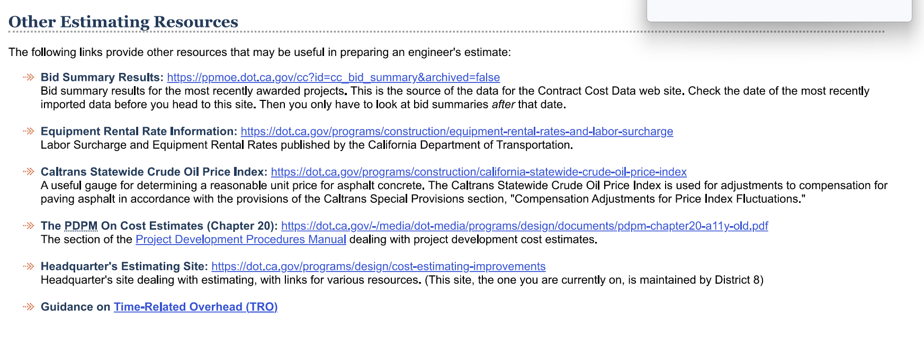
Industry Data Sources
Terry add in the site work specific industry sources here

Slide 18
State Sources
Contract Services | Nevada Department of Transportation
Texas Department of Transportation
https://www.dot.nm.gov/

Slide 19
Weapons Data Source
SCORE, DITS,PREDICT, Site Data, VEGA

Slide 20
Wrap-Up Discussion
A few questions to discuss with the audience
  What is the most dangerous data source?
  What are the most common mistakes you've seen in Step 6?
  What should be documented?

Slide 21
FY27 Training Working Group Efforts
Scope, Complexity, Options, Risks, Excursions (SCORE) training development for LPS use.
Overview training slides of the GAO 12 Steps

Slide 22
Questions?
Questions?

