Slide 1





AMO Strategic Analysis
Sustainable Manufacturing: Opportunities, Trends, and Technoeconomic Analysis
U.S. DOE Advanced Manufacturing Office FY2020 Program Review Virtual Meeting
This presentation does not contain any proprietary, confidential, or otherwise restricted information.

Slide 2
Current AMO Strategic Analysis Activities
Manufacturing Water Use/Resiliency
How can a better understanding of manufacturing water use characteristics and risks support water resiliency?
Manufacturing in a Connected Economy
How will the penetration of information and communication technologies (e.g., “smart” products, Internet-of-Things) affect advanced manufacturing R&D opportunities?
Performance Assessment/ Verification & Validation of R&D Projects
How can AMO effectively assess/communicate the progress and contribution of currently funded projects to focus technology areas and ultimately to strategic goals and success indicators?
Manufacturing /Energy/Grid Interface
What are the opportunities for greater combined heat and power (CHP) integration, potential, and impact at the manufacturing plant level?
Sustainable Manufacturing
What are the opportunities and impact of advanced manufacturing technologies on energy productivity, competitiveness, and moving towards a circular economy?
Credible data and analysis to inform current and future AMO priorities

Slide 3
Overview
The multi-laboratory (Argonne National Laboratory, Lawrence Berkeley National Laboratory, National Renewable Energy Laboratory, and Oak Ridge National Laboratory) AMO Strategic Analysis (StA) Team provides independent, objective, and credible analysis and information to inform decision-making in the manufacturing sector.
The StA team is submitting this presentation in lieu of posters for this year’s Program Review
This poster, “Sustainable Manufacturing: Opportunities, Trends, and Technoeconomic Analysis” includes information on seven projects
  Plastics Case Study – evaluating the impacts of implementation of next generation plastics recycling processes (NREL)
  Li-ion Battery (LIB) Recycling Case Study – What are the circularity implications of innovations in EV LIB lifecycles? (NREL)
  U.S. Food Supply Chain Waste Analysis (ORNL)
  Battery Rare Earth Element (REE) Recycling (ANL)
  Electrification of Cement Industry – Case Study (ORNL)
  Energy-Materials-Emissions Trade-offs in Sustainable Manufacturing Technologies – Quadrant Analysis (ANL)
  Wedge analysis framework and model (Emerging Futures, LBNL)
  Agent Based Model for implementing a Circular Economy for Photovoltaics (NREL)

Slide 4
Sustainable Manufacturing Project Objectives
Sustainable manufacturing encompasses a wide range of systems issues (e.g., energy intensity, carbon intensity, and use intensity)
Manufacturing systems have traditionally been designed based on a linear model, starting with raw materials extracted from nature and ending at disposal in a landfill at the end of the product’s useful life.
A circular economy (represented by the figure to the right) redirects this approach by providing opportunities to re-manufacture and reuse end-of-life consumer products, leading to more efficient use of materials.
Analyzing the supply chain and material flows through a product’s entire lifecycle can help to identify energy, material, and water savings opportunities throughout the greater U.S. economy, including the production and delivery of energy and energy use within the industrial, transportation, and buildings sectors.
The team’s past and current activities for sustainable manufacturing target reducing energy and material use in manufacturing and developing baseline knowledge
A key in doing so is addressing the challenge of how to evaluate different strategies’ potential by developing general evaluation approaches and establishing a baseline to use a reference point.

Slide 5
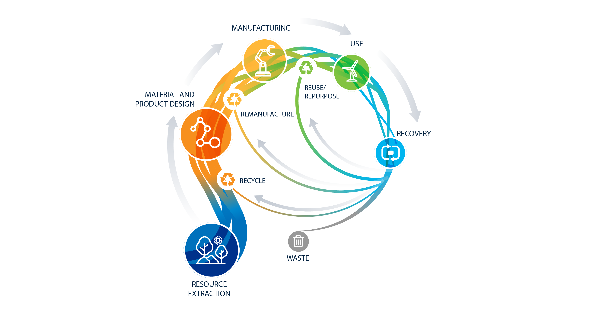
Decarbonization/Energy Efficiency Value
US Food Supply Chain Waste Analysis
Electrification of the Cement Industry
Past and current activities for sustainable manufacturing target reducing energy and material use in the manufacturing sector and developing the baseline knowledge
Supply Chain Analysis-Upcycling Recycled PET
Wedge Analysis Framework and Model and Quadrant Analysis
Battery Rare Earth Element Recycling
Agent Based Model for implementing a Circular Economy for PV
Li-ion Battery (LIB) Recycling

Slide 6
Plastics Case Study –
Evaluating the impacts
of implementation
of next generation
plastics recycling processes
Scott Nicholson, Arpit Bhatt,
Colin McMillan, Alberta Carpenter, NREL

Slide 7

Plastics Case Study – Evaluating the Impacts of Implementation of Next Generation Plastics Recycling Processes
Goal: identify material, energy, and emissions impacts from plastic waste sorting/recycling/repurposing techs
Focus is on plastics generating
highest volumes of waste:
  Polyethylene (PE)
  Polypropylene (PP)
  Polyethylene Terephthalate (PET)
  Polyvinyl Chloride (PVC) and others
Approach:
  Identify major plastics’ contribution to municipal waste streams (magnitude)
  Conduct literature review of
  potential technology solutions
  Estimate hypothetical technology
  adoption trajectories (timeframe)
  Wedge analysis to estimate combined impacts for multiple technologies (magnitudes + timeframes)
Applicable to recently-unveiled and AMO/BETO jointly-funded
BOTTLE Consortium
Plastic | Tech Group | Technology Description
PE, PP, PE | Separation for Recycling | Magnetic density separation (MDS), hyperspectral imaging (HSI)
PVC, PBS |  | Floatation with advanced oxidation by S2O82−/Fe2+
 |  | Floatation with advanced oxidation by S2O82−/Fe2+
Composite (CFRP) |  | Decomposition of an amine-cured epoxy resin
 |  | Decomposition of an amine-cured epoxy resin
ABS, PS |  | Boiling treatment
 |  | Boiling treatment
PET |  | Separating cotton / polyester blends via solvent dissolution
 |  | Separating cotton / polyester blends via solvent dissolution
PVC | Chemical Recycling | Dissolution-precipitation
 |  | Solvent-based polylactic acid recycling
PLA |  | Solvent-based polylactic acid recycling
 |  | Upcycling PET into glass fiber reinforced plastic (GFRP)
PET |  | Upcycling PET into glass fiber reinforced plastic (GFRP)
 |  | Alcoholysis, Hydrolysis, Aminolysis, Ammonolysis, Glycolysis
PET |  | Alcoholysis, Hydrolysis, Aminolysis, Ammonolysis, Glycolysis
PET | Incorporation into Construction Material | Use in road pavement
PET |  | Use in concrete/cement
Q1
Q2
Q2
Q3

Slide 8
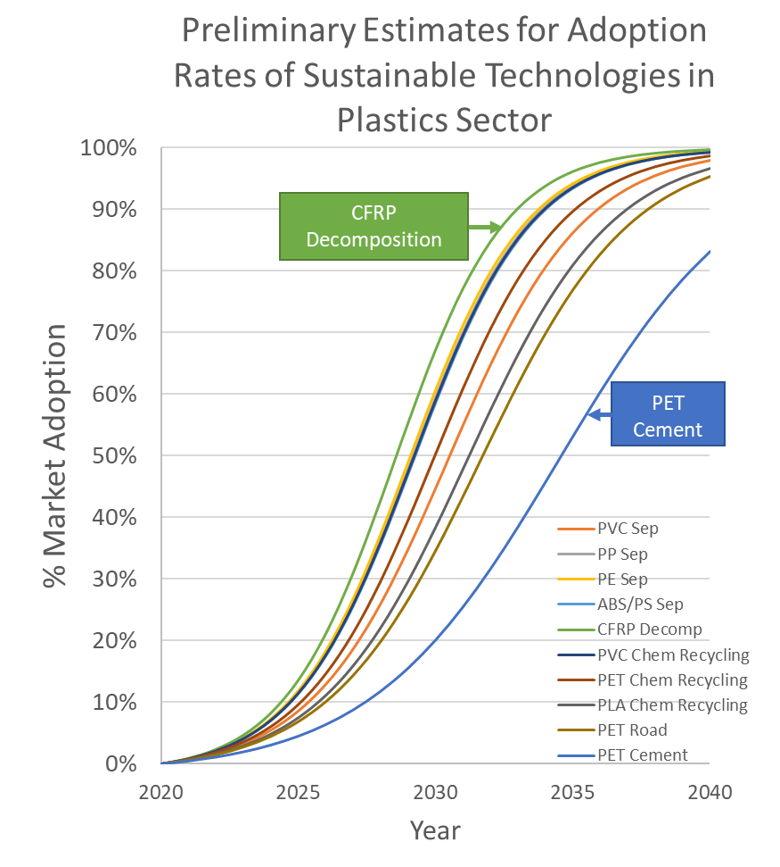
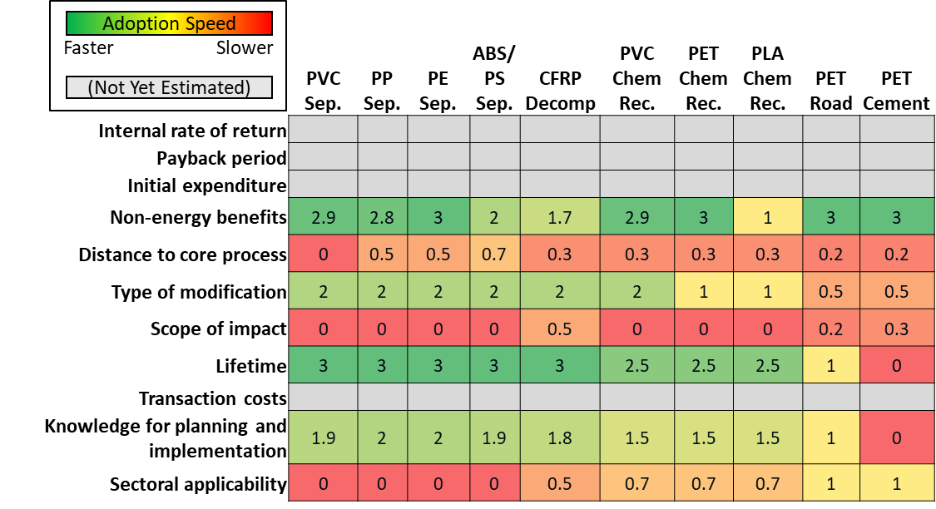
Plastics Case Study: Technology Adoption Analysis –
Applying Temporal Aspect to Wedge Analysis
Following Hanes et al. (2019) Quantifying adoption rates and energy savings over time for advanced energy-efficient manufacturing technologies J.Clean. Prod. (2019) [AMO-funded]
Use Bass diffusion curves to estimate the rate of technology adoption by assigning scores for each tech across 11 metrics
Next steps: Sensitivity analysis and estimation of economic parameters; combine these curves with magnitude estimates to complete wedge analysis

Slide 9
Li-ion Battery Recycling
Case Study
What are the circularity
implications of innovations
in EV LIB batteries?
Darlene Steward, NREL

Slide 10
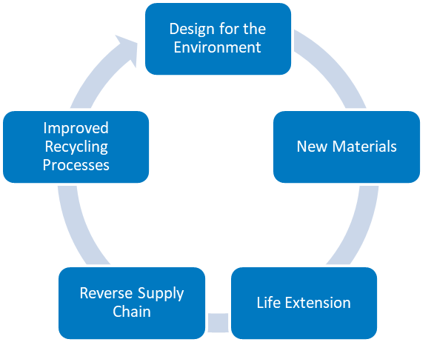
Li-ion Battery (LIB) Recycling Case Study – What are the circularity implications of innovations in EV LIB batteries?
Background:
The market for Electric Vehicle (EV) lithium ion batteries (LIB) is likely to continue its current upward trend for the foreseeable future. The rapid increase in demand coupled with supply chain bottlenecks has created a business opportunity for recycling of end-of-life (EOL) LIBs. Recovered high-value materials would have a ready market in battery manufacturers eager to reduce costs and supply chain uncertainty. However, the rapid evolution of the LIB market also poses threats to recyclers. Rapid turnover in technology leading to changes in material demand for battery manufacturing, and uncertainty in recycling profitability could hamper recycling of EV EOL LiBs. Analysis is needed to identify challenges, quantify their impact to the extent possible, and develop strategies for overcoming the barriers that EV battery recyclers are likely to face.
Objective
Evaluate the circularity impacts of changes in the Li-ion battery lifecycle from design for the environment to improved recycling processes
Scope
2020 – 2050 timeframe
EV batteries only
U.S. EV market
U.S. Recycling costs (labor etc.)
Methodology
Scenario approach analyzes the impact of innovations in EV battery design, reverse supply chain, and recycling processes
Two simple models; 1. Supply chain material flows, and 2. LIB recycling process material and energy balance model using cost inputs from the Argonne National Laboratory’s EverBatt model (https://www.anl.gov/egs/everbatt).
Innovation scenarios will be compared to a baseline case

Slide 11
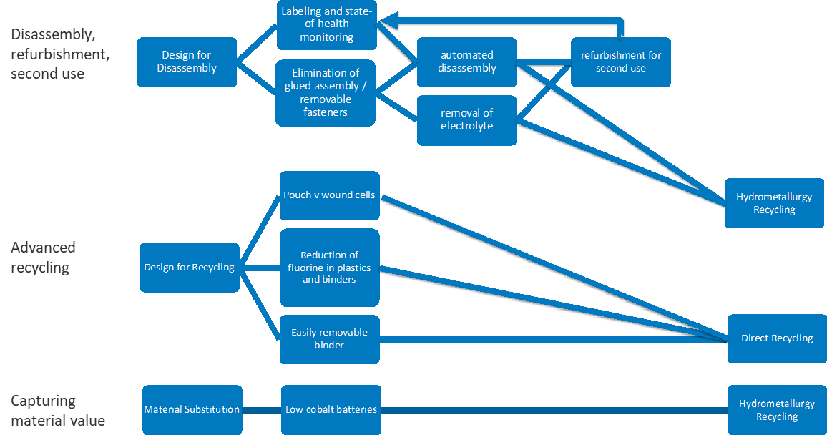
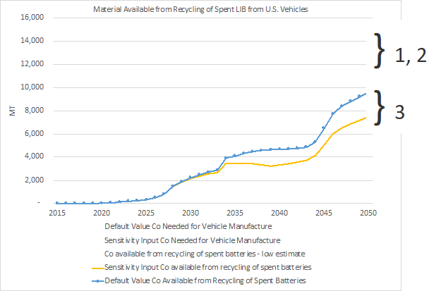
LIB Case Study: Progress - Literature review, scenario development, and data collection
Literature Review
Manufacturing material minimization and material substitution; Low-cobalt batteries and solid-state electrolytes
Battery in-use life extension and life-extension through second use
Reverse supply chain innovations
Innovations in recycling processes
Design for recycling
Scenarios
Next Steps
Total Material savings due to change in battery chemistry ←→ MFI modeling
Energy and emissions savings from circular economy strategies ←→ Wedge Analysis
Material recovery & costs for recycling processes. ←→ Circular Economy Analysis

Slide 12
U.S. Food Supply Chain
Waste Analysis
Wenquan Dong, University of Tennessee
Kristina Armstrong, Sachin Nimbalkar,
and Wei Guo, ORNL

Slide 13
U.S. Food Supply Chain Waste Analysis
Motivation, Goals & Previous Work
On-Farm
Manufacturing & Packaging
Distribution
Wholesale & Retail
Consumer
Food Services
Household
On-Farm Waste
M&P Waste
Distribution Waste
Wholesale & Retail Waste
Consumer Waste
Not Harvested
Unsold
Motivation and Goals
Previous Work – FY19
U.S. Food Related energy use
  Agriculture ~ 1.3 quads
  Food Manufacturing ~ 1.3 quads
  Home (fridge, stove, microwave) ~ 1.4 quads
  Commercial (W&R + Food Services) ~ 1.2 quads
Quantify food mass flow along the whole FSC
Identify technologies and practices to reduce food loss and waste and CO₂ emissions in different stages in food supply chain
Began initial FSC analysis
Yogurt Manufacturing Case Study
Methodology
Mass Flow Analysis using major food data resources
  U.S. Department of Agriculture (USDA)
    ERS- Food Availability databases
    ERS- Loss Adjusted Food Availability (LAFA)
    NASS - Agricultural statistic reports
  UN Food and Agriculture Organization (FAO)- FAOSTAT Trade data
Notes:
AMO is investigating the U.S. Food Supply Chain waste as part of its overall decarbonization efforts.
The U.S. Food Supply Chain, Food Loss and Waste, and Decarbonization efforts of FY20 build upon those from FY19. The initial Food Supply chain mass flow analysis and a yogurt manufacturing case study was completed.
For this work, the USDA and FAO data was heavily utilized
Energy use
Ag & Ind: https://www.eia.gov/energyexplained/use-of-energy/industry.php
Home: 2015 RECS, Home electricity use for refrigerators, cooking (stoves) and microwave X 3, convert to mmbtu + NG & Propane use for cooking
Commercial: 2012 CBECS, cooking + refrigeration

Slide 14
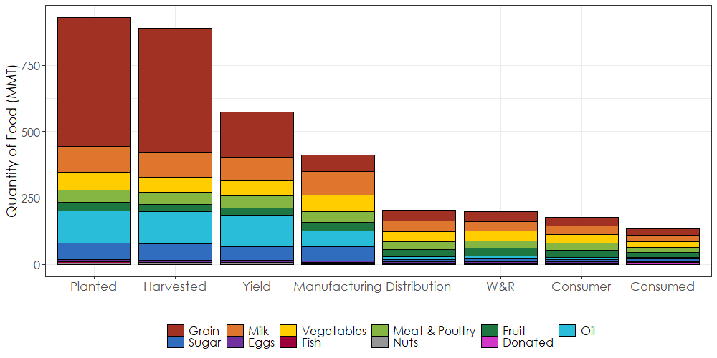
The FSC and Food Loss & Waste (FLW)
Labor Shortages, No/low Mkt
All Stages
Inaccurate forecasting
Transport Damage
Poor Storage (Spoiling)
Next Stage Rejection
Ind. Use
Animal Feed
Grade Stds.
Over serving
Over purchasing
Over preparing
Safety Concerns
Trimming
Confusing “Sell-by” Dates
Trimming,
Inedible,
Safety/QC,
Damage,
Evaporation
Overstocked
Oversaturated
Confusing “Sell-by” Dates
Spoilage
(Delays, Centralized)
Sources: USDA Agricultural Statistic; https://www.seafoodhealthfacts.org/seafood-choices/overview-us-seafood-supply; NRDC; FAO; Caldeira et al; Gunders & Bloom; U.S Grain Council and USDA; FAOSTAT and USDA; USDA LAFA
Details available in upcoming ORNL Report
Notes:
Food is removed from the FSC (lost) or wasted in various ways in each stage. On the farm, a lack of labor or market can cause farmers to not even harvest. Food not meant for human consumption is removed, and food is not sold to processors due to not meeting standards, damage, spoilage or just poor supply/demand forecasting.
In Manufacturing, food is lost because it is inedible (bones), trimming, safety or quality control, damage and just water evaporation.
In distribution and warehouse and retail, food may spoil (or thought to have spoiled because of confusing labeling), been damaged in transport or just, again, poorly forecasted.
At home and in food services, over serving and over portioning are big culprits.

Slide 15
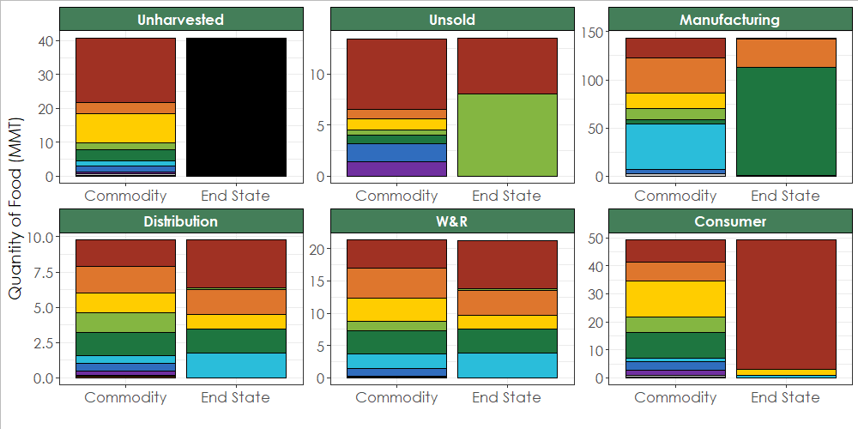
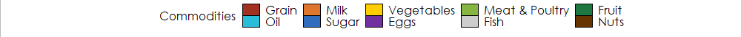
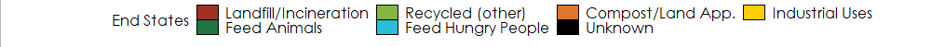
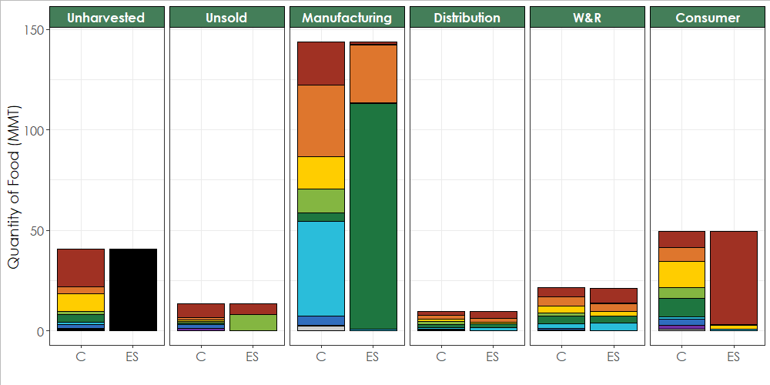
Is FLW waste? FLW Commodity Breakdown and End State
Do not know destination of Unharvested Waste
Manufacturing has highest FLW (143.6 MMT)
  Most becomes Animal Feed
  Actual Waste = 1.1 MMT
Consumer has 46.3 MMT waste (94%)
Sources: USDA Agricultural Statistic; https://www.seafoodhealthfacts.org/seafood-choices/overview-us-seafood-supply; NRDC; FAO; Caldeira et al; Gunders & Bloom; U.S Grain Council and USDA; FAOSTAT and USDA; USDA LAFA; https://dairygood.org/content/2015/did-you-know-milk-is-90-percent-water-plus-protein-and-so-much-more; https://www.chicagotribune.com/lifestyles/ct-xpm-2011-01-18-ct-tribu-daley-question-condensed-mil20110118-story.html
http://www.fao.org/3/a-au111e.pdf; https://ucanr.edu/sites/cottagefoods/files/209273.pdf;
Hartikainen, Mogensen, Svanes, & Franke; Food Waste Reduction Alliance
Details available in upcoming ORNL Report
Manufacturing, Wholesale & Retail, Food Services: Data from survey conducted by FWRA
Distribution: Assume it is the same as Retail
Household: Assume it is the same as Food Services
Alternate graph if you want to see relative sizes between stages
Notes:
But is it all “waste”? At home, most of the FLW goes to landfill, unambiguously wasted. At the manufacturing stage, a large portion is directly sent for animal feed or land application, so very little is truly wasted. The other stages are somewhere in between these two extremes.

Slide 16
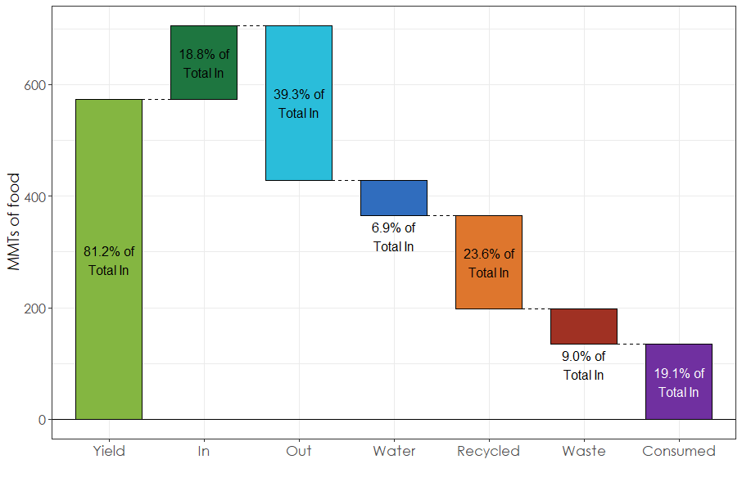
How much food is wasted and consumed?
Food entering U.S. Manufacturing
  9% is wasted
    (landfill/incineration)
  19.1% is consumed*
  23.6% is “recycled”
    Animal feed, industrial uses, land application/ composted
From planting…
  9.8% is wasted **
  16.7% is consumed
  15.7% is “recycled”
* Donated food is included in “consumed”
Yield: Harvested food intended for human consumption
In: Imports & Previous year’s stock
Out: Exports, remaining stock, food intended for industrial use or animal feed
** All unharvested food is considered “wasted”
Notes:
Overall, depending on where you start counting 9 – 9.8% of food is truly wasted (landfilled or incinerated), 17% - 19% is consumed, and 16% - 24% is “recycled” (animal feed, land application, composing, digestion)

Slide 17
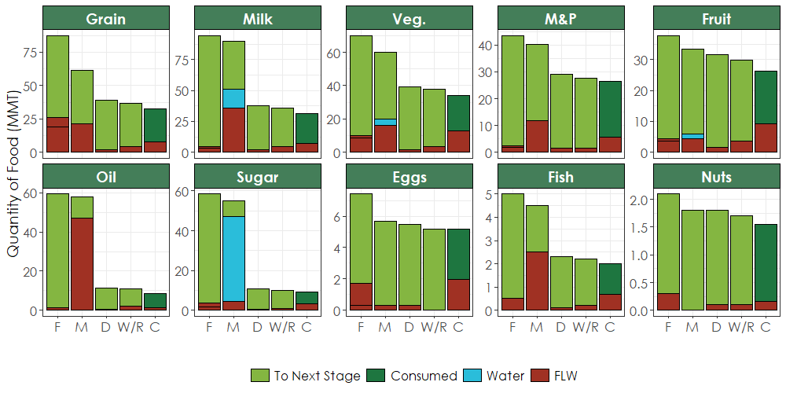
Commodities Loss & Waste
Grain has a lot of FLW at the Farm and during Manuf.
Milk has a lot of water & FLW during Manuf.
Most of the FLW for Fruit, Veg., Meat & Poultry is at Manuf. & Consumer
Oil has most FLW at Manuf.
Sugar has a lot of water removal during Manuf.
Sources: USDA Agricultural Statistic; https://www.seafoodhealthfacts.org/seafood-choices/overview-us-seafood-supply; NRDC; FAO; Caldeira et al; Gunders & Bloom; U.S Grain Council and USDA; FAOSTAT and USDA; USDA LAFA; https://dairygood.org/content/2015/did-you-know-milk-is-90-percent-water-plus-protein-and-so-much-more; https://www.chicagotribune.com/lifestyles/ct-xpm-2011-01-18-ct-tribu-daley-question-condensed-mil20110118-story.html
http://www.fao.org/3/a-au111e.pdf; https://ucanr.edu/sites/cottagefoods/files/209273.pdf
Details available in upcoming ORNL Report
Notes:
How much is lost or wasted depends on the commodity…

Slide 18
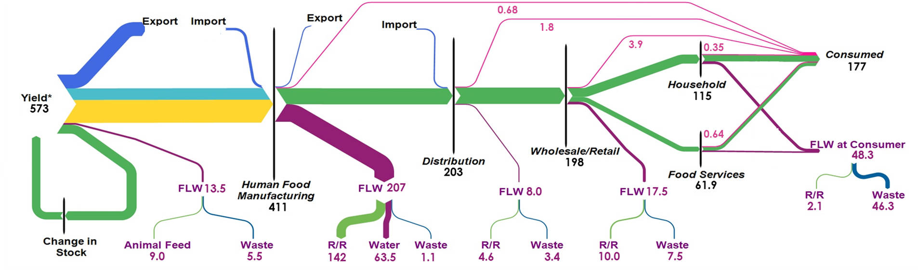
Technologies to Reduce Food Waste & CO₂ Emissions
Better matching production & demand
Low emission energy generation
Yield improvements
Changes to Grading Standards
Platform (online, real-time) for Food Donation/ Redistribution
Shelf-life Extension
Waste Tracking and Analyzing
Shopping Planning
Increase use of waste (‘Waste-to-Energy’ or as byproducts)
Better WWT technology
Increase precision (cutting/trimming)
Better handling
Increase safety/ decrease contamination
Changes to grading standards & systems
Advanced Packaging Technology/Practice
Non-thermal Processing
Pressure-driven Membrane Separation
Variable Speed Drives
Electrification + RE
CHP + WHR
Shelf-life extension
Supply chain & storage monitoring
Dynamic Pricing
Better matching supply & demand
Notes:
There are several technologies available to reduce food waste and CO2 emissions. Better matching or modeling supply and demand to production. Changing grading standards to allow more “marginal” food to be used for more processed commodities, improving manufacturing precision and handeling. There are also non-waste related decarbonization technologies such as VFDs, CHP, fuel switching and WHR. The first case study we will be looking at is advanced packaging technology and practices, with the aim of improving shelf-life, reduce breakage and reducing confusion.

Slide 19
Case Study: Impact of Better Packaging Technology/ Practices
Purpose of Packaging
Reasons for packaging-related FLW
Packaging FLW prevention
Protection
  From physical, chemical, biological changes
  Preservation
Containment
  Prevention of loss or pollution
  Enables storage, transport, distribution
Facilitate handling
  Easy to open/empty
  Unitization / apportionment
Communication
  Required info (nutrition, barcodes)
  Voluntary info (instructions, marketing)
At Household 10 – 25% reduction FLW:
  Too much food per package
  Confusing best/use-by label or spoilage
At Food Services 5% reduction FLW:
  Confusing best/use-by label or spoilage
At W&R Stage varies per commodity:
  Most FLW is due to actual/ assumed spoilage or packaging
    Passed best best/use-by date
    Damaged Product
    Damage Packing
Active Packaging technologies to interact directly with the perishable product/ its environment
In-package cold plasma to inactivate the foodborne pathogens
Edible coating technology directly on food
Package adjustments to ensure complete consumption and easy storage
Standardizing food labels dates and instruction
Intelligent or interactive packaging technology to monitor quality for logistics control
Notes:
There are several purposes for packaging…
However, these all cause FLW at later stages, due to confusion from the labels, food going bad before the box can be finished, or just insufficient protection.
Several technologies exist or are in development for reducing this type of waste.
2 = household, 3 – food services, 4 = W&R, the rest is for prevention
2. Williams, H., Wikström, F., Otterbring, T., Löfgren, M., & Gustafsson, A. (2012). Reasons for household food waste with special attention to packaging. Journal of cleaner production, 24, 141-148.
3. Verghese, K., Lewis, H., Lockrey, S., & Williams, H. (2013). The role of packaging in minimizing food waste in the supply chain of the future.
4. Lebersorger, S., & Schneider, F. (2014). Food loss rates at the food retail, influencing factors and reasons as a basis for waste prevention measures. Waste management, 34(11), 1911-1919.
5. Almenar, E. (2020). Innovations in packaging technologies for produce. In Controlled and Modified Atmospheres for Fresh and Fresh-Cut Produce (pp. 211-264). Academic Press.
6. Verghese, K., Lewis, H., Lockrey, S., & Williams, H. (2015). Packaging's role in minimizing food loss and waste across the supply chain. Packaging Technology and Science, 28(7), 603-620.
7. Verghese, K., Lewis, H., Lockrey, S., & Williams, H. (2013). The Role of Packaging in Minimising Food Waste in the Supply Chain of the Future: Final Report. RMIT University, Melbourne, available at: www. chep. com/foodwaste/(accessed March 10, 2019).
8. ReFED, A. Roadmap to Reduce US Food Waste by 20 Percent,(2016).
9. Müller, P., & Schmid, M. (2019). Intelligent packaging in the food sector: A brief overview. Foods, 8(1), 16.

Slide 20
Case Study: Impact of Better Packaging Technology/ Practices
Preliminary FLW Results
Preliminary CO₂ Results
 | FLW Reduction (MMT) |  | Demand Reduction (MMT)
Consumer | 8.89 | 18% | 8.89 | 5%
W&R | 20.7 | 97% | 29.6 | 15%
Distribution | 1.47 | 15% | 1.47 | 15%
Mfg. | 30.6 | 15% | 30.0 | 15%
On-Farm | 4.4 | 8% | 63.2 | 8%
Assuming these solutions can eliminate the FLW related to packaging & spoilage
FLW reduction at later stages also reduces demand and FLW at early stages
Initial Results - CO₂ avoidance
  If waste / demand reduction linearly relates to CO₂ reduction
  On-farm: 45.5 MMT CO₂ (out of 641 MMT CO₂)
  Distribution: 0.4 MMT CO₂ (1500 mi, 0.18 kgCO2/tonne-km)
  Landfill Disposal: 10.6 MMT CO2 (680 kg CO₂ / tonne waste)
Refinement of these results and other stages are in progress
  Need better value for solution efficacy (assumption of 100% is poor)
  Need more information about energy & GHG emissions in all stages
Notes:
Preliminary findings show if all of packaging related FLW can be prevented in the consumer, W&R and distribution stages, this “trickles up” for a total On-farm demand reduction of 8%, which could translate to up to 45.5 MMT CO2 per year reduction. This would also reduce CO2 emissions in other stages, distribution 0.4 MMT and end disposal in land fill 10.6 MMT. Other stages and refinement of these results is still a work in progress.
Of course, assuming that new technology and practices could reduce all the FLW in these stages, especially W&R where most of the waste is due to spoiling, is a poor assumption. These results are just a starting point
10. U.S. EPA. (2020). Inventory of U.S. Greenhouse Gas Emissions and Sinks: 1990-2018. Retrieved from https://www.epa.gov/sites/production/files/2020-04/documents/us-ghg-inventory-2020-main-text.pdf
11. Weber, C. L., & Matthews, H. S. (2008). Food-miles and the relative climate impacts of food choices in the United States.
12. Johns Hopkins. (n.d). Food System Primer. Retrieved from http://www.foodsystemprimer.org/food-distribution/
13. CEC. 2017. Characterization and Management of Food Loss and Waste in North America. Montreal,
Canada: Commission for Environmental Cooperation. 48 pp.

Slide 21
Future work
FY20
FY21 – potential ideas
Complete analysis of energy use and GHG emissions for each stage
Complete 2 more case studies on GHG reduction technology for the manufacturing sector of the U.S. FSC
Complete cases studies for technologies implemented in other sectors of U.S. FSC
Further investigate GHG reduction techniques and technologies beyond demand (FLW) reduction
  Electrification / Alternative Energy sources
    With/without RE
    CHP & WHR
  Distributed food supply network
    Current of interstate food flow and FLW by state
  GHG reduction potential
  SWOT analyses
Notes:
There is still much work to be completed this year and potentially new ideas for next year…

Slide 22
Battery
Rare Earth Element (REE)
Recycling
Nwike Iloeje, Kyle Sun, Alinson Santos Xavier,
Sarang Supekar, and Diane Graziano, ANL

Slide 23
Battery Rare Earth Element (REE) Recycling
Context: As emerging electronics and clean energy technologies drive up demand for rare earth elements (REEs), value recovery from recycling end-of-life products provides an option for securing critical battery materials, closing the material loop and conserving natural capital.
Challenge: The feasibility of securing REEs depend on the recovery technology, as well as the volumes and distribution of end-of-life batteries. Each of these factors also introduce associated energy, economic and environmental impacts.
Opportunity: Assessment tools that integrate techno-economic models of recycling technologies with robust reverse supply chain logistics modeling can provide a more realistic assessment of feasibility, secondary impacts and the effect of uncertain parameters.
Action: The Strategic Analysis team is developing frameworks and models that support robust analysis of the techno-economic economic viability of recycling for critical materials security under various projection scenarios.

Slide 24
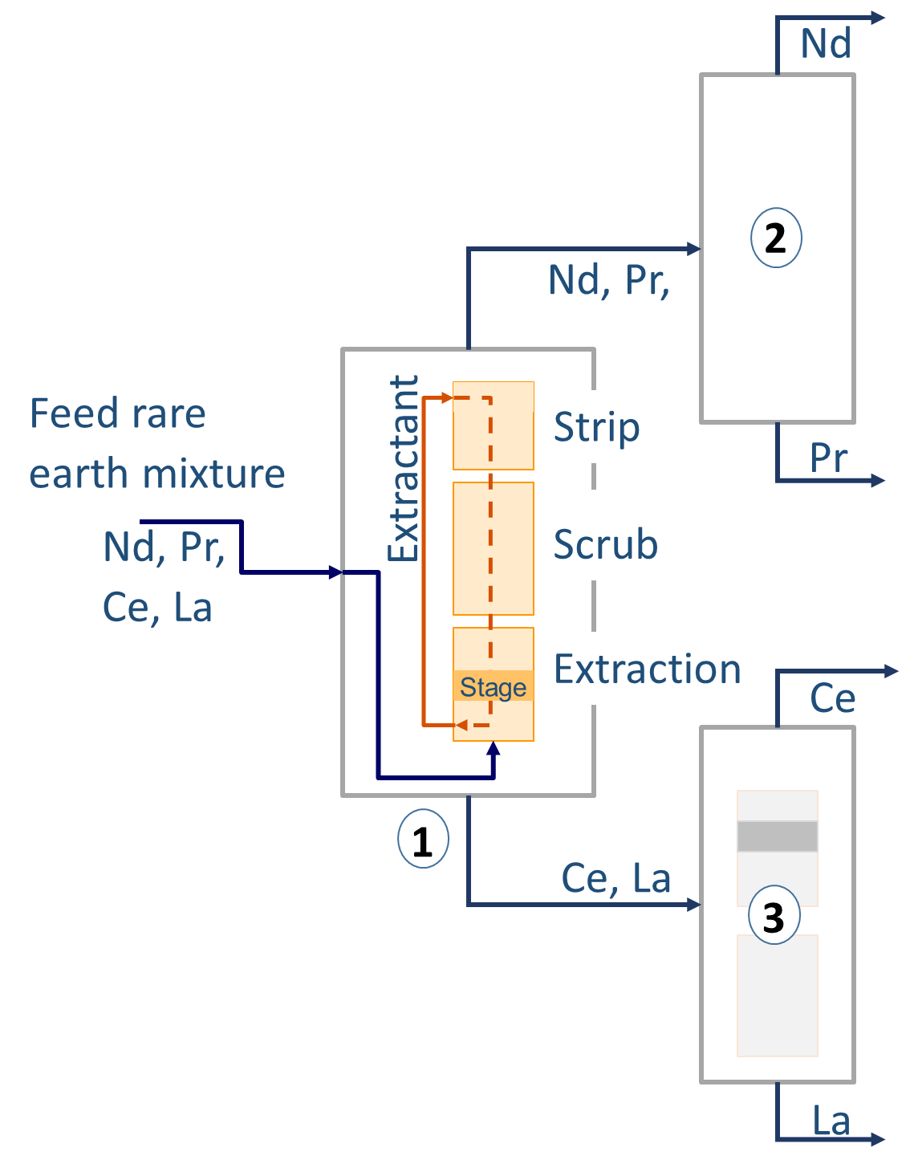
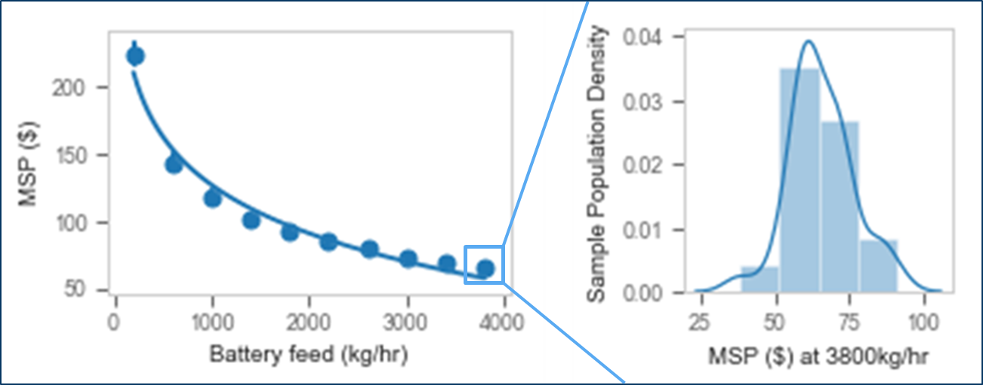
Battery Rare Earth Element (REE) Recycling – Facility Techno-Economics
NiMH battery
REE recovery
Integrated models effectively represent facility-level uncertainties and their propagated effects.
Disassembly
Scrap
Metals recovery
Scrap
Techno-economic viability of REE recycling depends on compositional and volumetric uncertainties associated with the feed input to the recovery process, their effect on recycling facility economics, and consequent environmental implications
Recovered metals
Didymium minimum sustainable price (MSP) for sample scenario

Slide 25
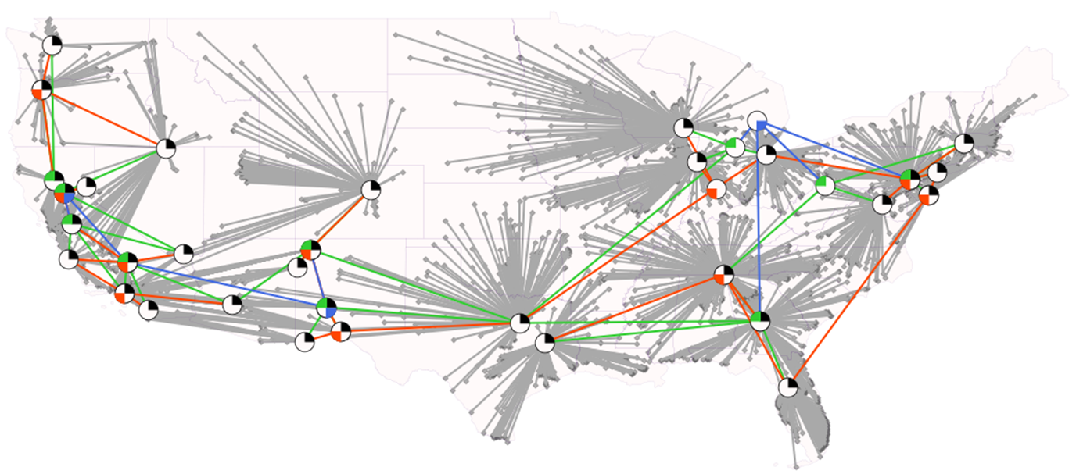
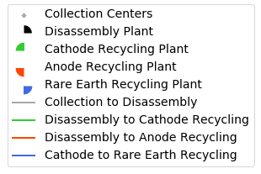
Battery Rare Earth Element (REE) Recycling – Supply Chain Optimization
Logistic decisions
What plants to build? Where? When?
What capacity should each plant have?
Which plants should serve what regions?
How are plants interconnected?
Should materials be disposed of?
Main features
User-defined reverse manufacturing pipeline
Multiple types of plants and materials
Multi-period optimization
Region-specific parameters and costs
Transportation costs
Implementation
Mixed-Integer Programming model
Implemented in Julia and JuMP
To be released as open source
Battery Rare Earth Element (REE) Recycling Network
Support Projections of Costs, Energy Use, and Emissions from Large-Scale NiMH Battery Recycling Infrastructure Scenarios in the U.S

Slide 26
Electrification of
Cement Industry –
Case Study
Kiran Thirumaran and Sachin Nimbalkar, ORNL
Sarang Supekar, ANL

Slide 27
Electrification of Cement Industry – Case Study
  Cement manufacturing is one the most energy and emissions intensive industries consuming 371 tBtu of energy and producing more than 25 million tons CO2 equivalent of combustion related emission onsite.
Scope
⎫
⎫
⎫
Included in On-Site Energy Analysis
Mining
Raw
Material
⎫
Included only in LCA model
⎦
Not considered
Goals
Determine the impact of electrification to energy use, material consumption and emissions in cement industry
Identify barriers to its implementation of electrotechnology and determine R&D requirements
⎫
Cement Manufacturing
Use
Phase
Mining
Fuel
⎫
⎦
End of Life
Recycle
⎫
⎦
⎫
Transport (Freight)
Fuel Transport
⎦
Electricity Generation
⎫
⎫
Solar, Wind
⎫
Renewable Equipment Manufacturing
Coal, Natural Gas
Analysis Outline
⎫
Baseline process model built from EIA and AMO Reports
Energy and process inputs cross-referenced with LCA database
Inputs and emissions for validated processes used to build LCA model
Material, Energy and Emission impacts scenario forecasts through 2050

Slide 28
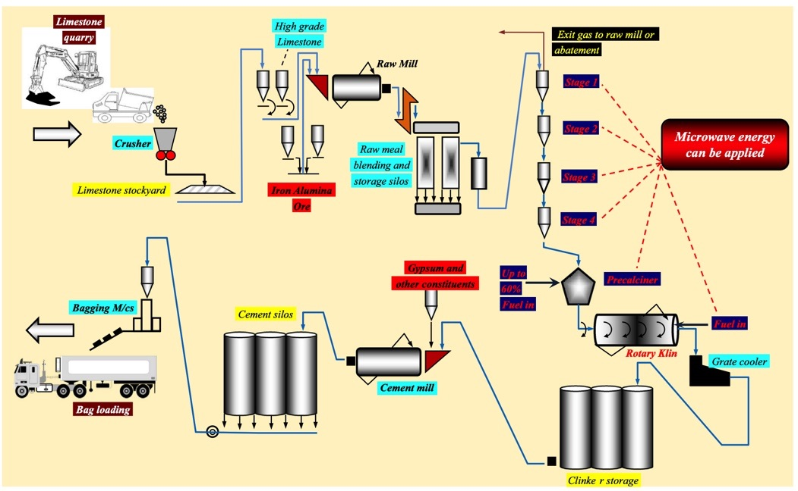
Electrification Pathway – Overview
The pyro-processing of clinker (sintering) is the most energy intensive process in cement manufacturing and it involves heating the raw material mix to over 2500 F.
Initial lab tests show that sintering of cement can occur at a lower temperature in a microwave environment.
A hybrid method proposed by Praphatsorn[1] of using 2.45 GHz MWs to sinter the material at 2100 F for 9 min followed 30 min in an electric furnace at 2400 F has shown promising results.
The figure provides an overview of a conventional cement manufacturing process. The flow of material and the areas for potential electrification is shown. (Makul [2])
The hybrid method was found to use 1,108 btu_electric/lb compared to 1,554 btu_fuel/lb consumed by current convention technology (Bandwidth studies). Note the primary energy will be higher for electric process.
1 Praphatsorn Kaewwichit et.al “Development of microwave-assisted sintering of Portland cement raw meal” Journal of Cleaner Production. June 2016.
2 Natt Makul et. al Applications of microwave energy in cement and concrete – A review. Renewable and Sustainable Energy Reviews. Sep 2014.

Slide 29
Building the Base Model - Methodology
Industry Projections
(2050)
Emissions Factors
Grid mix Projections
EIA Data
Impact on fossil Fuel
Transport
Mining and Processing
Emissions Impact
2020 to 2050
Bandwidth Analysis
Impact on Process Energy
Fuel Reduction
Incremental Electricity
Transport Energy
Research Publications
Impact on manufacturing process
Penetration Potential
Energy Impact
2020 to 2050
Onsite/
Offsite Material Consumption
Upstream Processes
Downstream Processes
Coal and NG for Fuel and Electricity - ET
Data Collection at Facilities
Cost Comparison Tool
Penetration Timeline
Material Impact
2020 to 2050
Vendor Interviews
Coal and NG for Electricity - BAU
Market Research
EIA Sector Data
Coal and NG for Fuel - BAU
BAU – Conventional technology (Business as usual case )
ET – Electrotechnology Case

Slide 30
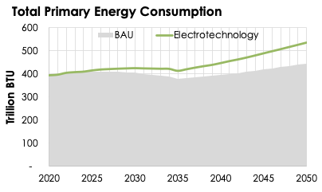
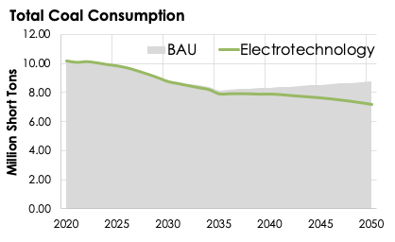
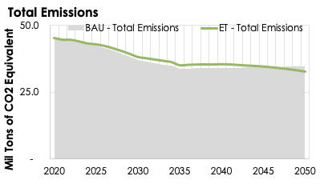
Initial Results from Baseline Process Model
The total primary energy consumed increased with the adoption of electrotechnology given the increased use of electricity.
Even with more primary energy used, the total coal consumption (and natural gas) is reduced indicating that more coal is reduced at the facility that what is added at electric generation.
A slight reduction in emissions is seen through 2050, higher technology adoption and a cleaner, decentralized grid will lead to this effect being magnified.
A linear adoption of 30% starting from 2025 is assumed for technology deployment.
Forecast done in AEO2020 is used to project the energy consumption in the Cement industry up to 2020.
The 80% RE grid mix model built by NREL is used for the projections for the grid.

Slide 31
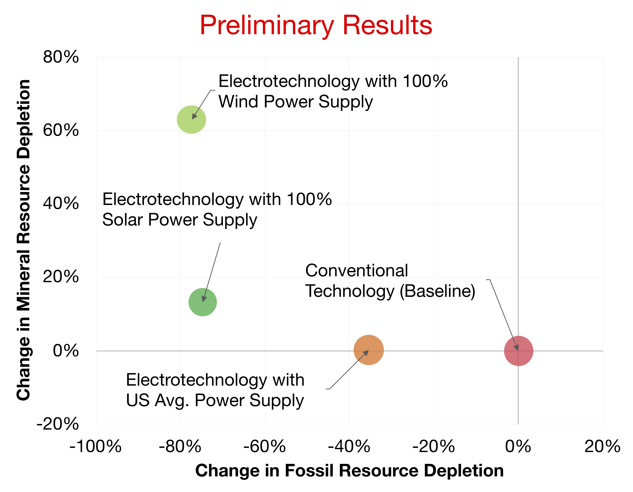
LCA Modeling and Initial Results
An LCA model was built using OpenLCA platform and the ECOINVENT database
The LCA model helps corroborate the base analysis and expands on it
  Impact on mining operation and the renewable energy infrastructure needs where not part of the base model.
The figure shows preliminary results for impact of cement electrotechnology on fossil resource depletion, mineral resource depletion, and GHG emissions.
It is seen that:
Electrification (irrespective of the grid considered) leads to a reduction in fossil resource depletion.
Electrification with greater than US average renewable power leads to a trade-off between reduced fossil depletion and increased mineral resource depletion from metals used in wind and solar power technologies.
Electrification does not significantly change the GHG intensity of cement since majority of GHG emissions are (non-energy) process emissions from calcination step.

Slide 32
Next Steps
Refine the model assumptions for technology adoption and other key model parameters based on inputs from industry.
Integrate technology-level results from the LCA into scenarios to forecast sector-wide impacts through 2050.
Conduct sensitivity analysis on identified parameters (grid mix, energy intensity etc.) to improve forecast accuracy.
Consider other pathways for electrification within the cement sector.
Future Work
Evaluate other decarbonization strategies (clicker substitution, fuel switching etc.) as potential pathways for emission reduction and perform similar impact analysis.
Include impacts of decarbonization pathways to components of the life cycle currently not considered such as raw material mining, product transportation and end of life recycling.
Use results from the analysis to inform work done by AMO to develop Deep Decarbonization Roadmaps.

Slide 33
Energy-Materials-Emissions
Trade-offs in Sustainable
Manufacturing Technologies
– Quadrant Analysis
Sarang Supekar, ANL

Slide 34
Sustainable Manufacturing and Circular Economy Technologies May Result in Environmental Trade-Offs
Trade-Off Analysis Will Focus on Material/Energy/GHG Impacts
Metrics based on LCA impact assessment methods
  Material Impacts: Abiotic Mineral Depletion Potential
  Energy Impacts: Abiotic Fossil Depletion Potential
  GHG Impacts: Global Warming Potential
Abiotic resource depletion (ADP) refers to the changes in natural stocks, flows, and funds of non-living natural resources (minerals, fossil fuels, nuclear fuels, land, water, …) resulting from anthropogenic activities.
Typically, depletion potential of a product/process/technology system for a resource is quantified as a ratio of extraction rate of the resource resulting from the system to the square of its total extractable stock (ultimate reserve).
Total ADP when dealing with multiple abiotic resources used in a system (such as different metals) is calculated by normalizing the ADP of each resource to the ADP of baseline mineral such as Fe or Sb (similar to how GWP is calculated for different GHGs in terms of kg CO2 eq).

Slide 35
Summary of resource depletion metrics in the impact assessment literature
We use the ILCD 2018 impact assessment methodology in our case studies since it differentiates between mineral and fossil abiotic resources
Methodology | Metric(s) | Source | Comments
CML 2001 | Abiotic Resource Depletion – Elements (kg Sb eq.) Abiotic Resource Depletion – Fossil (MJ, kg Sb eq.) | Institute of Environmental Sciences, Leiden University – Ref: Guinée, J. (Ed.). (2002). Handbook on Life Cycle Assessment: Operational Guide to the ISO Standards. Springer Netherlands. https://doi.org/10.1007/0-306-48055-7) | Most commonly-used characterization factors are based on ultimate extractable reserves Characterization Factors (CFs) updated in 2016 Schneider et al. (2015) proposed including anthropogenic stocks and losses in the depletion metric
ILCD | Resource Depletion – Mineral (kg Sb eq.) Resource Depletion – Fossil (MJ) | European Commission Joint Research Centre – Ref: EU JRC Institute for Environment and Sustainability. (2010, June 25). International Reference Life Cycle Data System (ILCD) Handbook—General guide for Life Cycle Assessment—Provisions and Action Steps. EU Science Hub - European Commission. https://ec.europa.eu/jrc/en/publication/eur-scientific-and-technical-research-reports/international-reference-life-cycle-data-system-ilcd-handbook-general-guide-life-cycle | CFs updated in 2018 Borrows methodology from Guinée (2002) Adds CFs for 16 rare earth metals (expressed as one generic REE), Ga, Mg, U MJ equivalents of kg fossil resources based on net calorific value
ReCiPe | Metal Depletion (kg Fe eq.) Fossil Depletion (kg Oil eq.) Water Depletion (m³) | Huijbregts, M. A. J., Steinmann, Z. J. N., Elshout, P. M. F., Stam, G., Verones, F., Vieira, M., Zijp, M., Hollander, A., & van Zelm, R. (2017). ReCiPe2016: A harmonised life cycle impact assessment method at midpoint and endpoint level. The International Journal of Life Cycle Assessment, 22(2), 138–147. https://doi.org/10/f9vc9s | CF based on additional costs society pays as a result of an extraction CFs updated in 2016

Slide 36
Analysis Would Help Identify Opportunities for Technology Improvements and Policy Interventions to Mitigate Trade-Offs
Other impacts such as ecotoxicity and material criticality that may be relevant to a given case study will be additionally discussed.
Examples of visualizations on which trade-off analysis and discussions in each case study will be developed

Slide 37
Wedge Analysis
Framework and Model
William Morrow, LBNL
Jeff GreenBlatt, Emerging Futures, LLC

Slide 38

Wedge Analysis Framework and Model
Context: In 2004, Pacala and Socolow introduced the world to “wedges”—a conceptual framework for quantitatively describing activities resulting in reductions in global CO₂ emissions relative to a reference trajectory. It has since been used in many different geographic, sector and metric contexts.
Challenge: To develop a versatile and useful framework to describe changes in material flows associated with industrial-sector economic activities, often in combination with changes in energy consumption, financial flows, greenhouse gas emissions or other metrics of interest.
Opportunity: Adapt the Pacala/Socolow wedge framework to this broader context by understanding its underlying principles and develop model(s) to facilitate quantitative estimates of changes in industrial activities.
Action: The Strategic Analysis team has developed both a framework and model that support robust quantitative analysis under a wide variety of user-specified scenarios for the U.S. manufacturing sector, leveraging several databases provided by federal agencies (DOE and EPA).

Slide 39
Circular Economy Wedge Analysis: Background
In a 2004, Socolow and Pacala introduced the wedge approach to reach a broader non0scientific audience by summarizing the complexity of greenhouse gas (GHG) emission reductions and communicating mitigation solutions through easily understood “stabilization wedges.”
Since 2004, the wedge approach has been used to communicate GHG mitigation wedges for California.
Greenblatt, J. B. (2015). "Modeling California policy impacts on greenhouse gas emissions." Energy Policy 78: 158-172
Williams, et al. (2012). "The Technology Path to Deep Greenhouse Gas Emissions Cuts by 2050: The Pivotal Role of Electricity." Science 335(6064): 53-59
And the wedge approach has evolved beyond GHG emissions to communicated transitions
Fraunhofer ISI (2019) Study on Energy Savings Scenarios 2050

Slide 40
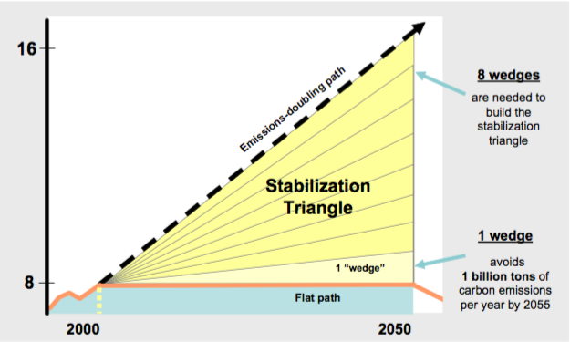
Wedge framework
A global CO₂ wedge is defined both in time and quantity:
Several wedges “stack up” to achieve a policy objective:
Here the reference scenario is increasing emissions, whereas the policy objective is to maintain flat emissions over the next 50 years

Slide 41
Wedge framework
Wedges are conceptually simple and may not represent real-world behaviors. For instance, all four of the “wedges” to the right represent the same total emissions:
For most metrics, it is the integrated area rather than annual flow that matters most for environmental impacts

Slide 42
Material wedges
Rather than greenhouse gas emissions, we are primarily interested in reducing material flows over time, e.g. steel:
Depending on the application, the metric of interest could be the flow of virgin material, total material production, or some other metric serving as a proxy for final impacts

Slide 43
Circularity definition
Full circularity is achieved when annual material flow reaches zero. However, this does not suggest that other quantities (GHGs, energy, etc.) also reach zero.
In actual practice, we may not achieve true material circularity. The goal of the analysis is to determine how much reduction is possible, and what trade-offs exist.
Decreased demand for product (e.g., increased longevity)
Baseline material demand
Increased material efficiency during manufacturing
Material quantity
Remaining material demand
Increased material re-use at end of life
Etc.
Time

Slide 44
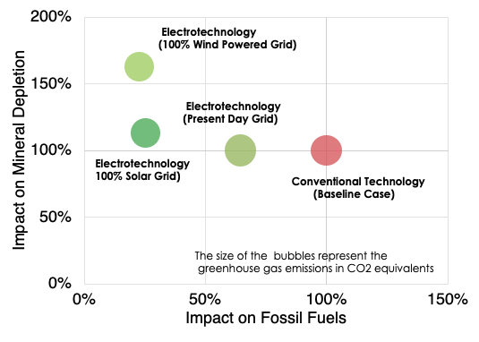
Material wedges in conjunction with others
In addition to material flows, we are generally also interested in energy consumption, green-house gas emissions, costs and possibly other metrics.
Sometimes it is useful to look at correlations of two variables:

Slide 45
List of material flows of interest
We have assembled an initial list of materials that will be of interest for tracking and modeling. In many cases, industrial processes may affect several material flows:
The modeling tool we have developed can track many of these material flows (plus energy and GHGs)
Commodity materials
Iron/steel | Wood
Aluminum | Pulp/paper
Copper | Plastics
Lead, zinc and tin | Glass
Non-critical precious metals | Cement and other construction materials
Other non-ferrous metals | Food
Energy carriers (hydrogen, methane, petroleum, etc.) | Fertilizers (nitrogen, phosphorus, potassium)
Fresh water | Municipal solid waste
Critical materials
Neodymium | Cobalt
Europium | Gallium
Terbium | Indium
Dysprosium | Manganese
Yttrium | Platinum group metals
Lithium | Vanadium
Tellurium | Battery-quality graphite
Critical Materials Institute, “CMI Factsheet,” https://cmi.ameslab.gov/materials/factsheet
Wiebe et al. (2019) Environ. Sci. Technol. 53: 6362−6373 and authors’ own inputs

Slide 46
Wedges tool
We adapted AMO’s prospective analysis tool LIGHTEnUP to calculate material wedges by adding an EPA materials flow dataset to two existing DOE energy datasets:
Major Datasets | Dataset Description
AEO2019RC | US DOE Energy Information Administration (EIA): Annual Energy Outlook (AEO) 2018 Reference Case (https://www.eia.gov/outlooks/aeo/)
MECS 2014 | US DOE Energy Information Administration (EIA): Manufacturing Energy Consumption Survey 2014 (https://www.eia.gov/consumption/manufacturing/)
SMM Vision2 Matl IO Tables | US EPA: Sustainable Materials Management (https://www.epa.gov/smm): The Road Ahead (Vision2) - a systemic approach to using and reusing materials more productively over their entire life cycles (https://www.epa.gov/smm/sustainable-materials-management-road-ahead)

Slide 47
Wedges Tool: Methodology
By specifying scenario details of how a specific activity changes energy, materials and other flows in specific sectors, the tool allows for the automatic calculation of impacts across the U.S. economy.
Annual Energy Outlook 2020 – Reference Case https://www.eia.gov/outlooks/aeo/
Technology Adoption’s Energy Wedge

Slide 48
Wedges Tool: Methodology
The tool can automatically calculate wedge diagrams showing changes in a metric of interest versus time for each specific scenario.
Annual Energy Outlook 2020 – Reference Case https://www.eia.gov/outlooks/aeo/
Technology Adoption’s Energy Wedge
2014 Manufacturing Energy Consumption Survey http://www.eia.gov/consumption/manufacturing/
Manufacturing Sector With Tech Adoption Wedge?

Slide 49
Wedges Tool: Methodology
The tool maps a Materials Input-Output (U.S. EPA: Sustainable Materials Management) to Manufacturing Sectors (EIA-MECS) and Energy Demand Projection (EIA AEO 2020) to automatically calculate material impact wedge diagrams.
U.S. EPA: Sustainable Materials Management (https://www.epa.gov/smm)
Material Wedge

Slide 50
Wedges Tool Example
Plastics Recycling Energy Wedges

Slide 51
Wedges Tool Example
Plastics Recycling CO₂ Wedges

Slide 52
Wedges Tool Example
Plastics Recycling Material Wedges

Slide 53
Agent Based Model -
Implementing
a Circular Economy
for Photovoltaics
Julien Walzberg, Garvin Heath and Alberta, NREL

Slide 54
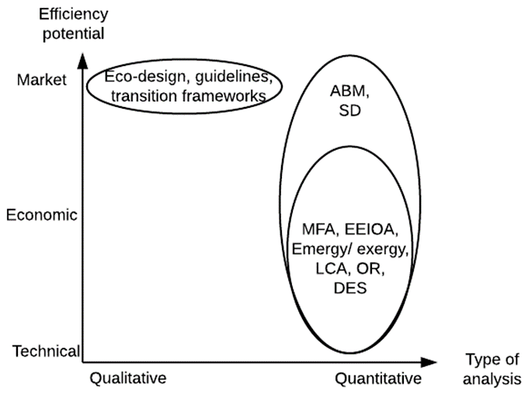
Agent Based Model (ABM) -
Implementing a Circular Economy for Photovoltaics
Background
Context
  Problem: between 2015-2060 photovoltaics (PV) raw materials demand projected to increase by 3000% & 2050 projected PV waste = 7.5-10 million tonnes
  Solution: The circular economy (CE) spurs material efficiency e.g., through reusing/recycling products → CE could capture value from PV waste, lowering demand for raw materials
Agent-based modeling (ABM)
  Bottom-up modeling where each agent follows its own behavioral rules
  Goal: Understand a system’s macro level behavior from the individual behaviors of the agents
  Widely used to study PV adoption (NREL dGen model, Rai & Robinson (2015))
  Enables studying the market potential of material efficiency strategies
Capacity of different methods to capture material efficiency potentials and type of analysis; ABM=agent-based modeling; SD=system dynamics; MFA=material flow analysis; EEIOA=environmentally extended input output analysis; LCA=life cycle assessment; OR=operations research; DES=discrete event simulation

Slide 55
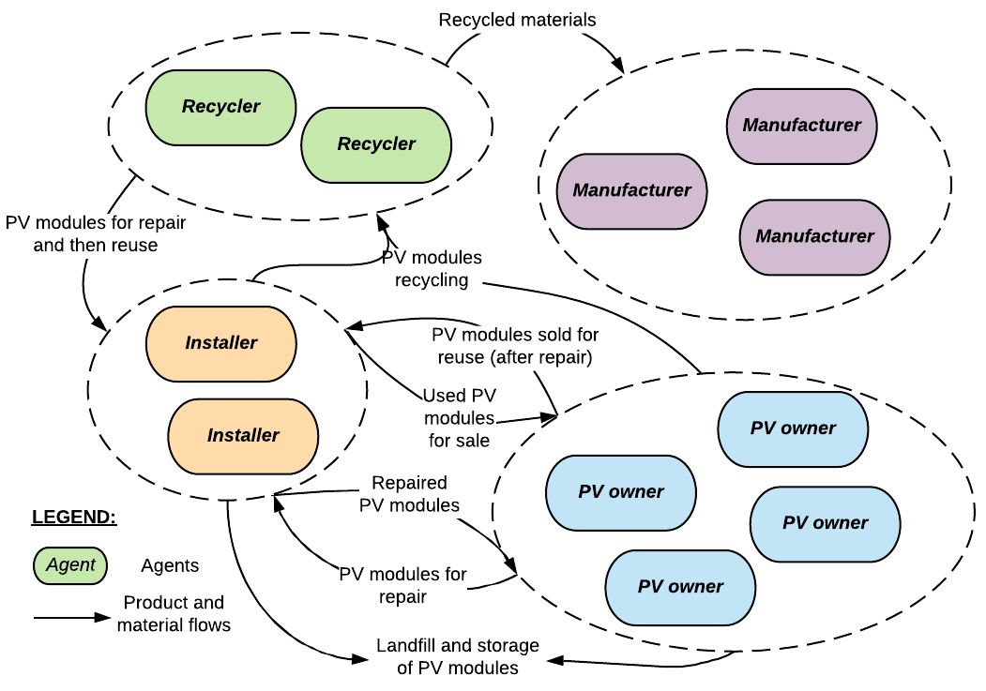
PV ABM – objectives and structure
Objective function: The maximization of the reuse/repair/recycle CE pathways measured by the fraction of mass of EOL PV modules ending up in each EOL pathway.
Agents’ behavioral rules:
-PV owners purchase new/used modules and manage their end-of-life
-Installers collect modules that may be refurbished / repaired and sold on secondary markets if modules are too costly to repair or there is no sufficient demand, they are recycled or landfilled/stored
-Recyclers sort between modules that may be repaired/reused, recover materials from modules, and improve their recycling processes
-Manufacturers buy recovered materials from recyclers and generate industrial waste

Slide 56
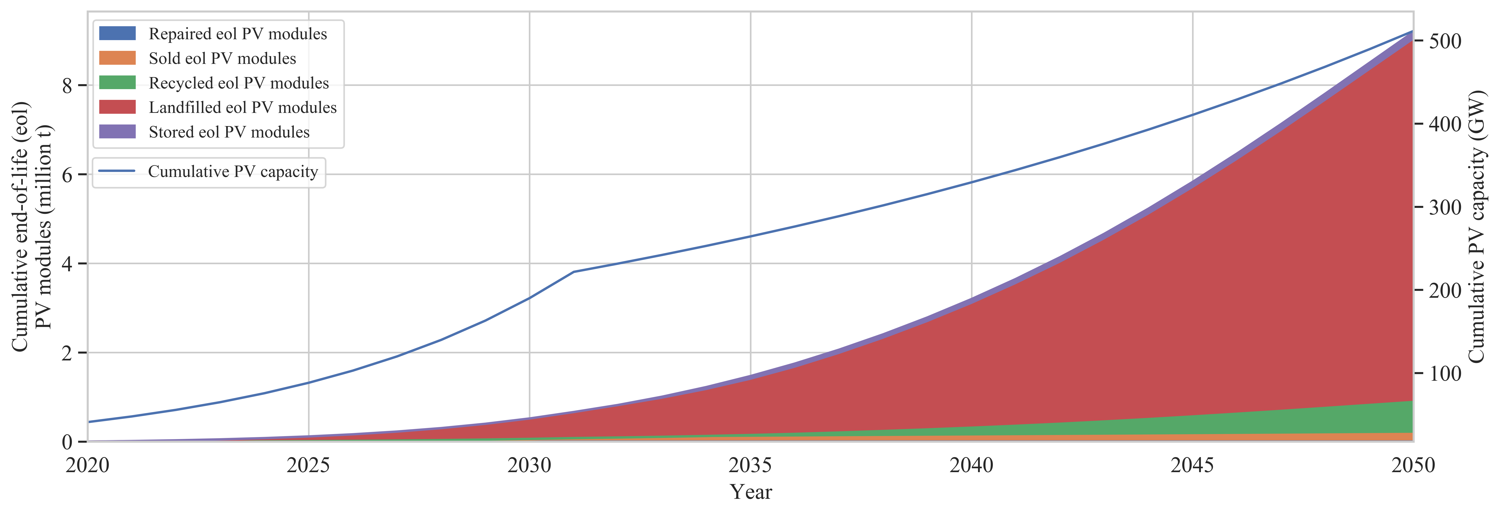
PV ABM - Preliminary results
Combination of levers: may prove the most efficient (with the right combination) to get a higher amount of EOL PV modules diverted from landfill.
For instance lower recycling costs and higher landfill costs increases the percentage of EOL PV modules diverted from landfill.
However, because the reuse pathway compete with the recycling pathway, encouraging reuse through improved warranties may not always be the best option to increase the amount of EOL PV modules diverted from landfill
Results for the baseline scenario (calibrated model) :
Only 10 % of PV waste is recycled or reused

Slide 57
PV ABM - Key takeaways
PV waste is going to grow subsequently in the next decades
Finding ways to retain the maximum value from end-of-life PV modules can improve the US resilience to materials criticality issues
Agent based modeling is a suitable tool to study the circular economy as it enables an analysis of all three material efficiency potentials (technical, economic and market potentials)
The developed model has been calibrated to the current situation and reproduce projected cumulative installed capacity and waste generation from the literature
A combination of different levers (e.g. decreasing recycling costs while increasing landfill costs) may prove the most efficient to maximize value retention from end-of-life PV modules

Slide 58
Thank you!

