Slide 1
Field Data Reporting (FDR) Presentation
John Ball (Introduction)
Anthony Getsinger (FDR)
Blake Connelly (FDR)
Adiran Trafidlo (Visual Planning)
August 13, 2026

Slide 2

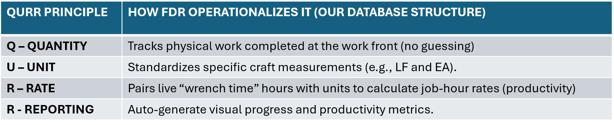
What is FDR?
FDR – The Field Data Reporting
Notes:
What is FDR? FDR is an application/database that was founded upon the QURR Principles. Quantity, Unit, Rate, and Reporting.
By structuring our database around the QURR Principles; we developed our application to actively track physical Quantities, Standardized Units, Productivity Rates, and Reporting within Power Bi dashboard. In doing so, we ensure that every byte of data in FDR is auditable, objective, and accurate.
How does it work?

Slide 3



How Does FDR Work?
Eliminates Subjectivity
Benefits
Early Issue Detection / Risk Mitigation
Transparency
Live Data Metrics
Improved Estimates
Notes:
FDR works by eliminating Subjectivity we collect Objective data such as, actuals hours, completed standardized quantities directly from the field. No mysteries.
FDR is able to visually show what happen that day, week, month, or year. Because we collect objective data, we are able to accurate produce and report Productivity. Productivity is calculated by taking the Actual Work Hours and dividing them by the quantities completed.
Because of our Objective data collection and Real-Time Productivity. FDR is able to provide the following Benefits.
Early Issue Detection and Risk Mitigation– Such as labor hour, quantity, and equipment trends. Behind/Ahead/or On-Schedule. Early Detection allows for Risk Mitigation (present/future).
Transparency – Data is available through the Power BI dashboard. Allowing management to actively view data.
Live Data Metrics – Live data updated.
Improved Estimates – Robust database of hours, quantities, productivity, and standardized units. Meaning estimators can drill down into actuals without hassle.

Slide 4
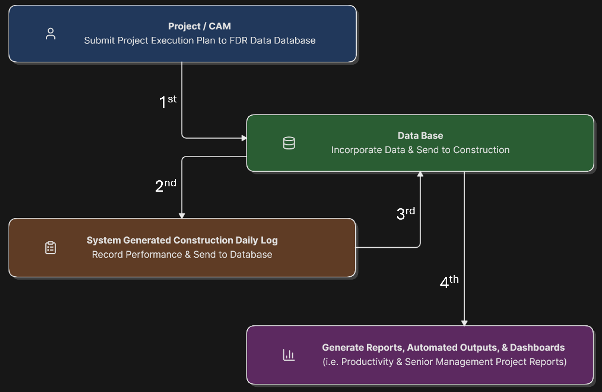
FDR: Process Workflow
Notes:
1. Project / CAM: Submit project execution plan directly to the central FDR Data Repository.
2. Data Repository: Consolidate planning baselines and route parameters down to the construction team.
3. Construction Daily Log: Field execution teams record daily shift performance (labor hours, completed quantities) and sync back to the repository.
4. Report Generation: System automatically synthesizes inputs to generate real-time metrics and executive reports.

Slide 5
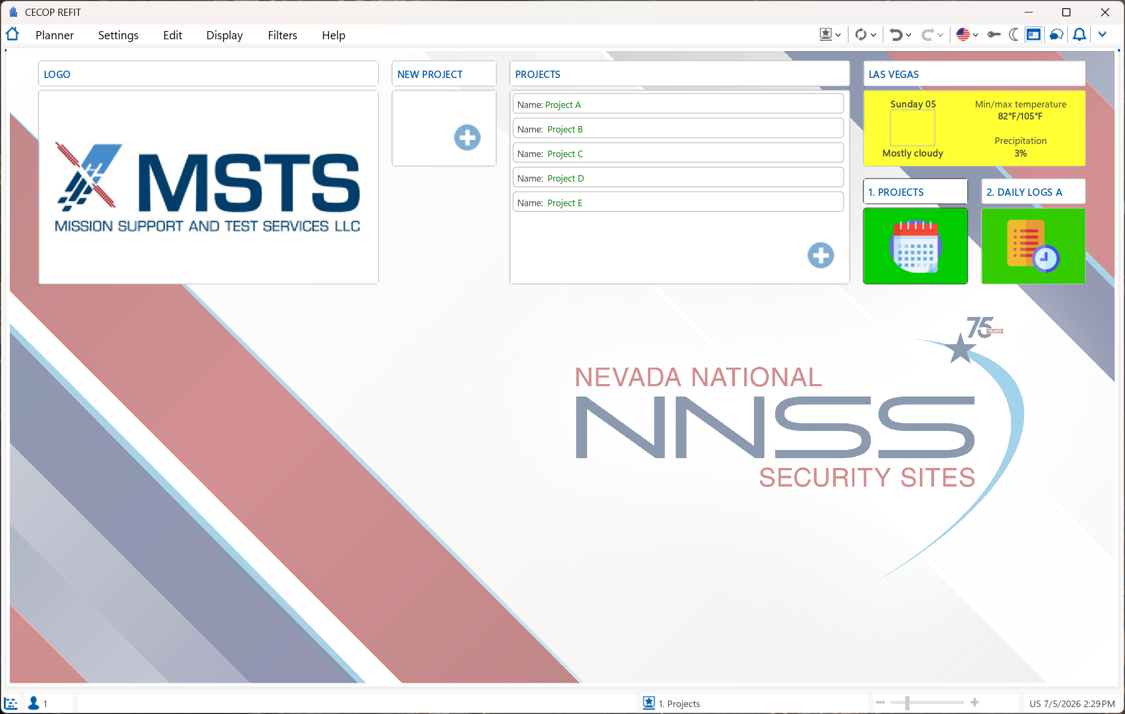
Field Data Reporting – Program & Landing Page
Notes:
The FDR Dashboard is the first stop in creating a project within the FDR application.

Slide 6
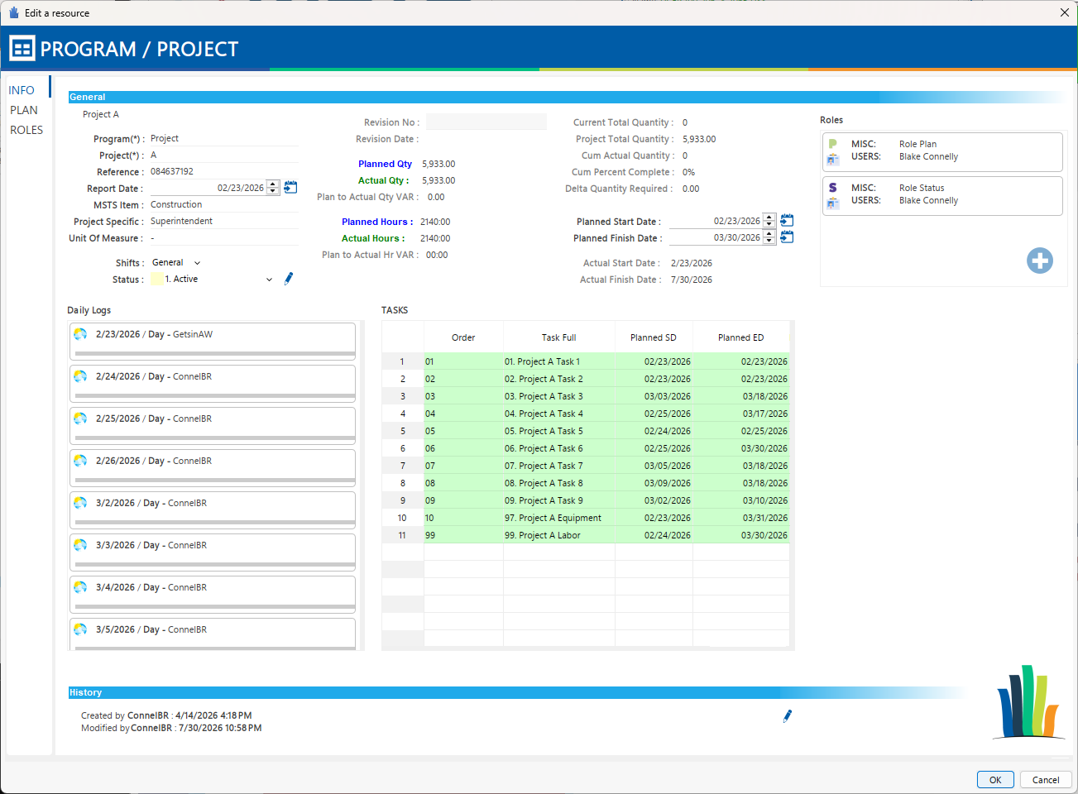
Field Data Reporting – Project Page
Notes:
FDR Info Page – Shows the Project Planned Start Date, Finish Date, Planned Qty, Planned Hours, Daily Logs and Scheduled Tasks.

Slide 7
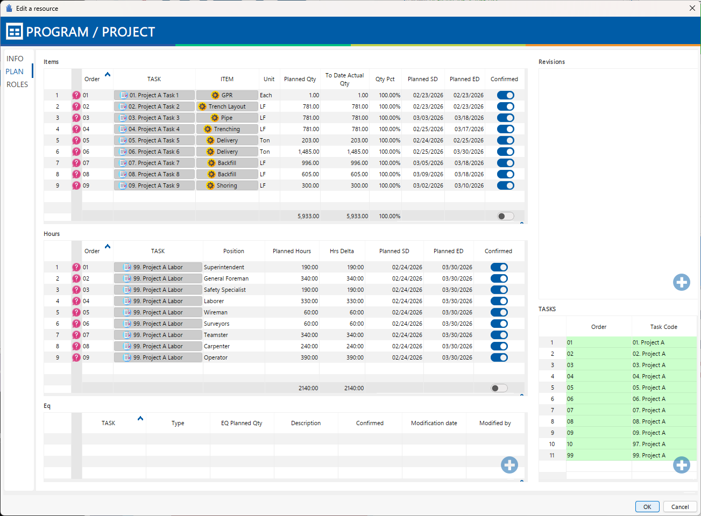
Field Data Reporting – Planning Page
Notes:
FDR Plan Tab – Task Creation that includes the ITEM, UNIT, Planned QTY, To Date Actual Qty and Remaining Qty.
To include, the Scheduled Labor Positions. You can plan the total hours each position is scheduled.

Slide 8
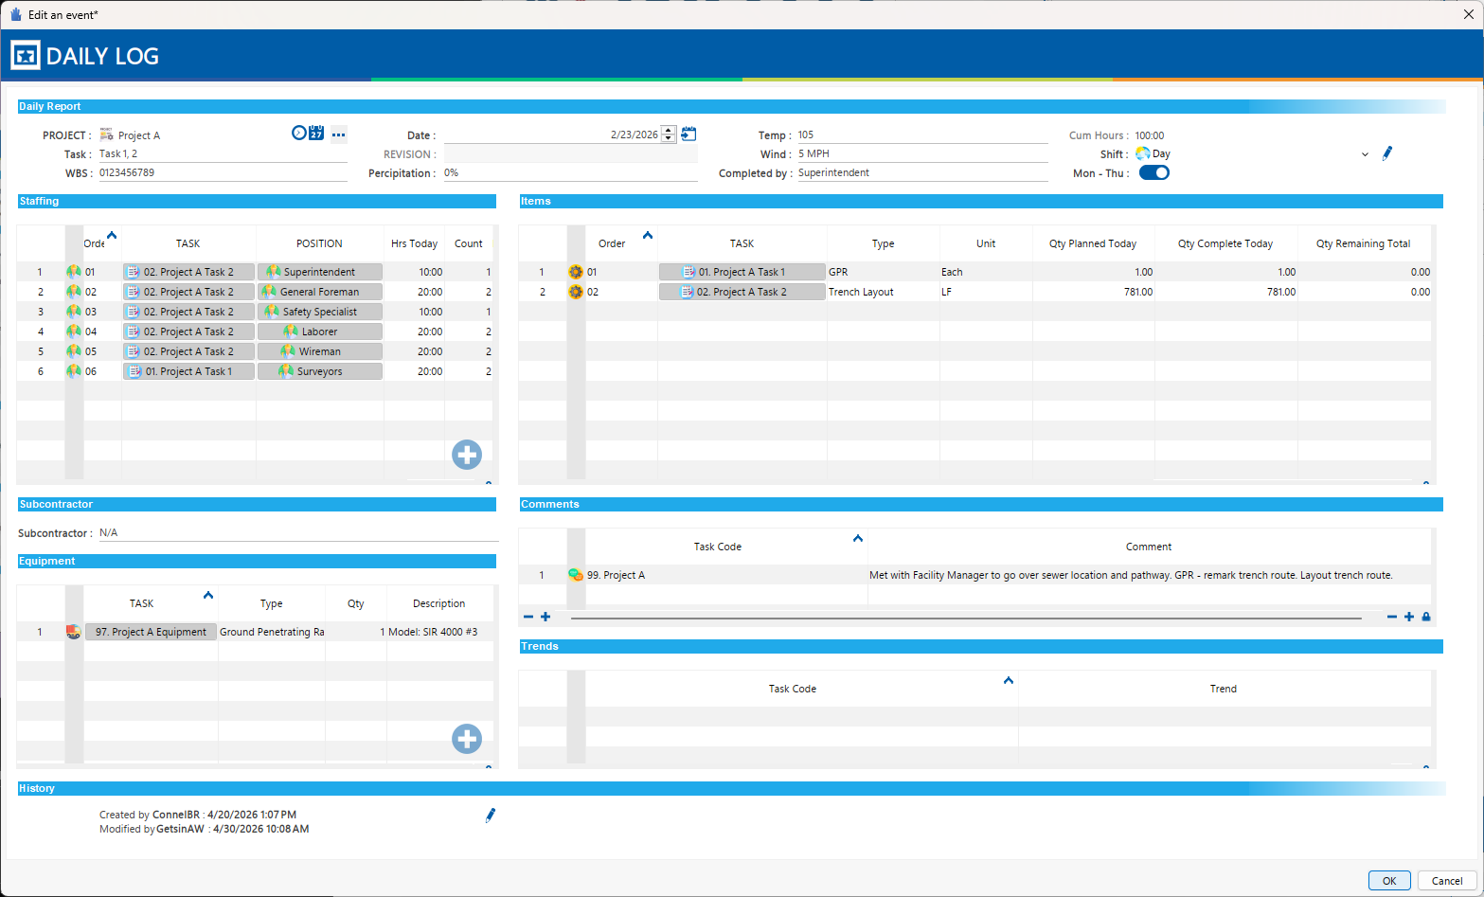
Field Data Reporting – Daily Log
Notes:
Daily Log:
This is where FDR makes the magic happen. Each Daily Log is automated and can generate a Day Shift Log and Night Shift Log. All that is required is a quick update within the system by the Superintendent, that day.
The Daily log also tracks Equipment, Highlights such as what occurred that day, and Trends. With input from our Project Manager and Superintendents we were able to give them an opportunity to provide insight as to any Delays or Issues they had during there shift. We were more than happy to provide it.
Reporting through Power BI!

Slide 9
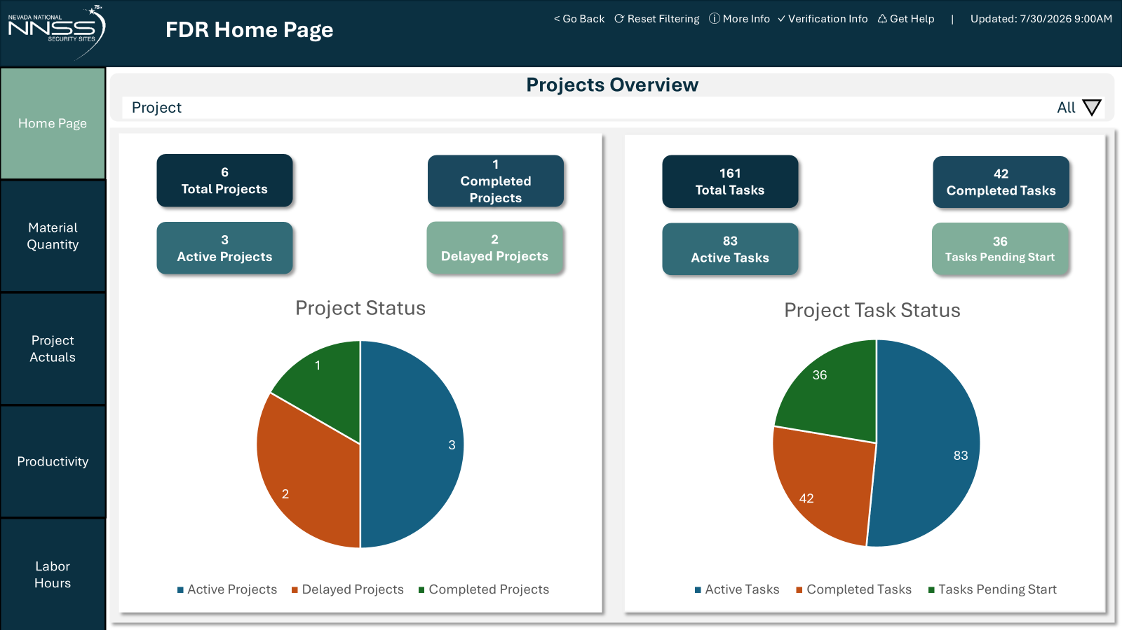
Project Management Dashboard
Notes:
Key Metrics Displayed
Work Order Status: Displays open work orders, pending approvals, and backlog tasks.
Schedule Metrics: Includes real-time indicators for Schedule Effectiveness
Execution Health: Gauges work order completion rates and highlights delinquent PMs (Preventative Maintenance) to identify process bottlenecks instantly.

Slide 10
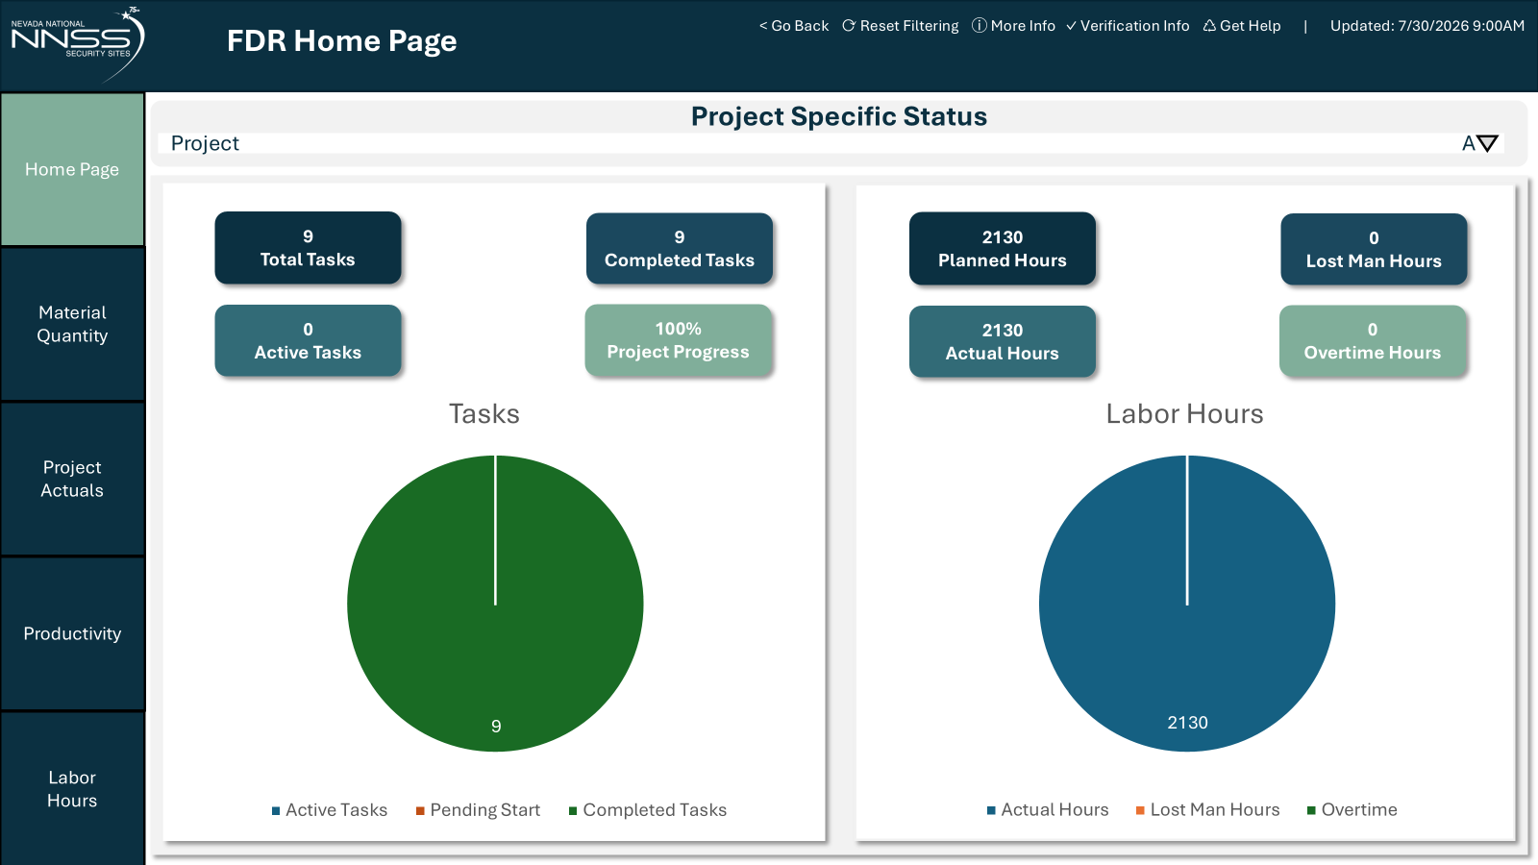
Project Management Dashboard
Notes:
Key Metrics Displayed
Work Order Status: Displays open work orders, pending approvals, and backlog tasks.
Schedule Metrics: Includes real-time indicators for Schedule Effectiveness
Execution Health: Gauges work order completion rates and highlights delinquent PMs (Preventative Maintenance) to identify process bottlenecks instantly.

Slide 11
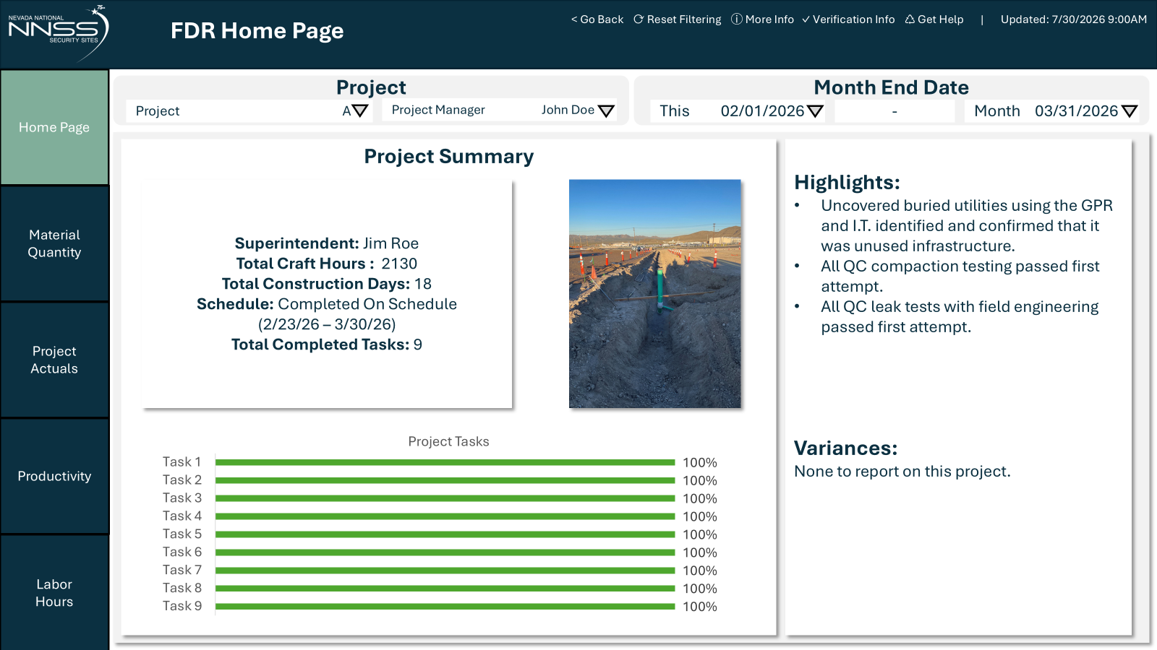
Project Management Dashboard
Notes:
Key Metrics Displayed
Work Order Status: Displays open work orders, pending approvals, and backlog tasks.
Schedule Metrics: Includes real-time indicators for Schedule Effectiveness
Execution Health: Gauges work order completion rates and highlights delinquent PMs (Preventative Maintenance) to identify process bottlenecks instantly.

Slide 12
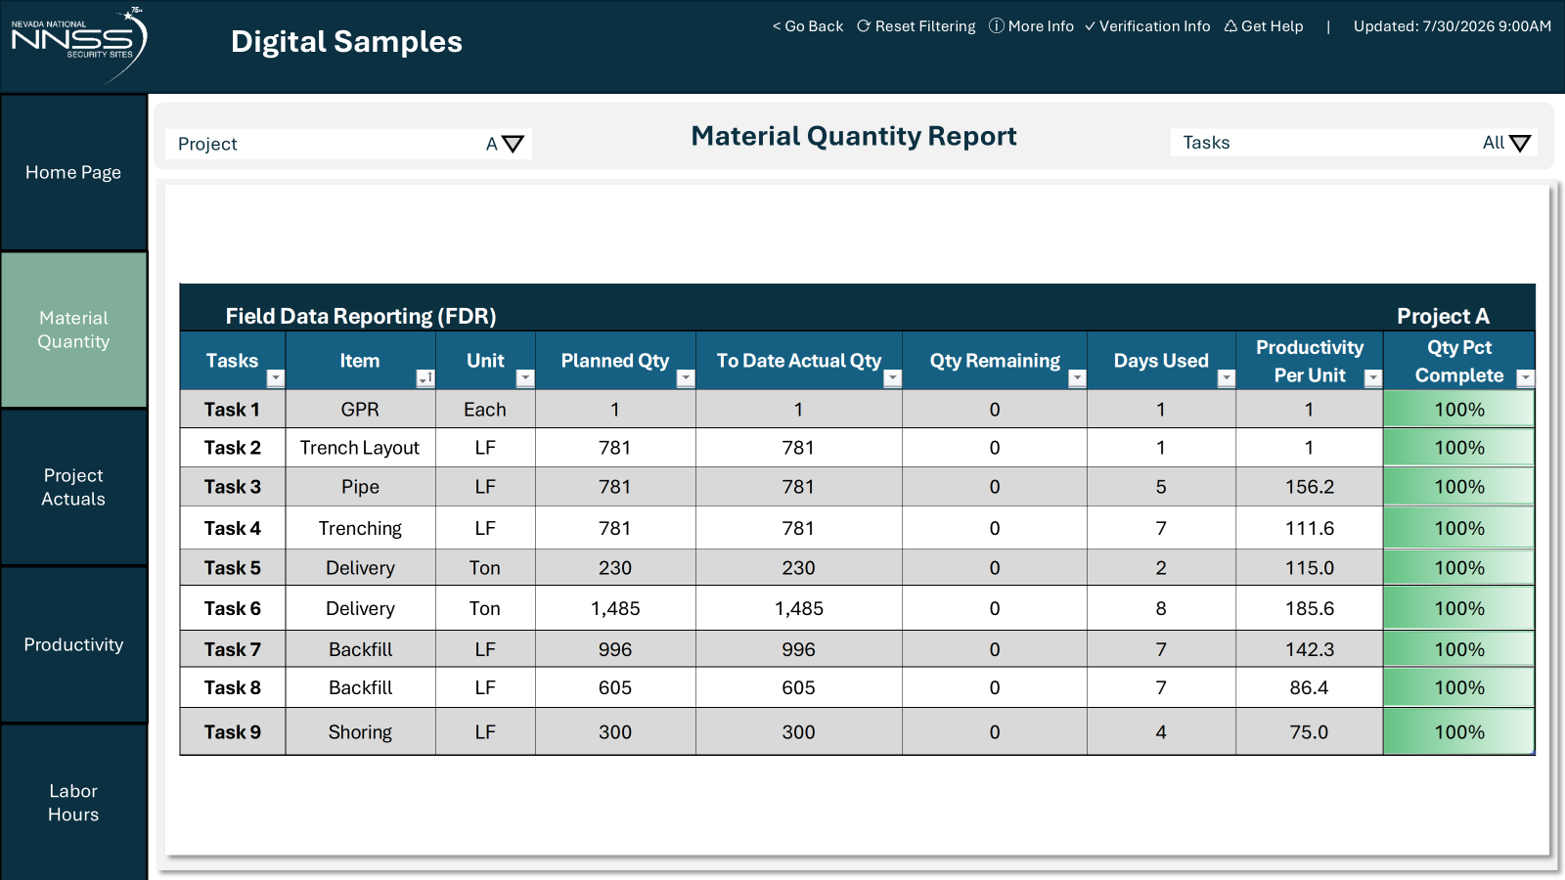
Detailed Task-Level Performance
Notes:
This slide displays a granular view of materials, planned vs. actual quantities, and physical progress at the task level.
Tracking Fields:
Project/Item/Task Hierarchies (e.g., Cut, Mesh, Rockbolts, Shotcrete)
Unit of Measure (LF, Each, etc.)
Planned Quantity vs. To-Date Actual Quantity
Quantity Remaining & Quantity Percent Completed
Cost Estimate Quantity & Variance Analysis (Plan vs. Estimating)

Slide 13
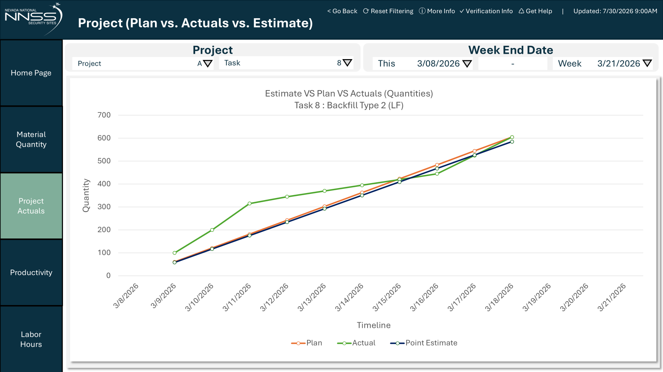
Performance S-Curves
Notes:
S-Curve Types Explained
Front-Loaded Profile: Accelerated initial resource mobilization and quick early progress.
Typical S-Curve: Standard project ramp-up, steady-state peak production, and gradual closeout.
Back-Loaded Profile: Delayed progress or slow early resource mobilization, requiring heavy acceleration toward the project end.
REMOVE EAC – KEEP PLAN/ ACTUAL / POINT ESTIMATE
COLORS AND NAMES

Slide 14
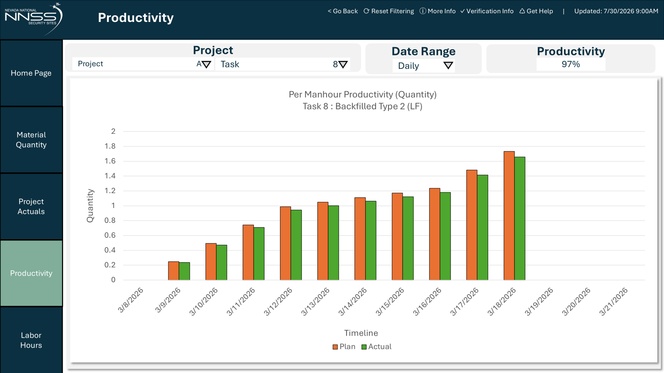
Integrated Labor & Productivity Tracking
Notes:
Integrated Controls
Dual-Axis Tracking: Combines planned, estimated, and actual labor hours with physical quantities produced daily.
Labor Burn-Rate Analysis: Tracks the rate of cumulative labor hours consumed against the physical completion of tasks.
Variance View: Displays trends where actual labor hours run over or under the planned baseline relative to the actual quantities installed each day, allowing direct assessment of labor productivity without cost or dollar indicators.
KEEP BUT CHANGE BOTTOM
MAKE BAR CHART
COLORS AND NAMES

Slide 15
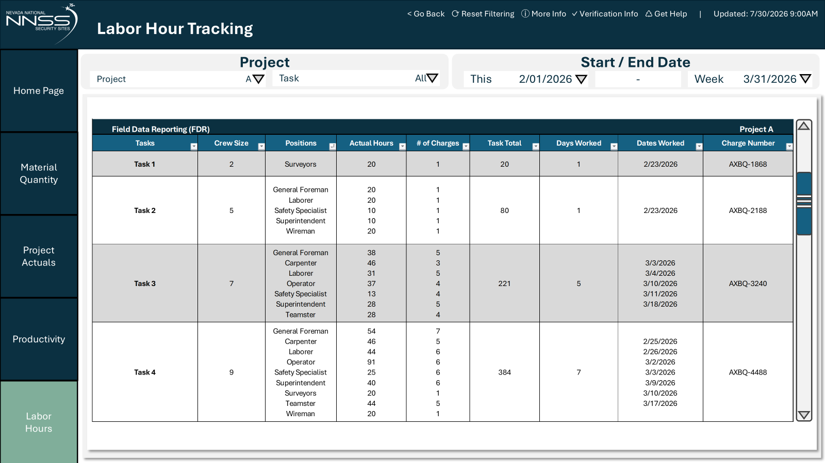
Detailed Labor Hour Tracking
Notes:
LABOR HOUR SLIDE, FIX NAMING

Slide 16
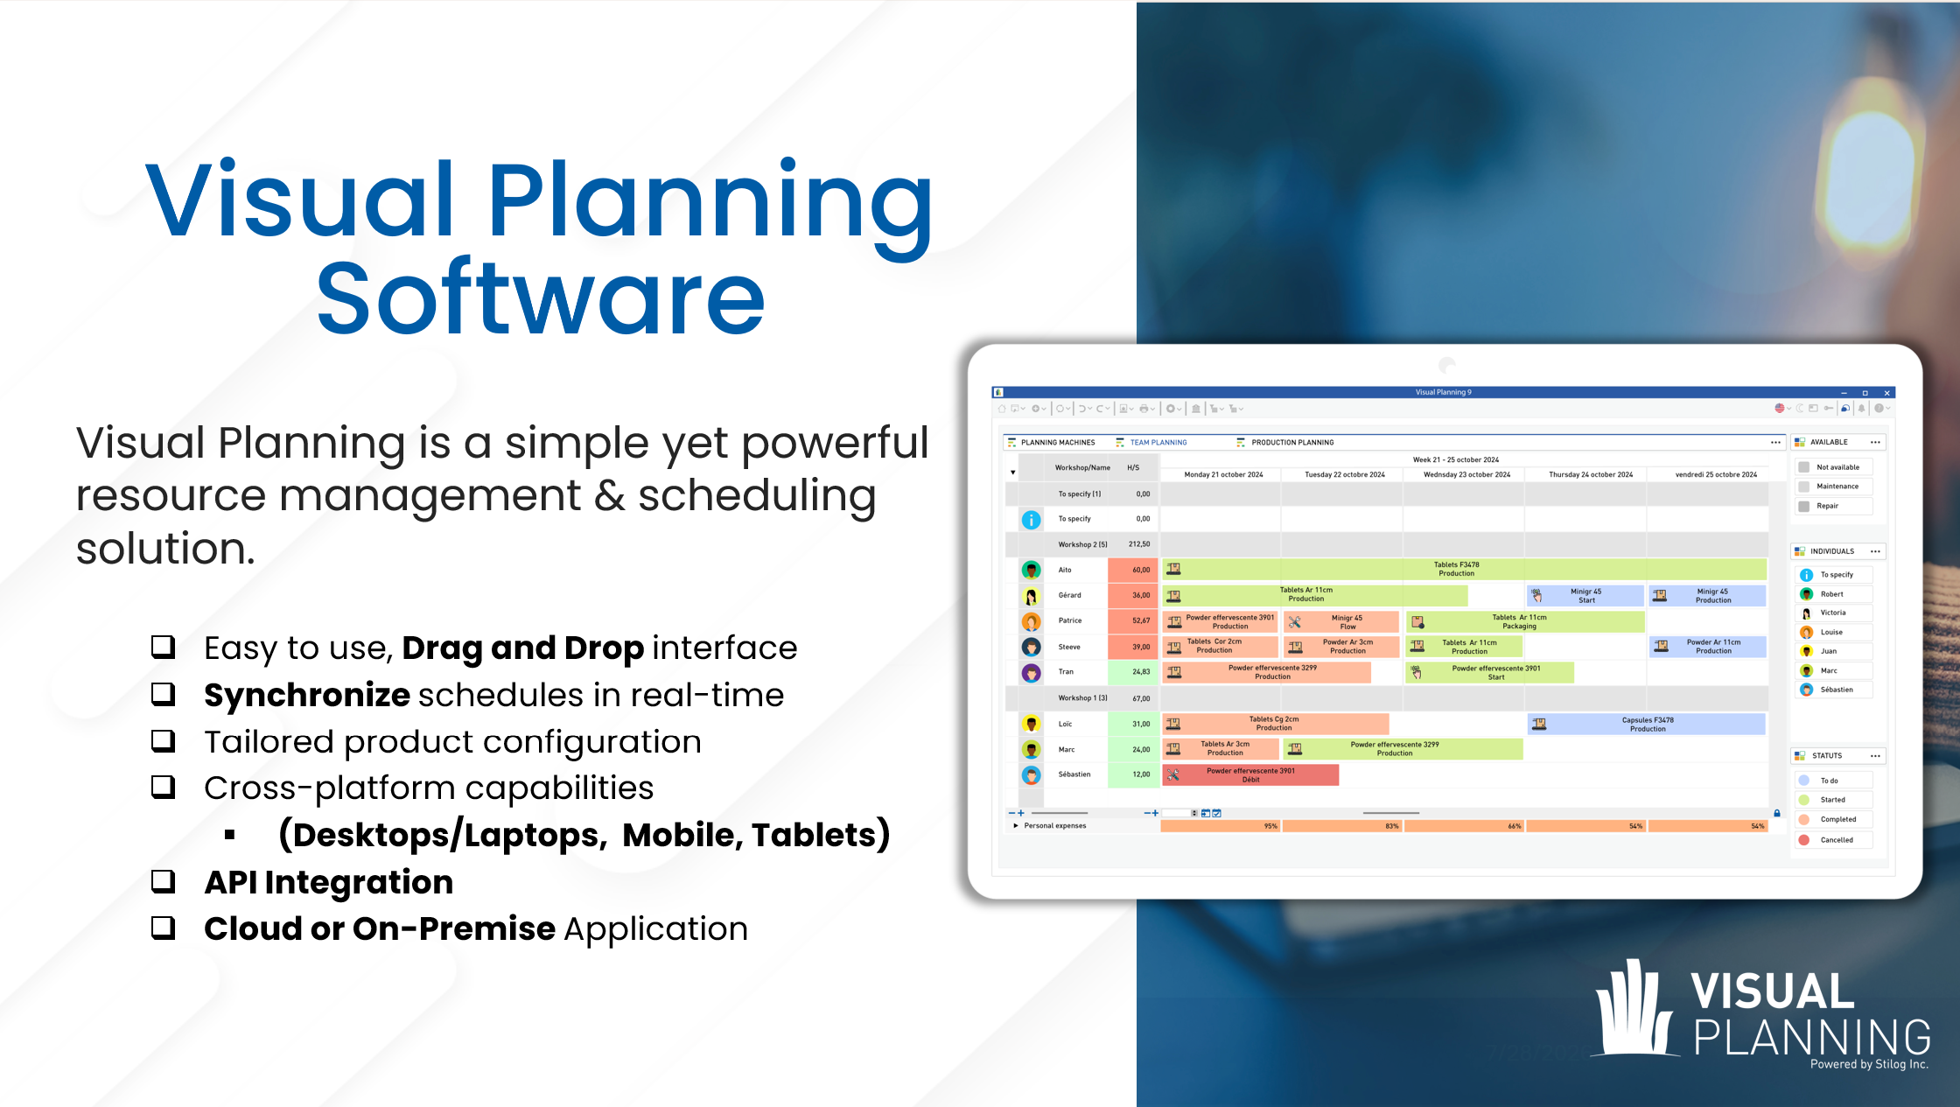
Overview

Slide 17
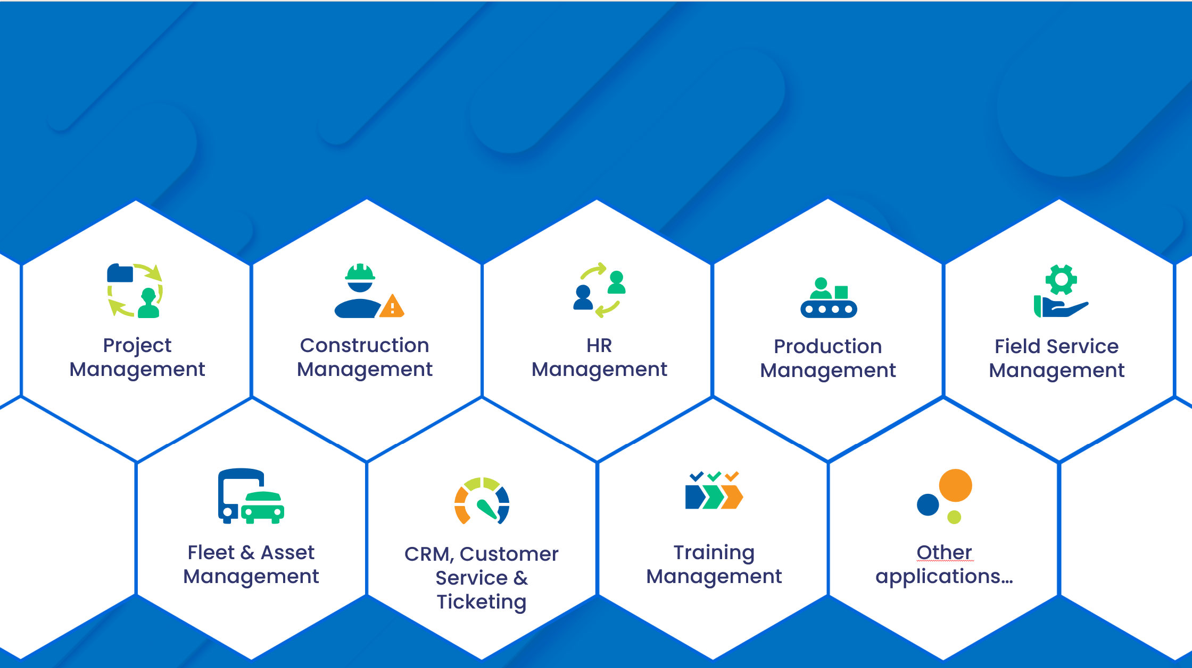
Scheduling Solutions

Slide 18
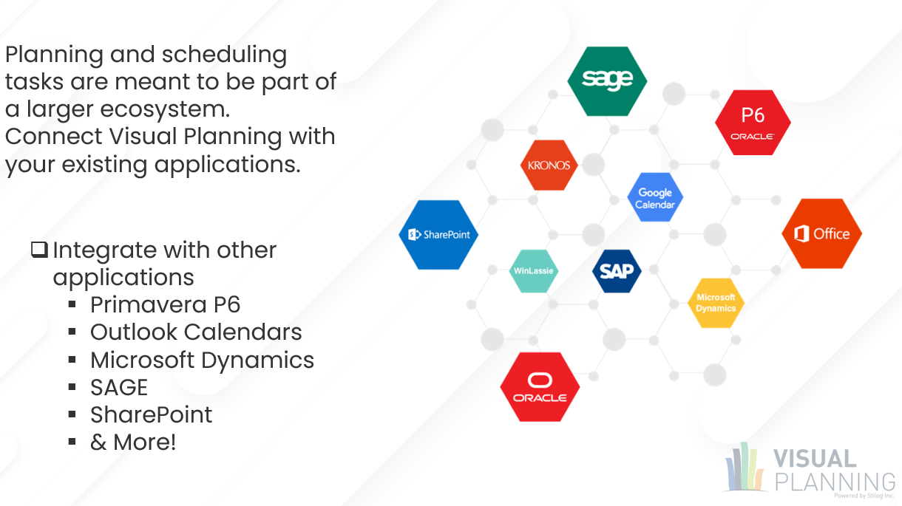
Visual Planning API Integrations

Slide 19
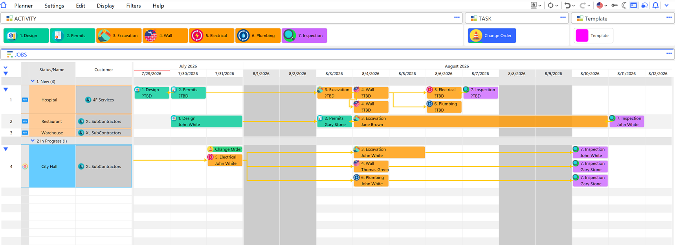
Scheduling Display

Slide 20
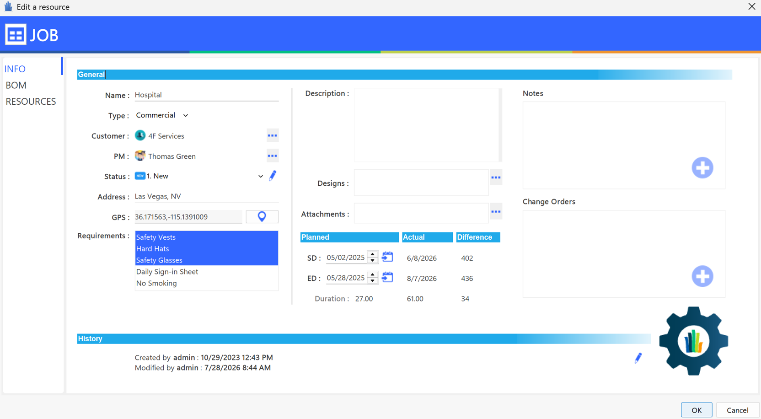
Job Order Form

Slide 21
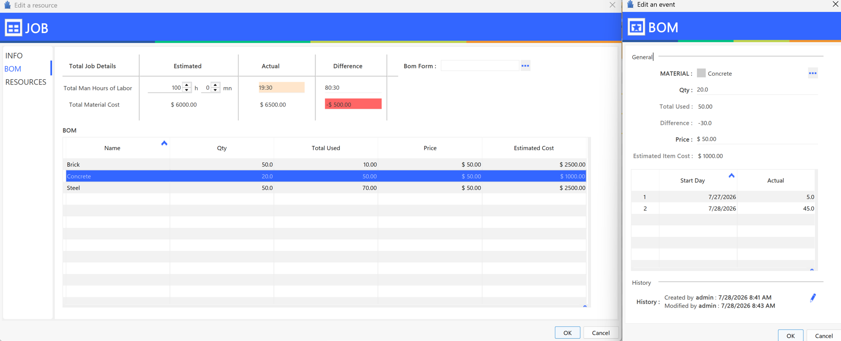
Bill of Materials

Slide 22
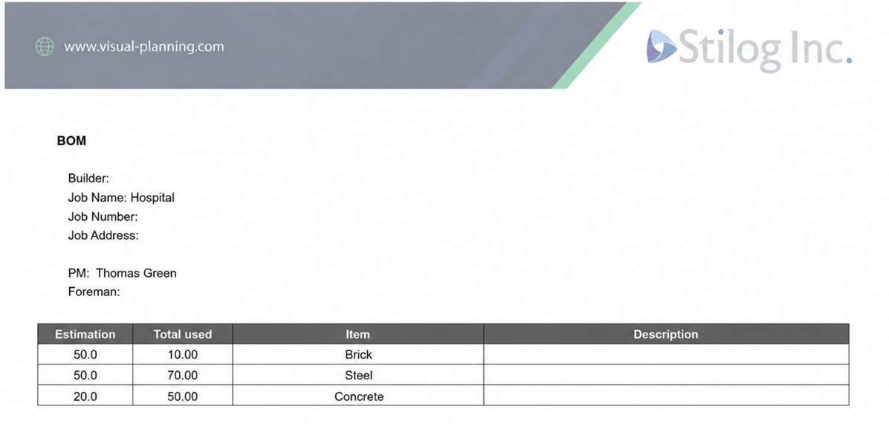
Printouts

Slide 23
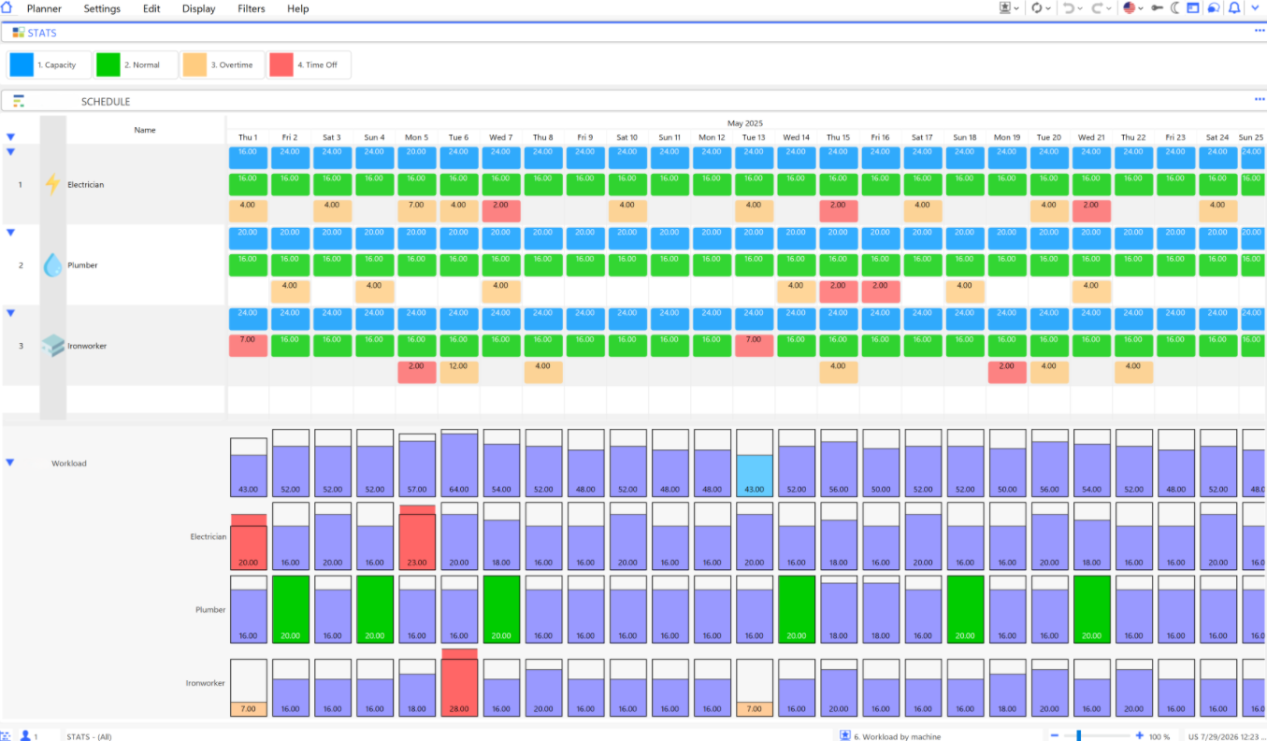
Employee Utilization

Slide 24
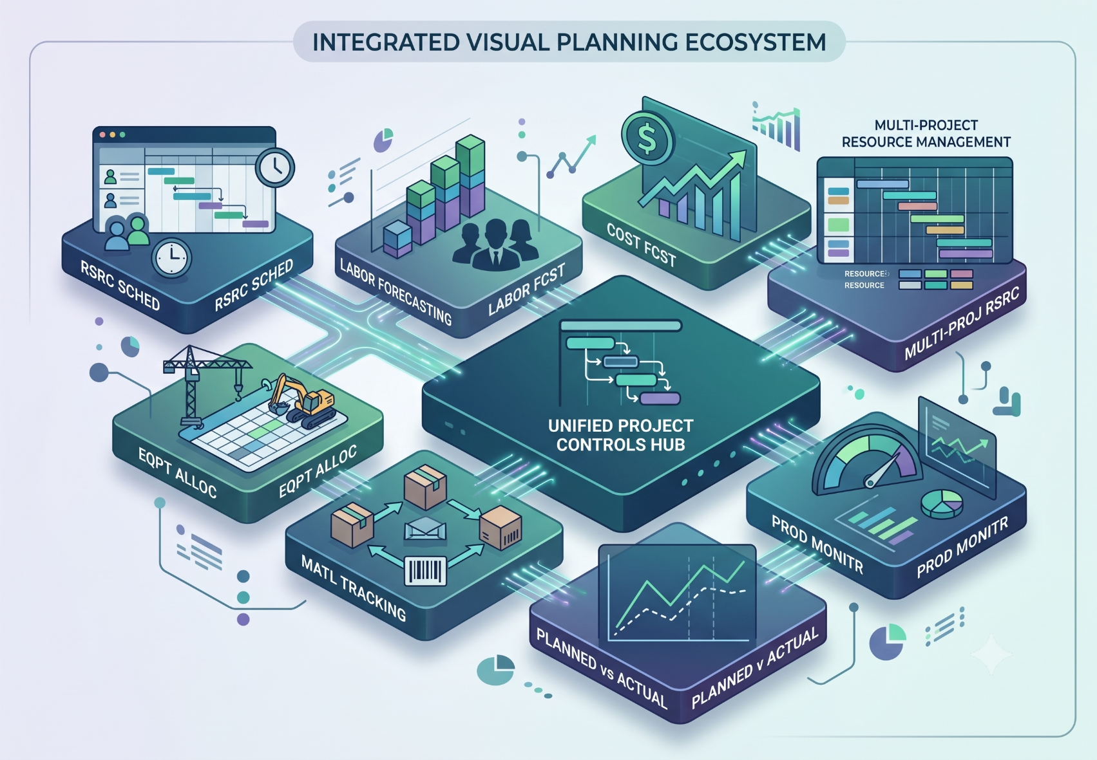
Visual Planning: For Construction Management
Additional Key Features
Labor Forecasting
Cost Forecasting
Equipment Allocation
Material Tracking
Productivity Monitoring
Planned vs Actual Analysis
Multi-Project Resource Management

Slide 25
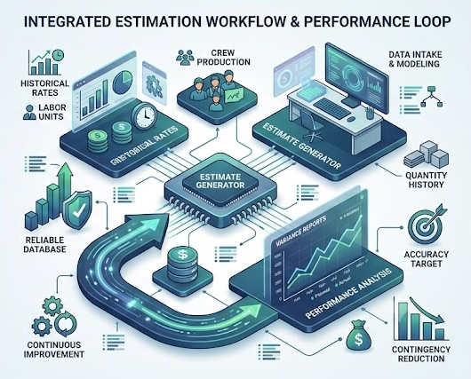
Why Estimators Care
Estimate Development
Historical Productivity Rates
Crew Production Rates
Labor Unit Rates
Quantity Production History
Validation
Compare Estimates vs Actuals
Improve Estimating Accuracy
Reduce Contingency
Build Reliable Databases

Slide 26




Questions?
Our team is always ready to help!
Email Address
shaunt.hosdaghian@stilog.com
Phone Number
(908) 291-2966
Scan to connect with our Team

