Slide 1
Advanced Manufacturing of Alpha Double Prime Iron Nitride (ADPIN): An Innovative Rare Earth Element (REE) Free Ultra-High Performance Permanent Magnet for Clean Energy Applications Contract Number: DE-EE0008306 FeNix Magnetics, Inc. Project Period: 05/01/2018 – 10/31/2020
David H. Matthiesen, Ph.D.
Chief Technology Officer
U.S. DOE Advanced Manufacturing Office Program Review Meeting
Washington, D.C.
June 2-3, 2020
This presentation does not contain any proprietary, confidential, or otherwise restricted information.

Slide 2
Overview
Project Title: Advanced Manufacturing of Alpha Double Prime Iron Nitride (ADPIN): An Innovative Rare Earth Element (REE) Free Ultra-High Performance Permanent Magnet for Clean Energy Applications
Timeline:
Project Start Date: 05/01/2018
Budget Period 1 End Date: 10/31/2019
Budget Period 2 End Date: 10/31/2020
Project End Date: 10/31/2020
Project Budget and Costs:
Budget | DOE Share | Cost Share | Total | Cost Share %
Overall Budget | $798,624 | $201,488 | $1,000,112 | 20.15%
Approved Budget (BP-1) completed | $365,469 | $201,488 | $566,957 | 35.54%
Approved Budget (BP-2) | $433,155 | $0 | $433,155 | 0.00%
Costs as of 4/30/2020 | $573,586 | $202,092 | $774,678 | 26.05%
Barriers and Challenges:
The goal of this proposed effort is to develop a fluidized bed reactor system to move beyond the current rate limiting step and produce large sample sizes (500 g) of nitrided powders for use in the subsequent steps that result in ADPIN powders for magnet fabrication.
BP1 on campus startup → BP2 transition to industrial space
Accelerated this timeline to BP1 and requested 6-month NCE between BP1 & BP2 to obtain required safety permits. This has been accomplished and BP2 has been initiated.
Budget Period 1 included a 6-month NCE
All milestones, tasks and Go/No Go decisions for BP-1 were accomplished
Project Team and Roles:
FeNix Magnetics, Inc.
AMO MYPP Connection:
Advanced Materials Manufacturing

Slide 3
Project Objective(s)
Alpha double prime iron nitride (ADPIN) α”-Fe₁₆N₂ is a high performance rare earth element free (REE-free) permanent magnetic material with the highest ever reported magnetization (M_{S}~2.8T).
ADPIN is ideally suited for applications in magnetic refrigeration and to challenge the price-performance dominance of rare-earth based magnets for other clean energy applications.
The development of ADPIN at commercial scale will enable economically advantaged and energy efficient magnetic refrigeration and HVAC chillers, which has a total technical energy savings potential of 1.25 quads/year.
It will also challenge the dominant permanent magnet material, Nd₂Fe₁₄B with Dy additions (NEO), for other clean energy applications such as electric vehicle motors and wind turbine generators.
The NEO market is estimated at 90,000 MT and has a 61% market share of the $20B permanent magnet market, which itself has an estimated 9.4% growth rate.
AMO Strategic Goals: Transition DOE supported innovative technologies and practices into U.S. manufacturing capabilities.
AMO MYPP: Advanced Materials Manufacturing: Advance technologies that accelerate the research, development, and demonstration of new materials, on a path towards integration of these materials into applications for cost effective, advanced clean energy technologies.

Slide 4
Technical Innovation
The rate limiting step of the current process is large scale production of magnetic powders.
FeNix Magnetics proposes to develop a fluidized bed reactor (FBR) technology for the prototype scale production of ADPIN magnetic powders.
This is a three step process:
Step 1) nitriding & quench to achieve γ-(Fe,M):N phase;
Step 2) cryo-deformation to transform the γ-(Fe,M):N phase to α’-(Fe,M)N martensite phase;
Step 3) annealing to transform the α’-(Fe,M)N martensite phase to α”-(Fe,M)₁₆N₂ phase.

Slide 5
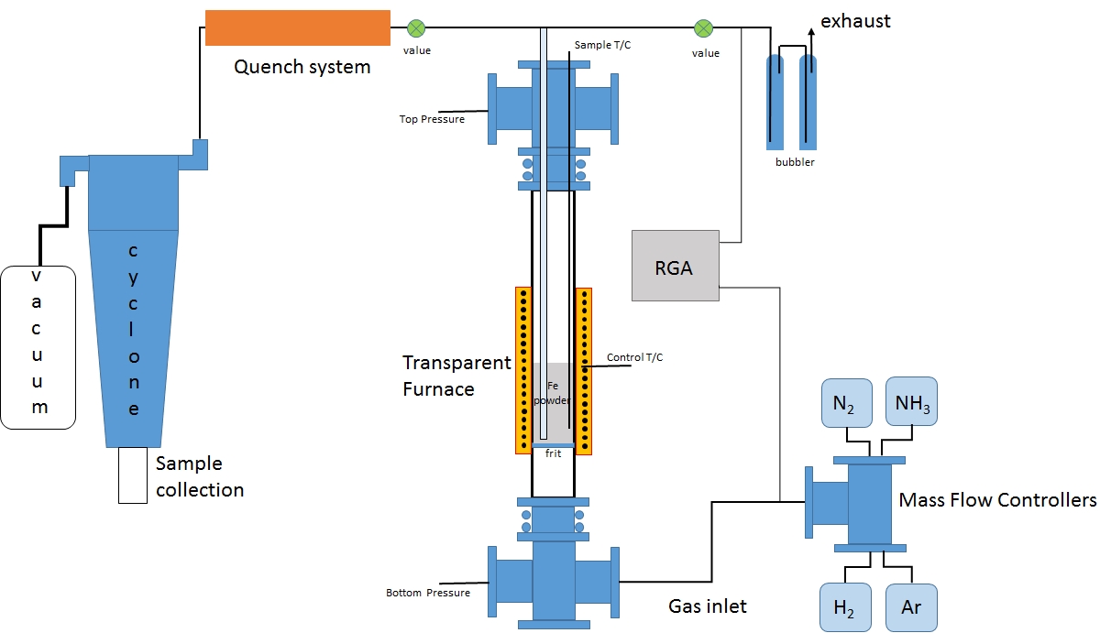
Technical Approach
Schematic of proposed fluidized bed reactor using a transparent fused quartz process tube and a transparent furnace system that will allow direct observation of the fluidized bed at operating temperatures and pressures.

Slide 6
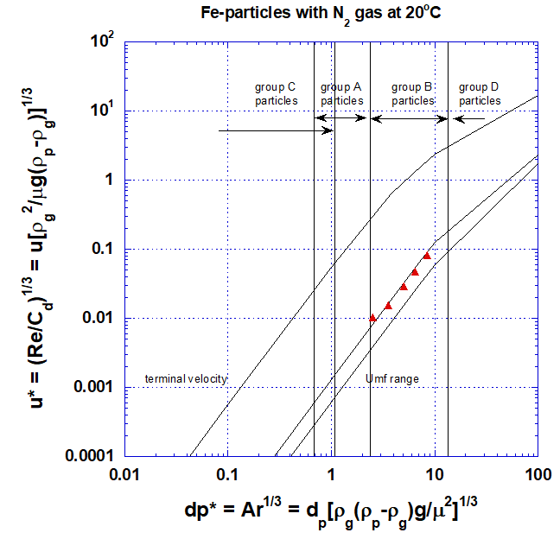
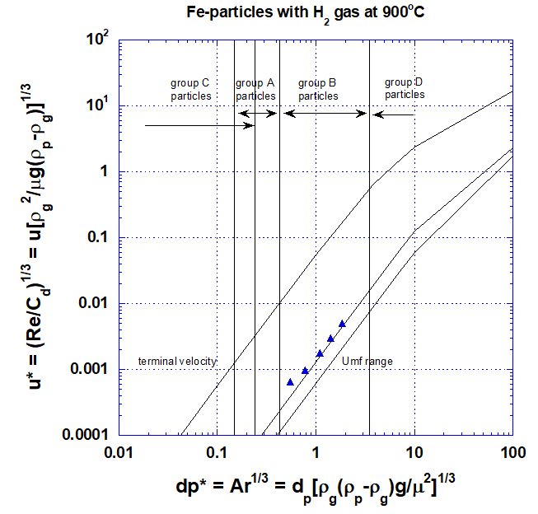
Technical Approach
Developed model (based on work by J.R. Grace) to map fluidization behavior based on non-dimensional flow velocity vs. non- dimensional particle size for a fluidized bed reactor.
This type of mapping has been used to predict the optimal fluidization behavior based on particle material, gas composition, and temperature to be utilized.

Slide 7
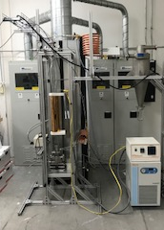
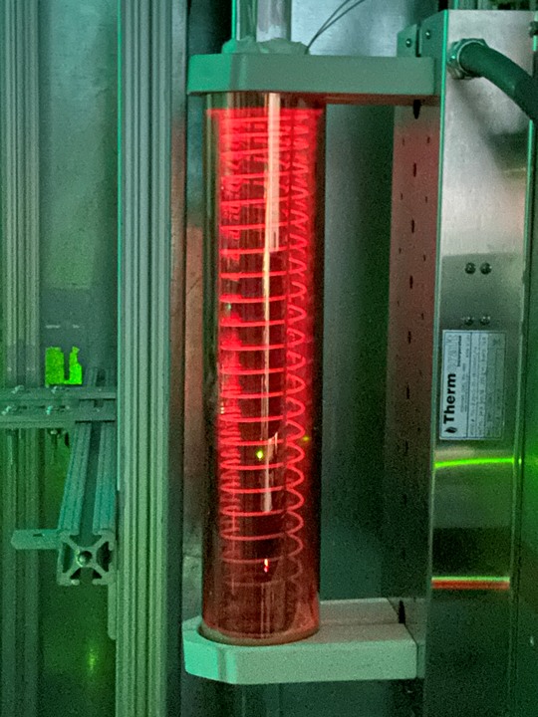
Results and Accomplishments
BP-1 Go/No Go milestone was to fluidize a given amount of iron alloy powder at a given temperature for a given time. The transparent furnace & fused quartz processing tube allowed movies to be made to verify this accomplishment and these movies were provided to DOE.
Fused Quartz Processing Tube
Transparent
Furnace
Fluidized iron alloy powder seen at temperature within the reaction chamber

Slide 8
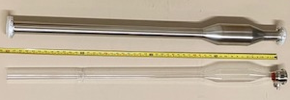
Results and Accomplishments
In BP-2 the transparent fused quartz process tube will be replaced with a stainless steel process tube, which will allow further scale-up in production volume.
Gen-2 FBR stainless steel processing tube design
Gen-1 FBR fused quartz processing tube design
Although progress has been made toward accomplishing BP-2 milestones, progress has been slowed as a result of government ordered restrictions due to the COVID-19 pandemic.

Slide 9
Transition (beyond DOE assistance)
This DOE-AMO sponsored project will transition this technology from TRL-3 at the beginning of the project to TRL-5 at the end of the project.
Next steps include:
Manufacture magnetic powder at pilot scale
Manufacture demonstration bonded magnet
Incorporate demonstration magnet in magnetic refrigeration application.
FeNix Magnetics has developed an IP strategy and has patent applications in processes

Slide 10
Questions?

