Slide 1
Excel 365 is Turing Complete!
Never Touch Analysis ToolPak Again
fx
=Coefficients(X_s(), Response_Column(), Allow_Intercept, Sample_Include())
Stephen Colodner
Office of Program Analysis and Evaluation (PA&E, NA-BA-40)
August 13, 2026

Slide 2
Twin Motivations
TRACEABILITY
AVAILABILITY
Static output is the bane of the estimator
Tool Use Limitations/Handoff
License lapses
A renewal slips and the seat goes dark.
When a formula becomes a value, the trail back to the data ends.
Version sunsets
A language or package drops out of support.
fx
=AVERAGE(Cost_Data)
↓
Review tightens
An add-in stops clearing the security baseline.
1,247,003
— the trail back to Cost_Data ends here
THE RESULT
Traceable Analysis in Vanilla Excel – No VBA, No Macros
Traceability — every formula is a visible, clickable trail back to the source.
Availability — already deployed, already cleared, on every estimator’s machine.
Notes:
[0:30] Motivation.
You may have had a tool pulled out from under a model. A license doesn't get renewed, a language version falls out of support, an add-in stops passing security review. When that happens the model doesn't just lose a feature — sometimes it can't be opened at all.
Excel has been on our machines for decades and is already cleared. Excel 365 added LAMBDA, which changes what you can build in it. Everything today rides on a platform that isn't going anywhere.
Don't oversell this. The point is availability and clearance, not that Excel is better than R.

Slide 3
Tradeoffs
Every approach has strengths. Here's the honest comparison.
 | Deployable here | Power | Dynamic | Traceability | Handoff
Analysis ToolPak | ● | — | — | ◐ | ◐
Code (R / Python) | ◐ | ● | ◐ | ◐ | —
This library | ● | ◐ | ● | ● | ●
●
strong
◐
moderate
—
limited
Notes:
[2:30] Tradeoffs.
Be honest here — this room has people who use R and Python. For raw modeling power, code wins. If you need a random forest or a hierarchical model, go to scikitlearn, statsmodels or pymc for python. ranger, lme4 for R.
What I’m most interested in highlighting is traceability. With code, the analysis reads a file or an export, and the result lives somewhere outside the data. Here, every formula points at the source table. Change a number and everything updates; a reviewer clicks a cell and follows it to the raw data.
This is for when the next estimator inherits your model, or you open your own model six months later, and you have to follow the logic. It aims to combine the flexibility of EDA and model comparison with the deployability and legibility of any vanilla excel file.
And the goal is to do all of this without touching VBA, for <reasons>.

Slide 4
Legibility: Two Healthy Habits
These are general good habits to maintain for model legibility throughout, not just in regressions.
Structured references
=AVERAGE(Life[Adult Mortality])
fx
Point at a table column by name, not a cell range. The formula says what it means — and a named reference survives inserted rows, sorts, and a reviewer's edits.
instead of =AVERAGE(K2:K3000)
Dynamic arrays + spill
=Coefficients(X_s(), Response_Column()) ▣ Vertical Spill
▣
▣
fx
One formula returns a whole table of results that sizes itself. Write it once in the corner cell; it fills the rest and shrinks when the model does.
one cell, many results
Notes:
[3:45] Two Excel features.
Worth knowing regardless of this library.
Structured references: point at a table column by name, not K2:K3000. The formula says what it means, and the reference survives inserted rows and sorts. That is what makes the analysis traceable.
Dynamic arrays: one formula returns a whole table of results that sizes itself. Write it in the corner cell; it fills the rest and shrinks when the model does.
Keep this fast — most of the room knows it. Two minutes maximum.

Slide 5
What is a LAMBDA function?
How 112 functions exist with zero macros, zero add-ins, and zero installation.
1
A formula
fx
=SQRT(A1^2 + B1^2)
Start with ordinary math.
2
LET names the parts
fx
=LET(a, A1, b, B1, SQRT(a^2 + b^2))
Like a table alias in SQL — name it, reuse it.
3
LAMBDA makes it callable
fx
=LAMBDA(a, b, SQRT(a^2 + b^2))(3, 4)
→
5
Arguments up front — call it right there.
4
Name it in the Name Manager
fx
=Hypotenuse(3, 4)
→
5
Now it works exactly like SUM.
Saved in the workbook as named formulas, callable like native functions — nothing to enable.
Notes:
[4:45] LET to LAMBDA.
How 112 functions exist with no macros. Four steps, and the last three are new to Excel 365 and make it a much more powerful tool.
Step 1 is ordinary math. Step 2, LET names the intermediate parts — the analogy for this room is a table alias in SQL. You alias a table once so you can refer to it cleanly for the rest of the query; LET does the same thing for values inside a formula. Same motive, same payoff in readability. This is hopefully a useful takeaway on its own, and good for all parts of your model to help shrink megaformulas.
Step 3 is the one this library is all about. LAMBDA by itself defines a function but doesn't call it. Put the arguments in parentheses right after the definition and it executes in place — that trailing (3, 4) is the call, and the cell returns 5. This is how you test a LAMBDA before you commit to it. Type it in a blank cell and it just works.
Step 4: Paste the same LAMBDA definition without a call into the Name Manager under the name Hypotenuse, and now =Hypotenuse(3,4) returns 5 from any cell in the workbook. Nothing else changed. That is the entire mechanism behind all 112 functions.
If you want an audience moment, do step 3 live in a blank cell — it lands better than the slide does.

Slide 6
LAMBDA functions compose
Biggest enabler for the no VBA approach
Once they’re in the name manager,
LAMBDAS behave like any native Excel function
Can invoke each other
Support nested function calls
Can compose other LAMBDAs, passing one function’s result to another
Take optional variables
Allows for highly complex calculations in a single cell, named once.
Definition for spill function T_Statistics
=LAMBDA(X_s, Y, [Allow_Intercept], [Include], [DF_Absorbed],
LET(
allow_arg, IF(ISOMITTED(Allow_Intercept), TRUE, Allow_Intercept),
filt_arg, IF(ISOMITTED(Include), TRUE, Include),
absorbed_arg, IF(ISOMITTED(DF_Absorbed), 0, DF_Absorbed),
Coefficients(X_s, Y, allow_arg, filt_arg)
/ SE_Coefficients(
X_s, Y, allow_arg, filt_arg, absorbed_arg
)
)
)
Notes:
What am I talking about when I say Excel is Turing Complete?
LET names all the variables then returns some calculation
Optional parameters in brackets; ISOMITTED sets default

Slide 7
What's in this talk
Excel Capabilities, Model Construction, and Regression Diagnostics
01
02
Declare the model, don't build it
A workflow you can defend
Roles and types on the source table replace hand-built dummy columns, hand-demeaned panels, and hand-maintained ranges. Categorical drivers and fixed effects become dropdown choices.
Screening through diagnostics, cross-validation, and prediction intervals — every number a live formula a reviewer can click through to the source data.
A new library of LAMBDA functions and templates to replace other regression methods
Notes:
[1:30] What's in this talk.
I’ve built a library of lambda functions and templates in Excel that I claim obviate some of these problems.
I’ll go through a regression template the modeling interface: you declare what each column of your table IS, and the sheet constructs the design matrix. That's what makes categorical drivers and panel fixed effects a dropdown choice instead of a morning of helper columns.
Second, the workflow: screening, diagnostics, cross-validation, and prediction intervals, all as live formulas a reviewer can click through.
Say plainly: if you never open this workbook, arc two is still the method you should be following in whatever tool you use.

Slide 8
What ships in the workbook
One .xlsx file. Eight sheets, 112 functions, and the dataset it was built against.
112 LAMBDA functions
Regression + Model Construction
Univariate Analysis
workbook-scoped · callable from any cell
the spec block and the full OLS engine
descriptives · histograms · distribution fitting
LAMBDA_functions catalog
Diagnostic Guide + Instructions
every signature, generated from source — never stale
how to read a diagnostic · how to adapt the sheet to your data
Also aboard: the WHO life-expectancy panel, 2,938 rows × 193 countries · a public dataset to demonstrate the templates
Notes:
[5:45] What ships in the workbook.
One .xlsx. Eight sheets. Orient them to the shape of the file before the demo so they aren't lost when we switch to Excel.
The catalog sheet is the one to call out: it's generated from the same source as the workbook, so the documentation cannot drift from the code.
The dataset is the WHO life-expectancy panel — public, so anything you see today you can reproduce. I use it because I can host it; the methods are the same ones I'd run on cost data.

Slide 9
REGRESSION TEMPLATE
Capabilities:
Model Declaration
Multilinear Regression
Categorical Variable Encoding
Fixed Effect Absorption
Time Series Modeling
Variable Transformation
*In backup, pending time and interest
Notes:
I’m going to go through some demonstrations on sample data. To keep this presentation from being CUI, I’ve used publicly available or synthetically constructed datasets.
The workbook I’m going to share at the end has a regression sheet that uses a lot of the workbook scoped lambda functions I’ve built, and some worksheet scoped ones so I can have different sheets with different regressions in the same workbook for comparison.
It’s got all the outputs you’d expect from Analysis Toolpak, plus more diagnostics that you’d expect from a dedicated statistics software package like minitab or statsmodels.
I’ve kept the layout the same as Analysis Toolpak provides it as much as possible, but I’ve had to add a lot more zones for the additional features, as you’ll see.

Slide 10
Full workflow on one worksheet
Five zones, one declaration — change the spec and every zone recomputes.
Model spec block
Regression output
Prediction + uncertainty
Role · Type · Reference · Sequence, one row per column
stats · ANOVA · coefficients + CI
point estimate · SE · interval
Screening + model selection
Per-observation residual table
Pearson · Spearman · skew · VIF · PRESS · AIC / BIC · Q-Q · Durbin-Watson
residuals · hat · studentized · Cook's D
It is all driven by one thing: the model spec block · no named ranges to maintain
Notes:
[20:15] Full workflow on one worksheet.
Orientation before the detail slides. Five zones, and the spec block drives all of them.
The line to land: there are no named ranges to maintain and no cell addresses anywhere in the workbook. Everything points at the source table by name or is derived from the declaration.

Slide 11
Three axes, one declaration
A column's value on one axis says nothing about its value on another.
Variable Role
Predictor Type
What the column is: Response · Predictor · Identifier · Filter · Omit · Fixed Effects. Exactly one Response; Filters are ANDed; Omit means never a candidate.
How a Predictor enters the design matrix — Continuous passes through, Categorical is encoded. A closed set, designed never to grow.
Sequence
Why keep them separate
A flag on at most one column: which variable orders the data. It never enters the matrix; it drives lags, differences, and serial-correlation tests.
Fiscal Year can be an Identifier, a Continuous predictor, and the Sequence axis at once. One combined dropdown would force you to pick.
Notes:
[8:00] Three axes.
The axes are deliberately orthogonal. A column's value on one says nothing about its value on another.
Role is what the column IS. Type is how a predictor ENTERS the matrix. Sequence is a structural flag: which column orders the data.
The bottom-right card is the justification. Fiscal Year is often an Identifier, a Continuous predictor, and the ordering axis all at once. A single combined dropdown would force you to pick one and lose the others.
If someone asks: this is essentially the tidymodels recipes role system plus Stata's factor-variable notation.

Slide 12
The model spec block
One row per column of your source table. Five declarations; the sheet derives the model from them.
Spec column | What it declares | Values
Role | What the column is in the model | Response · Predictor · Identifier · Filter · Omit · Fixed Effects
Include | Whether the column is a candidate in this run | TRUE · FALSE
Type | How a predictor enters the design matrix | Continuous · Categorical
Transform | How the column enters the fit, before anything else | None · Log
Sequence | Which column orders the data | TRUE on at most one column
DERIVED — NOT PART OF THE SPEC
X_s() · Response_Column() · Sample_Include() — the design matrix, the response, and the row mask. Built from the spec above — no ranges to maintain.
Nothing is hard-wired. The spec block plus one table reference is the model — swapping the dependent variable is a dropdown change, not a re-plumbing job.
Notes:
[9:15] The model spec block.
One row per column of your source table, and four things you declare.
Role is what the column is. Include is whether it is a candidate in this run. Type is how a predictor enters the design matrix. Sequence is which column orders the data.
That is deliberately all of it. Anything that only makes sense once another column has a particular value stays off this slide — you will see the categorical-specific controls on the next slide, in the context where they apply.
The bottom row is the point: X_s, Response_Column and Sample_Include are derived. There is nothing to hard-wire and no ranges to maintain. Swapping the dependent variable — cost, log cost, cost per unit — is a dropdown change, not a re-plumbing job.

Slide 13
Categorical drivers, no helper columns
Role
Include
Type
Reference
Sequence
Set Type = Categorical and the constructor emits k−1 reference-dropped indicator columns, named for their levels. The same encoder runs at prediction time against the same training level vector — so a level that never appeared in the fit fails loudly instead of quietly becoming a row of zeros.
By hand
Declared
helper columns you maintain
Type = Categorical
Phase_Design
=IF($C2="Design",1,0)
→
Reference
blank = first in sort order
Phase_Build
=IF($C2="Build",1,0)
Levels
live count, mask-aware
… and redo it when a level appears
Prediction
same encoder, same levels
Notes:
[10:30] Categorical drivers.
Left side is what most of us have done: a block of IF columns, maintained by hand, redone every time a new level shows up in the data.
Right side: set Type to Categorical. You get k-1 reference-dropped indicator columns, named for their levels, and a live level count that respects your row filters.
The sentence that matters most is about prediction. The same encoder runs at prediction time against the same TRAINING level vector. A level that never appeared in the fit fails loudly with an error rather than quietly becoming a row of zeros. Hand-built dummy columns get that wrong silently, and it is very hard to catch in review.

Slide 14
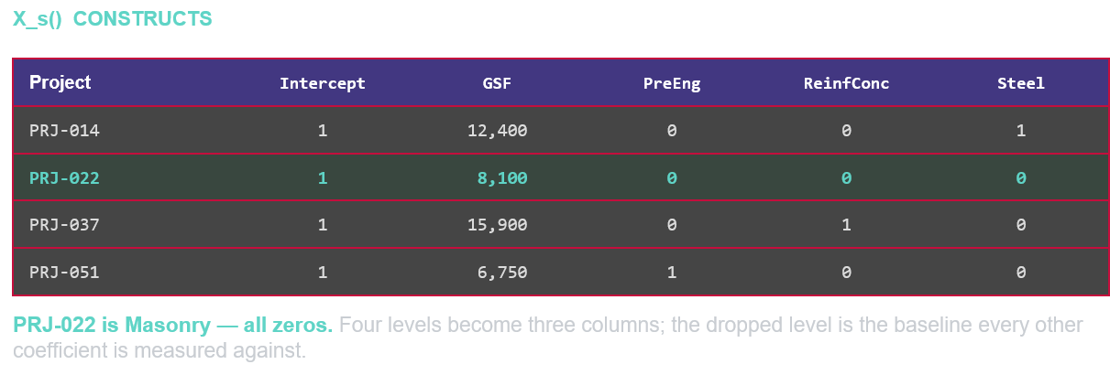
Template Constructs Regression Dataset
Set one dropdown to Categorical, and this is the matrix the sheet hands the regression engine.
YOU DECLARE
Building_Construction_Type
Role Predictor
Type Categorical
→
The Analysis ToolPak takes a contiguous block of numbers. Building this grid by hand is the work it leaves to you.
This is more consistent with minitab or statsmodels methodology.
Notes:
[7:00] You declare; the sheet constructs.
This is the conceptual center of the talk. Slow down, and let people actually read the grid.
Point at the left box first: one column of the source table, Role Predictor, Type Categorical. Two dropdowns.
Then the grid on the right. That is the design matrix. It is the object the regression actually runs on, and most people have never seen theirs. Four projects, and the construction type column has become three numeric columns.
Walk one row. PRJ-014 is steel frame, so it carries a 1 in the Steel column and zeros elsewhere. PRJ-037 is reinforced concrete, 1 in that column.
Now the row that matters, PRJ-022, highlighted. It is masonry, and it is all zeros. Masonry did not get a column. That is not an omission — the all-zero row IS masonry. Four levels became three columns, and the level that got dropped is the baseline every other coefficient is measured against. When you read "Steel Frame, plus 1.2 million," the unstated end of that sentence is "compared to masonry."
Then the bottom strip. The ToolPak takes a contiguous block of numbers, and that is the entire interface. It cannot take a text column and it cannot build this grid. Everything you are looking at is work it leaves to you, in helper columns you maintain by hand.
If one slide has to land, it is this one.

Slide 15
What the declaration replaces
The manual steps that used to sit between your data table and your model.
 | Categorical drivers | Panel / FE | Reference control | Prediction encoding | Auditable
Analysis ToolPak | — | — | — | — | ◐
Hand-built indicator columns | ◐ | ◐ | ◐ | — | ◐
Declared in the spec | ● | ● | ● | ● | ●
●
strong
◐
moderate
—
limited
Notes:
[15:30] What the declaration replaces.
The summary slide for this section. Three ways to do it: the ToolPak can't, hand-built columns can but fragilely, and the declaration does it by construction.
The row to point at is Prediction encoding. Hand-built indicator columns give you no mechanism to guarantee the prediction encoding matches the training encoding. That's the column where the manual approach doesn't just cost time — it's actually unsafe.

Slide 16
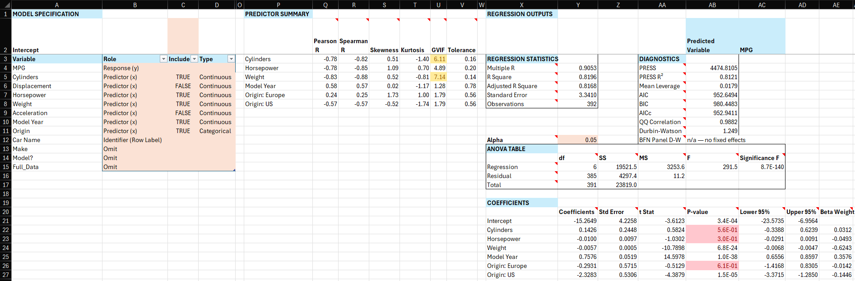
Demo 1 · Declaring a model
Lambda_Library.xlsx → Model Construction → Regression
Notes:
[16:15] DEMO 1 — five minutes. Declaring a model.
Run order:
Have a fallback screenshot ready. If Excel is slow to recalculate, talk over it rather than waiting in silence.

Slide 17
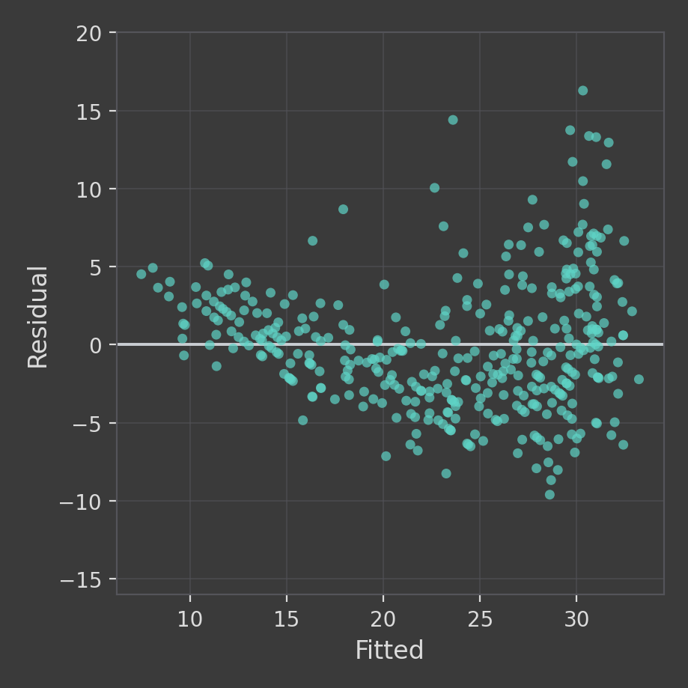
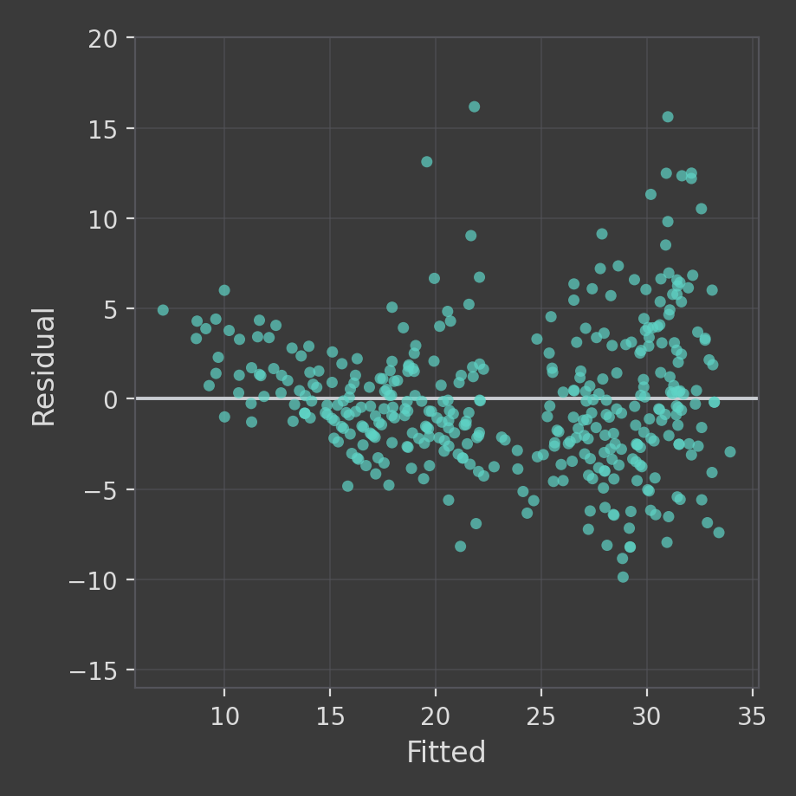
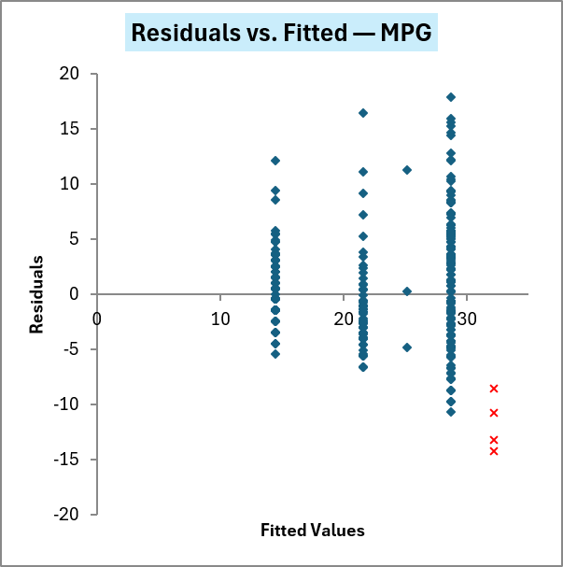
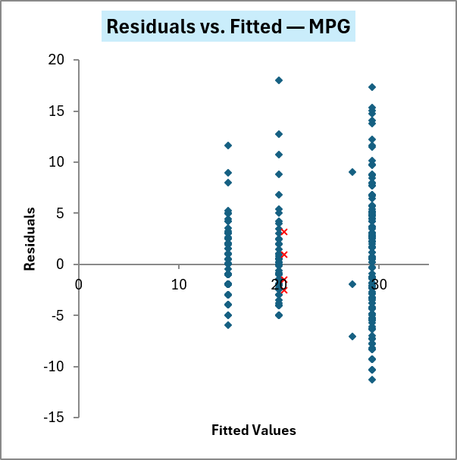
One dropdown changes the fit
Residuals vs. Fitted — same response, same predictor, same rows. Only Type changed. Important for decoding arbitrary data labels
Cylinder: Type = Continuous
Cylinder: Type = Categorical
Cylinder: Type = Continuous
Cylinder: Type = Categorical
Charts above also include HP.
Hard to see the category error with multiple Xs.
Level codes forced onto one slope — residuals curve away from zero instead of scattering randomly.
Each level gets its own intercept — the curve flattens into more random scatter; k−1 columns built for you.
Notes:
[11:45] FIGURE — one dropdown, two models.
Walk the two charts. Everything is held constant except Type on a single spec row.
On the left the level codes are being treated as a continuous quantity, so the model fits one slope through them and the fit is forced into a line that forces an assumption of linearity on your choice of labels.
This is the mistake that ordinal-coded variables invite, and it is common in real estimates.
On the right, Type is Categorical. Each level gets its own intercept, the reference level is dropped, and the k-1 columns were built for you.
Even better, leave them as the original values, don’t force ordinality.
An example of where I have seen this mistake is with Hazard Category encoding

Slide 18
Look before you model (No peeking)
EDA
Fit
Trim
Select
Diagnose
Predict
Pearson R
straight-line strength vs. target
Spearman R
any consistent up/down relationship
Skewness
shape — the cue to log-transform
Kurtosis
tails / outlier-proneness
GVIF
overlap with the other predictors
Reduces to Variance Inflation Factor when
Tolerance
1 / VIF — unique information
Reading it: Adult mortality ≈ −0.70 (top driver) · Pearson vs Spearman split → nonlinear · several drivers skew > 4 → log candidates
Notes:
[21:00] Look before you model.
Six diagnostics on every predictor at once, before anything is fit.
Two correlations: Pearson for straight-line strength, Spearman for any consistent monotonic relationship. When they disagree, the relationship is real but nonlinear — that's your flag to consider a transform.
Skewness and kurtosis describe shape. VIF and tolerance measure overlap among predictors.
We haven't fit anything. We're deciding what deserves to be in the model.

Slide 19
Fit, with confidence intervals
EDA
Fit
Trim
Select
Diagnose
Predict
fx
=Coefficients(X_s(), Response_Column(), Allow_Intercept, Sample_Include()) → estimate, std error, t, p, 95% CI
Driver
Coef
Std Err
t
p
Intercept
52.08
0.73
70.9
< .0001
Adult Mortality
−0.0179
0.0010
−18.6
< .0001
Alcohol
−0.104
0.031
−3.37
0.0008
percentage expenditure
0.00045
0.00006
7.66
< .0001
Intercept switch → whole table re-fits, live.
Notes:
[21:45] Fit, with confidence intervals.
Full regression in one call: each coefficient with standard error, t, p, and confidence interval.
The line worth saying out loud: a coefficient without a confidence interval is an opinion.
Note the formula now reads X_s(), Response_Column(), Sample_Include() — no ranges. The intercept switch re-fits the whole table live.

Slide 20
Trim collinearity — one toggle
EDA
Fit
Trim
Select
Diagnose
Predict
When two drivers move together, the model can't separate their effects — the coefficients get unstable. VIF flags it; the toggle fixes it.
Before
After one toggle
max VIF ≈ 7.6
max VIF ≈ 2.9
under-five deaths
7.59
→
under-five deaths
off
GDP
7.54
GDP
2.94
thinness 5–9
…
others
< 3
VIFj = 1 / (1 − R2j)
R2 = 0.87 → VIF = 7.6
standard error × √7.6 ≈ 2.8
Notes:
[24:00] Trim collinearity.
When two drivers move together the model cannot separate their effects, and the coefficients get unstable. VIF flags it; the Include toggle acts on it.
Work the two cards, then drop to the formula strip, which is the part worth adding.
VIF is one over one minus R-squared, where that R-squared comes from regressing one predictor on all the others. So it is not a mystical threshold — it is a direct readout of how much of this driver is already explained by the rest of your model. At 0.87, the other predictors already account for 87 percent of this one.
The right-hand end is what it costs you. VIF multiplies the VARIANCE of the coefficient, so the standard error moves by the square root. VIF of 7.6 means the standard error is about 2.8 times wider than it would be with independent drivers. Same coefficient, confidence interval nearly three times as wide.
That reframes the rule of thumb. People memorize "VIF above 5, or above 10" without knowing where it comes from. Now you can say: at VIF 10 your error bars are three times wider than they need to be, and that is the reason to care, not the number itself.
Turn the offender off, VIFs settle, coefficients update, and every interval downstream tightens.

Slide 21
Prediction R²: The honest metric
EDA
Fit
Trim
Select
Diagnose
Predict
0.851
0.837
R² (in-sample)
PRESS R² (held-out)
fit to data it already saw
each point predicted with itself removed
Barely drops out-of-sample. The model isn't memorizing — it'll generalize to the next case. A wide gap is what you want to catch before the review.
Notes:
[24:00] The honest metric.
R-squared measures fit to data the model already saw — it always looks good, that's its job. PRESS R-squared or Prediction R^2 predicts each point based on a regression with that point removed. It's an honesty check.
Here 0.827 versus 0.822 — barely moves, so the model generalizes. A wide gap means the fit is too sensitive to the sample, and it is much better to find that here than in the review.

Slide 22
A health check on the fit
EDA
Fit
Trim
Select
Diagnose
Predict
0.994
Q-Q correlation
residuals near-normal
0.0097
Mean leverage
under the 2p/n = 0.019 flag threshold
> 4/n
Cook's D flag threshold
n=1,649 → 0.0024 · severe above 0.9 regardless of n
Residuals vs. fitted — want a shapeless cloud on zero
Notes:
A health check on the fit.
Residuals against fitted values. Want a shapeless cloud on zero -- no funnel, no curve.
Q-Q correlation of 0.994 means residuals are close to normal, which is what lets the prediction intervals mean what they claim.
Leverage and Cook's D are the two outlier cards, and they answer different questions -- say this explicitly, because people conflate them. Leverage, the hat-matrix diagonal, measures how UNUSUAL a row's predictor values are, nothing about the response. High leverage alone is not a problem: a row can sit far out on the predictor axis and still land right on the fitted line. The flag threshold is 2p over n -- with p equal to 16 parameters and n equal to 1,649 rows here, that is 0.019, and our average of 0.0097 sits comfortably under it.
Cook's D is the one that matters on its own: it measures how much a row actually MOVES the fit if you drop it. The formula is the squared residual times leverage over one minus leverage squared, scaled by p and the residual variance -- so it only gets large when a row has both unusual predictors AND a residual the model does not explain. Flag threshold is 4 over n, which is 0.0024 at this n; anything above 0.9 is severe regardless of sample size.
The one-sentence version for the room: leverage tells you a row COULD be influential; Cook's D tells you it actually IS.

Slide 23
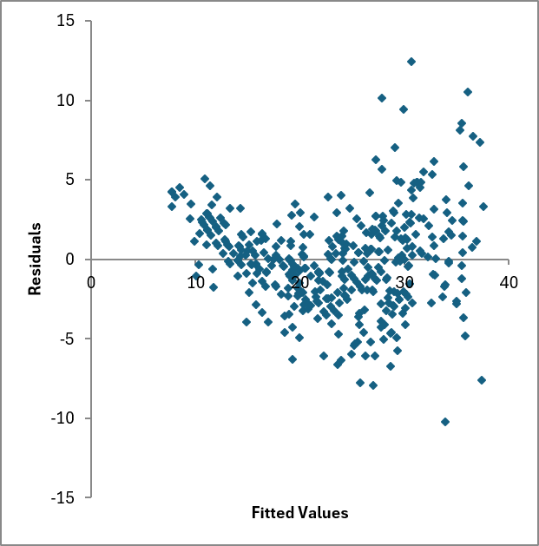
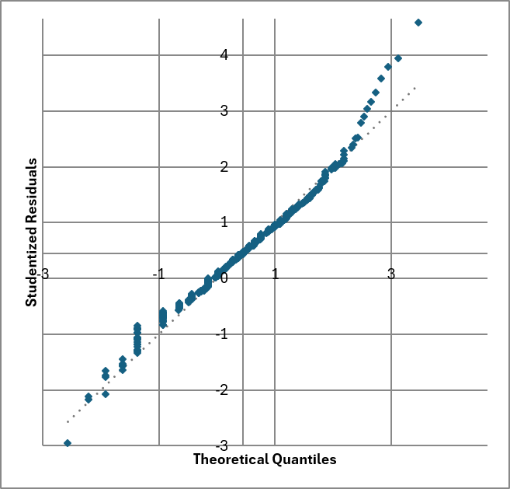
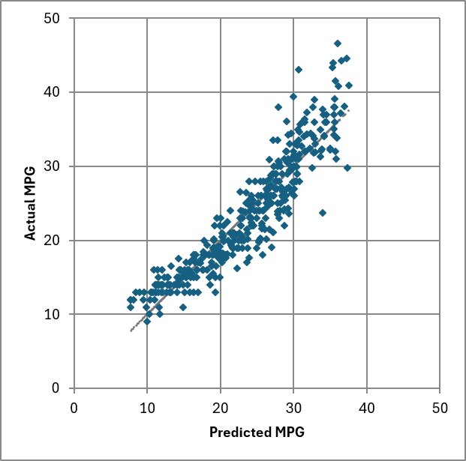
Seven views of the same fit
Tier 1 diagnostic plots the workbook builds for every model — reviewed left to right.
Residuals vs. Fitted
Normal Q-Q
Actual vs. Predicted
[ paste chart here ]
[ paste chart here ]
[ paste chart here ]
Want a shapeless cloud on zero. A funnel or curve flags nonlinearity or non-constant variance.
Studentized residuals against normal scores. Points on the diagonal mean normal errors.
Predictions against actuals with the 45° identity line. Tight along the line is a good fit.
Notes:
[23:15] FIGURE — three views of the same fit.
These are the three Tier 1 plots the workbook builds automatically for every model. The Diagnostic Guide sheet says: review these three every time, and only go to the Tier 2 plots if one of them raises a concern.
Left, Residuals vs. Fitted — you want a shapeless cloud sitting on zero. A funnel means the error variance grows with the fitted value; a curve means you've missed nonlinearity.
Middle, Normal Q-Q — studentized residuals against normal scores. On the diagonal means normal errors, which is what lets the prediction intervals mean what they claim. The QQ correlation cell puts a number on it.
Right, Actual vs. Predicted — the same information as the residual plot but from an angle anyone can read: dots on the 45-degree line is a good fit.
The point for this room: you didn't build any of these. They're pre-wired to the model, so they re-draw the instant the spec block changes. That's three standard diagnostics with zero setup, versus assembling them by hand off the ToolPak output.

Slide 24
Use Prediction Error, not Estimate Standard Error
EDA
Fit
Trim
Select
Diagnose
Predict
fx
=Prediction_Interval(X_s(), Response_Column(), x_new) → point estimate, SE prediction, t, lower, upper
ŷ
SE
[ , ]
Point estimate
Std error of prediction
Prediction interval
the model's best single guess
the spread of plausible actuals around it
range for a real new case
SE of prediction grows as the new case moves away from your data. The model penalizes extrapolation, automatically.
Notes:
[25:30] Predict, with uncertainty.
The piece that matters most for our work. Type a new case, get a prediction and the uncertainty around it.
This is a prediction interval for an actual new case — wider than a confidence interval on the mean, because it includes real-world scatter. The key output is the standard error of prediction.
It grows as the new case moves away from your data. The model penalizes extrapolation automatically, without you remembering to.

Slide 25
The interval, where it matters
fx
SE_prediction = s · √(1 + hₙ) interval = ŷ ± tα,df · SE_prediction
s
the regression's own scatter — the classic Standard Error of the Estimate (SEE).
hₙ (leverage)
grows as the new case moves away from the center of the fitted data.
At the center
interval is as tight as the model allows.
Past your data
it widens fast — that's the automatic extrapolation penalty.
t-distribution
on residual df — exact for the linear model, not an approximation.
Notes:
The interval, exactly.
For the people who want to see the arithmetic, and this is where the abstract's promise about surpassing SEE gets made good on.
s is the classic Standard Error of the Estimate -- the number everyone already reports, and the number that traditionally gets used as if it applied to every prediction equally.
It doesn't. SE of prediction equals s times the square root of one plus leverage, so it is ALWAYS at least as large as the plain SEE, and it grows specifically for cases that sit far from the center of your fitted data. Near the center, root of one plus a small h is barely above 1, so the interval is close to what SEE alone would give you. Extrapolate, and h grows, and the interval widens automatically -- no judgment call, no manual adjustment, just the same leverage number from the diagnostics slide doing a second job.
That is the concrete answer to "how is this better than SEE": SEE is a single number for the whole model; this is SEE adjusted row by row for how far out on a limb you are asking the model to predict.
The interval itself uses a t-distribution on residual degrees of freedom, so it is exact for the linear model, not an approximation.

Slide 26
Demo 2 · Screening, diagnostics, prediction
Lambda_Library.xlsx → Regression sheet, left to right
Notes:
[27:15] DEMO 2 — five minutes. Screening, diagnostics, prediction.
Work the Regression sheet left to right:
1. Screening panel — point at the highest VIF and the biggest Pearson/Spearman split.
2. Toggle the offending predictor off. Watch VIF, coefficients, PRESS all move together.
3. Flip the intercept switch. Whole table re-fits.
4. Residual plot and Q-Q. Point at one high-Cook's-D row in the residual table.
5. Enter a new case in the prediction block. Then move it far from the data and show the SE of prediction growing.
Step 5 is the one to protect if you're short on time — it's the most persuasive thing in the demo.

Slide 27
UNIVARIATE
Capabilities:
Histogram Binning/Charting
  3 Bin Count Formulas
    Freedman-Diaconis | Scott | Sturges
Distribution Fitting
  Closed Form
    Exponential | Normal | LogNormal | Triangular | BetaPERT
  Optimized (SLOW but no Solver)
    Weibull | Gamma | Beta
Goodness of Fit Comparison
Notes:
I’m going to go through some demonstrations on sample data. Again, this presentation and the final workbook use publicly available data to keep this presentation from being CUI. Here we can look at some WHO Life Expectancy data.
The workbook I’m going to share at the end has a Univariate sheet that uses a lot of the workbook scoped lambda functions I’ve built, and some worksheet scoped ones so I can have different sheets with different regressions in the same workbook for comparison.
I’ll quickly show that it calculates and charts for 3 different bin counts, from highest to lowest, FD, Scott, Sturges

Slide 28
Describe, visualize, formalize
The Univariate sheet, in the order you'd actually work — one input column drives all three sections.
1
Describe
This is where a three-point estimate stops being a guess.
Descriptive_Statistics returns all twelve at once — including a prominent missing count, because a silent n is how bad estimates happen.
2
Visualize
Sturges, Scott, and Freedman-Diaconis binning side by side. Three defensible answers to “how many bins” rather than one arbitrary one or Excel’s default.
3
Formalize
Fit distributions to the shape you just saw, and rank the candidates on the same table.
Skewness motivates the distribution choice
Notes:
[31:15] Describe, visualize, formalize.
Switching sheets. The Univariate sheet is one input column driving three sections in the order you'd actually work.
Descriptive statistics returns all twelve at once including a prominent missing count — a silent n is how bad estimates happen.
Three binning methods side by side: Sturges, Scott, Freedman-Diaconis. Three defensible answers to "how many bins" rather than one arbitrary one.
Then formalize the shape you just looked at. Say it directly: this is where a three-point estimate stops being a guess.

Slide 29
Distribution fitting without Solver
Eight candidates, maximum likelihood throughout, ranked in one table — and no add-in to enable.
1
Closed form where it exists
fx
NLL_Lognormal(data)
Normal, Lognormal, Exponential.
2
Grid search where it doesn't
fx
Grid_Search_Optimum(two-input Data Table)
Weibull, Gamma, Beta, BetaPERT, Triangular.
3
Ranked on a common scale
fx
GoF_AIC · GoF_Anderson_Darling
AIC, BIC, K-S, Anderson-Darling.
The obstacle was never “MLE without Solver” — it was MLE in closed form. A native two-input Data Table over the likelihood surface clears that bar, and every recalculation gives the same answer.
Notes:
[32:15] Distribution fitting without Solver.
Eight candidates: Normal, Lognormal, Exponential, Weibull, Gamma, Triangular, Beta, BetaPERT. Maximum likelihood throughout — not method of moments.
Closed form where it exists. Where it doesn't, grid search over a native two-input Data Table.
The reframing is the interesting bit: the wall was never "MLE without Solver," it was "MLE in closed form." A Data Table over the likelihood surface clears that bar, with no add-in and no optimizer — and it gives the same answer on every recalculation, which matters for auditability.
BetaPERT will get attention from this room. Be ready for it.

Slide 30
Demo 3 · Fitting a distribution, then taking it with you
Univariate Analysis → then Move or Copy into a workbook of your own
Notes:
[33:15] DEMO 3 — three minutes. Fit a distribution, then take the sheet with you.
1. Point the Univariate sheet at a column. Show descriptives and the skewness value.
2. Show the fitted comparison table ranked by AIC, and the Q-Q plot for the winner.
3. Then the portability piece: right-click the Regression tab, Move or Copy, into a second workbook, Create a Copy.
4. Show that all 112 functions came with it, and re-point the spec at a different table.
Keep this tight. If you're behind, drop steps 1 and 2 and do only the Move or Copy — portability is the thing people need to see to believe.

Slide 31
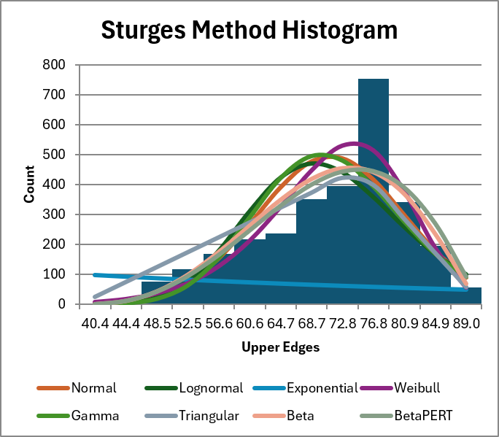
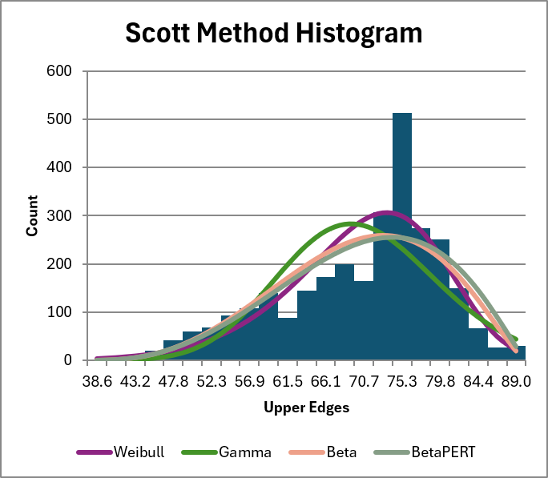
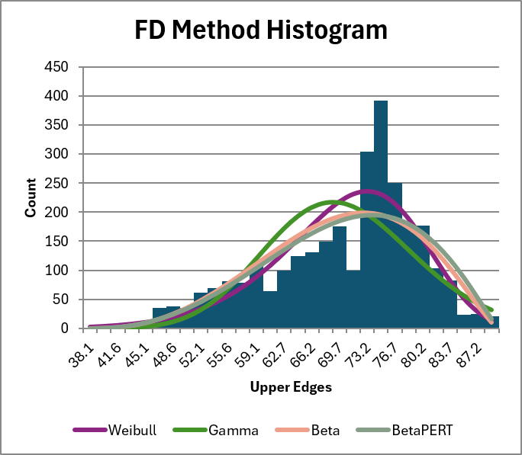
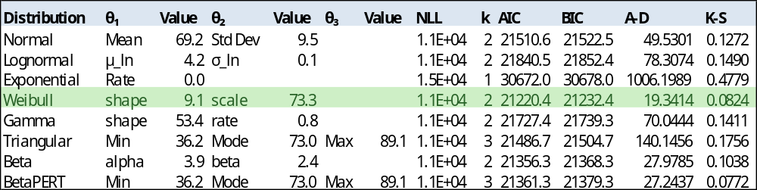
Lambda Library Workbook
3 bin formulas: Example n=2928,
Sturges bins 13, Scott 23, Freedman-Diaconis: 30
Notes:
The way I am version tracking this and keeping it reproducible is by generating the spreadsheet using python, but keeping all the calculations in Excel, so it works on any dataset.

Slide 32
Can you trust my math?: Results Verification
Same inputs, same answers — checked against the Analysis ToolPak and Python statsmodels on every release.
Regression statistics
ANOVA
Coefficient · Adult Mortality
Multiple R
0.909
F
518.9
Estimate
−0.0179
R Square
0.827
Significance F
≈ 0
Std error
0.00096
Adj R Square
0.825
df (reg / resid)
15 / 1,633
t Stat
−18.6
Std Error
3.680
MS residual
13.54
P-value
< 0.0001
Observations
1,649
95% CI
[−0.020, −0.016]
Notes:
[35:45] Results verification.
Before anyone asks: do the numbers check out.
The library reproduces the entire ToolPak regression output — regression statistics, full ANOVA, coefficient table with standard errors, t-stats, p-values, confidence intervals — and goes past it with VIF, Cook's D, leverage, studentized residuals, PRESS, AIC/BIC, and cross-validation.
Same model run three ways: this library, the ToolPak, and statsmodels. They agree to about ten decimal places. That's floating-point noise.

Slide 33
Benefits
Properties of a formula-based approach to regression.
Transparent
Traceable
Every calculation is a visible formula. Nothing hidden in modules or compiled code — what you see is what runs.
Formulas reference the source table by name. A reviewer can click any cell and follow it back to the raw data.
Live
Uncertainty-ready
Change an input and the entire model recomputes. No re-running, no scripts, no stale snapshots.
Built around prediction intervals and SE of prediction — not just a point estimate.
Notes:
[37:50] Benefits.
Four properties that make a formula-based approach a legitimate analytical choice, not a novelty.
Transparency, traceability, liveness, and uncertainty. Liveness is the one people underrate: because there's no re-run step, you can review several model specifications in the time it takes to run one script, which changes how much exploration you actually do.

Slide 34
What travels with the file
The workbook is meant to be self-documenting
The catalog is the documentation
Diagnostic Guide sheet
The LAMBDA_functions sheet is generated from the same source as the workbook. The formula in the sheet is the formula in the Name Manager. There are more details regarding the arguments, the description and a plain-language summary
Threshold reference, plot specifications, and common patterns with next steps — so reading a diagnostic doesn't require me standing next to it.
Instructions sheet
Release notes, in the workbook
How to point the spec block at your own table, and what each control does. Written for somebody opening the file cold.
Changes are recorded on a sheet inside the file, with an explicit flag for anything that would make a workbook you already built compute differently.
Notes:
[40:00] What travels with the file.
The workbook has to stand on its own when it is forwarded to somebody who was never in this room, so the documentation lives inside it rather than alongside it.
The catalog sheet is generated from the same source as the workbook, so the formula in the sheet is the formula in the Name Manager. There is no second copy to drift.
The Diagnostic Guide is the one people use most: thresholds, what each plot should look like, and common patterns with what to do next. The Instructions sheet is written for somebody opening the file cold.
Changes are recorded on a sheet in the file, with an explicit flag for anything that would make a workbook you already built compute differently. That flag is the only signal most people need.

Slide 35
Getting it onto your own data
The workbook is built for portability. Copy one sheet and the library comes with it.
112 LAMBDA functions
Sheet-scoped constructors
Scoped to the workbook. Copy a sheet that uses them and they travel with it — nothing to install, nothing to enable.
X_s, Response_Column, Sample_Include and friends read the spec block, so they follow whatever you declare on your own table.
Four steps, start to finish
1
Right-click the Regression tab → Move or Copy → your workbook → ✓ Create a copy
2
All 112 LAMBDA functions transfer automatically — they are workbook-scoped
3
Point the sheet at your table, then declare each column on the spec block:
Response = Cost Predictor = Weight, Phase, Contractor Filter = Complete Sequence = Fiscal Year
4
Everything recomputes on your data — design matrix, VIF, PRESS, diagnostics, intervals.
Notes:
[39:15] Getting it onto your own data.
The functions are workbook-scoped, so copying a sheet brings all 112 with it. The constructors are sheet-scoped and read the spec block, so they follow whatever you declare on your own table.
Four steps: Move or Copy the Regression tab into your workbook, point it at your table, declare the columns, done. Everything recomputes.
This is the slide people photograph. Pause on it.

Slide 36
Roadmap
Feature order is somewhat controlled by dependencies, but I am aiming to get useful cost estimating stuff done first
Transforms and unit-space R²
Model comparison sheet
Log from the spec block, Duan's smearing on the way back. Proper unit space comparison of Linear, Power, Exponential, Logarithmic model fits
One row per model — R², AIC, BIC, PRESS, n, k — with one shared what-if scenario driving all of them.
Weighted least squares
Two-sample tests
Weight as a Role, threaded as an optional argument defaulting to uniform — OLS is unchanged.
One-sample and two-sample t, Welch, paired, and an F-test that recommends which variant to use.
Resampling and simulation
Bootstrap and Monte Carlo from a pre-seeded table. A CI that moves on every recalculation is not a result.
Notes:
[40:45] What's next.
Ordered by what estimators ask for. Transforms first, because a Log dropdown plus Duan's smearing on the back-transform is what makes cross-model comparison honest — R-squared on logged cost and R-squared on cost are not the same quantity.
Then model comparison, then bootstrap and Monte Carlo.
On bootstrap, note the design choice: draws come from a pre-seeded table, not RANDARRAY. A confidence interval that changes every time the sheet recalculates, with no record of which sample produced which, is not a result.
Invite input — this order moves based on what this community asks for.

Slide 37

Where to get it
With Access to DOE github:
https://github.doe.gov/stephen-colodner/statistical_analysis_lambda_catalog
Download Lambda_Library.xlsx and open it. That's the install.
Email: stephen.colodner@nnsa.doe.gov
Please email me with any sticking points if you decide to use it in an estimate.
Notes:
[41:30] Where to get it.
Public repository. Download the .xlsx and open it — that is the entire install. No admin rights, nothing to clear.
Ask for two things: try it on a real estimate and tell me where it breaks, and tell me which roadmap item you'd want first.
[42:30] Open for questions. Backup slides follow on validation methodology and the function catalog.

Slide 38
BACKUP

Slide 39
The LAMBDA_functions sheet
A browsable catalog — the workbook documents itself.
Each row is one function
Name — the callable function name
Arguments — parameters, [optional] in brackets
Yields — scalar / vector / array
Formula — human-readable formula body
Plain Language Summary — plain-English explanation
The catalog is the spec
The formula in the sheet is the formula in the Name Manager — no separate documentation to go stale.
Open Name Manager and you see the same 126 entries — functions, arguments, descriptions — matching the catalog exactly.
Adding a function: edit the JSON source and rebuild. The catalog and the workbook update together, or neither does.
Notes:
BACKUP — the LAMBDA_functions sheet.
Use if asked how someone discovers what's available, or how the documentation stays current.
Each row is one function: name, arguments with optionals in brackets, what it yields, the readable formula body, and a plain-English description. The formula in the sheet is the formula in the Name Manager.
Adding a function means editing the JSON source and rebuilding — the catalog and the workbook update together, or neither does. There is no second copy to go stale.

Slide 40
Equation/Template Validation methodology
This library
=
Analysis ToolPak
=
statsmodels
native Excel LAMBDAs
Excel's built-in regression
Python reference
Analysis Toolpak capabilities:
Regression Statistics
ANOVA
Coefficients
95% CI
Predicted Values
Residuals
Standard Residuals*
Descriptive Statistics
Histogram Binning
Pearson Correlation
Additional features: tested against statsmodels only:
Predictor attributes (Pearson & Spearman R with y, Kurtosis, Skew)
GVIF
Tolerance
PRESS/LOOCV/Predicted R2
Studentized Residuals
AIC/AICc/BIC
Durbin-Watson (exp-aware)
Spearman & Partial Correlation
Distribution Fitting
Pearson & Spearman R with y, Kurtosis, GVIF, Tolerance
*Toolpak uses a different definition of “standard residual” than the internally studentized residual that accounts for residual degrees of freedom and observation leverage.
Notes:
BACKUP — validation methodology.
Use if challenged on correctness. Same model, three engines, every output compared: coefficients, standard errors, ANOVA, R-squared, PRESS. Agreement to roughly ten decimal places.
The point is independence: same textbook arithmetic implemented three separate ways, so you can verify against whatever tool you already trust.

Slide 41
Current Limitations
Real constraints, stated plainly. None of them are dealbreakers for cost work.
Scale – Not for BIG DATA
Two-way fixed effects
Comfortable in thousands of rows, not millions. Excel's ceiling is the tool's ceiling ~1.04M records, ~16k predictors
One Fixed Effects column absorbs today. Two is a visible status-block error — two-way absorption is on the roadmap.
Conditioning, not collinearity
Charts
Hardened against scale differences; it won't fix true collinearity — the VIF panel supports that judgment, doesn’t make it.
Plots can't consume live spilled results directly; they rely on minimally volatile OFFSET functions – can improve performance on a dataset of known size
Requires current 365
LAMBDA plus dynamic arrays — the key features that make it possible
Notes:
[38:30] Where it stops.
Say the constraints yourself before somebody finds them.
Thousands of rows, not millions. One fixed-effects variable absorbs today; two is a visible error, and two-way absorption is on the roadmap. The arithmetic is hardened against scale differences but that does not fix true collinearity — the VIF panel supports that judgment, it does not make it. Charts read fixed ranges. And it needs current 365.
None of these are dealbreakers for the kind of cost work we do, but you should hear them from me rather than discover them.

Slide 42
Fixed effects: absorb the group
Role = Fixed Effects. The column produces no coefficient — it removes the level differences you were never trying to estimate.
What it does
Why not just add dummies
Response and every design column are demeaned within group. What's left is how cost moves with a driver inside a program, not across programs.
A 60-program dummy set costs 59 columns nobody reads and a design matrix that conditions badly. Absorption gives the same slopes without it.
The degrees of freedom stay honest
It tells you when it can't
Absorbed groups feed an optional [DF_Absorbed] argument defaulting to zero — every standard error and interval corrects itself.
Two columns marked Fixed Effects is a visible status-block error, not a silently wrong answer. Two-way absorption is on the roadmap.
Notes:
[12:30] Fixed effects: absorb the group.
For panel data — Let’s say you’re trying to model some relationship with multiple data rows per program. Let’s say programs observed over several years. If we don’t want to pool all those, we can model a fixed effect. Program role equals Fixed Effects, and the column produces no coefficient. The response and every design column are demeaned within group.
What you are left with is the within-group relationship: how cost moves with a driver INSIDE a program, not across programs.
Two things to stress. The degrees of freedom correct automatically, threaded as an optional argument that defaults to zero, so a model with no fixed effects computes exactly as it otherwise would. And when it cannot do something it says so: two Fixed Effects columns is a visible error on the status block, not a wrong number. Two-way absorption is on the roadmap.

Slide 43
Absorbing the group
Actual vs. Predicted — same panel, same drivers. Only one column's Role changed.
No fixed effects
Fixed Effects = Program
[ paste chart here ]
[ paste chart here ]
Programs sit at different levels — the cloud splits off the 45° line by group.
Demeaned within program. Points tighten onto the identity line.
Notes:
[13:45] FIGURE — absorbing the group.
Same panel, same drivers, one column's Role changed.
On the left, programs sit at different cost levels and that between-program spread is being absorbed into the slope. The relationship you are estimating is a blend of within-program and across-program variation, and only one of those is what you meant to measure.
On the right, Fixed Effects on the program column. Everything is demeaned within group, and what is left is the within-program relationship.
Note that the degrees of freedom corrected themselves — the standard errors on the right already account for the absorbed groups.

Slide 44
Data transformation: Log the cost → lognormal
Costs are positive and right-skewed — a plain normal band can run negative.
1
Fit on ln(cost)
The skewness column tells you when you're here.
point the model's y at a log column — the functions don't care what's in it.
2
Predict in log space
you get a point estimate and SE on the log scale, as usual.
3
Exponentiate
back on the dollar scale: always positive, with a realistic long right tail.
Automatically adds Duan spread to the translation back into linear space. Don’t underestimate uncertainty based on a good Log-space fit
$0
Lognormal cost — long right tail, never negative
Notes:
[26:30] Log the cost.
One refinement for cost specifically. Costs can't go below zero and have a long right tail. A normal band around an estimate can run negative, which is nonsense for dollars.
Fit on the log of cost — these functions don't care what's in the column, so it's a one-line change. Exponentiate and the distribution is lognormal: always positive, realistic tail.
The skewness column from the screening panel is what tells you when you're in this situation.
Transform dropdown on the spec block is currently partially implemented, will have more roles in a future release. Lots of health checks on the regressions statistics need to be modified to give you unit space goodness of fit, not log space.

Slide 45
When your rows are a time series
Flag the ordering axis and the longitudinal machinery comes on. Nothing else about the model changes.
Gap-aware by construction
The period is inferred
Lag_By and Difference_By match on the actual period within group. A gap yields #N/A, never a stale value.
Δ is the modal spacing between consecutive periods, with a typed override when your data disagrees.
Durbin-Watson along the sequence
The panel statistic
Durbin_Watson_By walks the declared order. Ordinary DW can become meaningless once the dataset is sorted into a different order
BFN_Panel_Durbin_Watson is the right test once residuals are grouped by unit. It gates on the FE declaration.
The calendar warning
Spacings near 28–31, 90–92, or 365–366 get flagged — use a period index, don't quantize day counts.
Notes:
[14:30] Sequence and serial correlation.
If your rows are a time series, flag the ordering axis and this machinery comes on.
The gap-awareness is the part to emphasize. Lag_By matches on the actual period value within group. If a year is missing, you get #N/A — never the value from three years back, and never a fake zero. That failure mode is common in hand-built lag columns and it biases everything downstream.
Durbin-Watson walks the DECLARED order, not row order. An ordinary DW statistic becomes meaningless the moment someone sorts the table by cost, and nothing warns you.
Skip the calendar-warning card if you're behind time.

Slide 46
More Features and Future Work
More Regression Features:
Handling Fixed Effects
Treatment of Panel Data (Demeaning)
Weighted Least Squares (Weight role in spec)
Transforms beyond logarithm
Two-way FE (complicated – requires Absorbing two-way fixed effects, balanced demeaning, checking convergence)
Cluster and Time roles
Time Series
Other Features:
Model Comparison Sheet – all diagnostics at a glance across multiple models
Resampling & simulation without VBA (Monte Carlo & Bootstrap)
Bivariate/Two-sample
ANOVA
Fourier Analysis?
Decision Analysis?

Slide 47
Fixing one place the arithmetic could go wrong
Every leverage and prediction routes through a single matrix-inversion helper — by design.
fx
Hat_diagonal · PRESS · LOOCV · Studentized · Cook's · Prediction_Interval → Gram_Inverse
Today
Direct inversion of XᵀX.
Staged improvement
Scale each column before inverting — fixes precision when drivers live on very different scales, which cost data reliably does.
Why it's clean
Everything inherits from the one helper, so hardening it improves every diagnostic at once.
Scope
A numerical fix, not a statistical one — it changes precision, never the answers.
Notes:
One place the arithmetic can be wrong.
Every leverage and prediction routes through a single matrix-inversion helper. That's deliberate — one place to harden.
The staged improvement scales each column before inverting, which fixes precision when drivers live on very different scales. Cost data reliably does that: a weight in pounds next to a dollar figure in millions.
Because everything inherits from the one helper, hardening it improves every diagnostic at once. It's a numerical fix, not a statistical one — precision changes, answers don't.

