Slide 1
Operations Benchmarking
Justin Alcorta, Technomics, Inc.
Dr. John Derks, Technomics, Inc.
Office of Cost Estimating and Program Evaluation (CEPE), NA-1.3
National Nuclear Security Administration
August 11, 2026
UNCLASSIFIED

Slide 2

CEPE Background
Office of Cost Estimating and Program Evaluation (CEPE)
NA-1.3
  CEPE’s Statutory Role: “The Director shall be the principal advisor to the Administrator, the Deputy Secretary of Energy, and the Secretary of Energy with respect to cost estimation and program evaluation for the Administration.” - 50 U.S.C. § 2411 (b)(1)
  Established in the FY 2014 National Defense Authorization Act (NDAA) in recognition of a gap in the National Nuclear Security Administration’s (NNSA) capacity to independently determine the costs of programs and projects and adequately budget for them.
UNCLASSIFIED

Slide 3

Agenda
Problem
Challenge & Approach
Review Questions
Data Requirements
Forecasting
Review Tool
Next Steps
UNCLASSIFIED

Slide 4
Problem
A statutory review requirement exposed a practical challenge in assessing Operations requests.
“Reviewing the future-years nuclear security program [FYNSP] annually to ensure that the program is accurate and thorough.”
Statutory Requirement
— 50 U.S.C. § 2411(d)(1)(B)
Limited Review Basis
Significant Budget Exposure
Operations activities often lack formal cost estimates, project-style baselines, or lifecycle cost profiles.
Operations represent ~70% of Weapons Activities funding, and the FY26 Operations request increased by $5B, or 40%, between the 2023 and 2026 Presidential Budget Requests (PBR).
Review Need
CEPE needed a repeatable, independent benchmark to assess whether future Operations requests were reasonable and explainable based on historical performance.
UNCLASSIFIED

Slide 5
Challenge & Approach
!
Challenge
↗
Approach
?
Ideal Output
Operations funding requests are substantial and increasing.
Forecast Operations costs to create data-driven benchmarks.
Automated benchmark results presented in a flexible dashboard.
Operations often lack formal cost-estimates, making FYNSP review difficult to support consistently.
Condition, model, and validate historical cost data, then compare forecast results against FYNSP requests.
Identify where requests align with history, differ from forecast ranges, or need additional program justification.
UNCLASSIFIED

Slide 6
Review Questions
How does the request compare to historical behavior?
The analysis helps reviewers compare actual costs, planned funding, and FYNSP requests.
Alignment
Growth
Do actual costs, cost plans, and FYNSP requests tell the same story?
Is recent growth sustained, temporary, or concentrated in a few drivers?
Execution
Forecast Range
$
Does the request fall within a reasonable forecast range based on historical performance?
Is available funding being costed, or are balances and carryover accumulating?
Forecasting narrows the search: where the request and history diverge, analysts ask why.
UNCLASSIFIED

Slide 7
Data Requirements
DATA INPUT
REQUIRED STRUCTURE
WHAT IT ENABLES
Value in analysis
1
Historical Costs
Monthly cost and labor-hour actuals by site at the lowest NWBS activity; at least 12 observed months.
Builds the observed baseline used to forecast future cost behavior.
What was spent?
2
Cost Plans
Monthly, time-phased cost plans by site and NWBS activity; revisions submitted quarterly.
Measures plan-to-actual cost variance and identifies emerging execution gaps.
What was planned?
3
Available Funding
Monthly TAC by site and NWBS activity, calculated as current-year obligations + prior-year uncosted balances.
Reveals carryover, remaining spend capacity, and execution risk.
What remains?
4
FYNSP Requests
Budget-year and outyear requests by NWBS, fiscal year, revision.
Tests future requests against historical and planned benchmarks.
What is requested?
Common Key
All data sources must connect through the NNSA’s National Work Breakdown Structure
Analytical Output
Time-indexed data for comparing historical performance against future requests.
NWBS = National Work Breakdown Structure; TAC = Total Available to Cost
UNCLASSIFIED

Slide 8
Statistical Data Structure
What will it cost to complete a
defined scope of work?
What cost stream should we expect over
the next planning window?
Construction Projects
Operations Programs
Bounded lifecycle; phased cost profile
Recurring activity; historical cost stream
Start
Indexed cost
Actuals
Indexed cost
Plan curve
Historical actuals
Forecast start
Forecast
Closeout
Prediction interval
Start
Execution
Closeout
FY19
FY20
FY21
FY22
FY23
FY24
FY25
FY26
FY27
FY28
FY29
FY30
Defined start and finish
Milestone driven
Best suited for project estimates
Recurring mission support
Level, trend, and volatility are observable
Best suited for time-series benchmarks
UNCLASSIFIED

Slide 9
Time Series Forecasting
ARIMA
AutoRegressive Integrated Moving Average
  AR - Describes the degree to which successive values in a series depend on previous values (autocorrelation)
  How much does the past tell us about the present (and future)?
  MA - Forecasts are made using past forecast errors in a regression-like model
  How much does the past forecast error impact the current value?
  Requires data to be stationary
ETS (Exponential Smoothing)
Error, Trend, Seasonality
  Forecasts as weighted averages of past observations. More recent observations are given a higher weight.
  Error – Represents “noise” or “volatility”
  Trend – Represents direction
  Seasonality – Represents recurring patterns
  Does not require stationary data
Forecasting Challenge
Must forecast dozens of Operations of programs and thousands of program sub-elements.
Cannot know the context behind any individual program or program sub-element.
Only remaining option is univariate time series analysis.
Linear Regression
Simple univariate OLS with time as the sole predictor
UNCLASSIFIED

Slide 10
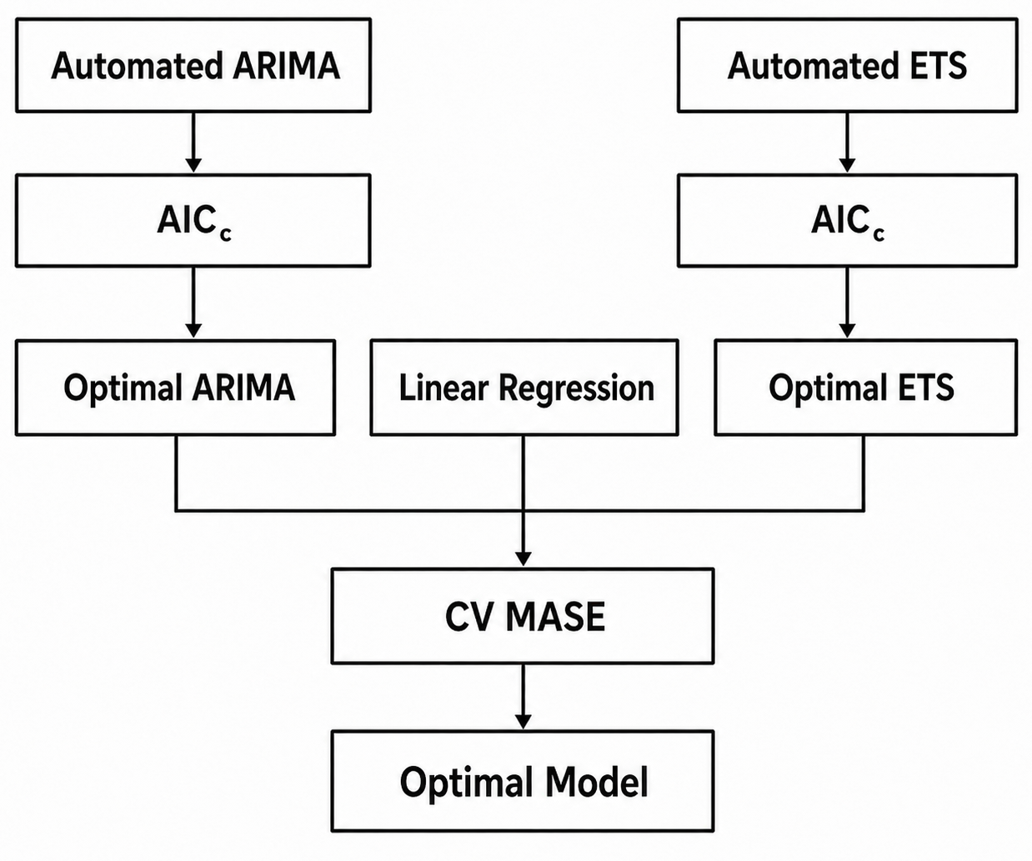
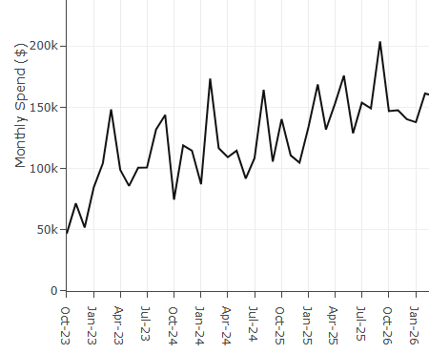
Dynamic Model Selection
Automatic ARIMA / ETS functions select the optimal ARIMA / ETS specification by minimizing the Akaike Information Criterion (AIC).
But how do we know whether to use an ARIMA, ETS, or linear model?
—
Which model is the best at forecasting over a future time horizon?
Mean Absolute Scale Error (MASE) to measure predictive accuracy.
Rolling-Origin Cross Validation MASE
"If I had been standing in the past and trying to predict the next __ months, how wrong would I have been?"
Input MASE within a rolling-origin cross-validation framework to measure accuracy over a future time horizon.
UNCLASSIFIED

Slide 11
Hierarchical Time Series with MinT
Minimum-Trace Optimal Reconciliation
1. Base Forecasts
2. MinT Weighting
3. Reconciled Result
County A: 56%
Historical Error: ±0%
Perfectly Reliable
National: 52%
Historical Error: ±4%
Moderately Reliable
County A: 56%
Moved 0%
Perfectly reliable
forecast holds
National: 51.45%
Moved –0.55%
Fairly reliable forecast absorbs some of the
adjustment
Uses each forecast’s historical uncertainty to determine how much it should move
National Reliability
Moderate = Low Flexibility
County B: 40%
Historical Error: ±20%
Low Reliability
County B: 46.9%
Moved +6.9%
Unreliable forecast
absorbs most of
the adjustment
County A Reliability
Perfect = Immovable
Base
County Forecast:
48%
≠
Base
National Forecast:
52%
County B Reliability
Low = High Flexibility
Reconciled
County Forecast:
51.45%
=
Reconciled
National Forecast:
51.45%
Alignment Problem:
Will Bob win?
Alignment Solution:
Bob will likely win
UNCLASSIFIED

Slide 12
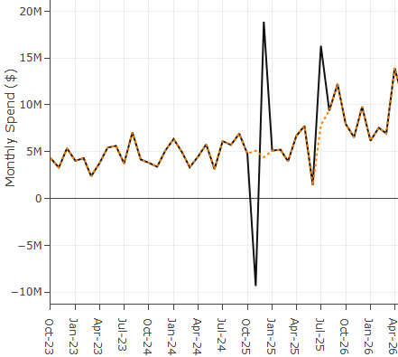
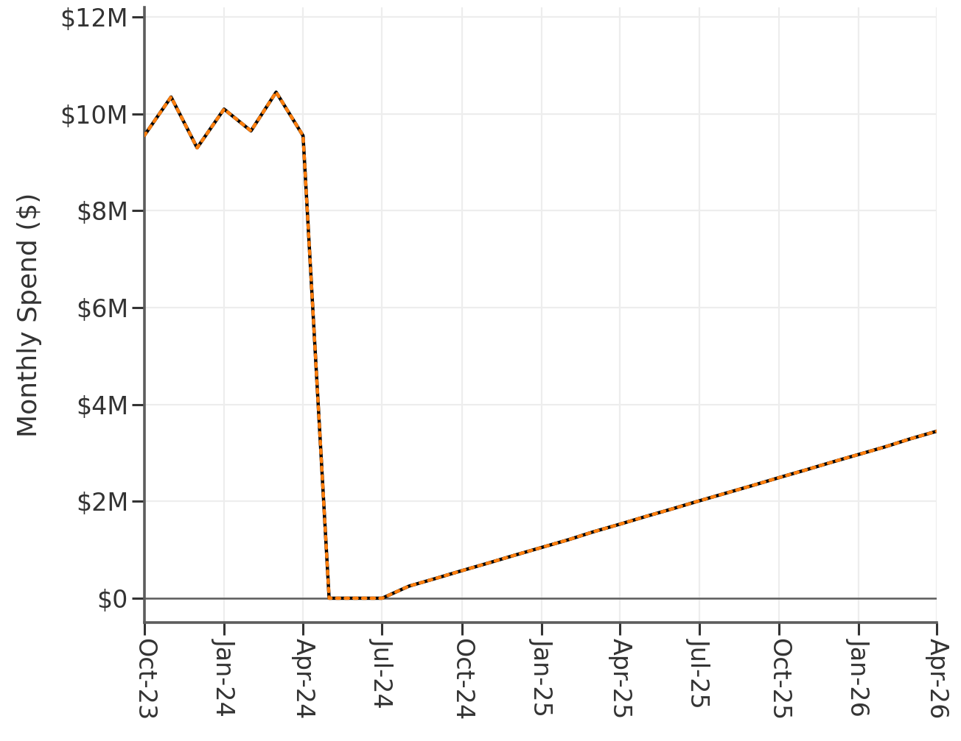
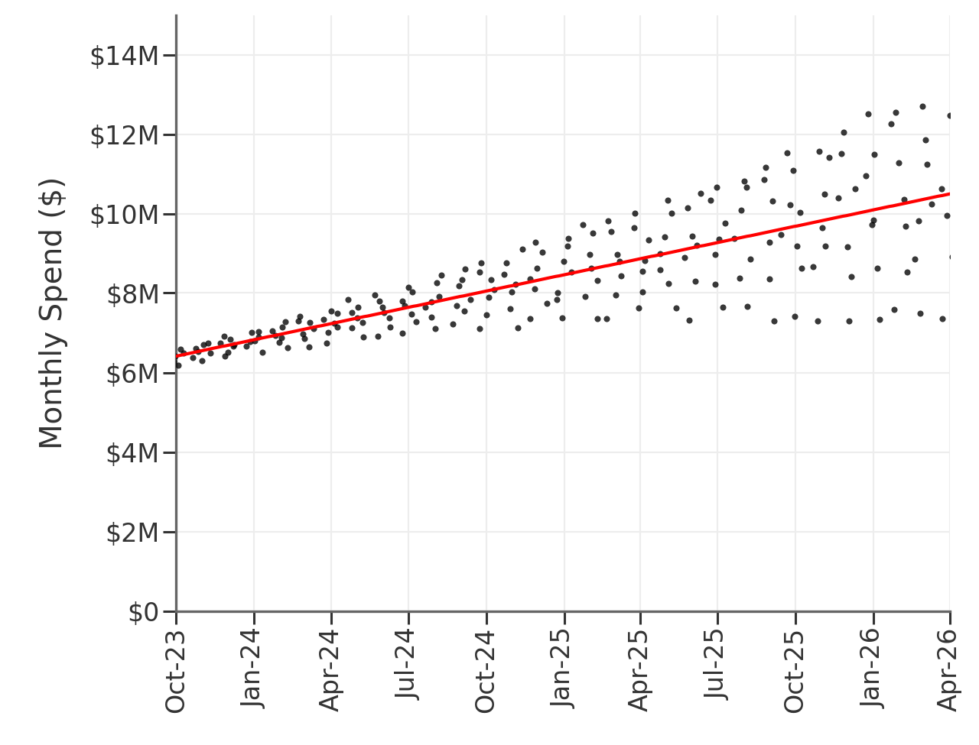
Series Conditioning
Box-Cox/Log Transformations
  Miscalibrated forecast uncertainty
  Impossible negative forecasts
  Overfitting to extreme values
Reconciling Negative Values
  Prevents logarithmic transformations
  Distortions in model selection and forecasts
Excluding "Discontinued" Series
UNCLASSIFIED

Slide 13
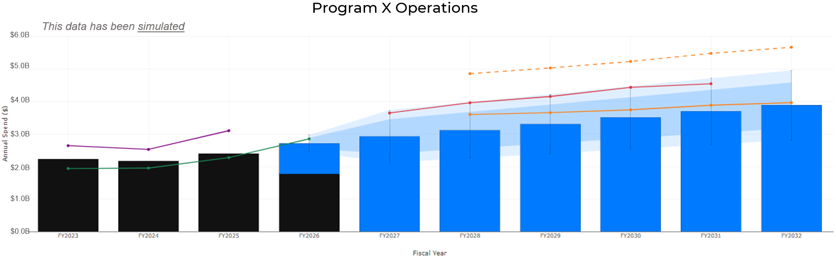
Forecast Benchmark
This data has been simulated
6
5
4
3
2
1
1
Historical costed
3
Total available to cost
5
FYNSP Request
2
Cost Plans
4
Forecast range
6
Review trigger
Forecast deviations trigger questions, not conclusions.
UNCLASSIFIED

Slide 14
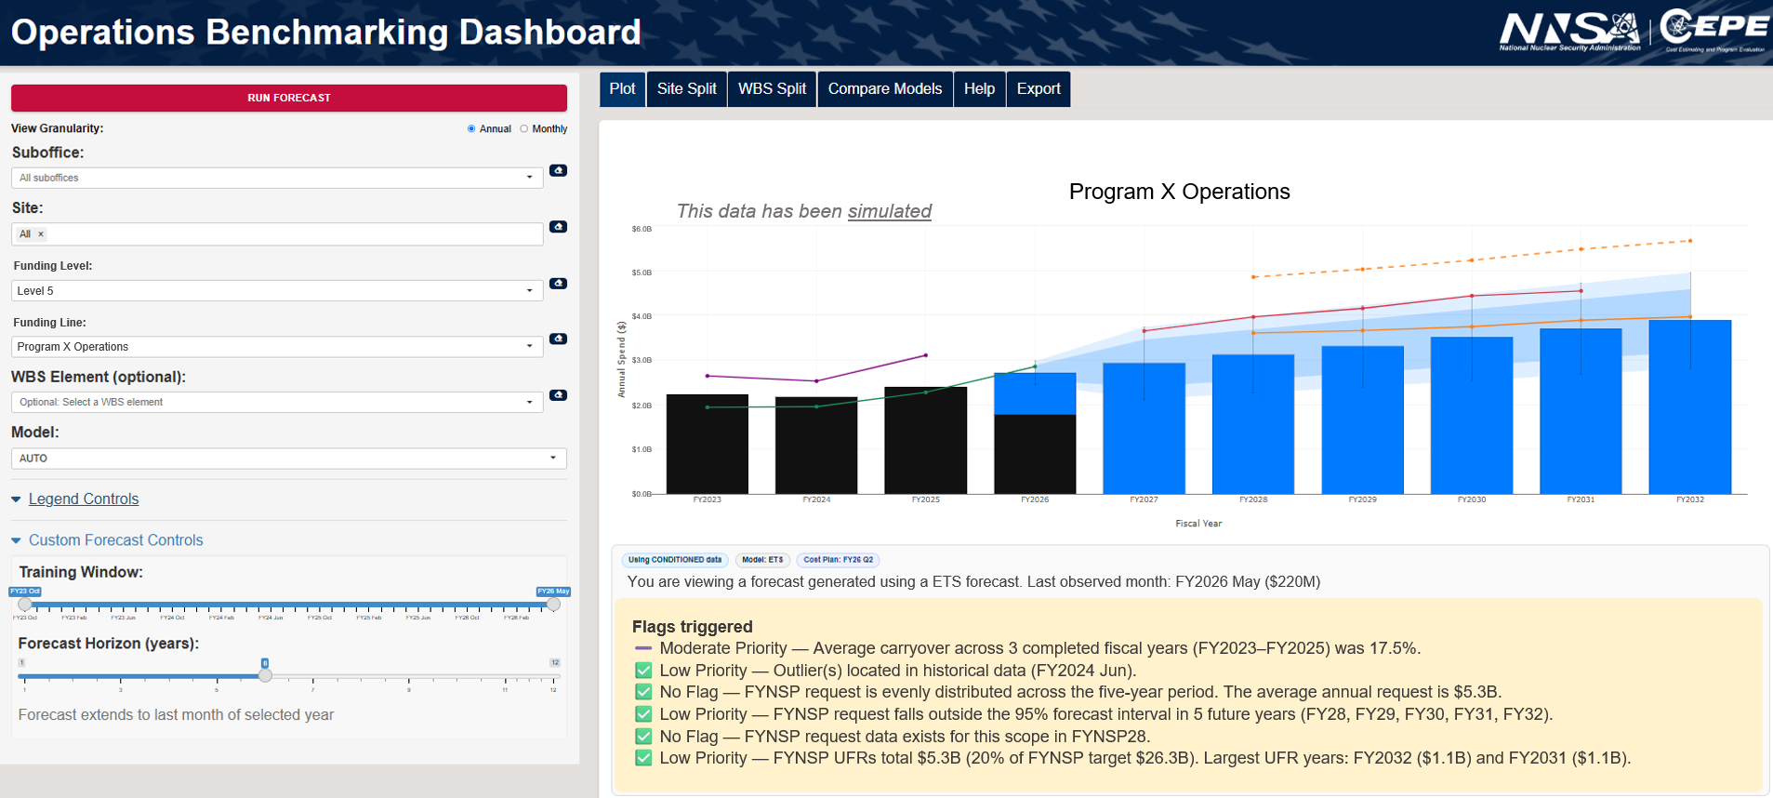
Review Tool
Compare request to benchmark
The chart overlays actuals, cost plans, request lines, forecasts, and prediction intervals
Select Scope
Choose granularity, site, program, sub-element, model settings, training window, and forecast horizon.
This data has been simulated
Review Flags
Identify carryover, outliers, forecast-range issues, and data availability concerns.
UNCLASSIFIED

Slide 15
Value Added
Before
Repeatable Tool
After
Manual data pulls
One-off comparisons
Limited repeatability
Review depth varied by series
Standardized comparisons
Automated forecast benchmarks
Documented assumptions and flags
Targeted review questions
Independent and data-driven method
Load
Clean
Forecast
Review
Same inputs, logic, and outputs.
Powered by modern statistical methods
What it changes for CEPE review
Time Saved
Coverage
Transparency
~10+ hours saved
per program reviewed
Dozens of programs reviewed
with consistent logic
Assumptions, exclusions,
and flags documented
The tool does not make budget decisions; it makes the review faster, more consistent, and easier to defend.
UNCLASSIFIED

Slide 16
Future Opportunities
Mature the benchmark into a mature programming capability.
Establish Review Guidelines
Program Engagement
Enable Continuous Monitoring
1
2
3
Define triggers and thresholds for analyst follow-up.
Share benchmark insights earlier in the FYNSP cycle.
Automate alerts for material changes and execution risks.
Standardize review takeaways while preserving analyst judgment.
Validate data, understand drivers, and document explanations for requests that diverge from history.
Reduce manual monitoring by focusing analyst attention on meaningful changes.
Embed the benchmark into the review workflow
UNCLASSIFIED

Slide 17
Questions?
UNCLASSIFIED

Slide 18
BACKUP
UNCLASSIFIED

Slide 19
Abstract
Program offices request billions of dollars in operations funding each year. These requests often lack a formal cost estimate, making it difficult for the enterprise to consistently evaluate and defend operations funding under strict budget constraints. As operations portfolios grow, this challenge increases the risk of unjustified growth and weakens decision-makers’ ability to prioritize funding across competing programs and projects. We introduce a benchmarking approach using time-series forecasting techniques built on historical execution data to project costs. This capability enables an independent evaluation of outyear funding requests, helping identify risks of surpluses and shortfalls while strengthening confidence in operations budgets.
UNCLASSIFIED

