Slide 1
Overview to EPA’s Soil Sampling Program
Santa Susana Field Lab; Area IV and Northern Undeveloped Lands
October 12, 2010

Slide 2
Today’s Presentation
EPA’s soil sampling objectives
Technical approach
Technical assistance to DTSC/DOE
Next Steps and Schedule

Slide 3
EPA’s Soil Sampling Objectives
Primary Objective:
- Characterize the general nature and extent of radiological soil contamination in SSFL Area IV and Northern Buffer Zone;
New Task:
- Collect and containerize soil samples for the DOE/DTSC chemical characterization effort

Slide 4
Parameters of EPA’s Rad Soil Testing
Locations: SSFL Area IV and the Northern Buffer Zone. May “chase” rad contamination from Area IV as appropriate.
Primary Data Screening Levels: Background radionuclide concentrations as defined by USEPA’s radiological background study
Rad Potential Contaminants of Concern:
- Default Suite: 53 rad analytes
- Site Specific Add-ons: Up to an additional 12 rad analytes based on site history

Slide 5
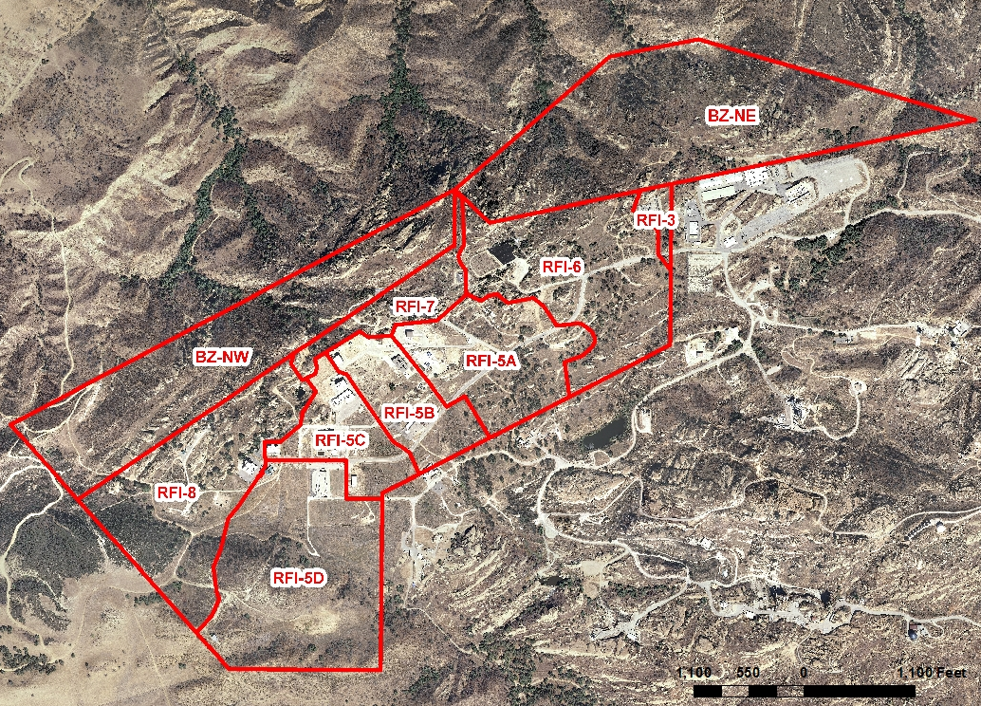
10 STUDY AREAS

Slide 6
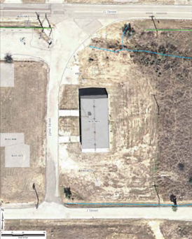
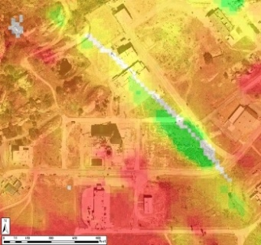
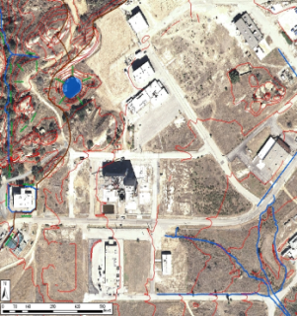
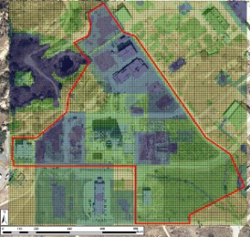
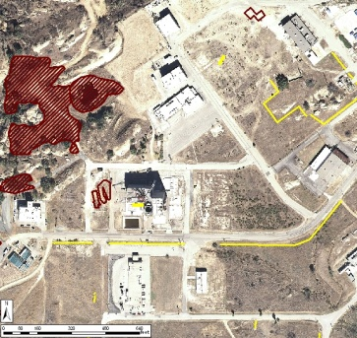
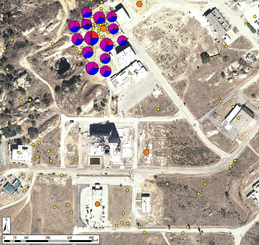

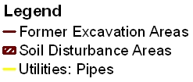
EPA’s Technical Approach for Indentifying Potential Source Areas
Historical Site Assessment
Process knowledge and facility operation history
Former worker interviews
Aerial Photo Interpretation
Past remediation and D&D
Gamma Survey
Field Observations
Identify PSAs
Gamma radiation
anomalies
Deposition or erosion areas
Topography
Drainages
Hypothetical
Hypothetical
Hypothetical Gamma Survey Results
Geophysical Survey
Past Environmental Data
Utilities
Former excavation areas
Areas identified by aerial photos and/or former worker interviews
Past characterization studies
Confirmation sampling results

Slide 7
Rounds of Soil Sampling
Round 1:
  Targeted Sampling: Based on all the technical inputs, soil samples are “targeted” to test each potential source area.
Round 2:
  Step-out Sampling: Based on Round 1 test results, “step-out” samples are needed to confirm extent of rad contamination only where screening levels where exceeded.
  Random Sampling: Systematic grid approach described in MARSSIM to randomly test areas that were not targeted during Round 1. Needed for complete coverage and test for drift from
  adjacent rad sources.

Slide 8
Summary of EPA’s Soil Sampling Approach
Step 1: Evaluate a wide range of information to identify potential source areas
Step 2: Use GIS Mapping to spatially locate each potential source area
Step 3: Prioritize and select potential source areas
Step 4: Layout targeted sample locations for selected source areas
Step 5: 1st Round: Collect and analyze targeted samples
Step 6: Evaluate and Publish 1st round data results
Step 7: 2nd Round: Collect and analyze step-out samples and random samples
Step 8: Evaluate and publish all data results

Slide 9
Status of EPA’s Soil Sampling Documents and Work
Master Soil Field Sampling Plan: Issued October 4th
Issue Sampling Addenda by Subarea: Subarea 5C Addendum for Round 1 Testing issued October 6th
Begin soil sampling in Area 5C: October 18, 2010
EPA will meet with Stakeholders concerning each Round 1 and Round 2 Addenda
Soil sampling work take approximately 14 to 18 months

