Slide 1
Office of Energy Efficiency & Renewable Energy
Advanced Manufacturing Office
An Overview of AMO Clean Water Analysis
Joe Cresko - Advanced Manufacturing Office, DOE
AMO Clean Water Workshop
Cleveland, OH
August 23, 2017

Slide 2

AMO Strategic Goals
Improve the productivity and energy efficiency of U.S. manufacturing.
Reduce lifecycle energy and resource impacts of manufactured goods.
Leverage diverse domestic energy resources in U.S. manufacturing, while strengthening environmental stewardship.
Transition DOE supported innovative technologies and practices into U.S. manufacturing capabilities.
Strengthen and advance the U.S. manufacturing workforce.
Multi-Year Program Plan
Describes the Office mission, vision, and goals
Identifies the technology, outreach, and crosscutting activities the Office plans to focus on over the next five years.
https://energy.gov/eere/amo/downloads/advanced-manufacturing-office-amo-multi-year-program-plan-fiscal-years-2017
Public feedback and comments can be sent to AMO_MYPPInfo@ee.doe.gov
2

Slide 3
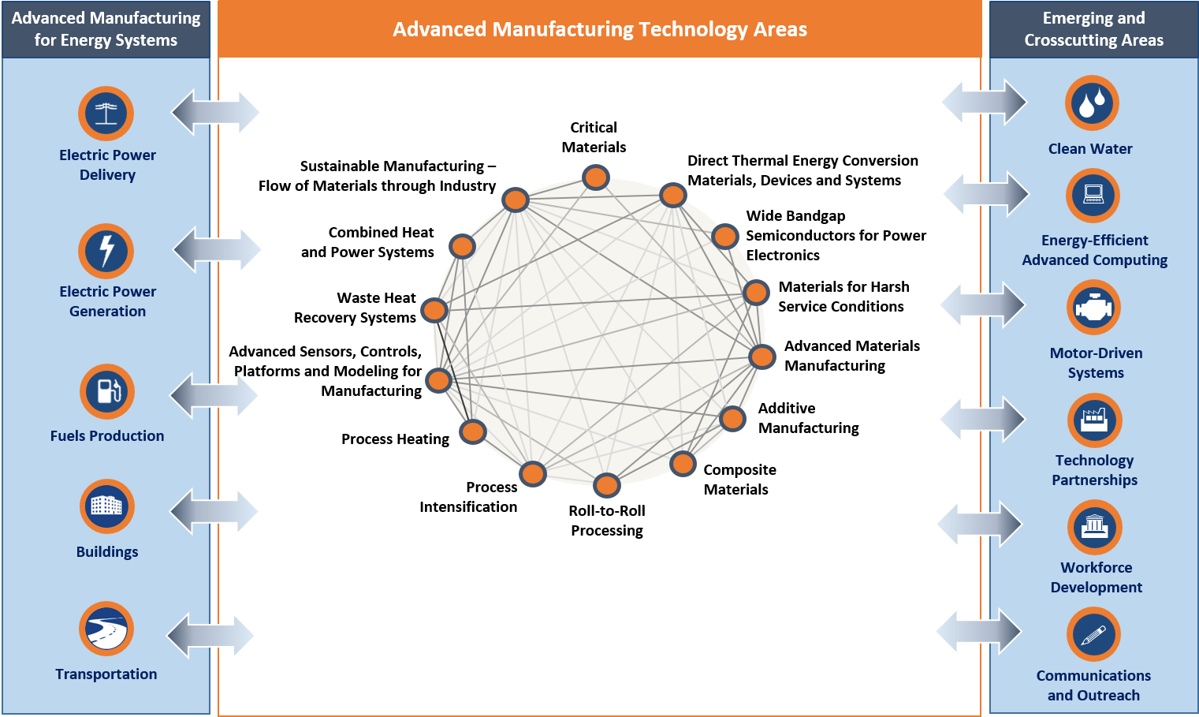
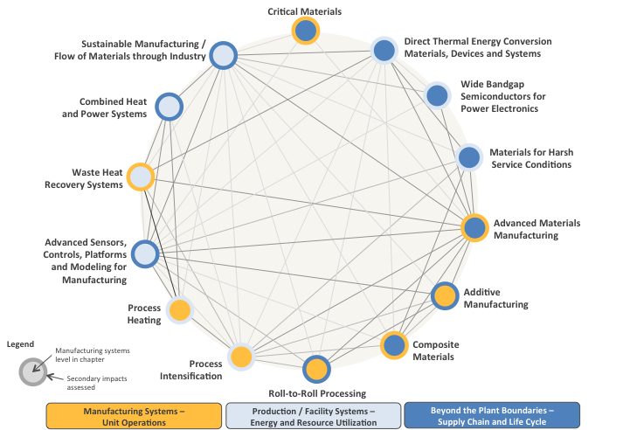
AMO Multi-Year Program Plan (MYPP) Framework and Clean Water
https://energy.gov/eere/amo/downloads/advanced-manufacturing-office-amo-multi-year-program-plan-fiscal-years-2017
Manufacturing Technology Assessments can be found here:
https://energy.gov/under-secretary-science-and-energy/quadrennial-technology-review-2015-omnibus#chap6ta
3

Slide 4
Clean Water Strategic Analysis Focus Areas
Manufacturing in a Connected Economy
e.g., What will be the impact of rapidly expanding information and smart products
Desalination Bandwidth Studies
e.g., What are the opportunities and impact of improved Desalination Technologies?
Clean
Water
Analysis Methodology, Tools & Integrating Analysis
e.g., How can we improve integrated water and energy analyses
Sustainable Manufacturing
e.g., Industrial water use; Advanced manufacturing technologies at the intersection of water, energy and materials
Goal: Increase the effectiveness of research into materials, technologies, and processes to reduce the impacts of water processing and water use.
Analysis outputs: DOE reports, Bandwidth studies, conference presentations, white papers and refereed journal publications.
4

Slide 5
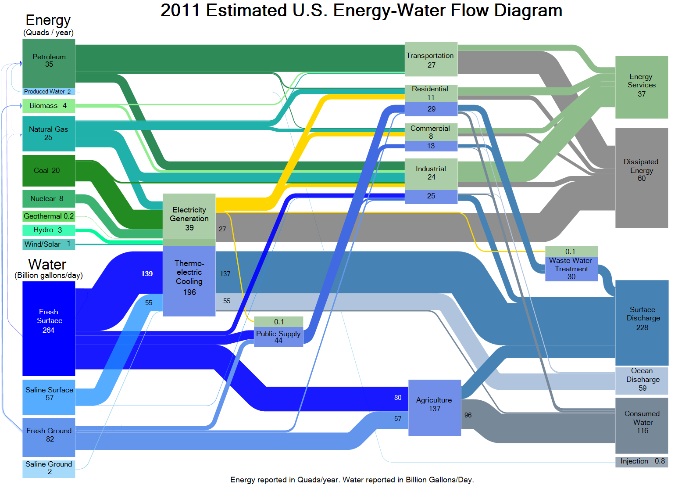
Energy-Water Nexus

Slide 6
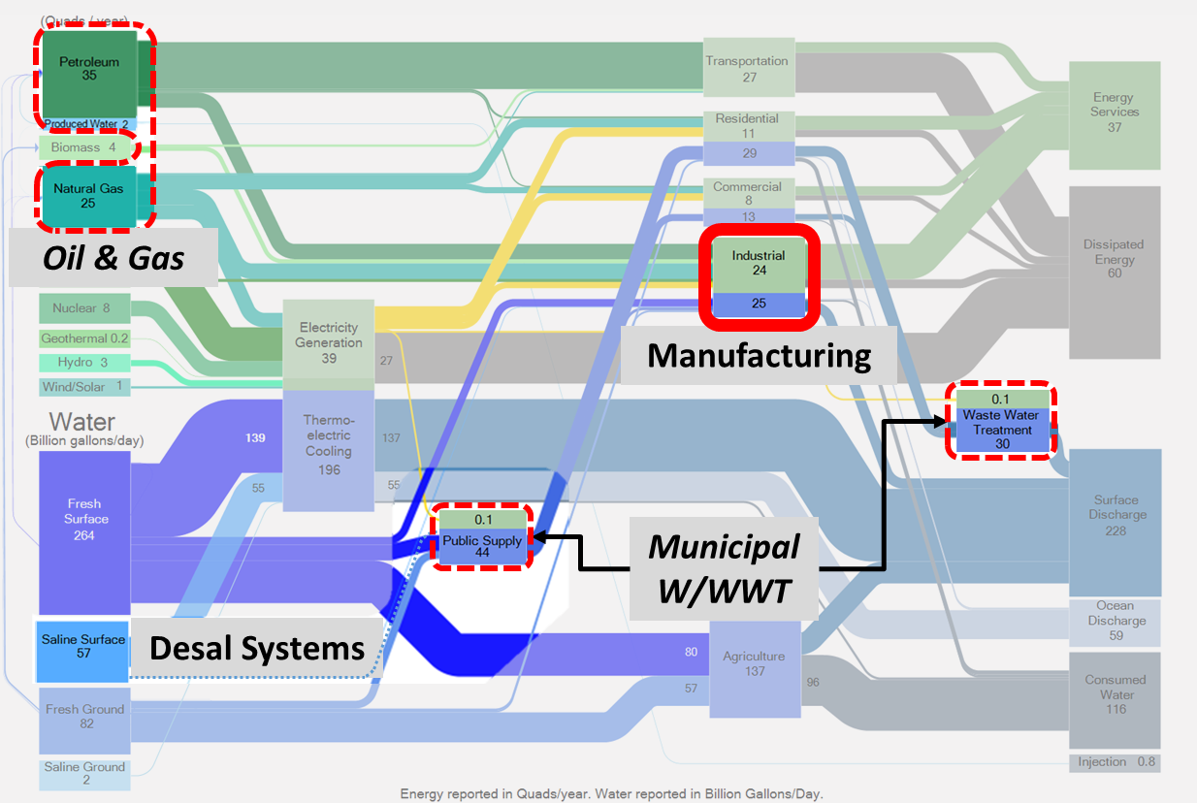

Targeted Analyses → Quantifiable Targets
High Salinity feed water with variable contaminant mix to produce industrial/ag grade water w/ FO, RO viable candidates
Reduce energy & water in specific sectors w/ sectors chosen based on watershed impact
Seawater for municipal potable water w/ RO, MSF, and MED candidates in focus
Reduce energy consumption of the water and wastewater sectors, including advanced resource recovery and reuse possibilities
Brackish water for potable water w/CDI, EDR, MF/NF, RO as candidates
Notes:
Desalination:
Seawater to produce municipal potable water w/ RO, MSF, and MED candidates in focus
Brackish water to produce potable water w/CDI, EDR, MF/NF, RO as candidates
Manufacturing
Opportunities to jointly reduce energy and water in specific sectors w/ sectors chosen based on watershed impact
Oil and gas: High Salinity feed water with variable contaminant mix to produce industrial/agriculture grade water w/ FO, RO among viable candidates
Municipal W/WWT: Opportunities to reduce energy consumption of the water and wastewater sectors, including advanced resource recovery and reuse possibilities

Slide 7
Crosscutting Technologies can have impact across the Energy-Water Nexus→ Quantifiable Targets
Separations
/treatment:
Membranes
Thermal
System integration:
Smart technologies
Modular designs
Processes
Joint energy grid/water system management
Fluids Pumping:
Motor driven systems
Materials
Heat transfer:
Corrosion resistant materials
Waste heat integration
Sustainability:
RE integration
Consumptive water use
Chemicals (alternatives)
Life cycle water use
Fit-for-use, reuse
ZLD
Infrastructure:
Piping
Structural materials

Slide 8
Water rates in the US (cost to customer)
Water costs (shown below for industrial customers) vary across the U.S.
Water Supply
City, State | Water Authority | Range of water supply rate (per m³)
Asheville, NC | City of Asheville | $0.64 - $1.17
Hartford, CT | Metropolitan District Hartford, CT | $0.94
Kansas City, MO | Kansas City Water Services | $0.97 - $1.68
Los Angeles, CA | LA Department of Water and Power | $1.68 - $2.27
Milwaukee, WI | Milwaukee Water Works | $0.41 - $0.70
San Antonio, TX | San Antonio Water System | $0.52 - $0.91
Virginia Beach, VA | City of Virginia Beach | $1.16
Rates taken from water authority website winter of 2016
Base and seasonal charges are not included
For more details see: DOE. 2016. Developing a Corporate Water Management Strategy for Manufacturers.

Slide 9
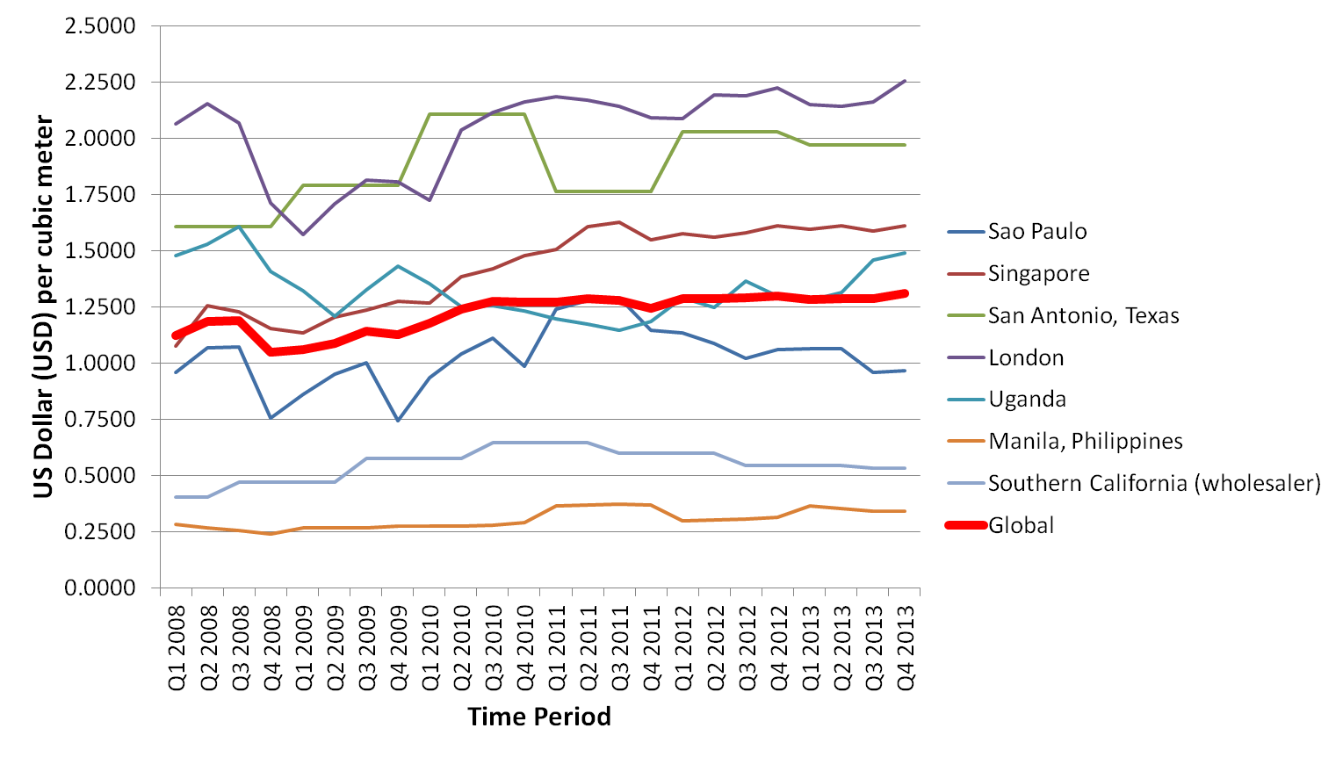
Cost of Potable Water Globally
Water costs vary by a wide margin globally, making the cost competitiveness of desalination location-specific
Cost = total cost of production/total delivered freshwater volume
From IBM Research: http://researcher.watson.ibm.com/researcher/view_group_subpage.php?id=5088

Slide 10
Bandwidth Analyses
8

Slide 11
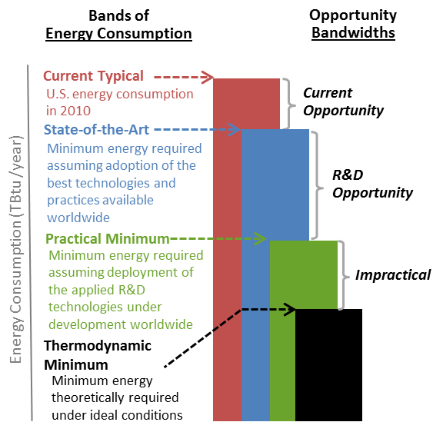
Energy Bandwidth Studies
4
2
Comparison of energy consumption for defined industrial process areas to determine bandwidths of energy savings opportunity
These bands of energy consumption and bandwidths of opportunity are useful for identifying areas of R&D technology focus.
Current Typical (CT) | State of the Art (SOA) | Practical Minimum (PM) | Thermodynamic Minimum (TM)
Literature review and stakeholder outreach, based on current typical processes in the U.S. | Literature review and stakeholder outreach, based on the most energy-efficient technologies and practices available worldwide | Calculated based on plausible energy savings from identified R&D technologies under development worldwide | Calculated analytically using Gibbs free energy assuming ideal conditions

Slide 12
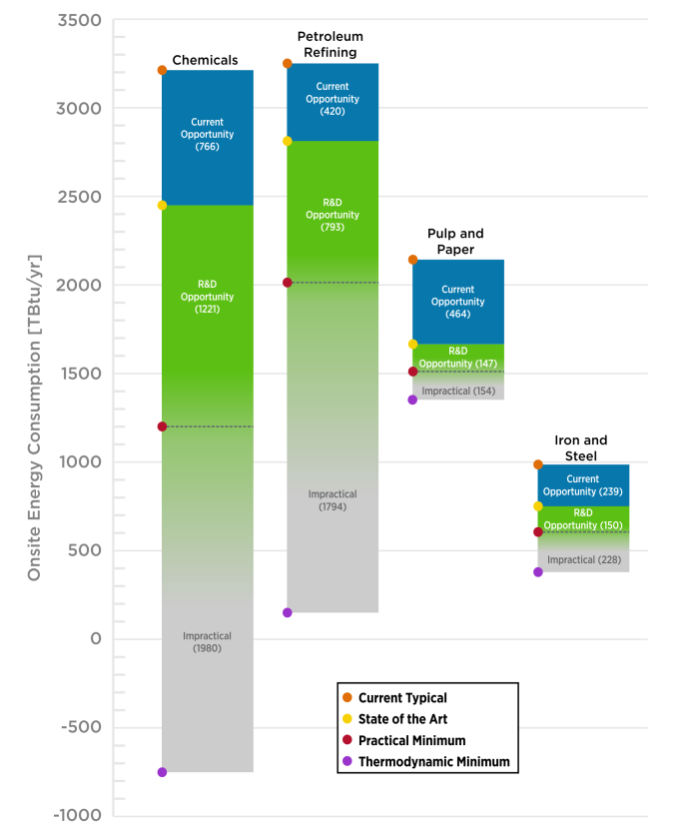
Recent Bandwidth Studies
Published 2015:
Chemicals
Petroleum Refining
Pulp and Paper
Iron and Steel
Published 2016:
Draft lightweight structural materials series:
Advanced High Strength Steel
Aluminum
Titanium
Magnesium
Carbon Fiber
Glass Fiber
Underway:
Cement
Glass
Plastics and Rubber Product
Food and Beverage
Seawater Desalination
https://energy.gov/eere/amo/energy-analysis-sector
Notes:
Which ones have been done (list sectors)
- Completed (published in 2015):
- Chemicals
- Petroleum Refining
- Pulp and Paper
- Iron and Steel
- Draft Lightweight Materials (published in draft 3/16)
- Advanced High Strength Steel
- Aluminum
- Titanium
- Magnesium
- Carbon Fiber Reinforced Polymer Composites
- Glass Fiber Reinforced Polymer Composites

Slide 13
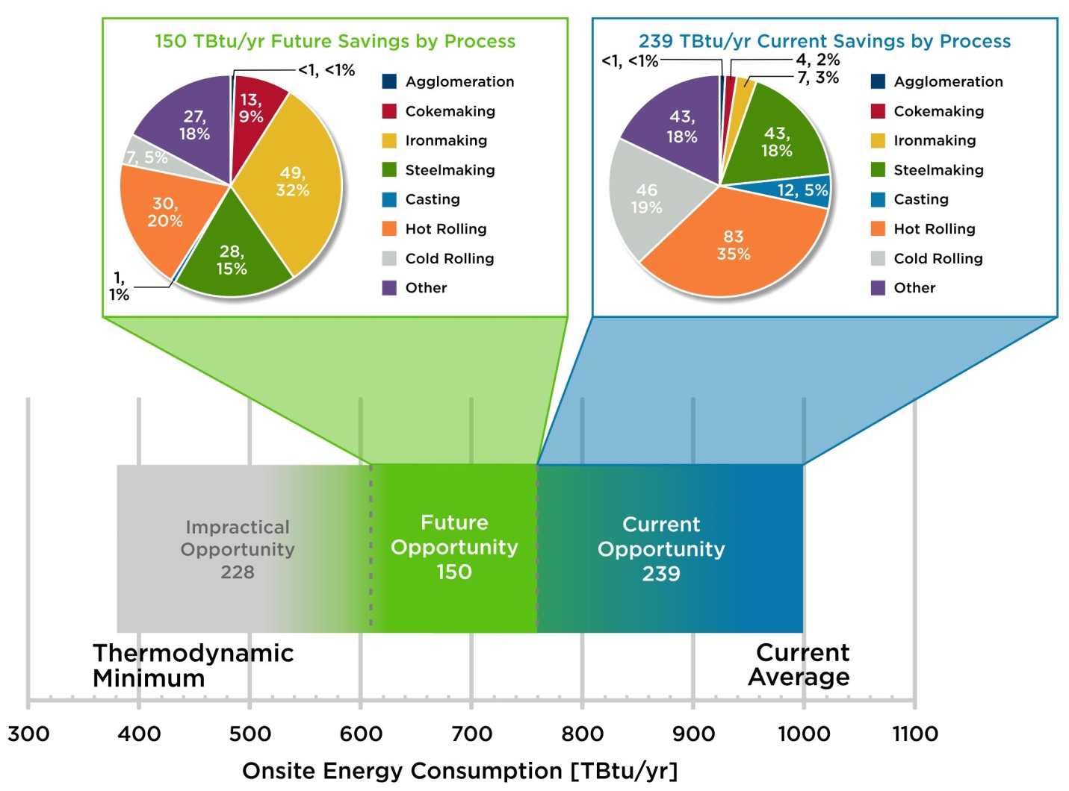
Bandwidth analyses are comprehensive, bottom-up studies starting at the manufacturing process/unit operation level ….
Technical Energy Savings Opportunities: Iron & Steel Industry
2015 Bandwidth Study – potential by major process area
Source: DOE/AMO, Iron & Steel Industry Energy Bandwidth Study (2014) Note: 1 quad = 1000 TBtu

Slide 14
Seawater Desalination Analysis
12

Slide 15
Energy Water Bandwidth Study of Seawater Desalination: 2 Volumes
Published
Volume | Contents
Volume 1: Survey of Available Information in Support of the Energy-Water Bandwidth Study of Desalination Systems | Boundary Analysis Framework Energy Intensities for Five Unit Operations of Desalination Framework for Desalination Uptake Scenarios
Volume 2: Bandwidth Study of Energy Use and Potential Energy Savings Opportunities in Seawater Desalination Systems | Energy Consumption and CO₂ Emissions for Several Sea-to-Potable Water Uptake Scenarios Evaluated at: Current Typical (CT) State-of-the-Art (SOA) Practical Minimum (PM) Intensity Thermodynamic Minimum (TM) Energy Consumption and CO₂ Emissions for Brackish Water to Potable Water at CT Energy and CO₂ Intensity Current and R&D Energy Savings Opportunity
Near Completion

Slide 16
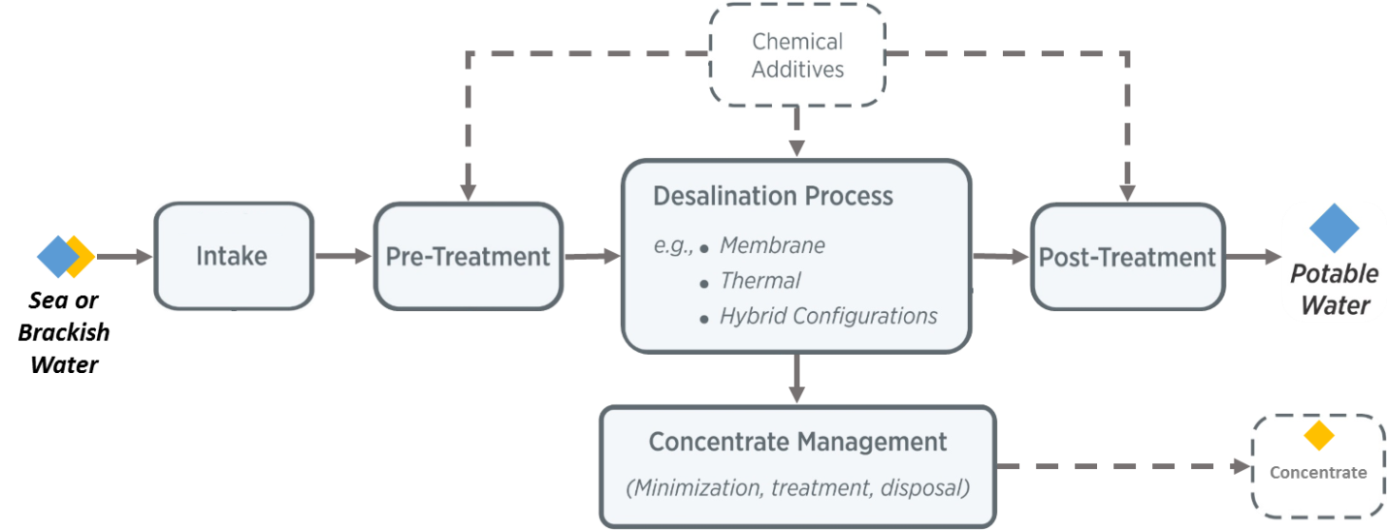
Desalination System Boundary
CT, SOA, PM, and TM determined for each unit operation

Slide 17
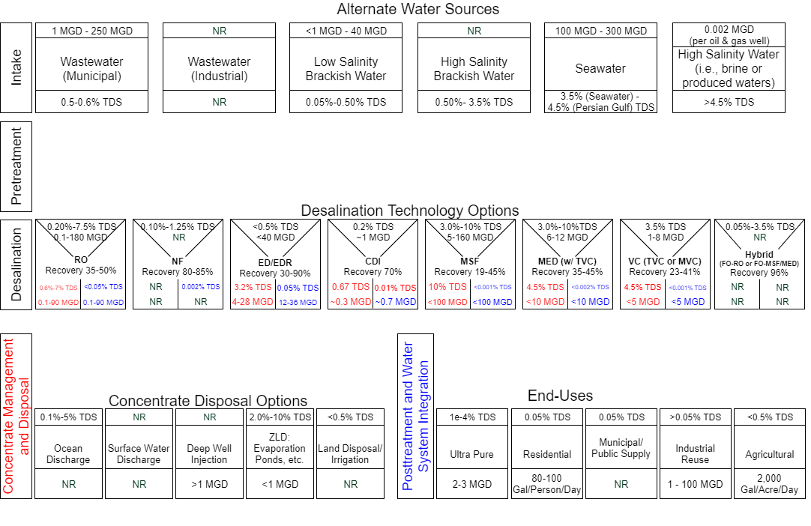
Many applications for water treatment through desalination
Notes:
Purpose of image:
1) To visualize the potential applications for desalination technologies to treat water across water sources and end use requirements
2) To provide a means to eliminate/select desalination technologies based on application and site considerations
3) Selection of appropriate technology/application pair will depend on the various criteria identified in later slide (“Tracking Relevant Characteristics: Whole System”)
Sources:
Rao, Prakash,Arian Aghajanzadeh, Paul Sheaffer, William R. Morrow, III, Sabine Brueske, Caroline Dollinger, Kevin Price, Prateeti Sarker, Nicholas Ward, and Joe Cresko. Volume 1: Survey of Available Information in Support of the Energy-Water Bandwidth Study of Desalination Systems. Lawrence Berkeley National Laboratory, 2016.
Alameddine, M. El-Fadel, Brine discharge from desalination plants: a modeling approach to an optimized outfall design. Desalination 214 (2007) 241-260
Joseph Imbrogno, Georges Belfort. Membrane Desalination: Where Are We, and What Can We Learn from Fundamentals? Annu. Rev. Chem. Biomol 2016.7:29-64
Scott Jenkins, Jeffrey Paduan, Philip Roberts, Daniel Schlenk, and Judith Weis. Management of Brine Discharges to Coastal Waters Recommendations of a Science Advisory Panel. March 2012.
Salinity of Ultra Pure Water: http://www.lenntech.com/applications/ultrapure/conductivity/water-conductivity.htm
Ag water demand: https://water.usgs.gov/edu/wuir.html
Residential water demand: https://water.usgs.gov/edu/qa-home-percapita.html
Ultra pure water demand (example from a wafer fabrication facility): http://electroiq.com/blog/2007/01/ultrapure-water-markets-and-technologies/
Salinity of wastewater: http://www.sciencedirect.com/science/article/pii/S0025326X0800101X?via%3Dihub
Volume of O&G produced water: http://www.ipd.anl.gov/anlpubs/2009/07/64622.pdf

Slide 18
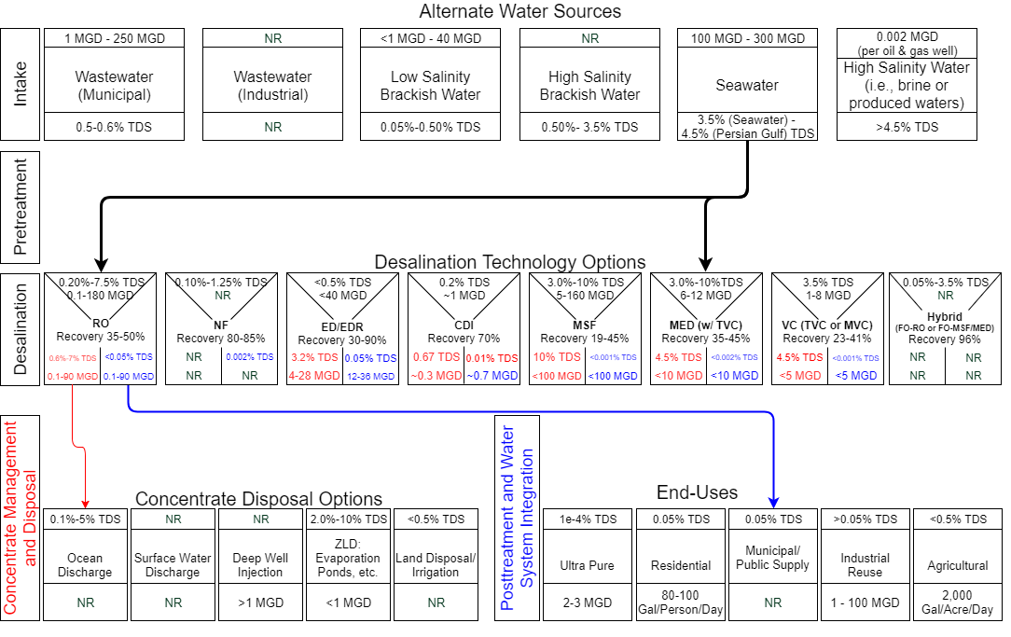
Seawater for Municipal Potable Water Pathways
Analysis for seawater looks at two pathways for desalinating seawater into municipal potable water
Notes:
Sources:
Rao, Prakash,Arian Aghajanzadeh, Paul Sheaffer, William R. Morrow, III, Sabine Brueske, Caroline Dollinger, Kevin Price, Prateeti Sarker, Nicholas Ward, and Joe Cresko. Volume 1: Survey of Available Information in Support of the Energy-Water Bandwidth Study of Desalination Systems. Lawrence Berkeley National Laboratory, 2016.
Alameddine, M. El-Fadel, Brine discharge from desalination plants: a modeling approach to an optimized outfall design. Desalination 214 (2007) 241-260
Joseph Imbrogno, Georges Belfort. Membrane Desalination: Where Are We, and What Can We Learn from Fundamentals? Annu. Rev. Chem. Biomol 2016.7:29-64
Scott Jenkins, Jeffrey Paduan, Philip Roberts, Daniel Schlenk, and Judith Weis. Management of Brine Discharges to Coastal Waters Recommendations of a Science Advisory Panel. March 2012.
Salinity of Ultra Pure Water: http://www.lenntech.com/applications/ultrapure/conductivity/water-conductivity.htm
Ag water demand: https://water.usgs.gov/edu/wuir.html
Residential water demand: https://water.usgs.gov/edu/qa-home-percapita.html
Ultra pure water demand (example from a wafer fabrication facility): http://electroiq.com/blog/2007/01/ultrapure-water-markets-and-technologies/
Salinity of wastewater: http://www.sciencedirect.com/science/article/pii/S0025326X0800101X?via%3Dihub
Volume of O&G produced water: http://www.ipd.anl.gov/anlpubs/2009/07/64622.pdf

Slide 19
Desalination Technologies Reviewed For Seawater Application
Intake | Pre-treatment | Desalination | Post-treatment | Concentrate
Open-ocean intake - Screened Subsurface intake - Beach wells - Offshore radial collector wells | Membrane filtration - Microfiltration - Ultrafiltration Media filtration Sand filtration Cartridge filtration Disc filtration Flocculation Sedimentation Chlorination Dissolved air flotation | Thermal vapor compression Mechanical vapor compression Multi-effect distillation Multi-stage flash distillation Reverse osmosis (RO) Forward osmosis in combination with RO or a thermal technology | Reminerali-zation Disinfection Boron removal | Surface water discharge Zero liquid discharge - Brine concentration - Crystallization

Slide 20
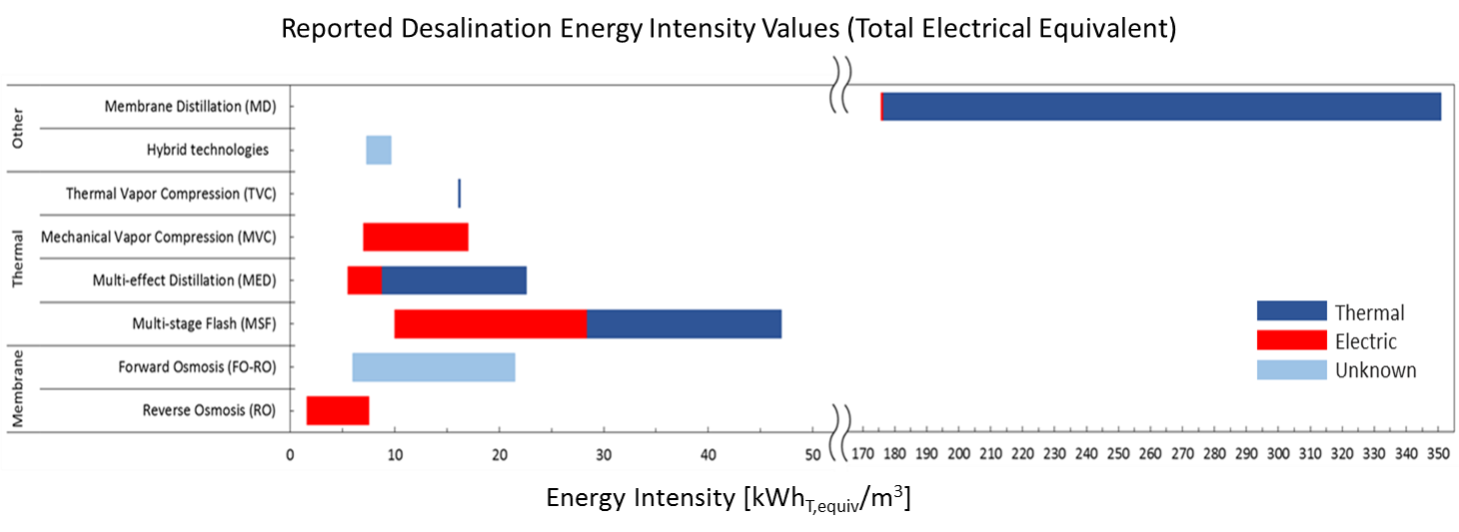
Preliminary Energy Data (Seawater)
Finding: Reported energy data needs further refinement before being used:
Values need to be reported with operational characteristics, e.g. intake and product water flow rate, recovery and plant size, salinity, and temps (for thermal processes), desalination unit operation, use of energy recovery or waste heat.
Addition of electrical and thermal must account for generation losses associated with converting thermal energy to work.
Notes:
Low MD: feedwater source (SW), salinity (not provided), water production rate (50 m3/day), water purity (not stated), Temperature (feed temperatures from 60 to 100 °C and cooling <40 °C) [see pg. 114 Camacho et al (2013)]
TVC: feedwater source (SW), salinity (not provided), water production rate (typical unit size 10,000–30,000 m3/day), water purity (about 10 ppm), Temperature (TBT ranges from 63 to 70C) [Al-Karaghouli et al. 2013]
MVC: feedwater source (SW), salinity (not provided), water production rate (not provided), water purity (not provided)
Low MED: feedwater source (SW), salinity (not provided), water production rate (Typical unit size 22,700 m3/d.), water purity (not provided), Temperature (Top brine temp maintained at 70 °C) [Ghaffour, Missimer, & Amy, 2013)]
High MED: feedwater source (SW), salinity (not provided), water production rate (not provided), water purity (TDS <20ppm), Temperature (not provided) [Gude, Nirmalakhandan, & Deng, 2010]
Low MSF: feedwater source (SW), salinity (not provided), water production rate (Typical unit size 90,000 m3/d), water purity (not provided), Temperature (Top brine temperature 120C) [Ghaffour, Missimer, & Amy, 2013)]
High MSF: feedwater source (SW), salinity (30,000–100,000 mg/L), water production rate (), water purity (<10 mg/L TDS ), Temperature (not provided) [Fritzmann, Löwenberg, Wintgens, & Melin, 2007]
Low FO: feedwater source (SW), salinity (35,000 ppm TDS), water production rate (not provided), water purity (not provided) [McGovern & Lienhard 2014]
High FO: feedwater source (SW), salinity (not provided), water production rate (not provided), water purity (not provided) [Cath 2015]
Low RO: feedwater source (SW), salinity (35,000 ppm TDS (McGovern&Lienhard)), water production rate (current typical single train capacity - <20,000 m3/d (NRC2008)), water purity (200-500 mg/L TDS (NRC 2008)); Temperature (<45C (NRC 2008)) [McGovern & Lienhard, 2014, NRC 2008, Voutchkov 2013, Birkett, 2011]
High RO (double pass): feedwater source (SW), salinity (), water production rate (not provided), water purity (not provided); Temperature (not provided) [Ng, et al., 2015]
RO: Low intensity value – 40-60% recovery. High Intensity value – double pass RO.
FO: No additional notes.
MSF: Low intensity value – includes integration of waste heat. High Intensity value – no additional notes.
MED: Low intensity value – includes integration of waste heat. High Intensity value – no additional notes.
MVC: No additional notes.
TVC: No additional notes.
Hybrid Technologies: Low intensity value – not for a specific hybrid technology, generalized as low as the technology could get. High Intensity value - SWRO/MED process.
MD: No additional notes.

Slide 21
Opportunities to reduce energy consumption for each unit operation
Unit Operation | Membrane Systems | Thermal Systems
Intake | Opportunities largely driven by improving pump and motor operating efficiency; site specific opportunities related to reducing total dynamic head may exist
Pretreatment | Significantly impacted by intake design with subsurface lower than open ocean | On par with subsurface intake membrane systems
Desalination | Newer plants implementing SOA for membrane, and semi-batch RO identified as PM | MED-TVC identified as SOA, with designs that can reduce steam pressure requirements identified as PM
Post-treatment | Not a significant factor | Not a significant factor, though higher than membrane system
Concentrate Management | Opportunities largely driven by improving pump and motor operating efficiency
Information on slides 23 – 31 will be included in forthcoming Bandwidth Study of Energy Use and Potential Energy Savings Opportunities in Seawater Desalination Systems available through DOE AMO.

Slide 22
2016 Uptake for Seawater Desalination in the U.S.
Energy Consumption (Billion Btu/yr) =
Energy Intensity (kWh_{total electrical equivalent}/m³ ) x Current Uptake (m³/yr) x
C (Billion Btu/kWh)
In the U.S., annual municipal potable water production capacity from seawater desalination was 128,000,000 m³ for 2016
Since largely dominated by Carlsbad facility and other RO systems, broad assumption that this is at 50% recovery
  255,000,000 m³ for intake annually
Assuming 16.5:1 concentrate dilution ratio for discharge, based on calculation
  2,231,000,000 m³ pumped annually for discharge
For reference: energy consumption to source all currently desalinated seawater in the U.S. from fresh and ground water sources (excludes distribution): 127 Billion Btu
  Assumes national average energy intensity for providing municipal water from freshwater of 0.29 kWh/m³
  Higher in some regions: Southern California: 1,136 Billion Btu

Slide 23
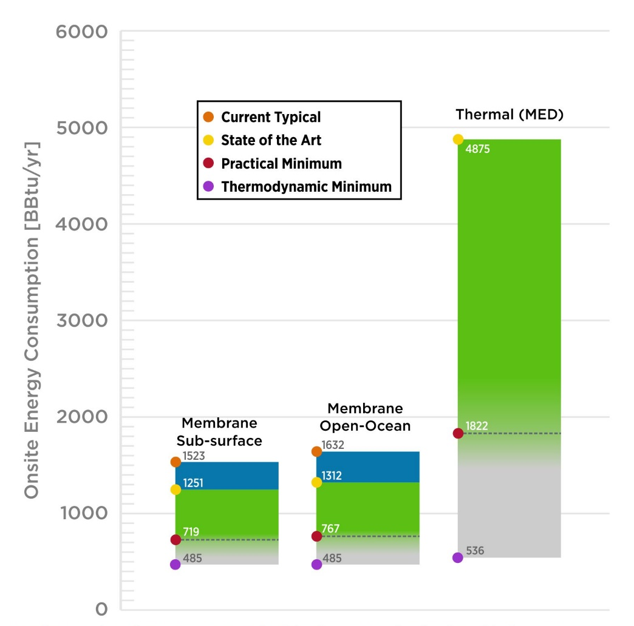
Energy Consumption and Savings Opportunity for 3 Systems
Membrane Sub-surface: RO-based w/ subsurface intake operating at 50% recovery of 500 ppm (0 ppm for TM) product water from 35,000 ppm feedwater
Membrane Open-Ocean: RO-based Open ocean intake at 50% recovery of 500 ppm (0 ppm for TM) product water from 35,000 ppm feedwater
Thermal: MED-based system at 35% recovery of <25 ppm (0 ppm for TM) product water from 45,000 ppm feedwater
Notes:
Intake and concentrate management values are TBtu/year/TDH – would vary based on total TDH
Membrane #1
Intake = Sub-surface intake (same intensities as open-ocean per TDH, as is calculated for pumping energy based on pump/motor efficiencies)
Pre-treatment = Cartridge filtration (CT/SOA); filtration/energy savings from pressure port (PM)
Desalination = RO, closed circuit RO (PM)
Post-treatment = Remineralization, disinfection and fluoridation
Concentrate mgmt. = ocean disposal (same intensities as intake per TDH, as is calculated for pumping energy based on pump/motor efficiencies)
Membrane #2
Intake = Open-ocean intake (same intensities as sub-surface per TDH, as is calculated for pumping energy based on pump/motor efficiencies)
Pre-treatment = Flocculation, coagulation, sand filtration, cartridge filtration (SOA);Vacuum-driven MF (PM)
Desalination = Same as membrane #1
Post-treatment = Same as membrane #1
Concentrate mgmt. = ocean disposal (same intensities as intake per TDH, as is calculated for pumping energy based on pump/motor efficiencies)
Thermal
Intake = open-ocean
Pretreatment = Media filtration (single-stage, granular, gravity-fed), and chlorination (for SOA); NF (for PM)
Desalination = MED-TVC (SOA); MED condensing (PM)
Post-treatment = Remineralization, disinfection and fluoridation
Concentrate mgmt. = ocean disposal (same intensities as intake per TDH, as is calculated for pumping energy based on pump/motor efficiencies)

Slide 24
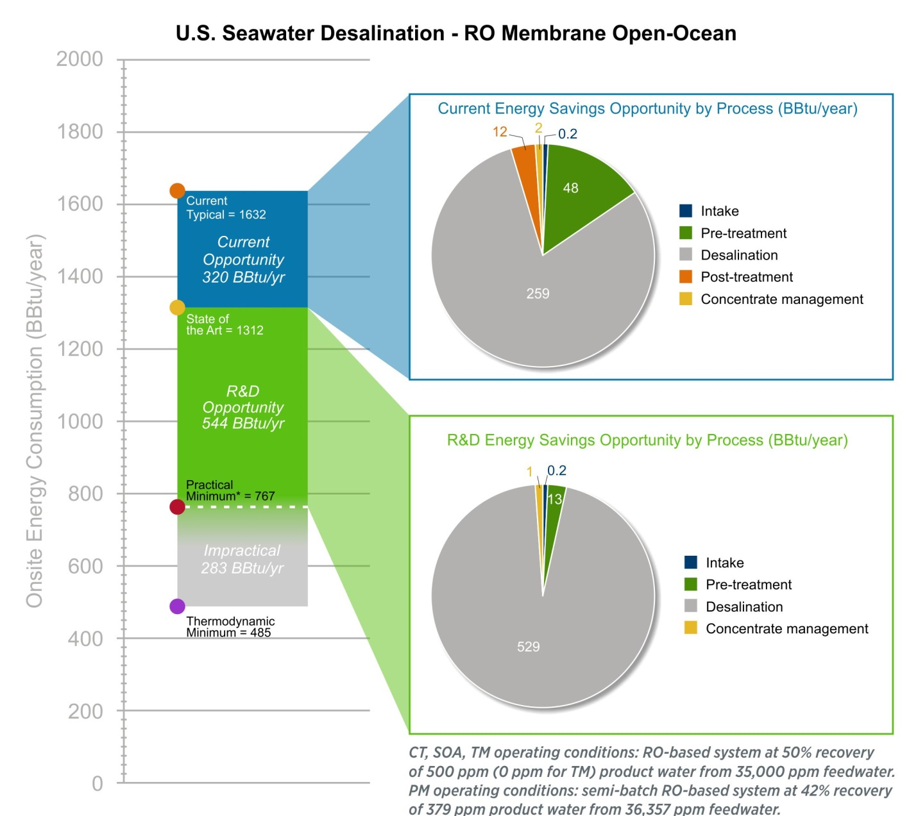
Energy Savings Opportunity for RO system w/Open Ocean Intake
91% of the energy saving opportunity is in the desalination operation
Pretreatment offers the next largest opportunity (7%)
Much of U.S. production already operating at SOA conditions
Notes:
Intake and concentrate management values are TBtu/year/TDH – would vary based on total TDH
- An R&D Energy Savings Opportunity for post-treatment that is well supported by the literature could not be found
-The PM energy consumption is based on today’s knowledge of R&D technologies tested between laboratory and demonstration scale, referencing the lowest energy intensity value (in this case for semi-bath RO for the desalination unit operation) in the available literature. Current research at the theoretical level (which does not meet PM definitions) of other systems or technologies may drive the PM energy consumption lower, closer to TM energy consumption. One example is fully batch RO, which when tested at a laboratory or higher scale may show a decrease in energy consumption

Slide 25
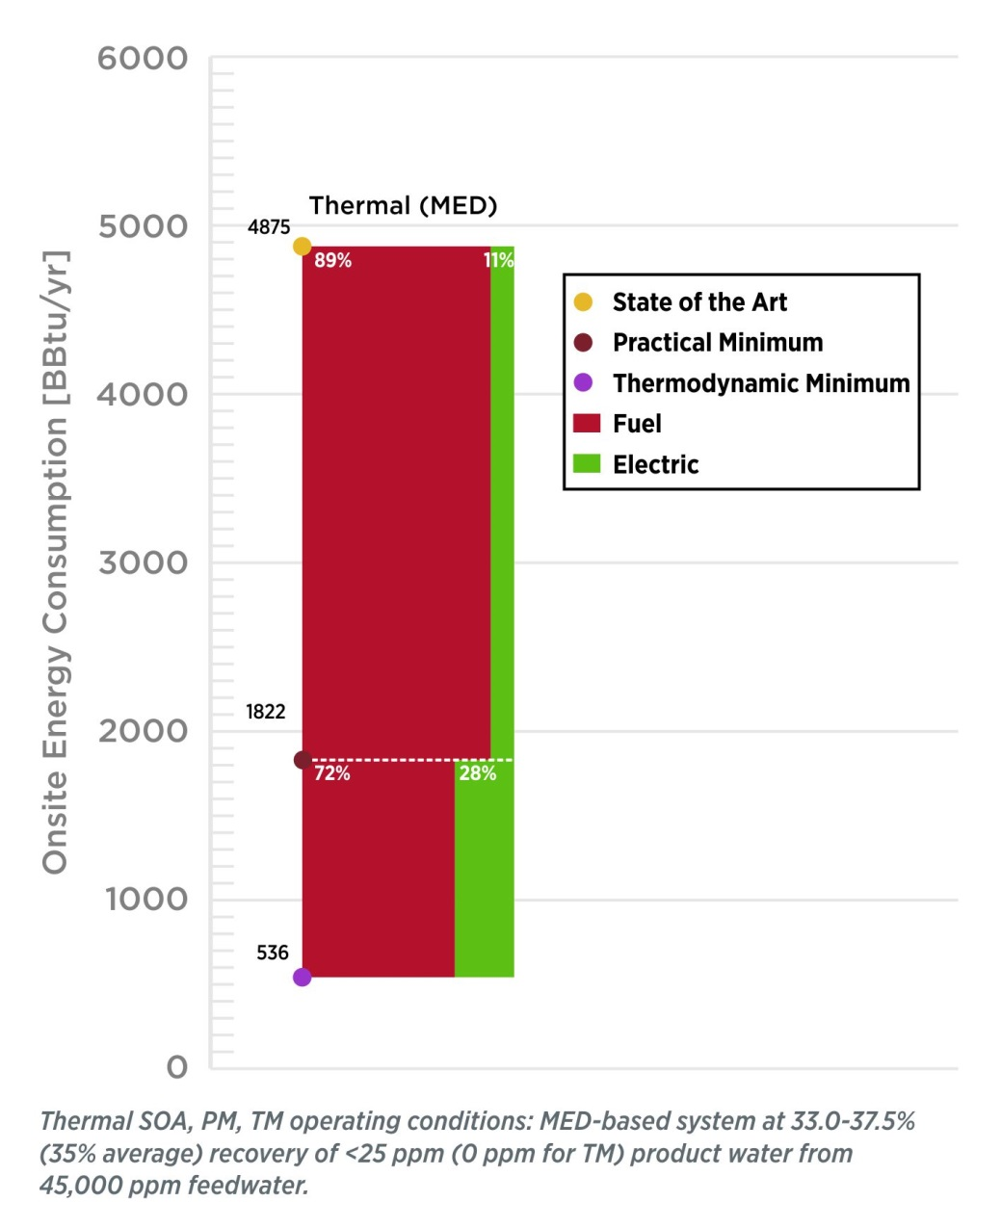
R&D Opportunity for Thermal (MED) System w/Open Ocean Intake
Fuel sources in thermal desalination accounted for nearly all of the total energy savings for the R&D opportunity
Opportunity for Waste Heat or Renewable Thermal Energy to Offset Direct Fuel Use in Thermal MED
Notes:
Intake and concentrate management values are TBtu/year/TDH – would vary based on total TDH
- An R&D Energy Savings Opportunity for post-treatment that is well supported by the literature could not be found
-The PM energy consumption is based on today’s knowledge of R&D technologies tested between laboratory and demonstration scale, referencing the lowest energy intensity value (in this case for semi-bath RO for the desalination unit operation) in the available literature. Current research at the theoretical level (which does not meet PM definitions) of other systems or technologies may drive the PM energy consumption lower, closer to TM energy consumption. One example is fully batch RO, which when tested at a laboratory or higher scale may show a decrease in energy consumption

Slide 26
Scenarios: Potential Impact Under Greater Adoption
Saline water (sea and brackish water) is a very small source of municipal water in the U.S. on the order of 0.1% → Hence, the impact on U.S. energy consumption is small at current uptake levels
Potential impact of greater uptake:
  Scenario 1: supply all continental U.S. county’s public water demand with desalinated water from U.S. coastal areas, and
  Scenario 2: supply all water stressed regions of the continental US with desalinated water from U.S. coastal areas
Evaluated using open ocean intake RO system operating at SOA conditions with water demand equivalent to 2010 public water demand (from USGS)

Slide 27
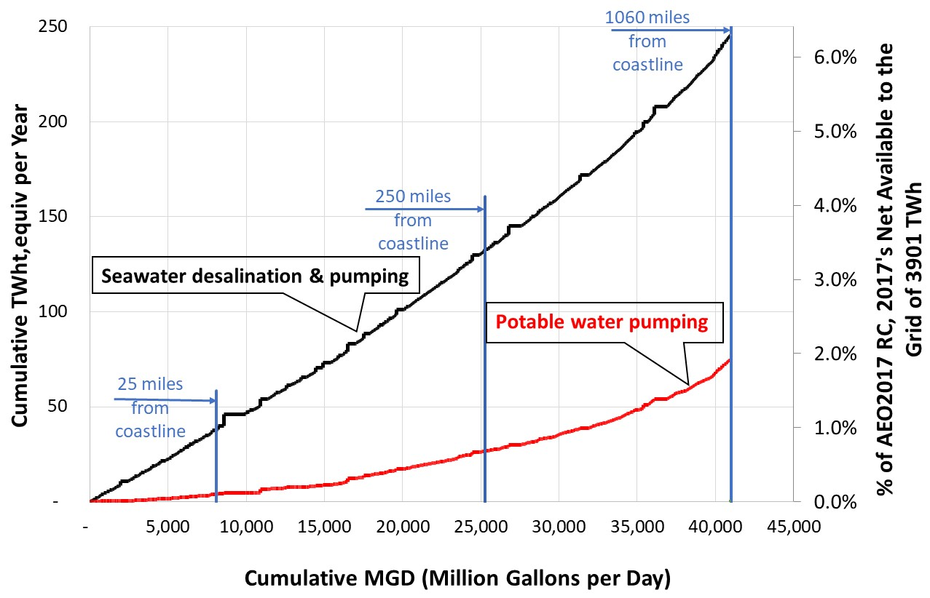
Scenario 1: Supplying All Municipal Water
Though impractical, sourcing all U.S. municipal water from seawater would represent ~6% of projected 2017 electricity production.
Provides an upper bound for seawater desalination impact on electric grid

Slide 28
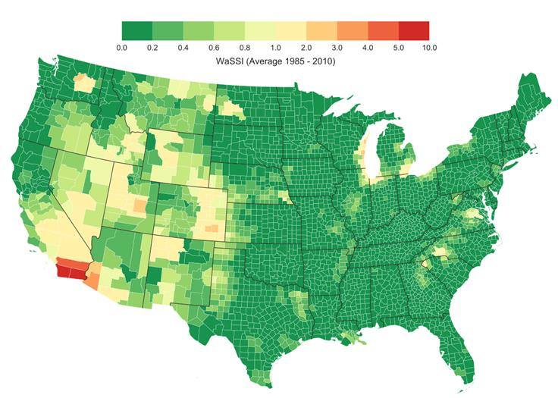
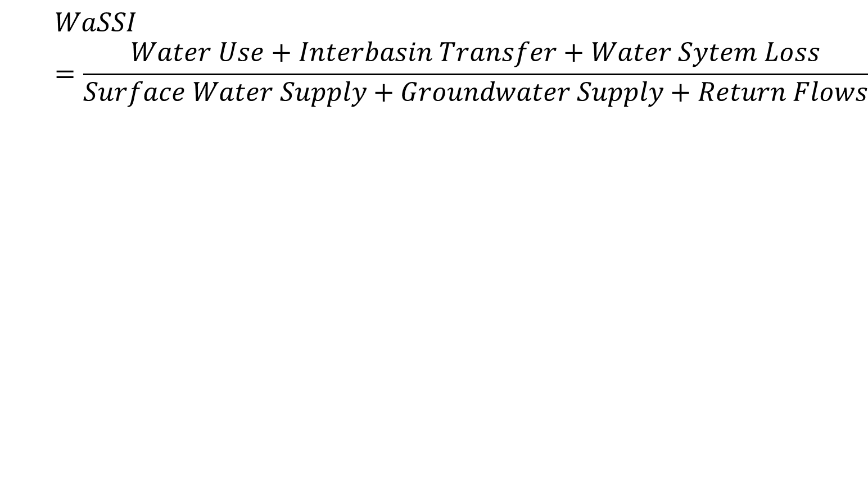
Water Supply Stress Index
WaSSI estimated using WaSSI Ecosystems Services Model by NC State, USDA, and US Forest Service

Slide 29
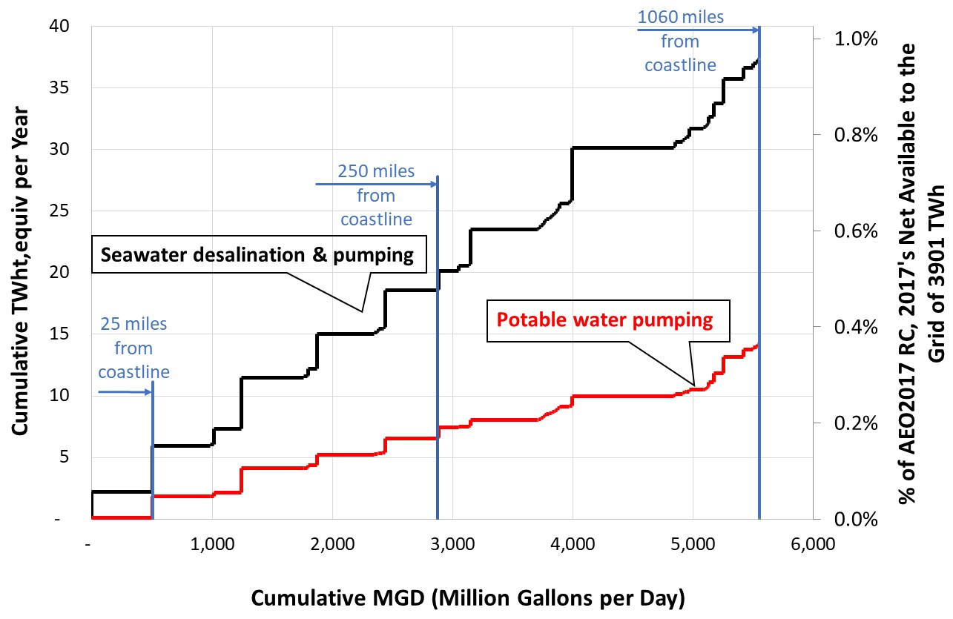
Scenario 2: Supplying Water Stressed Counties
Potable water pumping
Supplying public water for counties with WaSSI > 1 and 250 miles from a coastline would require 0.5% of projected 2017 electricity production
More likely that these counties would diversify water sources and some could meet a portion of their public water demand from seawater.

Slide 30
Manufacturing Water Use Analysis
29

Slide 31
Industrial water use in 2010
75% (~16,000 MGD) is estimated to be self supplied (e.g. onsite surface or ground)
  Mostly freshwater; only 6% saline
  Down 12% from 2005
  Down 38% from 1985
25% (~5,000 MGD) is estimated to be supplied from public supply
  USGS stopped estimating public supply by end use sector after 1995
  Assumed, based on 1995 estimates, that 12% of public supply is for industry
Estimates based on USGS data
Notes:
Industrial is manufacturing and construction

Slide 32
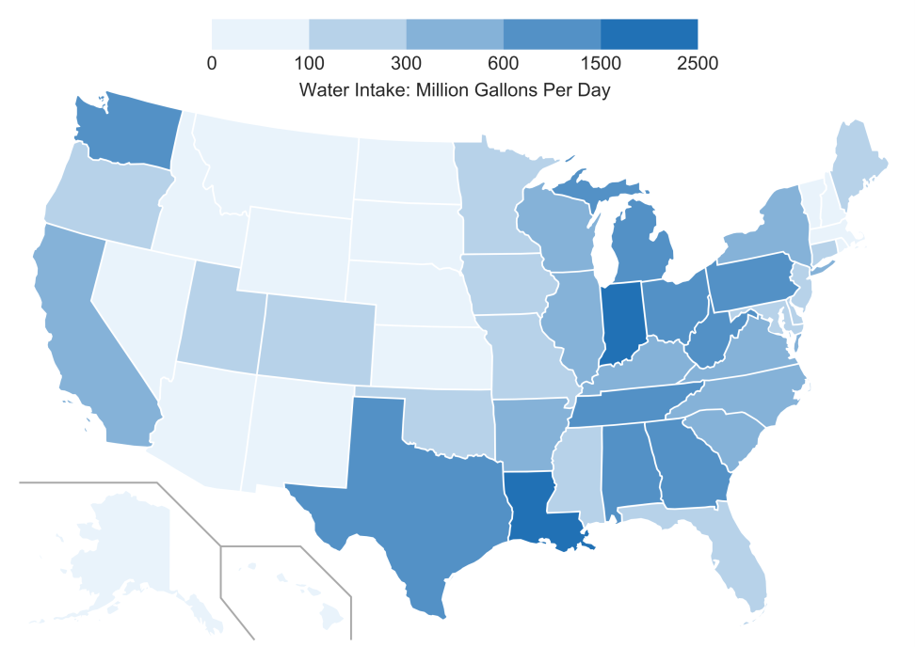
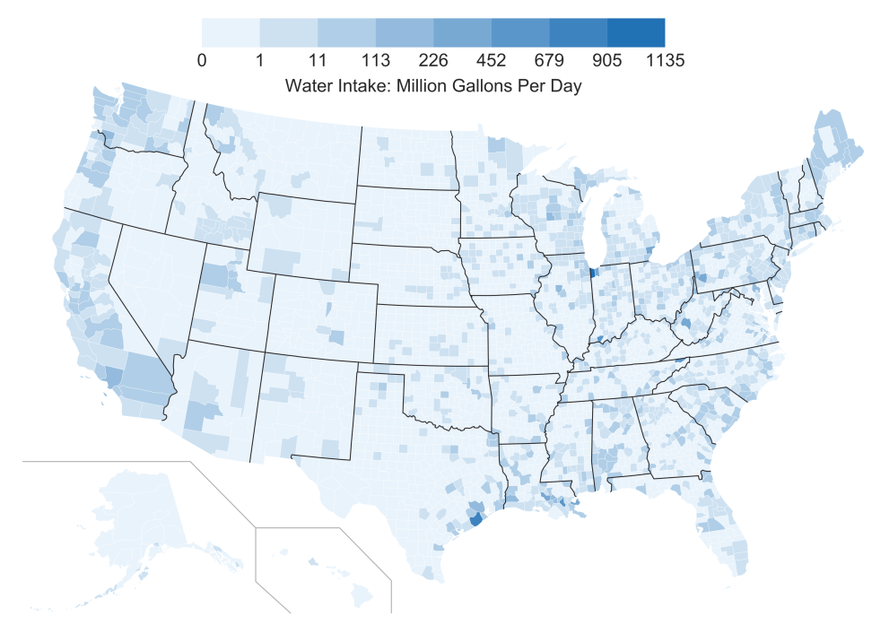
Geographic Spread of U.S. Manufacturing Water Withdrawal (Estimated)
State
County
Estimates based on USGS data
Notes:
Estimates of manufacturing water use by state and county in the US (includes surface, ground, and public supply)
Shows which states use the most water and where in the state water is used
Can see where specifically in a state water is withdrawn (e.g., Houston area and not west Texas)

Slide 33
Issues with U.S. Manufacturing Water Data Availability
Water use conservation driven by risk mitigation within the manufacturing sector
Little to no data on U.S. manufacturing water use and related characteristics
  Limited to USGS 5-year estimates
  Some data at individual state level or by sector
Water use issues and risk are a local phenomena requiring data at the watershed level
  Research based on broad national data may not target at-risk industries
Need for better data

Slide 34
Analysis Approach
Leverage existing data sets to:
  Quantify manufacturing water withdrawals and consumption at the national, state, and county-levels broken down by sector using Canadian water and economic, USGS, and U.S. Economic Census data
  Identify sectors at-risk, defined as those sectors with large footprints in areas with long-term over-usage of locally available water supplies
  Use the results from 1 and 2 to identify sectors for subsequent Energy-Water Bandwidth Studies and other manufacturing water use-related research
For further details on methods and results for estimates presented on slides 36-38, see: Rao, P., Sholes, D., Morrow, W.R., and J. Cresko. 2017. “Estimating U.S. Manufacturing Water Use”. American Council for an Energy Efficient Economy Summer Study on Energy Efficiency in Industry. Denver, CO. August 16 – 18.

Slide 35
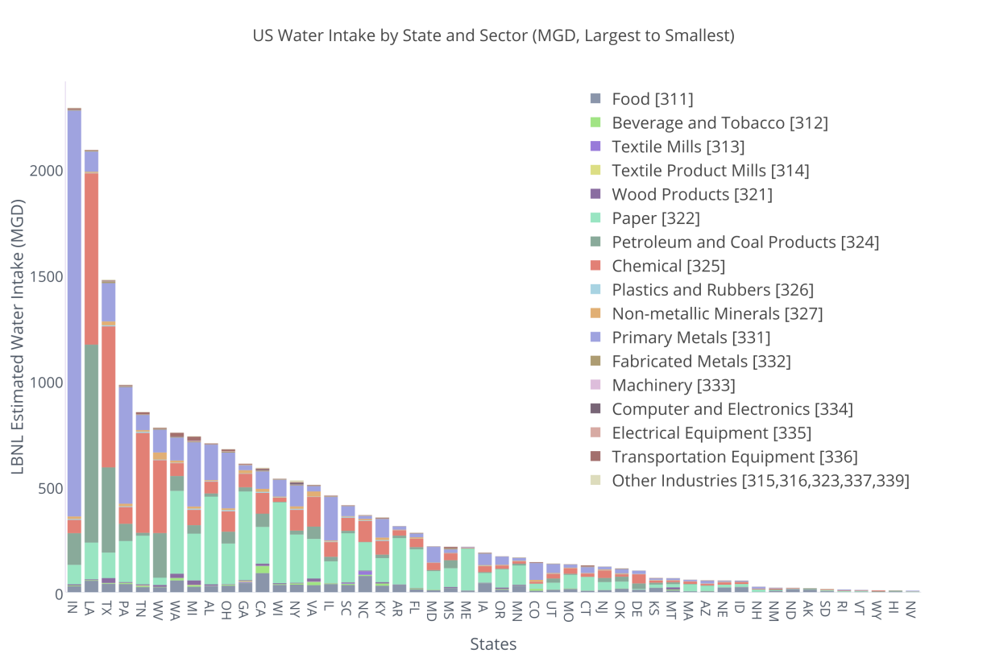
U.S. Manufacturing Water Withdrawals by Sector and State
Allows for better understanding of water use distribution:
IN and LA estimated to have the largest annual withdrawals
Withdrawals in some states dominated by single industry (i.e., primary metals in IN, paper & pulp in ME)
Other states have more diversity in their water withdrawals (e.g., MI, TX, NC)
Notes:
Further breakdown of how much water is withdrawn for each industry in each state. Primary metals in Indiana is by far the largest water withdrawal.

Slide 36
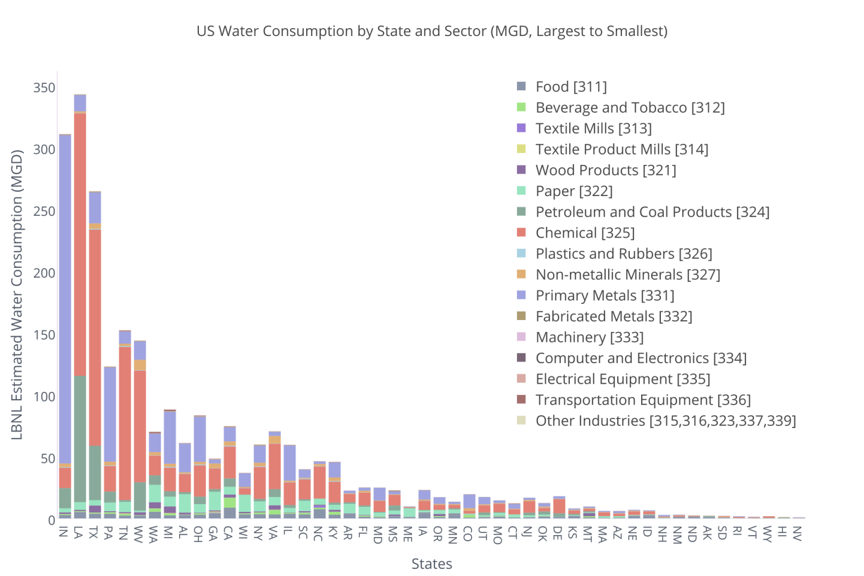
U.S. Manufacturing Water Consumption by Sector and State
Consumptive use will have greater impact on operational risk than withdrawals
LA has highest amount of consumptive use
Two of the top ten states in terms of consumption are drought prone (CA and TX)
Notes:
Consumptive water use by state and sector. For consumptive water use, LA is the largest user (Indiana had the most water withdrawn per the previous slide)

Slide 37
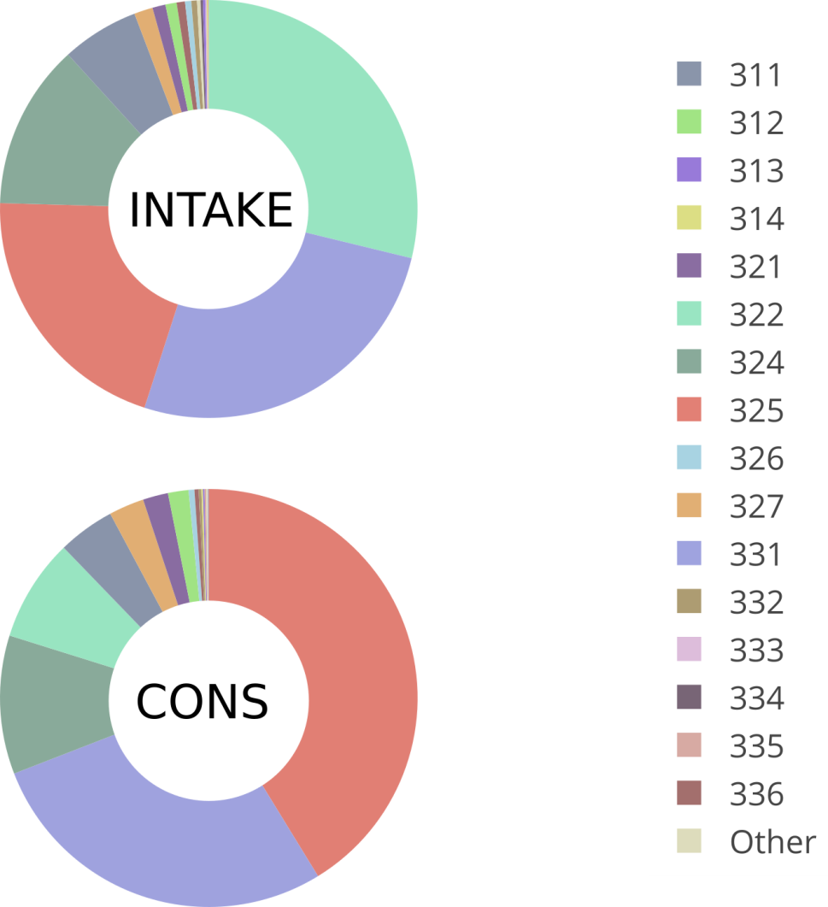
U.S. Manufacturing Water Withdrawals and Consumption
311 | Food manufacturing
312 | Beverage and tobacco product manufacturing
313 | Textile mills
314 | Textile product mills
321 | Wood product manufacturing
322 | Paper manufacturing
324 | Petroleum and coal product manufacturing
325 | Chemical manufacturing
326 | Plastics and rubber products manufacturing
327 | Non-metallic mineral product manufacturing
331 | Primary metal manufacturing
332 | Fabricated metal product manufacturing
333 | Machinery manufacturing
334 | Computer and electronic product manufacturing
335 | Electrical equipment, appliance and component manufacturing
336 | Transportation equipment manufacturing
Other | Other Industries
Paper
Pet./Coal
Chemicals
Primary Metals
Paper
Chemicals
Pet./Coal
Primary Metals
Notes:
Top - shows water withdrawals by sector across the US. Paper, Primary Metals, and Chemicals (in order) withdraw the most water
Bottom – show consumptive water use by sector across the US. Chemicals is the largest consumptive water use followed by Primary Metals and Petroleum.

Slide 38
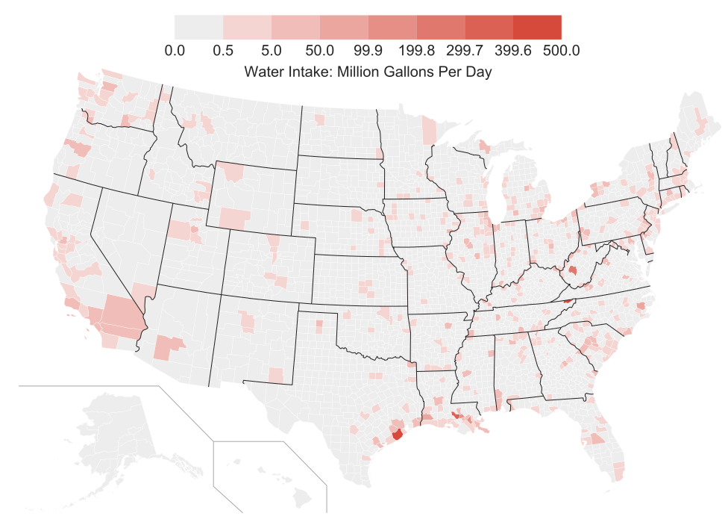
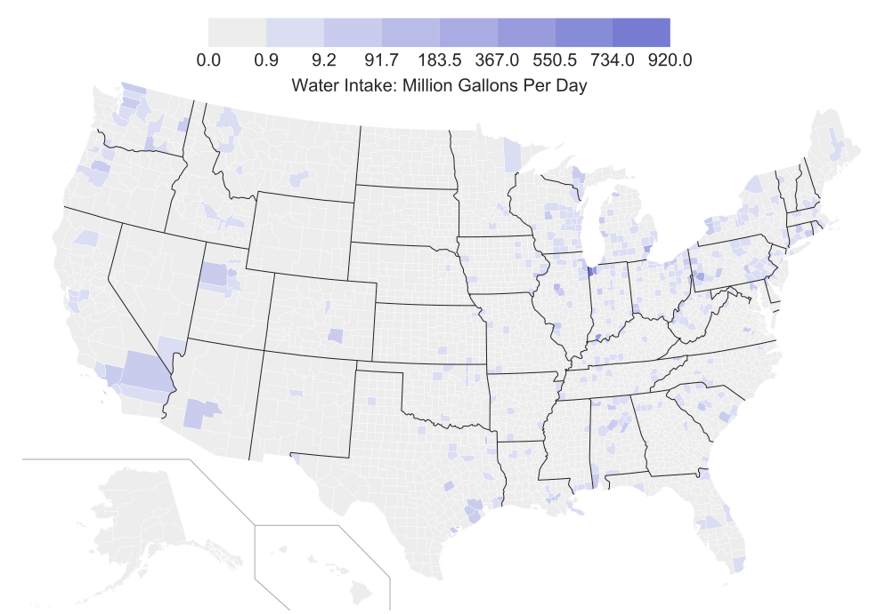
Water Withdrawals by Sector and County
325 - Chemicals
331 – Primary Metals
Notes:
Additional breakdowns of water withdrawals

Slide 39
Evaluation of Sector Water Use “At-Risk”
Sectors in red are those that have the highest share of their water use in locations with WaSSI > 1 (i.e., locations where total water use exceeds local supplies)
Manufacturing Sector | Estimated % Water Intakewithin each WaSSI Bin
 | [0.0,0.2) | [0.2,0.4) | [0.4,0.8) | [0.8,1.0) | [1.0,inf)
Food | 72 | 11 | 7 | 3 | 7
Beverage and Tobacco Product | 71 | 9 | 11 | 2 | 6
Textile Mills | 80 | 9 | 4 | 6 | 2
Textile Product Mills | 88 | 5 | 2 | 2 | 3
Wood Product | 84 | 6 | 3 | 6 | 2
Paper | 79 | 8 | 5 | 1 | 6
Petroleum and Coal Product | 52 | 29 | 9 | 1 | 9
Chemical | 66 | 25 | 5 | 1 | 3
Plastics and Rubber Products | 71 | 13 | 5 | 3 | 9
Non-metallic Mineral Product | 68 | 11 | 6 | 7 | 8
Primary Metal | 52 | 8 | 5 | 1 | 35
Fabricated Metal Product | 68 | 14 | 6 | 3 | 10
Machinery | 70 | 15 | 6 | 2 | 8
Computer and Electronic Product | 68 | 13 | 8 | 5 | 7
Electrical Equipment | 76 | 12 | 5 | 3 | 5
Transportation Equipment | 72 | 9 | 6 | 2 | 10
Other Industries [315,316,323,337,339] | 74 | 10 | 3 | 4. | 8

Slide 40
Extending the Analysis of Water in Manufacturing
Bandwidth Studies to understand technologies that could realize joint water-energy savings
Software tools to empower end users’ water conservation efforts
Analysis to identify water substitutes

Slide 41
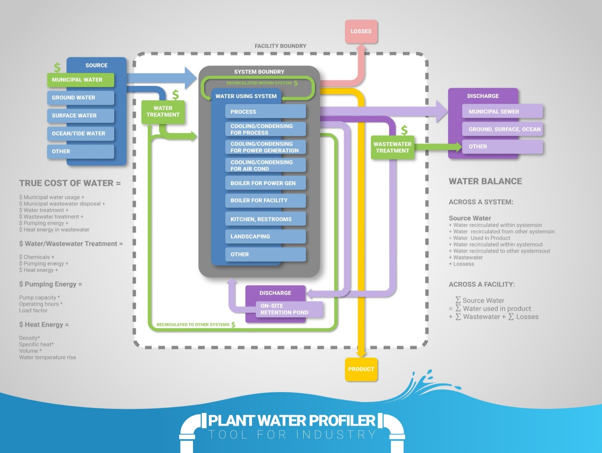
Plant Water Profiler (PWP) Tool for Industry
Identify how water is being procured and consumed at facilities,
Quantify true cost of water used in different systems,
Quantify potential water savings and cost savings,
Feed information back to inform R&D
Notes:
The Plant Water Profiler (PWP) Tool helps industrial plant managers identify how water is being procured and consumed at their plants, quantify true cost of water used in different systems, quantify potential water and cost savings, and list of next steps that could be followed to save water.

Slide 42
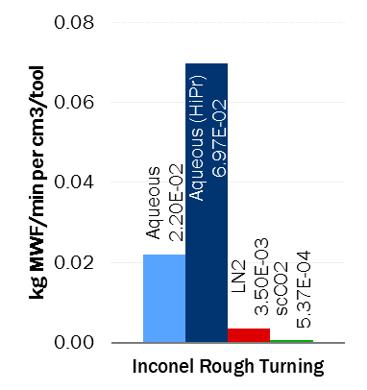
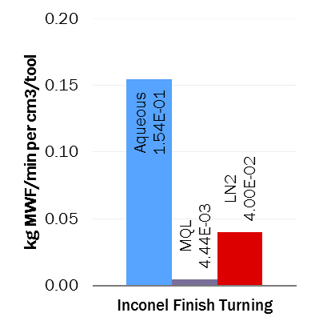
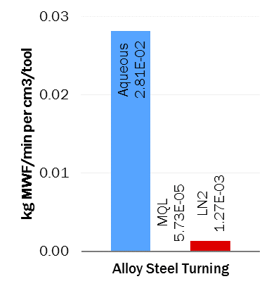
Water Substitution in the Fabricated Metals Industry
Motivation: Reduce the environmental and health burden of water use in the metals fabrication industry – substitution with industrial gases as process fluids.
Method: Deploy a metric to quantify, harmonize, and compare flow rates of different metalworking fluids (MWF) and their efficacy in heat removal and lubrication in a wide range of processes and materials
Early Results for Performance-Normalized MWF Usage
Notes:
Preliminary results from harmonization study of MWF usage based on published experimental data in peer-reviewed literature.
By eliminating direct water use, gas-based MWFs reduce exposure to air-borne particulates, endotoxins, carcinogens, and bacteria associated with aqueous MWFs in machine shops.
Use-phase water and health benefits of gas-based MWFs must be evaluated against higher upstream air emissions associated with the fossil energy used to produce N₂, CO₂, and compressed air.

Slide 43
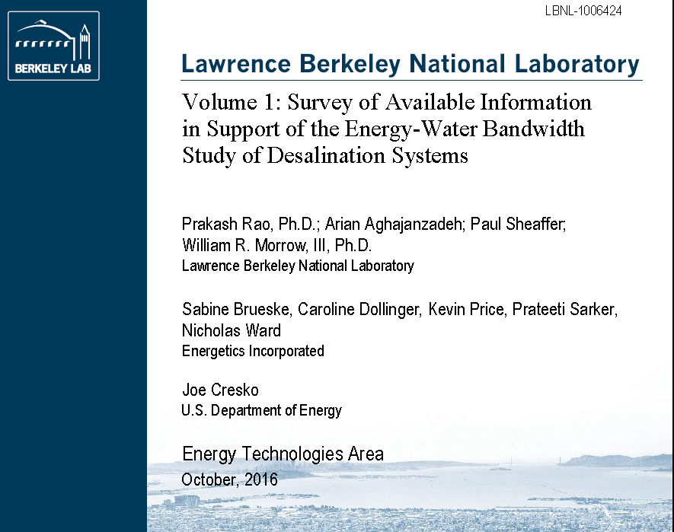
Take a look:
Volume 1 report published
Next steps:
Bandwidth Study of Energy Use and Potential Energy Savings Opportunities in Seawater Desalination Systems report to be published Summer of 2017.
Manufacturing analyses under development.

Slide 44






Thank you. joe.cresko@ee.doe.gov
ANL – Diane Graziano, Matt Riddle, Sarang Supekar
LBNL – Arman Shehabi, William Morrow, Sarah Smith, Prakash Rao
NREL – Alberta Carpenter, Maggie Mann, Rebecca Hanes, Samantha Reese, Kelsey Horowitz, Timothy Remo
ORNL – Sujit Das, Sachin Nimbalkar, Pablo Cassorla, Kristina Johnson
Energetics – Sabine Brueske, Heather Liddell, Caroline Dollinger, Hani Hawa

Slide 45
Back-up Slides

Slide 46
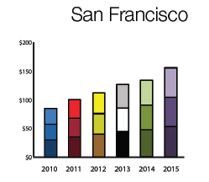
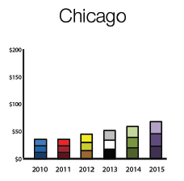
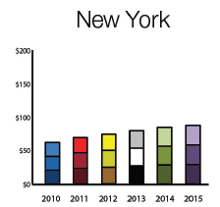
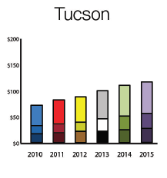
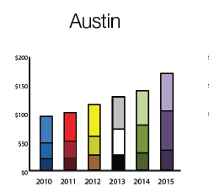
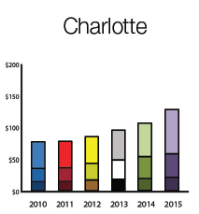
Water costs are rising
Across the U.S., potable water costs are on the rise. The cost of water from desalination can have less variability over time.
Monthly costs for a family of four
Source: Circle of Blue research, based on utility water rates: http://www.circleofblue.org/2015/world/price-of-water-2015-up-6-percent-in-30-major-u-s-cities-41-percent-rise-since-2010/

Slide 47
Energy Intensity for Membrane System w/ Subsurface Intake
Unit Operation | CT | SOA | PM | TM
Intake @ 1 m TDH | 0.0038 kWh_{e}/m³ (Subsurface) | 0.0036 kWh_{e}/m³ (Subsurface) | 0.0034 kWh_{e}/m³ (Subsurface) | 0.0028 kWh_{e}/m³ (Subsurface)
Pretreatment | 0.02 kWh_{e}/m³ (Cartridge filtration + bag filter) | Same as CT | Same as CT | 0 kWh_{e}/m³ (None)
Desalination (all at ~50% recovery and ~3.5% salinity) | 3.3 kWh_{e}/m³ (RO) | 2.7 kWh_{e}/m³ (RO at Carlsbad) | 1.48 kWh_{e}/m³ (Semi-batch RO) | 1.06 kWh_{e}/m³ (Salt from water)
Post-treatment | 0.11 kWh_{e}/m³ (Remineralization + disinfection) | 0.08 kWh_{e}/m³ (Remineralization + disinfection) | Same as SOA | 0 kWh_{e}/m³ (None)
Concentrate Management @ 1 m TDH | 0.0038 kWh_{e}/m³ (To surface water) | 0.0036 kWh_{e}/m³ (To surface water) | 0.0034 kWh_{e}/m³ (To surface water) | 0.0028 kWh_{e}/m³ (To surface water)
Notes:
Intake/Concentrate:
CT: 72.9% pump efficiency and 95% motor efficiency = 69.3% system efficiency
SOA: 81% pump efficiency and 95.8% motor efficiency = 77.6% system efficiency
PM: 84.8% pump efficiency and 96.6% motor efficiency = 81.9% system efficiency
TM: 100% pump efficiency and 100% motor efficiency = 100% system efficiency

Slide 48
Energy Intensity for Membrane System w/ Open Ocean Intake
Unit Operation | CT | SOA | PM | TM
Intake @ 1 m TDH | 0.0038 kWh_{e}/m³ (Open ocean intake) | 0.0036 kWh_{e}/m³ (Open ocean intake) | 0.0034 kWh_{e}/m³ (Open ocean intake) | 0.0028 kWh_{e}/m³ (Open ocean intake)
Pretreatment | 0.27 kWh_{e}/m³ (Flocculation/ coagulation/ sand and cartridge filtration) | 0.16 kWh_{e}/m³ (Flocculation/ coagulation/ sand and cartridge filtration) | 0.13 kWh_{e}/m³ (Vacuum-driven MF) | 0 kWh_{e}/m³ (none)
Desalination (all at ~50% recovery and ~3.5% salinity) | 3.3 kWh_{e}/m³ (RO) | 2.7 kWh_{e}/m³ (RO at Carlsbad) | 1.48 kWh_{e}/m³ (Semi-batch RO) | 1.06 kWh_{e}/m³ (Salt from water)
Post-treatment | 0.11 kWh_{e}/m³ (Remineralization + disinfection) | 0.08 kWh_{e}/m³ (Remineralization + disinfection) | Same as SOA | 0 kWh_{e}/m³ (None)
Concentrate Management @ 1 m TDH | 0.0038 kWh_{e}/m³ (To surface water) | 0.0036 kWh_{e}/m³ (To surface water) | 0.0034 kWh_{e}/m³ (To surface water) | 0.0028 kWh_{e}/m³ (To surface water)
Notes:
Intake/Concentrate:
CT: 72.9% pump efficiency and 95% motor efficiency = 69.3% system efficiency
SOA: 81% pump efficiency and 95.8% motor efficiency = 77.6% system efficiency
PM: 84.8% pump efficiency and 96.6% motor efficiency = 81.9% system efficiency
TM: 100% pump efficiency and 100% motor efficiency = 100% system efficiency

Slide 49
Energy Intensity for Thermal System
Unit Operation | CT | SOA | PM | TM
Intake @ 1 m TDH | N/A in U.S. | 0.0036 kWh_{e}/m³ (Open ocean intake) | 0.0034 kWh_{e}/m³ (Open ocean intake) | 0.0028 kWh_{e}/m³ (Open ocean intake)
Pretreatment | N/A in U.S. | 0.05 kWh_{e}/m³ (Gravity-fed media filtration + chlorination) | 0.04 kWh_{e}/m³ (NF) | 0 kWh_{e}/m³ (None)
Desalination (all at 35% recovery and 4.5% salinity) | N/A in U.S. | 11 kWh_{T,equiv}/m³ (MED – TVC) | 4 kWh_{T,equiv}/m³ (Condensing MED) | 1.20 kWh_{T,equiv}/m³ (Salt from water)
Post-treatment | N/A in U.S. | 0.11 kWh_{e} /m³ (Remineralization+ Disinfection) | Same as SOA | 0 kWh_{e}/m³ (None)
Concentrate Management @ 1 m TDH | N/A in U.S. | 0.0036 kWh_{e}/m³ (To surface water) | 0.0034 kWh_{e}/m³ (To surface water) | 0.0028 kWh_{e}/m³ (To surface water)
Notes:
Intake/Concentrate:
CT: 72.9% pump efficiency and 95% motor efficiency = 69.3% system efficiency
SOA: 81% pump efficiency and 95.8% motor efficiency = 77.6% system efficiency
PM: 84.8% pump efficiency and 96.6% motor efficiency = 81.9% system efficiency
TM: 100% pump efficiency and 100% motor efficiency = 100% system efficiency

Slide 50
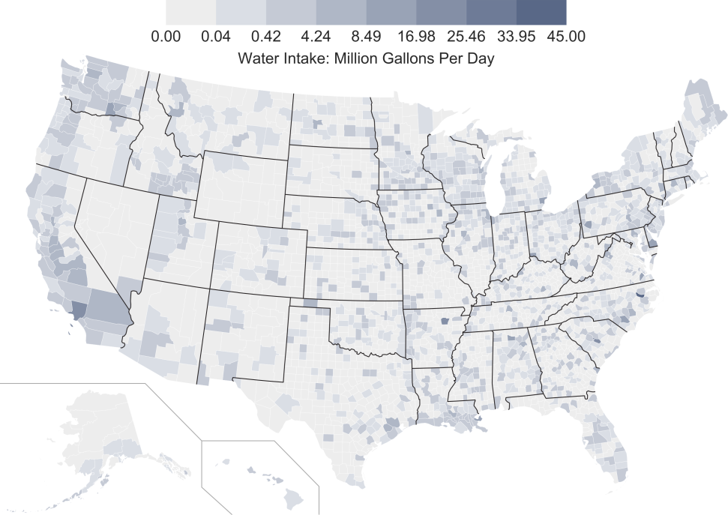
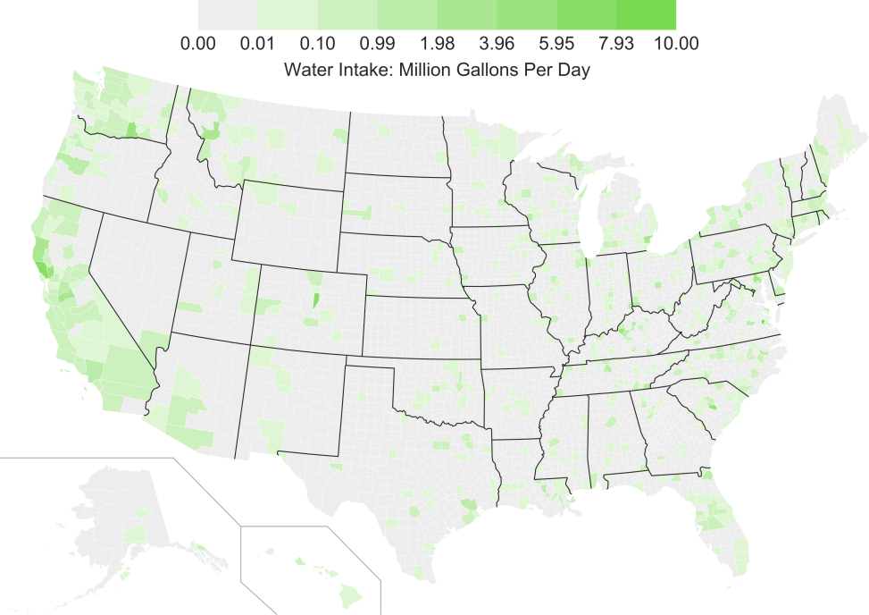
Water Withdrawals by Sector and County
311 - Food
312 – Bev. And Tobacco
Notes:
Additional breakdowns of water withdrawals

Slide 51
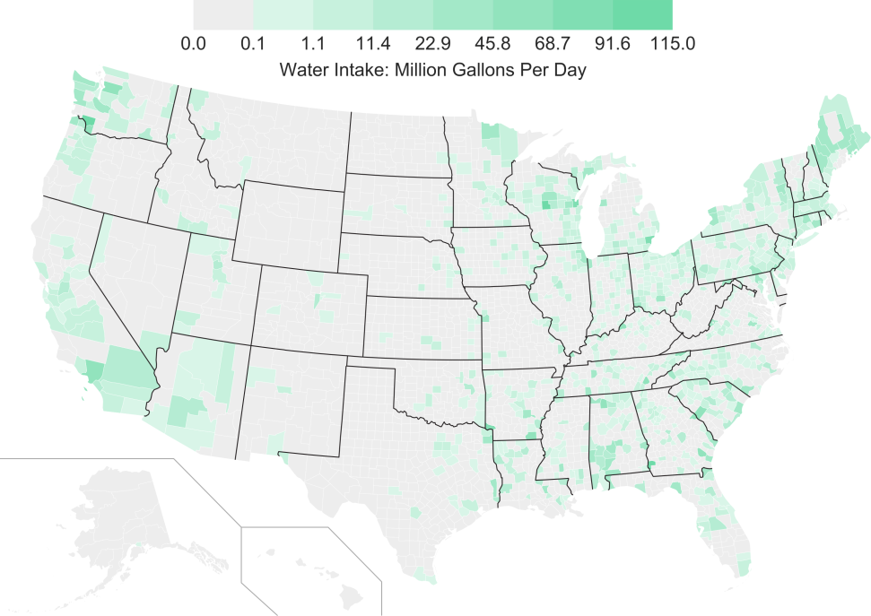
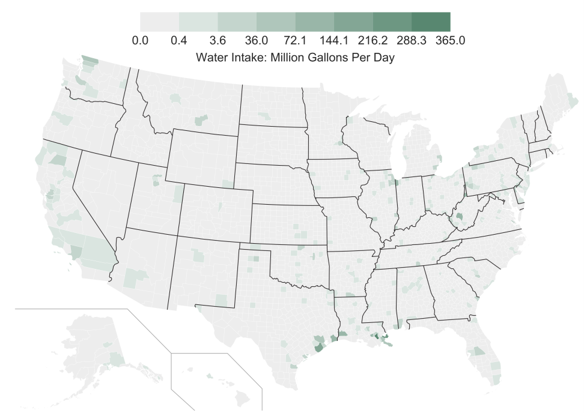
Water Withdrawals by Sector and County
322- Paper
324 - Petroleum
Notes:
Additional breakdowns of water withdrawals

Slide 52

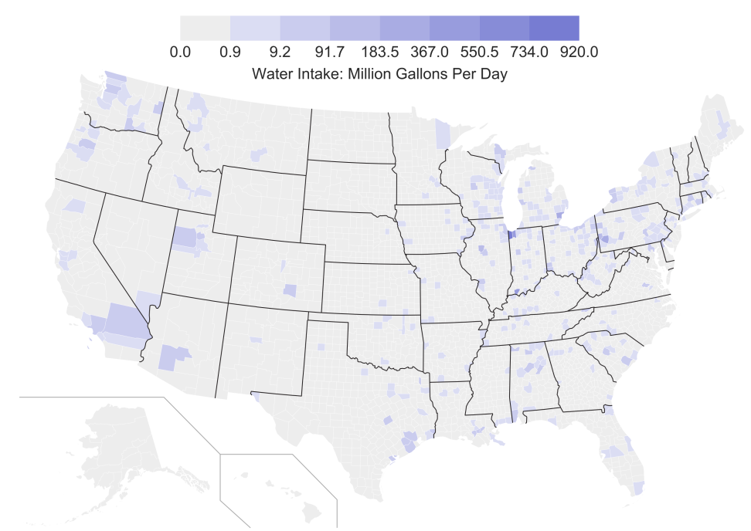
Water Withdrawals by Sector and County
325 - Chemicals
331 – Primary Metals
Notes:
Additional breakdowns of water withdrawals

Slide 53
Analysis Approach Flow Chart: Water Withdrawal Estimates
Data
Intermediate calculation
Result
Canadian Industrial Water Survey: water withdrawals by 3 digit NAICS code
Water withdrawal intensity (gallons/
employee) for each 3 digit NAICS Canadian sector
US County Business Pattern: Employment by NAICS code for each U.S. County and 3 digit NAICS sector
Initial estimate of U.S. water withdrawals by county and 3 digit NAICS sector
x
=
Canadian Employment Data: number of employees by 3 digit NAICS code
For each county, % breakdown of water withdrawals by 3 digit NAICS
USGS Estimates use in 2010: Water withdrawals by 3 digit NAICS code and county
Water withdrawals by 3 digit NAICS and county
x
=

Slide 54
Analysis Approach Flow Chart: Consumptive and by End-Use
Consumptive Water Use
Canadian Industrial Water Survey: water consumption by 3 digit NAICS code
Percent of total withdrawals that is consumptive for each 3 digit NAICS Canadian sector
Water withdrawals by 3 digit NAICS and county
Water consumption by 3 digit NAICS and county
x
Water Use by End Use
Canadian Industrial Water Survey: water withdrawals by end use by 3 digit NAICS code
Water Use by End Use for each 3 digit NAICS Canadian sector

Slide 55
Energy Bandwidth Concept
Unit Operation 1 (e.g., intake)
Industry or Sector-Wide
CT
SOA
PM
Unit Operation 2
(e.g., pretreatment)
Unit Operation 3
(e.g., desalination)
Current Opportunity
R&D Opportunity
Unit Operation 4
(e.g., post-treatment)
Energy bandwidth studies frame the range (or bandwidth) of potential energy savings, and the technology opportunities to realize those savings.
Unit Operation 5
(e.g., concentrate management)

Slide 56
Links to Bandwidths Studies
Chemicals Industry Energy Bandwidth Study, 2015. Available electronically at http://energy.gov/sites/prod/files/2015/08/f26/chemical_bandwidth_report.pdf
Bandwidth Study on Energy Use and Potential Energy Saving Opportunities in U.S. Pulp and Paper Manufacturing, 2015. Available electronically at http://energy.gov/sites/prod/files/2015/08/f26/pulp_and_paper_bandwidth_report.pdf
Bandwidth Study on Energy Use and Potential Energy Saving Opportunities in U.S. Petroleum Refining, 2015. Available electronically at http://energy.gov/sites/prod/files/2015/08/f26/petroleum_refining_bandwidth_report.pdf
Bandwidth Study on Energy Use and Potential Energy Saving Opportunities in U.S. Iron and Steel Manufacturing, 2015. Available electronically at http://energy.gov/sites/prod/files/2015/08/f26/iron_and_steel_bandwidth_report_0.pdf
Bandwidth Study on Energy Use and Potential Energy Saving Opportunities in Manufacturing of Lightweight Materials: Carbon Fiber Reinforced Polymer Composites, 2016 (DRAFT). Available electronically at http://energy.gov/sites/prod/files/2016/04/f30/Carbon%20Fiber%20Report.pdf
Bandwidth Study on Energy Use and Potential Energy Saving Opportunities in Manufacturing of Lightweight Materials: Glass Fiber Reinforced Polymer Composites, 2016 (DRAFT). Available electronically at http://energy.gov/sites/prod/files/2016/04/f30/Glass%20Fiber%20Report.pdf
Bandwidth Study on Energy Use and Potential Energy Saving Opportunities in Manufacturing of Lightweight Materials: Aluminum, 2016 (DRAFT). Available electronically at http://energy.gov/sites/prod/files/2016/04/f30/Aluminum%20Report.pdf
Bandwidth Study on Energy Use and Potential Energy Saving Opportunities in Manufacturing of Lightweight Materials: Advanced High Strength Steel, 2016 (DRAFT). Available electronically at http://energy.gov/sites/prod/files/2016/04/f30/AHSS%20Report.pdf
Bandwidth Study on Energy Use and Potential Energy Saving Opportunities in Manufacturing of Lightweight Materials: Magnesium, 2016 (DRAFT). Available electronically at http://energy.gov/sites/prod/files/2016/04/f30/Magnesium%20Report.pdf
Bandwidth Study on Energy Use and Potential Energy Saving Opportunities in Manufacturing of Lightweight Materials: Titanium, 2016 (DRAFT). Available electronically at http://energy.gov/sites/prod/files/2016/04/f30/Titanium%20Report.pdf

