Slide 1
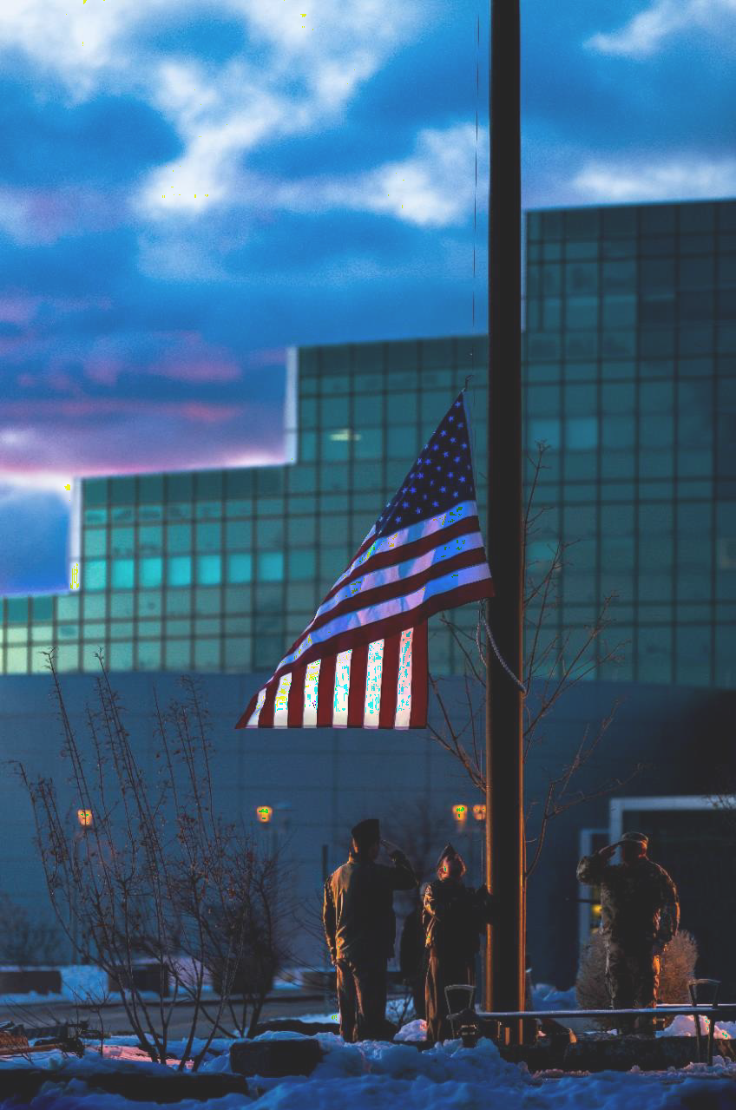
Cost estimation to study sustainment options for assembly and radiography infrastructure
2026 NNSA Cost Estimation Community of Practice (CECOP) Symposium
Nevada National Security Sites
August 12, 2026
Alexander S Lee and Tri D Tran
Controlled by: Alexander S Lee; alexanderlee5@lanl.gov
UNCLASSIFIED
LA-UR-26-26866

Slide 2
Presentation Outline
Introduction to Assembly and Radiography (A/R)
Current State of A/R Capabilities
Facility Capability Sustainment and Modernization
Cost Estimation Approach
  Operations
  Maintenance
  Recapitalization
  Construction
Data to study scenarios
  Cost projections for Baseline vs. RACR scenarios
Summary
UNCLASSIFIED
LA-UR-26-26866

Slide 3
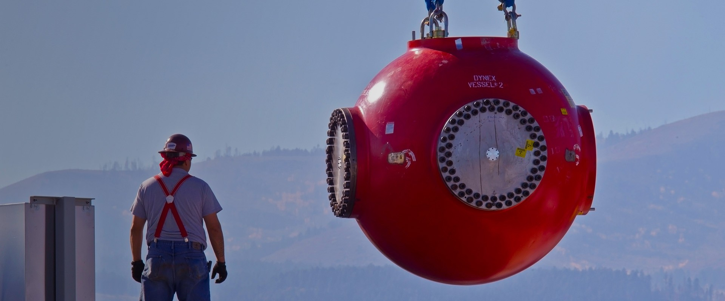
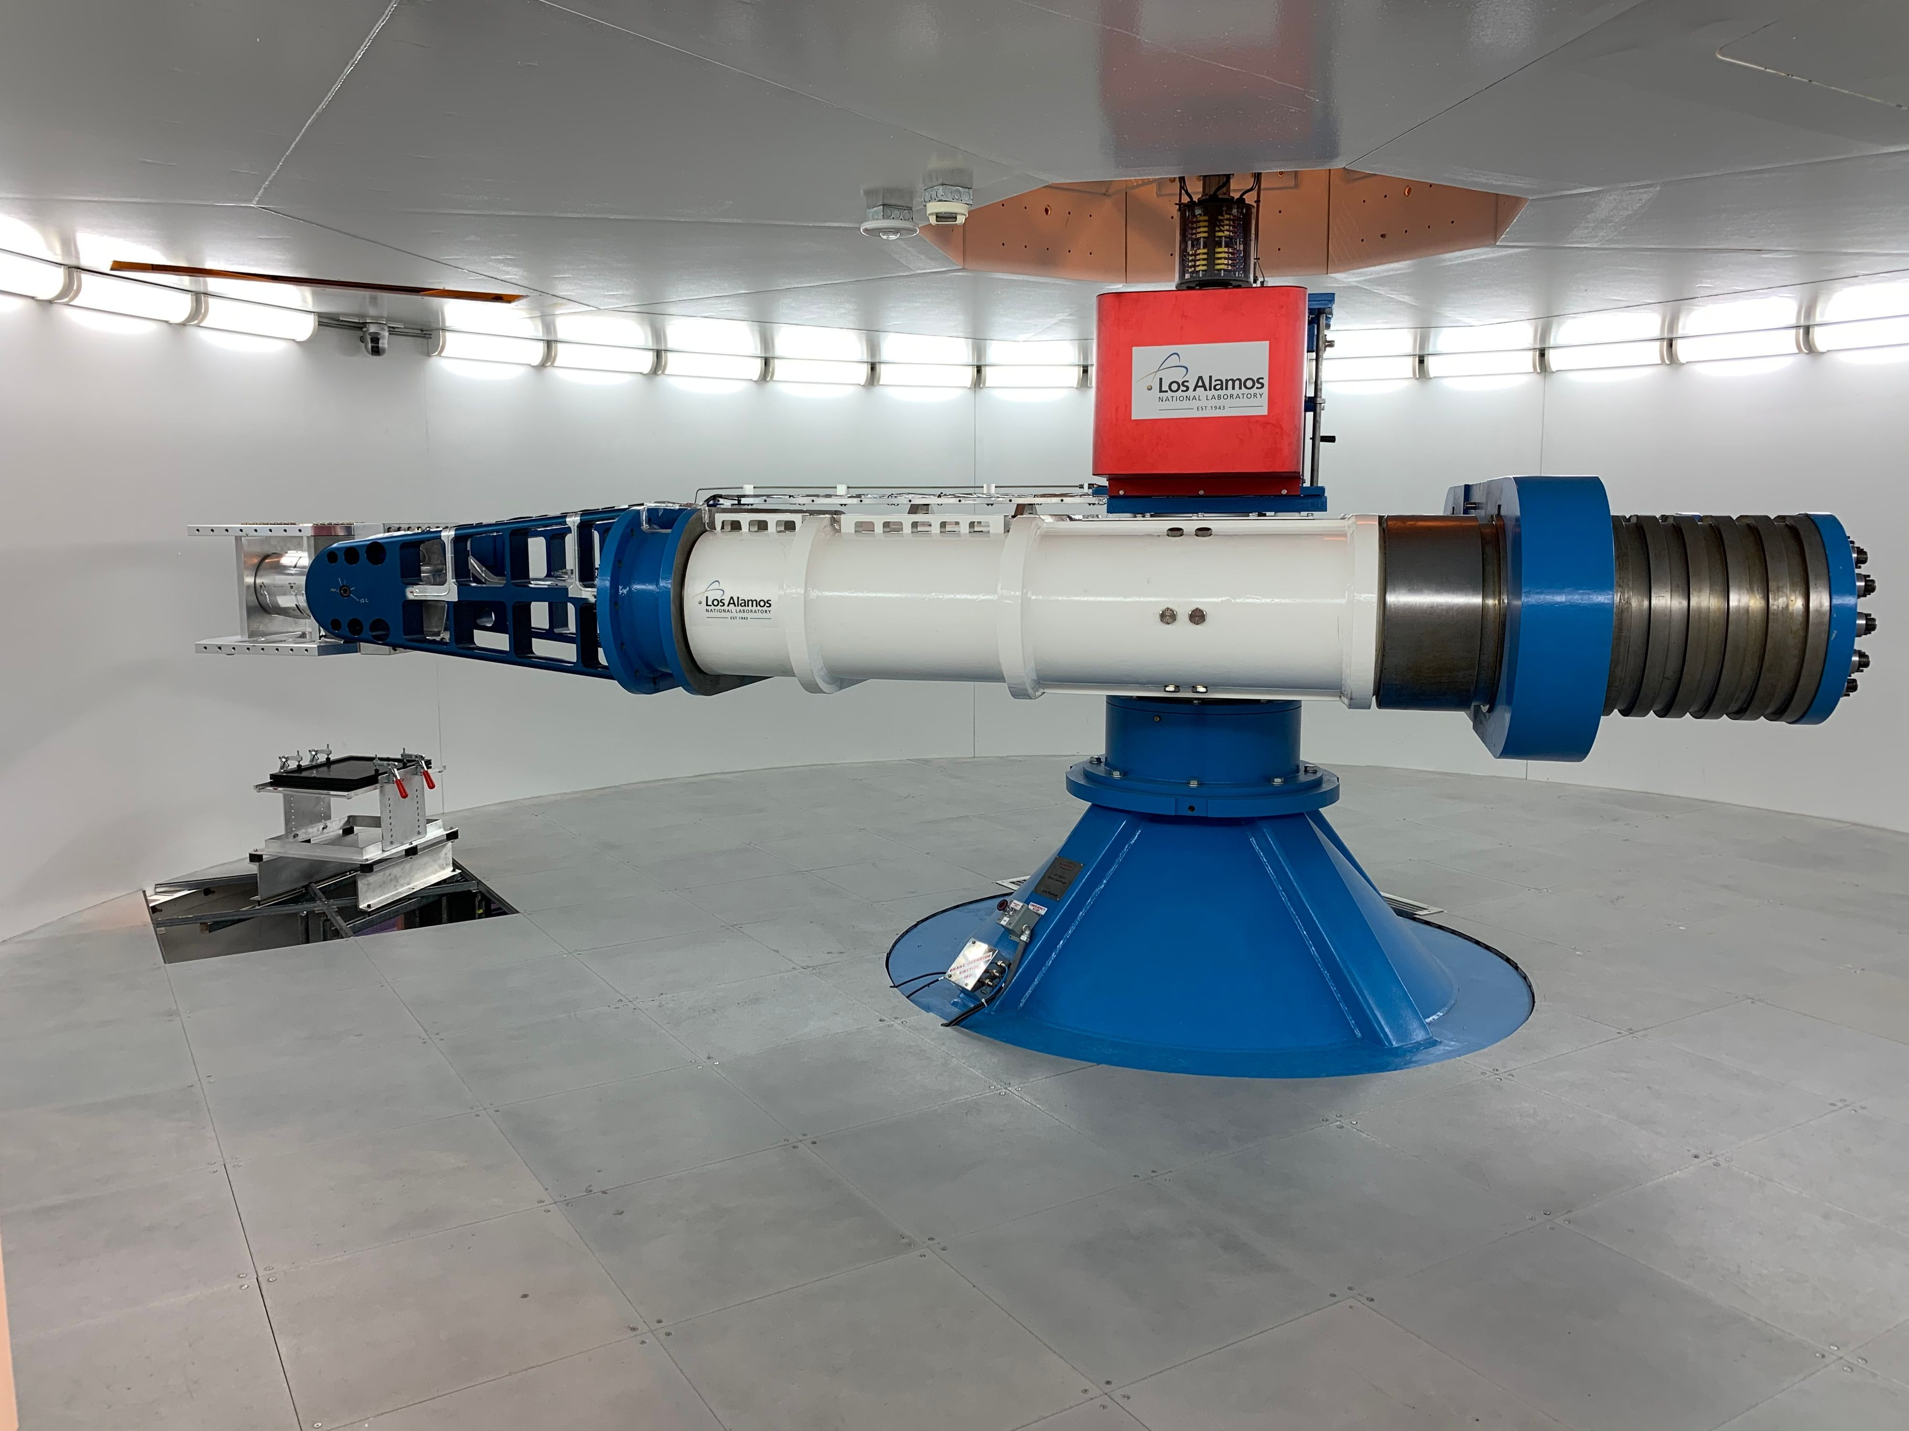
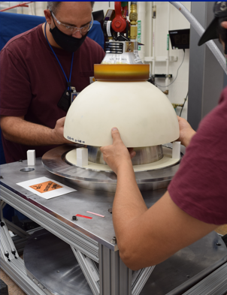
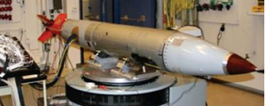
Assembly/disassembly operations prepare test units and diagnostics for many high fidelity, weapon-scale experiments
Test units at an assembly, sub-assembly, and part level are needed for:
  Materials, components, and sub-assembly testing
  Hydrodynamic and environmental testing
  Subcritical experiments
  Joint Test Assemblies (JTAs) and flight testing
Test units contain hazardous, high explosives (HE), and nuclear materials
Operations involves many supporting functions including storage, packaging and transportation
UNCLASSIFIED
LA-UR-26-26866

Slide 4
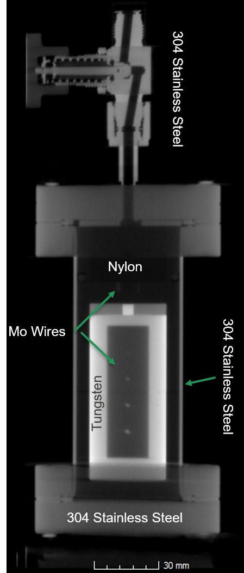
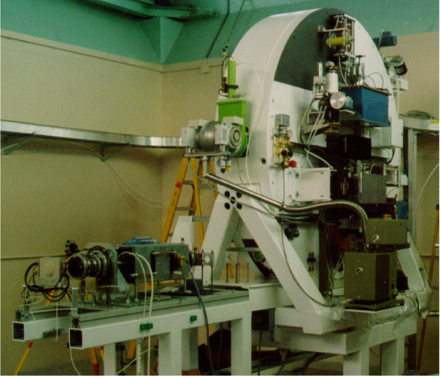
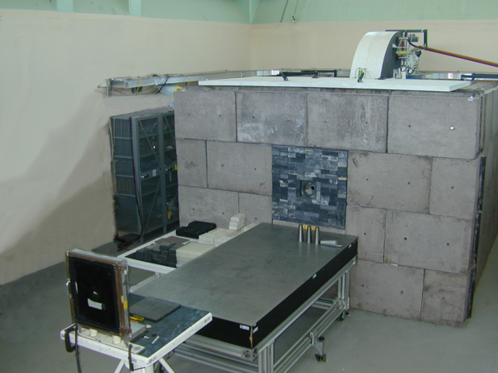
Test units are radiographed to ensure parts and diagnostics are assembled per specifications
High energy (5-20 MeV) radiographic machines (Microtron and K15) are used to inspect and qualify assemblies
  2D radiography
  3D computed tomography (CT)
  Slow radiographic movies
  Component, welding, and diagnostics inspection
UNCLASSIFIED
LA-UR-26-26866

Slide 5
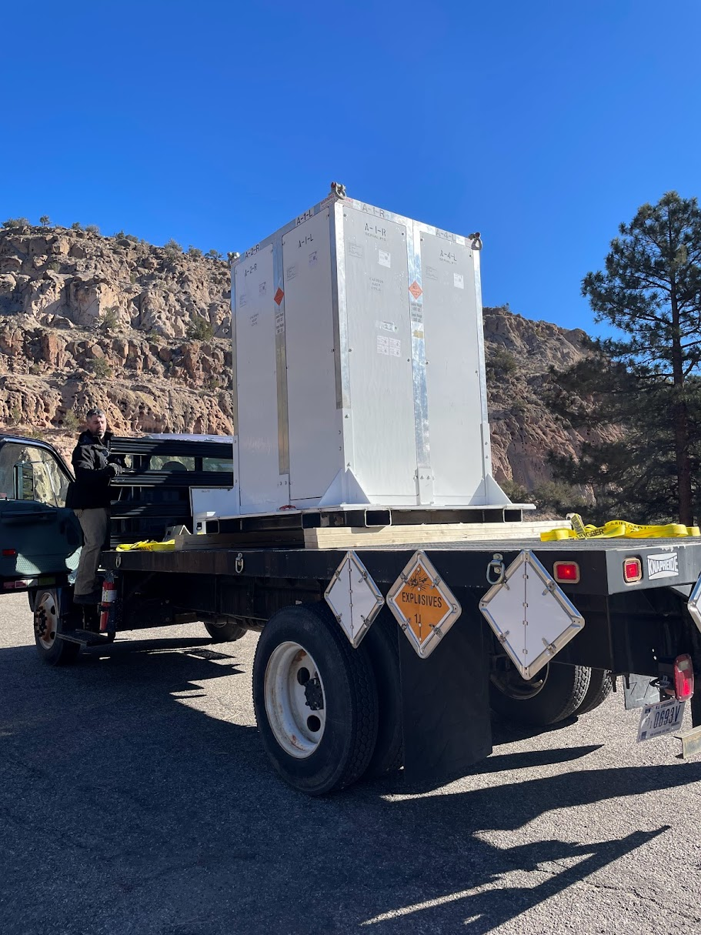
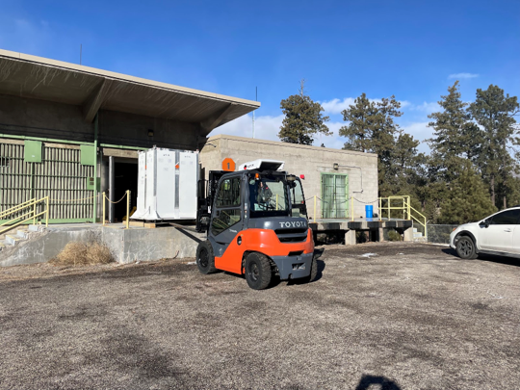
Currently, LANL’s A/R operations and supporting functions are done in 12 facilities and 11 structures
Capabilities | Facilities | Total Square Footage
Assembly/Disassembly, Packaging/Transportation | 3 buildings | 17,931
Radiography | 2 buildings | 4,745
HE Storage | 4 buildings | 6,919
Classified parts, tools, and storage | 2 buildings | 10,225
Unclassified parts, tools, and storage | Transportainers | 3,850
Office space | 1 building | 13,589
100’s of miles of transport annually
UNCLASSIFIED
LA-UR-26-26866
Notes:
Total square footage: 56K sq ft

Slide 6
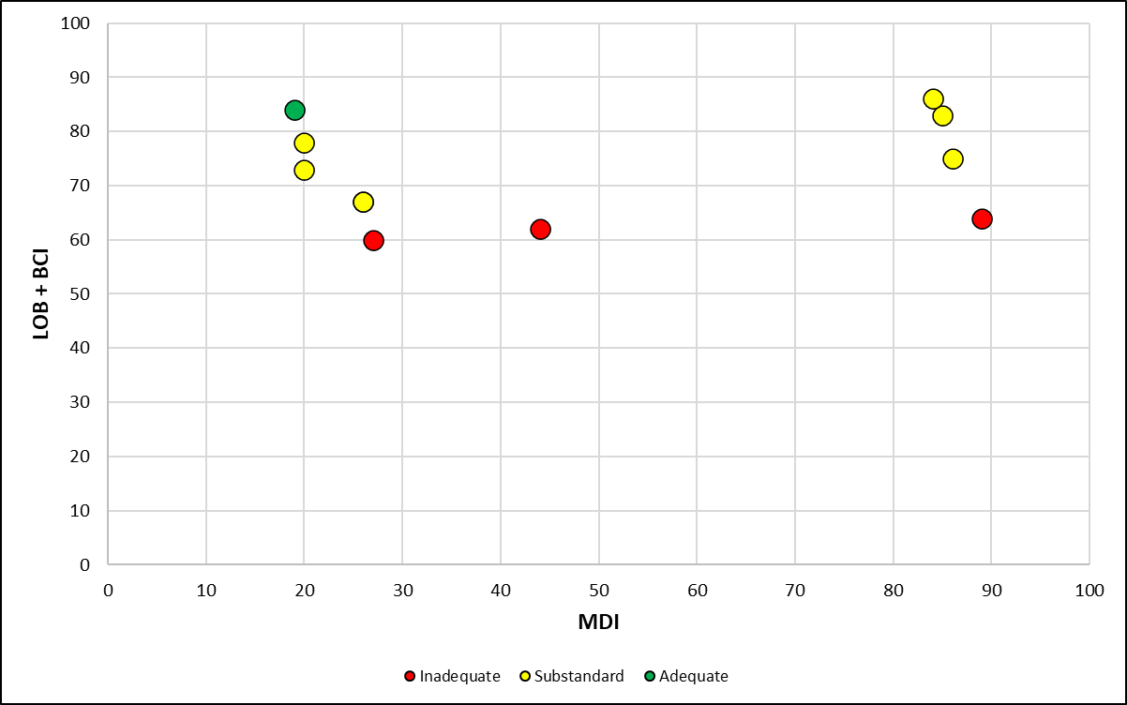
Many facilities (1950’s post-WW2 era) are degrading and in inadequate condition
Adequate
Laboratory Operations Board (LOB) assessment
Building Condition Index (BCI)
Substandard
Assembly and Radiography facilities
Storage and Office Facilities
Inadequate
UNCLASSIFIED
LA-UR-26-26866
Mission Dependency Index (MDI)

Slide 7
Assembly capabilities have degraded significantly
Factors leading to capability degradation:
  Temperature and humidity out-of-specifications
  More frequent utilities failure
  Aging/outdated building systems and space design
  Limited classified storage space
Operations (Test Units x 4)
Current capacity could be 30% less due to operations downtime in FY24-25
Time
FY25
UNCLASSIFIED
LA-UR-26-26866

Slide 8
Radiography capabilities have also degraded significantly
Factors leading to capability degradation:
  Facility downtime
    Crane issues
    No HVAC
    Asbestos abatement
    Control systems
  Microtron downtime
    Frequent component failure
    Maintenance service from a foreign source
  DOE Order 420.2D compliance investments
Operations (Test Units x 2)
Available capacity could be 30-50% less in FY22-25
Time
FY25
UNCLASSIFIED
LA-UR-26-26866

Slide 9
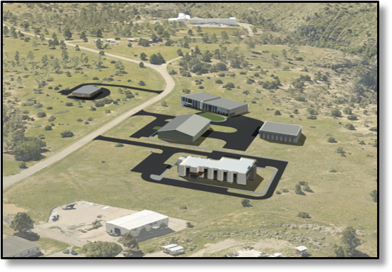
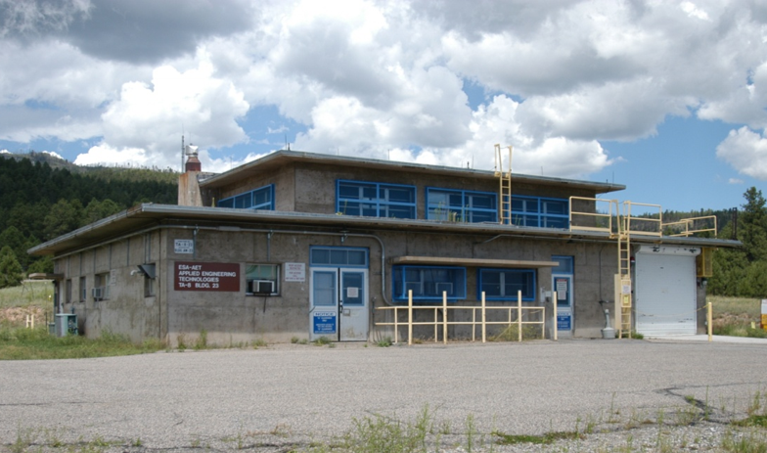
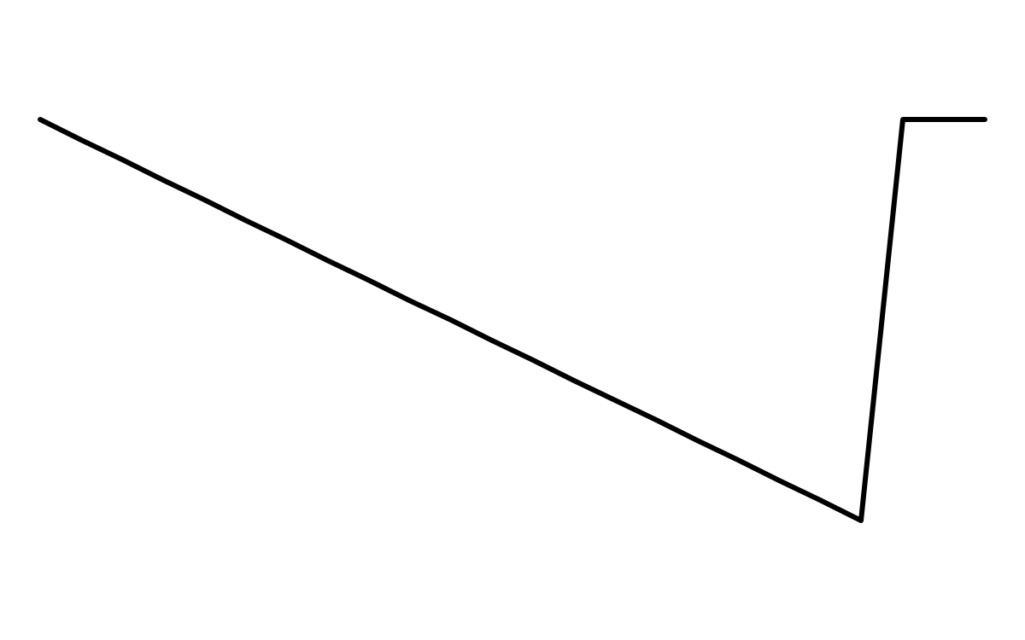
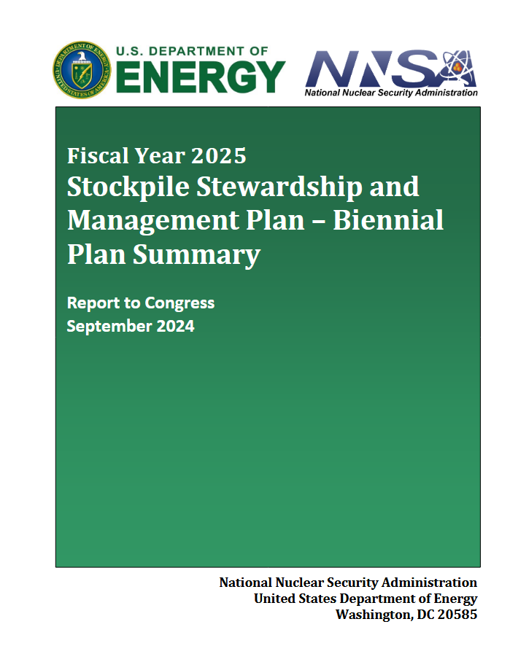
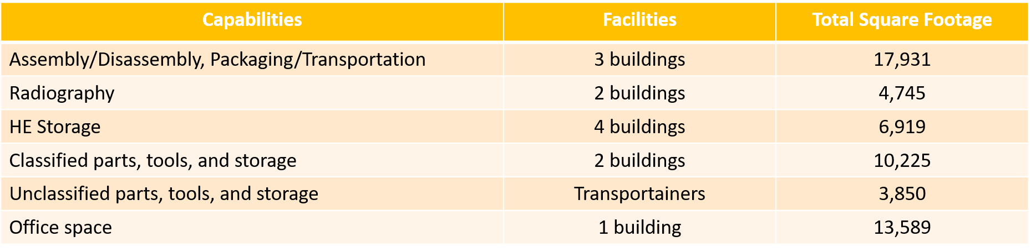
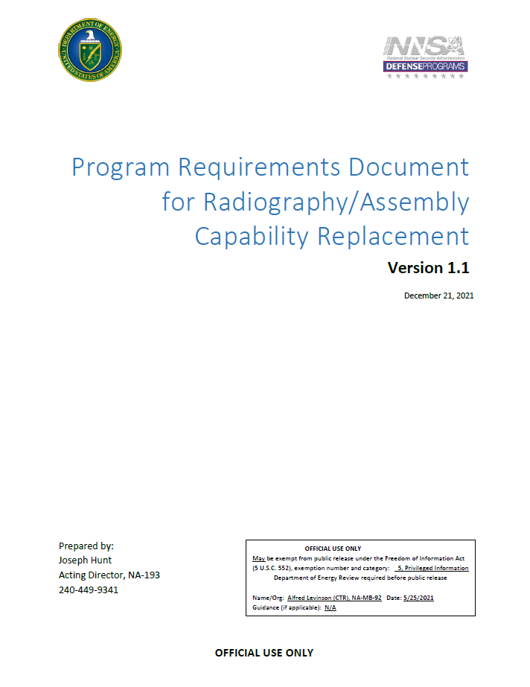
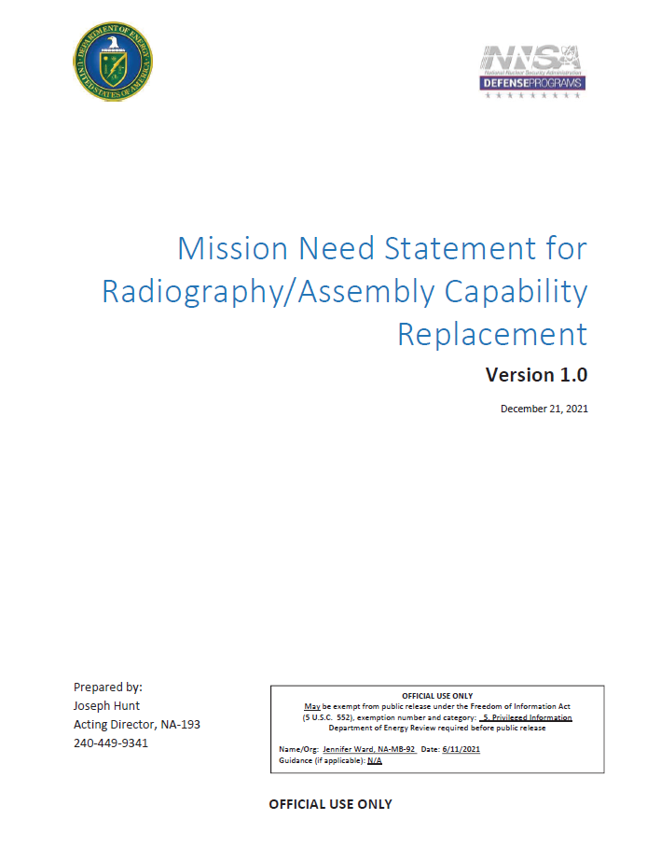
RACR is a line-item proposal to modernize the A/R complex
RACR
PRD
CD-0 2020
Operations
MNS
2026
Cost estimation to understand options
Consolidating 23 buildings
Cost estimates
1950’s
2034
RACR CD-4
Construction alternatives
LA-UR-26-26866
UNCLASSIFIED

Slide 10
An initial cost estimate is done to study sustainment and modernization options
Scope
Major A/R facilities only
2021-2040 planning window
Data
Facility Information Management Systems (FIMS)
G2
Approach
Historical data as basis
SME inputs
Planning Tool
Supporting buildings not yet completed
Builder
Weapons Facilities Operations (WFO)
Annual escalation
Current general plant project (GPP) limit
Plan of record (POR)
Visual representation of the cost elements and scenario costs
Equipment not included
Projection model
Business case analysis
UNCLASSIFIED
LA-UR-26-26866

Slide 11
Facility cost estimates are projected through 2040
Facility Life-Cycle Cost Elements
Operations
Maintenance
Recapitalization
Construction
Scenarios:
- Baseline
- RACR
- Non-LI Options
Legacy Facilities (23)
RACR
2021
Present
2034
2040
UNCLASSIFIED
LA-UR-26-26866

Slide 12
Estimating operations cost
Legacy facilities
  2021-2025: Historical
  2026-2040: 2025 actual with 3% annual escalation
RACR or a mix of legacy and new facilities
  2-year transition period when RACR becomes operational
  Legacy facilities (half the expected annual operations cost) + RACR (half the expected annual legacy facility operations cost)
Time Intervals | Assembly (Legacy) | Radiography (Legacy) | Assembly (RACR) | Radiography (RACR)
2021-2025 | $0.8M | $0.9M | - | -
2026-2030 | $0.8M | $1.0M | - | -
2031-2035 | $1.0M | $1.1M | $0.1M | $0.1M
2036-2040 | $1.1M | $1.3M | $0.6M | $0.7M
UNCLASSIFIED
LA-UR-26-26866
Notes:
Transition period example: 2035-2036 is the transition period if RACR becomes operational in 2034

Slide 13
Estimating maintenance cost
Legacy facilities
  2021-2025: Historical
    Note: 2025 maintenance is 3.5% and 5% RPV for radiography and assembly respectively
  2026-2040: 2025 actual with 3% annual escalation
RACR or a mix of legacy and new facilities
  2-year transition period
  Legacy facilities (half the expected annual maintenance cost) + RACR (half the expected annual legacy facility maintenance cost)
Time Intervals | Assembly (Legacy) | Radiography (Legacy) | Assembly (RACR) | Radiography (RACR)
2021-2025 | $11.2M | $7.6M | - | -
2026-2030 | $18.1M | $6.8M | - | -
2031-2035 | $20.9M | $7.9M | $2.2M | $0.8M
2036-2040 | $24.3M | $9.1M | $12.1M | $4.6M
UNCLASSIFIED
LA-UR-26-26866

Slide 14
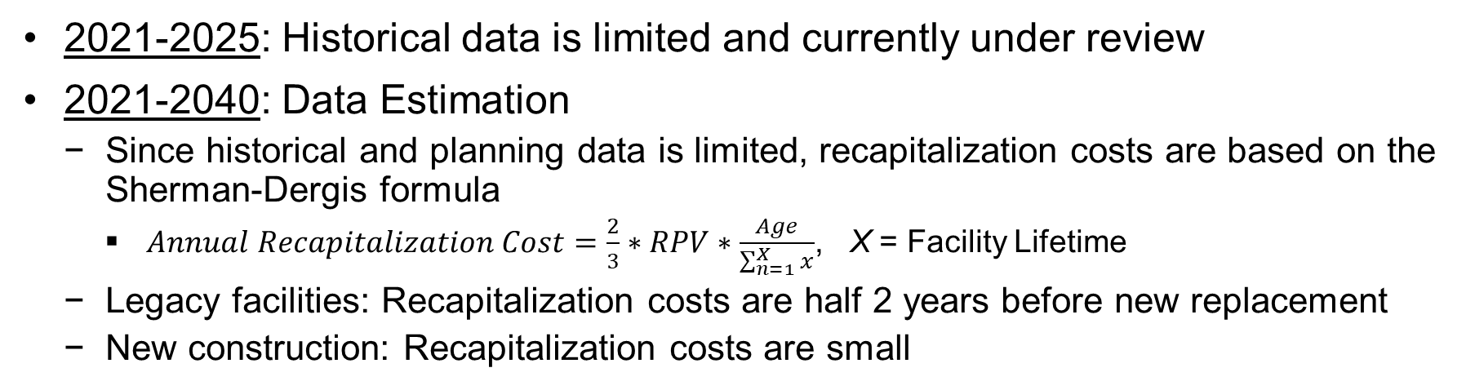
Estimating recapitalization cost
2021-2025: Historical data is limited and currently under review
2021-2040: Data Estimation
  Since historical and planning data is limited, recapitalization costs are based on the Sherman-Dergis formula
    $Annual Recapitalization Cost=\frac{2}{3}∗RPV∗\frac{Age}{\sum_{n=1}^{X}{x}}$, X = Facility Lifetime
  Legacy facilities: Recapitalization costs are half 2 years before new replacement
  New construction: Recapitalization costs are small
Time Intervals | Assembly (Legacy) | Radiography (Legacy) | Assembly (RACR) | Radiography (RACR)
2021-2025 | $11.8M | $6.8M | - | -
2026-2030 | $12.6M | $7.2M | - | -
2031-2035 | $13.4M | $7.7M | - | -
2036-2040 | $14.2M | $8.2M | $1.0M | $1.0M
UNCLASSIFIED
LA-UR-26-26866
Notes:
Sum of 1 to 50 is 1,275

Slide 15
Estimating construction costs
RACR Line Item: $250M – $330M (CD-0 cost revised by LANL in 2025)
Non-LI Projects: $34M (NNSA’s GPP investment limit)
 | RACR | Non-LI Facilities
Cost | $250M | $34M (4-5 projects)
CD-4 Estimate | FY2034 | FY2030 (Radiography) FY2032 (Assembly)
UNCLASSIFIED
LA-UR-26-26866

Slide 16
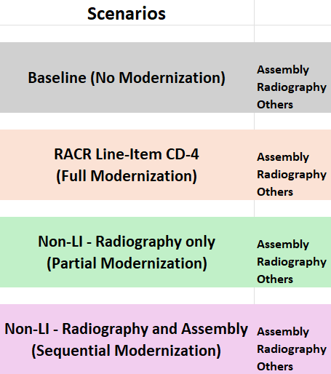
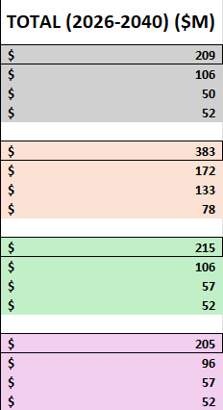
Costs for various infrastructure modernization scenarios can be projected
Historical
Projected
2021-2040 Annual Cost Estimates
Cost estimates for each element (operations, maintenance, recapitalization, and construction)
For Non-LI scenarios, full A/R capabilities will continue to be operational. Legacy facilities will need to be maintained
In addition to infrastructure cost, A/R capability require equipment and workforce for the full business case analysis
UNCLASSIFIED
LA-UR-26-26866
Notes:
2026-2040 total costs include the construction costs

Slide 17
Summary
Initial facility sustainment cost estimation was completed to study and understand A/R sustainment options based on given data and our current knowledge
Next Steps:
  Update and improve cost estimates with additional data/methodologies
  Include supporting facilities and equipment
This estimation process and business case analysis can be expanded to other modernization efforts at LANL
Pros
Reasonable estimates
Complete cost elements are evaluated
Cons
Historical data is limited
Estimates can be improved
Framework is useful for initial study of scenarios
No supporting facilities
No equipment
UNCLASSIFIED
LA-UR-26-26866

Slide 18
Backup Slides
UNCLASSIFIED
LA-UR-26-26866

Slide 19
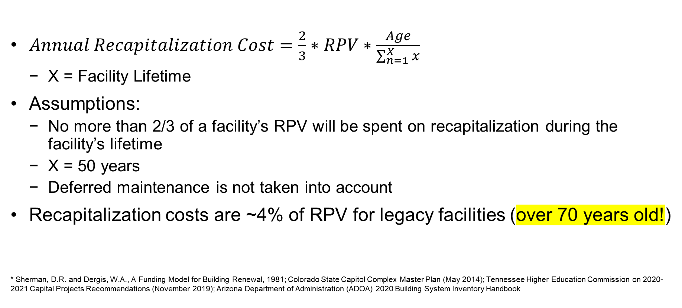
The Sherman-Dergis formula* has been used in several industries to estimate annual recapitalization costs
$Annual Recapitalization Cost=\frac{2}{3}∗RPV∗\frac{Age}{\sum_{n=1}^{X}{x}}$
  X = Facility Lifetime
Assumptions:
  No more than 2/3 of a facility’s RPV will be spent on recapitalization during the facility’s lifetime
  X = 50 years
  Deferred maintenance is not taken into account
Recapitalization costs are ~4% of RPV for legacy facilities (over 70 years old!)
* Sherman, D.R. and Dergis, W.A., A Funding Model for Building Renewal, 1981; Colorado State Capitol Complex Master Plan (May 2014); Tennessee Higher Education Commission on 2020-2021 Capital Projects Recommendations (November 2019); Arizona Department of Administration (ADOA) 2020 Building System Inventory Handbook
UNCLASSIFIED
LA-UR-26-26866

