Slide 1
The Connected Risk Journey:
Strengthening Enterprise Risk Management Across the Nuclear Security Enterprise
Eleni Rojtas (NA-181)
Chief Risk Advisor for Defense Programs
Jared Christenson
Program Analyst (NA-181)

Slide 2
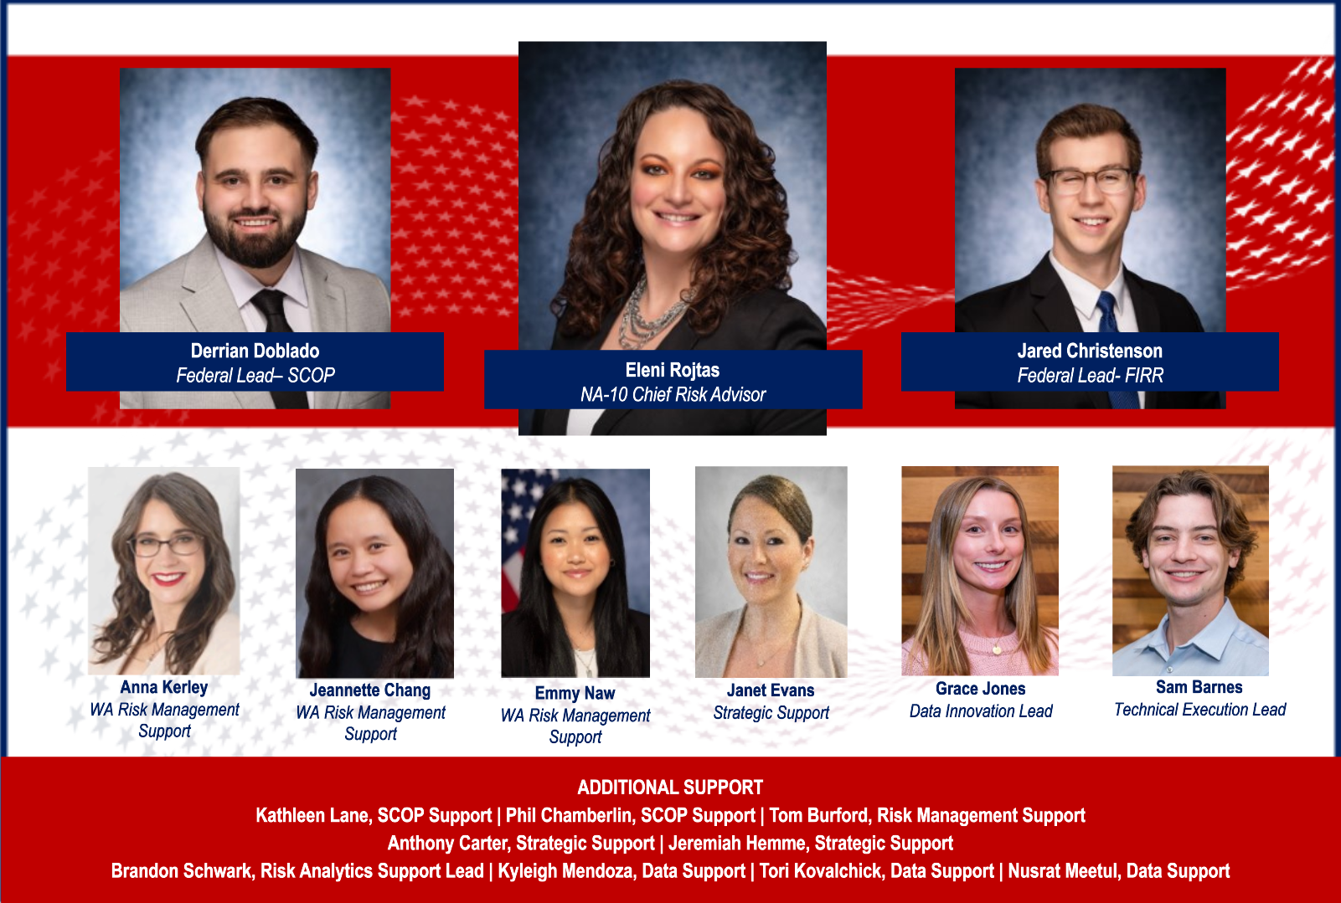
Defense Programs Risk Management (DPRM) Team
SCOP: Scheduling Community of Practice
FIRR: Federal Integrated Risk Register
WA: Weapons Activities

Slide 3
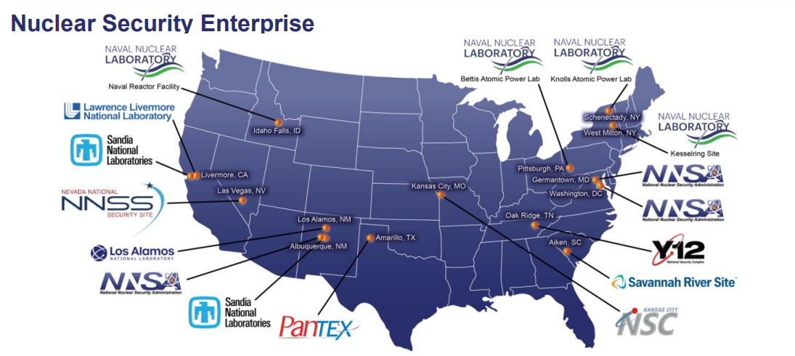
The Challenge: The Disconnect
Risk is not isolated
  Our journey building an enterprise risk program across multiple sites and headquarters shows how governance, culture, and technology transform scattered risks into enterprise intelligence.

Slide 4
Hidden Connections Across the Organization
Risks hide in silos in departments, processes, and systems.
Multiple projects may share the same risk.
Multiple working groups stood up to address different types of risk.
Where we have noticed disconnects:
  Project-level risks don’t consider enterprise impacts.
  Risk Reviews without appropriate stakeholder engagement.
  Incomplete risk profiles and unrecognized dependencies
Culture and process that facilitates cross-functional engagement
Opportunities:
  Combine resources and address risk holistically
  Centralize and consolidate to assess interdependencies

Slide 5

DP Risk Management (DPRM) Strategy
Mission
Vision
Defense Programs Risk Management accelerates the delivery of a modern, responsive deterrent by enabling accountable, risk-informed decisions across the nuclear security enterprise.
Risk Management is institutionalized as a decision advantage, driving accountability, speed and clarity across the National Security Enterprise.
Notes:
DP Risk Management (DPRM) Strategy
As we accelerate transformation and modernize, risk management is an enabler
If done right, risk management becomes NNSA’s strategic capability

Slide 6
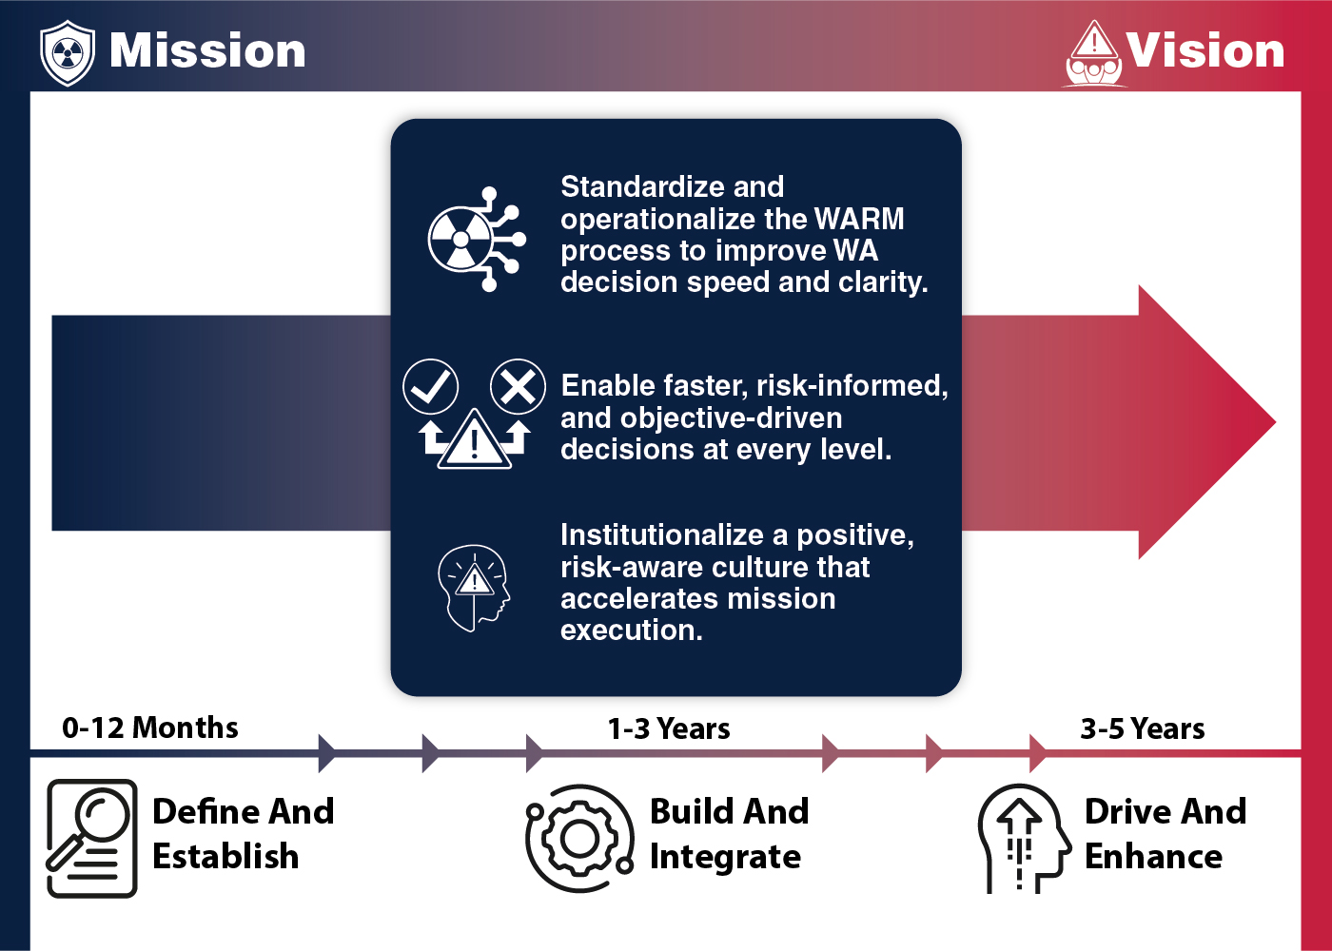
Strategic Vision to Operational Execution
Strategy only succeeds if linked to execution
Decision outcomes depend on risk-informed insights
Practical Application:
  Strategic Plan focusing on culture, risk informed decision quality and enterprise risk governance.
Notes:
People, Technology, Governance
Strategic Goals & Outcomes
Focused on three weapons-level shifts: Process discipline, decision enablement and cultural maturity
Outcomes are: enable risk-informed decisions, improve decision speed & clarity, accelerate mission execution

Slide 7
Strategy Execution: Culture

Slide 8

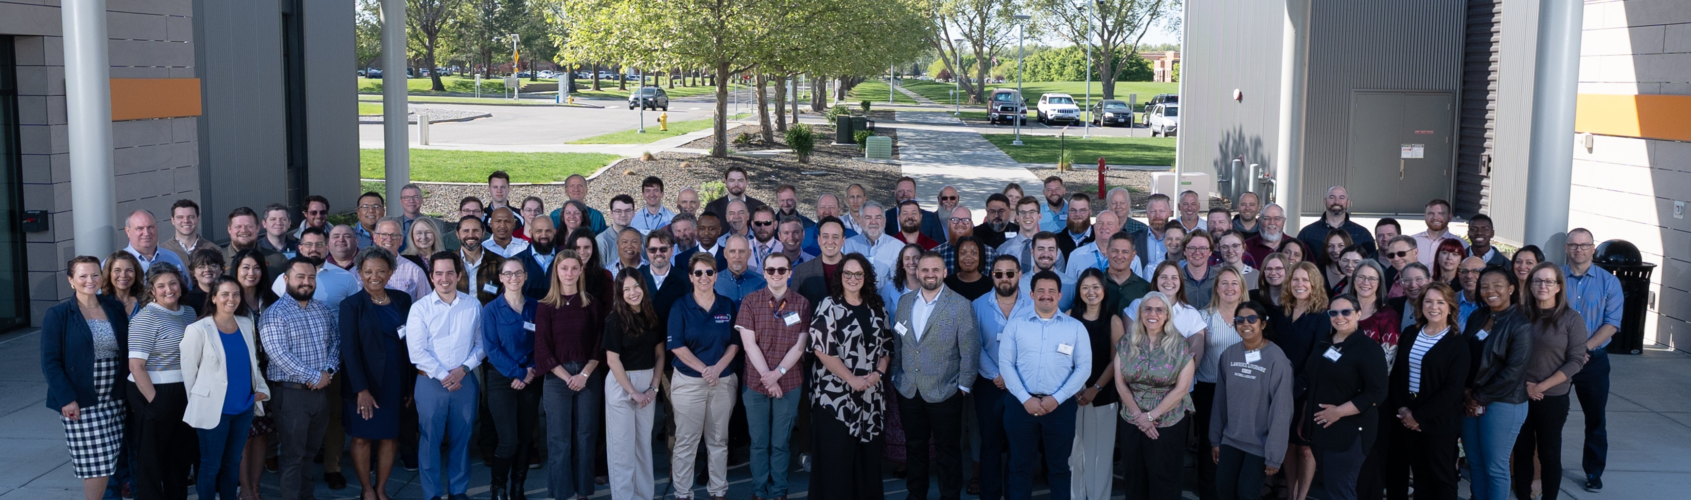
Risk Summits
Oct 2023
Nov 2024
Jan 2026
IMPACT
Normalize and harmonize risk dialogue across sites and programs
Strengthen accountability through established standards and expectations
Enable peer mentorship and practitioner development
Accelerate learning through enterprise exposure
Elevate professional rigor and consistency
Concept Inception
Engagement Expansion (Pantex)
Enterprise Momentum (SNL)
Established vision for recurring enterprise-wide risk collaboration forum.
Attendance tripled; pre-planning sessions introduced; structured outputs formalized.
Reinforced commitment to maturing enterprise risk capability.
Foundational Model (KCNSC)
Thematic Maturity (NNSS)
Sharing Perspectives (PNNL)
Launched inaugural Summit; defined structure and objectives.
Introduced intentional risk themes to align discussions with enterprise priorities.
Developed consistent approaches to evaluate risk likelihood and impact, enabling clearer prioritization.
Apr 2024
Apr 2025
May 2026
✔ A connected enterprise risk community
✔ Strengthens shared language and expectations
✔ Improves risk quality feeding WARM and FIRR
✔ Reinforces tone from the top on transparency and accountability
Enterprise Enablers
Risk Summits are a deliberate mechanism to shape enterprise culture.

Slide 9
Measuring DP Risk Culture & Maturity
Near-Term (Feb 2026)
In-Depth Analysis (March 2026)
Review qualitative feedback
Assess maturity spectrum
Action Plans (March 2026)
Adjust current initiatives where needed
Path Forward
Address immediate themes surfaced
Segment results (risk vs. non-risk; NNSA vs. LPS; leadership levels)
Define specific, measurable improvement actions
Culture Survey Baseline
January 2026
What We Are Assessing
First enterprise-level assessment of DP risk culture
Establishes baseline and informs targeted actions
Risk Perception and Leadership
Risk Information and Processes
Risk Management Tools
134
70%
75%
# Total Participants
(NNSA and LPS)
Non-Risk Professionals
NNSA Participants

Slide 10

Building Culture for Connection
Without a positive risk-aware culture, tools and governance fail.
Establish psychological safety and open communication.
Community of Practice
Risk Newsletters | Information Sessions
Digital Platforms
Risk Awareness Week
Stakeholder Engagement
Schedule Community of Practice
Notes:
Really want to talk about the importance of culture, especially when you are driving organizational change.
Focus on the wins that each of these efforts have established for us.
Empowering our risk community to mature into risk managers, not just reporters.

Slide 11
Strategy Execution: Objective Driven Risk Analysis

Slide 12
DP Risk Governance Updates (Requirements & Guidance)
Before
Legacy
Transition
After
Consistent &Comparable
Clear Escalation
Ambiguous
Inconsistent
Compliance-Driven
Updating R009, T057, T056
Cross-Enterprise Content Teams
Writing workshops at HQ
Aug 2025, Feb 26
Alignment with industry standards
Outputs from Risk Summits
Risk embedded in decisions
Accountability and ownership
Enterprise Enablers
✔ Drive Consistency
✔ Stronger linkage between risk and strategic objectives
✔ Consistent inputs into FIRR for WARM governance
✔ Plain-language risk dialogue for risk-informed decisions
Clear Requirements & Guidance → Consistent Execution → Better Decisions
Notes:
We're not just updating documents, we are strengthening decision quality
Current State:
Variability in application across programs
Inconsistent linkage between risk analysis and decision forums
Ambiguity between required vs recommended practices
Future state:
Consistent, comparable risk analysis across programs
Clear escalation thresholds to leadership
Risk analysis embedded in key decisions
Stronger accountability and ownership

Slide 13
AI in DPRM
DPRM developed a strategy for piloting AI use cases for select risk management and analysis activities.​
AI is uniquely capable of uncovering insights in unstructured, text-based data, making it particularly useful in a risk context.​
AI applications paired with human expertise can enhance risk management within DPRM and support informed decision-making across the enterprise.
Through the AI taskforce, we aim to accelerate responsible and impactful AI implementations for risk.​
Goal: The purpose of the Risk AI Taskforce is to identify, prioritize, test, and make accessible specific, enterprise-level AI use cases for the risk community.

Slide 14

Federal Integrated Risk Register (FIRR)
FIRR operationalizes risk transparency at enterprise scale.
Centralized enterprise risk repository: Federal instance of ARM (Low FIRR & High FIRR) with enterprise-wide licensing (500 users)
Uniform data structure and configuration: Standardized data fields, uniform schema, improved automation
Portfolio-level aggregation (supports WARM & RRB): Traceability from programs to portfolios, data normalization, better resource allocation
Cross-site interdependency and visibility: Enables risk escalation across organizations and shared risk notifications
FUTURE STATE
Fragmented data: Separate Active Risk Manager (ARM) instances at each site, different software versions and administrators
Limited portfolio visibility: Program-level focus
Missed interdependencies: Systems do not communicate
BEGINNING STATE
  Enterprise License Agreement secured (Riskonnect)
  High FIRR and Low FIRR stood up and data migration began Q1 FY26
  Supporting governance documents and training resources developed
  Monthly townhalls to drive adoption & alignment
  Configuration Management Board (CMB) set up to formally review suggested changes
Implementation Progress
Notes:
Here you can talk about the technical and programmatic execution of FIRR:
FIRR Execution Team (FIRRET) with representatives from all programs migrating over, monthly townhalls for all stakeholders to ask questions, connect.gov page to keep all stakeholders up to date and to track all questions and answers.
Discuss Success to date

Slide 15
FIRR: Successes
FIRR Execution Team (FIRRET) agreed to a standard set of fields for all FIRR users that meets the needs of all programs currently using ARM​, the team later transitioned to our Configuration Management Board (CMB)
  Fields were shared out to stakeholders at the LPS through their FIRRET members and with a survey sent out to all​ stakeholders
Enterprise License Agreement (ELA) procured from vendor with 500 licenses and installation of High FIRR on ESN Hub and Low FIRR on the Joint Unclassified Cloud Environment (JUCE)
  Developed a Power App License Tracker to support the additions of programs utilizing FIRR
Developed a documentation ecosystem supporting the FIRR
  Information Security Plan to address concerns of NTK and user permissions​
  FIRR User Guide that goes through an in-depth look at each of the fields in FIRR
  FIRR Training Module that explains details on how to use the tool
Notes:
Challenges

Slide 16
FIRR: Challenges
NNSA traditionally does not host software, making dedicated technical support difficult to obtain
  As trailblazers for the ESN Hub and JUCE, we faced added complexity – particularly around access restrictions
  Dedicated technical support not clearly identified: to meet our aggressive timelines, we became our own technical support, relying on AI.
Server Corruption
  Reliance on AI combined with limited in-house technical knowledge created challenges

Slide 17
Building Confidence Through Risk Insight
Risk Dashboards
Program Support
Maturity Assessments
Peer Reviews
LPS Risk Projects
Lessons Learned/Best Practice

Slide 18
Strategy Execution: Enterprise Risk Management

Slide 19
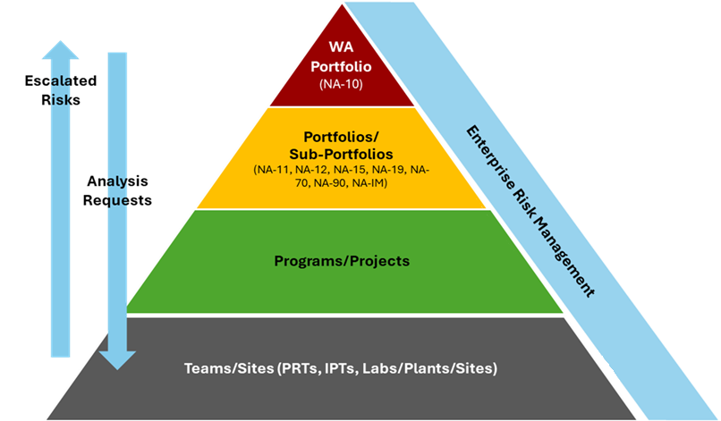
Weapons Activities Risk Management (WARM)
WARM is shifting NNSA from reactive issue management to proactive risk visibility.
Purpose
What We Have Established
Defined roles, governance, and escalation pathways
Framework for integrating cross-functional and interdependent risks
Quarterly WARM Risk Review Boards (RRBs) with NA-10 leadership (Mar 2025)
Impact to Date
Held 4 RRBs via Requirements Management Advisory Board (RMAB)
Aggregated 934 risks across 12 programs into a unified dataset
Identified structural data gaps limiting enterprise insight
Established improvement roadmap
What This Enables
Comparable risk data across programs
Clearer WA and enterprise risk prioritization
Better-informed leadership decisions at portfolio level
Formal WARM process signed by NA-10 (Jan 2025)
Create a high / portfolio-level Enterprise Risk Management (ERM) Plan that enables enterprise visibility, integration, and informed decision-making across Weapons Activities (WA).

Slide 20
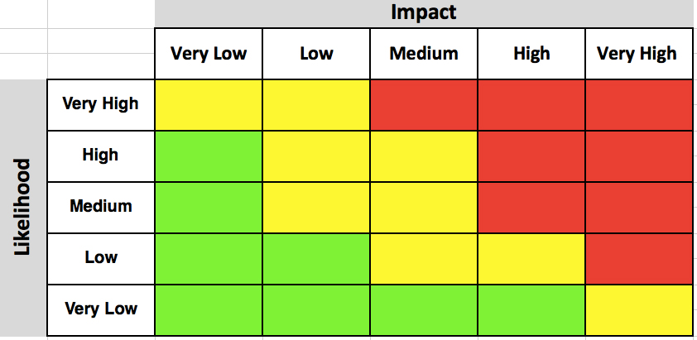
Example Analytical Framework
Hypothesis: Traditional risk characterization is inherently over-simplified, leading to weak & often misaligned analysis outputs not conducive to actual decision-making.
Goal: Develop an action-oriented risk decision framework that leverages prioritization methodologies, decision trees, process flows, data management & analytics, cost & schedule estimating, and advanced AI applications.
Traditional Risk Prioritization Approach
Expanded Criteria Analytical Framework
Criteria | Risk A | Risk B | Risk C
Likelihood | Medium | High | Low
Impact | Medium | High | Low
Velocity | Low | Medium | High
Persistence | Unknown | Unknown | Unknown
Recoverability | Medium | High | Low
Controllability | High | Low | High
Interdependencies | High | High | Unknown
Strategic Alignment | High | Low | Unknown
Risk | Action | Rationale
A | Mitigate | While likelihood & impact might suggest that the risk is not our top priority, high interdependencies, strategic alignment, and controllability suggests mitigation
B | Avoid | While likelihood & impact might suggest mitigation is appropriate, low controllability means avoiding the risk is more appropriate
C | Investigate | Many characteristics cannot be evaluated. More research required to understand risk before proceeding
B
Risk | Priority
A | 2
B | 1
C | 3
A
C
20

Slide 21
Risk Management Analytical Process
Expanded analytical approach begins with scoring risks on a comprehensive set of risk criteria, which is subsequently used to determine enterprise risk escalation, risk categorization, and ultimately action recommendations.
Expanded Risk Scoring
Recommend Solution Strategies
  Step 1. Determine the 8 enterprise criteria / characteristics
  Step 2. Execute rules to score a risk on the enterprise criteria
  Step 3. Assign archetypes based on defined rules
  Step 4. Provide handling strategy recommendation (Elevate, Mitigate, etc.)
  Step 5. Provide specific strategy recommendation (funding, policy, etc.)
Define Enterprise Criteria
Assign Escalation Archetypes
Recommend Specific Actions/COAs
Please note that this methodology and the specific technical details of each step are notional and are being presented as a set of concepts.
More work will be required to formalize and define each step of this methodology before real-world application

Slide 22
Step 1 – Define Enterprise Criteria
Each risk is scored on a comprehensive set of criteria to ensure that the risk’s profile is fully understood.
This is critical as it ensures that subsequent risk elevation and action recommendations are based on comprehensive information.
We have identified current FIRR fields to be used as the baseline for scoring the criteria, making the framework theoretically viable to implement.
Probability
# | Criteria | Description
1 | Likelihood | Probability across the enterprise (recurring issue, macro trends)
2 | Impact | Enterprise-wide consequences (financial, reputational, compliance, market)
3 | Velocity | Time between trigger and full enterprise impact
4 | Persistence | How long a risk would affect us once triggered
5 | Recoverability | Enterprise resilience (capital, resources, alternatives)
6 | Controllability | Ability to influence through enterprise levers
7 | Interdependencies | The number of programs/outcomes that are tied to a risk
8 | Strategic Alignment | Determine if a risk will affect core mission, regulatory obligations, or growth strategy
Risk Level
Exposure Start
Impacted Activity Date
Exposure Start
Schedule Impact
Manageability Rating
Relevant Programs / Sites / POCs
Strategic Objectives

Slide 23
Step 2 – Expanded Risk Scoring
Using the FIRR fields as a starting point, scores can be determined for enterprise criteria. These scoring methods are purely notional and rubric finalization require additional work
# | Metric | Calculation | High | Medium | Low
1 | Likelihood | Current Probability | 61-100 | 41-60 | 1-40
2 | Impact | Current Risk Level | 19-25 | 10-18 | 1-9
3 | Velocity (Speed of Onset) | Impacted Activity Date - Exposure Start | 0-50 days | 51-100 days | 100+ days
4 | Persistence (Duration) | Velocity + Schedule Impact | 120+ days | 61-120 days | 1-60 days
5 | Recoverability | Determined by leadership | Low chance of recovery | Moderate chance of recovery | High chance of recovery
6 | Controllability | Manageability Rating | 4: Limited or 5: No Influence/Control | 3: Moderate | 1: Complete or 2: Near Complete​
7 | Interdependencies | Count of Relevant Programs / Sites / POCs + Count of Shared Risk | 5+ relevant parties | 2-4 relevant parties | 1 relevant party
8 | Strategic Alignment | Strategic Objectives | Tagged to an NA-10 level objective | Tagged to a portfolio level objective | Tagged to a program level objective
Comprehensive scoring system ensures that each risk’s full profile is well-understood. This expanded scoring data determines the most appropriate action for that unique risk / set of risks.

Slide 24
Lessons Learned
Start with culture and governance, not just tools.
Risk maturity is uneven. Meet sites where they are but set enterprise standards.
Interconnections surface when you bring people together, not just data.
Governance provides the structure, culture provides the energy, and technology provides the connective tissue.
Notes:
I’m always learning new lessons, my goal is just not to learn the same lessons.

Slide 25
Thank you!

