Slide 1
Composites
Chad Schell, Technology Manager
G. Jeremy Leong, Technology Manager
Blake Marshall, Technology Manager
Advanced Manufacturing Office
AMO Peer Review
June 2020 | Washington, DC
manufacturing.energy.gov

Slide 2
Composites Background
AMO investments and collaborations focus on fiber reinforced, polymer matrix composites
  New focus area for AMO with significant investments beginning in 2013 with ORNL Carbon Fiber Test Facility (CFTF) and Composites Institute (IACMI) in 2015
Objective is to advance material production technologies that
  Reduce embodied energy and emissions and
  Reduce cost of composites.
Relative lightweight, high-strength, high-stiffness and other unique properties make composites an important cross-cutting technology in U.S. manufacturing.
Composites have the potential to improve the energy efficiency of the transportation sector, enable more efficient power generation, improve the storage and transport of low-carbon fuels, and improve manufacturing processes*
AMO supports work in advancing the materials and manufacturing of parts:
  Production of reinforcing fibers focused on carbon fiber but also including established glass reinforcing fibers and lesser used and emerging fibers like basalt, bio-based such as nanocellulose, and other nanomaterials
  Thermoset and thermoplastic matrix materials
  Improving the energy efficiency and cost to produce composite parts
*Materials: Foundation for the Clean Energy Age. The Minerals, Metals, and Materials Society (TMS). Sponsored by AMO/U.S. DOE and contracted through ORNL. In cooperation with ASM International and The Energy Materials Initiative. Available online at: https://www.tms.org/portal/downloads/publications/Studies/MaterialsandEnergyEfficiency/Materials_Foundation_for_Clean_Energy_Age_Press_Final.pdf

Slide 3
Composites Challenges and Barriers
Material costs: high raw material costs, particularly for reinforcing fiber precursors.
Scalability: lack of generally applicable, high-production-volume manufacturing methods for composite materials and components.
Production speeds: long cycle times and low throughputs for composite part manufacturing, including joining techniques.
Manufacturing energy intensity: high raw material embodied energy and manufacturing energy requirements, reducing some of the energy advantages of lightweighting.
Recyclability: difficulty in separating fiber reinforcements from cured thermoset matrix materials; inferior mechanical properties in recycled materials compared to virgin products; immature infrastructure for collecting and re-using composite materials at end-of-life.
Validation and in-line diagnostics: lack of standard performance validation techniques for crashworthiness and other safety-critical applications; lack of low cost high speed in-line diagnostics for quality control to minimize defects in materials and components.
Prognostics: lack of established design protocols and reliable end-to-end predictive modeling techniques for composite materials and components.

Slide 4
Composites Objectives and Targets
OBJECTIVE
1. Reduce cost of composites to be competitive with current materials and manufacturing methods, to enable widespread use of composite materials in energy-related applications.
TARGETS
7.1: Reduce production cost of finished carbon fiber composite components for targeted energy-consuming applications by 50% compared to 2015 state-of-the-art technology
 | 2015 Baseline | Progress to Date
Auto | $55-$78 per kg | $32 per kg (42% improved)
Wind | $16 per kg | $12 per kg (25% improved)
Pressure Vessel | $28 per kg | Research ongoing

Slide 5
Composites Objectives and Targets
OBJECTIVE
1. Reduce cost of composites to be competitive with current materials and manufacturing methods, to enable widespread use of composite materials in energy-related applications.
TARGETS
Target 7.2: Develop composite molding manufacturing process with <1.5 minutes part-to-part cycle time for a structural component with surface area >0.5 square meters (m²).
2015 Baseline | Progress to Date
3.5 - 9.0 minutes depending on component and process | Automobile seat back compression molded approximately 2 min cycle
 | Fender with 40% carbon fiber reinforcement injection molded in approximately 60 second cycles

Slide 6
Composites Objectives and Targets
OBJECTIVE
Reduce cost of composites to be competitive with current materials and manufacturing methods, to enable widespread use of composite materials in energy-related applications.
Reduce embodied energy and emissions.
TARGETS
Target 7.5: Develop fiber-reinforced polymer composites with projected cost and embodied energy parity with 2015 typical glass fiber composites and with performance of carbon fiber composites.
 | 2015 Baseline | Progress to Date
Cost | $25/kg (representative automotive part – injection overmolded) | Carbon fiber cost reduced to $21.56/kg (31% improved) for large tow carbon fiber produced by CFTF
Embodied Energy | Embodied Energy: 94 MJ/kg (representative automotive part – injection overmolded) | Research ongoing

Slide 7
Composites Objectives and Targets
OBJECTIVE
Reduce embodied energy and emissions.
TARGETS
Target 7.3: Develop manufacturing technologies that reduce the embodied energy and production-associated greenhouse gas (GHG) emissions of carbon fiber reinforced polymer (CFRP) by 75% compared to 2015 typical technology.
 | 2015 Baseline | Progress to Date
Auto | 1409 MJ/kg (carbon fiber) | 1004 MJ/kg (20% improved)
Wind | 1409 MJ/kg (carbon fiber) | 717 MJ/kg (23% improved)
Pressure Vessel | 2247 MJ/kg | Research ongoing

Slide 8
Composites Objectives and Targets
OBJECTIVE
Reduce embodied energy and emissions.
TARGETS
Target 7.4: Develop technologies that recycle or reuse >95% of fiber reinforced polymer composites into useful components with projected cost and quality competitive with virgin materials
2015 Baseline | Progress to Date
30% raw material scrap typical continuous fiber composites | Carbon fiber recovered successfully from scrap materials. Research in progress to incorporate into components.

Slide 9
Composites Portfolio and Activities
Manufacturing Demonstration Facility
  See previous presentation for details
Institute for Advance Composites Manufacturing Innovation (IACMI)
  Collaborative Composites Solutions Corporation
  June 2015 to December 2020 with budget of $196M ($70M DOE)
  Beginning transition to self-sustaining, post initial DOE funding phase
  Public/private consortium
Innovative High-feed Rate Additive Manufacturing Using Nano- Micro- Cellulose-Reinforced Thermoplastic Composites
  Oak Ridge National Lab & University of Maine
  June 2019 to September 2022
  FY20 DOE funding $6.6M
Carbon Fiber Technology Facility (CFTF)
  Oak Ridge National Lab
  $29.8M DOE funding FY16-FY20
  The Carbon Fiber Technology Facility (CFTF) serves as a national resource to assist industry in overcoming the barriers of carbon fiber cost, technology scaling, and product and market development. CFTF is intended to be the bridge from R&D to deployment and commercialization of low-cost carbon fiber

Slide 10
Composites Collaborations and Connections
Fossil Energy
Wind Power Technologies Office
-Coal pitch and other carbon fiber precursors
Bioenergy Technologies Office
-Bio-derived precursors, resins and reinforcing fibers
-AMO joint BOTTLE recycling initiative, $25M
Advanced Manufacturing Office
-Addresses manufacturing challenges across sectors
Hydrogen and Fuel Cell Technologies Office
-Compressed H2 composite storage
-Joint AMO 2020 topic carbon fiber and tank development, $15M
-Next generation carbon fiber blades
-Recycling of current blades
-Automated finishing and other technologies
Water Power Technologies Office
-Composite water turbines (emerging)
Other Federal Agencies
-NASA, Air Force, DOD
-Complimentary efforts
-Vehicle light-weighting, CNG composites tanks
-Joint AMO 2020 topic for composite vehicle parts, $15M
Vehicle Technologies Office

Slide 11
IACMI Overview
TIMELINE
June 2015 – May 2020
Project 90% Complete
Total Budget: $196M
  KEY PARTNERS
National Laboratories
National Renewable Energy Laboratory
Oak Ridge National Laboratory
Universities
Michigan State University
University of Dayton Research Institute
University of Tennessee
Vanderbilt University
University of Kentucky
Purdue University
Colorado School of Mines
Key Regional Partners
Utah Advanced Materials & Manufacturing Initiative
Composites Prototyping Center
Composite Recycling Technology Center
Trade Organizations
American Composites Manufacturing Association (ACMA)
JEC Group
American Chemistry Council
CompositesWorld
SAMPE
BUDGET
 | BP1 | BP2 | BP3 | BP4 | BP5 | Total
DOE Funded | $5.1M | $14.8M | $17.3M | $18.4M | $14.4M | $70.0M
Cost Share | $4.1M | $18.9M | $35.8M | $41.2M | $26.0M | $125.9M
Total | $9.2M | $33.7M | $53.1M | $59.6M | $40.4M | $195.9M
State Partners
Tennessee Dept. of Economic & Community Relations
Michigan Economic Development Corp.
Indiana Economic Development Corp.
Colorado Office of Economic Development & International Trade
JobsOhio
BARRIERS
High cost of carbon fiber reinforced polymers (CFRP)
Low rate-of-production for creating CFRP and advanced composites
High embodied energy for manufacturing CFRP
Low recyclability of CFRP
Lack of trained workforce to support composites industry
  MEMBERSHIP As of 4/1/20
148 current members representing academia (9%), associations (3%), government (6%), LE (30%), and SMEs (49%)
Notes:
Budget:
For projects that are fully funded, e.g. in response to an open solicitation, please indicate funding by budget period and show costs incurred to date.
For Consortia, list funding received and costs incurred to date.
For lab projects, include actual FY17 amount received and the total planned FY18 amount received, NOT actual to date.
Separate lines can be used to differentiate operating versus capital funding if desired.
Be sure to include cost share.
Please confirm values with your DOE Technology Manager.
The information in the left column describes the magnitude and timing of the investment in your project. The information in the right column describes the players and the issues that are to be overcome.
For projects that include multiple partners, please identify the roles of each and how the overall project is being managed.

Slide 12
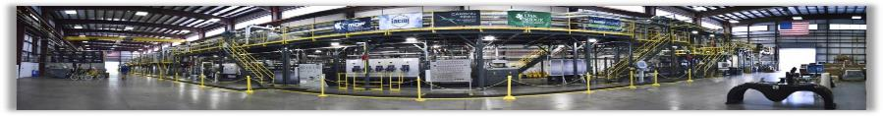
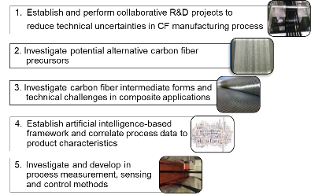
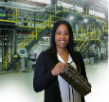

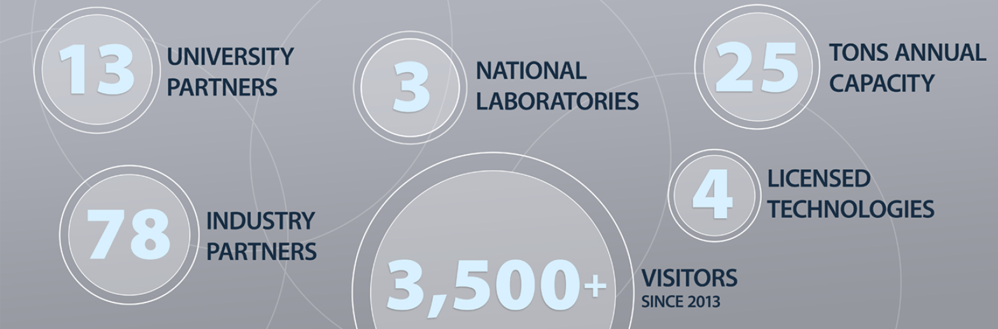

CFTF Overview
The Carbon Fiber Technology Facility CFTF
Only Open Access State-of-the-Art Facility in the U.S
42,000 ft² facility with production capacity of 25 tons/year of fiber from multiple precursors in various forms
The Carbon Fiber Technology Facility (CFTF) serves as a national resource to assist industry in overcoming the barriers of carbon fiber cost, technology scaling, and product and market development. CFTF is intended to be the bridge from R&D to deployment and commercialization of low-cost carbon fiber
Demonstrate carbon fiber production using lower-cost precursors and reduced energy
Enable development of domestic commercial sources for production of low-cost fiber or high-volume composites applications
Formulate a Workforce Development program for carbon fiber and advance composites workforce
Project Tasks
Advanced Manufacturing Office
  Up to 70% reduction of carbon fiber manufacturing process embodied energy

Slide 13
Composites Accomplishments/Successes
IACMI has met all overall Institute goals through specific project achievements
  Contributing to overcoming all identified barriers and projects are addressing all AMO composites objectives and targets
  Demonstrated greater than 80% recyclability of polymer composites
  Reduced production costs of carbon fiber composites by over 25%
  Reduced embodied energy of carbon fiber composites by 50%
  Partners and associated activities resulted in announcement of >3000 composite industry jobs with $400M of investments
  Commercialization of recycled carbon fiber
    Vartega new facility and commercial offerings
    CHZ key validations complete and working towards opening OH regional facility
  Example of automotive success
    Volkswagen lift gate for Atlas vehicle validated: https://youtu.be/YM9FrTciWQg
    IACMI helped catalyze a new innovation center partnership between Volkswagen and the University of Tennessee:
  Collaborating with partners on COVID response
  Transitioning to self-sustaining Institute

Slide 14
Composites Accomplishments/Successes
ORNL CFTF
  Achieved $5/lb target low cost PAN based CF with twice the throughput and 41% reduction in embodied energy when compared to conventional CF manufacturing
  Successfully developed splicing technique for large tow carbon fiber
  Developed process for plasma oxidized textile fiber with tensile strength >400 Ksi, ~35 Msi modulus
  COVID support: Piloted production of N95 material, collaborating with the inventor of the N95 material, with knowledge transfer to potential commercial producers.

Slide 15
Composites Portfolio and Future Efforts
Introspective review of progress in meeting composites objectives and targets is ongoing, focused on IACMI projects
IACMI roadmaps have outlined technology needs and gaps with industry input.
  Assessment of IACMI progress and remaining needs is ongoing and will inform future efforts.
With transition of IACMI to an self-sustaining Institute, AMO is evaluating needed research in the outstanding technology gaps.
Challenge of cost and embodied energy of carbon fiber is still in need of research
Recycling and circular use of composites and other plastics will be an ongoing focus of AMO
Changing dynamics of transportation, renewable energy and energy efficiency will require additional composites innovations
THANK YOU!

