Slide 1
Combined Heat and Power
Bob Gemmer, Technology Manager
Advanced Manufacturing Office
AMO Peer Review
June 2020 | Washington, DC
manufacturing.energy.gov

Slide 2
Combined Heat and Power (CHP) Background
Definition
  CHP is the concurrent production of electricity or mechanical power and useful thermal energy (for heating, cooling, and/or process uses) from a single energy input
Market space
  CHP has largely saturated large industrial plants (> 20 MW electricity)
    Provide demand reduction to the grid primarily in recent years
    Engineering and operating staff have the needed technical expertise to support cost-effective installation and operation of CHP systems
    Considering adding capacity and providing ancillary services to the grid when needed
  Small/midsized industrial enterprises (SMEs) represent an important area of “white space” due to their large electric load (1-20 MW) and familiarity with self-generation
    Electric suppliers in select markets are looking at SME generation for capacity and ancillary services due to increases in variable generation
    SMEs are limited currently by technology barriers with available technologies in addition to regulatory and business barriers
    Additional technologies are needed to integrate these generation resources to the grid
The Opportunity: Flexible industrial CHP systems
  Traditional CHP systems are sized to match the host facility’s own electricity load, but don’t typically meet the thermal needs of the host
  An “oversized” CHP system could generate additional revenue for the host site by providing additional electricity and other services to the grid

Slide 3
CHP Challenges and Barriers
Cost and complexity of installation and operation: capital investments can often be cost prohibitive, particularly in a rapidly changing policy and economic environment.
Reliability, availability, maintainability, and durability: need for improved performance characteristics verification for CHP systems.
System packaging: need for pre-packaged CHP solutions that harmonize multiple components and can be easily selected and installed.
Scalability: need for higher-efficiency CHP systems in the 1-5 MW size range.
Fuel flexibility: lack of versatility to use a variety of input fuels, including renewable fuels.
High power-to-heat ratios: lack of high P/H ratios to enable broader adoption in end-use sectors.
Materials challenges: lack of economical materials that can operate at higher temperatures and resist corrosion.
Combined-cycle integration: need for balance of power distribution between cycles and optimization of internal mass and heat flows.
Hybrid CHP-renewable energy: need for commercially proven and available hybrid CHP-renewable energy systems.
Regulatory barriers: inconsistent interconnection requirements and standards; need to quantify CHP’s full energy and non-energy value in utility procurement and resource planning and incentives, and accurately apportion rates based on cost of service; unfavorable standby rates.

Slide 4
CHP Objectives and Targets (AMO MYPP)
OBJECTIVE
Advance technologies and develop strategies that accelerate the adoption of combined heat and power through streamlined installation processes; operating improvements; increased flexibility of fuel use; and reduced cost, emissions, and perceived customer risk.
TARGETS
Achieve a ten-fold cumulative increase in direct CHP technical support activities to potential commercial, institutional, and industrial end-users.
Advance the development of cost-effective CHP systems that are responsive to site demands as well as grid requirements.
Develop cost effective, high power-to-heat (P/H) ratio CHP systems with >65% electric generation efficiency, >75% system efficiency (HHV), and P/H greater than or equal to one (>= 1).
Support a 20% reduction in installed cost of commercially available, packaged (<10 MW) CHP systems (while maintaining >75% system efficiency at HHV).

Slide 5
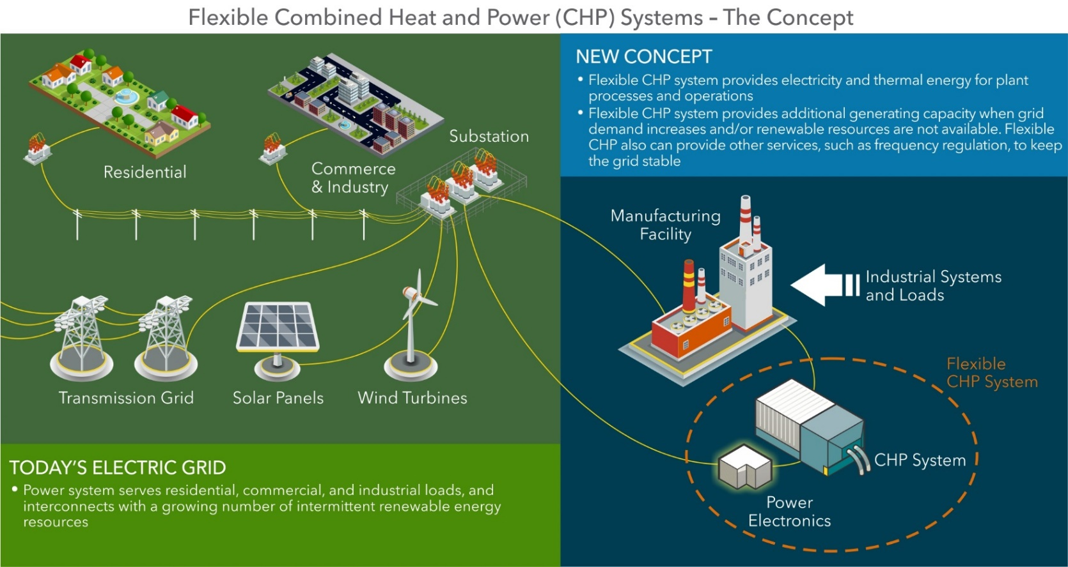
Key Concept: Flexible CHP Systems (the Basics)
Concept can improve grid reliability and resiliency, along with providing economic benefits to manufacturing facilities
Technology advancements are needed to bring the concept to fruition

Slide 6
CHP Current R&D Portfolio
Flexible CHP Systems to Support Grid Modernization, 2018 selections. (Target #2 - cost)
  7 awards from 2 topics ($9.2 million in AMO funding, 20% cost share)
    4 awards in Power Electronics and Control Systems (strong connection with Power Electronics technical topic area)
    3 awards in Electricity Generation Components
2018 Lab Call
  4 awards from 2 topics ($7.9 million in AMO funding)
    2 awards in Highly Efficient Turbines (Target #2 - cost)
    1 awards in District Energy and Microgrids, Congressionally directed (Target #1 - TA)
AMO FY19 Multi-Topic FOA (awards announced February 2020)
  8 awards from 2 sub-topics ($17.6 million in AMO funding, 20% cost share)
    3 awards in High Power to Heat Ratio, High Efficiency CHP (Target #3 – high P/H)
    5 awards in Verification and Validation of CHP and District Energy. Congressionally directed. (Target #1 - TA)
AMO FY20 Multi-Topic FOA (released on May 20, 2020): CHP Demonstration in a District Energy System Integrated with a Renewably-Fueled Municipal Generating Station. Congressionally directed. (Target #2 - cost)

Slide 7
CHP Current Deployment Portfolio
Address Targets #1 and Targets #4
Technical Assistance Partnerships (TAPs) (Congressionally directed activity)
  10 regional centers across the country
  Competitively selected every 5 years
Lawrence Berkeley Laboratory Support
  CHP eCatalog
  Packaged CHP Accelerator
  CHP Market Resources Support
Deployment Budget | Budgets | Doe Funding | Cost Share
Techncial Assistance Partnerships | Available Funds | $24,998,700 | 20%
 | Approved Budget | $9,917,685 | 20%
LBNL Support | Carry-over Funds | $3,691000 | 0%
 | 2020 Budget | $2,000,000 | 0%

Slide 8
CHP Deployment Activities
TAPs
  End User Engagement: Partner with strategic End Users to advance technical solutions using CHP as a cost effective and resilient way to ensure American competitiveness, utilize local fuels, and enhance energy security. CHP TAPs offer fact-based, non-biased engineering support to manufacturing, commercial, institutional and federal facilities and campuses.
  Stakeholder Engagement: Engage with strategic Stakeholders, including regulators, utilities, and policy makers, to identify and reduce the barriers to using CHP to advance regional efficiency, promote energy independence, and enhance the nation’s resilient grid. CHP TAPs provide fact-based, non-biased education to advance sound CHP programs and policies.
  Technical Services: As leading experts in CHP (as well as microgrids, waste heat to power, and district energy) the CHP TAPs work with sites to screen for CHP opportunities as well as provide advanced services to maximize the economic impact and reduce the risk of CHP from initial CHP screening to installation.
Packaged CHP
  eCatalog: Reduce risks for end-users and vendors through a national web-based catalog (eCatalog) of DOE-recognized packaged systems and suppliers, and a partnership with state/utility partners with CHP market engagement programs
  Accelerator: Work with utilities, states and federal agencies committed to promoting
  packaged CHP to characterize packaged CHP system performance in small/medium industrial, commercial, institutional and government markets.
Market Resources
  Help assure messaging consistent with AMO CHP strategy
  Publications, tools, analyses and technical materials to support CHP TAP mission; educate state and local policy makers, regulators, end users, trade associations, and CHP stakeholders; and inform AMO CHP program planning

Slide 9
CHP Collaborations and Outreach
Upcoming Outreach
  Packaged CHP eCatalog and Accelerator Program Session at DOE Better Buildings/Better Plants Virtual Summit (June 10, 2020)
  CHP TAP Booth at FEMP Energy Exchange (August 11-13, 2020 in Atlanta, GA)
  Workshop on the Role of CHP in Industry and the Grid
    Potential partnership with CHP Alliance and Council of Industrial Boiler Owners
  CHP TAP Directors Meetings (recurring; next one Fall 2020)
Major Past Outreach Events
  Dispatchable Distributed Generation: Manufacturing’s Role in Support of Grid Modernization workshop (February 2016 in Austin, TX)
  Flexible CHP Portfolio meeting (October 2019 in Charleston, SC)
Regular collaboration with partners and stakeholders (regional energy organizations, state energy offices, utilities, nonprofits, trade organizations, manufacturers, suppliers, end users)

Slide 10
Accomplishments: Impact of Flexible CHP Concept on the Grid (Modeling of the California Market)
Analysis Results
Objective: Estimate value of added flexible CHP at California industrial and institutional sites due to increased revenue from grid services and lower CHP costs.
Three scenarios modeled: Added flexible CHP systems on the CA grid in 2024:
Baseline: 33% renewables on grid, 3,400 MW existing CHP for site loads
Traditional CHP: Serves site loads + 10% capacity for grid services <500 hr/yr
Advanced CHP: Serves site loads + large flexible capacity for grid services
Combined Scenario: Selects most profitable option (between traditional and advanced) at each site
Key findings:
Reduced grid operating costs:
  All scenarios reduce grid operating costs by $1 Billion or more.
Increased generation capacity: Alleviates need for new centralized power plants.
Lowers site energy costs and provides additional revenue stream:
  Sites receive average additional revenue of $40,000 - $780,000 / MW surplus capacity.
Reduction in grid stress:
  Eliminates hours when reserves may not be met or transmission ratings exceeded.

Slide 11
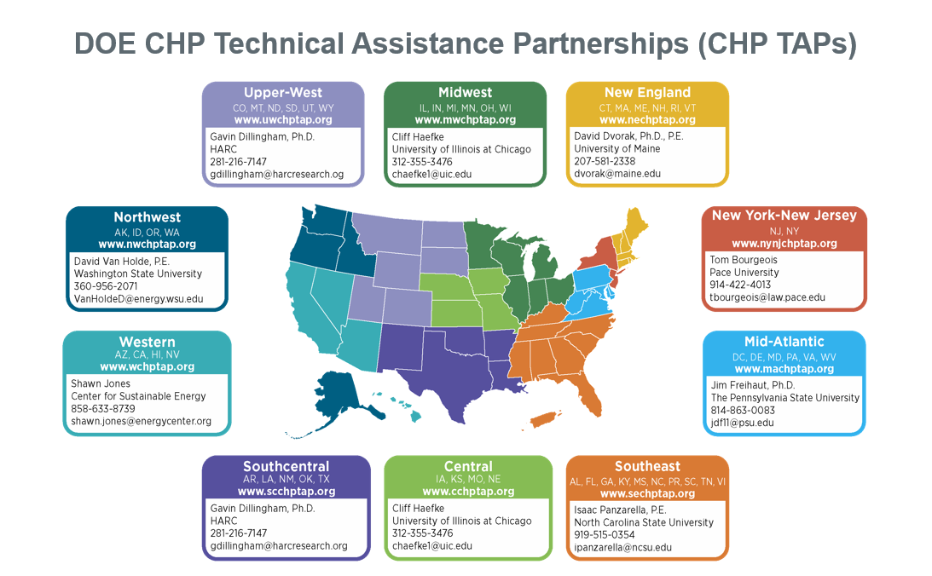
CHP TAP Regions

Slide 12
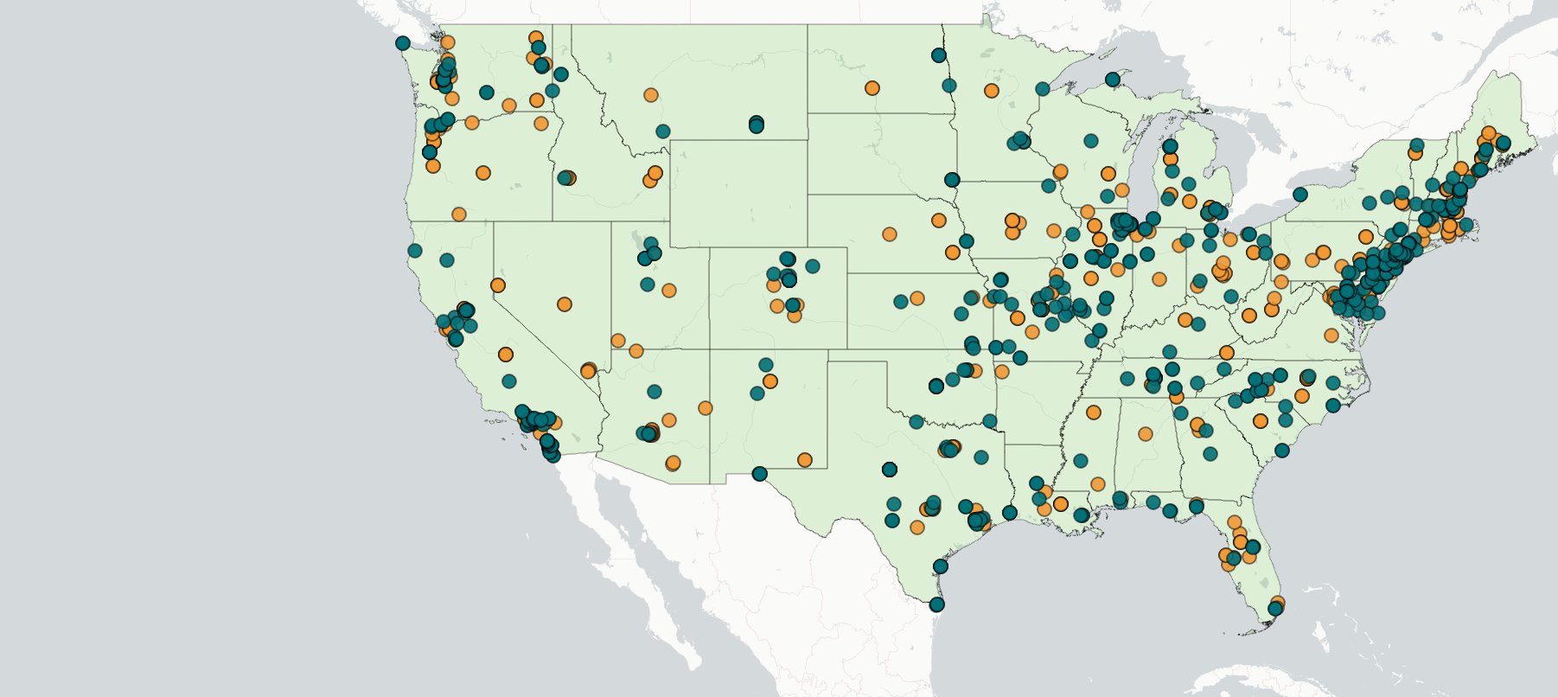

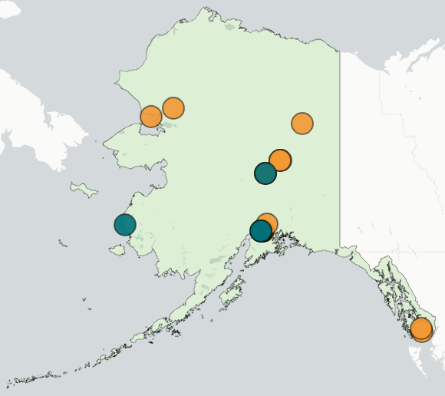


CHP TAP Accomplishments: FY19 and FY20 [through March 2020]
Completed over 502 TA activities with an estimated capacity of ~800 MW
Identified 75 end-user partners and completed 247 engagements
Identified 120 stakeholder partners and completed 165 engagements
Some partner engagements physically occur in a single state and engage representatives from multiple states (e.g. at regional conferences, workshops, etc.). These engagements are reflected once in the map in the state where they occurred, even if they impacted other states. For example, multiple engagements occurred with representatives from Wyoming and South Dakota, although these are not reflected in the map because the engagements occurred outside their states.

Slide 13
AMO CHP Team & Additional Program Presentations
Federal Staff:
  Bob Gemmer, Technology Manager, CHP Program
  Jamey Evans, Technical Project Officer (TPO) for CHP TAPs
Contractor Support:
  Tommi Makila, Technical and Program Support
  Patti Garland, DOE CHP TAP Coordinator
Detailed presentations on the CHP Program are available on the Peer Review website
  Individual R&D projects
  CHP TAPs
  CHP Deployment Program
THANK YOU!

Slide 14
Process Heating and Waste Heat Recovery
Bob Gemmer, Technology Manager and Joe Cresko, Chief Engineer
Advanced Manufacturing Office
AMO Peer Review
June 2020 | Washington, DC
manufacturing.energy.gov

Slide 15
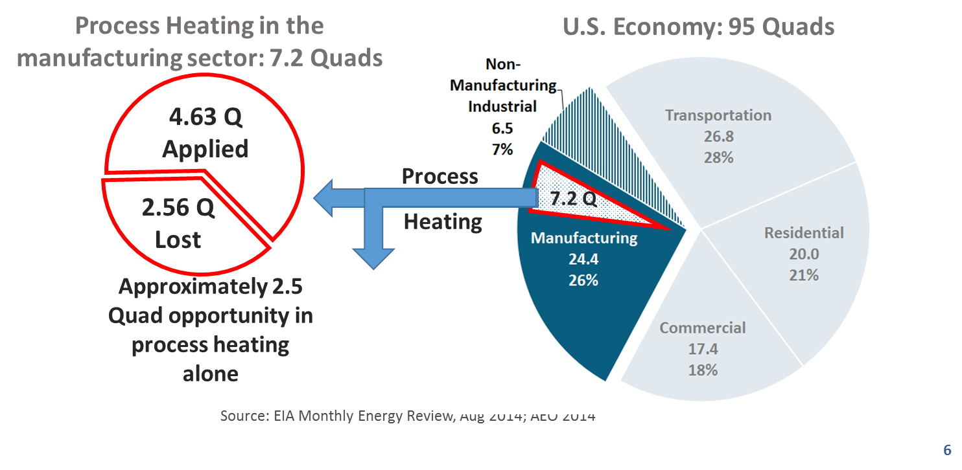
Process Heating and Waste Heat Background
7 Quads opportunity space. Process heating accounts for a sizable fraction of total U.S. energy use, and more direct energy use than any other energy consuming processes in manufacturing. Currently process heating is 95% fossil fuel based. .
95% fossil fuel based. Traditional industrial (thermal) processes can be inefficient, difficult to control and result in materials and products with compromised quality and performance.
1.25 Quads potential. Assuming half of the energy lost in current process heating operations can be avoided, this represents a > 1% reduction in the total energy used in the U.S. economy.

Slide 16
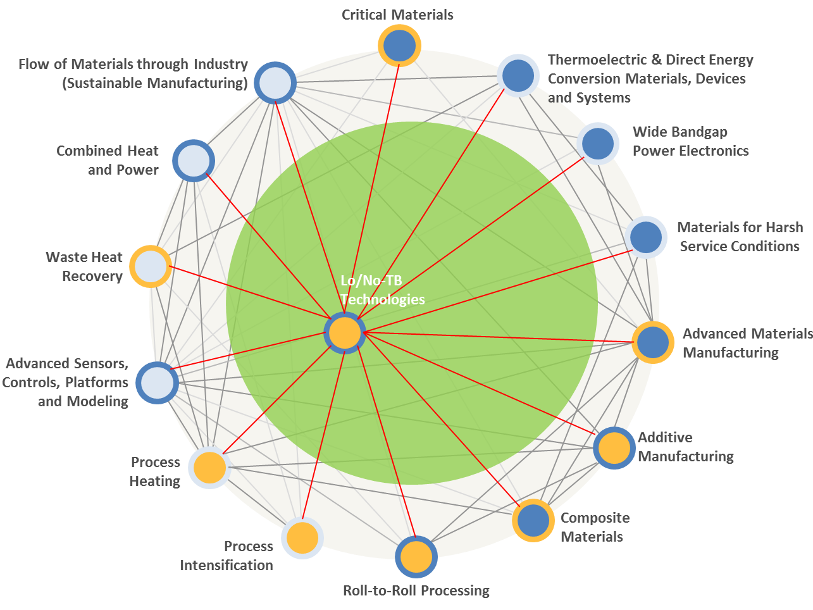
Process Heating Background
Thermal process intensification opportunities include:
Improved product quality – more uniform heating, less oxidation or distortion during heating.
Mfg. Flexibility – expanded options for automation, controls and process integration.
Productivity - faster heat-up and cool-down time resulting in production flexibility, reduced labor cost etc.
Implications for U.S. Manufacturing competitiveness are significant.
Other countries, including Japan, India and Germany, have made advances that put at risk U.S. competitiveness in manufacturing industries identified by DOE as critical.

Slide 17
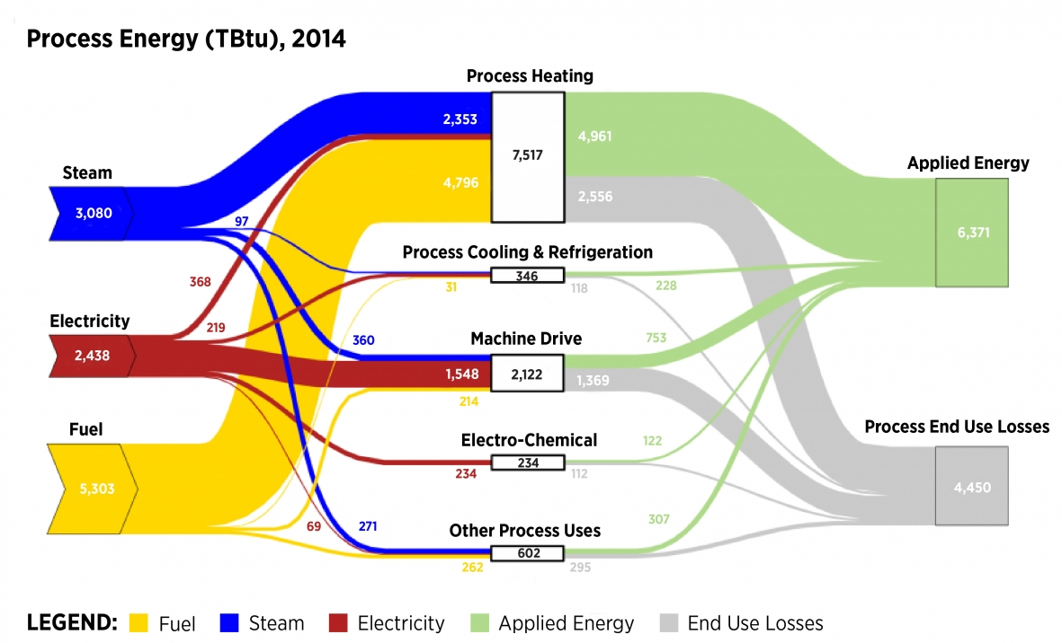
The Opportunities
Note: 1 quad = 1,000 TBtu
https://www.energy.gov/eere/amo/static-sankey-diagram-process-energy-us-manufacturing-sector-2014-mecs

Slide 18
Challenges and Barriers
There are a number of critical challenges and barriers common across the process heating industry:
Equipment inventory: lack of comprehensive and detailed understanding of the demographics (e.g., age, state, utilization capacity) of process heating equipment in the U.S.
Electrotechnologies: currently very limited (<5%) use of electric and hybrid-electric systems for heating, curing, drying, and other operations to take advantage of selective and/or volumetric heating energy benefits.
Multi-physics modeling and design tools: lack of models to optimize energy use and heat transfer in high-temperature applications, including hybrid systems.
Sensors and controls: lack of reliable, robust, and affordable sensors and process controls for use in high-temperature and corrosive environments.
Retrofittable technologies: lack of strategies for integrating new furnace technologies into existing systems to improve performance without major interruptions.
Fuel flexibility: poor compatibility of most process heating systems with a variety of input fuels, including fuel blends and low-heat-value fuels, such as waste products.
Combustion processes: lack of understanding of fundamental processes (e.g., turbulent mixing, flue gas stream characteristics, conversion of fuels in catalytic combustion systems).
Emissions: challenges in controlling greenhouse gas and fine particle emissions especially under diverse or varying process conditions.

Slide 19
Technical Topic Objectives and Targets
OBJECTIVE
Advance cost effective technologies for process heating that improve the properties of manufactured products, and develop alternative, low thermal budget technologies that reduce the energy requirements of materials processing.
TARGETS
Develop low-thermal-budget manufacturing technologies that reduce energy intensity (energy consumed per unit of physical output) by at least 50% compared to 2015 typical technology.
Develop advanced process heating unit operations that provide improved properties, quality, and/or product value at cost parity to conventional techniques.

Slide 20
Current Process Heating Portfolio
AMO FY19 Multi-Topic FOA (awards announced February 2020)
  Subtopic 2.1 - 6 awards, $11.7 million in AMO funding, 20% cost share. All address Target #2 – process drying:
    Forest Concepts, LLC
    Iowa State University
    Molecule Works Inc.
    Palo Alto Research Center, Inc.
    United Technologies Research Center
    Worcester Polytechnic Institute
  Subtopic 2.2 – 2 awards, $9.4 million in AMO funding. 20% cost share. Both address Target #1 – low thermal energy processes.
    University of Florida – led team
    3 M
  All are in the process of being negotiated
    Projects will be available at the next Peer Review
AMO FY20 Multi-Topic FOA (released on May 20, 2020): Enhanced Efficiency of Drying Processes. Congressionally directed. (Target #2)

Slide 21
Waste Heat Recovery Background
As noted above, waste heat recovery offers significant potential to increase industrial efficiency; approximately 2,500 trillion Btu/year waste heat remains unrecovered from industrial manufacturing operations.
  This heat ranges from as low as <450°F to as high as 3000°F.
  The largest sources of waste heat for most industries are exhaust and flue gases and heated air from heating systems such as
    High-temperature gases from burners in process heating
    Lower temperature gases from heat treating furnaces, dryers, and heaters
    Heat from heat exchangers, cooling liquids, and gases.
  Waste heat is also discharged in the form of hot surfaces, steam leaks, and boiler blow-down water.
Redirected waste heat can serve a number of useful purposes in an industrial facility, including combustion air preheating, boiler feedwater preheating, load preheating, power generation, steam generation, space heating, and water preheating.

Slide 22
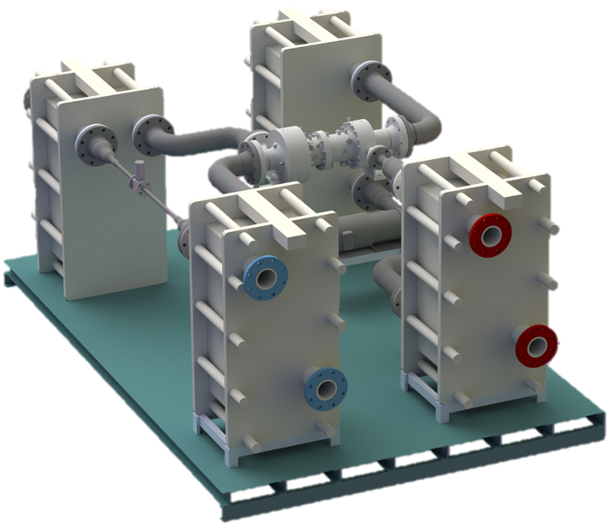
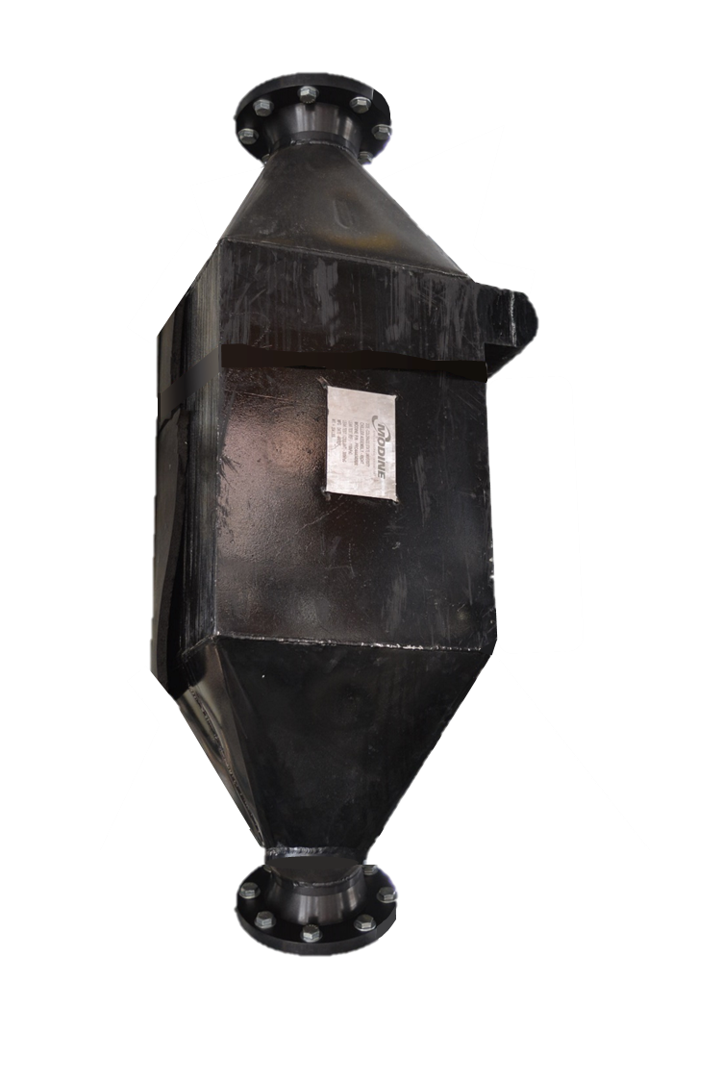
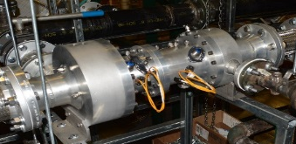
Waste Heat Recovery Background
Practical limits – both technical and economic
  Heat quantity,
  Heat temperature
  Composition of the waste heat source
    Especially contaminants in the flue gas
  Logistical constraints
    Operating schedules
    Availability
Energy-intensive industries provide the greatest potential for waste heat recovery.
  Aluminum
  Cement
  Chemicals
  Food processing
  Glass
  Iron and steel
  Petroleum refining
  Paper industries.

Slide 23
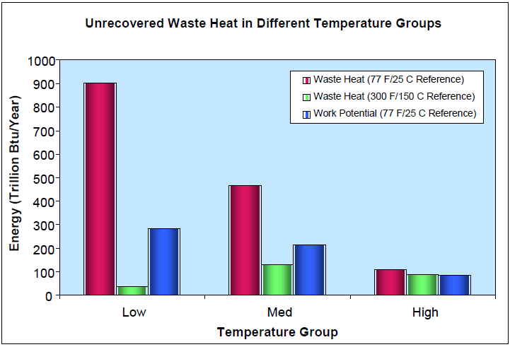
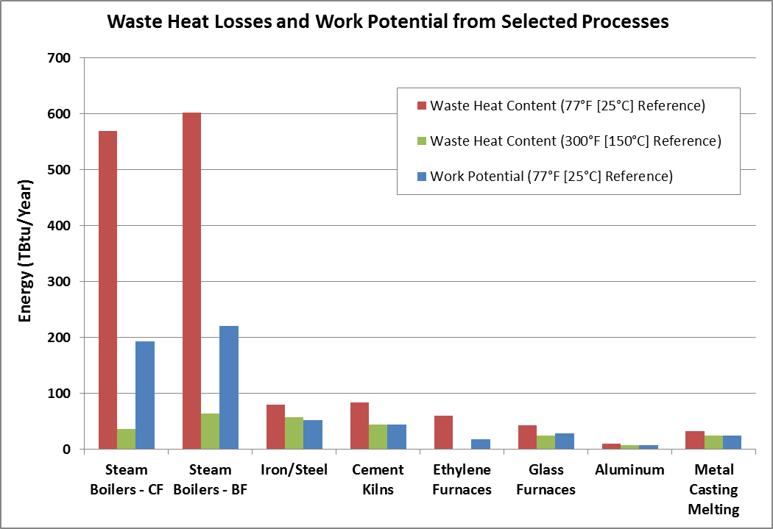
The Opportunity
Waste Heat Source | Temperature Range (°F) | Cleanliness
Furnace or heating system exhaust gases | 600 – 2,000 | Varies
Gas (combustion) turbine exhaust gases | 900 – 1,100 | Clean
Reciprocating engines
Jacket cooling water | 190 – 200 | Clean
Exhaust gases (for gas fuels) | 900 – 1,100 | Mostly clean
Hot surfaces | 150 – 600 | Clean
Compressor after-inter cooler water | 100 – 180 | Clean
Hot products | 200 – 2,500 | Mostly clean
Steam vents or leaks | 250 – 600 | Mostly clean
Condensate | 150 – 500 | Clean
Emission control devices | 150 – 1,500 | Mostly clean

Slide 24
Challenges and Barriers
There are a number of critical challenges and barriers common to waste heat recovery in industry:
Cleanliness of waste heat streams: fouling and interference with heat exchange as a result of moisture, particulates, and chemical contamination in waste stream.
Lack of end use for waste heat: certain waste heat streams may have no viable end use within the facility, especially for low-temperature and contaminated gases.
Low temperature waste heat: non-viable recovery for lower temperature (low quality) waste heat streams from cost and energy efficiency standpoints.
Ultra-high-temperature waste heat: special materials required for ultra-high-temperature applications; material and equipment design critical.
System maintenance challenges: lack of cleaning systems to allow on-line or automatic removal of contaminant materials on heat transfer surfaces.
Materials availability: need for low-cost materials compatible with corrosive, high-temperature conditions.
Equipment size: large system footprints make retrofitting challenging in space-constrained facilities.

Slide 25
Technical Topic Objectives and Targets
OBJECTIVE
Advance technologies for waste heat recovery systems that enable the cost-effective capture and use of energy from industrial waste heat in order to reduce overall energy demands of manufacturing facilities.
TARGETS
Develop enabling technologies for low maintenance, high reliability recovery systems for industrial waste heat streams, and reduce payback period by at least 30% compared to existing systems in various temperature ranges.
Develop material and system advancements to enable greater recovery from high-temperature (>650°C) and heavily contaminated industrial waste heat streams, and cost-effectively utilize 30% of available waste heat in this temperature range.
Develop innovative, cost-effective systems to recover heat from low-temperature (<230°C) waste heat sources and successfully utilize 20% of available waste heat in this temperature range.

Slide 26
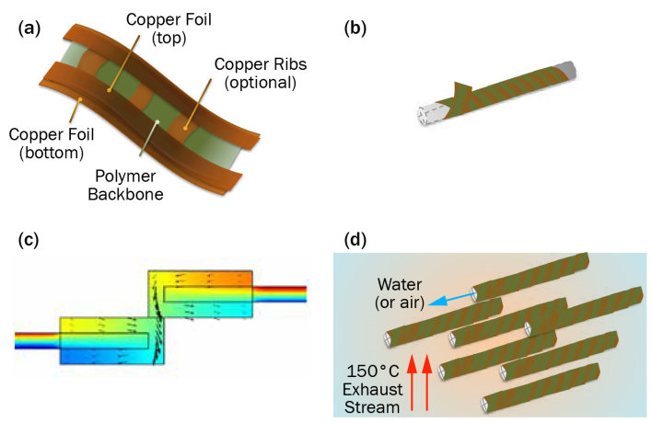
Technical Topic Current Portfolio
Emerging Research Exploration FOA
  Two awards (Target #3):
    Colorado State University – Turbocompression cooling for ultra-low waste heat recovery
      DOE funding $1.9 million, 20% cost share
    University of Illinois, Champagne-Urbana – Roll-to-roll manufactured hybrid metal-polymer heat exchangers for anti-fouling and self-monitoring waste heat recovery
      DOE funding $1.0 million, 20% cost share
2018 Lab Call
  One awards (Target #1):
    NREL and LBNL – Simulation-based design and optimization of waste heat recovery systems
      DOE funding $3,0 million, no cost share
      Congressionally directed

Slide 27
AMO Technical Topic Team
Bob Gemmer
Joe Cresko
THANK YOU!

Slide 28
Backup Slides

Slide 29
Overview of Process Heating
Fuel, Steam or Electricity-based Systems
4. Sensors and Process Controls
Heating, Melting, Drying, Curing, Heat Treating, Forming, etc.
Control System
Energy Source
Electricity
Natural Gas
Oil
Coke or Coal
Opportunity Fuel (e.g., waste product)
Combustion Products
Steam
Resistance
Ionizing Radiation
Non-Ionizing Radiation
Energy/Heat Transfer
Direct or Indirect
Conduction
Convection
Radiation
Product or Charge Material
Energy/Heat Generation
Energy/Heat Containment
Energy/Heat Discharge
Conduction
Convection
Radiation
Energy Losses - Not Recovered
Recovered Heat Energy
Waste Heat Management
Energy Losses - Recovered
Electricity
Enabling Technologies
Advanced Materials
Design Tools, Models, and System Integration

Slide 30
Energy Use and Loss by Industrial Subsector
Manufacturing Industry | NAICS code | Process heating energy use (TBtu) | Percent of total U.S. manufacturing process heating energy use (%)* | Process heating energy loss (TBtu) | Percent of process heating energy lost within sector (%) | Percent of total U.S. manufacturing process heating energy losses (%)* | Process heating energy applied (TBtu) | Percent of process heating energy applied within sector (%) | Percent of total U.S. manufacturing process heating energy applied (%)*
Petroleum refining | 324110 | 2,250 | 31.2% | 405 | 18% | 16% | 1,845 | 82% | 26%
Chemicals | 325 | 1,455 | 20.2% | 335 | 23% | 13% | 1,120 | 77% | 16%
Forest products | 321-322 | 980 | 13.6% | 706 | 72% | 27% | 274 | 28% | 4%
Iron and steel | 3311-3312 | 729 | 10.1% | 335 | 46% | 13% | 394 | 54% | 5%
Food and beverage | 311-312 | 519 | 7.2% | 291 | 56% | 11% | 228 | 44% | 3%
Cement | 327310 | 213 | 3.0% | 85 | 40% | 3% | 128 | 60% | 2%
Glass | 3272, 327993 | 161 | 2.2% | 89 | 55% | 3% | 72 | 45% | 1%
Fabricated metals | 332 | 138 | 1.9% | 50 | 36% | 2% | 88 | 64% | 1%
Plastics and rubber | 326 | 87 | 1.2% | 20 | 23% | 1% | 67 | 77% | 1%
Alumina and aluminum | 3313 | 82 | 1.1% | 38 | 46% | 1% | 44 | 54% | 1%
Transportation equipment | 336 | 65 | 0.9% | 23 | 36% | 1% | 42 | 64% | 1%
Foundries | 3315 | 61 | 0.8% | 28 | 46% | 1% | 33 | 54% | 0%
Computers, electronics, and electrical equipment | 334-335 | 43 | 0.6% | 15 | 36% | 1% | 28 | 64% | 0%
Textiles | 313-316 | 41 | 0.6% | 23 | 56% | 1% | 18 | 44% | 0%
Other Mfg. |  | 342 | 5% | 134 | 39% | 5%
Machinery | 333 | 38 | 0.5% | 14 | 36% | 1% | 24 | 64% | 0%
All manufacturing | 31-33 | 7,204 | 100.0% | 2590 | 36% | 100% | 4,614 | 64% | 64%

Slide 31
Energy Use and Loss by Key Unit Operations
Process Heating Operation | Description / Example Applications | Typical Temperature Range (ºF) | Estimated U.S. Energy Use (2010) (TBtu)
Fluid Heating, Boiling, and Distillation | Distillation, reforming, cracking, and hydrotreating for chemicals production, food preparation | 150–1000°F | 3,015 TBtu
Drying | Water and organic compound removal | 200–700°F | 1,178 TBtu
Metal Smelting and Melting | Ore smelting, steelmaking, and other metals production | 800–3000°F | 968 TBtu
Calcining | Lime calcining | 1500–2000°F | 395 TBtu
Metal Heat Treating and Reheating | Hardening, annealing, tempering | 200–2500°F | 203 TBtu
Non-Metal Melting | Glass, ceramics, and inorganics manufacturing | 1500–3000°F | 199 TBtu
Curing and Forming | Polymer production, molding extrusion | 300–2500°F | 109 TBtu
Coking | Cokemaking for iron and steel production | 700–2000°F | 88 TBtu
Other | Preheating, catalysis, thermal oxidation, incineration, softening, and warming | 200–3000°F | 1,049 TBtu
Total |  |  | 7,204 TBtu

Slide 32
Candidate Technology Opportunities with Associated Energy Savings
Technology Opportunity | Applications | Estimated Annual Energy Savings Opportunity (TBtu/yr) | Estimated Annual CO₂ Emissions Savings Opportunity (million metric tons [MMT]/yr)
Advanced non-thermal water removal technologies | Drying and Concentration | 500 TBtu | 35 MMT
“Super boilers” to produce steam with high efficiency, high reliability, and low footprint | Steam Production | 350 TBtu | 20 MMT
Waste heat recovery systems | Cross-Cutting | 260 TBtu | 25 MMT
Hybrid distillation | Distillation | 240 TBtu | 20 MMT
New catalysts and reaction processes to improve yields of conversion processes | Catalysis and Conversion | 200 TBtu | 15 MMT
Lower-energy, high-temperature material processing (e.g., microwave heating) | Cross-Cutting | 150 TBtu | 10 MMT
Advanced high-temperature materials for high-temperature processing | Cross-Cutting | 150 TBtu | 10 MMT
Net and Near-Net-Shape Design and Manufacturing | Casting, Rolling, Forging, Additive Manufacturing, and Powder Metallurgy | 140 TBtu | 10 MMT
Integrated Manufacturing Control Systems | Cross-Cutting | 130 TBtu | 10 MMT
Total |  | 2,210 TBtu | 155 MMT

