Slide 1
DEVELOPMENT OF A PLANAR FOCUSING
COLLECTOR FOR CSP
K. C. Toussaint, Jr., P. M. Ferreira University of Illinois at Urbana-Champaign
L. J. Guo University of Michigan
T. Wendelin, G. Zhu, M. Gray National Renewable Energy Lab

Slide 2


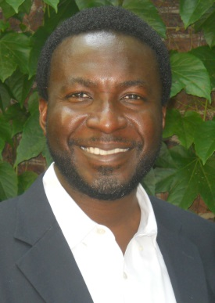

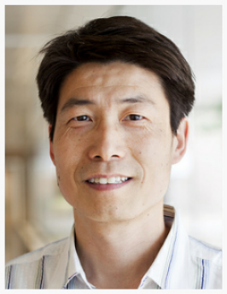

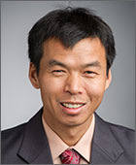


TEAM
Kimani
Toussaint, Jr.
Placid
Ferreira
L. Jay
Guo
Tim
Wendelin
Guangdong
Zhu
Matthew
Gray

Slide 3
OUTLINE
Project Goal
Impact
Innovations and Impact
DOE Impact
Approach
Testing

Slide 4
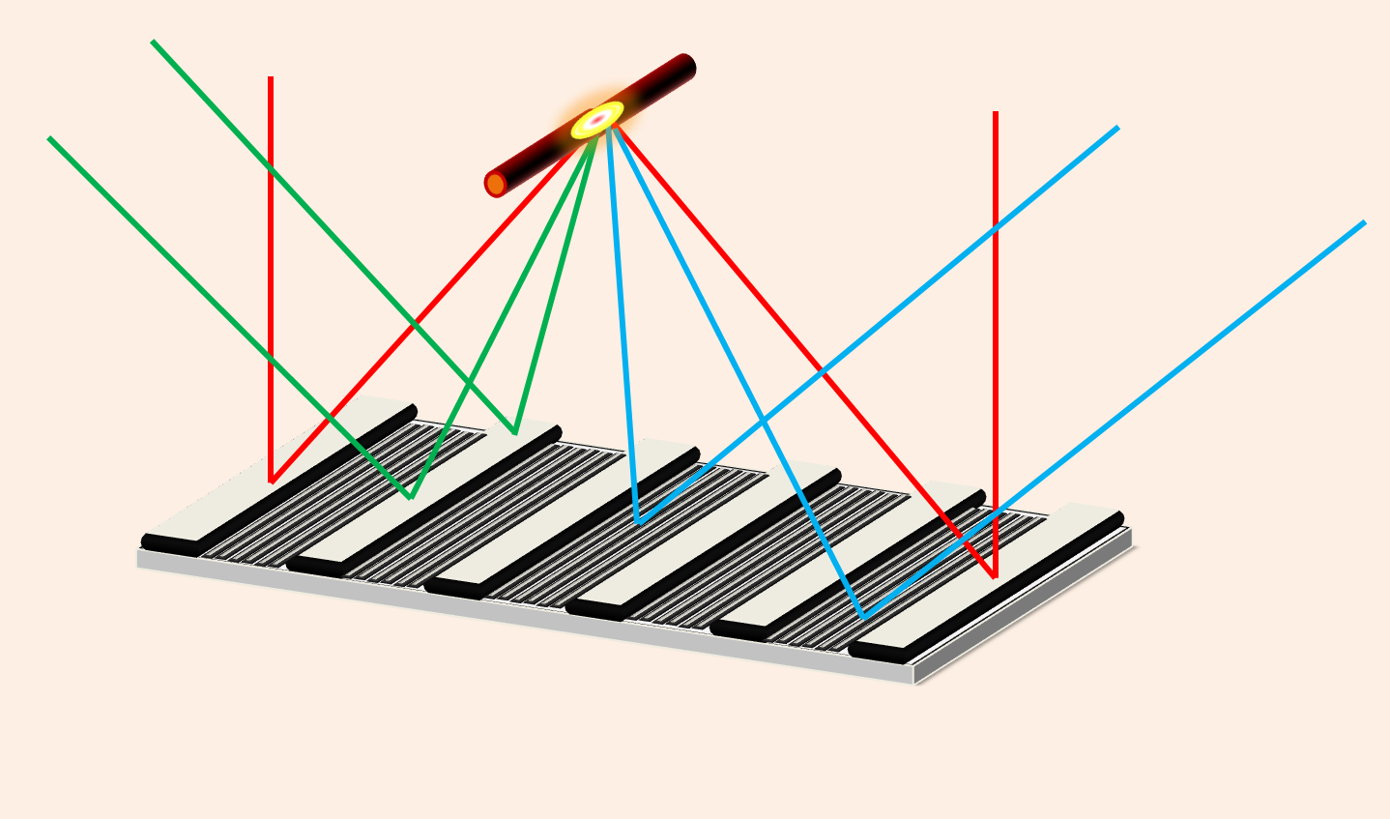
PROJECT GOAL
Development of a planar focusing collector (PFC)
as low-cost alternative to parabolic trough collector (PTC)
Final deliverable: PFC with >97% solar weighted efficiency from ~400-2500 nm
Target cost: < $50/m²
TRL 3 to TRL 5

Slide 5
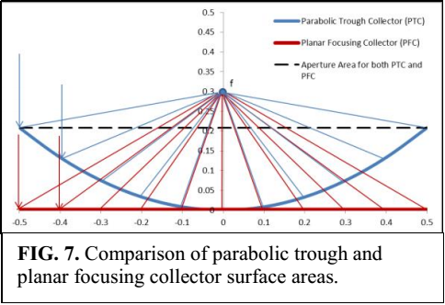
INNOVATION AND IMPACTS
Apply cutting-edge advancement in optics to reduce cost of solar collector field in CSP
PFC utilizes less surface area than PTC
  Save ~ 11% reflector area, compared with a state-of-the-art 6-meter-aperture trough design.
Eliminate requirement of maintaining a curved surface, thus enabling lower-cost manufacturing process designs

Slide 6
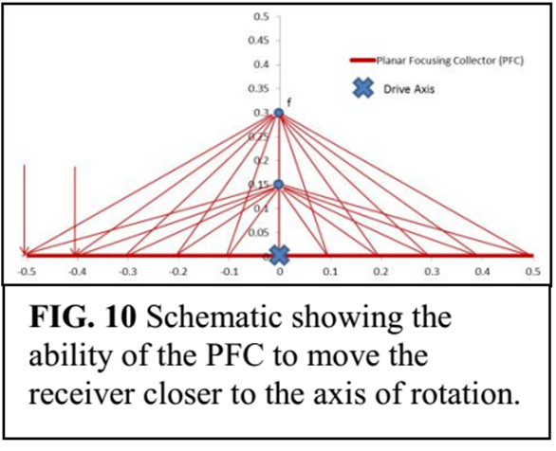
INNOVATION AND IMPACTS
Enabling focal length independent of reflector width
  Reducing focal length will not lead to the increase of surface area
  Reducing focal length leads to lower profile, thus lower wind load requirement
PFC provides larger design flexibility
  Can take advantage of lower cost manufacturing of a larger industry such as PV panels.

Slide 7
DOE IMPACT
Provide an innovative, potentially transformative (low-cost manufacturing) reflector design to minimize reflector/collector costs to achieve the SunShot goal
May impact other areas of solar thermal energy harvesting
  Water desalination – water shortage emerging in southwestern states
  Industrial process heat (IPH) – 36% total energy in manufacturing sector
May lead to a new application domain for metasurfaces and transformation optics

Slide 8
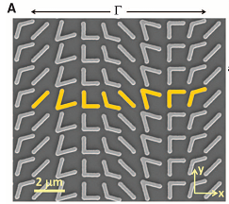


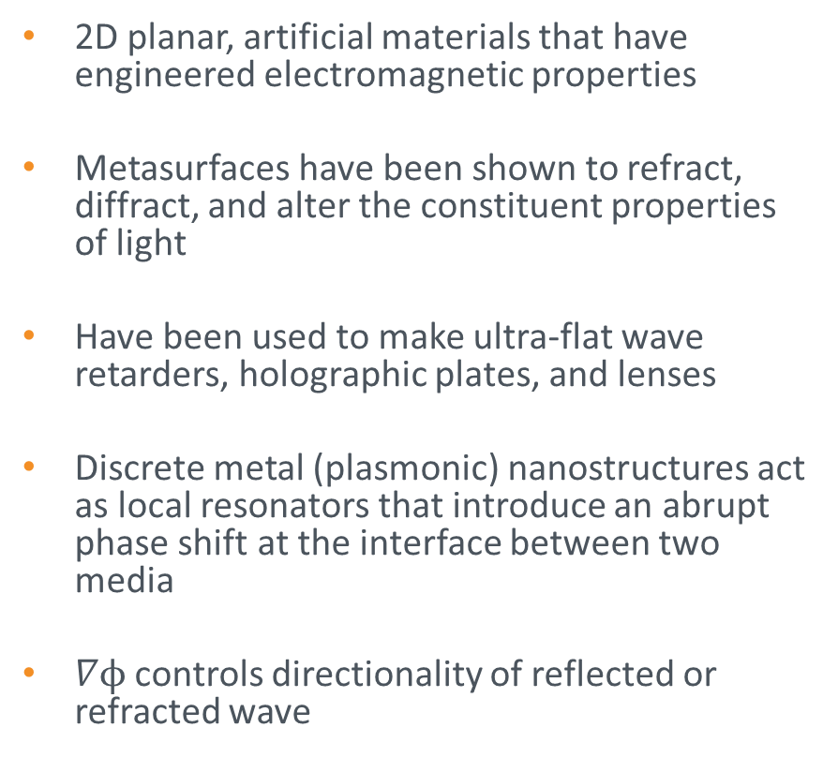
PRINCIPLE OF OPERATION
2D planar, artificial materials that have engineered electromagnetic properties
Metasurfaces have been shown to refract, diffract, and alter the constituent properties of light
Have been used to make ultra-flat wave retarders, holographic plates, and lenses
Discrete metal (plasmonic) nanostructures act as local resonators that introduce an abrupt phase shift at the interface between two media
$∇ϕ$ controls directionality of reflected or refracted wave
N. Yu, et al. Science 334,333-337 (2011)
Generalized Snell’s Law
Generalized Law of Reflection

Slide 9
COMPENSATING FOR LOSS
2D nanostructuring reduces confinement loss
Unlike conventional plasmonics, spatial confinement is NOT the goal of the proposed activity
Approach will investigate 2D metal nanoantennas and combination of various metalized groove designs

Slide 10
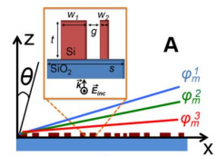
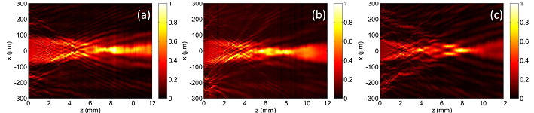
COMPENSATING FOR CHROMATIC ABBERATION
Capasso Group showed that metasurface can be divided into unit cells (he used 600), with each cell designed to compensate for a specific λ (1300 nm, 1550 nm, and 1800 nm)
Idea of correcting at multiple wavelengths is the same as standard doublet lenses
F. Aieta, et al. Science 347, 1342-1345 (2015)
Experimental Results (Capasso Group)
λ₁
λ₂
λ₃
M. Khorasaninejad, et al. NanoLetters 15, 5358-5362 (2015)

Slide 11
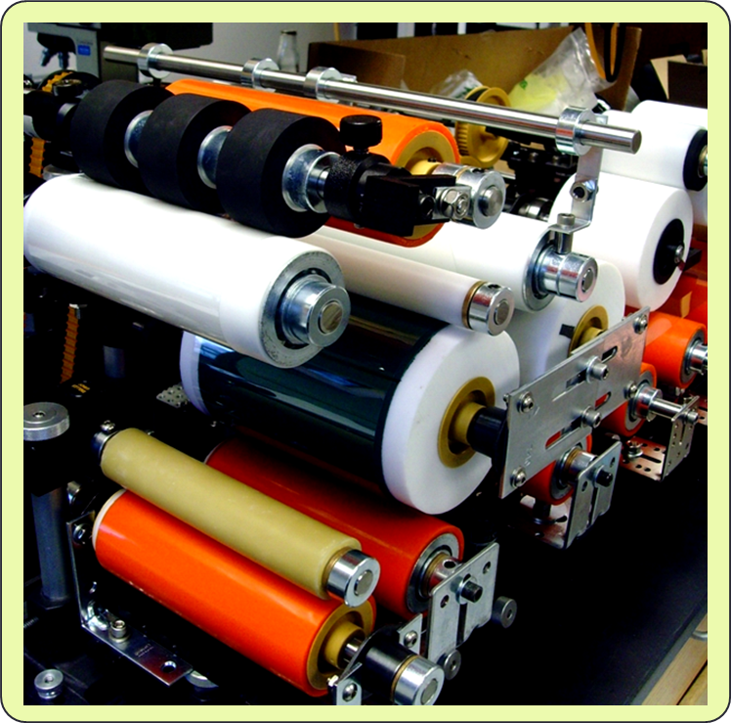
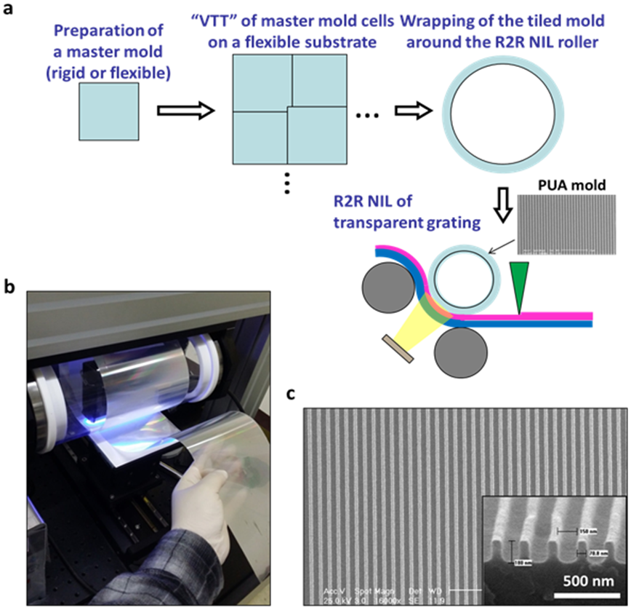
COST REDUCTION BY ROLL-TO-ROLL MANUFACTURING
Continuous R2R nanoimprint on 4” wide substrate
Developed by J. Guo (UM)
S. Ahn et al. Adv. Mater. 2008, 20, 2044; and ACS Nano, 2009, 3, 2304

Slide 12
TESTING
Various optical tests will be carried out with the aim of a concentration ratio of 50
Hemispherical reflectance testing ~400-2500 nm
Adhesion testing
Accelerated exposure testing

Slide 13
TECHNO-ECONOMIC ANALYSIS
Modeled annualized optical efficiency
-Using non-imaging optics model and SAM at the reference location of Daggett, CA.
Cost analysis (< $50/m²)
-Utilize a cost model that incorporates latest market cost estimate for system components for a solar concentrating collector

