Slide 1


Low Cost Concentrated Solar Power (CSP) Collector
Presentation
Greg Mungas, Chief Technical Officer, Hyperlight Energy

Slide 2
PROJECT SUMMARY
PROJECT: Low Cost Concentrated Solar Power (CSP) Concentrator
FUNDING OPPORTUNITY: DOE COLLECTS
PI/Technical Manager: John King/Greg Mungas
PARTNERS: Co-PI Guangdong Zhu, National Renewable Energy Laboratory
PROJECT DURATION: 2.5 years
PROJECT BUDGET: $1.5M DOE + $750K CEC + $773K Hyperlight
OBJECTIVES:
  PHASE I (9 Mos): Product Design, Analysis, Prototyping
  PHASE II (9 Mos): Phase II Project Pilot
  PHASE III (12 Mos): Phase III Commercial Pilot
PATH TO MARKET: Pilot at Commercially Relevant Pilot Site. Ongoing business development to secure commercial contracts in geothermal augmentation and enhanced oil recovery.

Slide 3
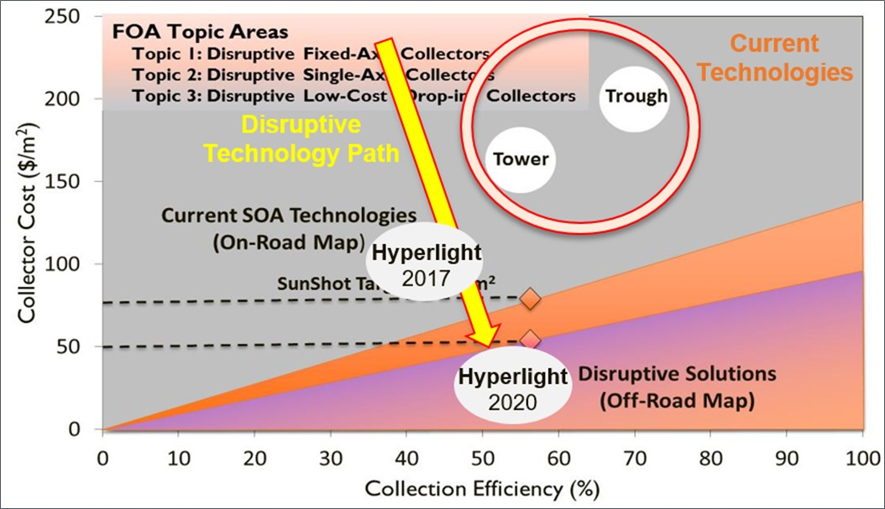
PROJECT OBJECTIVES RELATIVE TO SUNSHOT FOA ROADMAP

Slide 4
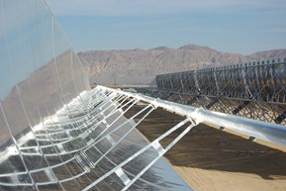
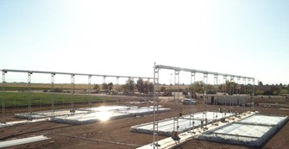
Collector Material Considerations
Low cost
Expensive
kg / m²
Reflectech
Estimate:
$220/m²
Target:
$50/m²
Key innovation: replace steel and concrete with plastic and water. See appendix for further detail.

Slide 5
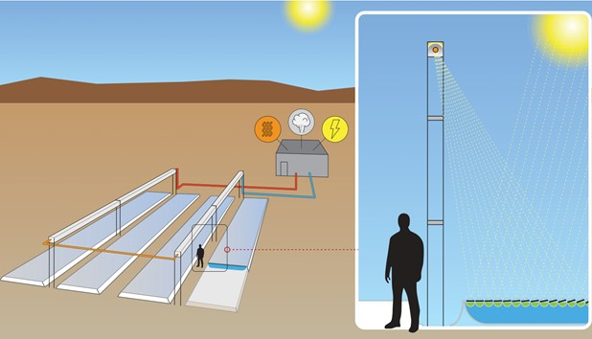
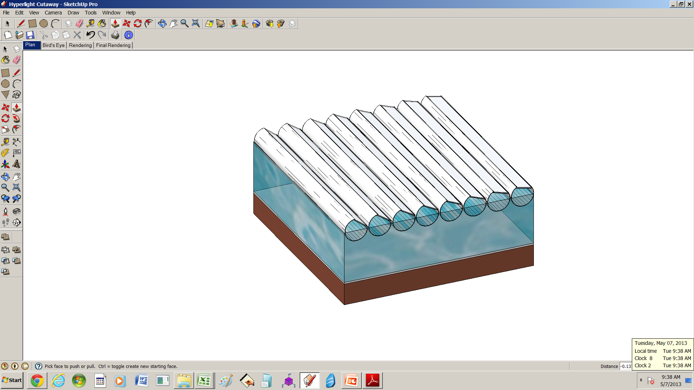
Hyperlight Technology Executive Summary
UV-stabilized plastic pipe
Mirror
Water ballast
Low Cost, Linear Fresnel Reflector (LFR) Configuration
  Plastic is cheap, but isn’t strong enough as a drop-fit replacement for steel/concrete.
  Water as a bearing surface changes the equation, and makes plastic work.
Water support
30-year pond liner
Earth
Five patents issued; one pending.

Slide 6

COLLECTOR CHARACTERISTICS I
CONFIGURATION
  LFR Flat mirror reflectors mounted in low cost, precision plastic extrusions are integrated into raft assemblies and floated on low-cost, sealed waterbeds
  LFR raft assemblies operate with a simple kinematic mechanism that allows the reflectors to optimally track the sun over the course of a day and focus sunlight onto an elevated heat collector element (HCE)
  Packaged solar collector kits are being designed to be very quickly and cost-effectively field-deployed with minimal on-site construction and labor costs
  Similar to agricultural operations, field kits and deployment operations readily scale to 1000’s of acres and more

Slide 7
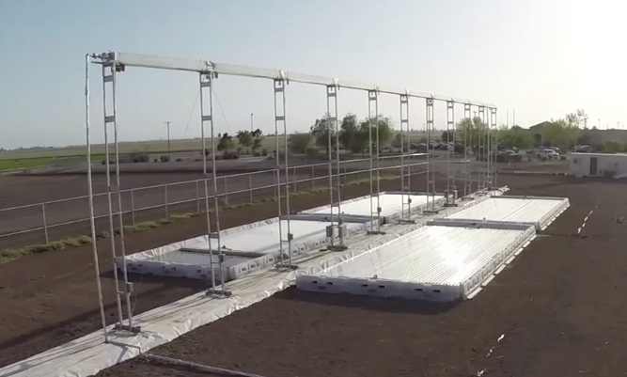
COLLECTOR CHARACTERISTICS II
Environmental Performance
  Given the low, flat profile of the Hyperlight® collector assemblies and the mass of water contained in the Hyperlight® water bed basins, Hyperlight’s optomechanical collector assemblies are naturally very stable without requiring additional structure and cost to maintain pointing tolerances under large wind loads
Modular Low Cost Solar Thermal
  Fully functional, operational systems can be as small as ¼ acre thereby minimizing the capital costs required to pilot a solar-thermal field project

Slide 8
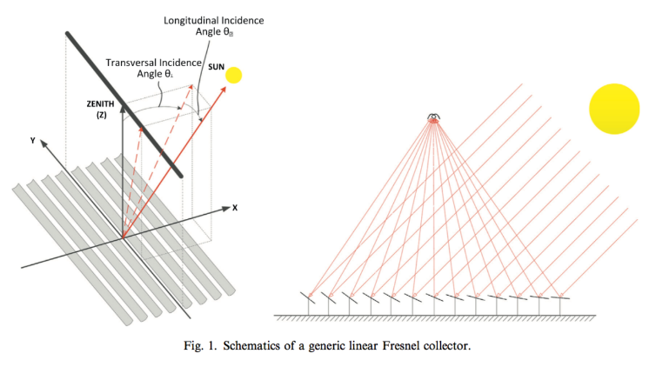
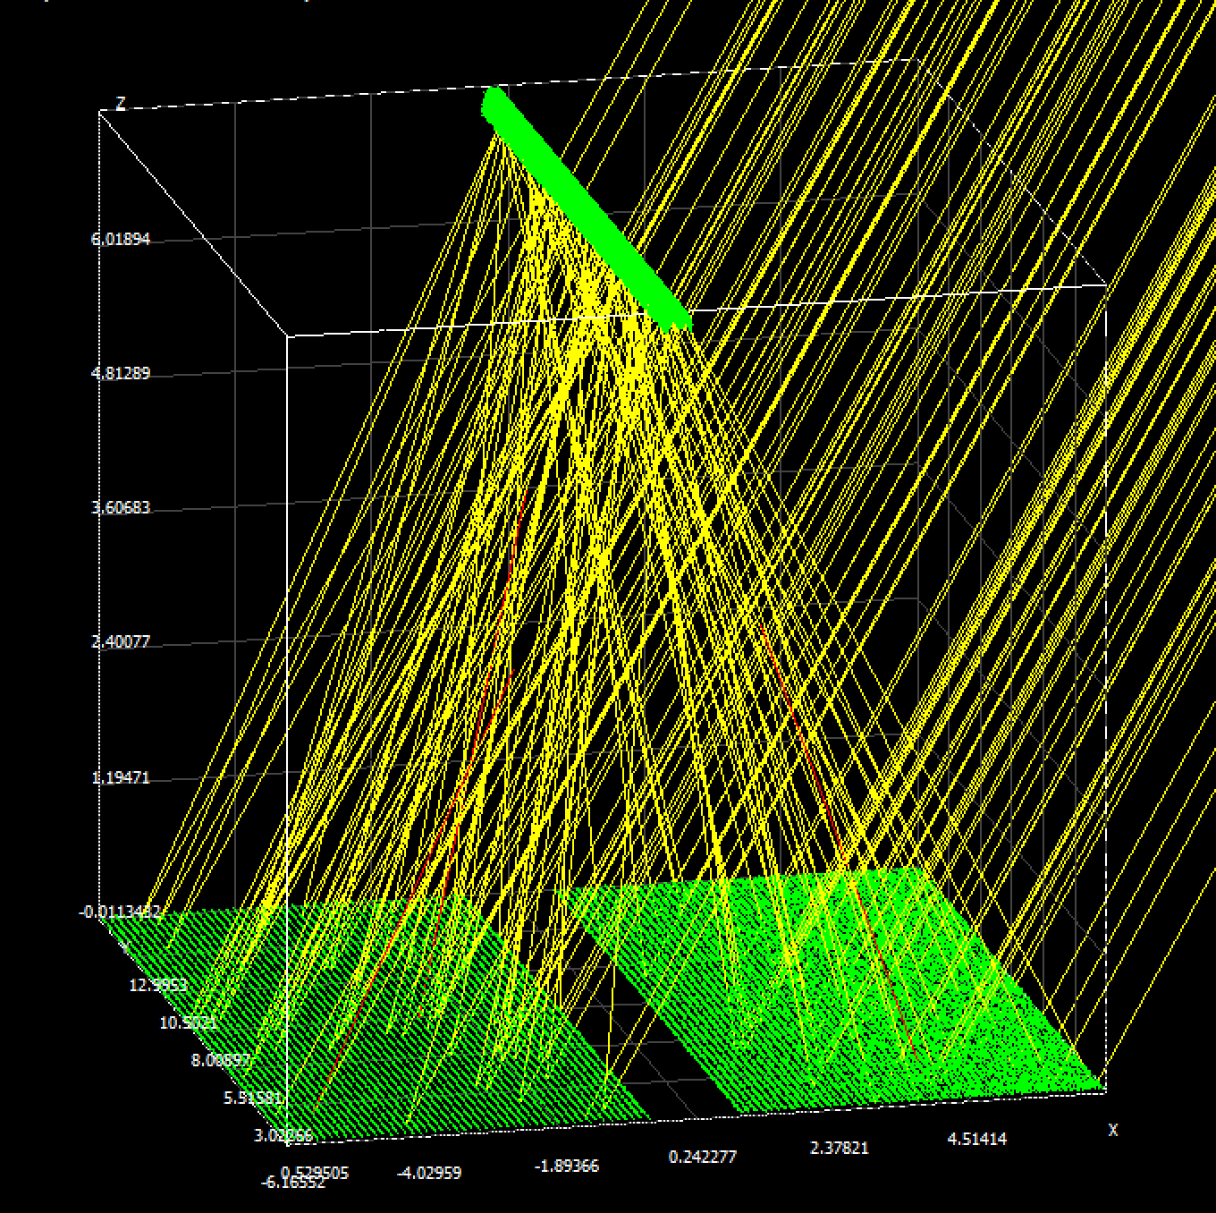
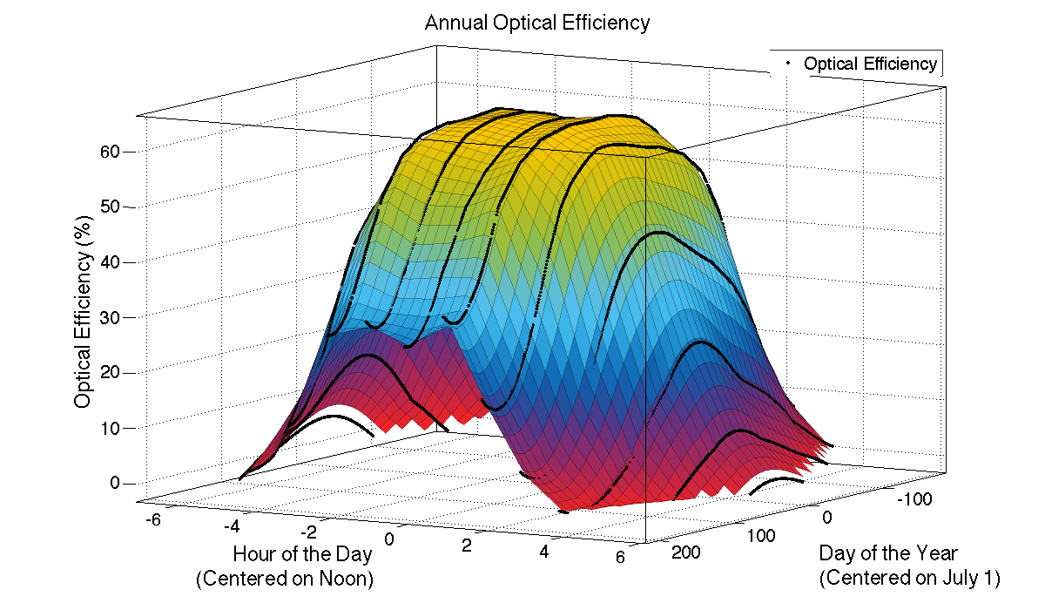
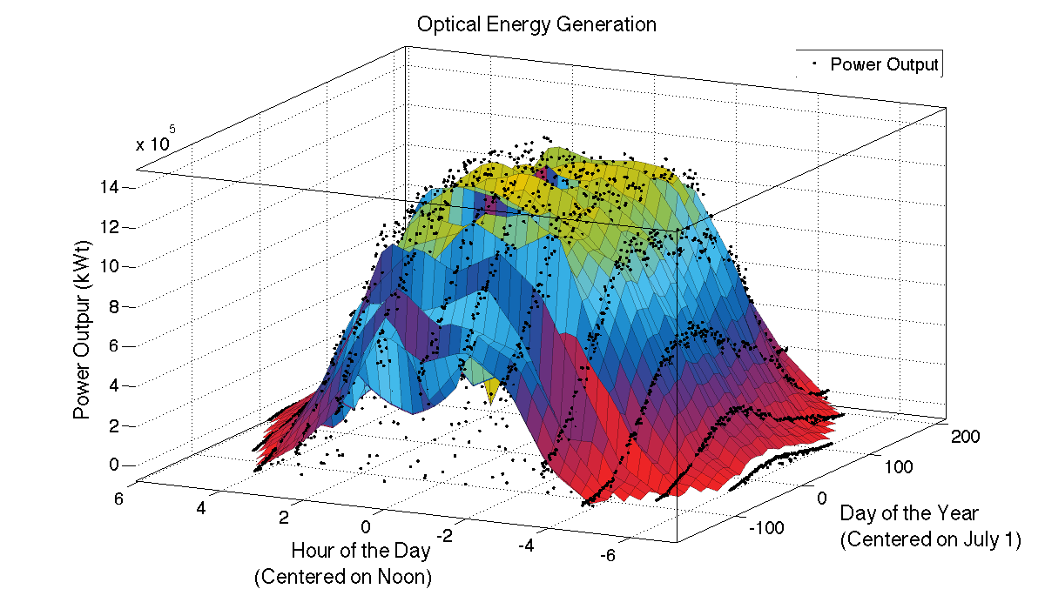
Phase I Modeling and Design Optimization
Modeling Activities
  NREL is supporting Hyperlight’s ongoing collector design optimization and overall collector/receiver predictive modeling efforts accounting for statistical manufacturing and assembly tolerances, alignment errors, sun-tracking pointing errors, and statistical weather variability in the solar resource
  Via Monte Carlo simulation, developing relative performance degradation model associated with real system tolerances and errors. Model used to derive manufacturing, assembly, operations tolerances and specifications.
  Thermal Energy Commodity pricing and Business Internal Rate of Return (IRR) metrics are being applied in the global optimization for the Hyperlight® minimum viable product design

Slide 9
Phase I Hardware Fabrication & Test
Optimized Product Design
  Design for High Volume, Low Cost Manufacturing
  Design for Low Cost Assembly and Installation
Low Cost Manufacturing
  Set-up and evaluate in-house production line for precision plastic pipe extrusion
Quality Assurance
  Develop and test quality assurance processes unique to product
Assembly & Calibration
  Develop and test assembly and calibration processes
Lifecycle testing
  Set-up testbed to simulate 30 years of cycles accumulated under worst case contaminated kinematic conditions

Slide 10
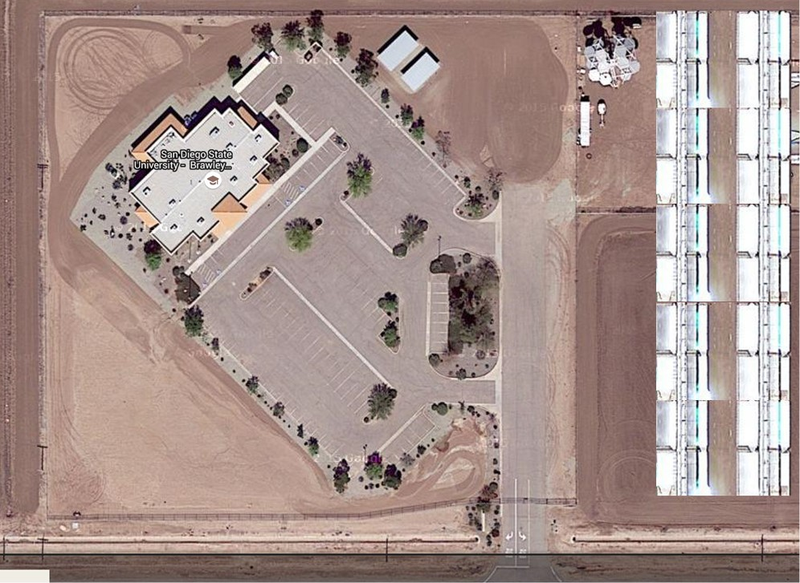
Phase II Pilot Project
Phase II pilot project (0.25 – 1 acre) in Brawley, CA
  Solar Resource Characterization
  Test loop: (0.25 MWt – 1 MWt) demonstration
  Predictive Model Validation
  IAMPO certification (indendepently funded)

Slide 11
Phase III
Evaluating multiple commercially relevant pilot sites for Phase III deployment including two geothermal plant sites, one of which has currently been baselined
  Small pilot installation with options to support aggressive expansion

Slide 12
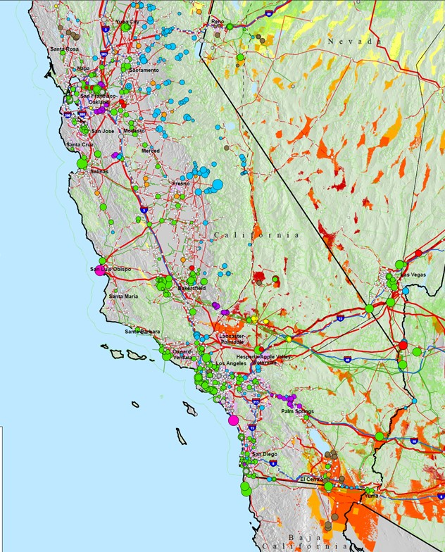
Path to Market
Geothermal boost is a lucrative market opportunity for low cost solar thermal
  Mitigates Solar Thermal need to install separate power conversion infrastructure that may otherwise be retired
  Supports Geothermal needs to address resource shortfalls that results in geothermal plants operating well below capacity
  Aligns well will existing geothermal resources
  CSP coupled will thermal storage increases commodity value for geothermal
Enhanced Oil Recovery
  Evaluating steam production opportunities for oil fields interested in reducing carbon footprint

Slide 13
Conclusions and Q&A
The Hyperlight® CSP collector concept leverages low cost materials (water and plastic) to provide a path to address DOE’s FOA low cost collector goals and support Hyperlight®’s ongoing commercialization efforts in cost-sensitive solar thermal commodity areas
We have provided a summary of our project outline for our DOE funded COLLECTS project under SunShot
We have summarized some of the imminent business opportunities for our Hyperlight® CSP collector
Questions

