Slide 1

Cost Estimating and Analysis Group (CEAG) Overview and Ways to Get Involved
August 11th, 2026
Cash Fitzpatrick
Director, NNSA’s Office of Program Analysis and Evaluation (PA&E, NA-BA-40)
CEAG Council Chair
Unlimited Unrestricted Release (UUR)
May be exempt from public release under the Freedom of Information Act (5 U.S.C. 552). Department of Energy review required before public release.
Controlled by: NA-BA-40, NNSA/DOE
UUR Category: BASIC
Name/Org: Cash Fitzpatrick, NA-BA Date: 7/31/2026
Guidance (if applicable): N/A

Slide 2
Welcome to CECOP X
1
Overview of NSE Cost Community
2
Year in Recap
3
Ongoing Initiatives & How to Get Involved

Slide 3


Overview of NSE Cost Community
Cost Estimating Analysis Group (CEAG)
Collaborative NSE-wide entity focused on continuous improvement of NSE’s cost estimating capability.
Chaired by PA&E with council reps from all 8 labs, plants, and sites
Technical working groups to jointly develop and share:
  Historical data
  Modeling techniques
  Training
Cost Estimating Community of Practice (CECOP)
Annual symposium focused on collaborative exchange best practices, methodologies, and community building.
Cost estimating and related practitioners
Open externally and routinely attended by DOE, DoD, NASA, and GAO

Slide 4
1
Overview of NSE Cost Community
2
Year in Recap
3
Ongoing Initiatives & How to Get Involved

Slide 5
Year in Recap
Lots of wins this year
Big GAO shoutout on CEAG’s standard cost guidance
  “We found the framework met or substantially met the 12 steps to develop a high quality and reliable cost estimate process described in the GAO Cost Estimating and Assessment Guide.” *
Weapons programs continue to build on their successes
  Successfully piloted new estimate methodology on W80-5 WDCR, shortening delivery timeline by ~1 year
Capital line-items are beginning to deploy improvements
  CEAG’s standard cost guidance (CAEF) successfully piloted on two large projects at SNL and LANL.
  CEAG completed cost reviews for two large line-items (SRPPF at Savannah River, CREST at SNL).
…But challenges remain
Rapid and continued expansion of the program of record. “Do more systems more quickly”
Large construction projects continue to experience significant cost & schedule growth
Execution and carryover challenges
Which is causing
Increased scrutiny from Congress and OMB
Difficult decisions during programming (e.g. growth in large projects cause deferments or cancellations)
Source: GAO Report: Additional Actions Needed to Plan for Science, Technology, and Engineering Facilities and Workforce Investments. July 2026. GAO-26-107904

Slide 6
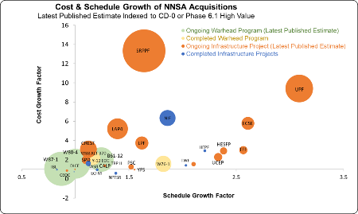
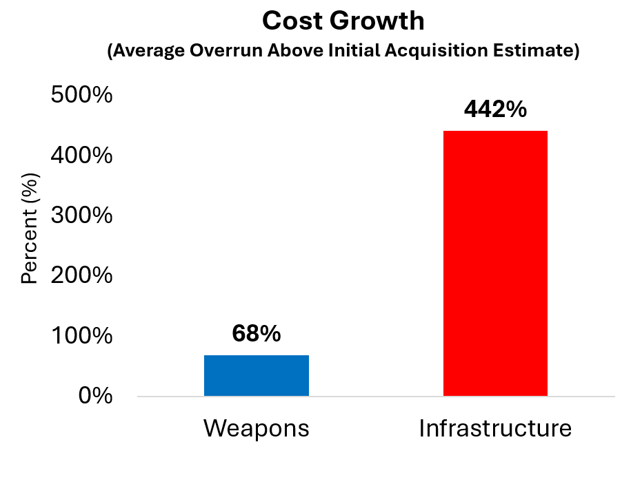
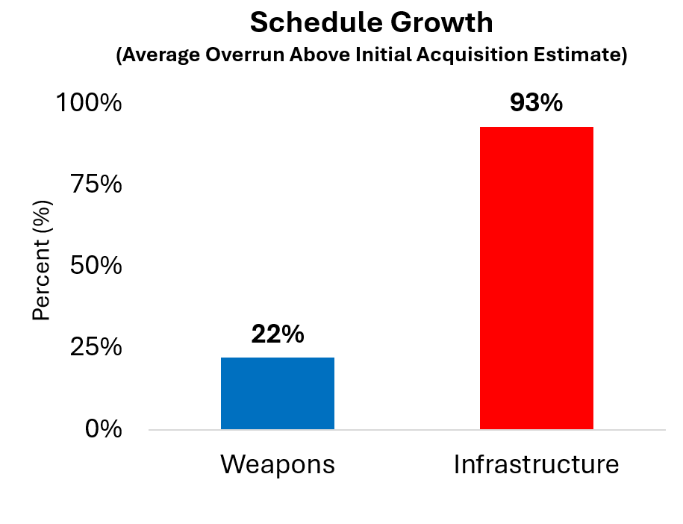
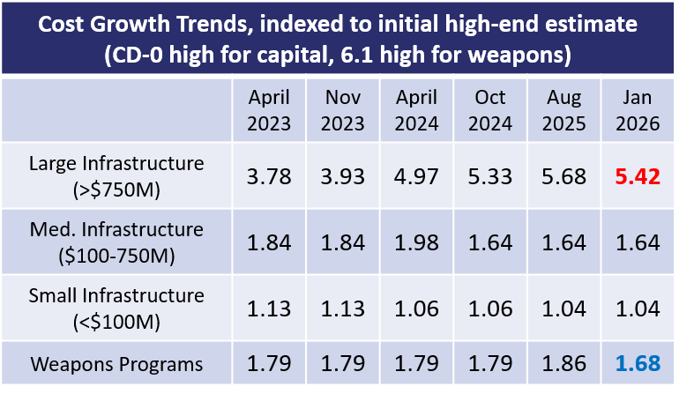
Tracking Cost and Schedule Growth
NNSA continues to track cost & schedule growth for both weapons and construction acquisitions
Continue tracking cost & schedule growth on all large projects
[New] Summary portfolio metrics of large acquisitions
6

Slide 7

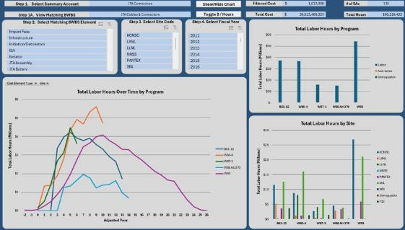
Cost Estimating Improvements to Weapons Modernization
Successful pilot on accelerating acquisition schedule
  Shortened W80-5 WDCR timeline to 6 months vs 18-24 months
  Accelerated program schedule & reduced costs
SCURA-thon 2026
  Six teams across the NSE
  Develop and standardize best practices to improve risk analysis storytelling, enhance stakeholder communication, and proactively support leadership decision‑making
Improved weapons estimate reviews
  Implemented robust training, review, and feedback mechanisms for W93 WDCR and W80-5 BCR
  Deployed “Component Benchmarking Tool” to better evaluate site inputs
    See more at "Reviews You Can Use" CECOP presentation
  Mock version of Component Benchmarking Tool for W93 WDCR. Mar 2026.
NNSA continues to elevate weapons cost estimating
7

Slide 8
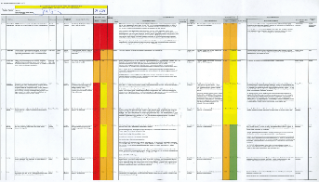
Infrastructure Modernization and Cost Estimating Are NNSA’s Highest Risk
NNSA required to report its most significant risks annually to White House ¹
Includes cost estimating in top two risks:
  FY26 Risk Profile. Published March 2026.
Risk #1: Infrastructure Modernization | “Focus on improving planning and execution of large line-items. This includes continuing to execute the agency’s implementation plan to improve line-item cost estimate quality and an additional effort to improve project management.”
Risk #2 Program and Project Management | “If NNSA cannot sustain effective program and project management capabilities including cost estimating, then cost, product quality, and mission delivery schedules may be adversely affected, and NNSA may be unable to achieve its mission goals and objectives.” “NNSA’s very large projects which are forecasted to cost billions of dollars and take as long as a decade to complete, are not being completed on time and are experiencing significant cost growth. Two root causes, improper cost-forecasting and sub-optimal project management, are being addressed. We need to improve project planning… including the interrelated areas of scope, schedule, and risk.”
  1: OMB Circular A-123, Management’s Responsibility for Enterprise Risk Management and Internal Control
8

Slide 9
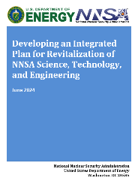

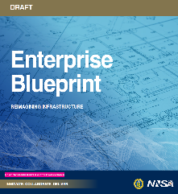
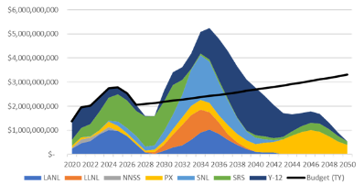
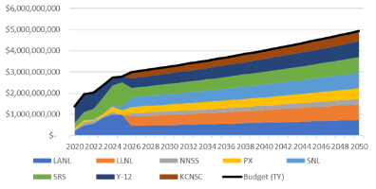
New Portfolio Level Tools for Infrastructure Planning
Developed through Integrated Infrastructure Planning (IIP)
Underpins infrastructure plans for strategic initiatives
Promotes portfolio thinking, i.e. “if we approve this new scope, what are we not going to do?”
Future applications
  Integrated PPBE infrastructure planning
  AoAs and future acquisition decisions
  Integrated Plan for Revitalization of NNSA ST&E (2024)
  Enterprise Blueprint (2024)
  Enterprise Blueprint 2.0 (2027)
  Models and tools allow for site and leadership priorities to create stable, predictable
New portfolio level tools enable integrated infrastructure decisions balancing work across sites and programs.
9

Slide 10
1
Overview of NSE Cost Community
2
Year in Recap
3
Ongoing Initiatives & How to Get Involved

Slide 11
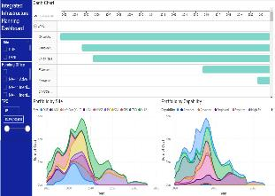


CEAG Working Groups
Opportunity to Get Involved
Modeling Working Group (Lead: Charlie Loelius, Charles.Loelius@nnsa.doe.gov)
  NSE wide group sharing modeling methods & tools
  Key activities: escalation methods, cost estimate growth analysis, glovebox cost modeling, pit production modeling
Historical Data Working Group (Lead: Charlie Loelius, Charles.Loelius@nnsa.doe.gov)
  NSE wide group sharing data gathering methods and dissemination
  Key activities: weapons cost data, databases, dashboards
Training Working Group (Lead: Daniel McCollom, Deenriq@sandia.gov)
  NSE wide group identifying & sharing training opportunities
  Key activities: leverage existing expertise, identify common core materials
Actively looking for new members. Contact working group leads!

Slide 12

Schedule Community of Practice
Opportunity to Get Involved
Schedule Community of Practice (SCOP)
The Schedule Community of Practice (SCOP) is a dynamic forum dedicated to the exchange of scheduling principles, best practices, and critical knowledge.
Our mission is to elevate the performance of programs and projects by fostering a collaborative environment for continuous learning and improvement.
Integration with CEAG
Support for Infrastructure Reviews
Support for Weapon Program Reviews
Merge with existing working groups
For more information contact scop@nnsa.doe.gov
Actively looking for new members. Contact leads!

Slide 13
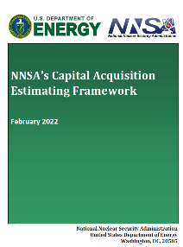
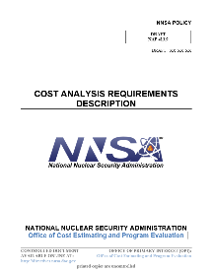
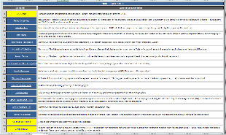
Opportunity to Get Involved
Other Upcoming CEAG Efforts
CEAG maintains list of Subject Matter Experts to support future:
  Estimate reviews (Weapons and/or capital acquisitions)
  Drafting and/or reviewing cost policies
  Developing guides
CEAG periodically updates cost estimating products (e.g. guides)
Opportunity to review draft NNSA cost policies and materials
Contact your CEAG representative to get involved!

Slide 14
Questions?
Speaker: Cash Fitzpatrick
Director, Office of Program Analysis and Evaluation (PA&E, BA-90)
CEAG COUNCIL MEMBERS
Cash Fitzpatrick - CEAG Chair | NNSA
Eric White | Y-12
Nathalie Lemmon | PX
Tim Hogan | KCNSC
Todd Proffitt | LANL
Carol Meyers | LLNL
John Ball Jr. | NNSS
Blair DuBois | SNL
John Salter | SRS
CEAG SITE REPRESENTATIVES
Steve Blake | KCNSC
Clint Bowman | KCNSC
Gabe Andrade | LANL
Elliot Sondheim | LANL
Hannah Goldstein | LLNL
Amanda Walton | NNSS
Chris Nesbit | SNL
Carla Moncayo Jordan | SNL
Rhonda Tiller | SRS
Russ Howell | PX
Keith Burd | PX
Randy Miller | Y-12
Julie Anderson | NNSA
Charlie Loelius | NNSA
Contact your representatives to get more involved!

Slide 15
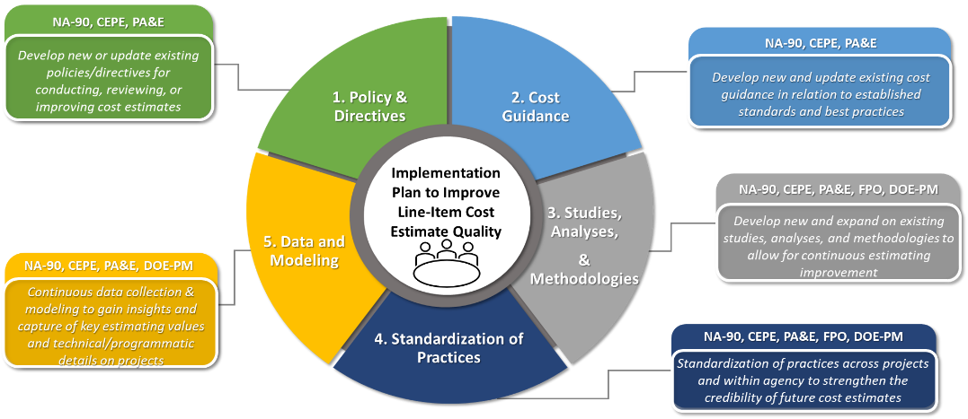
Cost Estimating Improvements to Infrastructure Modernization
BACKGROUND
2023: Institute for Defense Analysis (IDA) report on NNSA line-item cost estimating
2023: OMB directs NNSA develop an Implementation Plan
2024: NNSA delivers plan to OMB
2024 – Now: Execution with annual updates to OMB
APPROACH
Joint PA&E, CEPE, Office of Infrastructure implementation
5 functional areas:
  Policy & Directives
  Cost Guidance
  Studies, Analyses, and Methodologies
  Standardization of Practices
  Data and Modeling
  Excerpt from “Implementation Plan to Improve Line-Item Cost Estimate Quality” Brief. 2024.
NNSA continues to mature capital line-item cost estimating

