Slide 1

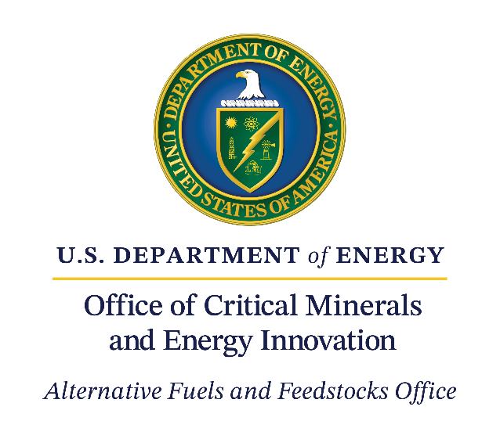

Bioenergy Basics 101

Slide 2
Fun in the Sun
The Raw Materials
From Field To Pump
Fueling the Future
Check Your Source
100
100
100
100
100
200
200
200
200
200
300
300
300
300
300
400
400
400
400
400
500
500
500
500
500

Slide 3
The process in plants where light energy is converted to chemical energy is referred to as .
Return to Main Board
Answer

Slide 4
Photosynthesis
Return to Main Board

Slide 5
These are the three things that are required for photosynthesis to proceed.
Return to Main Board
Answer

Slide 6
Carbon dioxide (CO₂), light energy, and water
Return to Main Board

Slide 7
These are the two end products of photosynthesis.
Return to Main Board
Answer

Slide 8
Oxygen and sugar (i.e., glucose)
Return to Main Board

Slide 9
This is a complex sugar compound that is used to store future energy needs or to build new tissues, and is created from excess glucose from photosynthesis. It is also the most common carbohydrate in the human diet.
Return to Main Board
Answer

Slide 10
Starch
Return to Main Board

Slide 11
This organic compound is the main component of plant cell walls, providing structural support and preventing cell damage.
Return to Main Board
Answer

Slide 12
Cellulose
Return to Main Board

Slide 13
This is an energy resource derived from plant-and algae-based material that can be converted to fuels, chemicals, or power.
Return to Main Board
Answer

Slide 14
Biomass
Return to Main Board

Slide 15
These are a diverse group of primarily aquatic organisms that lack true roots, stems, and leaves, and can turn sunlight into energy through photosynthesis.
Return to Main Board
Answer

Slide 16
Algae
Return to Main Board

Slide 17
The energy stored in biomass can be released to produce what three forms of usable energy?
Return to Main Board
Answer

Slide 18
Electricity, thermal energy (heat), and transportation fuels
Return to Main Board

Slide 19
First-generation biofuels are produced from these types of biomass.
Return to Main Board
Answer

Slide 20
Food crops (e.g., corn) and vegetable or animal fats and oils
Return to Main Board

Slide 21
Second-generation/advanced biofuels are produced from these types of biomass.
Return to Main Board
Answer

Slide 22
Non-food/feed/fiber biomass (e.g., corn stover, perennial grasses, forest residues, and algae)
Return to Main Board

Slide 23
Ethanol is a renewable fuel made from this class of macromolecules that contain sugars and starch.
Return to Main Board
Answer

Slide 24
Carbohydrates
Return to Main Board

Slide 25
Biodiesel is a renewable fuel that can be manufactured from plant or animal-based fats and oils. Oils and fats are considered this class of macromolecules.
Return to Main Board
Answer

Slide 26
Lipids
Return to Main Board

Slide 27
This is the process carried out by yeast in which simple sugars are converted to ethanol and carbon dioxide.
Return to Main Board
Answer

Slide 28
Fermentation
Return to Main Board

Slide 29
Cellulase, which breaks down cellulose molecules into simple sugars, is an example of this class of protein that accelerates chemical reactions.
Return to Main Board
Answer

Slide 30
Enzymes
Return to Main Board

Slide 31
Renewable gasoline, jet fuels, and diesel fuels are composed primarily of molecules containing atoms of hydrogen and carbon, which are classified as this type of compound.
Return to Main Board
Answer

Slide 32
Hydrocarbons
Return to Main Board

Slide 33
What is the end product when biomass is converted directly into a liquid fuel.
Return to Main Board
Answer

Slide 34
Biofuel
Return to Main Board

Slide 35
Ethanol is typically mixed with this type of transportation fuel in blends of E10, E15, or E85 (depending on the percentage of ethanol).
Return to Main Board
Answer

Slide 36
Gasoline
Return to Main Board

Slide 37
These are the two most common types of biofuels used in the United States today.
Return to Main Board
Answer

Slide 38
Ethanol and Biodiesel
Return to Main Board

Slide 39
This term is given to biofuels that can be used to power transportation in the airline industry.
Return to Main Board
Answer

Slide 40
Sustainable Aviation Fuel
Return to Main Board

Slide 41
Another name for biomass-derived renewable hydrocarbon fuels that are compatible with existing cars, trucks, jets, and infrastructure, and serve as a complement to petroleum-derived gasoline, jet fuels, and diesel fuels.
Return to Main Board
Answer

Slide 42
“Drop-in” fuels
Return to Main Board

Slide 43
In the United States, this is the most widely used energy resource for transportation.
Return to Main Board
Answer

Slide 44
Petroleum
Return to Main Board

Slide 45
Biomass is this type of energy source as it can be replaced naturally and used again.
Return to Main Board
Answer

Slide 46
Renewable
Return to Main Board

Slide 47
Coal, petroleum, and natural gas are considered this type of resource.
Return to Main Board
Answer

Slide 48
Fossil fuel
Return to Main Board

Slide 49
Biomass materials can be turned into these, which are renewable alternatives to products derived from petroleum or natural gas, and include plastics, fertilizers, lubricants, and industrial chemicals.
Return to Main Board
Answer

Slide 50
Bioproducts
Return to Main Board

Slide 51
The materials that go into the production of bioenergy and bioproducts are called ____.
Return to Main Board
Answer

Slide 52
Feedstocks
Return to Main Board

