Slide 1
To the BAT-CAIV!
A Practical Guide for Building to Cost Targets
August 12, 2026

Slide 2



Meet the Authors
Logan Hartley, CCEA®
Logan has extensive technical experience in working with data via model development, programmatic data analysis, and tool building.
​
Zachary Matheson
Zachary is an analyst in the National Nuclear Security Administration Office of Programming, Analysis, and Evaluation (PA&E).
Payton Deeney
Payton Deeney supports PA&E through project coordination, cost estimation, and the development of analytical methods and models using VBA programming.

Slide 3
Agenda
Introduction
Theory and Methodology
BAT-CAIV
Case Study
Improvements
Conclusion

Slide 4
Background

Slide 5
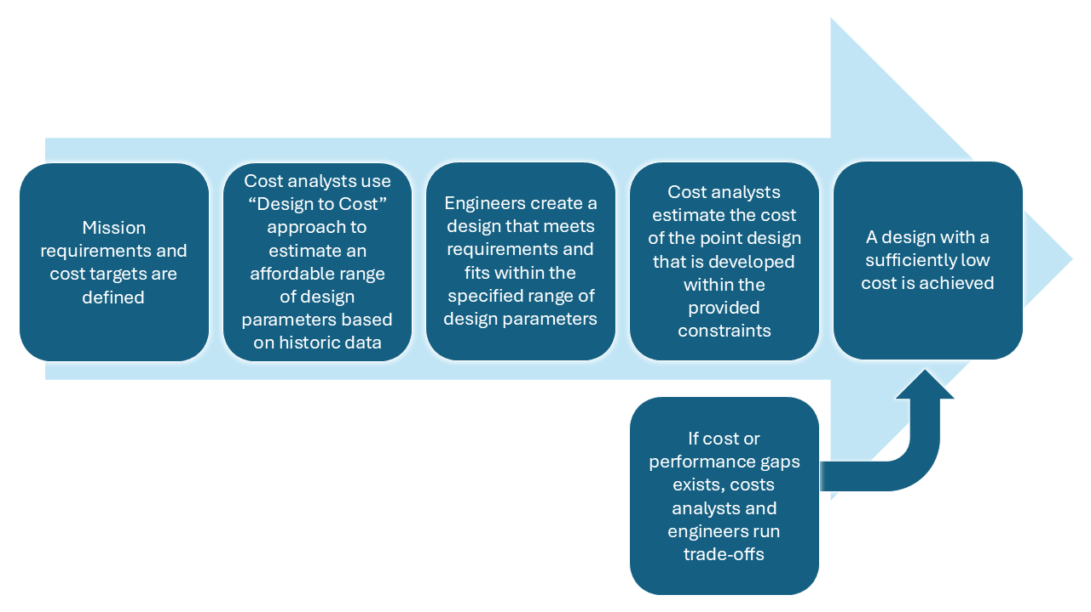
Introduction and Background
Technical scope uncertainty is a key contributor to cost, schedule, and scope growth
  Occurs most often when requirements and scope decisions are made independently of potential cost impacts.
Methodologies that explicitly consider cost during requirements development could reduce growth
  CAIV may be the solution to the iterative process on the right
Cost As an Independent Variable (CAIV) treats cost as a fixed constraint, rather than a variable outcome.
  Allows cost to dictate requirements
Overview of cost-constrained design analysis process; Extracted from Sukley (2023)

Slide 6
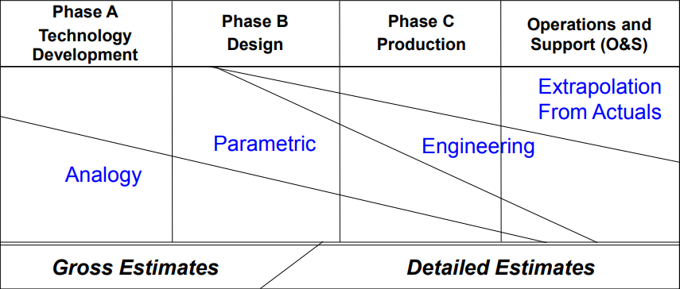
Theory and Methodology
CAIV methodology relies on parametric estimating relationships, and can be created via two primary ways:
  Option 1: Transforming an existing Cost Estimating Relationship (CER)
  Option 2: Performing regression analysis (more statistically sound)
CAIV is most effective during the early stages of a project, where tradeoffs in scope are most often communicated and actionable
CD-0
CD-1
CD-2/3
CD-4
Technology and Logistics Life Cycle Management Chart, Defense Acquisition University (DAU)

Slide 7
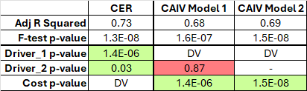
Theory and Methodology – Option 1: Transformation
CER transformation involves solving for a technical variable in an existing parametric and making cost the independent variable.
Pros | Cons
Simple and quick to perform | Possible loss of predictive power for existing variables
Works well for bi-variates | Only works reliably for linear models
Good substitute when data not readily available | Inaccurate error terms
Tests of statistical significance show that predictiveness of parameters can change in power upon transformation
$$CER:Cost \left(\$\right)=a∗Driver_1+b∗Driver_2+ε$$
$$CAIV Model 1:$$
$$Driver_1=a∗Cost+ b∗Driver_2 \left(No Longer Significant\right)+ ε$$
$$CAIV Model 2: Driver_1=a∗Cost+ ε$$
An analyst should only transform a parametric when faced with inadequate data or simple equations. Otherwise, a regression analysis should always be conducted

Slide 8
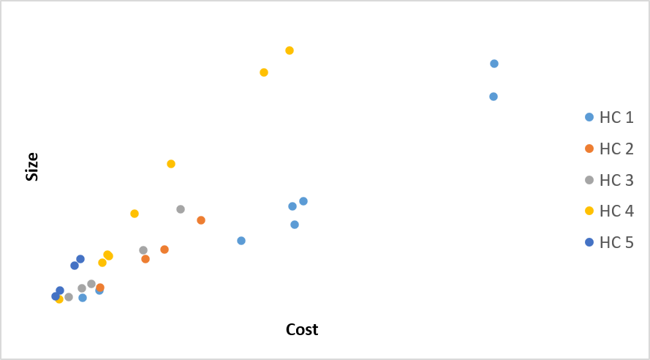
Theory and Methodology – Option 2: Regression Analysis
Deriving a CAIV parametric via regression analysis follows the same process as any other regression test and carries many of the same implications.
Pros | Cons
Statistically validated predictor variables | Time consuming
Representative error terms | Limited data availability
Functional across multiple spaces | May result in no viable parametric models
 | df | SS | MS | F
Regression | 2 | 3.60935E+11 | 1.8E+11 | 74.10582427
Residual | 26 | 63316885179 | 2.44E+09
Total | 28 | 4.24251E+11
 | Coefficients | Standard Error | t Stat | P-value
Intercept | b | 7100.896676 | -3.54528 | 0.00151163
Cost | a | 2.13737E-05 | 12.00748 | 4.13411E-12
HC # | 32961.49803 | 6438.249576 | 5.119637 | 2.45138E-05
$$Size=Cost ∗ a+HC \# ∗32961−b$$
CAIV parametrics derived by regression analysis are the recommended approach

Slide 9
BAT-CAIV

Slide 10

BAT-CAIV Background
Given a set of particular budgetary constraints, PA&E was tasked with estimating the size of a new office building
The following section details the development of a CAIV model for office buildings, which was developed to support programmatic requests for rightsizing new office space.
Los Alamos National Lab (LANL) Office Building

Slide 11
BAT-CAIV – Data Collection
Data was collected from DOE databases (G2 and FIMS) for office facilities constructed from 2005 to 2024
Data included Gross Square Feet (GSF), Total Estimated Cost (TEC), and number of occupants.
  Project costs normalized to Base Year 2024 dollars (BY 2024$) using the Engineering News-Record Construction Cost Index (ENR-CCI)
  Locality-based cost impacts were accounted for by using RSMeans location-adjustment factors
Metric | Quantity
Count | 14
Min GSF | ~3,000
Max GSF | ~350,000
Min TEC (BY24$) | ~$3M
Max TEC (BY24$) | ~$200M
Min Occupants | 16
Max Occupants | 991
Summary Statistics of data used for BAT-CAIV Development.

Slide 12
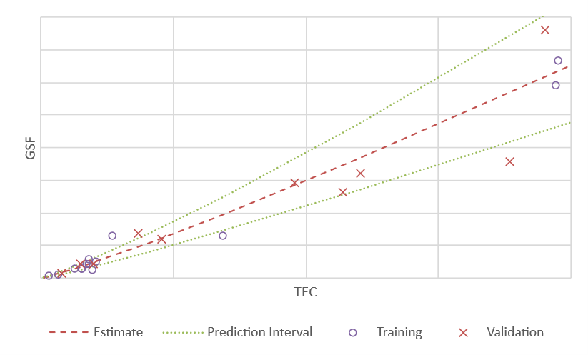
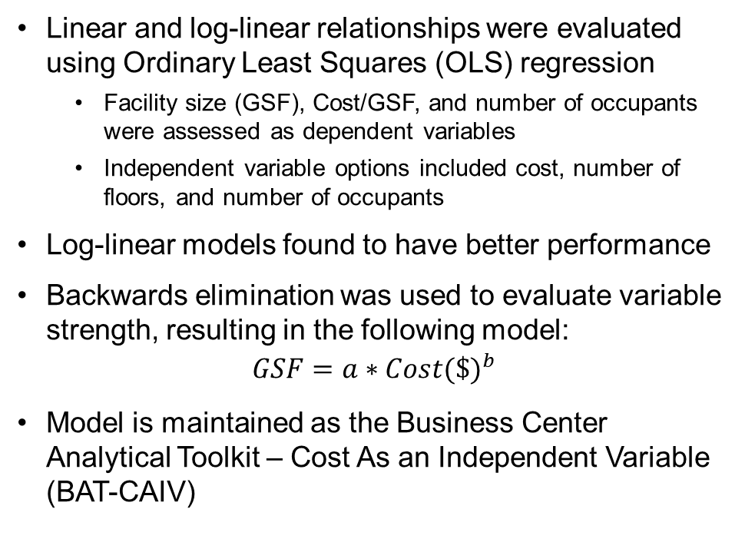
BAT-CAIV – Model Development
Linear and log-linear relationships were evaluated using Ordinary Least Squares (OLS) regression
  Facility size (GSF), Cost/GSF, and number of occupants were assessed as dependent variables
  Independent variable options included cost, number of floors, and number of occupants
Log-linear models found to have better performance
Backwards elimination was used to evaluate variable strength, resulting in the following model:
$$GSF=a∗{Cost(\$)}^{b}$$
Model is maintained as the Business Center Analytical Toolkit – Cost As an Independent Variable (BAT-CAIV)
BAT-CAIV with a 60 percent prediction interval, with markers indicating both training and validation data points.

Slide 13
Case Study

Slide 14
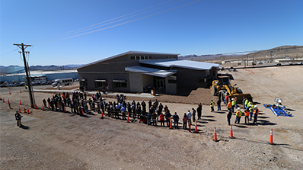
Case Study Background
In recent years, an increasing number of staff at production and research sites has required the NNSA to dedicate more resources to fund the construction of office space
Two traditional approaches have been explored:
  Trailers (cheaper, shorter lifespan, hard to attract workers)
  Office Buildings (limited by cost and oversight obstacles)
Potential solution: Standardized Acquisition and Recapitalization (STAR) Buildings
  Cheaper and built to standardized specifications (designed to fall below a certain cost threshold)
  Can be built and operational within 2-4 years
The BAT-CAIV model was used to analyze the viability of STAR buildings as a long-term option
Mercury Building, located at NNSS, was one of the first STAR buildings

Slide 15
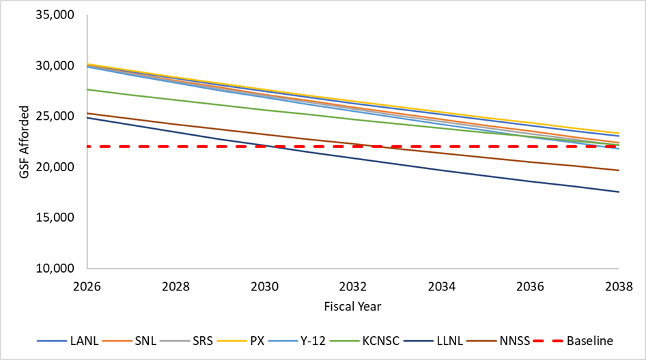
Case Study Results
Maximum size of STAR buildings is 22,000 GSF
  This was used as the baseline for this analysis
Using the Minor Construction ($34M) threshold as the IV, among NNSA’s seven major laboratories, plants, and sites (LPS), only 2 are unable to meet the technical sizing requirement of a STAR building past 2030 and 2033, respectively
All other sites are able to affordably build STAR buildings with costs falling below the threshold until at least 2038
Conclusion: STAR buildings are a viable option for quickly and cheaply supporting mission needs
Lines indicate each site’s relative buying power in terms of GSF year over year.

Slide 16
Future Improvements and Applications

Slide 17
Improvements to BAT-CAIV
PA&E has identified several ways in which BAT-CAIV can be improved upon and expanded
  Average Gross Square Footage Per Occupant Deep Dive: Investigate correlation between GSF and number of occupants
  Amenities: Study how the inclusion of amenities such as cafeterias, auditoriums, general stores, and post offices affects facility construction cost
  Limited Areas and SCIFs: Quantify the construction cost impacts of classified space requirements

Slide 18
Future Application within the NNSA
NNSA has experienced a recent history of growth in large major acquisition projects
  CAIV may be used to inform or validate requirements for these projects
Explore CAIV approaches using other variables
  Independent variable candidates: locality, mission capability, facility type, or nuclear designation
  Dependent variable candidates: GSF, programmatic equipment capacity, throughput

Slide 19
Conclusion

Slide 20
Conclusion
CAIV as a methodology has potential within NNSA and across industry
  May be used to prevent future cost growth across portfolios
  BAT-CAIV serves as an example of applied and defensible use of CAIV for future applications
Cost-constrained thinking is a decision-making framework that uses cost targets to set constraints on the decision space, which can inform requirements, provide more realistic cost objectives, and support the cost management process

Slide 21
Questions?

