Slide 1
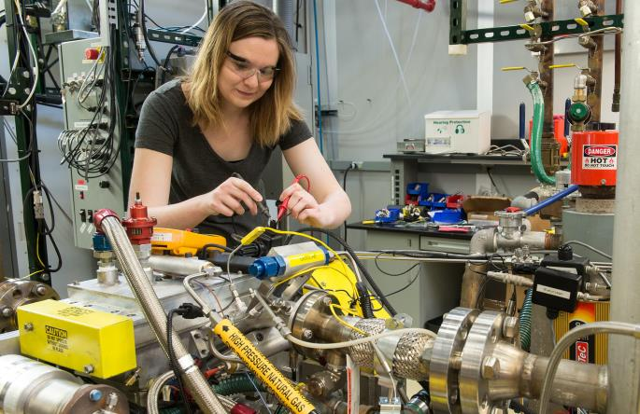
Clean
Water
Technology
Seth w. snyder, Ph.D.
DOE AMO Clean water processing
Cleveland OH, August 2017
Water research leader
seth@anl.gov 630-252-7939
Adjunct professor, northwestern
Chief scientist, Current
Notes:
Shown:
Argonne working with Ford and FCA US to study dual-fuel vehicles
Scientists at Argonne National Laboratory are partnering with industry to study a tricky fuel mixing problem that could lead to more efficient engines.
The pre-competitive research is focused on exploring technical concepts and development of engine technology that simultaneously uses natural gas and traditional gasoline to maximize the best characteristics of both fuels, while reducing oil consumption and making the most of the recent boom in natural gas supplies in the United States. The project partners Argonne with Ford Motor Company and FCA US LLC, under a cooperative research and development agreement (CRADA).
Visiting IIT Professor Carrie Hall troubleshoots the engine wiring harness. The system can replicate speed and load conditions found during typical vehicle operation for both naturally aspirated as well as turbocharged engines.

Slide 2
The key is to develop new water
Technology – Policy – Social tools
Efficiency
Alternative water sources
Fit-for-purpose

Slide 3
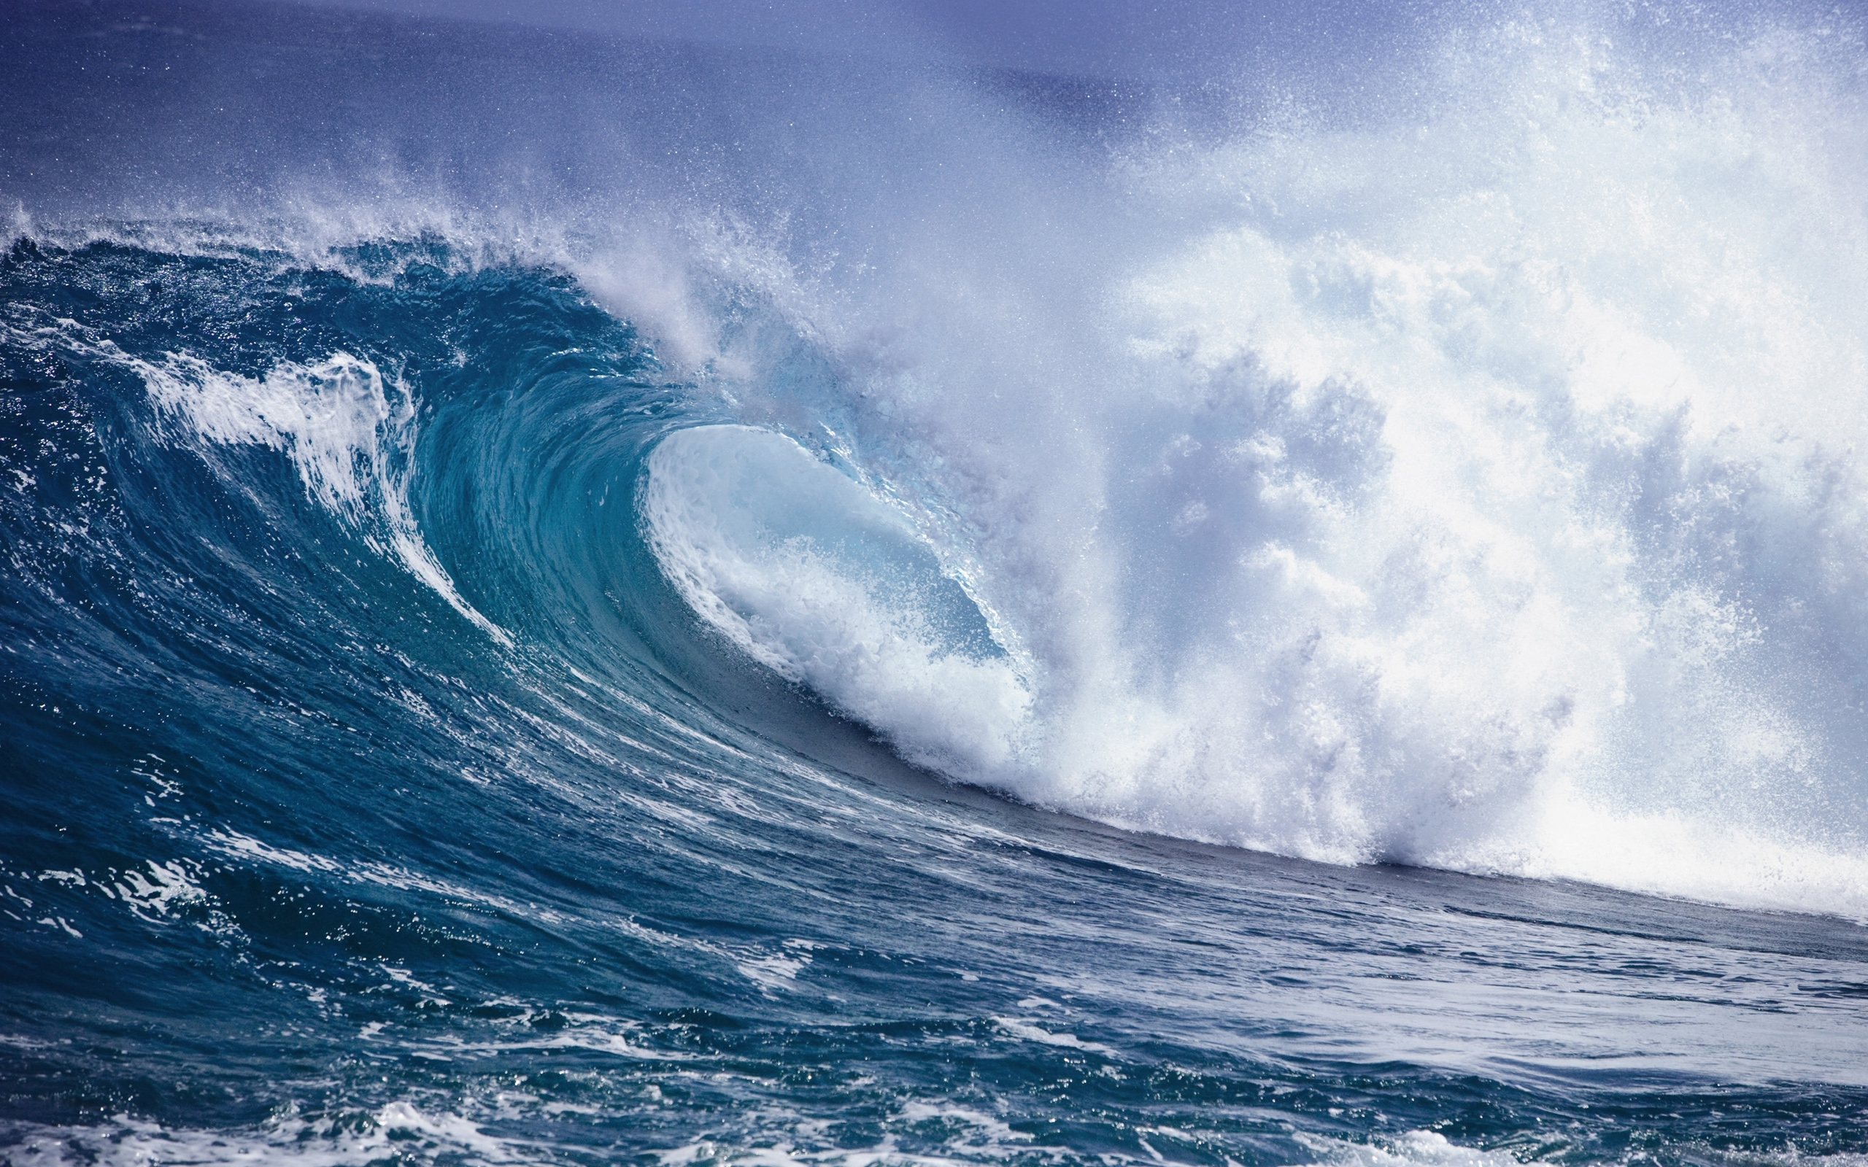
Feed solution: sea water (30-35 g/l)
Most common feed water
Main issue: high salinity
High energy cost
Great availability
Easy brine management

Slide 4
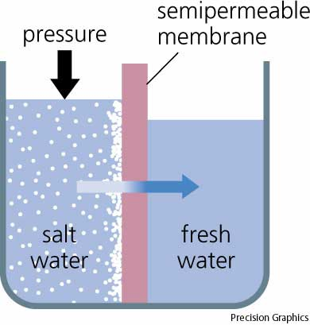
Dominant technology:
Reverse osmosis (RO)
pump
(75 atm)
State of the art
High energy efficiency (2.5 kWh/m³)
Requires 40-80 bar of pressure for seawater
Large reject water volumes
Removes water from salt
Similar energy for brackish water
high pressure brine

Slide 5
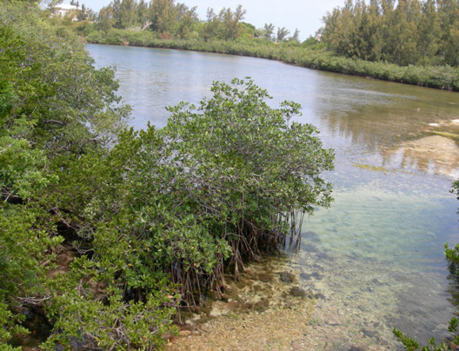
Feed solution: brackish (2-10 g/l)
Main issue: salinity
Lower availability
Brine management can be difficult

Slide 6
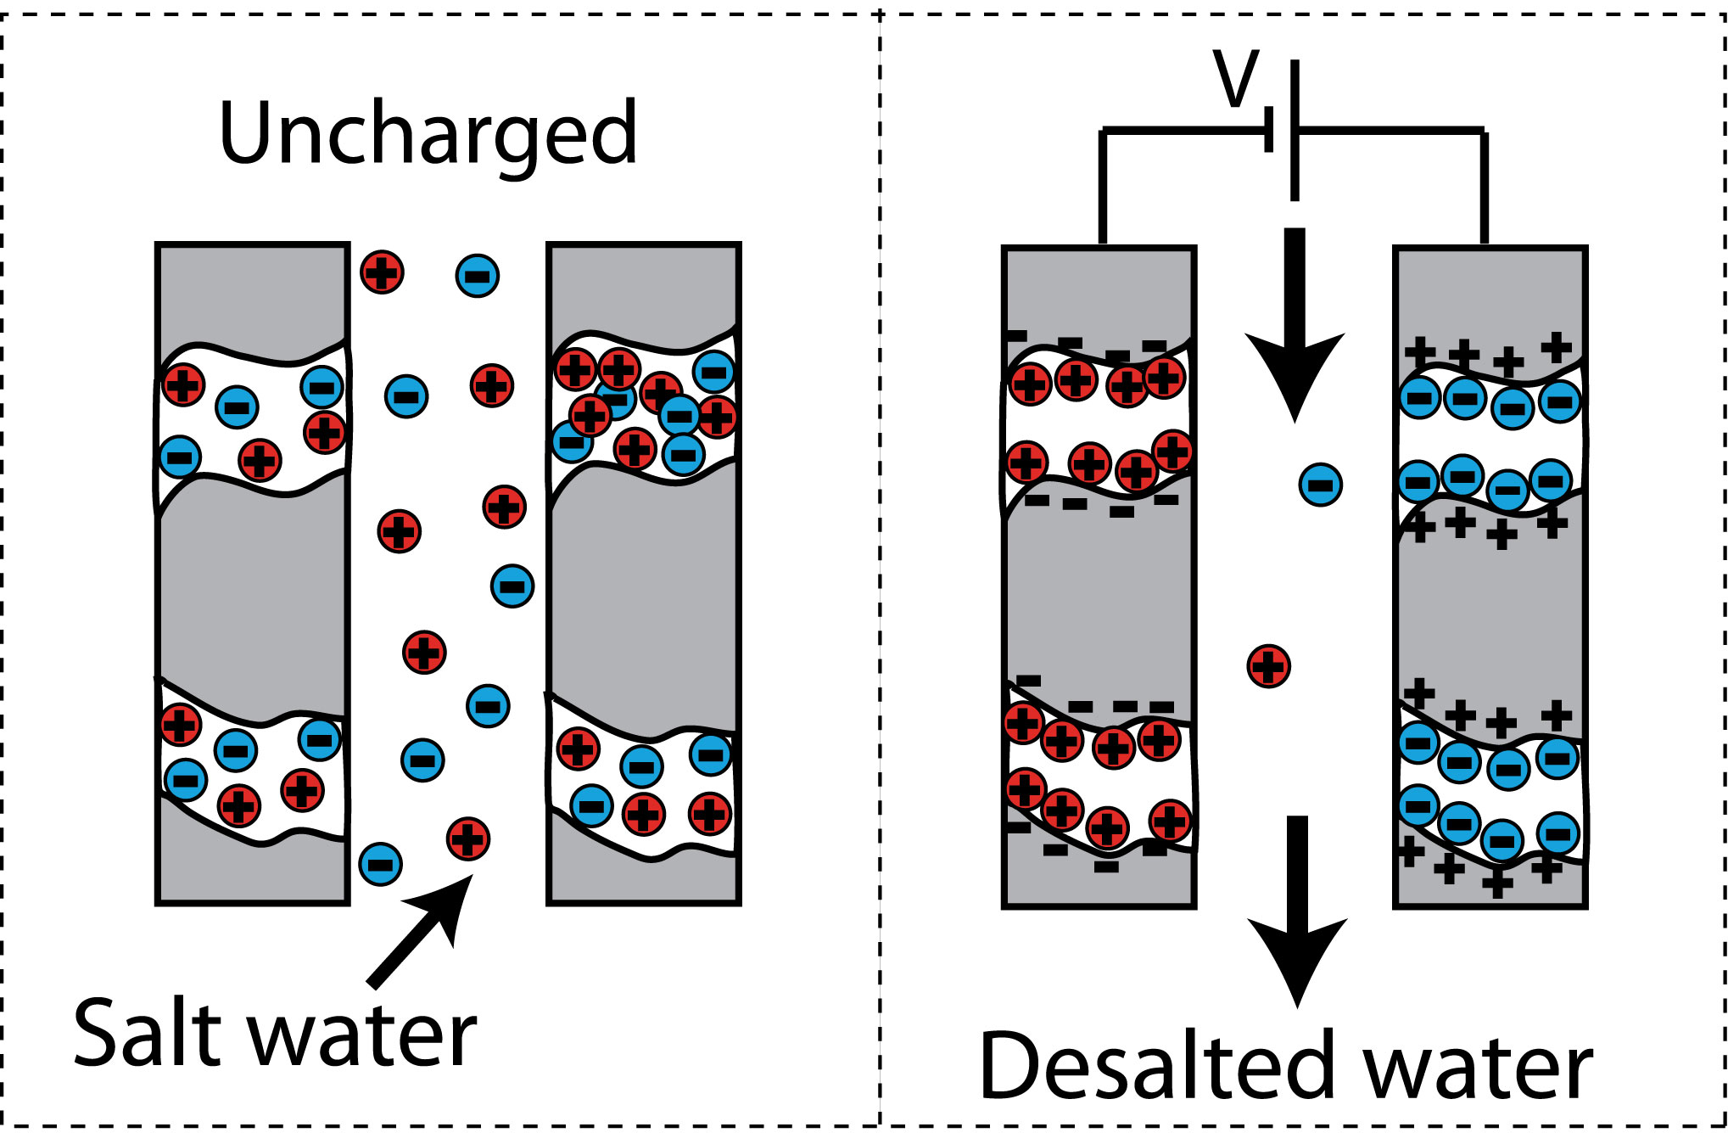
Emerging Technology:
Capacitive desalination (CDI)

Slide 7
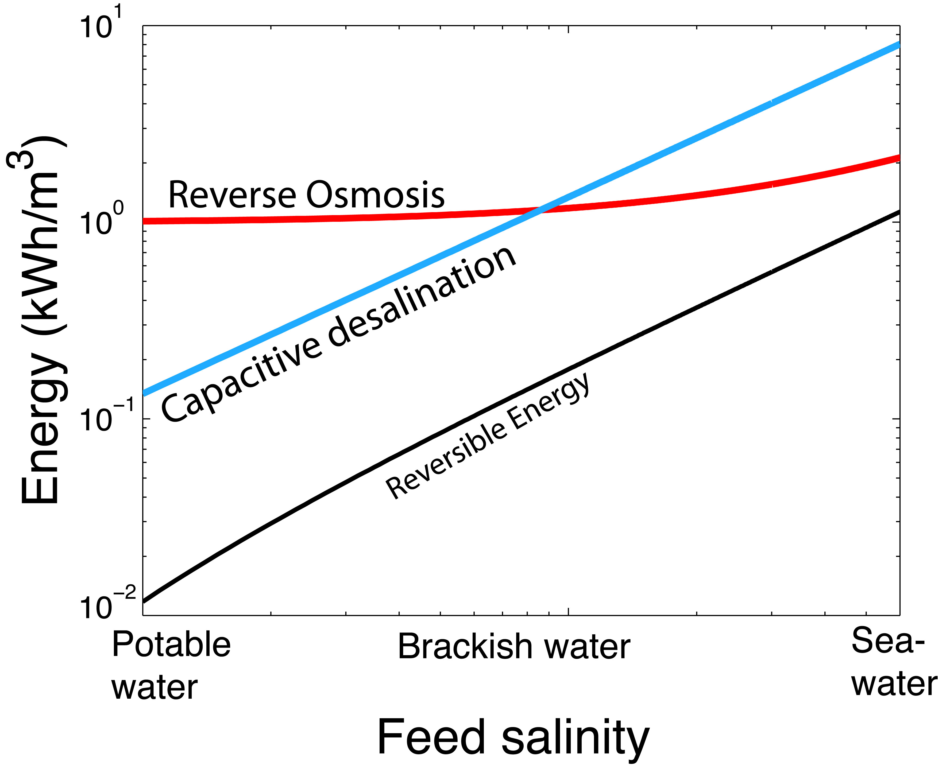
Energy cost scaling with salinity
RO lower limit is given by membrane resistance
CDI energy cost scales with concentration throughout
Energy cost for CDI is much lower for low salt concentrations
Notes:
10 kPa can be delivered by 1m³ pressure head

Slide 8
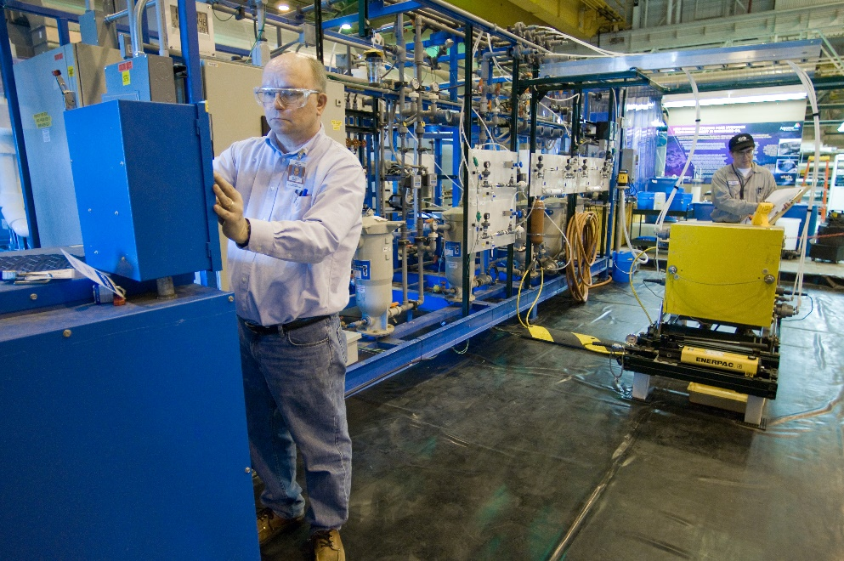
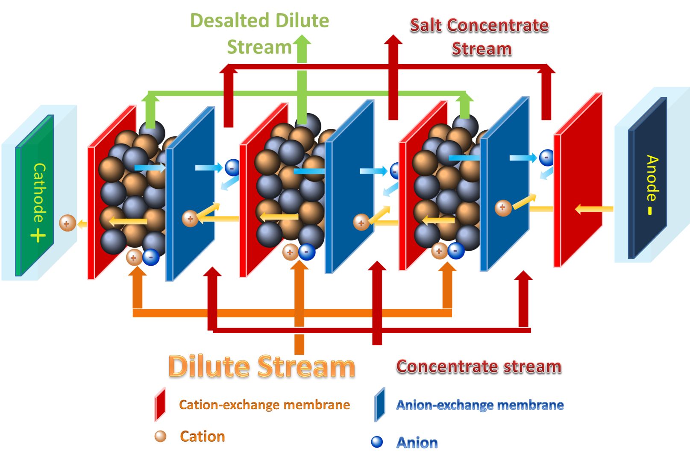
Emerging Technology: Resin-Water Electrodeionization
Applications: cooling towers, brackish, produced water, industrial water processing,
RWEDI (similar to CDI) removes salt from the water
More energy efficient than RO for brackish water
High recovery rates (>90%)
Reduced brine volume for inland brackish water

Slide 9
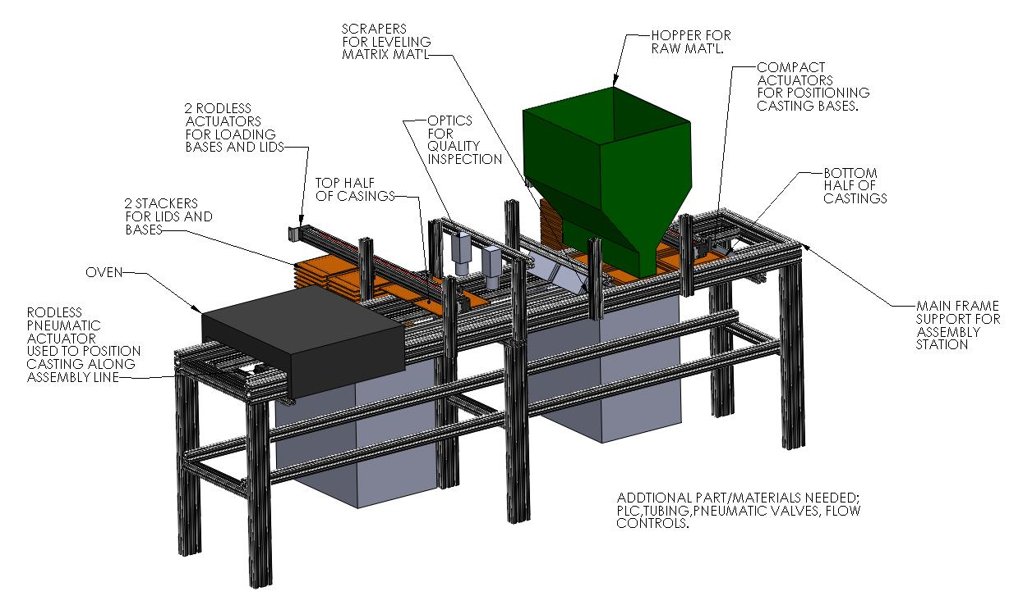
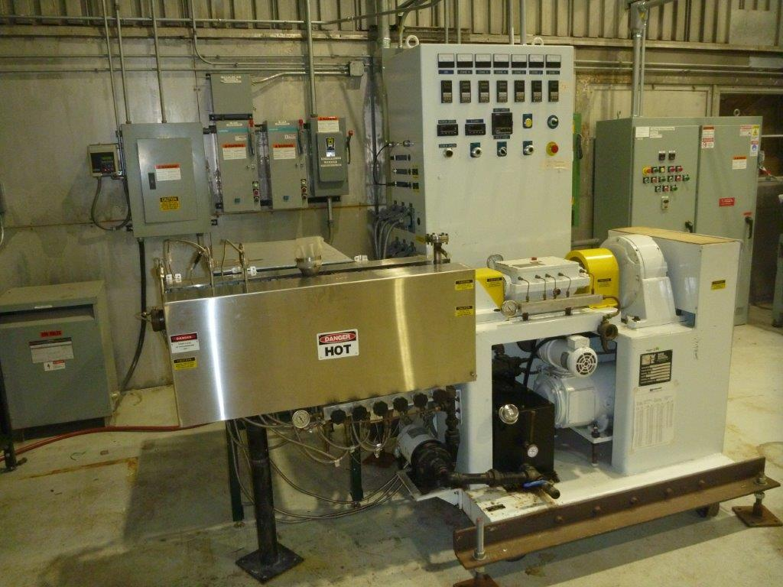
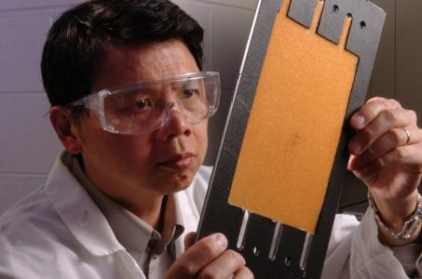
RWEDI – developing a manufacturing process
Currently fabricate resin wafers manually – take a full day to fabricate one lab scale stack
Developing a roll-to-roll process with AMO support – target – continuous manufacturing process
R2R consortium: Claus (ORNL) – PI, Hardy (AMO) - Program Manager

