Slide 1
AMO Education and Workforce Development
Steve Shooter
Nebiat Solomon

Slide 2
AMO Education and Workforce Development Vision
Develop the workforce to enable the future of manufacturing and an energy efficient economy for the nation.

Slide 3
Education and Workforce development Background
Background
Education and workforce development (EWD) activities within AMO are those programs with a focus on providing training related to R&D innovation topics
There are EWD activities in Technical Partnerships, R&D projects and Consortia pillars
These programs serve Undergraduate students, graduate students, professors, incumbent workers, innovators and much more
AMOs role in EWD
Build capacity to pursue energy efficiency across the manufacturing sector
Support capacity building for technology and process innovation related to energy and resource efficiency in manufacturing
Industry partners are confident of the availability of workforce familiar with new technologies and training for their staff

Slide 4
AMO EWD Focus
Technical Partnerships: primarily focus on addressing energy efficiency in existing manufacturing facilities across different trainee profiles.
Consortia: primarily focus on developing workforce relevant to the technology area and trainee level that is most needed by the technology sector that is the primary focus of the consortia R&D effort.
R&D projects: focus on specialized training developing the next generation of workers for the innovation that is funded by AMO.
Direct Lab Engagement: primarily focus on engaging future workforce in domains directly relevant to AMO innovation at the national labs.

Slide 5
AMO EWD Program (a sample of current projects by trainee type)
Graduate Student | Undergraduate | Incumbent Worker | Innovators | Community Colleges
CHP TAPS training | IACMI EWD | Better Plants | Build 4 Scale | CESMII EWD
Power Electronics Traineeship | Power America EWD | CHP TAPS training | Laboratory Embedded Entrepreneurship Program | IACMI EWD
RAPID EWD | RAPID EWD | RAPID EWD
IACMI EWD | Enhanced Preparation for Intelligent Cyber manufacturing Systems(EPICS) | IACMI EWD
Power America EWD | MS and MENG in Advanced Manufacturing for Energy Systems
Robotics internships | Robotics Internships
IAC | IAC

Slide 6
EWD Accomplishments/Successes
Industrial Assessment Center: Nearly 60 percent of IAC graduates go on to careers in the energy industry. John would have statistics for how many students have passed through the program.
Better Plants: Technical expertise gained through the INPLTs help companies overcome common, critical barriers to adopting energy management practices and technologies. We’ve conducted over 120 in-plants, training over 2,100 workers since the start of the program.

Slide 7
EERE National Robotics Internship Program
Places Undergraduate and Graduate Students in 10 week internship program with a mentor at National Labs
Re-started program for summer 2019
Had over 490 applicants for 22 positions
Mentors supply project descriptions
Intern applicants rank projects in order of interest
Mentors select interns from applications
Interns prepare a final report and presentation on their project AND the impact of the experience on their education and career plans
Process facilitated by the Oak Ridge Institute for Science and Education

Slide 8
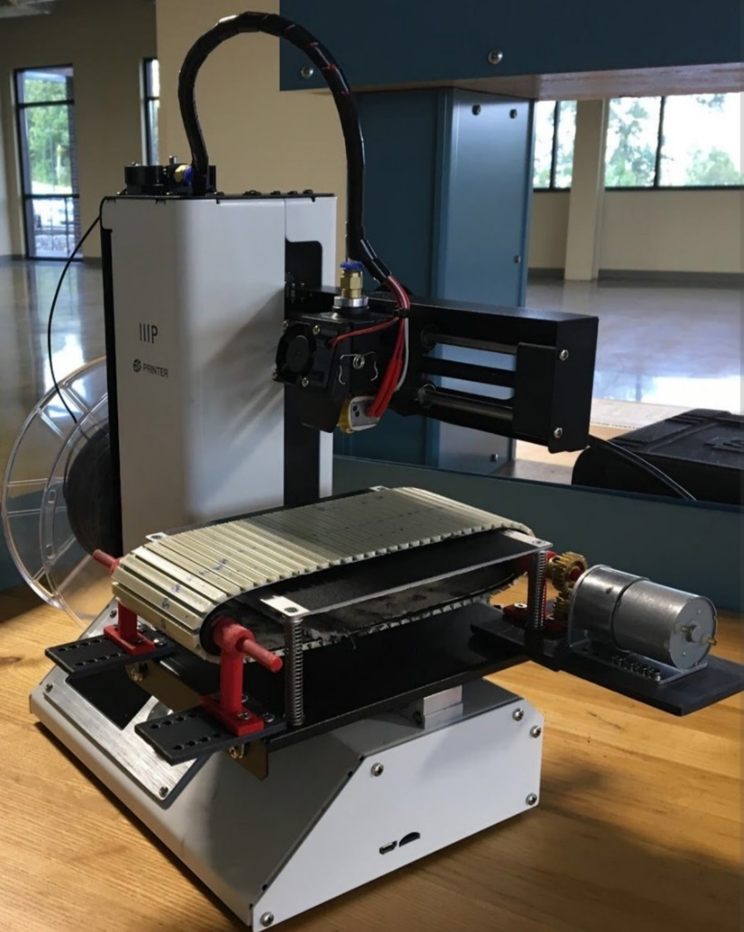
Elizabeth Andreyka – Mentor – Amy Elliott at Oak Ridge National Lab Continuous Conveyor Belt 3D Printing on Mechanically Captive Build Platform Junior in Mechanical and Manufacturing Engineering at Oregon State University
EERE National Robotics Internship Program
Impact
Elizabeth had done undergraduate research in robotics at OSU
She reported that she was not aware of the national labs and research opportunities there
She now plans to go to graduate school to study robotics

Slide 9
Conclusion & Next Steps in EWD for AMO
Workforce development is key to implement AMO’s mission
Next Steps:
Currently reviewing the complete education and workforce development portfolio in relation to AMO mission.
Revise, supplement and coordinate the portfolio based on analysis.

