Slide 1



Slide 2
MULTI-DISCIPLINARY TEAM
BIO-ENGINEERING
NURSING
SOFTWARE ENGINEERING
INTERACTION DESIGN

Slide 3
TEAM MEMBERS
DWAYNE WESTENSKOW, Ph.D.
Device Development, Clinical Monitoring, Evaluation
JIM AGUTTER, M.Arch
Interface Design, Clinical Monitoring, Evaluation
LARA BREWER, Ph.D.
Clinical Decision Support, Clinical Monitoring, Modeling
ALEXA DOIG, Ph.D., B.Eng., R.N.
Nursing Technology, Interruptions, Clinical Monitoring, Evaluation
NOAH SYROID, M.S.
Simulations, Clinical Monitoring, Software Eng., Evaluation, Modeling
DIANE TYLER, R.N.
Simulations, Clinical Nursing, Training
KEN JOHNSON, M.D.
Simulations, Clinical Monitoring, OR Technology, Military Medicine
BOAZ MARKEWITZ, M.D.
ICU, Errors, Clinical Decision Making, Clinical Monitoring

Slide 4
INTERFACE DESIGN

Slide 5
DESIGN GOALS
IMPROVE TRIAGE CAPABILITIES
REDUCE OVERLOAD
DECREASE RESPONSE TIME
INCREASE SITUATIONAL AWARENESS
DECREASE ERRORS

Slide 6
METHODS
Research
Understand constraints
Environment
User needs
Data
Ideation
Develop multiple ideas
Evaluate with users
Refinement
Refine interfaces
Implement
Evaluate

Slide 7
RESEARCH PHASE
USAGE REQUIRMENTS & DESIGN
AREAS FOR UNDERSTANDING
Environment
Nurse Roles
Nurse Tasks
Equipment
Data
Types of Alarms

Slide 8
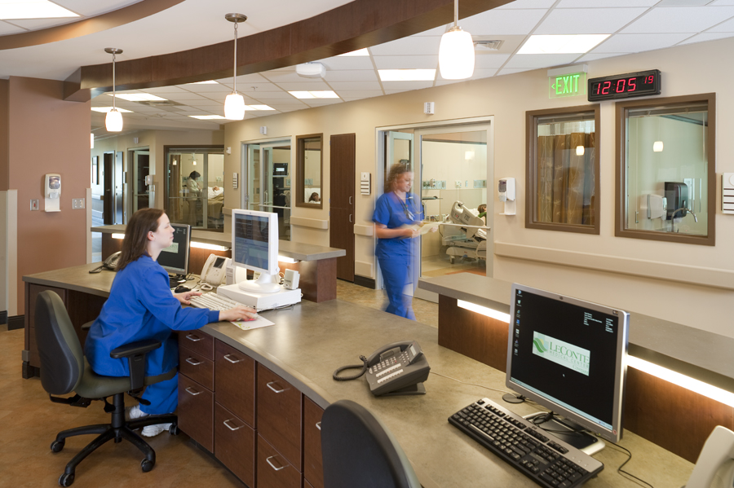
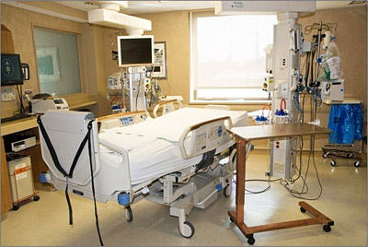
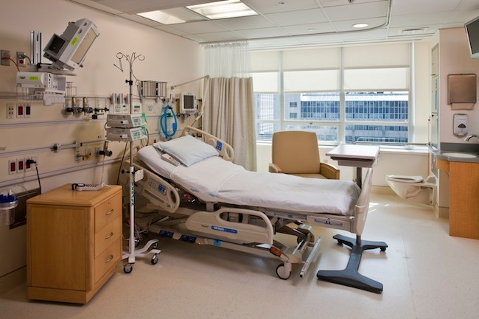
RESEARCH PHASE
ENVIRONMENT
Specialty Surgical Transplant Unit
Acute Internal Medicine Unit

Slide 9
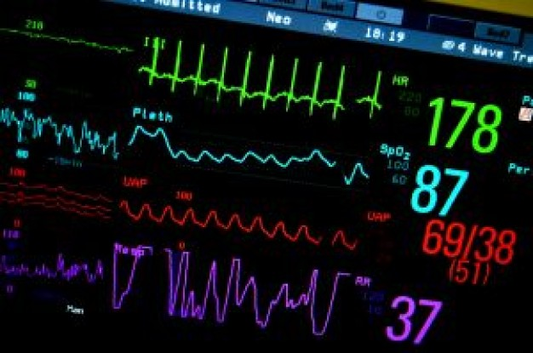
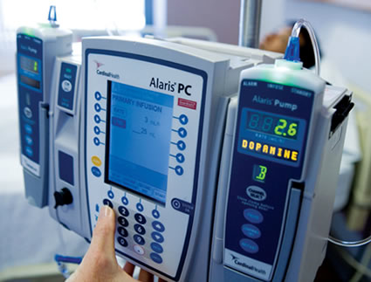
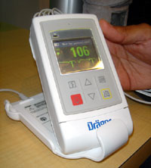
RESEARCH PHASE
EQUIPMENT
Patient Vital Sign Monitor
Patient Telemetry
Infusion Pumps

Slide 10
RESEARCH PHASE
DATA
HR
Blood Pressure
SpO2
RR
Alarms
Thresholds on Vital Signs Monitors
Infusion Pump Alarms

Slide 11
RESEARCH PHASE
ALARM TYPES
Patient Related
HR
  Blood pressure
  SpO2
  RR
Equipment Related
Battery low
Lead disconnected
Workflow Related
Infusion near complete
Notes:
These categorization is helpful for us to think about the issues. We are not addressing all issues identified nor testing but it helpful framework for future investigations. It also helps us frame how we might present information to the user.

Slide 12
IDEATION PHASE
METHODS
Semi Structured Interviews
Short Survey
Interviews to Elaborate
Systematic Review of Alarms
Develop Multiple Iterations
Refine Iterations Based on Feedback & Scenarios
Finalize Design Concepts

Slide 13
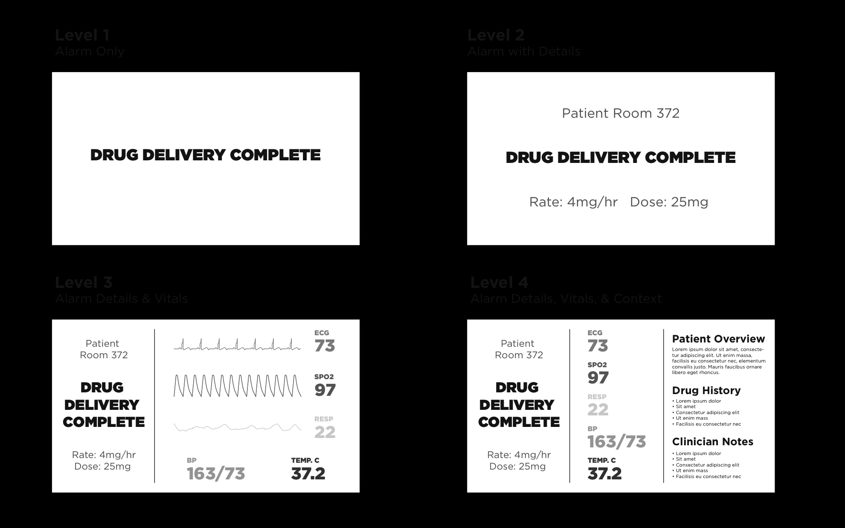
IDEATION PHASE
Notes:
These categorization is helpful for us to think about the issues. We are not addressing all issues identified nor testing but it helpful framework for future investigations. It also helps us frame how we might present information to the user.

Slide 14
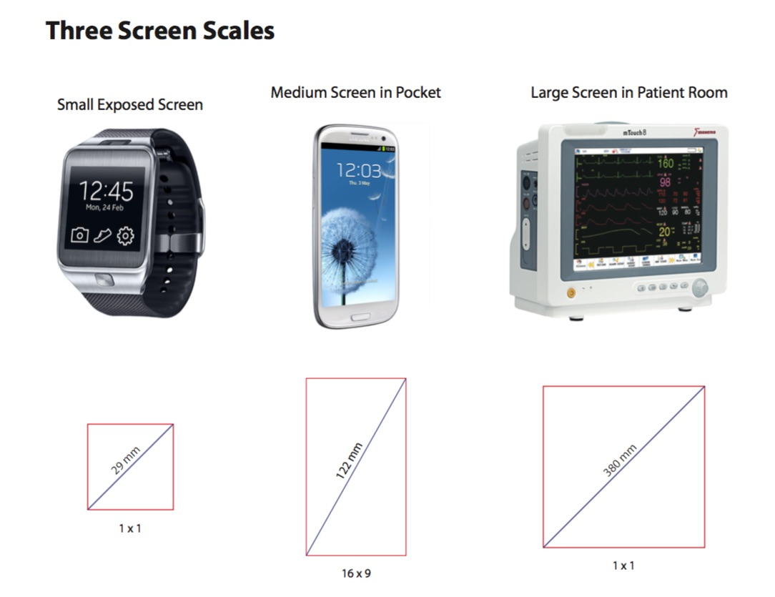

Slide 15
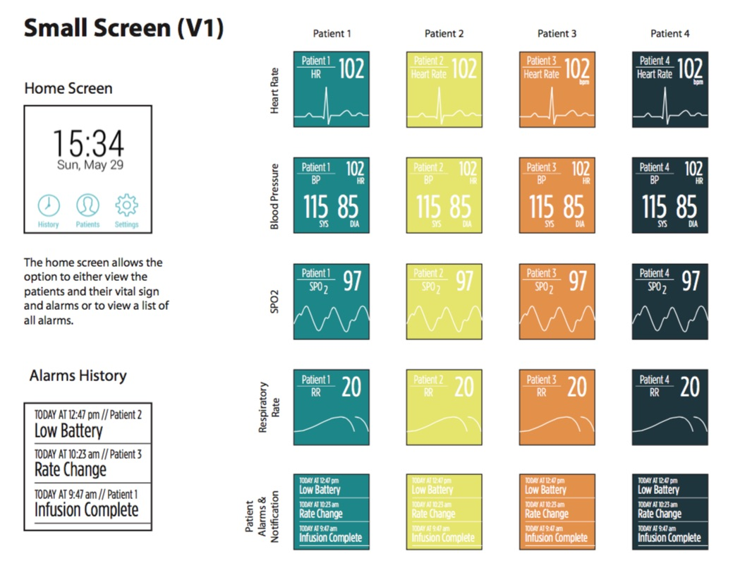

Slide 16
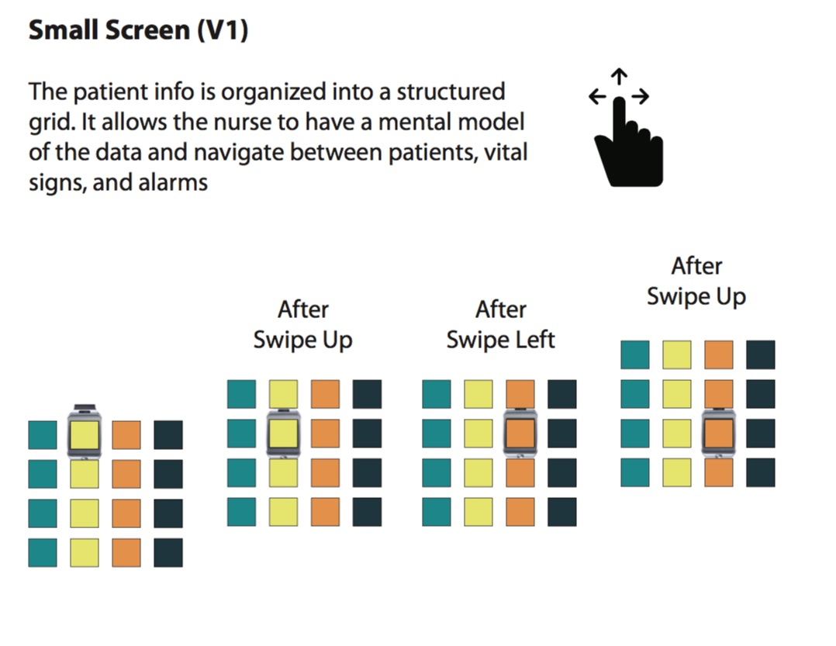

Slide 17
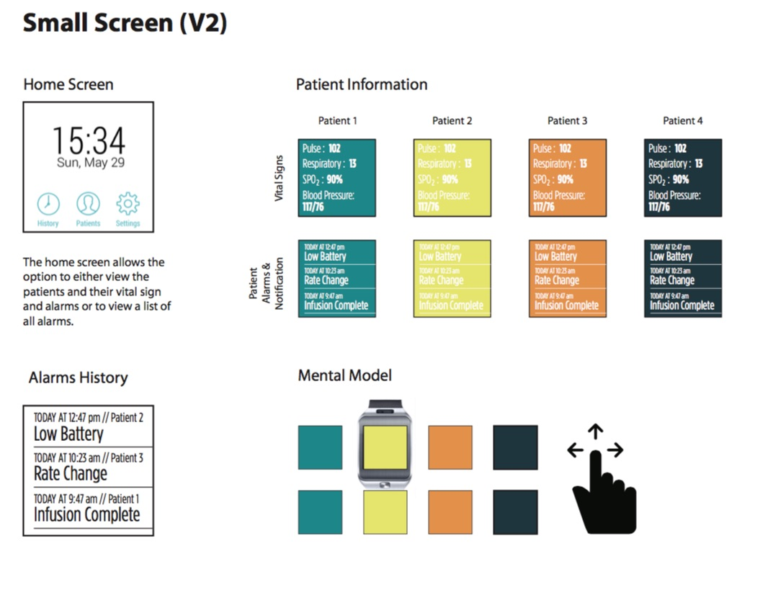

Slide 18
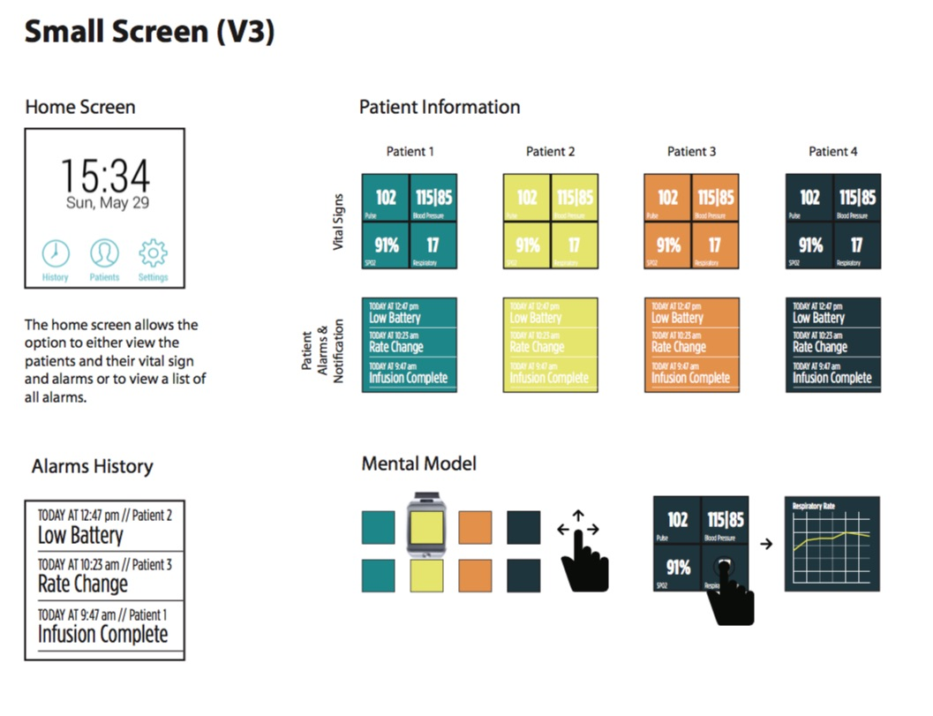

Slide 19
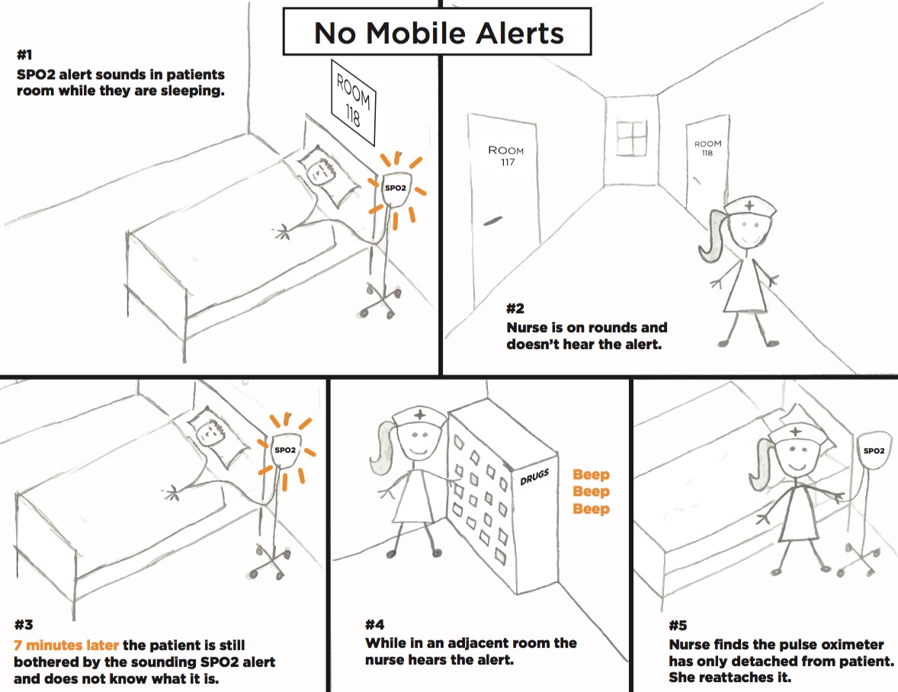

Slide 20
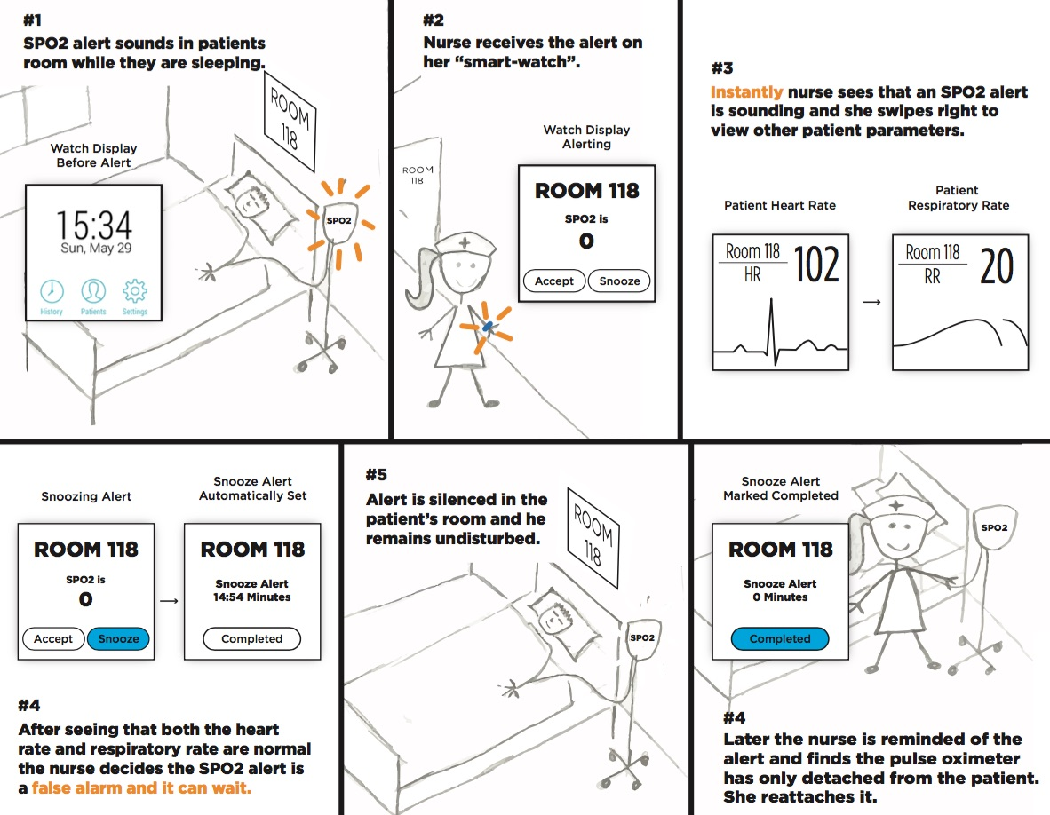

Slide 21
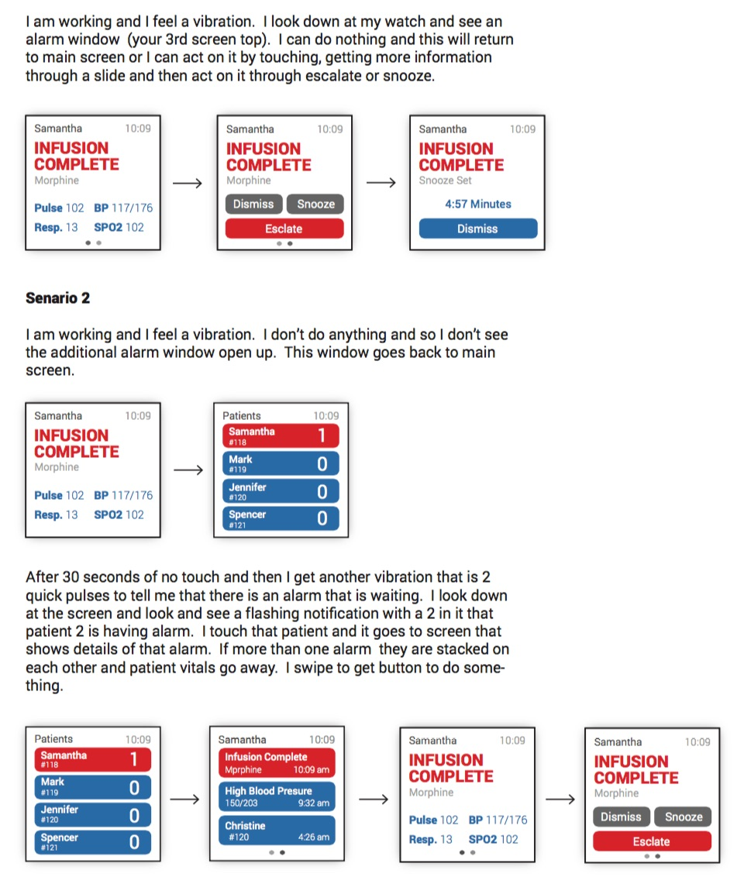

Slide 22
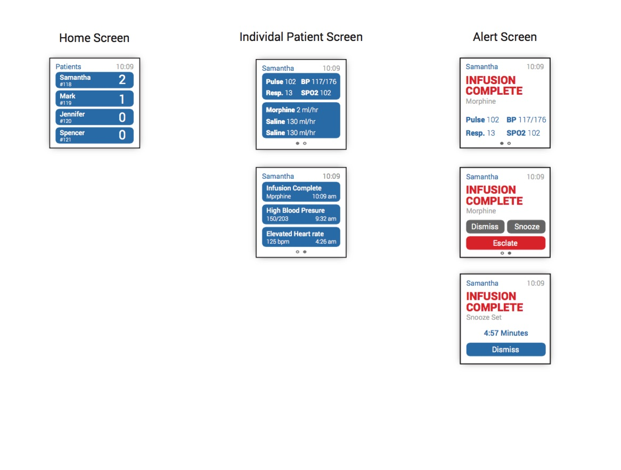

Slide 23
SIMULATION EVALUATION

Slide 24
SETTING
SIMULATION LEARNING CENTER
COLLEGE OF NURSING

Slide 25
PATIENTS
PATIENT 1 – s/p bowel resection surgery
Infection precautions, IV fluids
Developing sepsis
PATIENT 2 – heart failure exacerbation
O2 saturations keep dipping below threshold
PATIENT 3 – s/p prostatectomy
Patient controlled analgesia, IV fluids
PATIENT 4 – deep vein thrombosis
IV heparin infusion, IV fluids
PATIENT 5 – pneumonia
IV antibiotics
Difficulty maintaining O2 saturations

Slide 26
NURSING TASKS
Change of shift report

Slide 27
NURSING TASKS
Task List

Slide 28
CONFEDERATES
Interruptions
Environmental changes

