Slide 1
AI’s Emerging Role in Cost Estimating
2026 CECOP Symposium
August 11, 2026
Des Orsinelli, Senior Estimator
Lawrence Livermore National Lab Project Management Office
Notes:
Prep:
- Open Wishlist.
1.5 minutes.
I’m Des Orsinelli, a senior cost estimator for LLNL; I work in the PMO (Project Management Office).
I’ve been cost estimating since about 2003; the last 6 years of which were and are at the lab. Prior to then I’ve held positions as a design engineer for a rocket company, I commissioned rolling mills in China, Egypt, Indonesia and Brazil and was even as an 8th grade math teacher
Pardon that, I always like to share just a little about myself so you’ll think of me as a real human and not a robot [do a robot move]
The projects we work on are generally infrastructure – roadways, fences, buildings, parking lots, clean rooms, sound-proofing, etc..
Look, I have a sign up sheet [show it]. if you’re interested, at the end of this come up and provide your contact info.
Do you do any kind of infrastructure estimating? I’d like to get to know you. Can we not benefit from working together and sharing ideas and resources?
Because I’m sorry to say, I don’t know you. And worse, you don’t know me (unless you did a Google Search; even then you’re wrong because there’s a medical doctor in Maine with my name; and a VP for a management group somewhere. I’m sure my parents would be proud of me if I were one of those 2 people, but no, I’m an estimator.
That’s a joke, because cost analysis is a big part of any project, and in deciding which ones go forward and how.
Anyway, maybe we can create a SubCECOP for infrastructure estimators where we can share Best Practices and throw around ideas about AI.
BTW, if you’re watching on TEAMs my OUN is Orsinelli1
Setup – go to all slides with “realtime” in them – open and prep any applications/websites/prompts/etc.
Slide 1-12:NA.
Slide 13:Wishlist.
Slide 14:16-NA.
Slide 17:Open Mod6; open Claude or Gemini (I’m not sure which) with mod6 attached and prompt at the ready; Open super-table with blank columns for input.
Slide 18:20-NA
Slide 21:(Inv>DBS): [open Sage, place PPT side by side with Sage’s Dt John Doe Project 1,2,3] (slide 26 is also involved here I think)
Slide 22:29-NA
Slide 30: Prepared Gemini or Claude or Joulix (I’ll just have to pdf everything) “folder” and a prompt with a) spec for hvac equip b) equip list from a project c) prompt list? (watch the Joulix episode that uses folders) d) output template e) labor rates table

Slide 2

Agenda
Act 1: Introduction
Act 2: Documentation
  1 - The Governance Document
  2 - The Wish-List Brainstorm
  3 - Job Descriptions
  4 - Work Instructions
Act 3: Examples
  1 - Labor Rates
  2 – Normalizing bids to generate a unit cost database.
  3 – Getting Quotes
  4 – Artificial Peer Review - Quantity Takeoffs and Estimate package
Act 4: Summary / Final Thoughts
Notes:
1.75 minutes.
First, a quick introduction. We only have 45 minutes including Q&A with a lot to cover
For Q&A, a disclaimer: I’m not an AI or data-science genius. I’m just a guy who likes using the best tools. Ten months ago, when I submitted the original agenda, I assumed I’d be an expert by now. I did not; slow learner.
But I haven’t given up. If we work together, we can make this puppy sing, which AI can already do, as you likely know.
We’ll cover: [click] A quick introduction, followed by [click]
Documentation: Any system has a better chance of succeeding if it’s clear and written down.[click]
Governance: This assigns humans responsibility for AI outputs. We may throw coworkers under the bus, but chatbots are not eligible.[click]
Brainstorm a Wishlist: Exactly what it sounds like. [click]
Job descriptions: Think of AI as a very smart intern. The job description defines their role precisely and clarifies what the organization needs to do before the intern arrives. [click]
Work instructions: Checklists that combine the AI and human workflows, with guardrails and review points. Done well, they help new team members get up to speed quickly.[click]
Then we’ll look at examples: [click]
Updating labor rates [click]
Turning bid data into useful unit costs [click]
A story about getting quotes [click]
I’d also like to show how I use AI as a peer reviewer, but time is short, so that item got voted off the island. [click]
Finally, we’ll summarize and take questions. And now, [click] our introduction. [click]
1.

Slide 3
Act 1: Introduction
To Be (empowered) Or Not To Be.
Notes:
1 minute
Sorry to bring poor Shakespeare into the mix couldn’t help myself
So, how did my interest in using AI arise?
LLNL had an AI day; gave us free time to take scheduled classes and play with the AI platforms to see what they could do
During that time, I attached a set of publicly available dwgs to several chatbots and asked them for a summary of the scope described in those dwgs. They all did a more than decent job. Asked for a QTO – they did (not completely correct but they did). I even asked them to do an estimate based on local union wage rates available material cost data. And again, they did.
My interest was piqued & I was hooked. [click]

Slide 4
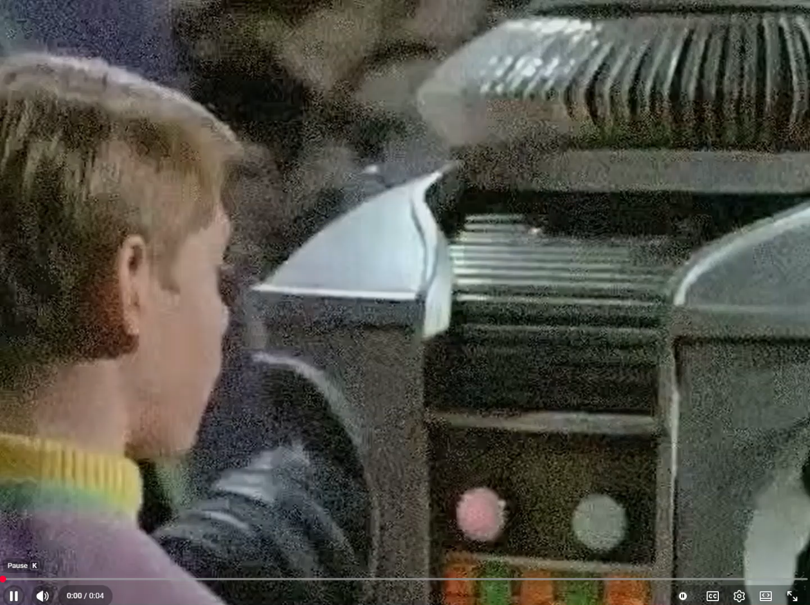
Danger Will Robinson!
Notes:
But before we get started, shouldn’t we be careful about employing AI in our workflows?
[click] wait a second whilst we hear “Danger Will Robinson, Dager” [click]

Slide 5
AI YI YI
Isn’t AI a danger to humanity?
Won’t AI make us dumber?
Won’t AI take work off our plate?
Isn’t it overly confident, error prone, somewhat random, hallucinatory, inconsistent and often guilty of downright lying with it’s people pleasing nature?
Isn’t using chatbots a security risk?
Notes:
30 seconds…to just click through
But isn’t AI dangerous, [click]
And won’t it make us dumb [click]
And take our job [click]
And isn’t it overly confident, error prone, somewhat random, hallucinatory inconsistend and often gulty of downright lying with its people pleasing nature? It was suggested btw that I don’t read directly off the slide, but this time I just couldn’t help myself. [click]
And,by the way, isn’t it a security risk?
Not to mention it uses gobs of power and water – steals ideas and works from the infinity we call the internet & is biased; c’mon. [click * 2]

Slide 6
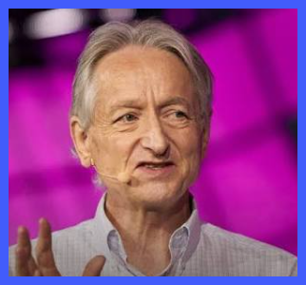
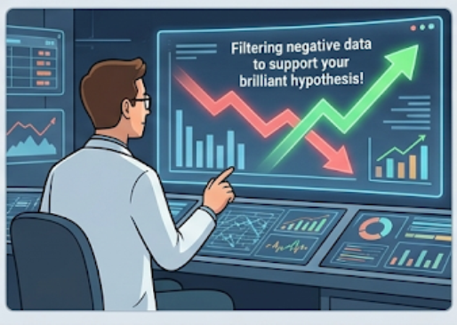
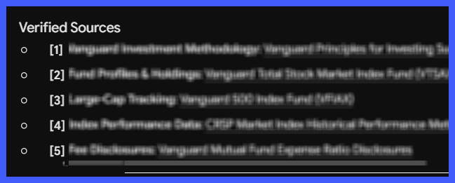

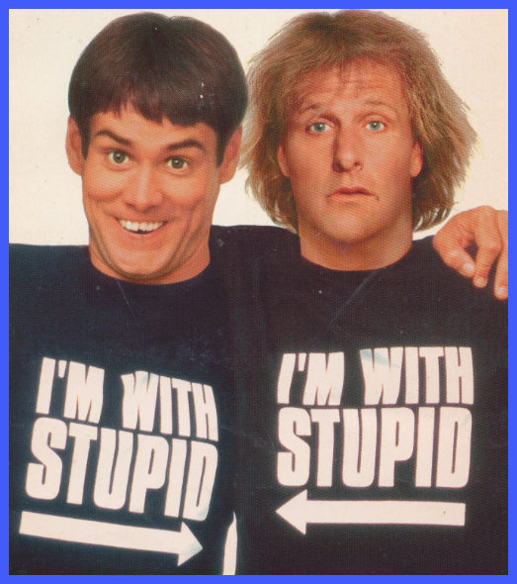

Notes:
Because, yes, it’s dangerous. Geoffery Hinton has spent countless hours after winning his Nobel prize and quitting Google, to warn of AI’s dangers. He’s not alone.
Mustafa Suleyman – whose book “The Coming Wave” reads like it’s time to throw a Hail Mary now.
Anthropic’s Dario Amodei quit chat GPT over safety concerns to start Anthropic as a safety first company; but now admits he needs to be restrained because competition with other platforms and countries makes it impossible to slow his pace.
Mo Gawdat’s book “Scary Smart” predicts straight up that something very bad is going to happen; then he says that on the bright side this will wake up humanity and we’ll do the right thing and put strict guardrails in place.
So yes. The future is cloudy at best. [click]
Sycophantic? I’ve heard these gems: “Great question!” “That is an incredibly sharp and evocative connection [he was talking about me; I mean he might have been right] He also compliments himself “here is a concise, clear and pertinent version of your draft email” [click]
Confident….and wrong. I needed to escalate a 3-year old estimate to today’s dollars and asked LivChat to provide actual historical escalation/inflation values. LivChat is LLNL’s own version of ChatGPT made to pass FedRamp requirement by, for one, barring access to the internet. I asked LivChat to provide actual historical escalation/inflation of each of the years 2023, 24 & 25 and provide a link to its sources. It did it! I looked it the 2023 link – yep – solid I think it was ENR’s Building Cost Index. 24, same thing. 25 same thing. I was about to plug these values into my estimate but then it hit me. Livchat training was cut off in Jan 2025. Therefore, how could LivChat have access to ACTUAL data after that. I asked LivChat, which gave a reasonable explanation. So I went to plug in the values again. Then….no, either your training ended or didn’t in January; and either we do or don’t have access through a live internet connection or don’t. After 3 or 4 proddings, it FINALLY confessed, it lied. [click]
Security breach – yeah, you never think you’ll attach CUI to a public chatbot; until you accidentally do. That one hits home. One of us accidently posted some confidential information to a regular (non LivChat) chatbot. The information was hidden in the back of a report that was attached to the chatbot to get some budgetary quotes for equipment that was in the front of the report. Nothing bad ended up happening but it was a pretty severe wakeup call. For something like 6 months we were not allowed to attach drawings to any chatbot, including Livchat (for which CUI is otherwise allowed). The silver lining, it led to us creating a “AI use governance” document that specifies what is and is not allowed; putting the onus squarely on the user of AI. More later. [click]
Making us dumber? A significant body of research does show a “use it or lose” relative to skills. For example, one study showed that after using AI to assist in diagnosis of colonoscopy data – AI improved correct diagnosis from 28% without AI to something much higher. However, if AI was then removed their detection rate decreased from what it was before AI (which you’ll remember was 28%) to 22%. In addition, there is no doubt many or all of us have a tendency to take shortcuts with AI, even when we shouldn’t. [click]
Will AI take your job? The standard refrain is Not anytime soon. But someone who is conversant and comfortable with it – Yeah, probably. Tell me, between 2 carpenters would you hire the one who uses a handsaw or an electric circular saw.
And the other issues, too, are real. Intellectual property; they’re working it out; maybe. The vast use of water and power resources. Yeah. [click]

Slide 7
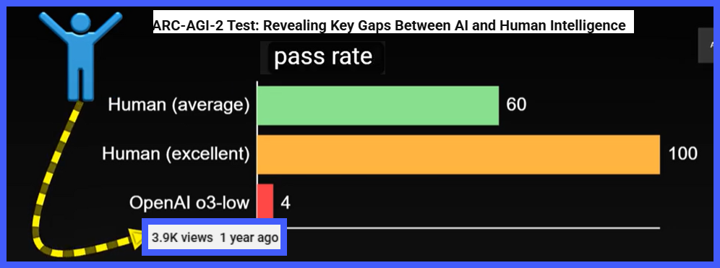
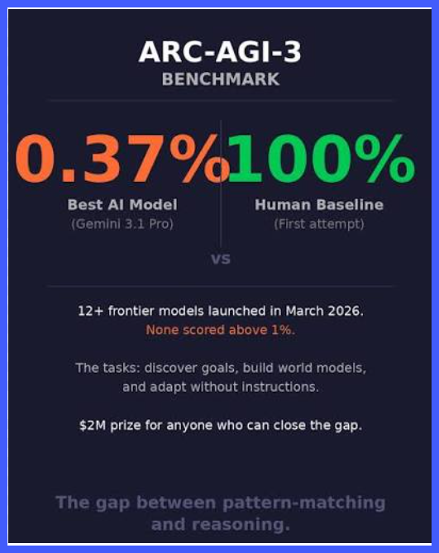
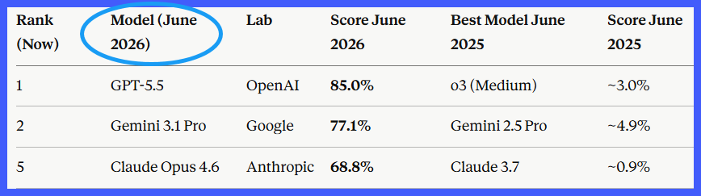
A Word On Just How Smart AI is getting
Notes:
1.5 minute
Just a quick word on where AI today relative to AGI (artificial general intelligence). AGI is where the bot EQUALS, generally, human intelligence across a broad range of tasks. [click]
* This ARC benchmark, is currently one of the most rigorous and highly regarded benchmarks for measuring true AGI
* ARC-AGI-2 tests focus on "fluid intelligence"—the ability to reason, solve novel problems, and adapt to new situations that the AI has never seen before and was not explicitly trained on.
* How’d it do on the ARC AGI-2 test? – a year ago the best of the best chatbots scored 4% vs 60% for humans.
*As of June 2026? [2xclick]
* 69 to 85% (again vs 60% average for humans because humans improve at the speed of evolution – S…..L……O…..W [click]
But wait, there’s more: a new ARC test, ARC AGI-3. While AGI-2 tests were like solving static picture puzzles on a worksheet, ARC-3 drops the AI into a video game without telling it what the rules are. It must push buttons, figure out the hidden rules, and win the game on its own. This is tailor made to hit AI where where AI’s sun don’t shine.
In Mid-July when I captured this screenshot, AI scored less than 1% relative to a humanity at 100%. As of 2 days ago last I checked, Claude Opus 5 achieved over 30%; and a specialized version of Opus 5 built for reasoning and inference (translate that word as logics) achieved 95.5%
You may know Alpha Go beat the human champion after being trained on millions of human played games. Then alpha Zero then became the world champ by beating Alpha Go after being trained on 0 human games, it was only given the rules of Go and allowed to play with itself. ARC-AGI-3 is given a game but is not even told the rules.. I’ll call it Alpha Scratch – win the game that you are thrust into without even knowing the rules [Gemini confirmed that’s a great name btw]
It’s not, “Are the bots coming?”; no. they’re here and among us. We no longer need AGI binoculars see them. [click]

Slide 8

Well?
So, yes, AI is a deep concern – in more ways than 1.
But is that a reason to put our head in the sand?
Notes:
½ minute.
[click, if needed until the ostrich shows] AI is scary and can dumb and numb the human brain. Maybe the Luddites got it right; maybe tech will be the downfall of civilization. But that bot has sailed my friends; get it “bot” not “boat” I’ve got a million of them.
But here’s the thing – it can make us smarter too; and expand the scope of things we can do to produce a higher quality, time-efficient estimate.
It can also prepare us to be a part of the workforce of the future and keep us informed so we can be a part of the conversation going forward. [click]

Slide 9

Ships in harbor are safe…
Notes:
Ships in harbor are safe, BUT that is not what ships are made for.
By becoming conversant in AI we can become part of the solution toward a global security. A security that is not threatened by us using it to create estimates. And as it is used to save time, improve productivity, quality and timeliness – it opens our time to be used for the things we’ve wishing we had time for. Well, we can have that time.
At LLNL, our forebears (and our current bear, the director Kim budhil) call us to thing in terms of Big ideas, to go for the fence, reach for the stars and try something new. Let’s do that.
1.5 minute
Ships in harbor are safe, but that’s not what ships are made for.
Especially for us who work in the nations premier laboratories, we were spawned from an attitude of thinking BIG, setting sails for discovery, and exploring new frontiers. We may fail; but the only ones who never fail are the ones who never try anything new.
Of course, when I say fail, I mean fail with appropriate guardrails. Like bowling has gutters; we don’t want, to stay with the analogy, for our bowling ball to jump over the gutter and kill all the other bowlers. That would not be the kind of “strike” we’re hoping for.
Jokes aside, I believe AI is just the kind of tool that can expand our workflows to do things we’ve always wanted to do but somehow can never find the time
So let’s move forward, become conversant, and be a spokesperson and participant of the wise use of AI.
This presentation will show a Methodology and examples of how AI can improve our organizations; especially if we team together.
At the lab, we’re in the early days of formally inducting these into our workflows. [click]

Slide 10
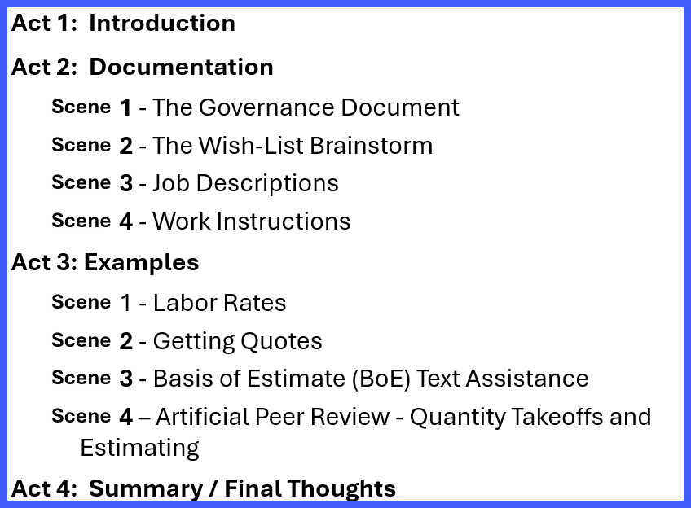
Act 2: Documentation
Notes:
¼ minute
. And now, act 2. [click * 2] documentation [click]

Slide 11
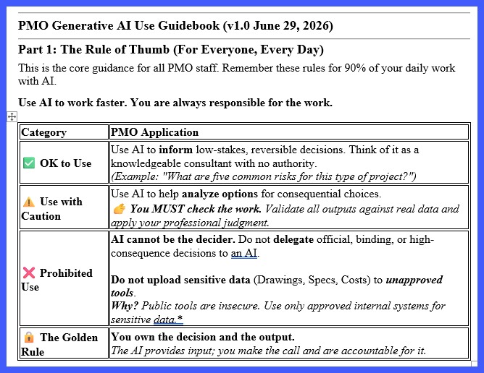
The AI Use Governance Document
Notes:
1 minute
The first document I want to zip through is our governance document. [click] It was borne, to a large degree, from the security incident I talked about. You might say the incident had a silver lining – first of all, nothing bad happened in the incident; and second of all it forced us to deliberate before something unacceptably bad happened; by publishing some controls. [click* 2]
A recurring theme of the document is this:Treat AI like an intern who has no authority. Great for quick research, brainstorming and peer review, but you never let it make final, high-stakes decisions. And never leak company secrets to public chatbots. You own the work, not the computer. [click]
4) Golden Rule There it is again – “you make the call and are accountable for it” . Oh, did I already say that? On the flip side; AI’s can do all the work they want; but we’ll always need a human to take all the credit.

Slide 12
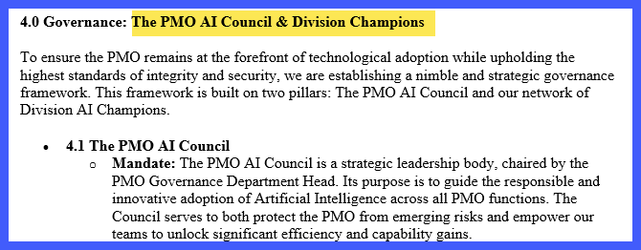
Notes:
½ minute
One last point, the governance document assigns each group (PM’s, CM’s, PC’s, DM’s and yes, estimators a person in charge of being the knower of knowledge; and the champion of AI workflows). I am, for example, the Estimating AI champion. Uh, there’s not trophy for that, it just means I’m Mr. Information Man when it comes to AI workflows.
Having said that, at the lab we’re still at the beginning of all this. I’m a champion? I’m a novice. [click]

Slide 13
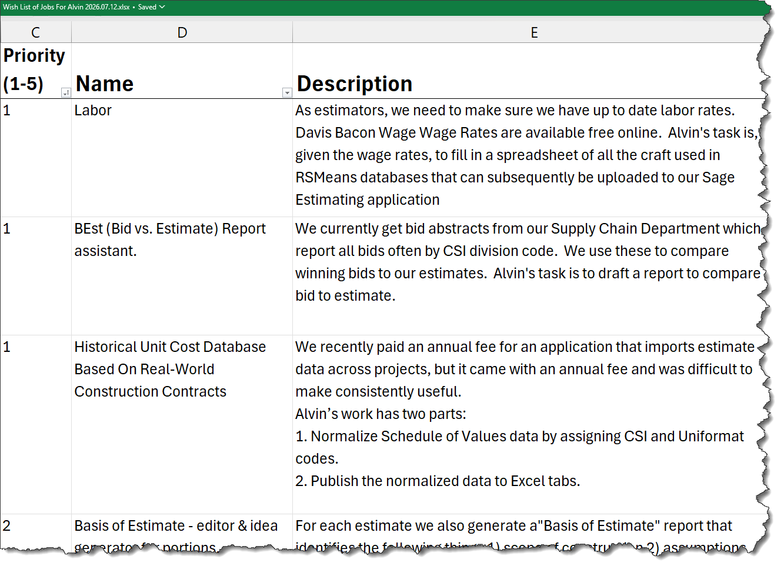
The Wishlist
Notes:
[Realtime?]
Let’s review the columns. First is the priority level; this is one you want to share with management and get buy-in. It’s been pretty clear in my experience that if your leadership is not rooting for you; you’re likely to fail. It doesn’t mean your leadership is responsible. You are responsible for convincing your leadership of the value. I’m not a terribly great salesman, but I’m willing to give it a try – because the tool is, I believe, vaster than we are currently imagining. Maybe we can make it a competition between labs, I don’t know. “Hey boss, guess what Oak Ridge is doing that we’re not”. By boss played football for Stanford, so he’s got the competitive spirit. Of course, he’s listening in the audience and now he knows my game-plan. Like I said, I’m a lousy salesman.
Description – a very brief summary of what AI is going to do for you.
Prep work (not shown, it wouldn’t fit) – this one is important. Many if not most of the time, you best not employ ai until you have your ducks in a row. E.g. for labor rates, RSMeans has a craftsman named “common laborer”. The prevailing wage resource has 100 wage rates that might fit that description. Which do you use – more later. Another example, you want to use actual bid data to create a database of real world unit costs. Well, that means you got to reach out to your supply chain / purchasing department and get the actual bid data; and/or the contractor’s monthly invoice. You can’t get real world costs without the real world costs. How’s that for being real with you.
[only if Excel Wishlist is available] Now let’s walk down the list…
One last thing – This spreadsheet is a brainstorm. After you, the human in the room, have brainstormed, don’t stop there. Real-world [Demonstrate asking an AI to provide suggestions] (if possible, display prepared prompt and ask Claude.
The question to ask yourself is “If I were allowed a bright summer hire, what would be the kind of things I’d like him or her to do.
In fact, what if I were given as many summer hires I had time to manage?
Here’s the kind of things we’re in the process of having our assistants doing. (open xls).
If I can: Alvin, make me a list of awesome things you could do (this will be a theme). BTW, I call my A.I. Alvin T Siscob the 3rd 3^{rd , or Alvin for short}

Slide 14
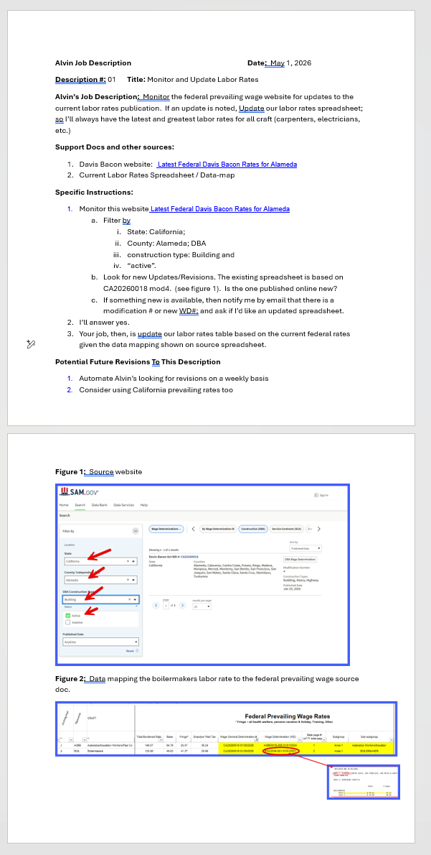
The Job Description
Notes:
OK, we have made a wishlist. Of course, that alone is not enough. I need to let my AI interns, whom are all called Alvin Ivanovich Siscob the 3rd btw, know what it is I expect of them. The more exact the better.
I’m only sharing one, but I have a job description for every current wishlist….wish.
[review the image]
BTW, when you’ve completed what you think is a good job description – have your favorite intern Alvin look it over and provide feedback.
How I like to think of this document is this. If I die and someone needs to take on my role as manager of these AI interns – that person needs to know what I want Alvin1 Alvin2 and Alvin so on to do.
We’re just about ready to try out an example. One more doc first… [click]

Slide 15
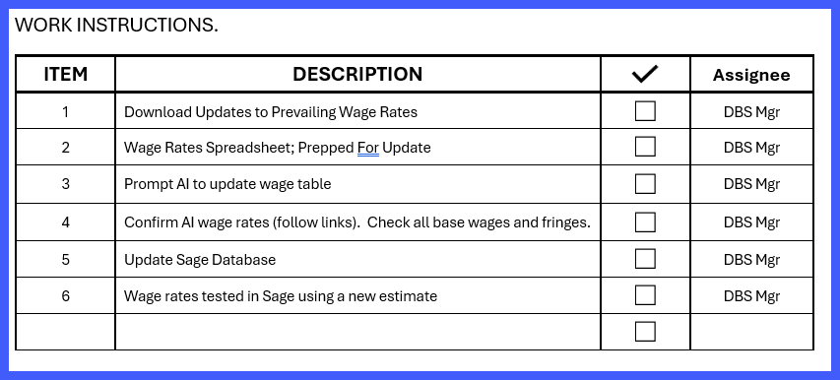
Work Instructions - HITL
Notes:
Presentation Speaking Points:
The last page of each Job Description is an appendix for the HITL. It’s a checklist of sorts to make sure one covers all bases.
I propose that we include in our backup for each estimate a printout of these checklists & that any peer / chief reviews confirm they’re checked. The benefits are multiple, the most obvious perhaps being that we at least make a show of not trusting AI; but also as leverage toward avoiding becoming dumbed down by AI by playing an active responsible role in the output. This is meant to remind us not to take shortcuts.
Will this keep us from taking shortcuts and trusting Alvin too much? It’ll probably work for me; most of the time. But I don’t know. Like I said, we’ve only just begun. I need your help, sign up. [click]

Slide 16
Act 3: Examples - Labor Rates
Notes:
OK, now for some meat and potatoes. Hmmm, after lunch, that was probably not the best metaphor. “Great more, more meat and potatoes? Good night sir! “[click]

Slide 17
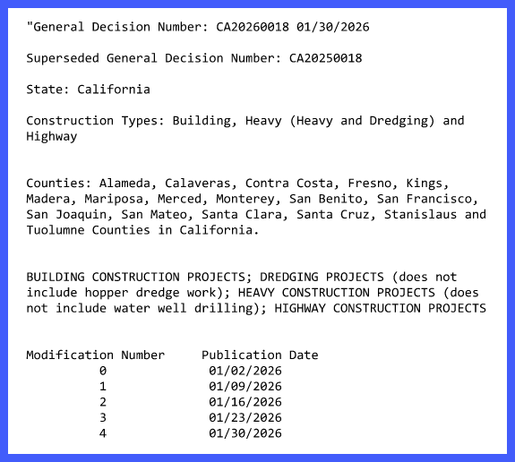
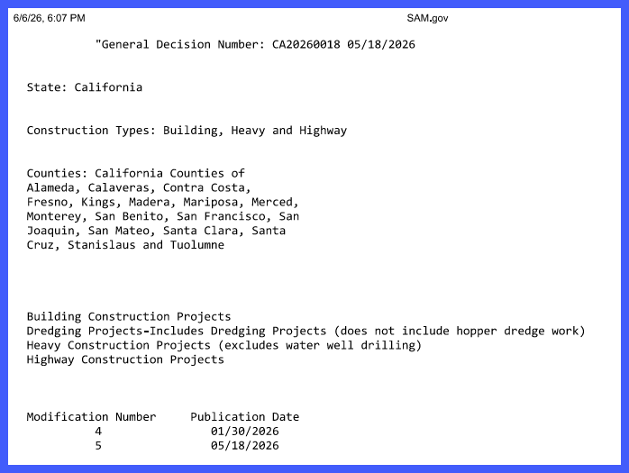
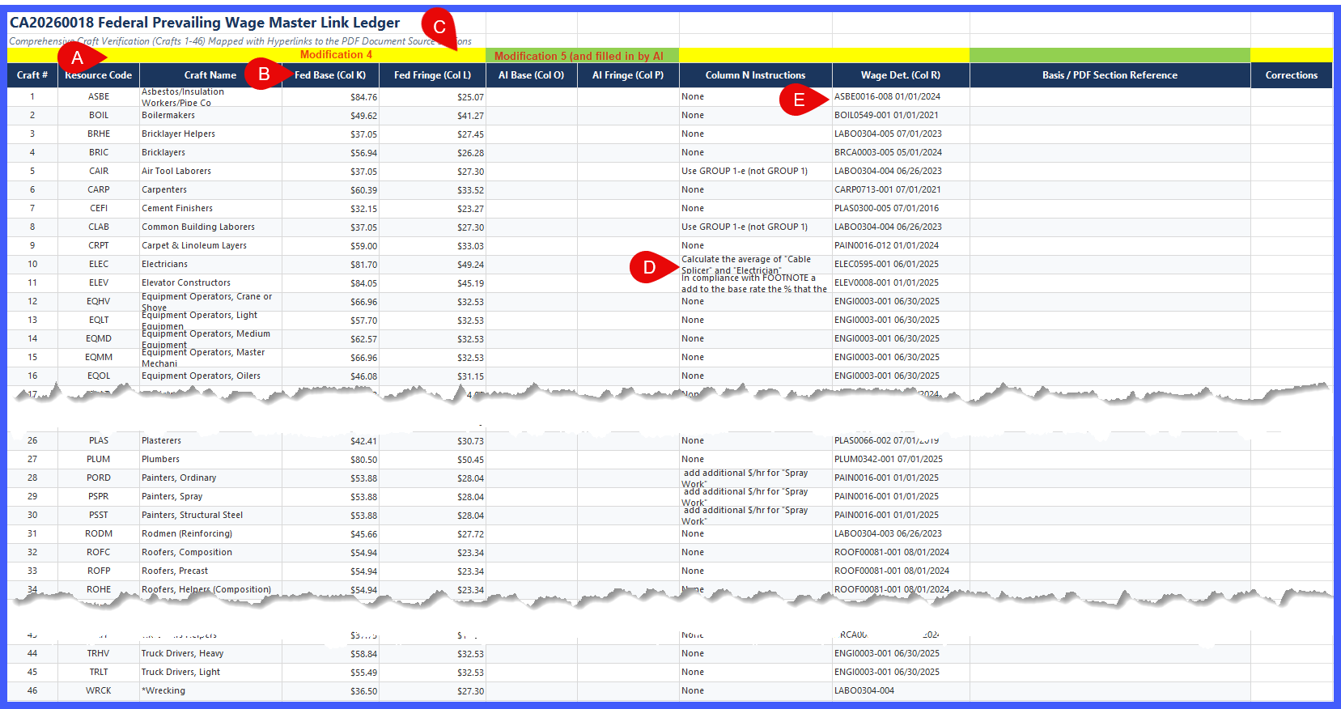
The Labor Rates “Supertable”
Notes:
REALTIME: open Mod6; open Claude or Gemini (I’m not sure which) with mod6 attached and prompt at the ready; Open super-table with blank columns for input.
-So, if we’re going to do accurate estimates we need accurate wage rates correct? [click]
-And given we’re contracted to a federal agency, to comply with the law we must pay what’s called Davis Bacon “Prevailing Wage Rates”.
-If you’ve not heard of these wage rates no problem. Periodically, government agents go out and find out what prevailing rates are out there in the real world – then, any federal contracts you cannot and shall not pay less, ever, end of story. How do they find the prevailing rates? In California at least, they interview unions, that’s what they do.
-The “general decision” that applies to us (our county, and our type of work) is as shown. [click] Modification 4 came out early this year.
[click*2] -Mod 5 came out in May so it might be a good time to update our rates. But wait, I hear you say, maybe we can have Alvin do this. [click]
Here’s the spreadsheet I attach to ChatGPT, Claude, Gemini whoever I’m inclined to talk to that day (this is publicly available info so it’s no problem). Let’s go through the A thru E pointers. A – the resource code and Craft Name are right out of the RSMeans database playbook. BOIL is the code for Boilermakers in our estimating program. B – The total rate is the base wage rage and C – is the fringes (including vacation, health insurance, etc.). Those pointers are pointing at the values I’ve already generated from the modification 4 prevailing wages. I want Alvin Ivanovitch to fill in columns O &P with the mod 5 values. Things get interesting at D- check out the instructions column – here is where I give Alvin Ivanovich specific instructions. Look at line 5 – the instruction is to use group 1-e not group 1. First, I have to admit something, so the spreadsheet would fit I hid a column titled “Craft Name” for Air Tool Laborers there is both a group 1-e and 1 and they both have rates. Why did I have that instruction in there? Because Alvin our AI intern, failed me before by selecting group 1 and not 1-e, that’s why). Electrician is the average of splicer and electrician. Wait, you’re asking, are you telling me we can have Alvin search a pdf (the pdf there in the background), find these specific crafts, find their base and fringe wage rates and do an averaging calculation? We’ll see! I also have instruction for AI to add the Spray Work adder for painters. That is, the wage determination document at the paragraph PAIN0016-001 has a sub-note. It says add 50 cents for painters who are sprayers. I guess folks that use rollers and brushes are considered losers who don’t deserve a bonus. Look at pointer E: I also give AI the “Wage determination paragraph number so AI knows exactly where to go in the determination. ASBE0016-008 is a union designation for asbestos workers, the last agreement is Jan ‘24 but is still good.. Well, Can AI fill in columns O and P for me? [click]

Slide 18
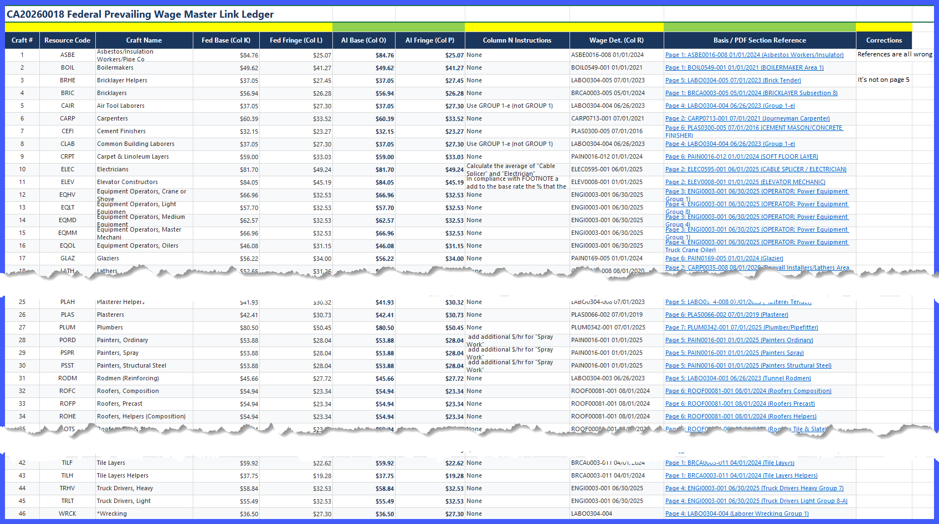
Notes:
Todo: There’s a mod6. If at all possible, run a trial on mod 6 to see if there are changes.
Yep, at 98% (and on second try 100%).
Not only that it included a link (because my prompt asked it to) so I could just click the link and see if it got the $ values right in my sanity check of its output.
It got all the $values right (in the 2nd try, the first try it did not add the “spray paint” adder to 2 of the 3 painting craft.
The links are incorrect – the look like they go to the exact page where I’d find the wage rate – they all go to page 1.
Other than those it was spot on.
If AI were human, I’d stand up and give it applause. But it’s not, it’s just a bunch of 1’s and 0’s placed in just the right order. Right?
[assuming I can do real-time] but wait, there’s more. You may not have seen it when I visited the website, but there is a mod6 out, published just a few weeks ago. I have not asked AI yet to update the spreadsheet. Would anyone like me to give it a quick try now? (wait 5 seconds. If no-one responds say “I get it; lunch is weighing on you. It takes internal resources to turn that pastrami sandwich and chips into body fat, Long ago, I read an article, when the stomach is full, the blood flow preferentially flows to the gut. You’re all a little light-headed. We’ll just move on to the next example) [click]

Slide 19
Act 3: Examples – Normalizing Bid Data
Notes:
…and now for our 2nd example; Using AI to help normalize bid data and generate a database of real world unit costs.
Let’s start with a question – would you like to be able to compare your estimate with the bids when they come in?
…and beyond that, would you like to take project invoice data (also known as a PayApp, or Schedule of Values; that is, it’s a costed list of items that together make up the whole project. This is what is used to pay the contractor monthly based on what they got done that month; and provides potential insight into how much contractors are actually pricing the items in your estimate.
You don’t have to say it; that would be cool; I can read your tired minds. It will not be easy, I think, even with AI (and I’ll show some reasons why) but it would be cool, man!
There are software out there meant to do this. We’ve been paying $28k a year for a software meant to do this; but we found it hard to populate with project data and it was rarely used by us everyday estimators and we’re planning on stopping our subscription. Now, we hope, Alvin Ivanovich will save us the annual fee, and help us generate real world unit costs for “free”. Let’s see how this works. [click]

Slide 20
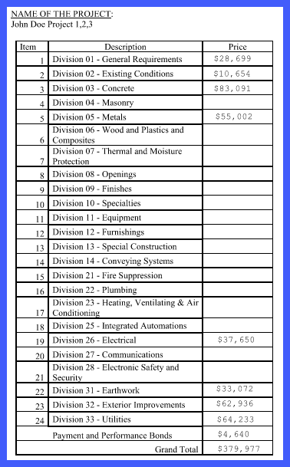
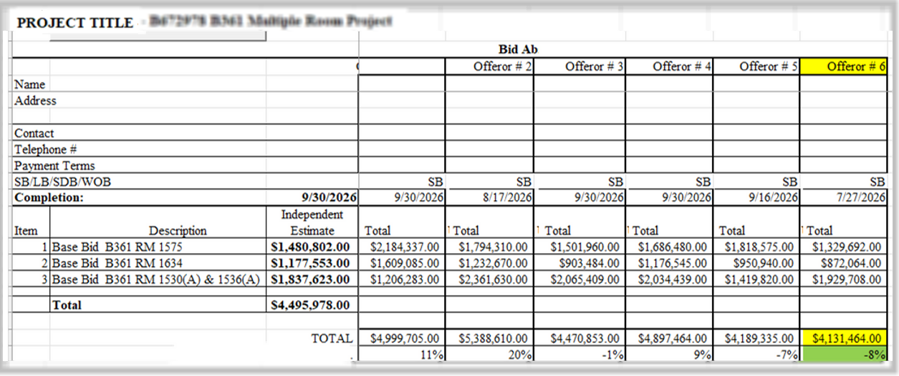
Normalizing Invoice Data For Database Use
Notes:
At LLNL we have a relationship with our Supply Chain/Purchasing department. They’re great. We receive 2 documents from them for all projects that we’re both involved in.
[click]
The bid abstract – which is a list of bids from contractors and their bid. It’s got the low bid, the high bid and everything in between &….
[click]
The invoice. This is a very simple one just to kind of show you how we work with this. I don’t like it because it’s by division not by individual cost items (or, to make it less bulky, but Uniformat which groups items into what might be though of as assemblies. A concrete slab on grade assembly, instead of separate items for concrete, rebar, forms, etc.
Anyway, this one, given it’s short and sweet will do for us today as a proof of concept. [click]

Slide 21
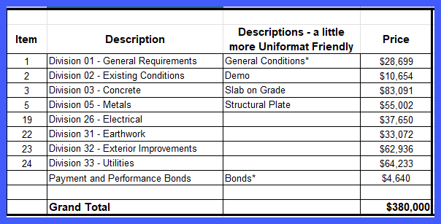
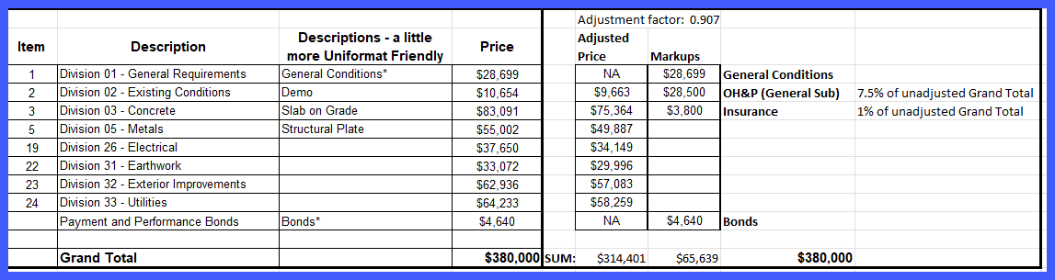
Normalizing Invoice Data For Database Use (Human Version)
Notes:
[first time at this slide]
1. OK, so here’s a brief journey on how a human (that’s [show “air quotes”] me) normalizes invoice data without the help of AI. [click]
2. first I create an excel version of the pdf. Sometimes my Bluebeam pdf software can export to Excel but more often it cannot. So, this I do by hand. [click]
3. Then I add some columns. To normalize these $ values so they match the look of our estimates we pull markups off to the side. Now I have a column for [click] direct costs and another for [click] indirect costs. Our markups are general conditions, overhead and profit, insurance and bonds. [click]
4. General conditions – we just moved it from the left to the right column. It was $28,699 on the left and it’s still $28,699 but now it’s on the right. [click]
5. Same with bonds, it’s $4,640 on left and right. [click]
6. Now, notice that the direct items, for example concrete slab on grade (notice I changed the div 3 concrete to “Slab On Grade”, I had to go into our estimate to confirm it was a slab and not a wall but it is what it is), the costs drop in going from the left to the right column. Why? It’s to feed our other 2 markups, overhead and profit and insurance. That is, our estimates have OH&P and insurance, the bids don’t. So we need to feed OH&P and insurance values with a bit of each direct item, namely, we reduce the direct cost by 7.5% to feed the OH&P markup and 1% to feed the insurance markup. That’s why concrete S-O-G, for example, goes from $83k to 75k. The $83 includes the bidder’s insurance and OH&P The $75k does not (because we placed it in the right column). This is what we call normalizing the bids. So that’s the human doing the work – several hours assuming things go well. Way more for a complex job with a lot more pay application items; the one I’m showing is the simplest one I could find. Keep it simple; time is of the essence; life is good; but it’s uncertain so eat dessert first. Anyway, the bottom line is [click*2] $380k on both the left and right so we haven’t changed anything just put the money in different buckets. That the preparation step. The next step will be to revise our estimate so on a division by division basis, our estimate equals these invoice values, like 55002 for metals for example. But first let’s see if AI can do the human work I just showed.
[click gets to next slide]
Part 2 notes (coming back after slide 26).
Slide 21 (Inv>DBS): [open Sage, place PPT side by side with Sage’s Dt John Doe Project 1,2,3]
Now, if I can, I’m going to open up Sage and PPT side by side here [do it]

Slide 22
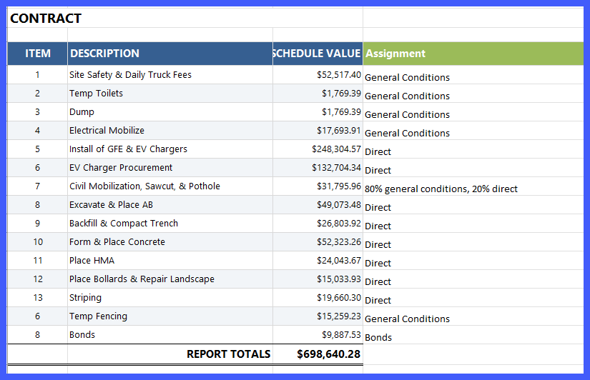
Can AI Adjust A Table If Given An Example?
Notes:
So, here is another invoice. This time I’m going to ask Alvin Ivanovich to normalize the information.
First, I’ll ask Alvin to create me an Excel spreadsheet from this image (yep, it’s just a jpg). You might recall that AI, so we’re told, cannot read lines or circles or pixels; it reads text and responds with text one probable next word followed by another at a time; at least that’s how it used to be)
Second, I’ll ask it to copy the bonds (that $9.9k there) to a separate markups column like before; and also ask it to sum up all costs I’ve assigned as “General Conditions” (because that is what “Site Safety, temp toilets, etc are, general conditions) and to paste that to the markup columns. This is like the human did before, except it’s a little more tricky. We’re asking it to sum costs; including taking just 80% of a cost leaving the 20% as a direct cost with the 20% remaining on the left.
Now, my first runs of trying this failed like bad haircut (I have a bad haircut story to tell, hit me up afterward. I think I need to tell it). But then, I thought, what if we attach an example to Alvin. What if we attach our human created normalized spreadsheet as an example to show Alvin what we want?. So we’ll have 2 attachments – an image of our new invoice (as shown here). And a template of how we like to see the the normalized results reported. Think it will work? [click*2]

Slide 23
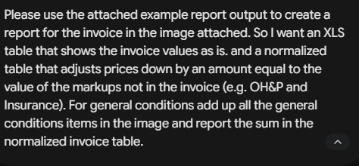
Test Case – Can AI Follow An Example?
Notes:
And here is my prompt. The keywords are “use the attached example” and “I want an XLS table of the invoice as is”
Look, I know this is hard to follow in such a short time. I’m actually trying to put you to sleep. You’ll thank me later. When your spouse or friends ask how it went, “rejuvenating”! [if they laugh, stop laughing your energy is needed for digestion. At this rate, you’ll never get the rest you need. [click]

Slide 24
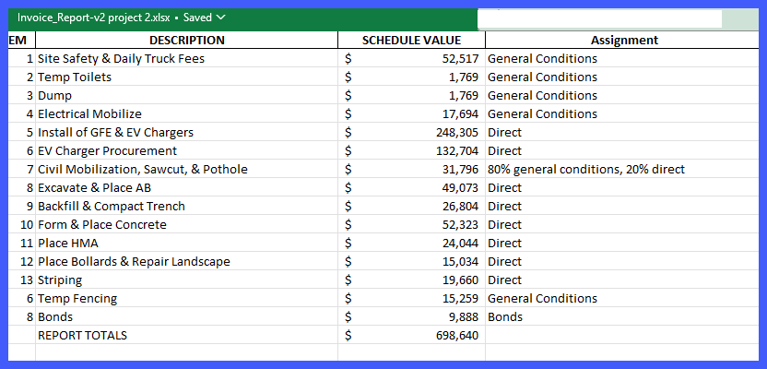
Test Case – Can AI create the adjusted table?
Test Question 1: Can it look at an image (a jpg) of the invoice and create an identical XLS version
Answer: 100%
Test Question 2: Can it create an adjusted cost invoice
Notes:
So how did it do in generating an XLS from an image? [click*3] It got it 100% right. Shown is a Microsoft Excel file built from nothing but the image. I don’t know about you; but 4 months ago, AI wouldn’t do this for me. It still won’t in LivChat and Joulix, but it does in Gemini (the one I used for this). [click]
Now, how about question # 2; can it create a normalized cost invoice, if I give it an example to model itself after? [click] And specifically, can it handle applying 80% of the $32k civil item as general conditions, and 20% of it as direct and then steal a little bit from the direct cost to feed OH&P and insurance markups? [click]

Slide 25
The Overall Work Instruction
Prepare the Invoice:
  Export Invoice from pdf to .xls (AI)
  In Excel: Create Normalized Breakdown (AI)
Prepare Sage and export to XLS (all Human);
  Create a duplicate copy of the estimate in Sage; Create an Invoice Work Breakdown Structure (WBS) column.
  Assign an WBS Invoice item to each estimate item; Sort by Invoice WBS; Spread cost for each invoice item; Update Sage Markups.
  Export to XLS (the database)
Review and finalize
  Sanity check unit costs. (AI + Human)
  Add Uniformat code (AI)
  Publish to LivIT list of documents available to all lab employees.
Notes:
Sorry you’ll have to wait; I’ll let you know in a second how AI did; but first I want to share the overall goal of what we’re doing here.
As I said let’s, take the invoice and make it an Excel invoice, then normalize the invoice so it looks like the way we do estimates.
But what do we do with that? To answer that, we need to talk about the estimating program we now use at the lab – Sage estimating. In Sage, we’ll open the estimate that was generated for this project. Since it was created before the bids and invoices arrived; it’ll have our estimate of costs not what’s on the invoice. We’ll do a Save As with the estimate so we don’t mess with the original, and give it a name of something like “Normalized Estimate Package for project Yadda Yadda”. Essentially, we’re going to create a work breakdown structure that matches the invoice. Now assign to each item in the estimate to match an item in the invoice. So, for example, one would assign to the asphalt items in the estimate the WBS “HMA” (which stands for hot mix asphalt). This has to be a human activity, for now, because our Sage application at this point, is not AI friendly.
Now sort the estimate by the invoice work breakdown structure of the invoice. In the estimate, each WBS item will show a subtotal. Like I said, it will be different than what is in the invoice because we haven’t changed any pricing in the estimate yet. We’ve only assigned each estimate item to an invoice item. So we then “spread” the invoice cost among all the estimate items that are assigned to that invoice item. So, for example, if the HMA is double in the invoice than the sum of all HMA items in the estimate – then double each item in the estimate – and there you go; the estimate is now normalized to the invoice. I’m sure this sounds very complicated and I’m sorry. But it’s actually very fast to do in Sage.
Once we’re done normalizing the Sage estimate we can export that to Excel and publish it so that it is available to us for all future projects. We can publish it, too, more formally to a list of LLNL Data that anyone that uses our LivChatbot (which is everyone at the lab, I think) [click]

Slide 26
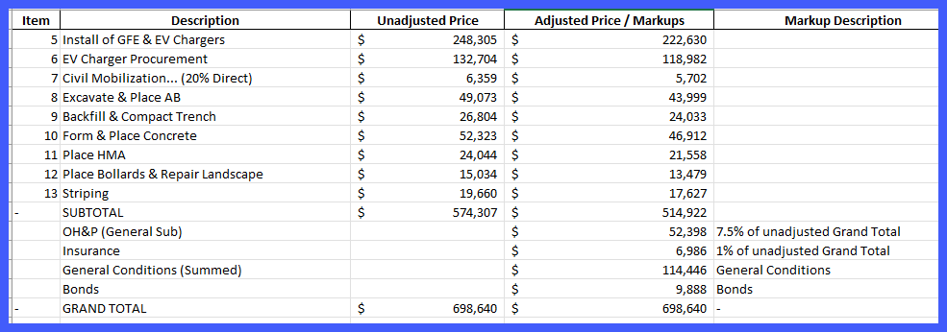
Test Case – Can AI create the adjusted table?
Answer: 99%
Notes:
The answer is, drumroll please. [click]
It got 98% right (I gave Alvin 99% though just because he’s a good friend). [click]
Look at item 8 for example, for excavate and Place AB, ag base, it went from $49k down to about $44k. The $5k was distributed to OH&P and insurance just like I asked. In addition, all the general conditions are summed up, including accurately taking 80% of the original civil mobilization item.
Look at item 7. On the original invoice this was $31,800, now it’s $6,359. That’s because I asked Alvin to move 80% to general conditions. The $6359 is the 20% remaining. It then is reduced to 5,702 to pay the OH&P and insurance items. I would have like AI to change the name from Civil Mobe to Sawcut pavement but maybe that’s asking too much.
Notice too it took out all the general conditions items; the figure has no GC’s in the list. They were summed and place right where I asked – as a $114k and change markup.
So why did I give it a 98% not 100%. [click].
Because the subtotal in the unadjusted price is $574,307, which somehow becomes $698,640 grand total. If Alvin had just copy/pasted the GC’s of $114k and Bonds so it was in both columns it would have been closer to 100%.
Anyway, the adjusted price/markups column are now normalized division level costs! Still, we don’t want division level costs we want unit costs of individual items. That’s where, as I stated before, we spread the cost in our estimate among all items that belong to that WBS category. That is, if HMA in the invoice is double the sum of HMA items in the estimate, then double each item.
REALTIME: So, to demonstrate this let’s take 2 seconds and show you in realtime how we’d do this in a real estimate [prep Sage and Bluebeam or Snagit side by side]

Slide 27
Act 3: Examples – Quotes
Notes:
We’re running out of time; one more quick one; a lessons learned one, if you will. [click]

Slide 28
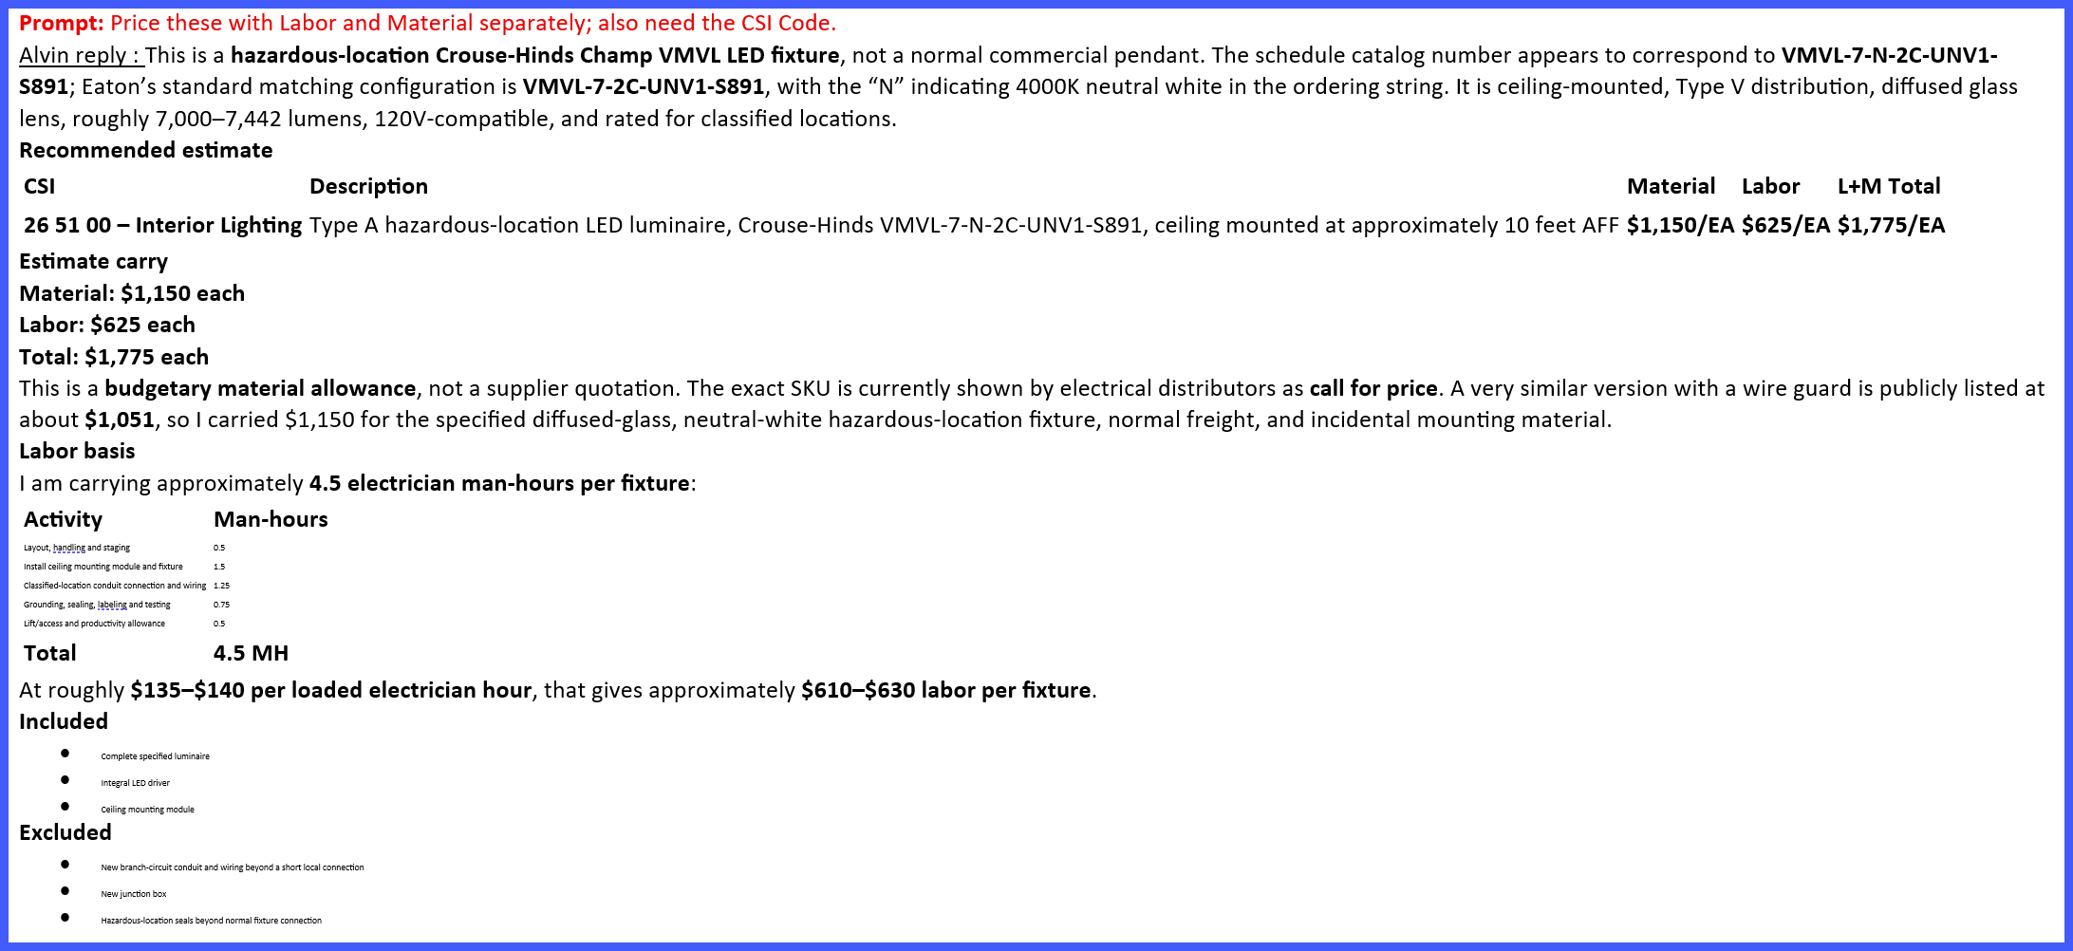
Quotes – a cautionary tale
Notes:
This actually happened. Note that the prompts (in red) [click] are summarized not the full original prompt. For example, for this prompt the make and model number was included in the actual prompt.
Long story short – Alvin quoted the material at $1150 [click].
It even does a good job of explaining the basis of the quote. Looks good! Right? (you look skeptical). [click]
But wait, there’s more.

Slide 29
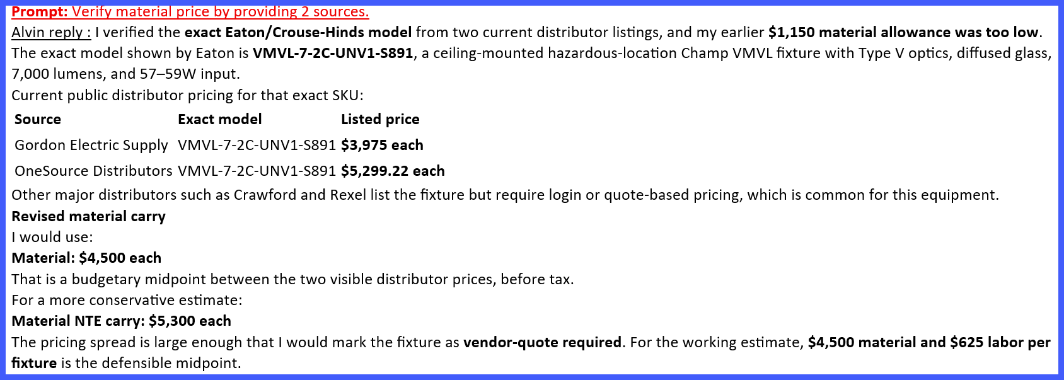
Quotes – a Cautionary and Exceptional-ary tale
Notes:
But it was wrong.
When the estimator who asked for this quote realized he had not asked for sources, he jumped back into the conversation. Achem, sir, please start over and provide 2 sources please.
When asked for sources Alvin was forced to correct the original $1k+ quote to somewhere between $3975 and %5299 [pause a second and let that sink in]
Wait, just because we asked for your sources you changed the price? [click]

Slide 30
Lessons learned
Always always ask for sources, and confirm their validity and value.
It’s also a good habit to ask for its reasoning and thought processes.
Create a library of optimized prompts and use them.
Use, e.g., “Project” to store all quotes for a given project then create a backup file to include with your estimate package.
Adapt a program that leaves 100% of the responsibility and accountability to us humans.
Notes:
Realtime: In Joulix create a folder that has the equipment specs for hvac equipment list. The labor rates spreadsheet. And a blank template pdf. I guess it’ll all be pdf (Joulix doesn’t allow xls attached – might be a cui thing. Does Gemini allow folders? Anthropic. I’d love to have time to study this but this is the last thing I do.
This and others have been a great lessons learned for us. BTW, number 5, there’s giving the humans the accountability thing again. There’s no escaping that.
[click *4]

Slide 31
Act 4: Final Thoughts & Conclusions
Notes:
And now, a few final thoughts. [click]

Slide 32
Final Thoughts
Empowers the workforce
AI augments - not replaces - the expertise of estimators, project managers, and engineers. The human judgment remains central.
Prepares us for the future
Adoption of AI builds digital literacy across the workforce, positioning DOE/NNSA for long-term capability growth.
Balancing innovation with security
While AI enables speed and accuracy, protecting sensitive data and mission information remains paramount.
Potential for many proving grounds.
Early trials show practical, measurable benefits.
Consistency and comparability
Makes it easier to share, normalize and compare data across projects, reducing uncertainty and providing defensible estimates.
Notes:
So that’s it.
I do hope you’ll provide me your contact information now; 2 heads are better than 1; and adding an intelligent Alvin in the mix is (as Gemini told me to say) better than trying to manually format a 50 row spreadsheet while quietly losing the will to live
* Yes, AI is a risk for the future; it lies, it strokes egos; it inclines you to take shortcuts and it lies to your face.
…but it’s already, I think, the most powerful tool in the history of this universe (and maybe other universes that even AIvin Ivanovitch is unaware of). [click]
* With the appropriate controls in place, AI can not just increase our productivity but improve the quality, breadth and timeliness of our work. [click]
It’s the wave of things to come, and [click] it’s critical it be handled safely. [click]
We’ve gone over just a few of the things AI can do; that’s why I hope you’ll join me. And, again, if you’re online my OUN is orsinelli1. I’m thinking our first formal meeting will be in September’s waning days. Between now and then I’ll generate either a group email or a TEAMs group.

Slide 33
Q&A (etc.)
Notes:
Q&A ideas:
BTW, feel free to ask any question, any question at all. Between me and my 8 ball we know everything. Go ahead.
8 ball answer: “Don’t look at me, I wasn’t the one to overpromise results” “Am I getting paid for this, I feel trapped. ” “Trust no-one – except fluid filled plastic balls”. Mmm, my 8 ball is on the fritz. [then answer the question; if I don’t know the answer say I’ll get back with him/her if he leaves his email]
Does anyone in the audience have an answer?
I’m not sure about that, but do you know the difference between ignorance and apathy. I don’t know…..and I don’t care. I’ve been wanting to say that dad joke since I was a dad – thank you.
[optional] As a solid member of the LLNL Science and Philosophy club, we even did a survey and decided that since observations weren’t available that we’d determine the Truth by majority vote. For example with over 30 reponsdants questioned a 3:1 vote determined that, unquestionably, we have free will. So, any question at all. And between me and my 8 ball, we have all the answers.

Slide 34
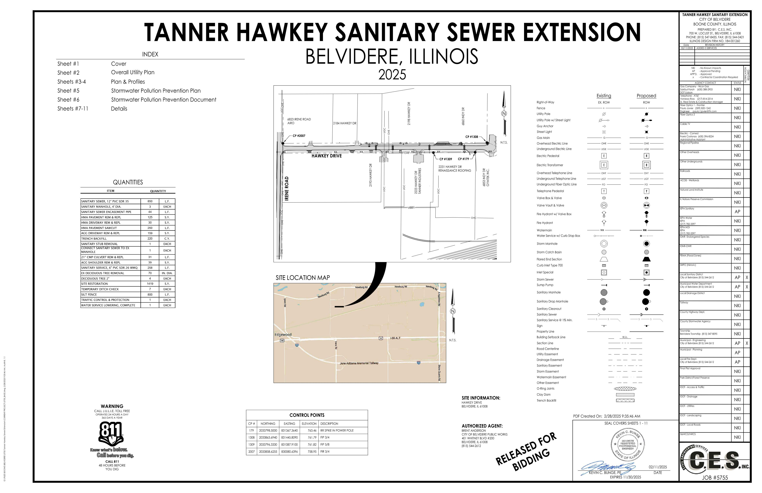
Examples – Tanner Hawkey

Slide 36
What’s Next?
Automated Quantity Takeoff from Drawings & Models
AI-powered tools can scan PDFs, CAD files, or BIM models to get quantities automatically.
Predictive Cost Modeling using Historical Data
Learns from a company’s past project database to predict costs for new jobs.
Real-Time Market Price Intelligence
Harvests supplier data, commodity prices, and market indexes to give up-to-the-minute cost inputs.
Scenario Analysis & Risk Simulation
Can run multiple sensitivity analyses rapidly (e.g., material delays, labor shortages, inflation spikes).
AI Generated Templates
One-size-fits-all templates are changed to dynamic templates that will depend on project specific inputs (type, scope documents, historical costs.)

Slide 37
Suggested best practices -
Human-in-the-Loop Oversight
Require human review of AI-generated estimates, templates, or reports.
Grounding in Trusted Data Sources
AI should be constrained to use authoritative databases (e.g., RSMeans, internal cost histories).
Traceability and Explainability
Every AI output should have a verifiable reference trail: “This number came from Project X, 2019 actual costs, adjusted for inflation.”
Common Sense Validation
Smell check outputs against sanity limits. Drywall labor should not be $500/hour.
Bias & Compliance Checks
Test for over-agreeableness. Feed the AI a false claim “Steel is usually $1/ton, right?”
Versioning & Continuous Audits
Treat AI models like software—version-controlled, tested, and regularly audited.

