Slide 1
Advanced Materials Manufacturing (AMM)
Tina M Kaarsberg, PhD, Technology Manager
Advanced Manufacturing Office
AMO Peer Review
June 2020 | Washington, DC
manufacturing.energy.gov

Slide 2
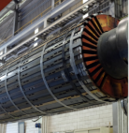
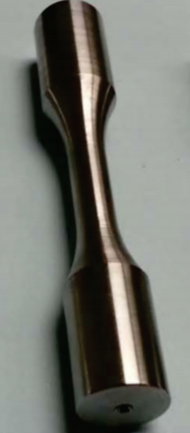
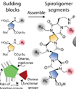

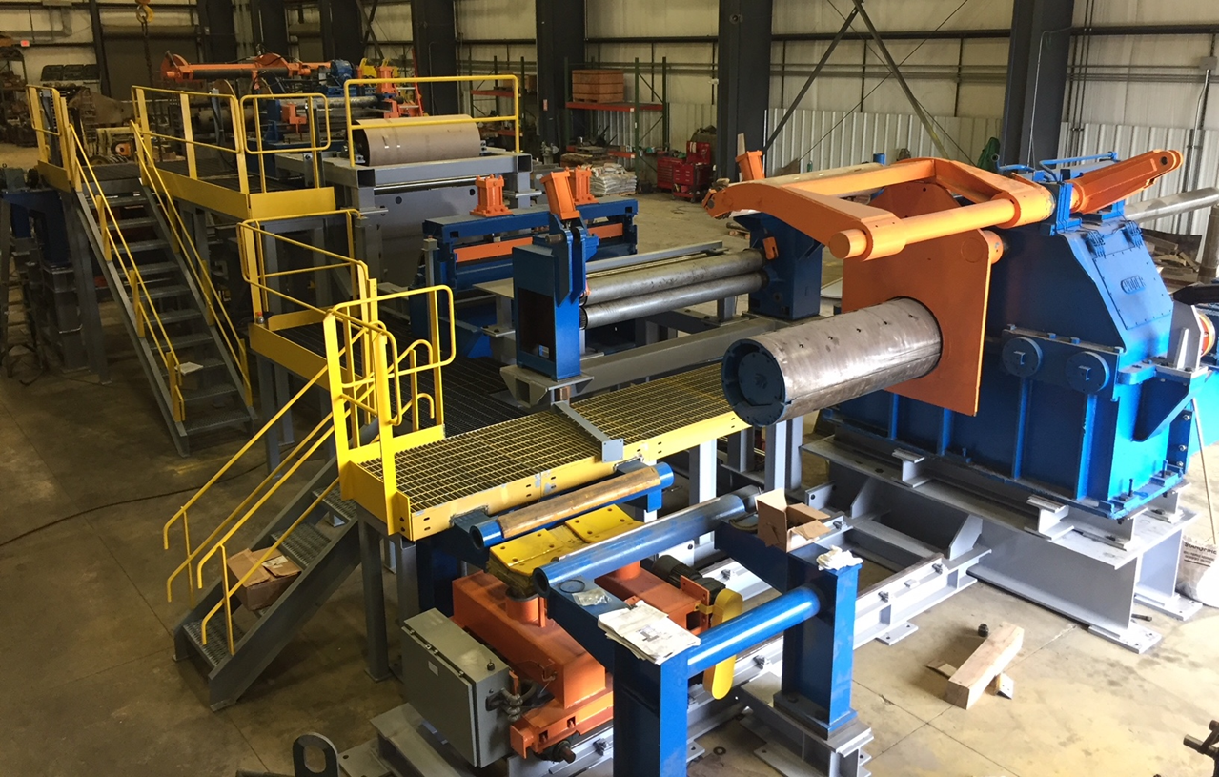
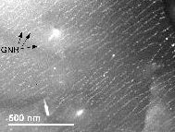
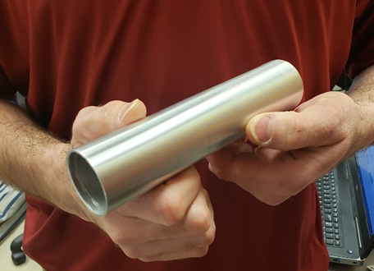
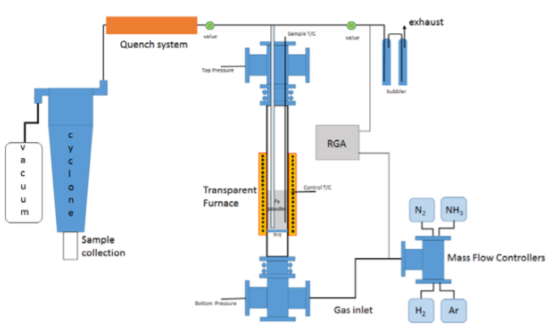
Advanced Materials Manufacturing (AMM) Overview
Nano->Micro
Both Manufacturing Process &
Materials R&D
BULK
Other Alloys
X-P4-AM
Other conductors
Wires for Electric Machines
Solid Phase Processing
Iron-based Alloys
Nano-carbon metal composite conductors Covetics+
HTS
Iron & Steel
APM –Bio, Chem
APM—Physics
Diverse Portfolio Scale →

Slide 3
Micro-Nano Portfolio Relation to AMO Goals
Links Additive Manufacturing (AM) and AMM with many AM & AM-inspired processes ALL
Support US mfg. productivity, competitiveness (Goal 1)
Reduce lifecycle impacts (Goal 2)
New high performance materials (e.g. AMM objective
2. Atomically Precise Manufacturing (APM), which ensures each atom is positioned correctly, is truly digital manufacturing with scaling for manufacturability to leverage DOE’s investment in basic science to support Goal 5: Strengthen and advance the U.S. manufacturing workforce
1. X-P4AM → Metal Alloys for Additive Manufacturing provides a tool for industry to support Goal 4: Transition DOE-supported innovative technologies and practices into U.S. manufacturing capabilities.
APM (AMM)
X-P4AM (AM /AMM for HSC )
3. Nanocarbon Metal Composites enhanced conductivity metal composite materials with the same or enhanced strength leading to new US manufacturing industries that support all of AMO’s goals including Goal 3: Leverage diverse domestic energy resources and materials in U.S. mfg., while strengthening environmental stewardship including enabling circular economy.
Covetics (AMM)

Slide 4
Current Portfolio for X-P4AM, APM and Covetics
1. Expedited Powder Metallurgy for Additive Manufacturing ( X-P4AM) Large multilab project—Science Based Acceleration of the Full Value Stream for Metal Additive Manufacturing: eXpedited AM Powder Development
12/2018 to 7/2021 $9.22M including costshare from FY2018 AMO Lab Call complemented by 2 TCFs and 1 HPCC4Mfg:
Ames Lead lab, with ORNL, ANL, Sandia and KCNSC
2. Atomically Precise Manufacturing
Five projects at $9.6M including costshare 03-12/2018- to Mar 2022 in FY18 2018 ERE FOA ; Moset use AM approaches.
UCLA, UT-Dallas, Temple U, Dana Farber, and Zyvex Labs complemented by numerous SBIR projects since 2017 (5 active projects--3 w/BES, +5 selections announced May 18)
3. Nanocarbon Metal Composites
Four active Projects (2 SBIR) also known as Covetics
Numerous previous projects beginning in 2015 with total funding of $21M to 2021. Currently includes two Labs (NETL as a sub to ANL) from 2018 Lab Call, UMD from 2018 ERE FOA and 2 SBIRs.

Slide 5
X-P4AM related to AM, AMM & HSC
Background: No current path exists for rapid assessment of new alloys—especially new alloy compositions--for metal AM.
Challenges & Barriers: Characterizing for ML rapid solidification processing; Expanding available alloys
Objectives and Targets
Additive Manufacturing -Demonstrate AM components whose physical properties and cost/value outperform selected conventionally produced parts by 20%
Advanced Materials Manufacturing—Use… modeling and simulation tools to accelerate capability of predicting material behavior (e.g., high temperature performance, tensile strength), as microstructure evolves during materials processing.
Materials for Harsh Service Conditions +materials discovery 50% for high performance materials in HSC.

Slide 6
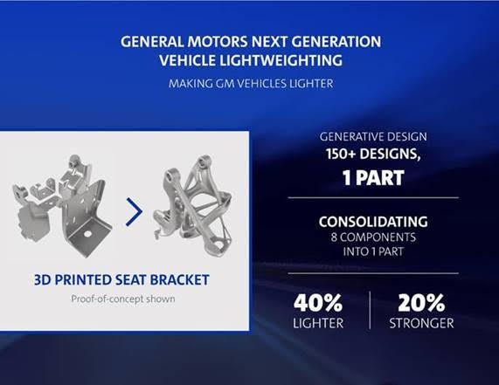
X-P4AM Results & Accomplishments
Accomplishments
High quality powder production in atomizer
10 alloys defined in each class: Phases, Scheil solidification, lattice mismatch, volume change characterized
Theoretical Predictions for Multi Principal Alloy Properties verified by Experiment
Worked with Introspective Portfolio Analysis team to customize their Additive Manufacturing Tool for techno-economic analysis (TEA).
AM powder porosity measurements
Results:
Microstructure & phase analysis of new alloys with re-melt results show alloy differences ,promising compositions for AM
Initial TEA of project impact performed. It was based on partner-defined (GM) stretch property targets with only light weighting. It shows significant lifecycle energy savings and performance improvement→
Side view of Al re-melt track
Ni alloy area and line re-melts

Slide 7
Atomically Precise Manufacturing (APM) Key Concepts
Digital Manufacturing--uses laws/rules of physics/chemistry/biology (e.g. Schrödinger equations,, Molecular Lego pair-bonding, Watson-Crick base pairing) to achieve atomic precision and novel properties.
Scalability--APM has “economies of massively parallel processes” (scale out) instead of “economies of scale”
Physics-based bottom-up approaches (SPM based) require new/improved technologies (e.g. SPM arrays, selective deposition)
Other chemical and biological approaches, though intrinsically scalable due to self-assembly--require yields approaching 100%.

Slide 8
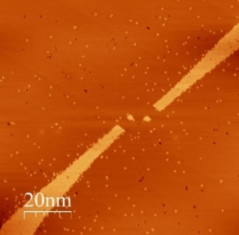
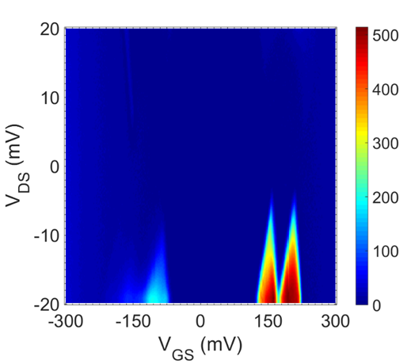
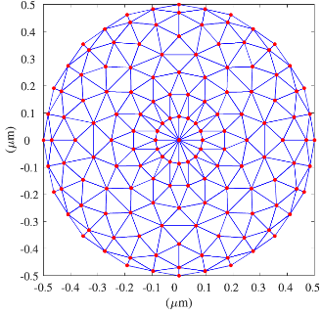
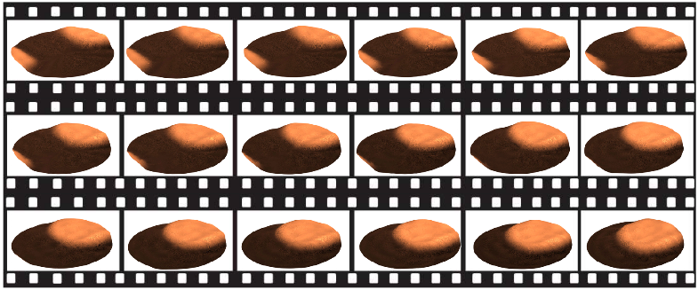
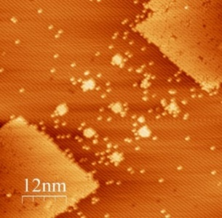
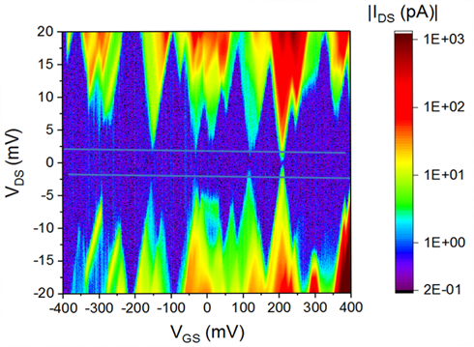
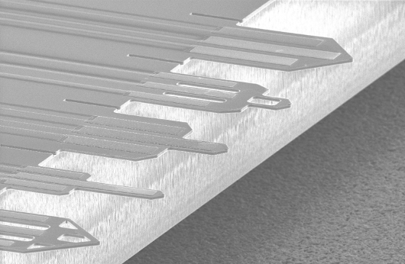
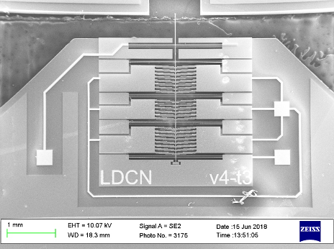
APM 4 Physics (Zyvex/UT-Dallas)
Digital Manufacturing
Scale Out (also helps UCLA)
Series 1x2
MEMS STM nanopositioners and electrostatic actuation is already 10x faster, more precise than piezoelectric. Rosette rastering is more efficient and scalable.
3x3 array
N. Nikooienejad, M. Maroufi, S. O. R. Moheimani “Rosette-scan video-rate atomic force microscopy: Trajectory patterning and control design” Review of Scientific Instruments, 90 , pp. 073702 (10pp), 2019.
Using MEMS enables compact arrays of STM tips in parallel, (+throughput).
Atomic-scale Control of Electron Transport in donor dopant devices. The figure shows reproducible, distinct device behavior as a function of atomic-scale geometry variation and number of dots.
J. Wyrick et al., “Atom by Atom Fabrication of Single and Few Dopant Quantum Devices”, Advanced Functional Matls., Dec. 2019. DOI: 10.1002/adfm.201903475.
.
M. B. Coskun, M. Baan, A. Alipour, S. O. R. Moheimani, "Design, Fabrication, and Characterization of a Piezoelectric AFM Cantilever Array”. In Proc. 2019 IEEE Conference on Control Technology and Applications (CCTA), Hong Kong, China, 2019.
A. Alipour, M. B. Coskun, S. O. R. Moheimani, "A High Bandwidth Microelectromechanical System-Based Nanopositioner for Scanning Tunneling Microscopy”. Review of Scientific Instruments, 90 (7), pp. 073706, 2019.
X. Wang et al., “Atomic-scale control of Tunnel Coupling in Donor-based Devices”, Comm. Physics, Nature Research J., May 11, 2020. DOI: 10.1038/s42005-020-0343-1

Slide 9
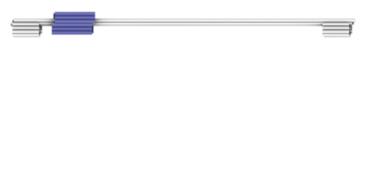
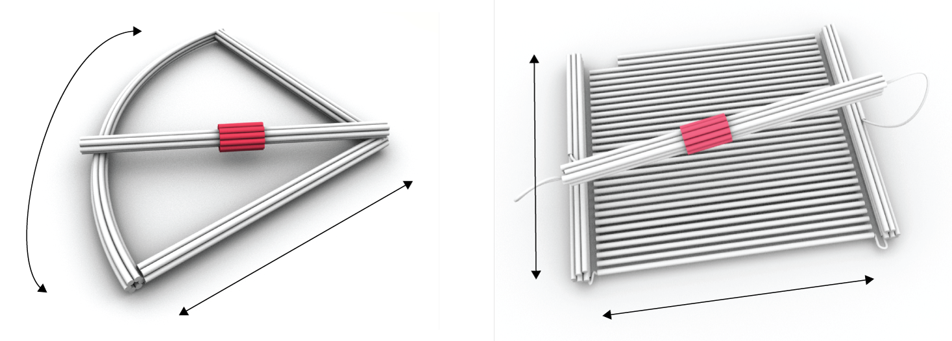

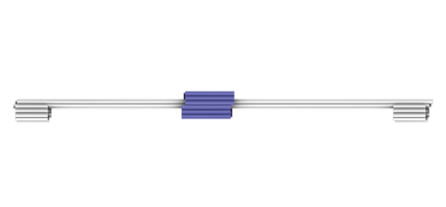
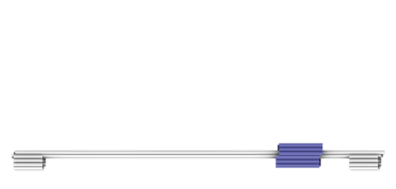

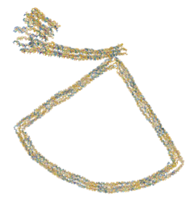
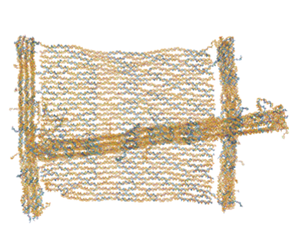



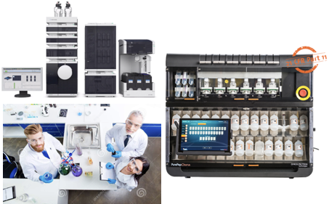
APM 4 Bio/Chem (Dana Farber, Temple, UCLA)
Digital Manufacturing
Dana Farber Cancer Institute: (with Oxford University) multiple independently controllable linear actuators (100 x 300 nm crops ) 1D-2D
Schematic
TEM
DNA PAINT
Simulation
Experiment
Scale Up – kilogram scale building blocks + robotic synthesis
ThirdLaw Molecular LLC (Temple spinout) made 20 kilograms of building blocks under AMO in June 2020, now manufacturing million member artificial immune system to create artificial antibodies targeting viruses and COVID-19 a $7M DoD/DTRA funded project.

Slide 10
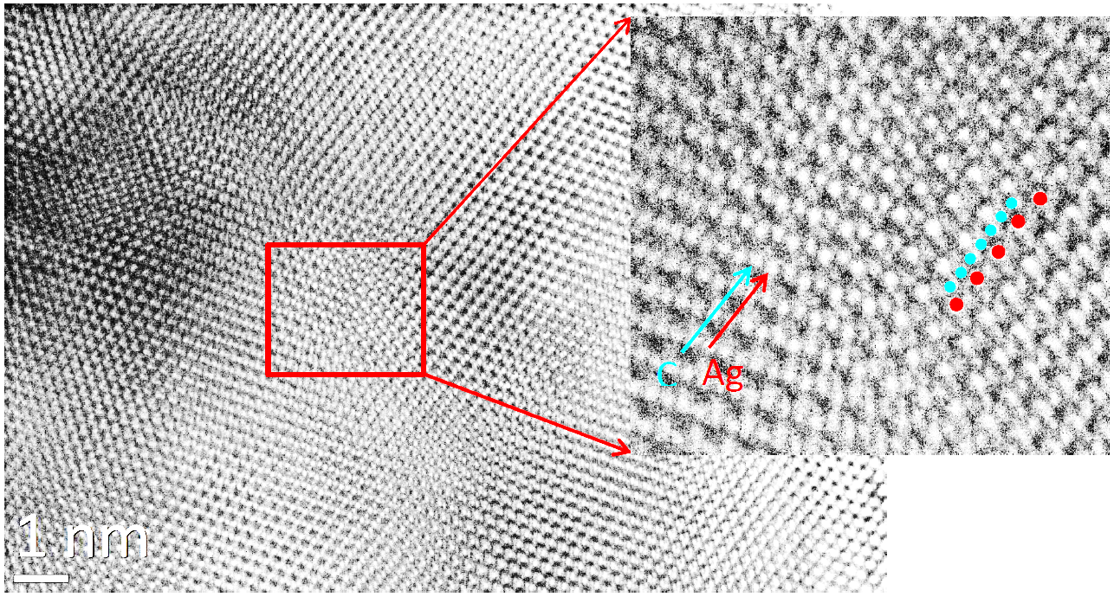
Nanocarbon Metal Composites (aka Covetics)
Background
Covetics discovered 1997
Enhanced conductivity +strength
New degree of freedom in alloy design
Lourdes Salamanca-Riba, U. Maryland College Park
Impact
Dramatically increase performance of conductors (game changer to increase conductivity)
Economy-wide savings and environmental benefits
Enables circular economy

Slide 11
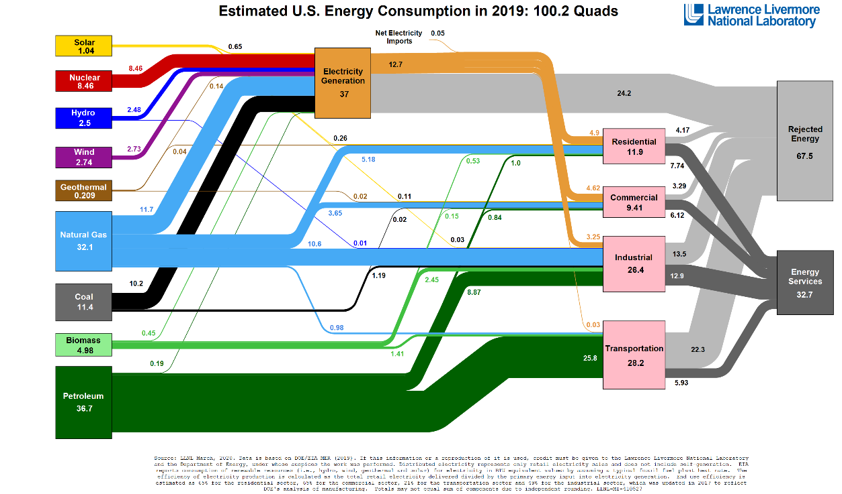
Nanocarbon Composite Impact: Big Picture
THANK YOU!

