Slide 1

Step 5: Project Operations & Maintenance (O&M)

Slide 2
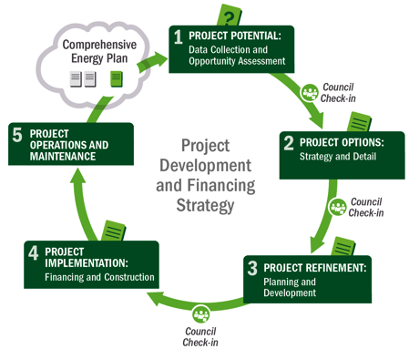






Project Development Process
5
Operations & Maintenance
5
Operations & Maintenance
1
Potential
2
Options
3
Refinement
4
Implementation
Notes:
Slide 2
Now lets turn to the long term care of the project: the operations and maintenance functions.
Overall, this step is the longest of them all because it spans the entire life of the project.

Slide 3
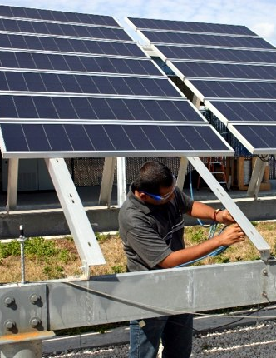
Step 5: Operations & Maintenance (O&M)
Purpose: Conduct or ensure ongoing O&M, including repair and replacement (R&R)*
O&M Costs:
Equipment maintenance and upkeep
Gearbox/inverter replacement
Insurance
Labor and staffing
Extended warranty agreements
If leasing, lessor often manages maintenance
If PPA, vendor typically manages maintenance
* Esp. if owner – role of highest O&M risk
Photo from Florida Solar Energy Center, NREL 14728
Notes:
Slide 3
Operations and maintenance, also called O&M, is the long term care of the renewable energy project to ensure maximum operating efficiency and availability.
Depending on the role selected by the Tribe, the renewable energy asset may be managed by a qualified 3rd party or the Tribe itself.
O&M costs for renewable power plants tends to be much less than fossil plants because there typically is no fuel cost (the exception is biomass). However, there are other maintenance costs to consider, including:
Equipment maintenance and upkeep (including using water to clean PV panels)
Gearbox replacement (Wind turbine); or inverter replacement for solar
Insurance
Labor and staffing
Extended warranty agreements
The developer partner will often have this in their proposal, if you have a partner.

Slide 4
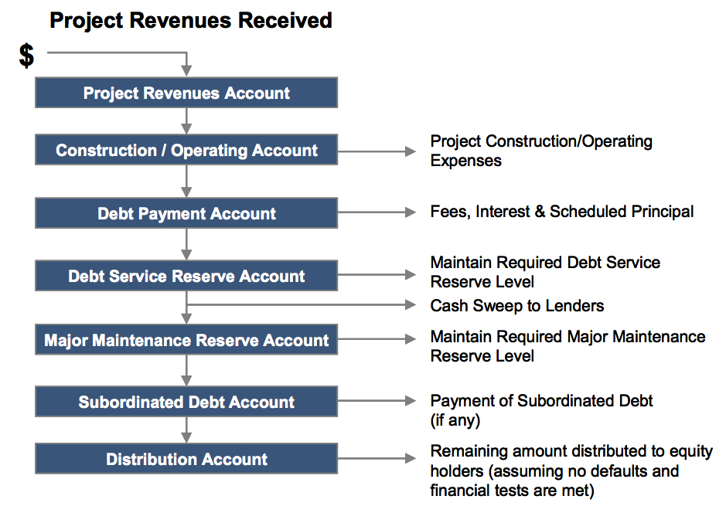
Project Cash Flow Waterfall

Slide 5
Post-Procurement: Project O&M
O&M agreements
Warranties
Monitoring system
System performance
Production guarantees
Buyout options
Notes:
So, with this idea of a long term relationship in mind and given that a lot of people will come and go during the 30 year life of these projects, it is important to keep this list in mind.
Of course, depending on whether or not the Tribe has purchased a system directly or has entered into a PPA, the importance of the various items in the list varies.
As mentioned, O&M will be the responsibility of the PPA provider under a third party owned project, but it will be the Tribe’s responsibility (either directly or managing the O&M contract, if subbed out).
Monitoring the system’s performance is also critical regardless of the project ownership structure. Unfortunately, it is not unheard of for a system to be underperforming or not producing electricity at all for a month or two, without anyone realizing it.
If the RE system has a production guarantee, it is important to confirm that the system is exceeding this guarantee and if not, request the compensation based on the formula laid out in the contract.
And finally, if it is a third party owned system and there are various buy-out dates, as these dates approach, is anyone taking the time to evaluate whether or not the Tribe should buy the system, and if so, is financing being arranged to do so.
In general, given that the process of procuring a RE system can be so time consuming, we often reach the commissioning stage and feel like we’ve finished the race. When in reality, we are just getting started.

Slide 6
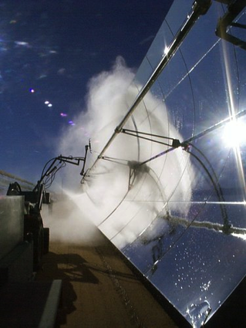
Step 5: O&M– Outputs
Ensure responsible party carries out O&M/R&R*
Measuring and tracking success
Correlation with business plan and strategic energy plan
Revenue management
Contract compliance
Reporting of generation
* Esp. if owner
Photo from Henry Price, NREL 14952
Notes:
Slide 6
Step 5 is like a marathon, where you need to pace yourself and do regular check-ins. Attention to detail can ensure the responsible party carries out their O&M responsibilities. Several times a year, it is important to measure and track success, manage revenue and ensure contract compliance. All of this can best be tracked by reporting and analyzing generation output.

Slide 7
Commercial-Scale Project Risks – Post Step 5
 | Risks | Risk Assessment Post Step 5
Development | Poor or no renewable energy resource assessment Not identifying all possible costs Unrealistic estimation of all costs Community push-back and competing land use | Low; site picked Low; detailed model Low; detailed model None; addressed
Site | Site access and right of way Not in my backyard (NIMBY)/build absolutely nothing anywhere (BANANA) Transmission constraints/siting new transmission | None; site secure None; opposition addressed None; addressed
Permitting | Tribe-adopted codes and permitting requirements Utility interconnection requirements Interconnection may require new transmission, possible NEPA | Low; complete Low; complete None; complete
Finance | Capital availability Incentive availability risk Credit-worthy purchaser of generated energy | None; finalized None; finalized None; finalized
Construction/Completion | Engineering, procurement, and construction (EPC) difficulties Cost overruns Schedule | None; contracted None; construction complete
Operating | Output shortfall from expected Technology O&M Maintaining transmission access and possible curtailment | Being managed by appropriate party
Sources: Adapted from Holland & Hart, RE Project Development & Finance & Infocast, Advanced RE Project Finance & Analysis
NOTE: Underlining signifies that the risk assessment outcome changes during the step at hand.
Notes:
Slide 7
As you can see, in Step 5 - operation, since the project is operating the long term O&M is being managed by the appropriate party. If this is the Tribe, then the Tribe has more responsibilities to ensure long-term project performance.

Slide 8
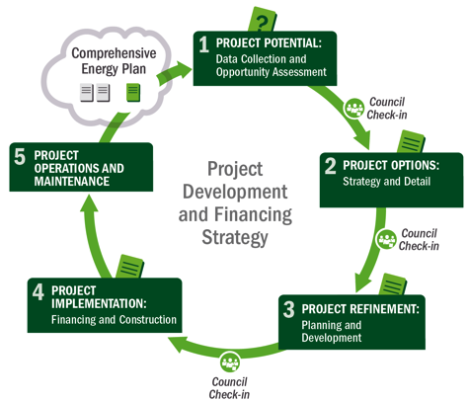
Not Quite Done!
Check back in with planning document – update as necessary
Identify next potential project from plan
Notes:
Slide 8
Now that the facility is operating and being maintained, you may think you are done, but you are not quite done!
The renewable energy project is now a part of your energy and financial portfolio. Integrating this project into your energy planning process is critical to making sure that what you learned from this project is carried into future projects.
From there, you can follow this same cycle as you approach additional potential projects that you’ve identified in your comprehensive energy plan.

Slide 9
Summary of Actions by Step
5
Operations & Maintenance
1
Potential
2
Options
3
Refinement
4
Implementation
Data Collection and Opportunity Assessment
Options and Strategies
Planning and Development
Financing and Construction
Step 1: Gather all relevant data in order to make first pass at potential
project, understand Tribal role options
Step 2: Estimate value to Tribe, consider ownership approach, begin to identify
off-takers, partners, vendors, begin planning permitting and site use
Step 3: Finalize economic assumptions and Tribal roles, finalize permitting, interconnection, transmission and off-take agreements, and determine financial partnerships, ownership structure
Step 4: Finalize agreements (including vendor contracting); financial close and construction; project commissioning, begin operation
Celebrate!
Step 5: Maintenance plan implementation (conduct or ensure ongoing O&M, R&R)
Notes:
Slide 9
This has been a more detailed review of this project development framework, in the context of developing a commercial project where the power is sold to another entity (like a utility). It’s very important to remember that this process is iterative and involves increasing refinement of information in order to know if the project is going to achieve the Tribe’s goals.

Slide 10
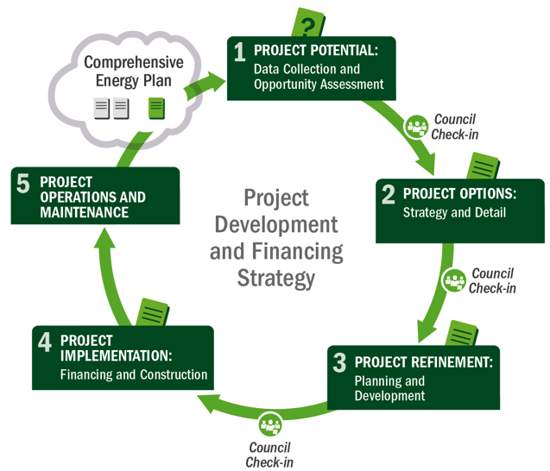
Wrap-Up: Project Development Process
Notes:
Slide 10
Overall, this 5 step process can help you consider the key tasks along the way, and the many check-ins needed to complete a renewable energy project. Project partners are needed at key steps – and they sometimes can be quite beneficial and save you time and money overall.

