Slide 1

Step 3: Project Refinement Iterations

Slide 2
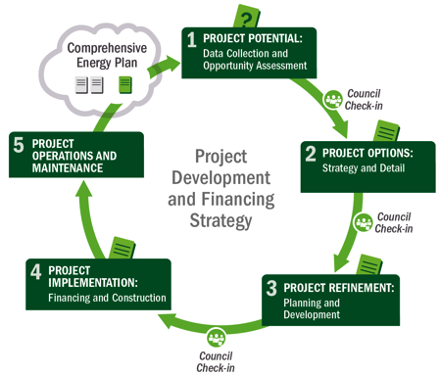






3
Refinement
5
Operations & Maintenance
1
Potential
2
Options
3
Refinement
4
Implementation
Notes:
Slide 2 - PAUSE
Here we move to step 3 in the process: project refinement

Slide 3
Agenda
Recap: Tax-Equity Finance and Federal Tax Incentives
Project Financing Structures
Offtaker Agreements and Vendor Selection

Slide 4

Recap: Tax-Equity Finance
And Federal Tax Incentives
4

Slide 5
The Competitive Power Business
    Role: Independent power producer (IPP)/non-utility generator (NUG)
    Commercial-scale: Long-term, revenue-generating facility on Tribal land that sells power to one or more utilities
Rewards: Typical Goals
Challenges
Generate revenue for Tribe
Job creation (construction, O&M)
Available, Tribe-controlled location
  May/may not be Tribe-owned
Found interested party to
off-take/purchase power
Have enough capital for a large-scale project
Environmental sustainability
Self-sufficiency, pride
Capital intense
Development risk and time
Involves external players
Competes with wholesale price of elec.
A commercial project is dependent upon market forces. The project needs to be competitive with wholesale rates, or non-Tribal projects and/or provide a clear differentiator.
See Tribal Business Structure Handbook www.irs.gov/pub/
irs-tege/Tribal_business_structure_handbook.pdf
Notes:
Slide 5
Commercial projects will be competing against the wholesale electricity price. Therefore, these large projects will compete against other electricity providers (sometimes referred to as independent power producers, or IPPs).
There can be many rewards and goals for a commercial-scale project. They can include:
Generating revenue
Job creation
Using an available resource on Tribal land
Successfully identifying an offtaker
Using available capital for the investment
Environmental sustainability, and
Self sufficiency
Challenges can include:
This scale of project is capital intense – and requires the Tribe to invest capital
Development takes longer lead times and thus there is much more risk for the Tribe capital
External players are most certainly involved and
This scale is more market driven than other scales – because you need to compete with the wholesale price of electricity

Slide 6
So Why Seek a Tax-Equity Finance Partner?
Tax incentives (MACRS and either PTC or ITC) can represent up to half the project value, or reduce project’s capital costs by ~50%
Tax incentives can help to achieve a competitive price of power, since they are sizable
Many projects also require state-level incentives in order to be economically viable
Notes:
UPDATES IN THIS SLIDE NEED TO BE TRANSFERRED TO ADV #4

Slide 7
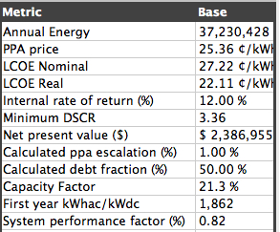
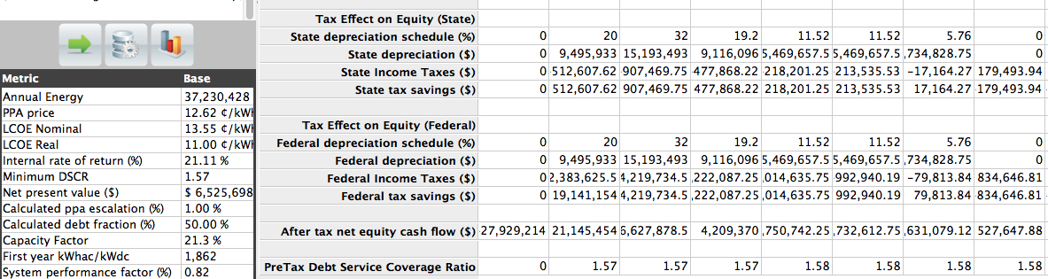
Third-Party (i.e. Tax Equity) vs. Tribal Ownership
Tribal Owned (Without Incentives)
50% decrease
Third-Party Owned (With Incentives)
Notes:
Here’s difference with incentives

Slide 8
If Tribal Ownership is the Goal…
Tribes should not expect to purchase a renewable energy project from tax equity in the initial years of operation because this will jeopardize the tax credits. They must wait a number of years depending on the technology:
  Solar: 6+ years (recapture, MACRS, lease term)
  Wind: 10+ years (length of PTC)

Slide 9
If Tribal Ownership is the Goal (cont.)
If and when a Tribe purchases a renewable energy project, they must do so at “fair market value.”
  This will be a nontrivial cost for the Tribe
  Though it will be less than if the Tribe were the original owner
There are methodologies for calculating FMV for a renewable energy project in the future.
  Tribe could get a sense of how much capital will be required and plan accordingly

Slide 10
Step 3: Capital to Pay for the Project
Process Stage | Activity | Primary Capital | Secondary Capital
1. Potential | Feasibility studies | Developer equity | None
2. Design | Permitting, environmental, site control | Developer equity | None
3. Refinement | Engineering | Developer equity | Debt
4. Implementation | Construction | Construction debt | Vendor finance Equity
5. Operations & Maintenance (O&M) | Completed | Project cash flows | Reserve fund from term debt
Notes:
Slide 10
Lets review the chart we showed previously about the different capital at each stage of project development. The farther you get in the development process the more capital financing sources become available, but also the greater amount of cash outlay. Generally the different sources can include:
Developer/Sponsor Equity
Vendor Financing
Tax Equity
Construction Debt and
Term Debt (long term financing)
The combination of financing potentially available will depend on the risks of your project and the risk appetite of the investor. This chart will help you match the investor type with the process stage.

Slide 11
Federal Tax Incentives
Production Tax Credit (PTC)
Investment Tax Credit (ITC)
Modified Accelerated Cost Recovery System (MACRS)

Slide 12
Comparison of Tax Incentives
 | PTC | ITC | Accelerated Depreciation
Value | Tax credit of 2.3¢/kWh or 1.1¢/kWh, depending on tech | Tax credit of 10% or 30% of project costs, depending on tech | Depreciation of eligible costs (not all project costs qualify)
Select Qualifying Technologies | Wind Geothermal Biomass Hydro | Solar Fuel cells Small wind Geothermal | Depreciation can be taken with either PTC or ITC
Basis | Energy produced over 10-year period. Can be combined with depreciation. | Eligible project cost. Credit taken at the time the project is placed in service. Can be combined with depreciation. | MACRS: 5-year depreciation schedule
Expiration | Start construction before 1/1/2014 | Placed in service before 1/1/2017* | MACRS: None

Slide 13
Project Financing Structures
13
Notes:
Review, as this is also covered in Advanced #3.

Slide 14
Direct Ownership (Single Finance)
Parent Company: Taxable Corporation
Corporations
Tax Benefits
Project Company/
Pass-Through Entity
5% Potential
10% Design
Tax Equity
A completed project is a business with commercial activity.
25% Refinement
Project Company
60% Implementation
Project Development Stages – % Resource Inputs, Time/$
Notes:
Slide 14
Now we are getting into the different project ownership models. At the commercial scale, it could make sense to partner with a tax equity partner (especially for large projects) in order to gain the tax credit benefits, and to engage a partner with enough money to pay for the upfront capital needed.
This slide shows the general breakdown in the time and money spent at each stage of project development – through to the operational stage. Generally the most time/$ are spent on the implementation and refinement stages of development, with considerably less in the potential and design phases.

Slide 15
Third-Party Financed Power Purchase Agreement:
Where Electricity is Sold to a Utility
Corporations
Electricity Sales (PPA)
Project Company/
Pass-Through Entity
Utility: Purchase
Tax Equity
$ Purchase Output
Potential Tribal Role
(Potential $ Payments)
Tribe: Host
The Tribe is the host in this
Structure. The utility agrees to buy electricity generated by the renewable energy system.
Site Access
Project
$ Principal and Interest
Lender/
Capital Provider
Tax attributes: Modified Accelerated Cost Recovery System (MACRS) and either Investment Tax Credit (ITC) or Production Tax Credit (PTC)
Lends $ to the Project or Debt Capital
Tax-
Equity
Investor
Benefits:
No/low up-front costs
No O&M
Save on electricity costs
Equity Investment $
15
Notes:
Slide 15
An alternative to direct ownership, is the third party model – where some combination of the developer and its financial partners, develop a RE project. In this case, the Tribe is the Host – and provides the renewable resource to the project. The power is sold to a utility through a Power Purchase Agreement or PPA; the utility agrees to buy 100% of the electricity that the RE system generates. There are some Tribes that own utilities, therefore a few Tribes might be the purchaser of electricity as well. I will cover the additional roles the Tribe can play, as project developer or sponsor equity investor in the next few slides.
Without worrying too much about the details shown on this slide, let me give you a quick overview.
A separate legal entity (often a limited liability corporation, or LLC) will own the RE project. This entity will finance the RE system using tax equity capital, sponsor equity and debt. Together these project partners, finance, install, own, operate and sell the electricity from a RE project. The proceeds from the electricity sales will be used to operate and maintain the system, repay debt and provide some level of return to the equity investors. In the third party model, the tax incentives available for RE projects will accrue to what is known as the tax equity investor. This is an investor who invests capital and then the return on this capital is based on both cash flow from the project and the various tax-based incentives available. Third party finance is common for large scale projects and in particular with entities , such as Tribes, that are exempt from state and federal income taxes.
Step 1 – Instead of purchasing system, Tribe hosts system; and electricity from the project is sold to the utility via a power purchase agreement (PPA)
Step 2 – If the Tribe also acts as a project developer, or sponsor equity investor – then upon flip or expiration of risk, the Tribe can exercise an option to purchase the pre-owned system

Slide 16
Capital Structure with Tax Equity
Corporations
Project Company
Project Company/
Pass-Through Entity
Tax Equity
Potential Capital Financing Sources
Tax
Equity
Debt
Cash Equity
Other
Tax-Equity Investment Structures
Partnership Flip
Sale Leaseback
Inverted Lease
Notes:
Slide 16
Now, I’m going to discuss a specific type of business structure referred to as tax equity – and the three main financing structures that are used today. We’ve discussed tax equity throughout our courses because it is a critical part of understanding how RE deals are financed.
Understanding these advanced financing structures is particularly important at the commercial-scale, since it is possible the Tribe will be one of the project developers, and may choose to invest sponsor equity into the project. In the next few slides, I will explain the structures listed along the bottom, they include the partnership flip (most often used for wind projects), the sale leaseback (usually used for solar PV), and the inverted lease (similar to the sale leaseback, with the roles flipped around; it is becoming popular for solar).
Importantly, for the Tribe to be the project developer and contribute sponsor equity to the project, the Tribe will likely have to secure a PLR from the IRS. The Tribe might also have to set up a Tribal business structure, depending on the outcome of the PLR. Engage your General Counsel early to identify the full range of available options for you.

Slide 17
Partnership Flip
Partnership Flip
Rent/Royalty $
Resource Owner
Access/Site Control
Corporations
Project Company/
Pass-Through Entity
Debt Payments ($/mo.)
Lender/
Capital Provider
Tax Equity
Debt Capital $$
Potential Tribal Role
Project
Electricity
Utility/
Off-taker
PPA ($/kWh)
Income: 99% Pre-Flip;
5% Post-Flip
Tax-
Equity
Investors
Income: 1% Pre-Flip;
95% Post-Flip
MACRS and either ITC/PTC
Project Developer
Equity Investment $$ (99%)
Developer Equity $ (1%)
Source: Graphs adapted from “Renewable Energy Project Finance in the U.S.: An Overview and Midterm Outlook” (Mintz Levin Green Paper, 2010)
Notes:
Slide 17
Here is the partnership flip structure – as you can see there are a lot of moving parts. Luckily, it is a very well known structure within the industry, especially for wind. There are a few critical points to understanding the partnership flip.
Fundamentally, it is a partnership between Tax Equity and Project developer (though can include debt as well – see the blue box)
Typically, the TE investors contribute most of the upfront capital and in turn receives most of the income, and nearly all of the tax benefits (tax credits and depreciation)
At this point the project developer is receiving a low % of the income (maybe only 1%) at first
In the future (year 11 for wind and year 7 for solar), once the TE has received their capital investment and a rate of return back, the investment ratios flip so that the project developer receives most of the benefits, and the tax equity investor just receives a very small portion.
An important feature of this financing structure is that the project developer must contribute some portion of the initial investment. Even if it is a very small percentage such as 1%; it is still required.
Other players in this structure include the resource owner and the project electricity/REC purchaser
Tribal role – the Tribe acts as the landlord/host in all cases. If the Tribe has a lot of capital, it could act as the lender / debt provider. The Tribe might also be able to act as developer, depending on the results of your project’s PLR from the IRS. And if the Tribe owns a utility, could also purchase the system’s power and environmental attributes.

Slide 18
Cash Flow Example: Partnership Flip, No Debt
Project Development
    Project Construction
    Project Operation
Cash Flows and Tax Benefits*
Development Costs
Flip point after year 5
Capital Investment
Year
Notes:
This is a hypothetical representation of what a cash flow distribution could look like in a partnership flip structure without debt. Notice that the developer incurs all costs up to the point of the tax equity investment, and even some at the point of investment (though the tax equity investor comprises the bulk of capital expenditure at this point). Notice that this particular project’s flip point happens after year five, which is common in the market

Slide 19
Project Finance: Partnership Flip Tax-Equity Structure
Advantages:
Tax equity provides most of the capital up front
Easier way for Tribe/developer to own the project in the long run (than other advanced financing structures)
Generally familiar structure for wind and solar industry, so many tax-equity investors have experience
Challenges:
Limited distribution payments to Tribe/developer until later in project (e.g., year 6-7 for solar; year 10-11 for wind)
Still requires up-front capital contribution from Tribe/developer
Developer must consult tax equity on major decisions
Notes:
Slide 19
There are several advantages / challenges to this structure
Advantages:
Tax equity provides most of the upfront capital
Easier way for the Tribe (as a developer) to own the project in the long run
And it is used frequently, particularly for wind, so several tax equity investors have experience with it
Challenges:
Limited distribution payments (i.e. small return) for the Tribe / developer until later in the project (year 6-7 for solar and year 10-11 for wind)
Still requires some upfront capital from the Tribe
Tribe and developer must consult tax equity on major decisions

Slide 20
Capital Structure with Tax Equity
Corporations
Project Company
Project Company/
Pass-Through Entity
Tax Equity
Potential Capital Financing Sources
Tax
Equity
Debt
Cash Equity
Other
Tax-Equity Investment Structures
Partnership Flip
Sale Leaseback
Inverted Lease
Notes:
Slide 20
The second financing structure is the sale leaseback

Slide 21

Sale Leaseback Structure
Tax Equity
Sale Leaseback
Potential Tribal Role
1) Developer sells project to tax-equity investor. Developer receives: sale proceeds and cash from PPA (less lease payments and O&M). Option to purchase asset from tax equity both during and at end of the lease.
Tax-
Equity
Investor
(Lessor)
2) Tax equity leases project back to developer. Tax equity receives: ITC, MACRS, and lease payments.
Project Developer (Lessee)
$
Rent
($)
Site
Access
    Sale leaseback can provide 100% financing from tax-equity investor. Tax equity receives full ITC and MACRS.
Utility/
Off-taker
Resource Owner
Notes:
Slide 21
Developer
Finances the project through design and implementation up to the commercial operation date (often called the COD)
Sells project/asset to Tax Equity Investor at fair market value (FMV) within 90 days of commercial operation
Leases project/asset back from Tax Equity Investor in role of Tenant – and thus pays rent
Developer has option to purchase the project/asset at end of lease for FMV at that time
Tax Equity Investor
Takes on role of Landlord while owning project/asset
Receives tax credits and depreciation
Offtaker
Pays Developer for energy generated in form of power purchase agreement (PPA)
Sale Leaseback
Why do it?
Potential higher return (IRR) for tax equity investor
Developer can recoup investment quickly
Tribal role – the Tribe acts as the landlord/host in all cases. The Tribe might be able to act as developer, depending on the results of your project’s PLR from the IRS. And if the Tribe owns a utility, could also purchase the system’s power and environmental attributes.

Slide 22
Cash Flow Example: Sale Leaseback, No Debt
Project Development
    Project Construction
    Project Operation
Cash Flows and Tax Benefits
Development Costs
Capital Investment
Year
Notes:
Note, in this hypothetical representation of the sale leasback’s cash flows over time, the entirety of the project’s initial capital investment is contributed by the tax equity investor. This represents the sale of the asset. The cash distributions after commercial operation are more evenly matched between developer and tax equity investor than in the partnership flip model. The resale of the project back the developer in this example is indicated at year 12 where the developer pays the tax equity investor directly for the value of the project. Thereafter the developer owns project and, provided there is no remaining loan to be paid off, will receive the full amount from electricity sales.

Slide 23
Project Finance: Sale Leaseback Tax-Equity Structure
Advantages:
Tax equity provides 100% of the financing (at time of sale)
Efficiently monetizes the tax benefits
Developer gets large cash distribution upon sale of project
Familiar structure among solar community
Challenges:
Most costly for Tribe/developer to acquire long-term ownership of project (buy project back from lessor ~ after year 7)
Tribe/developer operates the project
Lessee on the hook for the lease payments regardless of system performance
Not possible for PTC-based project (e.g., wind)
Notes:
Slide 23
Like the other structures several advantages / challenges
Advantages:
No upfront $ required from developer, TE puts up all the permanent financing costs
Developer gets large cash infusion from ‘selling the project’
Also frequently used, especially for solar.
Challenges:
Typically expensive for Tribe or project developer to purchase ownership in the project down the road
The Tribe or project developer will operate the project
Requires a large equity contribution from the tax equity investor (and they may limit the amount of money they invest if they think the project development team doesn’t have enough experience, for example)
Limited participation, and therefore limited upside (or opportunity to make money) until Tribe or developer buys tax equity out of the project
This is not available for projects using the PTC, like wind.

Slide 24
Capital Structure with Tax Equity
Corporations
Project Company
Project Company/
Pass-Through Entity
Tax Equity
Potential Capital Financing Sources
Tax
Equity
Debt
Cash Equity
Other
Tax-Equity Investment Structures
Partnership Flip
Sale Leaseback
Inverted Lease
Notes:
Slide 24
Finally we turn to the inverted lease financing structure

Slide 25
Inverted Lease/Lease Pass-Through Structure
Inverted Lease
Tax Equity
1) Developer owns project and leases it to tax-equity. Developer receives: lease payments; retains MACRS. Developer owns asset in full at expiration of lease
Potential Tribal Role
2) Tax equity pays rent to lessor and sells power under the PPA. Receives ITC pass-through (in return for partial upfront funding of project) and cash from PPA.
Tax-
Equity
Investor
(Lessee)
Project Developer (Lessor)
    In the inverted lease, ITC is passed through to the tax-equity investor, allowing developer to retain ownership and some tax benefits (MACRS). IRS PLR seems to indicate Tribe may be developer; legal opinion required.
$
Rent
($)
Site
Access
Utility/
Off-taker
Resource Owner
Notes:
Slide 25
The inverted lease is an exception to the rule that only an owner can claim tax benefits of a project.
Under the inverted lease, the relationship is reversed between the developer and tax equity investor. By that I mean the developer actually buys the project from the tax equity investor and then leases it back to the tax equity investors. This is done as a way to pass the ITC to the tax equity investor who does not actually own the project. Note that depreciation deductions stay with the owner (lessor), and if all owner partners are taxable, then they can use the full MACRS.
This was the structure that recently received an IRS PLR. And note, if a Tribe is one of the developers, then depreciation (accelerated or straight line) is lost.
Tribal role – the Tribe acts as the landlord/host in all cases. The Tribe might be able to act as developer, depending on the results of your project’s PLR from the IRS. And if the Tribe owns a utility, could also purchase the system’s power and environmental attributes.

Slide 26
Cash Flow Example: Inverted Lease/Lease Pass-Through, No Debt
Project Development
    Project Construction
    Project Operation
Cash Flows and Tax Benefits*
Development Costs
Capital Investment
*The difference between structures is in the timing and magnitude of values
Year
Notes:
Unlike in the sale leasback model, where the developer has the option to purchase the project at the end of the lease term, in the inverted lease, the developer already owns the project. All cash flows therefore revert to the developer at the end of the lease term (in this slide’s hypothetical example, this happens at the end of year 5), assuming there is no debt. Note that, to execute this structure, project owners must make a significant capital contribution up front. Tax equity partners will also take a majority of the cash flows before the lease term is up so that they can reach their target rate of return. Thus, while the inverted lease does allow the project owner to retain control of their asset, it is a comparatively expensive option.

Slide 27
Project Finance: Inverted Lease Tax-Equity Structure
Advantages:
Tribe/developer maintains controlling interest and ownership in project
Cash flows to Tribe/developer from beginning (lease payments)
Limits risk to tax-equity investor, possibly increasing availability of investment
The developer resumes control of the project after the expiration of the lease term
Challenges:
Most complicated of all three tax-equity structures
Not possible for PTC-based project (e.g., wind)
Limited upside for tax-equity investor
Notes:
Slide 27
Several consideration for this structure as well:
Advantages:
Tribe gets more control in the project
Cash flows to the Tribe from the beginning, so there is more immediate upside
Limits risk to tax-equity investor, possibly increasing availability of investment
The developer owns the project after the expiration of the lease term
Challenges:
Most complicated of all three tax-equity financing structures
Developer contributes more up-front capital into the project
Not available for the PTC (or wind projects); is only for ITC
Limits upside for TE (thus some investors may not be interested)

Slide 28
March 8, 2013 IRS Private Letter Ruling – 111532-11
An Indian Tribal government is not considered a “governmental unit” or “tax-exempt organization” for purposes of solar energy tax subsidies
This presumably could permit Tribal governments to enter into an inverted lease structure without jeopardizing access and use of federal tax incentives (potentially big change)
Despite the favorable ruling, we understand that the tribe who got the PLR didn’t pursue it and instead went with a different project structure.
IRS Private Letter Ruling (PLR): http://www.irs.gov/pub/irs-wd/1310001.pdf
Potential Tribal implications: http://www.renewableenergyworld.com/rea/news/article/2013/05/solar-tax-credit-opportunity-for-indian-Tribes
Notes:
Slide 28
In March of this year, the IRS issued an interesting private letter ruling relevant to a Tribe using the investment tax credit for a solar project
For this one Tribal project it appears that the Tribe can invest equity and be a partial owner of the project (i.e. be a party to one of the tax-equity financing structures), without jeopardizing access and use of the investment tax credit.
Depreciation, however, is subject to different IRS rules than the investment tax credit and would likely be depreciated on a straight line basis over at least 12 years and possibly longer (instead of a 5 year accelerated depreciation schedule)
If the PLR is interpreted by the IRS in the same way for other Tribes, then it is possible Tribes can play a larger development role than simply site host or energy purchaser. The exact financing structures are still being debated and legal advice is necessary. The inverted lease (or lease pass through) is the probably the most clear at this point, because the PLR states that it is permissible for that that particular Tribe to pass through the ITC to the lessee.
The potential implications are not clear for all Tribes, since this PLR applies to this one project by this one Tribe. Any Tribe wanting to follow in their footsteps should seek legal counsel and apply to the IRS for their own PLR (unless the IRS issues a general ruling applicable to all Tribes).
While this ruling only applies to the one Tribe’s project, past experience has shown that other entities eligible for PLRs have been able to successfully secure PLRs if their situation is similar. The Tribe would have to prove that the two circumstances are the same.

Slide 29
Project Financing Structures: Comparison
Structures | Overview | Characteristics | Tax-Equity Returns
Partnership Flip | Common to wind/solar deals, two participants (tax-equity and developer). | Typically 99%/1% allocations until flip (approx. 6 years), then 5%/95% | 8%–12%
Sale Leaseback | Extensive use in solar deals, at least two participants (1. tax-equity investor/lessor, 2. developer/lessee) | Developer sells completed project to tax-equity, leases it back (10–15 years) | 10%–15%
Inverted Lease/ Lease Pass-Through | More complex and less common, at least two participants (1. tax-equity investor/lessee, 2. developer/lessor) | Project majority owned by developer, leases to investor, (7–10 years) | 10%–15%

Slide 30
Financing Structures and Tribal Implications
 | Direct Ownership | Partnership Flip | Sale Leaseback | Inverted Lease/Lease Pass-Through
Financing | User self-finances system and consumes power on-site | Investor can provide up to 99% financing. Debt can also be part of capital stack. | Investor provides 100% financing. Debt can also be part of capital stack, commonly at developer level. | Investor provides partial financing. Debt is a common part of capital stack.
Up-front Tribal Capital Req. | $$$$ | $ | $ | $$–$$$
Ownership | User-owned | Co-ownership by developer and investor | Developer has option to purchase assets at lease term | Assets revert to developer at the lease term
Tax Credit | NA | PTC or ITC, and MACRS | ITC and MACRS | ITC and MACRS
Investor Preference | Certain firms have preferences for/familiarity with particular structures and/or technologies. Project specifics may also dictate financial structure selected.
Notes:
Slide 30
Here are some financing structures that have been used to finance renewable energy development in the U.S. These were presented in some of the advanced financing courses, and the considerations of choosing one over another are shown in the table above. Generally, the factors to consider include the amount of upfront capital required from the Tribe, who owns the project, what type of tax credit is available (ITC or PTC), and the preference of the money provider (the investor)

Slide 31
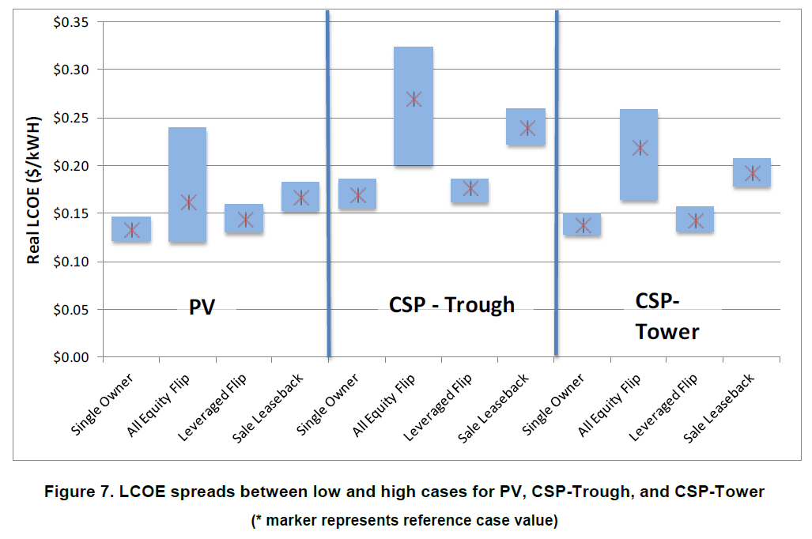
Advanced Financials: Solar Example
Mendelsohn, M.; Kreycik, C.; Bird, L.; Schwabe, P.; Cory, K. (2012). “Impact of Financial Structure on the Cost of Solar Energy.” 40 pp.; NREL Report No. TP-6A20-53086. March. http://www.nrel.gov/docs/fy12osti/53086.pdf

Slide 32
Small Group Exercise
Brainstorm the pros and cons of working with a tax-equity partner

Slide 33
Offtaker Agreements and vendor selection
33

Slide 34
Offtaker Agreements and Vendor Selection
Identify and address outstanding risks
Finalize off-take agreement; PPA in place
Complete environmental reviews and finalize permits
EPC vendor selected – criteria applied
Transmission/interconnection agreement with utility
Financing structure determined

Slide 35
Request for Proposals (RFP) and Power Purchase Agreement (PPA) Deep Dive
NREL Project Finance Team RE Contract Library
Federal Energy Management Program (FEMP) On-site Power Purchase Agreements

Slide 36
Small Group Exercise
Evaluate the RFP responses provided by identifying overall goals and developing values to help rank responses

Slide 37
Commercial-Scale Project Risks – Post Step 3
 | Risks | Risk Assessment Post Step 3
Development | Poor or no renewable energy resource assessment Not identifying all possible costs Unrealistic estimation of all costs Community push-back and competing land use | Low ; site picked Low; detailed model Low; detailed model None; addressed
Site | Site access and right of way Not in my backyard (NIMBY)/build absolutely nothing anywhere (BANANA) Transmission constraints/siting new transmission | Low; site secure None; opposition addressed Low; process started
Permitting | Tribe-adopted codes and permitting requirements Utility interconnection requirements Interconnection may require new transmission, possible NEPA | Low; complete Low; complete Low; identified
Finance | Capital availability Incentive availability risk Credit-worthy purchaser of generated energy | Low; PPA complete Low; risk on developer Low; PPA complete
Construction/Completion | EPC difficulties Cost overruns Schedule | Low; allocate to EPC or developer
Operating | Output shortfall from expected Technology O&M Maintaining transmission access and possible curtailment | Assumed low, mitigable, or allocatable
Sources: Adapted from Holland & Hart, RE Project Development & Finance & Infocast, Advanced RE Project Finance & Analysis
NOTE: Underlining signifies that the risk assessment outcome changes during the step at hand.
Notes:
Slide 37
This slide shows a comparison of the various risks that may emerge out of the stage 3 for the refinement. We are still determining whether the risks of the commercial scale solar PV project in AZ are acceptable, or can be reduced/eliminated.
Because risk has been analyzed and controlled where possible during Stage 3 refinement, each of these risk factors are estimated at low. While no project will have zero risks, the analysis has shown that there is likely a viable renewable energy project here. Once the risks appear to be low enough across all the variables, you will be able to engage a tax equity partner or a debt lender.

