Slide 1

Step 1: Identifying Project Potential

Slide 2
Tribal Role Options
Project Operator/O&M
Project Developer
Equity Investor/ Generation Equipment Owner
Renewable Resource/Land Owner/Land Lessor*
Tribe
Off-taker (Power Purchaser/
User)
Lender/
Debt Provider
* Also called Tribal Host
Notes:
Takeaway:
KEEP IN MIND HOW YOU WOULD LIKE TO PARTICIPATE THROUGHOUT THIS TRAINING—IT WILL INFORM HOW YOU APPROACH THIS MATERIAL
Slide 2
This graphic shows the full list of project development roles that a Tribe can potentially play for a commercial scale renewable power project. Notice that between the previous slide and this one, a few roles dropped off that are really most appropriate for other project partners.
Each of the roles that a Tribe can play at the commercial scale level are different in nature, between the level of involvement on a short and long term basis, the level of risk at stake, the potential upside of the project, and the degree of control of the project and team.

Slide 3
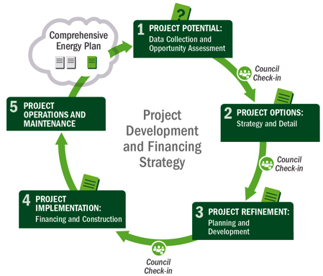






1
Potential
5
Operations & Maintenance
1
Potential
2
Options
3
Refinement
4
Implementation
Notes:
Here is the five step process again. We are starting with Step 1: Potential
Slide 3
Here I am showing you the project development and financing strategy. Another way to think of this is as a five-step project development process. It will be used throughout this presentation to highlight where a certain activity or effort falls into the big picture of developing a RE project.
You will notice that this process is depicted as both a circle and as a straight line. This is because when developing a RE project, you may encounter both repetitive processes (as in the circle representation) and sequential processes (as in the line representation). For example, sometimes you may evaluate a project and eventually reach a decision to not proceed on the project any further. At this point you will begin the process anew for another type of development or a variation on the project. On the other hand, there are can be milestones to be met before proceeding to the next phase of development. It is important to have the whole picture in mind not just the step immediately before you, as different processes will proceed at different paces, depending on where your project is located.
Broadly speaking, we have categorized five steps in the process which will be discussed in detail in the remainder of the presentation. These are:
Project Potential
Project Options
Refinement
Project Implementation
Operations and Maintenance

Slide 4
Agenda
Market and Offtakers
Initial Site Considerations
Resource
Permitting & Regulation
Project Savings and Production Potential

Slide 5
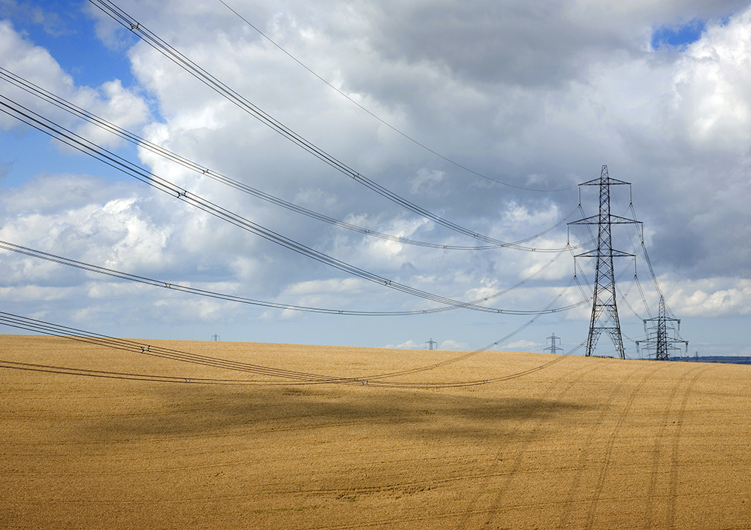
Market & Offtakers
5

Slide 6
Commercial-Scale Considerations
Need an off-taker to buy your electricity
  A utility
  A large commercial, industrial, or government agency (e.g., military base)
Utility motivated by RPS compliance
Nonutilities motivated for a number of reasons, including: cost savings, sustainability goals, and energy hedging
Notes:
Commercial scale is sale of power to an offtaker, this principally means a utility
There are other potential off-takers such as federal facilities given the RE mandates that these entities and agencies have. Military bases in particular are large load centers. In addition, large commercial customers, for example, data centers, might also be potential off-takers.
Utilities and RPSs
Not all offtakers are created equal, so be sure that your counterparty is creditworthy, could threaten your energy payments and project solvency

Slide 7
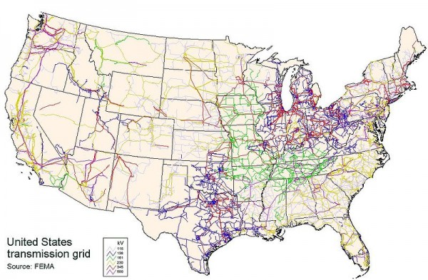
The Electricity Grid
It is not enough to identify
a market for the electricity
Can you get the electricity
to market?
  Existing transmission lines?
  Capacity on those lines?
Notes:
Identifying a market by looking at which states have RPS is not enough. Even if a potential market exists for the electricity (i.e. someone will buy your power) , you need to assess how you will physically get it to this market
In other words, does the transmission infrastructure (e.g. wires and poles) exist to transport this electricity from our site to the customer? If it t does, is there spare capacity on the line?
As can be seen in the map, the midwest and east coast are blanketed by transmission. But even there, capacity is still an issue. As one moves West, there is much less transmission infrastructure.
Furthermore, when we talk about getting our electricity to market, we need to understand where in the electricity grid our project sits and how far we have to transmit it to get to our market. The required infrastructure for long distance transmission is distinct from medium distance, sub-transmission infrastructure which is in turn, distinct from transmission at the distributed level which is where we get down to the individual homeowner and commercial customer.
And of course, to the degree a Tribal project needs to incorporate or upgrade additional grid infrastructure to get the electricity to the intended market, the incremental costs can be material, and often prohibitive.

Slide 8
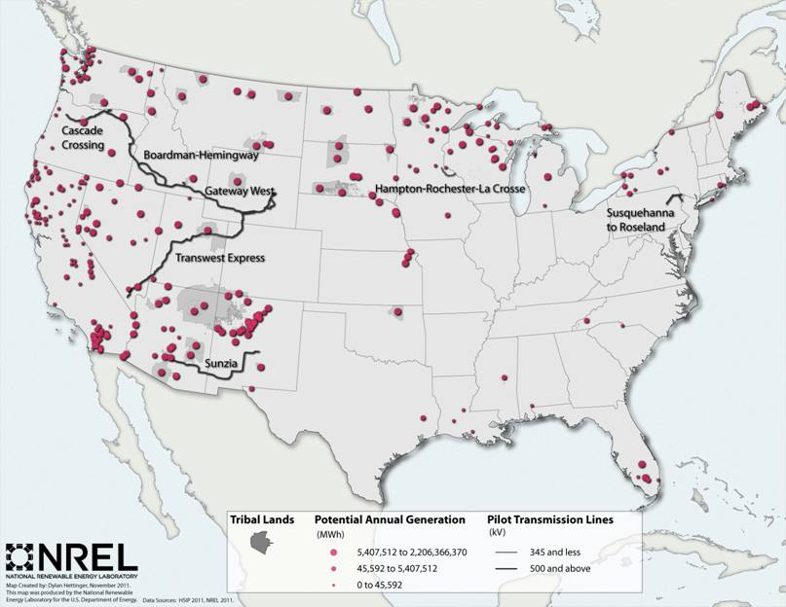
Projected Transmission
Notes:
There is some additional projected transmission scheduled for the West as illustrated in this slide, although none of it appears to be connecting to the California market which as we saw from a previous slide has the most aggressive RPS mandates. This slide also highlights certain tribal lands and as can be seen, some of them align with projected, new transmission infrastructure, whereas others do not.

Slide 9


Identifying a Market: Western States’ RPS Policies
State | RPS
AZ | 15% by 2025
CA | 33% by 2020
CO | 30% by 2020 (IOUs) 10% by 2020 (co-ops/munis)*
MT | 15% by 2015
NM | 20% by 2020 (IOUs) 10% by 2020 (co-ops)
NV | 25% by 2025*
OR | 25% by 2025 (large utilities)* 5%–10% by 2025 (small utilities)
WA | 15% by 2020*
UT | GOAL: 20% by 2025
Renewable portfolio standard
Minimum solar or customer-sited requirement
Renewable portfolio goal
*
Extra credit for solar or customer-sited renewables
Source: www.dsireusa.org
Notes:
As it relates to the commercial scale projects and identifying if there is a market for the electricity that a Tribal project will produce, it is instructive to look at the Western landscape. In the slide, the various Renewable Portfolio Standards that exist in the western region of the United States are listed.
The RPS, as the renewable portfolio standards are known, stipulate what percent of a state’s electricity supply must come from renewable resources. Of course, what is considered renewable varies across states and within states, which utilities are subject to the RPS also varies. But as can be seen in the table, the percentage of renewable energy required by the 2015-2025 range is significant. And this creates opportunities for commercial scale, renewable energy projects looking for markets that it can sell electricity into.
An additional point to make with regards to this slide, is that some states, as illustrated by the sunburst on five of the states, have what are known as solar or distributed generation carve-outs within the overall RPS. These carve-outs create shelf space if you will for renewable technologies, like solar, that might be more expensive than wind or biomass projects, for example. As a result, utilities often offer additional incentives in order to meet its carve-out requirements, which would primarily benefit facility or community scale solar projects.

Slide 10
California
Avg Elec. Prices (c/kWh)
Retail (2012) | Wholesale (2011)
12.96 | 3.00
Projected to need an additional
400–13,000 MW installed by 2020
to meet RPS obligations
No major projected transmission expansion in California
Policy | Limit
RPS | 33% by 2020
Interconnection | No Limit
Net Metering | 1 MW
Electricity Sales
Total | % US Res | % US Comm | % US Ind | % Total US
19,000 GWh | 6.2% | 8.8% | 4.3% | 6.6%
State TECHNICAL Potential (GW)
Roof Solar | Utility Solar | CSP | Wind | Bio. | Geo.
61 | 4,111 | 2,726 | 1,052 | 4 | 16.7
Tribal RESOURCE Potential (GW)
Roof Solar | Utility Solar | CSP | Wind | Bio. | Geo.
ND | 13.8 | 10.6 | 0.68 | .127 | 9
Major Utilities
Los Angeles Department of Water & Power
Pacific Gas & Electric Co.
San Diego Gas & Electric Co.
Southern California Edison Co.
Notes:
Slide also taken from ATNI Workshop presentation (need to credit) – looks like sources are below
Building off of the question of what do these RPS imply as far as actual market opportunity for Tribes, we first take a look at California. As noted, it is the Western state with the most ambitious RPS target at 33% by 2020 and the projections for additional capacity needed to meet this target is significant.
So, from a potential market opportunity, California appears attractive. But can you get the electricity to market with the current transmission infrastructure? As we saw on a previous slide, and as this slide states, with no major projected transmission scheduled for California, it may be difficult to get your electricity to this market, despite its promise. The technical potential for RE resource generation, and in particular, solar, for the state in general and the Tribes specifically within the state are material as evidenced by the data in the charts.
So, the demand exists given the California RPS and the technical potential exists, but we have a transmission barrier.
Sources:
2020 RPS data = Haase et al 2012
2010 RPS data = Ryan Wiser, data listed on DSIRE
Policy data = DSIRE
Consumers by utility, major utilities = EIA (http://205.254.135.24/electricity/data.cfm#sales) *major utilities = utilities with 1M customers or more
Prices
Retail: http://www.eia.gov/cneaf/electricity/epa/revenue_state.xls
Wholesale: SNL
Technical Potential
Lopez et al forthcoming. Wind includes on and offshore, solar includes urban and rural, geothermal includes hydrothermal ONLY.
-Tribal RESOURCE potential
-NREL internal analysis

Slide 11
Oregon
Avg Elec. Prices (c/kWh)
Retail (2012) | Wholesale (2011)
8.32 | 3.00
RPS obligations began in 2011
Projected to have 340–1,700 MW in excess of RPS obligations in 2020
Large projected transmission expansion across the state
Policy | Limit
RPS | 25% (large utilities), 10% (small), 5% (smallest) by 2025
Interconnection | No limit
Net Metering | 2 MW
Electricity Sales
Total | % US Res | % US Comm | % US Ind | % Total US
4,000 GWh | 1.7% | 1.3% | 1.2% | 1.4%
State TECHNICAL Potential (GW)
Roof Solar | Utility Solar | CSP | Wind | Bio. | Geo.
5 | 1,898 | 1,017 | 252 | 2 | 2.4
Tribal RESOURCE Potential (GW)
Roof Solar | Utility Solar | CSP | Wind | Bio. | Geo.
ND | 26.4 | 7.8 | 1.12 | .0001 | 6
Major Utilities
None
Notes:
Taken from ATNI Workshop presentation – need to cite – sources at bottom
Conversely, Oregon is projected to exceed its RPS obligations by 2020 and so that could indicate that it may be a tougher state to develop new large RE projects if the pipeline is already quite developed.
And distinct from California, there is transmission expansion planned for the state.
And in fact, this may be why Oregon is expected to exceed its RPS obligations because the electricity has a way to make it to the market and to the final end-users.
What these two slides show is that a Tribe contemplating getting involved in a large, utility scale RE project needs to really understand the local electricity markets.
This is true if the Tribe intends to play the role of the developer of a project, but it is also true if a Tribe is approached to lease its land to a developer since the Tribe will want to evaluate the developer’s proposed business plan to make sure it makes sense and that a market would exist for the electricity generated from the project.
Regardless, determining whether or not there is a market or not for your electricity obviously needs to happen at the beginning of a project’s lifecycle.
Sources:
2020 RPS data = Haase et al 2012
2010 RPS data = Ryan Wiser, data listed on DSIRE
Policy data = DSIRE
Consumers by utility, major utilities = EIA (http://205.254.135.24/electricity/data.cfm#sales) *major utilities = utilities with 1M customers or more
Prices
Retail: http://www.eia.gov/cneaf/electricity/epa/revenue_state.xls
Wholesale: SNL
Technical Potential
Lopez et al forthcoming. Wind includes on and offshore, solar includes urban and rural, geothermal includes hydrothermal ONLY.
-Tribal RESOURCE potential
-NREL internal analysis

Slide 12
Renewable Project Finance
Key Contract: Power Purchase Agreement (PPA)
  A long term, financeable commitment to buy project output
  Generally addresses energy and attributes (like RECs)
  Allows developer to monetize tax or other policies
  Finding a power purchaser/off-taker is key for securing capital
Notes:
Mention resources here (http://www1.eere.energy.gov/femp/financing/mechanisms.html and financere)
[MAYBE IMPORT JASON’S SLIDE ON PPA
Note to slide presentation: PPA covered in Advance #2]
Talking Points:
To provide a high-level framework to the process, and avoid the disorientation that can occur, we work with several overriding principles from the commercial project development sector to use as touchstones and references.
First, one must establish fundamental project motivation – why are you thinking about this project? What basics about your energy use and environment do you need to understand to decide if you should move forward. This motivation needs to be established to overcome the challenges in the project development process, and also must be anchored in sound fundamentals to be valid.
Once motivation is established, its time to dig into the process for how to create a successful project. The framework we’ll present is designed to organize the system and provide a sort of roadmap to a disciplined, repeatable, and proven process to achieve successful project development results.

Slide 13
Summary: Understanding Electricity Markets
Who Is Your Market?
  On-site
  Utility/utilities
  Nearby federal agencies (especially Department of Defense)
  Large commercial or industrial off-taker
Getting Power to the Market
  Proximity to transmission
  Current capacity of existing transmission
  New transmission being planned
  Required transmission studies take time; start early
Contracts Needed to Put It All Together
  Signed power purchase agreement (PPA) with creditworthy buyer
  Signed interconnection agreement
  Signed transmission agreement
Notes:
To Summarize, Understanding electricity market is critical
Who is your market?
Can you get it to market?
And the contracts that document the process of selling the electricity to your market

Slide 14
Summary: Understanding Market Potential
Free tool for understanding local current energy needs/costs: State & Local Energy Data (SLED Tool) www.eere.energy.gov/sled
    Lists utility names
    Shows available rates
    Electricity demand by sector
    Consumption trends
    Renewable energy resource maps
Think through growth and energy need scenarios (e.g., building a new recreation center will increase load)
Sled Demonstration (https://www.youtube.com/watch?v=VAzAGlX1zag&list=UU7EGgnYFEIOaAa47ZBpninw)

Slide 15
PermitTIng and REgulation

Slide 16
Permits
Purpose:
Understanding necessary regulatory requirements for the project particularly if seeks to inter-connect and/or deliver off reservation.
Considerations:
Interconnection
Environmental (National Environmental Protection Agency (NEPA): Environmental Assessment (EA) or Environmental Impact Statement (EIS)
Cultural
Federal, Tribal, and/or State Use Permits
Notes:
TALKING POINT:
-not all of these will apply – state and local permits vary widely and may or may not apply to Tribes

Slide 17
Policy: Regulatory Bodies for the Electricity Grid
Federal Energy Regulatory Commission (FERC)
North American Electric Reliability Corporation (NERC)
  Regional Reliability Councils
Utility commissions and districts regulate privately and publicly owned electricity providers
  Utilities Commission
  Utility Regulatory Commission
  Public Utilities Commission
  Public Service Commission (may be civil service oversight body rather than utility regulator)
  Public Utility District (Tribal, state, or government owned utility, consumer owned and operated, small investor owned)
  Publicly owned utilities include cooperative and municipal utilities
  Cooperative utilities are owned by the customers they serve (farmers and rural communities)
Notes:
The Federal Energy Regulatory Commission (FERC) is the U.S. federal agency with jurisdiction over interstate electricity sales and wholesale electric rates.
The North American Electric Reliability Corporation (NERC) is a nonprofit corporation whose mission is to "ensure the reliability of the North American bulk power system.“ NERC oversees eight regional reliability entities and encompasses all of the interconnected power systems of the contiguous United States, Canada, and a portion of Baja, California, in Mexico. Regional Reliability Councils include the Western Electricity Coordinating Council (WECC) and the Southwest Power Pool, Inc. (SPP).
In North America, the majority of electricity generated is produced by investor-owned utilities. Utility commissions are to serve the public interest by regulating utilities so that customers receive safe, reliable, and reasonably-priced services.

Slide 18
Considerations for Permitting, Regulations, and Laws
Determine ownership before applying for federal, tribal, and state laws and regulations. http://teeic.indianaffairs.gov/triballand/
  Two types of individually owned land: (1)trust land and (2)restricted fee land
  Three types of tribally owned land: (1)trust land, (2)restricted fee land, (3)fee land purchased by Tribes
  Consider whether the project will fall under as a government function for the Tribe or a profit-making enterprise?
Consult with a lawyer early in the renewable energy development process to verify business model and eligibility of the project for federal incentives.
What local tribal laws might apply for this renewable energy project? Projects are more likely to get external investment (if necessary) if there is evidence that tribal leadership is committed to the project. See http://www1.eere.energy.gov/tribalenergy/guide/legal_issues.html.

Slide 19
Permitting and Regulating
Outside Tribal Boundaries
In general, if located on private, non-tribal land, or state properties; local and state land-use policies do apply.
Inside Tribal Boundaries
In general, state and local land-use laws do not apply.
If located on tribal-owned fee land outside of reservation boundaries, then subject to state and local land-use, permitting jurisdiction.
In addition, the extent to which federal rules and regulations apply depends on the type of project, its location, and size.
Tribal law, regulations, and policies will apply.
Tribes may “self-regulate” under federal law including TERA’s and Hearth Act.

Slide 20
Determine What Type of Permitting is Necessary
Key Types of Permitting at Tribal Community & Facility Level | Always | Sometimes | Rarely
Interconnection agreement | ü
Environmental permitting |  | ü
Transmission permitting |  | ü
Off-take agreement | ü
Local and State permitting |  |  | ü
Federal permitting |  | ü
Local Tribal permitting | ü

Slide 21
Environmental Regulations to Consider – NEPA
National Environmental Policy Act (NEPA)
  All federal agencies must assess environmental impact of proposed actions
  Federal funding may trigger assessment for tribal projects (federal nexus, e.g. federal grants, BIA initiated/approved projects)
  Each federal agency may have their own particular NEPA procedure – need to check with appropriate agency
  Timeline: Approximately 1 to 3 years depending on project size and complexity (unlikely for community scale)
  Recommendations:
    Draft the EIS concurrently with other applicable federal statutes and regulations
    If necessary, work with NEPA experts to determine and prepare required analysis

Slide 22
NEPA continued
Three types in order of complexity and time:
  Categorical Exclusions (short) – “The categorical exclusions are categories of actions that Federal agencies have determined do not have a significant effect on the quality of the human environment and neither an EA nor an EIS is required.”
  Environmental Assessment (EA) (medium) – “The EA is the document that provides sufficient analysis for determining whether a proposed action may or will have a significant impact on the quality of the human environment and therefore requiring the preparation of an EIS.”
  Environmental Impact Statement (EIS) (long) – “If an action is expected to have significant impacts, or if the analysis in the EA identifies significant impacts, then an EIS will be prepared.”
http://www.bia.gov/cs/groups/xraca/documents/text/idc009157.pdf

Slide 23
Environmental Regulations to Consider – Other
Clean Air Act (CAA)
  Purpose is to protect the nation’s air and public health.
  Mandates identification of both mobile and stationary pollutants and the sources----gives authority to U.S. Environmental Protection Agency (EPA) for listing such pollutants.
  Establishes a process for the states and applying the National Ambient Air Quality Standards (NAAQS).
Clean Water Act (CWA)
  Goals are to make the nation’s water fishable and swimmable by 1983 and eliminate the discharge of pollutants into navigable waters by 1985.
  Gives authority to the EPA to regulate National Ambient Water Quality Standards (and effluent limitations applied to all point sources of pollution).
  Paved the way for nationally uniform technology-based standards imposed on individual sources through a permit system (NPDES permit; National Pollutant Discharge Elimination).
Endangered Species Act (ESA)
  The purpose is to protect plants and animals that are listed by the federal government as “endangered” or “threatened”.
  Enforced by the U.S. Fish and Wildlife Service (FWS—see Secretary of the Interior) and the National Marine Fisheries Services (NMFS—See’s Secretary of Commerce).

Slide 24
Initial site considerations

Slide 25
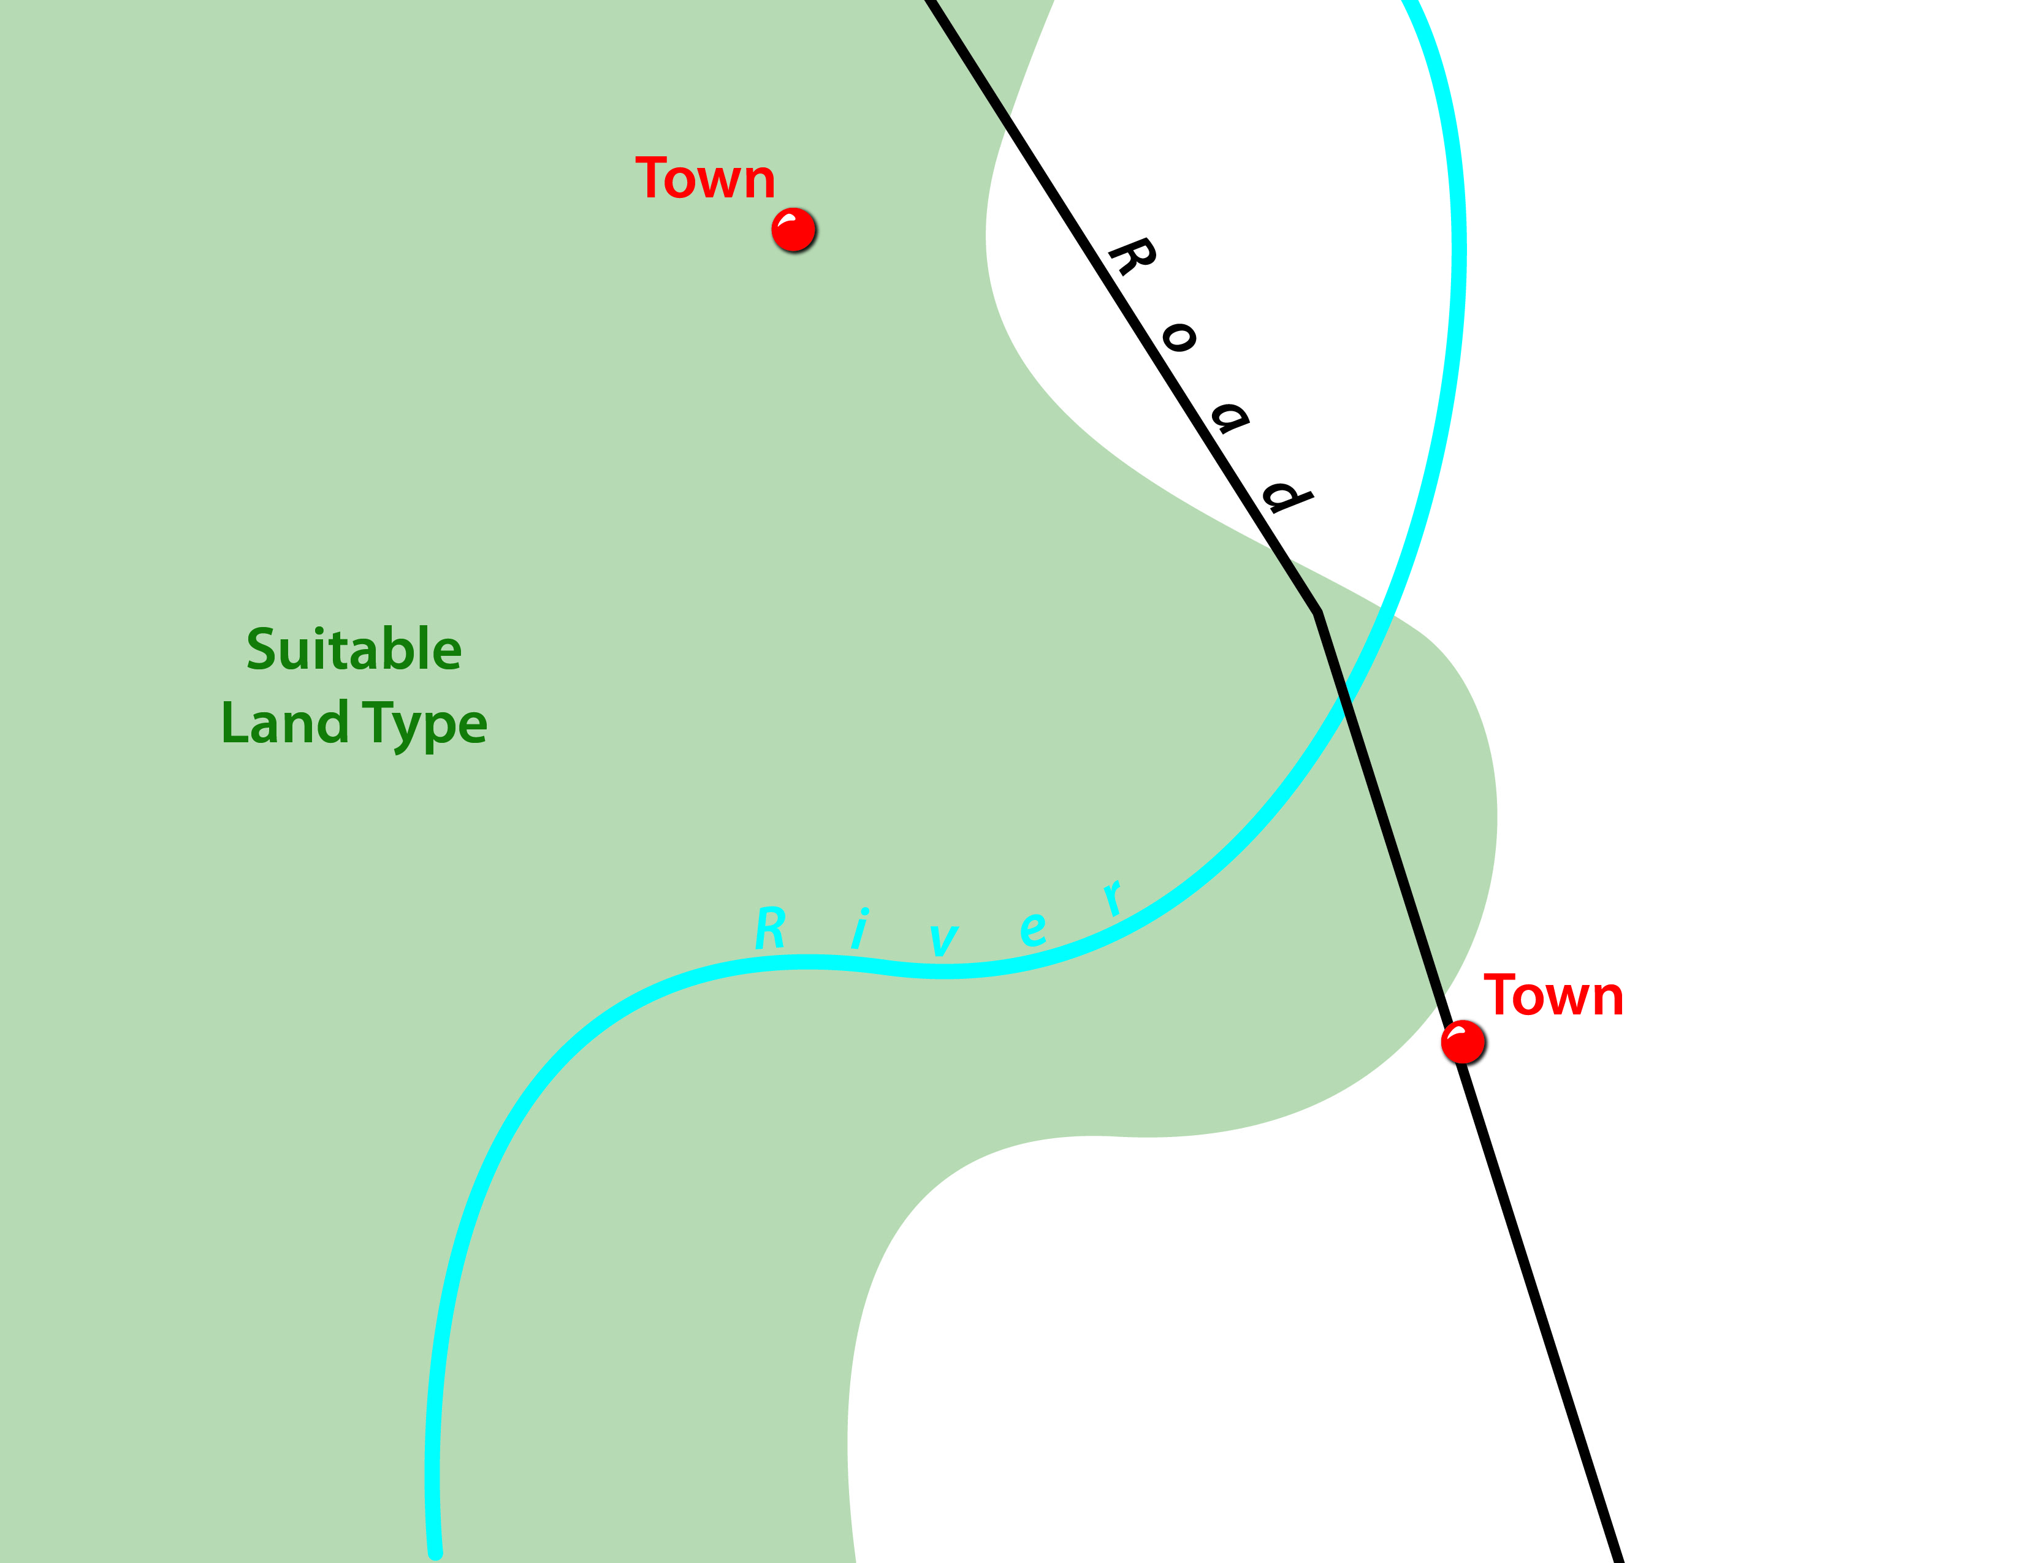
Initial Site Considerations

Slide 26
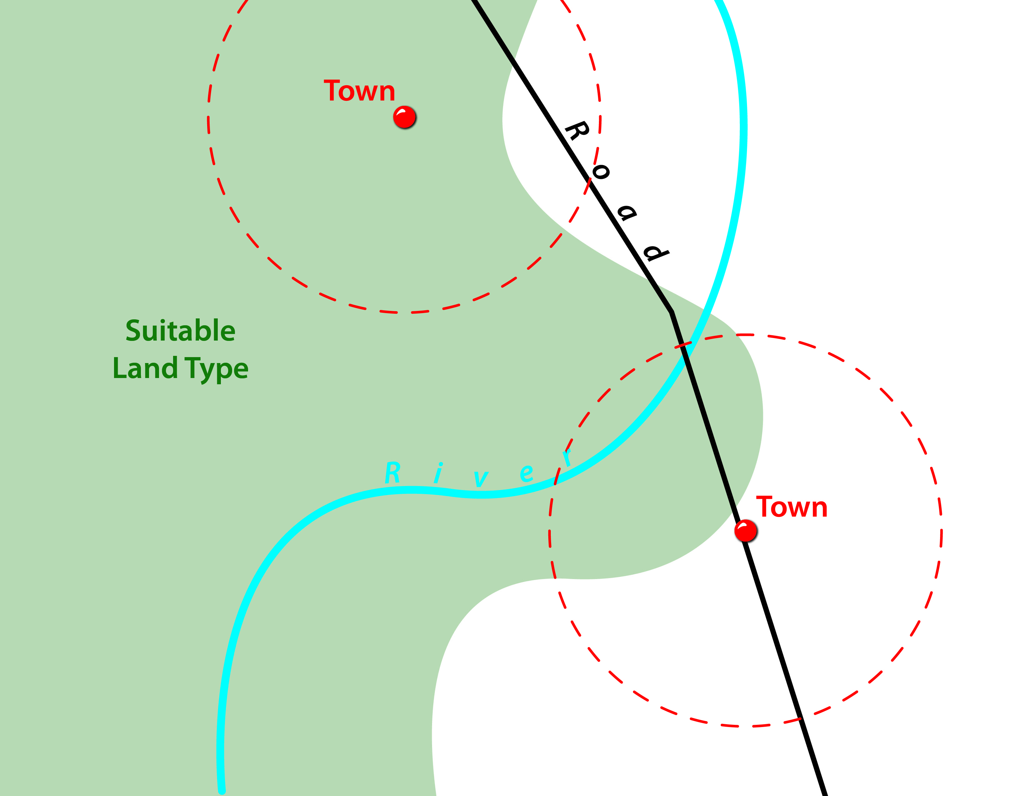
Initial Site Considerations – Urban Centers

Slide 27

Initial Site Considerations - Rivers

Slide 28
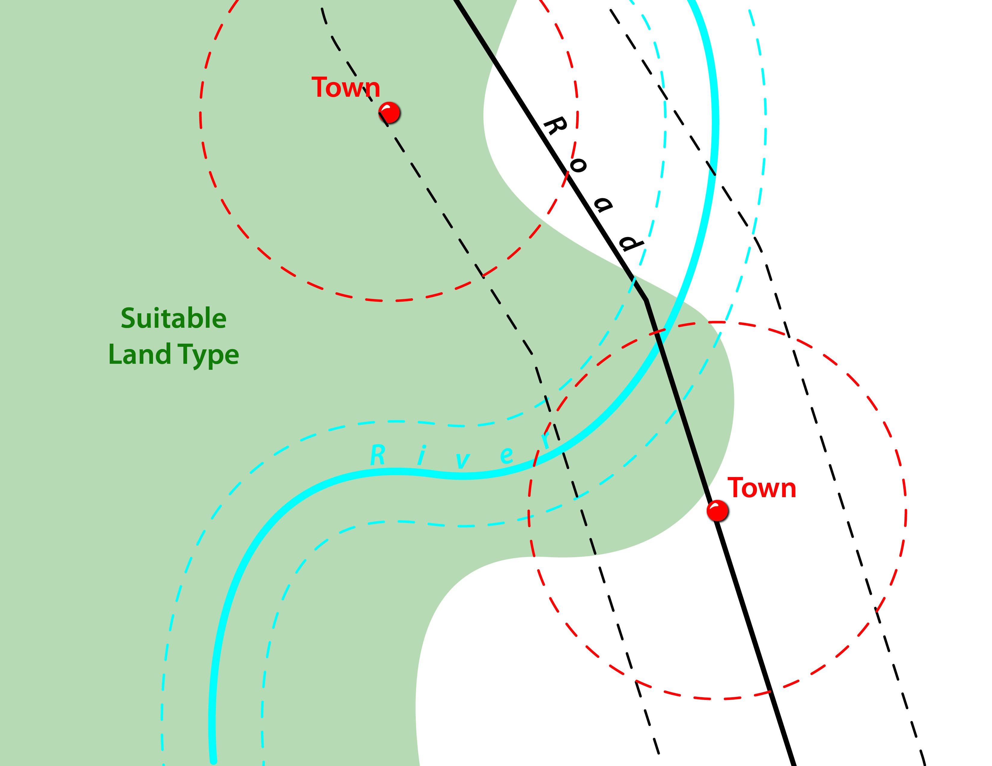
Initial Site Considerations - Roads

Slide 29
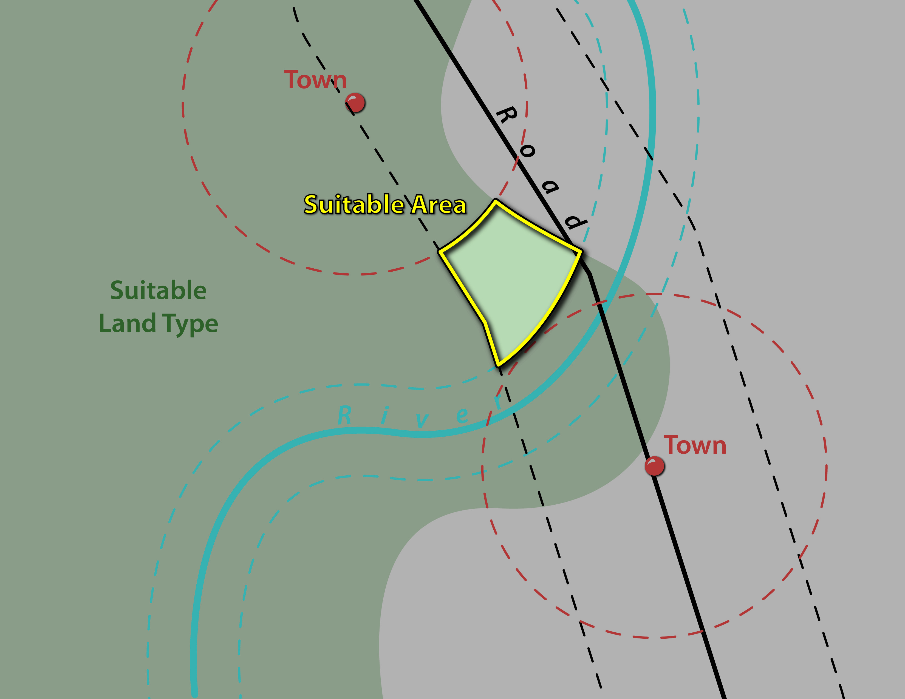
Initial Site Considerations – Suitable Area

Slide 30
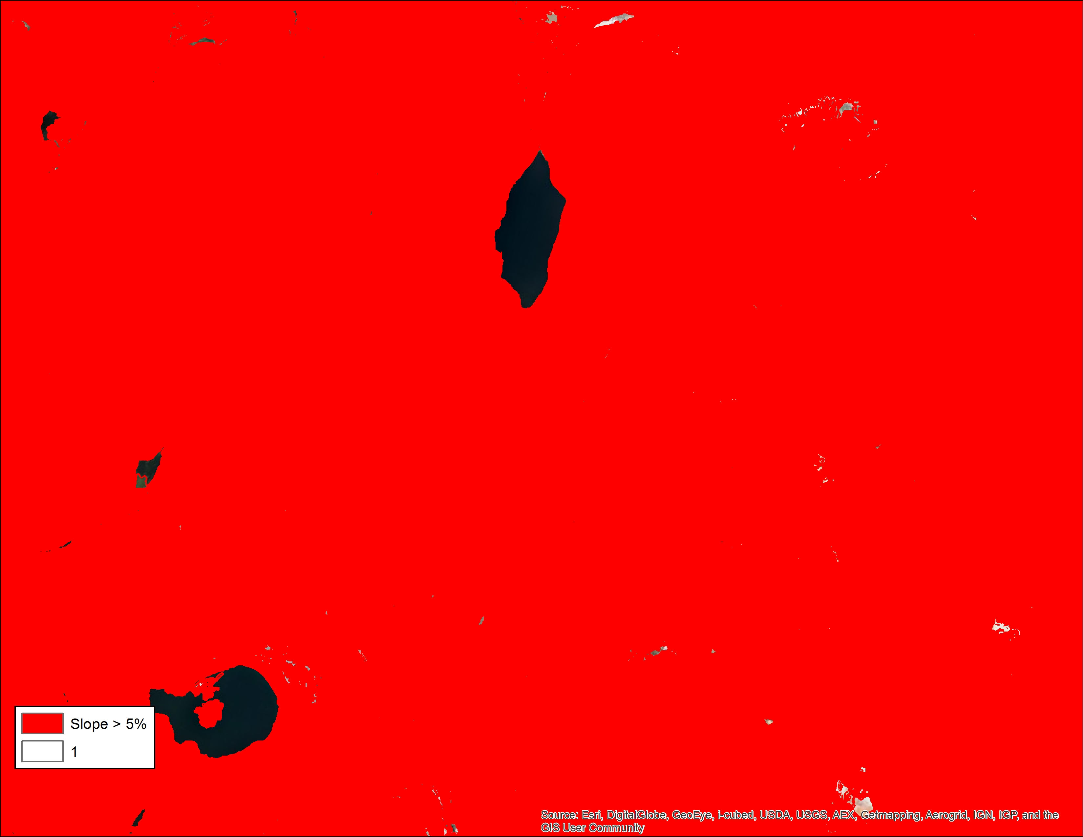
Initial Site Considerations – 1% Slope
1%
Notes:
In some areas where the terrain is very steep and slope requirements are stringent, you won’t be able to find sites for renewables development.

Slide 31
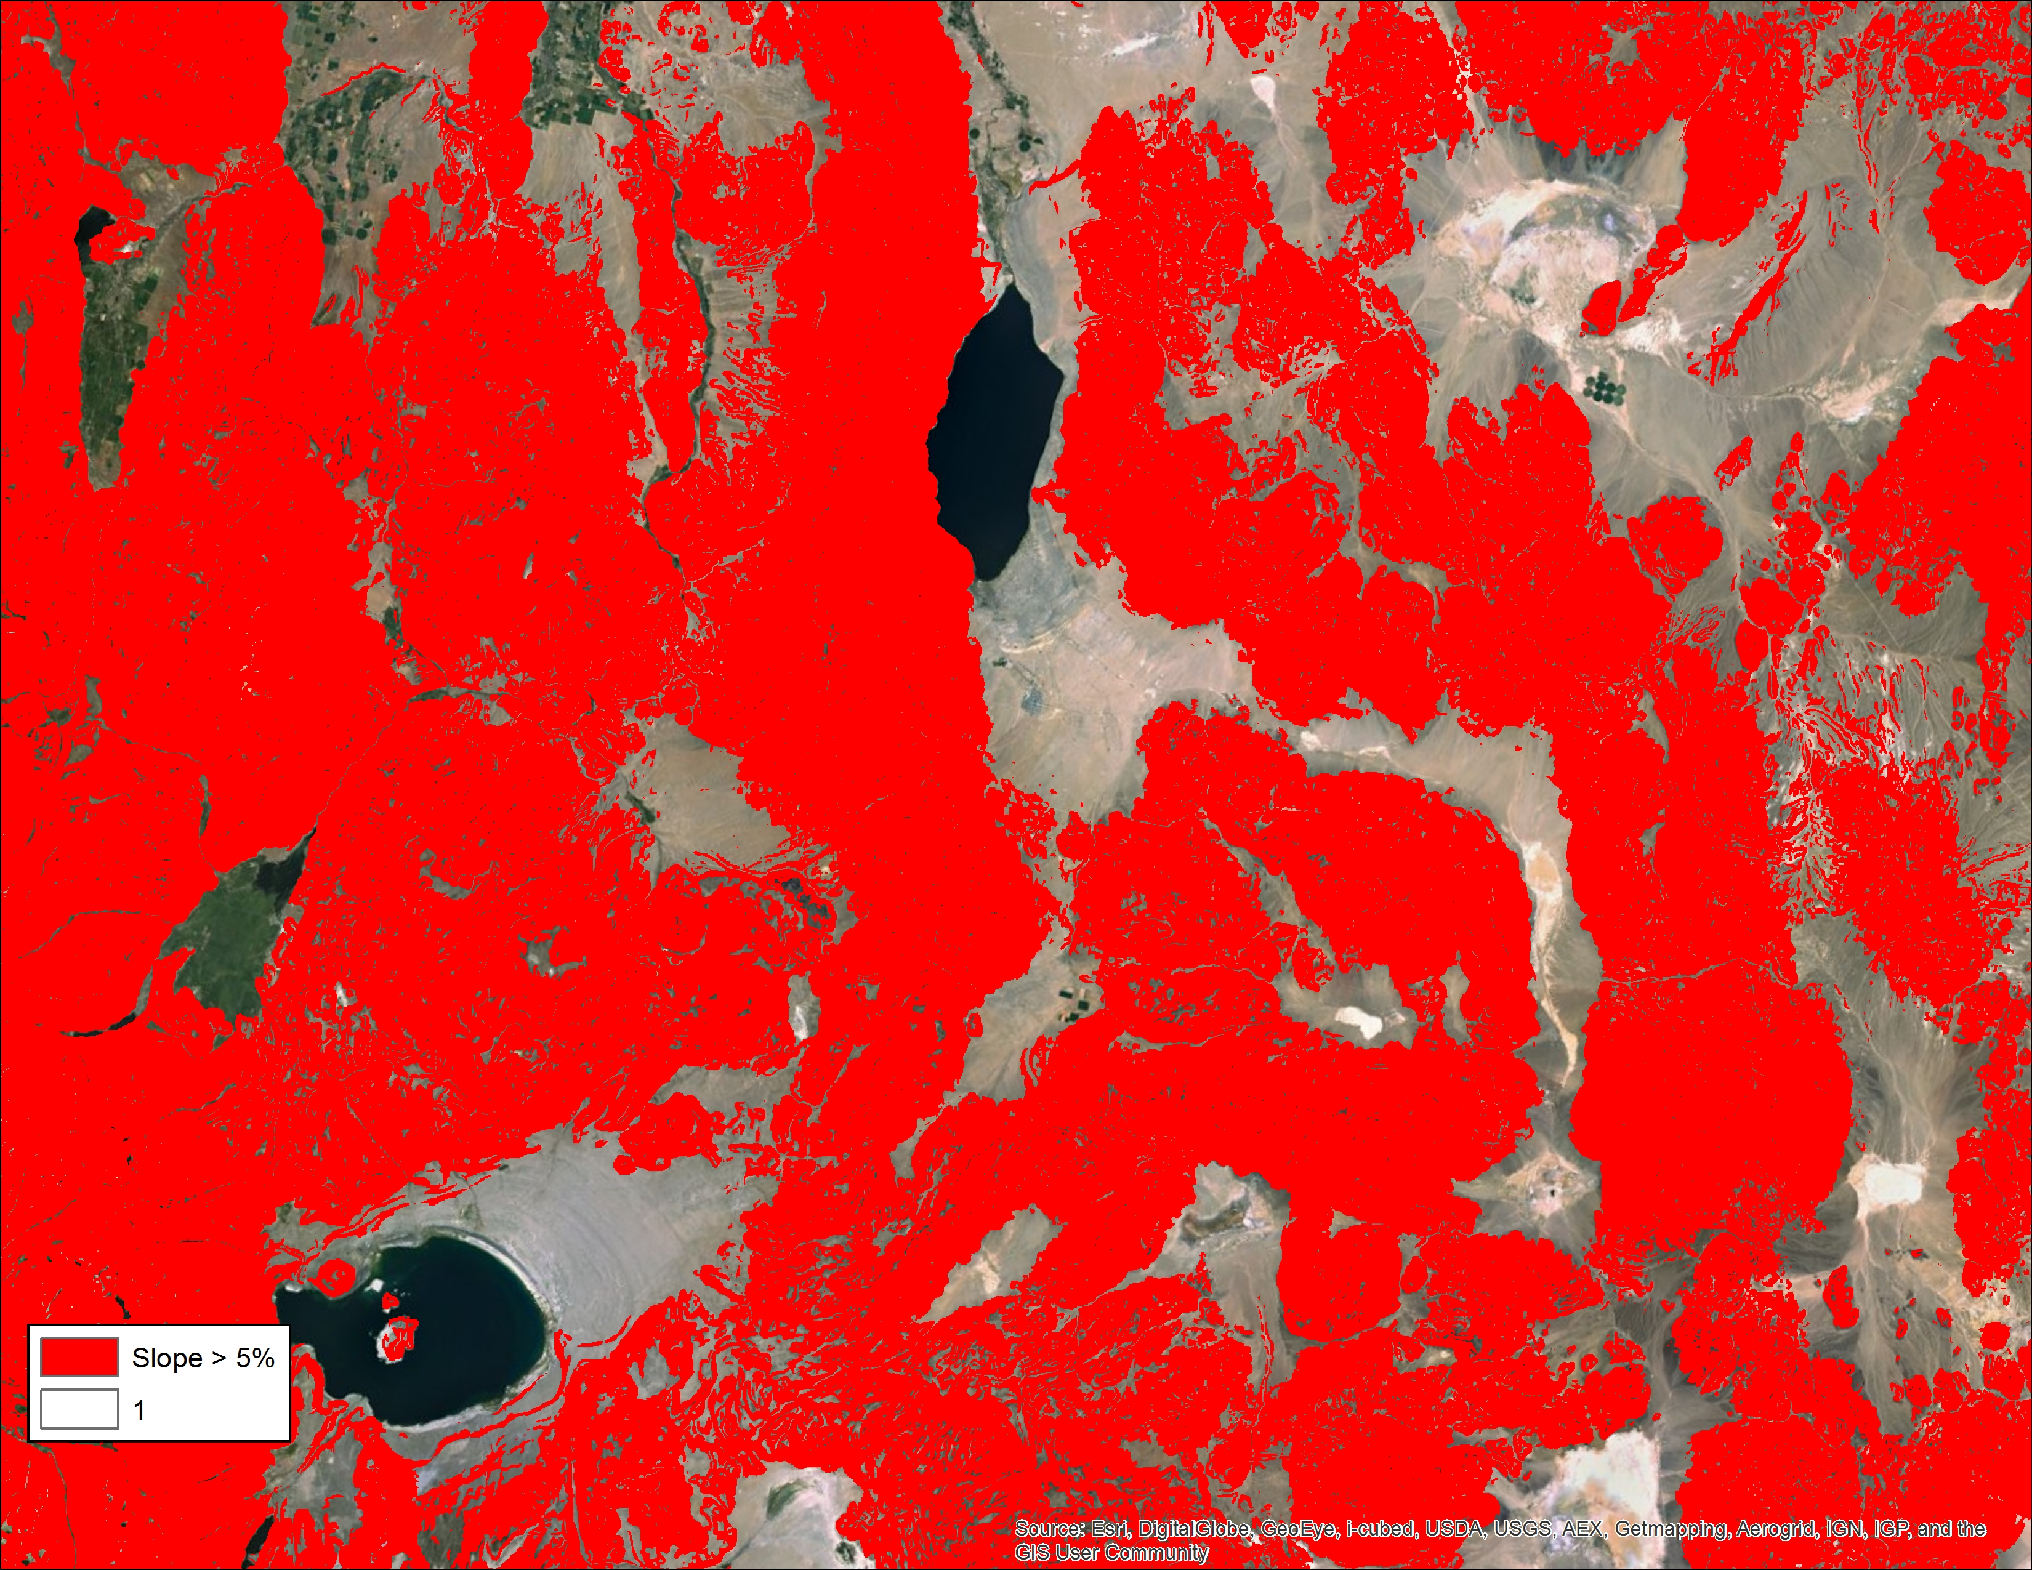
Initial Site Considerations – 5% Slope

Slide 32
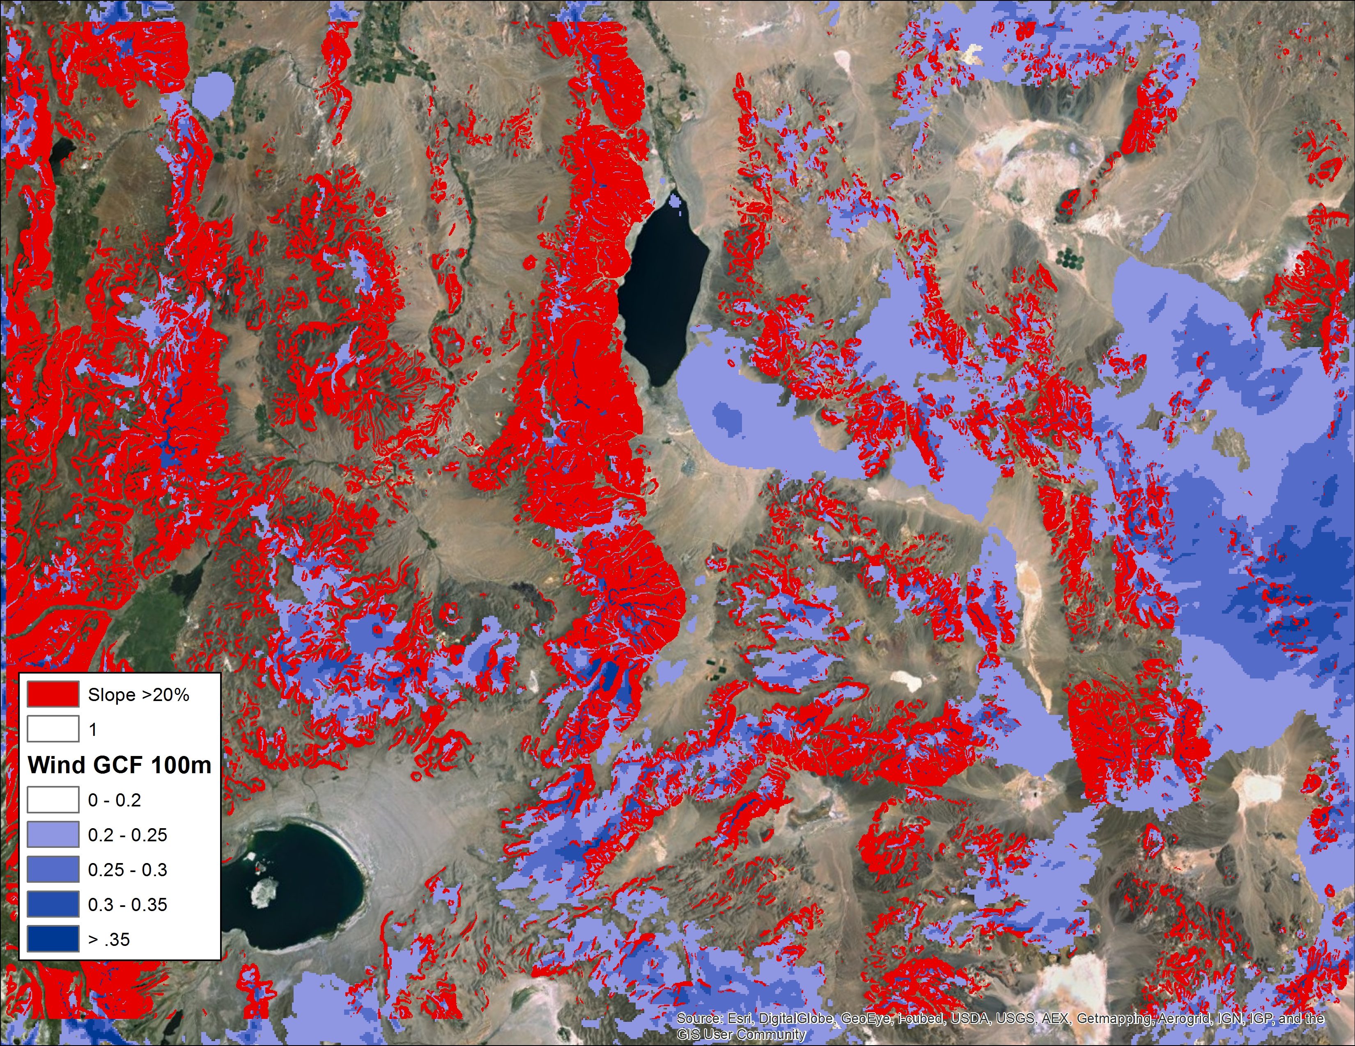
Initial Site Considerations – 20% Slope

Slide 33
Resource

Slide 34
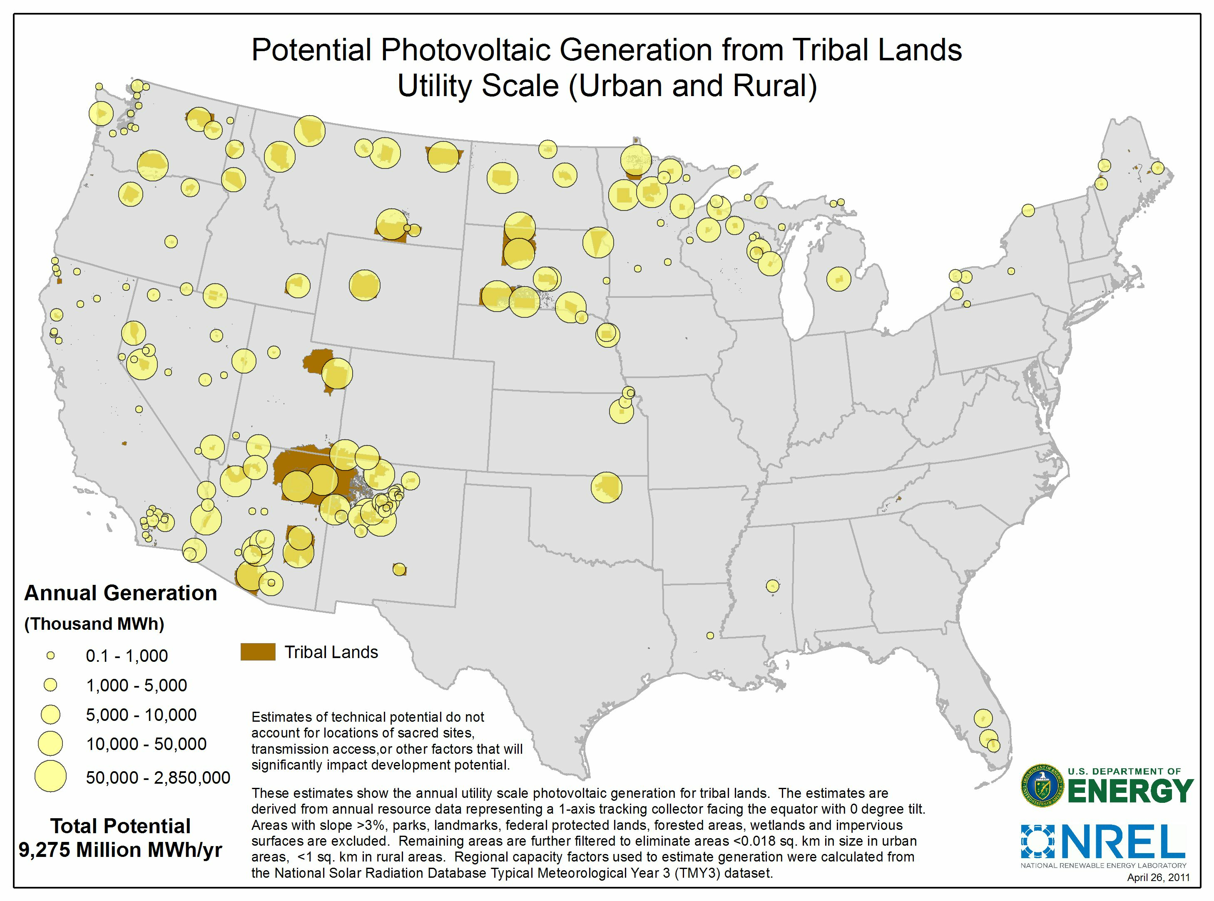
Solar PV Energy Resource Mapping
Notes:
Key point: you need a skilled Geographic Information System, or GIS, to make sense of mass of data and present it in a meaningful way.

Slide 35
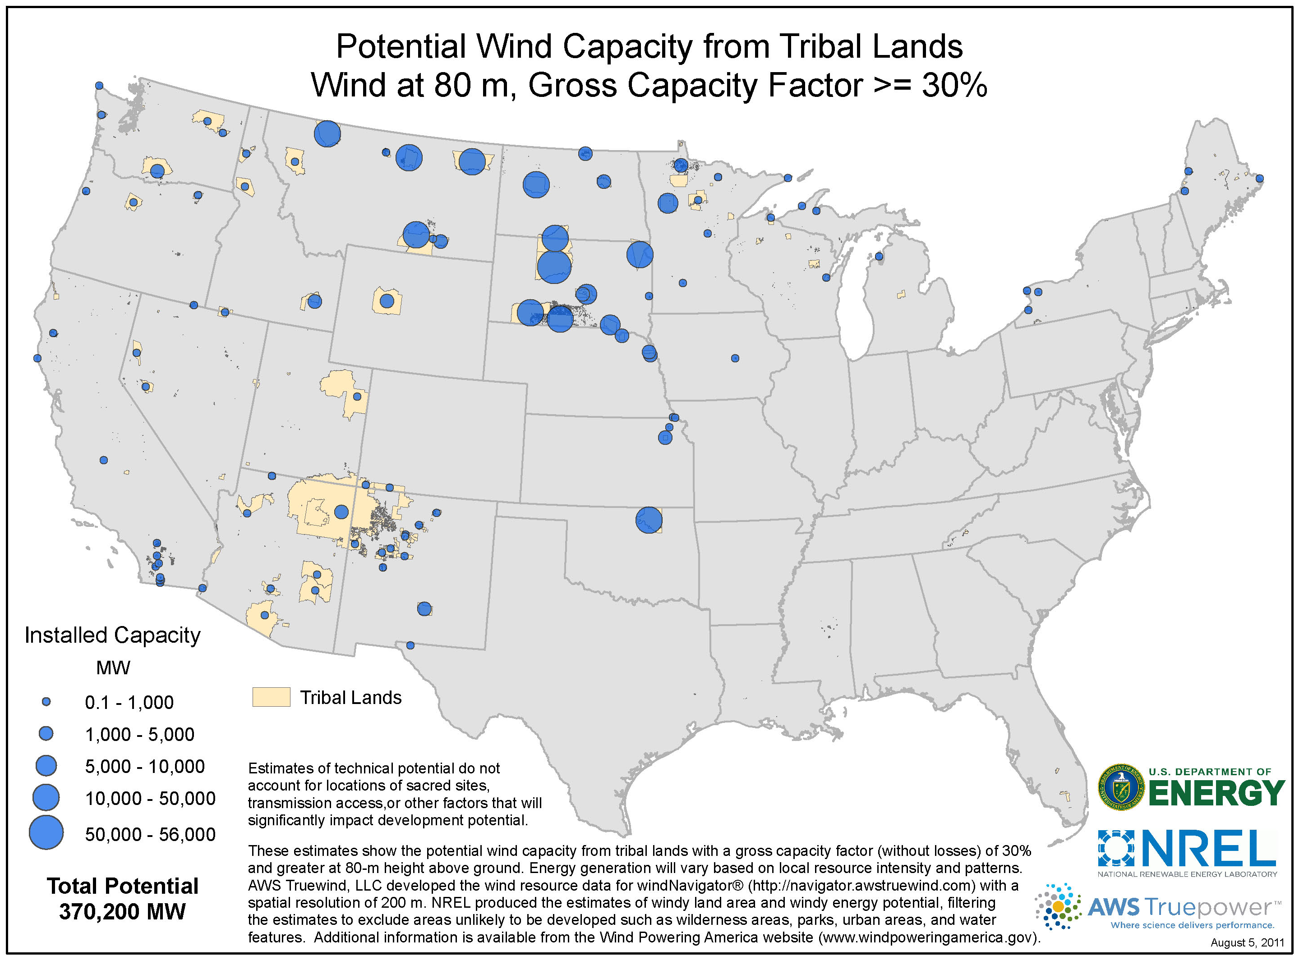
Wind Energy Resource Mapping
Notes:
Mention binder

Slide 36
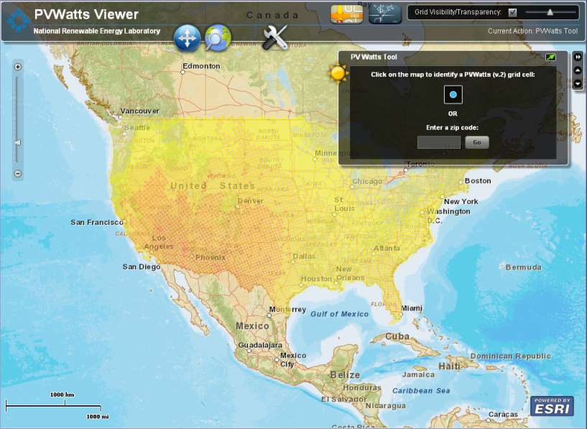
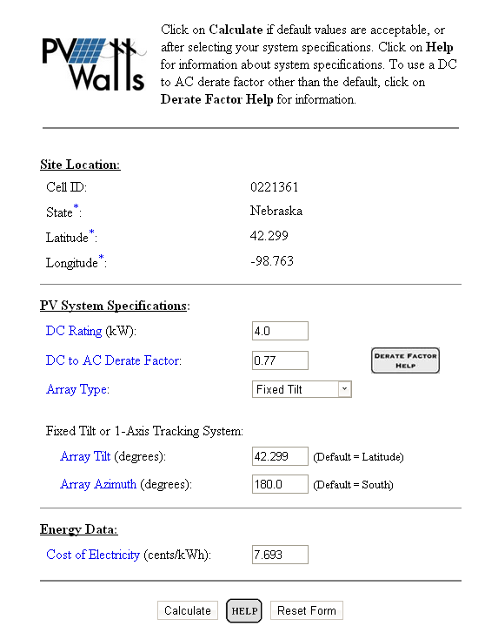
PVWatts
http://maps.nrel.gov/pvwatts
Basic PV Modeling
Project Description
The PVWatts application is an interactive map-based interface to rapidly utilize the PVWatts calculator. The PVWatts calculator is a basic solar modeling tool developed at NREL to allow non-experts to quickly obtain performance estimates for grid-connected PV systems.
Project Impact
This project is focused on providing the general public with a basic solar performance modeling tool and is one of the most heavily visited page on the NREL website. Users can get an estimate of expected monthly and annual solar resource values for any location in the United States.
Users
Generally solar installers, but really anyone is able to use this to get a first cut of the potential output. Many national subsidy providers use PVWatts to determine the amount of subsidy a homeowner can receive.
Data Analysis and Visualization Group Project Lead: Dan Getman
Dan.getman@nrel.gov
Notes:
The PVWatts application is an interactive map-based interface to rapidly utilize the PVWatts calculator. The PVWatts calculator is a basic solar modeling tool developed at NREL to allow non-experts to quickly obtain performance estimates for grid-connected PV systems. This tool is useful to homeowners as well as solar experts.

Slide 37
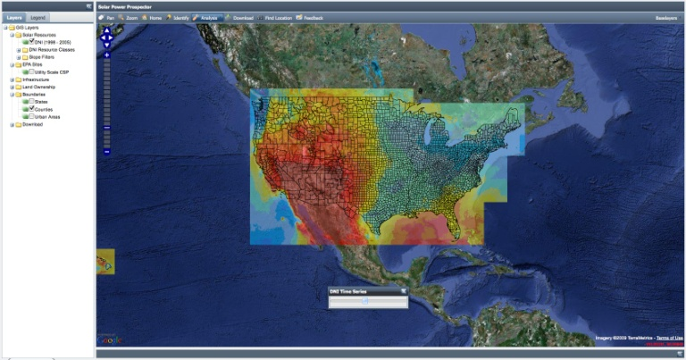
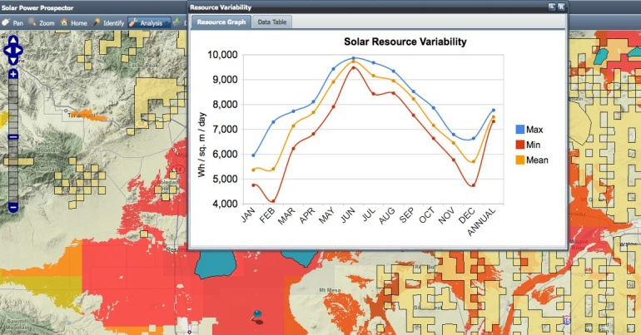
The Solar Prospector
http://maps.nrel.gov/prospector
Citing Utility-Scale CSP
Project Description
The Solar Prospector is a Web-based Geographic Information System (GIS) tool designed to assist industry professionals in the siting of utility-scale solar plants. The tool employs various GIS datasets to help identify areas that may have a high potential for solar plant development. Additionally, the Solar Prospector forms a platform to disseminate all solar related geospatial data to the larger industry and analysis community.
Project Impact
This project provides the location of solar resources, land ownership, and general infrastructure in an easy to use map format. Users can quickly download hourly solar resource data for specific locations and perform temporal analyses for any location in the United States and North Mexico.
Users
Originally developed for CSP and expanded to PV; the CSP project development industry is a heavy user of the tool
DOE/Lab analysts
PV developers interested in information from the federal government
Data Analysis and Visualization Group Project Lead: Ted Quinby
ted.quinby@nrel.gov
Notes:
Project Description
The Solar Prospector is a Web-based GIS tool designed to assist industry professionals in the siting of utility-scale solar plants. The tool employs various GIS datasets to help identify areas that may have a high potential for solar plant development. Additionally, the Solar Prospector forms a platform to disseminate all solar related geospatial data to the larger industry and analysis community.

Slide 38
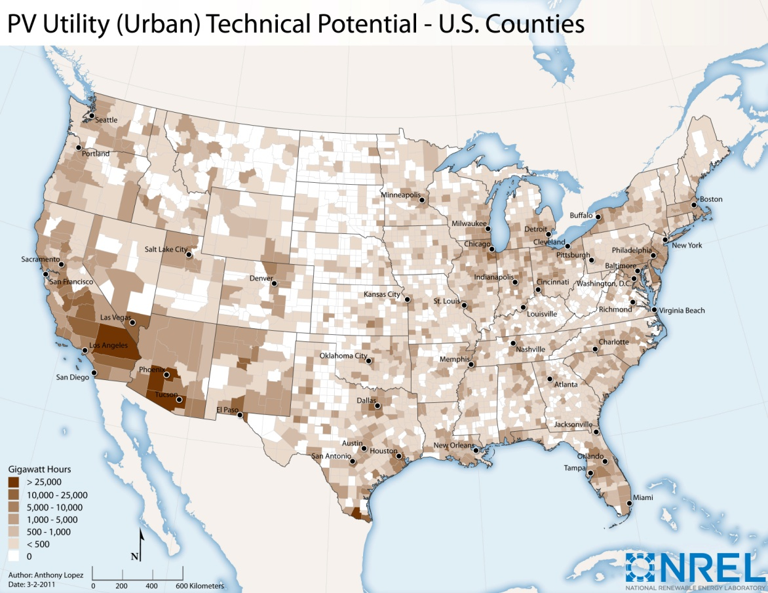
Renewable Resource Characterization & Technical Potential
Layer Stacking
Regional (or cell based) Capacity Factor
Resource
Water Features
Urban Areas
Land-Use Constraints
Wetlands
Contiguous Area
Topographic/Area
Constraints
Slope
Federally Protected
Lands
Habitat/Protected
Land Constraints
Area of Critical
Environmental Concern
  Photovoltaic (PV) Utility – Urban & Rural
  PV Rooftop
  Concentrating Solar Power (CSP)
  Onshore Wind
  Offshore Wind
  Biopower – Gaseous and Solid Biomass
  Geothermal
  Hydropower
Region
Technical Potentials produced:
Available Land
Regional Generation (MWh) = Σ(available land (km²) * power density (MW/km²) * capacity factor (%) * 8760 (hours/year))
*See Technical Potential Worksheet for data sources, descriptions, and details
Notes:
This Prospector tool is also available for wind and geothermal resource. Please refer to your binder for links to these tools.
NREL’s GIS team calculates the actual total amount of resource that could potentially be built out (the “technical potential”) using a funnel type process as indicated on the slide. We have done this for Indian lands previously.
We also have this prospector tool for both wind and geothermal.

Slide 39
NREL Tools Links
Map Apps at NREL http://maps.nrel.gov
MapSearch http://www.nrel.gov/gis/mapsearch/
REAtlas http://maps.nrel.gov/reatlas
IMBY http://mercator.nrel.gov/imby
SAM http://sam.nrel.gov
HyDRA http://maps.nrel.gov/hydra
RE_Atlas http://maps.nrel.gov/re_atlas
Solar Prospector http://maps.nrel.gov/prospector
OpenPV http://openpv.nrel.gov/gallery
PVDAQ http://maps.nrel.gov/pvdaq
LCOE Calculator http://www.nrel.gov/analysis/tech_lcoe.html
GeoREServ API http://rpm.nrel.gov/docs/georeserv/
REEDS http://www.nrel.gov/analysis/reeds/
PV JEDI http://www.nrel.gov/analysis/jedi/
OpenEI http://openei.org
Smartgrid.gov http://smartgrid.gov
Notes:
These are some Web links related to the sites that we have discussed today. Most are web-based but a few (like SAM and CREST) are free downloads.

Slide 40
Small Group Exercise
Evaluate pre-identified 10 sites on a map for potential development (considering what you just learned)

Slide 41
Project Savings and Production Potential
41

Slide 42
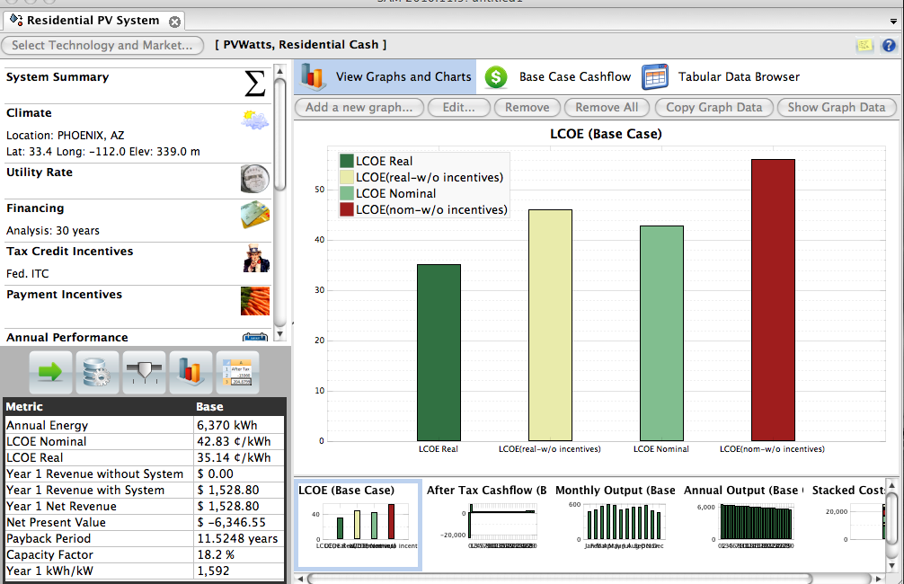
Advanced Tool: NREL’s System Advisor Model
Available at: https://www.nrel.gov/analysis/sam/
NREL’s System Advisor Model (SAM) is a free computer program that calculates a renewable energy system’s hourly energy output over a single year and calculates the cost of energy for a renewable energy project over the life of the project.
Solar, wind, geothermal, and other renewable and fossil technologies available
These calculations are done using detailed performance models, a detailed cash flow finance model, and a library of reasonable default values for each technology and target market
Notes:
Slide 42
As a side note, one way to help estimate the economics of a wind project is by using a levelized cost of energy, or LCOE estimate.
NREL has a number of LCOE tools which can be used to estimate the cost of power from a renewable energy system.
NREL has a free tool relevant for commercial scale projects at the website listed, called the system advisor model or SAM for short. SAM is an analytically powerful tool and is suited for detailed system performance, economic and financial modeling. It is available for multiple RE technologies and is used by utilities, project developers, regulators (and even commercial companies like Google) to evaluate renewable energy project potential.

Slide 43
General Modeling Workflow
Weather Data
System Specs
Electricity Production
System
Financing Options
Utility Rates & Incentives
Cost Data
Economics
Results of Annual, Monthly, and Hourly Output
Levelized Cost of Energy (LCOE), Net Present Value (NPV), Payback, Revenue, Capacity Factor
Notes:
The SAM model is unique in providing detailed performance modeling as well as detailed financial modeling to achieve the real-world metrics that will influence if a system is cost-effective.

Slide 44
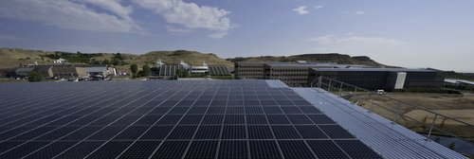
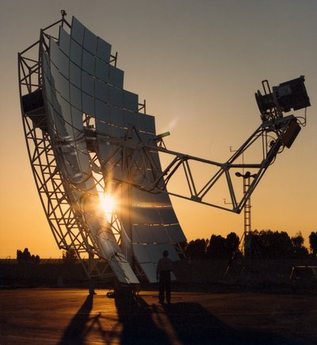
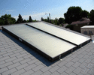

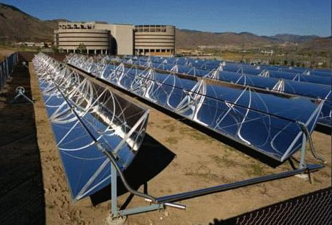
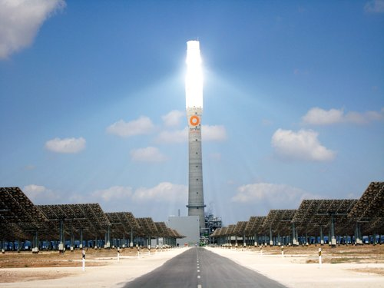
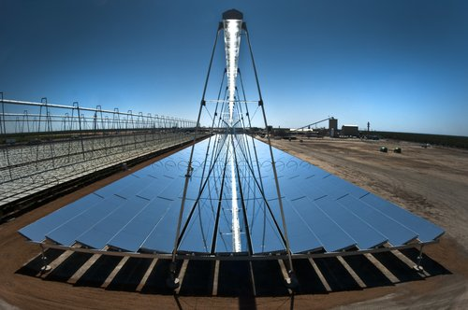
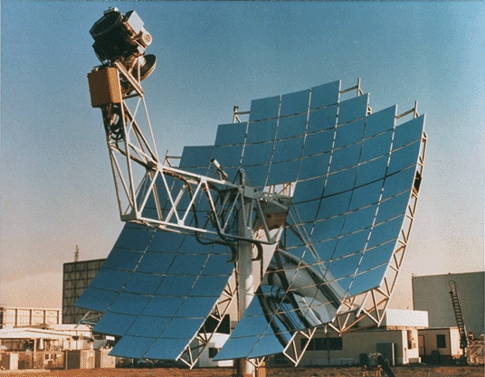
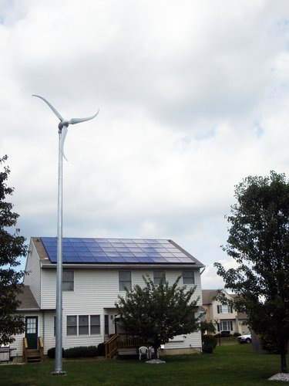

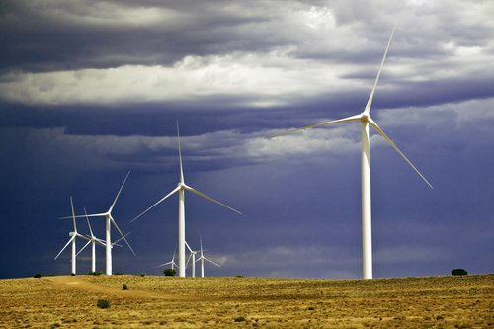
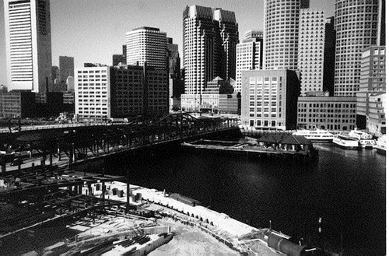
Technologies in SAM
Photovoltaics
Concentrating PV
Solar Water Heating
Geothermal
Parabolic Trough
Power Tower
Linear Fresnel
Dish-Stirling
Small Wind
Utility-Scale Wind
Biomass Power
Conventional
Notes:
The SAM model contains a number of technologies that can be modeled. Most are related to solar power (PV or CSP) but it also includes wind, solar hot water, geothermal power plants, and electricity from biomass.
Analyses can be done across the various technologies in a consistent framework and with consistent assumptions.
Photo Credits
Photovoltaics: NREL/PIX 21300
Concentrating PV: NREL/PIX 08728
Solar Water Heating: NREL/PIX 13529
Geothermal: NREL/PIX 05559
Parabolic Trough: NREL/PIX 04242
Power Tower: NREL/PIX 19807
Linear Fresnel: NREL/PIX 19882
Dish-Stirling: NREL/PIX 08469
Small Wind: NREL/PIX 14936
Utility-Scale Wind: NREL/PIX: 16701
Biomass Power: NREL/PIX: 10589
Conventional: NREL/PIX: 08465

Slide 45
Small Group Exercise
Use SAM to choose optimal site(s) for renewable development

Slide 46
Commercial-Scale Project Risks – Post Step 1
 | Risks | Risk Assessment Post Step 1
Development | Poor or no renewable energy resource assessment Not identifying all possible costs Unrealistic estimation of all costs Community push-back and competing land use | Screened good sites Reduced Reduced Reduced
Site | Site access and right of way Not in my backyard (NIMBY)/build absolutely nothing anywhere (BANANA) Transmission constraints/siting new transmission | Unchanged; Critical to have site control and community support
Permitting | Tribe-adopted codes and permitting requirements Utility interconnection requirements Interconnection may require new transmission, possible NEPA | Reduced Reduced High risk, reduced
Finance | Capital availability Incentive availability risk Credit-worthy purchaser of generated energy | High risk, unchanged Reduced Unchanged
Construction/ Completion | Engineering, procurement, and construction (EPC) difficulties Cost overruns Schedule | Assumed low, mitigable, or allocatable
Operating | Output shortfall from expected Technology O&M Maintaining transmission access and possible curtailment | Assumed low, mitigable, or allocatable
Sources: Adapted from Holland & Hart, RE Project Development & Finance & Infocast, Advanced RE Project Finance & Analysis
NOTE: Underlining signifies that the risk assessment outcome changes during the step at hand.
Notes:
Slide 46
Here is a list of project risks that are likely to be highlighted or exposed in step 1. Just because a project may or may not have some of these risks, does not mean it is viable or not. It is just an indication of the likely challenges needed to overcome and something to keep in mind as the project moves forward. As shown in the last column, several of the risks were reduced thanks to analysis done in step 1 – the more data that is gathered and the more analysis that is done, the lower the risks become.
The main difference to keep in mind between commercial and facility and community scale projects is that commercial aims to generate revenue and can be a much larger size to make the economics work. With the size of the projects comes a much more serious look at the business case and the more far reaching impacts of larger systems.

