Slide 1
Nuclear Energy Advisory Committee (NEAC) Meeting
Krystal D. Milam, Designated Federal Officer
August 9, 2023

Slide 2
Overview of today’s agenda
Time | Topic | Presenter
9:00 am | Welcome and Opening Remarks | William D. Magwood, Chair, NEAC Dr. Kathryn Huff, Assistant Secretary
9:30 am | Office of Nuclear Energy Update | Dr. Kathryn Huff, Assistant Secretary
9:40 am | Briefing on Nuclear Energy Liftoff reports | Julie Kozeracki, Senior Advisor, LPO
10:15 am | Break
10:25 am | Briefing on National Academies Advanced Reactor Report | Dr. Michael Ford, ALD for Engineering, PPPL
10:55 am | Briefing on National Academies Fuel Cycle Report | Paul Dickman, Committee Member, National Academies
11:25 am | Break
11:40 am | Physical Infrastructure Update | Physical Infrastructure Subcommittee
12:15 pm | Consent-based Siting Update | Consent-based Siting Subcommittee
12:50 pm | Lunch
1:45 pm | Workforce of the Future Update | Workforce of the Future Subcommittee
2:20 pm | Break
2:30 pm | International Engagement Update | International Engagement Subcommittee
3:05 pm | Break
3:15 pm | Public Comment | Public Attendees
3:35 pm | Closing Remarks | Dr. Kathryn Huff
4:00 pm | Adjourn

Slide 3
Opening Remarks
Assistant Secretary for Nuclear Energy, Dr. Katy Huff
The Honorable William D. Magwood, IV, Chair

Slide 4
Office of Nuclear Energy Update
Assistant Secretary Dr. Katy Huff

Slide 5
Briefing on the Nuclear Energy Liftoff Reports
Julie Kozeracki
Senior Advisor, Loan Programs Office

Slide 6
Pathways to Commercial Liftoff
Advanced Nuclear | June 2023

Slide 7
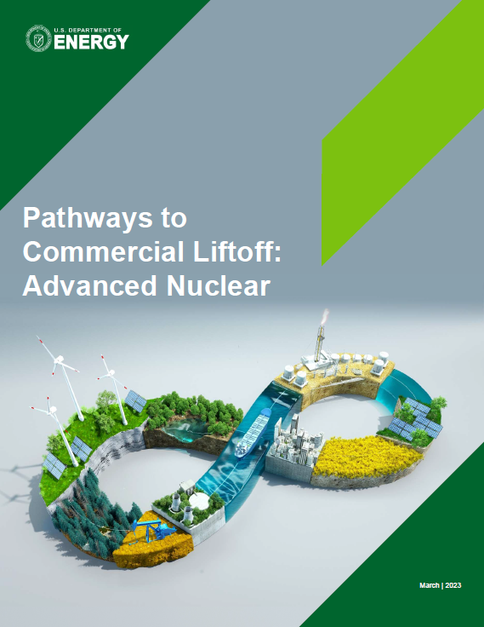
Liftoff reports are a cross-DOE effort to create a shared fact base for answering key investor and stakeholder questions
What is advanced nuclear and its value proposition? Report covers Gen III+ and IV across large reactors, SMRs, and microreactors; nuclear provides competitive value as a clean firm resource for a resilient decarbonized grid
Do we need new nuclear for net zero when renewables are so cheap? Yes, likely 200 GW of new nuclear in the US by 2050, especially given renewables buildout
Why will it be different than recent over-budget builds? SMRs may avoid historical cost and constructability challenges; Vogtle provides important lessons on rigorous pre-construction planning
Report was a collaboration between the Loan Programs Office, the Office of Clean Energy Demonstrations, the Office of Technology Transitions, and the Office of Nuclear Energy

Slide 8
Advanced nuclear includes five major technology types across two generations
Gen III+
Gen IV
Large Light Water
Light Water SMRs
High Temperature Gas Reactors
Metal/Salt Cooled
Micro
Power output
~1+ GW
~70–300 MW
~80–270 MW
~200–800 MW
~1–50 MW
Typical fuel
LEU
LEU
HALEU
HALEU
HALEU
Coolant
Water
Water
Gas, e.g., helium
Metal or salt
Various
Select programs (reactor developer)
LPO loan guarantees for Vogtle Units 3 and 4 (Westinghouse)
Carbon Free Power Project (NuScale)
Advanced Reactor Demo. Program (X-energy)
Advanced Reactor Demo. Program (TerraPower)
DOD Project Pele (BWXT), Eielson Air Force Base RFP (TBD)

Slide 9
Achieving net-zero in the U.S. by 2050 would require ~550–770 GW of additional clean, firm capacity
Capacity in lower renewables case, GW
Capacity in higher renewables case, GW
3,878
2,669
44%
67%
Variable
1,278
1,278
19%
205
14%
Non-clean, firm
37%
19%
Clean, firm
206
2021
2050
2021
2050
~5x clean, firm (~770 GW)
~3.5x clean, firm (~550 GW)

Slide 10











Nuclear has a unique value proposition for the net-zero grid
Clean?
Firm?
Low land use?
Low transmission buildout?
Concentrated local economic benefits?
Additional applications?¹
Cost competitive today?
High
Low
Nuclear
Hydropower
Geothermal
Renewables + storage²
Renewables: offshore
Power source
Renewables: onshore
Natural gas + CCS
Coal + CCS
Natural gas
Coal
Additional applications include clean hydrogen generation, industrial process heat, desalination of water, district heating, off-grid power, and craft propulsion and power
Renewables + storage includes renewables coupled with long duration energy storage or renewables coupled with hydrogen storage

Slide 11
Nuclear is expected to be cost competitive with other clean firm resources
Estimated LCOE of clean firm energy resources, $/MWh
NOAK with tax credits
FOAK with tax credits
Advanced nuclear¹
66
109
Renewables with storage
for 24/7 load matching²
69
119
Natural gas with carbon
capture and storage³
63
99
1. Advanced nuclear estimated LCOE from $3,600/kW (NOAK) and $9,000/kW (FOAK) overnight capital cost and includes 30% 48E ITC (without either 10% adder) 2. Renewables with storage for 24/7 load matching from LDES Council’s “A path towards full grid decarbonization with 24/7 clean Power Purchase Agreements” and the LCOE is calculated as (annualized cost of renewable generation + storage capacity) / clean energy delivered to the off-taker excluding additional costs or revenues that would impact final PPA price and includes the ITC under section 48 for the full investment cost of the facility 3. Natural gas with carbon capture and storage numbers from the McKinsey Power Model and include the 45Q tax credit

Slide 12

Three key stages inform path to deploying advanced nuclear at scale
Today
2035
2050
Tech. demonstrations
1. Committed orderbook
Need committed orderbook of 5-10 (likely) Gen III+ SMRs by 2025
2. Project delivery
Need to deliver reasonably (±20%) on-time and on-budget
3. Industrialization
Need to scale workforce, supply chain, and licensing capacity

Slide 13
Waiting until mid-2030s to deploy at scale could lead to missing decarbonization targets or overbuilding supply chain
New nuclear deployment starting in 2030
Annual deployment (GW / yr) built and Cumulative GW online
New nuclear deployment starting in 2035
Annual deployment (GW / yr) built and Cumulative GW online
GW deployed by year
Cumulative GW
Cumulative GW
GW / yr
Cumulative GW
  Steady-state achieved in 2046 at 20 GW / yr deployed
  Overbuild – stranded assets
GW / yr
  Steady-state achieved in 2040 at 13 GW / yr deployed
200
20
200
20
150
15
150
15
100
10
100
10
50
5
50
5
0
0
0
0
2030
35
40
45
2050
2030
35
40
45
2050
1. Construction and manufacturing | Assumptions: 2-year licensing timeline concurrent with early site prep; Manufacturing (1 yr) followed by construction (3 yrs) occurs post-licensing and site prep

Slide 14
Vogtle root causes and systemic issues
Root causes lead to…
…systemic issues which lead to…
…lagging indicators of poor performance
Root causes
Systemic issues
Lagging indicators
Incomplete design
1
Extensive rework / remediation
Schedule slippage
Inadequate level of detail in Integrated Project Schedule / inflexible timelines; poor project controls system
2
Supply chain delivery issues (for modules)
High CPI (hours worked / hours earned ratio), low productivity
3
Low individual productivity
Inadequate quality assurance / control practices; improper documentation standards
4
High levels of attrition and absenteeism
Poor risk assessment
Limited design constructability
Shortage of experienced labor
Within project leadership control
COVID-19 pandemic
Outside of project leadership control

Slide 15





Why will new projects be different than recent over-budget builds?
Potential advanced nuclear FOAK to NOAK overnight capital costs, $/kW
~10,000
~3,800
~6,200
500
200
50
~3,600
400
Recent FOAK projects
Cost reductions driven by best practices
Best practices FOAK
Yard/cooling/
installation
EPC
Nuclear island equipment
Turbine island equipment
Owner’s costs
NOAK
~40%
Total cost reduction
Cost reductions by individual cost category
30-40%
40-50%
40-50%
20-30%
10-20%
30-40%
Key drivers of cost reduction
Best practice project delivery, esp. pre-planning
Learning by doing
Supply chain development
Driven by reductions in other cost categories
Standardization
Modularization
Build time reduction

Slide 16
Catalyzing the orderbook may require interventions to help manage completion risk
Nuclear industry is in a stalemate
Possible accelerants for generating orders
The nuclear industry is stuck in a stalemate where utilities and other potential owners recognize an increasing need for nuclear power, but are too afraid of uncontrolled overrun and project abandonment risk to place committed orders
Developing a committed orderbook could be facilitated by pooling demand, e.g., with a consortium of utilities
Participation in such a model could be accelerated with financial support (either public or private) to help de-risk the first 5-10 projects
Cost overrun insurance
A percentage of construction costs over and above a certain amount are covered by the government or private insurer
Tiered grant
Large grant amount per kW, ramping down over each successive deployment, e.g., second reactor receives less than the first
Government as the owner
Government commits to build and/or operate reactors to provide pooled demand
Government as the off-taker
Government signs offtake contract for some or all of generation from an orderbook

Slide 17
Advanced Nuclear Pathways to Commercial Liftoff: Executive Summary
Report aims to create a shared fact base for answering key investor and stakeholder questions
  What is advanced nuclear and its value proposition? Report covers Gen III+ and IV across large reactors, SMRs, and microreactors; nuclear is clean, is firm, uses land efficiently, requires less transmission buildout, provides regional economic benefits, and has additional use cases and benefits beyond traditional electricity generation
  Do we need new nuclear for net zero? Likely 100-200GW in the US by 2050, especially given renewables buildout
  Why will it be different than recent over-budget builds? SMRs may avoid historical cost and constructability challenges; Vogtle provides lessons on the importance of rigorous pre-construction planning
Requirements for scaling to 200GW of new US nuclear by 2050
  Waiting until mid-2030s to deploy at scale would lead to missing targets and/or significant supply chain overbuild
  Need committed orderbook of (likely) Gen III+ SMRs by 2025, 5-10 of one design; one design is necessary, but not sufficient and Gen III+ is likely for nearest-term deployment given utility risk tolerance
  200GW cumulative deployment will require developing a workforce of ~375K and scaling and adapting component supply chains that are sub-scale today; reduced, predictable licensing timelines also key
  Need to identify incentive and location(s) for long-term spent fuel storage implications
Potential solutions
  Utilities are afraid of uncontrolled overrun and project abandonment risk; catalyzing the orderbook will require intervening to manage completion risk, e.g., overrun insurance, tiered grants, government ownership/offtake
  Project delivery for first reactors needs to actively incorporate Vogtle lessons, with potential EPC partnerships
  Industrialization will require large-scale financing (e.g., low-cost debt) and programs (e.g., labor recruiting, training)

Slide 18
Modeling results show demand for 200+GW of new nuclear capacity
Low case
Infrastructure/renewables limitations
High case¹
Model
Advanced nuclear capacity, GW
Demonstration and Deployment Pathways Modeling (this report)²
2050
NREL, 2022 “100% Clean Electricity by 2035”
2035
Princeton University “Net-Zero America: Potential Pathways, Infrastructure, and Impacts”
N/A
2035
Breakthrough Institute, 2022 “Advancing Nuclear Energy”
2050
N/A
Vibrant Clean Energy, 2022 “Role of Electricity Produced by Advanced Nuclear Technologies”
2050
N/A
Pacific Northwest National Laboratory, 2022 “Scenarios of Nuclear Energy Use in the United States in the 21st Century”
2050
1.“Low” and “high” refer to the level of nuclear build out; methodology for “low” and “high” nuclear build-out cases differ report to report; 2. NZD Low-RES case sensitivities shown

Slide 19
LCOE expected to achieve sub $60/MWh if capex costs reach <$5000k/kW
LCOE of advanced nuclear given varying overnight capital costs, $/MWh
Overnight capital cost
Financing
Opex, fuel, and sustaining capital
Tax
Tax credit (ITC)
Potential FOAK estimates
Potential NOAK estimates
140
109
120
85
100
77
80
69
66
60
40
20
0
3
3
3
-11
3
-10
3
-20
-40
9,000
6,000
5,000
4,000
3,600
Overnight capital cost, $/kW
Source: NREL “Examining Supply Side Options to Achieve 100% Clean Electricity by 2035”, Inflation Reduction Act, EIA Annual Energy Outlook 2022

Slide 20
The IRA provides a powerful boost to nuclear power economics, but may not be sufficient to accelerate commitments for deployment at scale
Advanced nuclear FOAK LCOE before and after IRA impact, $/MWh
No IRA
PTC
ITC
Both adders
No adders
140
120
118
109
100
88
87
80
66
60
60
40
20
0
No IRA
PTC
ITC
No IRA
PTC
ITC
No IRA
PTC
ITC
High end FOAK
$9,000/kW
Best practice FOAK
$6,200/kW
NOAK
$3,600/kW
1. “Both adders” represents the ITC / PTC with the addition of both 10% adders for energy communities and domestic content

Slide 21
Small modular reactors can provide more certainty of hitting a predicted cost target
Probability distribution of cost of advanced nuclear
SMR
300
Large reactor
250
200
150
100
50
0
4,000
6,000
8,000
10,000
12,000
14,000
Total installed cost ($/kW)

Slide 22
Demonstration programs are underway to demonstrate the technological viability of novel nuclear technologies
Program
Reactor developer
Reactor type
Years of award
Awardee cost-share
DOE cost-share
DOE cost-share (%)
Advanced Reactor Demonstration Program (ARDP)
TerraPower
Sodium fast reactor
2021-2028
$2.0B
$2.0B
50%
ARDP
X-energy
High temperature gas reactor
2021-2027
$1.2B
$1.2B
50%
Carbon Free Power Project (CFPP)
NuScale
Light water reactor
2020-2030
$3.6B
$1.4B
28%

Slide 23
Break
Return: 10:25 AM

Slide 24
Briefing on the National Academies of Science Advanced Reactor Report
Dr. Michael Ford

Slide 25
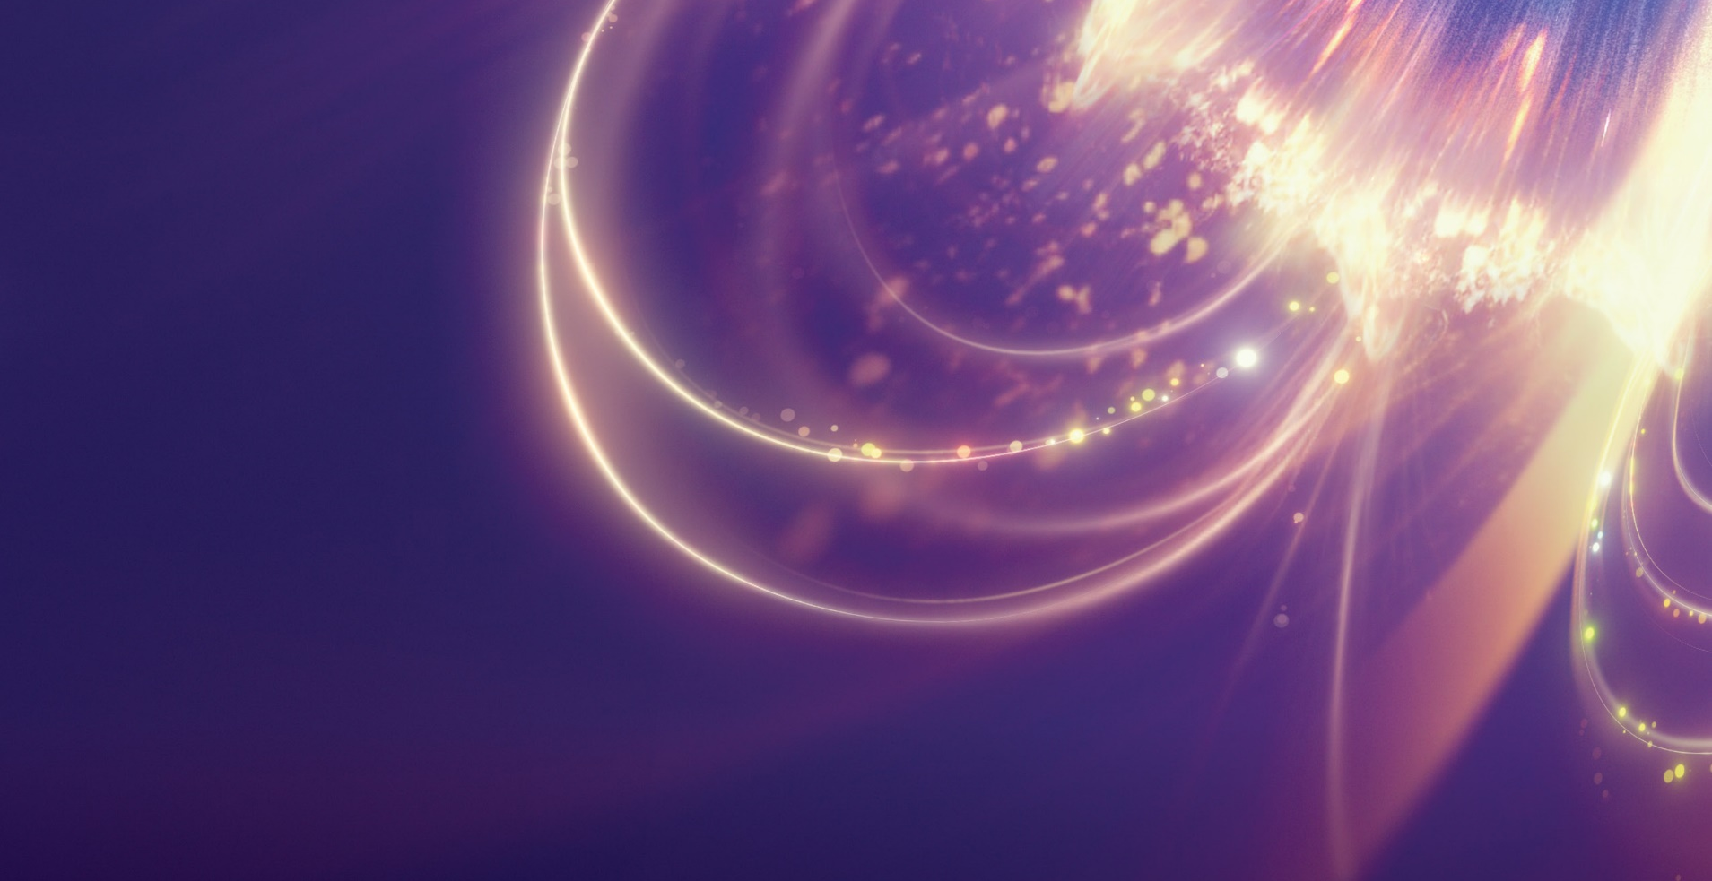


Laying the Foundation for New and Advanced Nuclear Reactors in the United States
Committee Chair: Richard A. Meserve, Covington & Burling LLP
Study Director: Kasia Kornecki, Board on Energy and Environmental Systems
Briefing Lead: Michael J. Ford, ALD for Engineering, PPPL
Consensus Report Briefing

Slide 26


What will it take for new and advanced nuclear reactors to play a role in a net-zero emissions future?

Slide 27
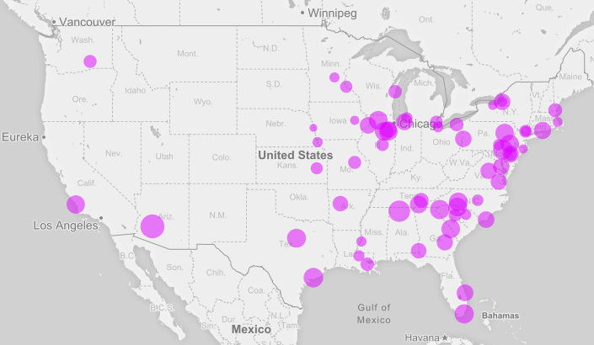
The Current State of Nuclear Power in the U.S.
18.2%
U.S. electricity
Nuclear power plants are the largest source of low-carbon electricity in the United States. They supply 18.2% of total U.S. electricity and half of total low-carbon electricity.
92
Power Plants
There are 92 nuclear power plants in the United States (442 across the globe).
40
Years
The initial license lifetime of a nuclear power plant in the United States.

Slide 28
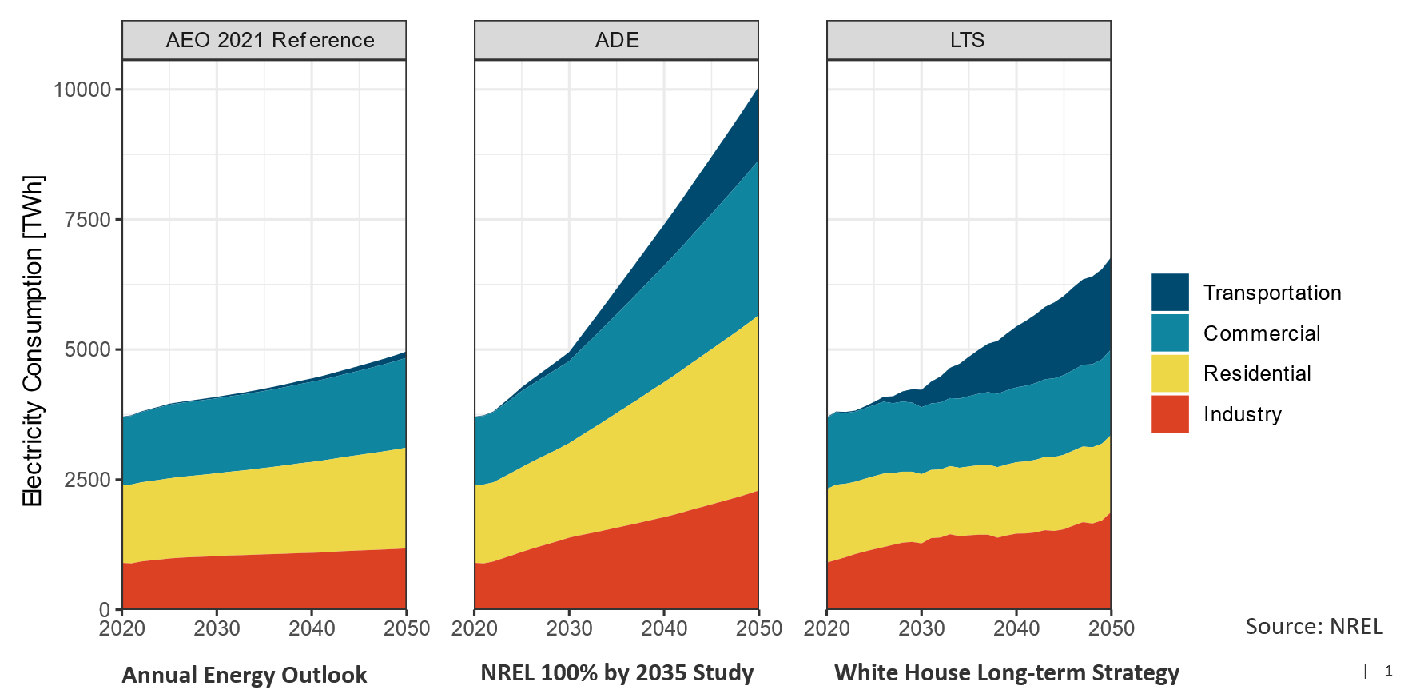
U.S. Demand for Electricity Projected to Grow
Annual Energy Outlook
NREL 100% by 2035 Study
White House Long-term Strategy

Slide 29
About the Study
Origin: Congressional interest, interest within the National Academy of Engineering, discussions between the Board on Energy and Environmental Systems and the Nuclear and Radiation Studies Board
Sponsors:
A philanthropic donation to the National Academy of Engineering by Dr. James J. Truchard
DOE’s Office of Nuclear Energy
Framing Questions: What would it take for new nuclear technologies to be an option in an increasingly decarbonized and continually decarbonizing energy system? What are the opportunities and barriers?
Outputs: A workshop proceedings (2022), a consensus report (2023), a follow-on workshop (TBD)
This briefing shares the results of the committee’s report.

Slide 30
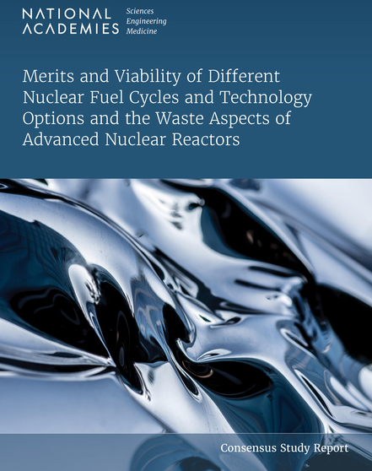
About the Study – Scope
What IS in scope
Identifying opportunities and barriers to advanced nuclear reactor commercialization in the United States over the next 30 years as part of a decarbonization strategy. Topics include:
Research, development, and demonstration
Manufacturing, construction, and operational characteristics
Economic, regulatory, societal, and business challenges
Applications outside the electricity sector
Role of the U.S. government
National security and nonproliferation
Future workforce and educational needs
What is NOT in scope
Read the companion report:
https://nap.nationalacademies.org/26500

Slide 31
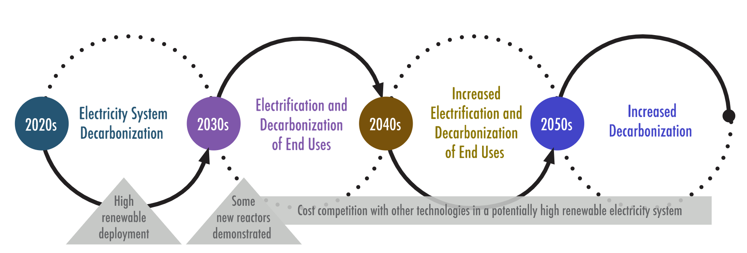
The Evolving Electricity System:
Different Opportunities and Challenges Every Decade
The race against climate change is both a marathon and a sprint

Slide 32










Core Variables Crucial for Commercial Success
Reactor Technology
Research
Safety Regulations
Project Management and Construction
Workforce
Alternative
Applications
Federal Funding from Design to Deployment
Community Engagement and Acceptance
Security and Safeguards
International
Marketing
Financing

Slide 33
What Are New and Advanced Nuclear Reactors?
Technological maturity
Reactor Technology | Technology Experience | Technology Gaps
Small Modular LWR | Evolution from currently operating LWRs | Develop and qualify unique plant components
Liquid Metal Fast Reactor | Several small SFRs operating worldwide | Qualify annular metal fuel and advanced steel alloys Perform source term experiments to reduce conservatisms
High-Temperature Gas Reactor | Several small HGTRs operating worldwide | Qualify fuel and graphite (<1100 K outlet temp designs) Qualify materials used in heat exchanger and other components (>1100 K outlet temp designs)
Fluoride Salt-Cooled Reactor | FHR designed, reduced-scale prototype planned for demonstration | Demonstrate corrosion/control for Flibe-based salt in presence of neutron field Demonstrate materials for strength, corrosion resistance, and irradiation stability in operation Demonstrate tritium migration and radioactivity control Demonstrate passive safety systems
Heat-Pipe-Cooled Reactor | LANL space reactor demonstrated concept at reduced power scale | Develop compact PCU operation and integration with heat-pipe core cooling Develop autonomous control and instrumentation Demonstrate passive safety systems
Molten Salt-Fueled-Cooled Reactor | ORNL experiments operated without power conversion systems | Demonstrate corrosion control for salts, tritium migration and control, materials for long-term operation Demonstrate passive safety systems
Gas Fast Reactor | No reactor ever built | Qualify fuel, clad, and structural materials for safety and radiation damage Demonstrate passive safety systems

Slide 34
Reactor Technology R&D
New research and development is needed to close technical maturity gaps and enable faster demonstrations and deployments
RECOMMENDATION 2.2: The Department of Energy (DOE) should initiate a research program that sets aggressive goals for improving fuels and materials performance. This could take the form of a strategic partnership for research and development involving DOE’s Office of Nuclear Energy and Office of Science, the U.S. Nuclear Regulatory Commission, the Electric Power Research Institute, the nuclear industry, national laboratories, and universities. The program should incentivize the use of modern materials science, including access to modern test reactors, to decrease the time to deployment of materials with improved performance and to accelerate the qualification (ASME Section III, Division 5 or equivalent) and understanding of life-limiting degradation processes of a limited number of high-performance structural materials, e.g., reactor core materials and cladding.

Slide 35
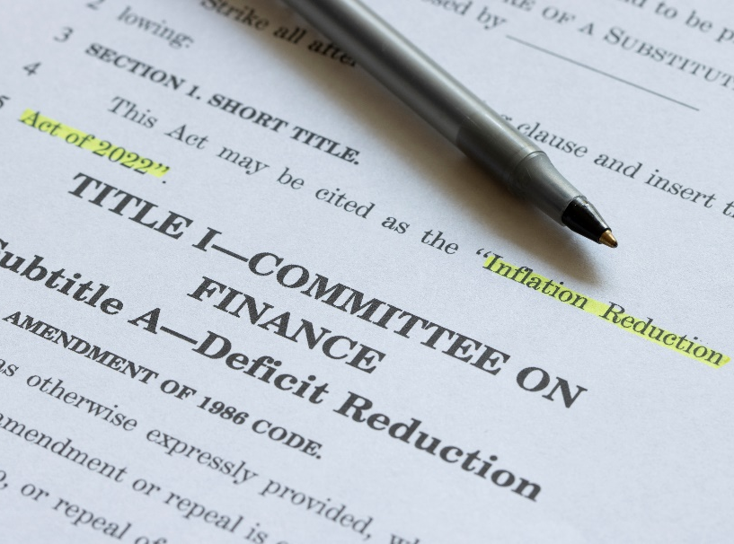
Financial Incentives
Incentives at various levels of government will be required
RECOMMENDATION 4.4: To enable a cost-competitive market environment for nuclear energy, federal and state governments should provide appropriately tailored financial incentives (extending and perhaps enhancing those provided recently in the Inflation Reduction Act) that industry can use as part of a commercialization plan, consistent with the successful incentives provided to renewables. These tools may vary by state, locality, and market type. Continued evaluation of the recently passed incentives will need assessment to determine their adequacy. The scale of these incentives needs to be sufficient not only to encourage nuclear projects, but also the vendors and the supporting supply chains.

Slide 36
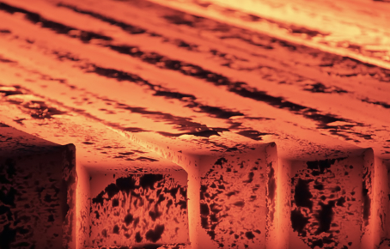
Electricity will be the Main Mission for Nuclear, but…
Realistic models for non-electric deployment scenarios are needed for investors and industrial partners
RECOMMENDATION 5.1: Industrial applications using thermal energy present an important new mission for advanced reactors. A key R&D need is to assess system integration, operations, safety, community acceptance, market size as a function of varying levels of implicit or explicit carbon price, and regulatory risks, with hydrogen production as a top priority. DOE, with the support of industry groups like EPRI and the nuclear vendors, should conduct a systematic analysis of system integration, operation, and safety risks to provide investors with realistic models of deployment to inform business cases, and work with potential host communities.

Slide 37
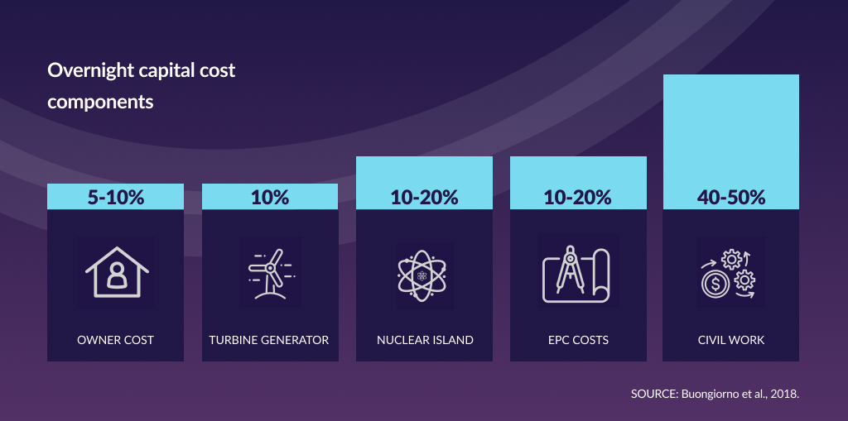
Project Management and Construction
Historical overnight capital cost components (based on LWRs)

Slide 38

Investment in Advanced Construction Techniques
To streamline timelines and reduce costs, site preparation and construction R&D must be a priority
RECOMMENDATION 6.8: While it is vital to demonstrate that advanced reactors are viable from a technical perspective, it is perhaps even more vital to ensure that the overall plant, including the on-site civil work, can be built within cost and schedule constraints. Since it is likely that costs for onsite development will still be a significant contributor to capital cost, and the ~$35M in DOE funding for advanced construction technologies R&D is small in comparison to the hundreds of millions spent on nuclear island technology research, more should be done over an extended period to research technologies that may streamline and reduce costs for this work. The Department of Energy should expand its current efforts in advanced construction technology R&D and make these advanced technologies broadly available, including to vendors participating in the ARDP Risk Reduction and ARC20 programs.

Slide 39

Ensuring Successful Project Management
To make subsequent deployments possible, building and maintaining skilled labor from project to project is key
RECOMMENDATION 6.2: Nuclear owner/operators pursuing new nuclear construction should consider establishing a consortium or joint venture to pursue the construction on behalf of the group, thereby enabling the creation and maintenance of the necessary skilled personnel to pursue projects successfully. Alternatively, advanced reactor developers operating within the traditional project delivery model should implement a long-term business relationship, preferably an equity partnership such as a joint venture or a consortium, with a qualified engineering, procurement, and construction (EPC) firm experienced in the nuclear industry.

Slide 40
Preparing for an Expanded Workforce
To prepare for an expanded workforce, identifying critical skills gaps and funding training programs is key
RECOMMENDATION 6.1: In anticipation of the necessary expansion in workforce to support more widespread deployment of nuclear technologies, the Department of Energy should form a cross-department (whole of government) partnership to address workforce needs (spanning the workforce from technician through PhD) that is comparable to initiatives like the multi-agency National Network for Manufacturing Innovation. The program would include the Departments of Labor, Education, Commerce, and State, and would team with labor organizations, existing construction craft training programs, industry, regulatory agencies, and other support organizations to identify gaps in critical skills and then fund training and development solutions that will close these gaps in time to support more rapid deployment. In carrying out these efforts, it will be important to take full advantage of existing efforts at universities, commercial nuclear facilities and national labs that already have well established training and workforce development infrastructure in place.

Slide 41
Timely Updates to Regulatory Requirements
Adequate staffing and funding is needed to expedite rulemaking
RECOMMENDATION 7.4: The NRC should expedite the requirements and guidance governing siting and emergency planning zones (EPZs) in order to enable vendors to determine the restrictions that will govern the deployment of their reactors.
RECOMMENDATION 7.1: Advanced reactors will not be commercialized if the regulatory requirements are not adjusted to accommodate their many differences from existing light water reactors. A clear definition of the regulatory requirements for a new technology must be established promptly if timely deployment is to be achieved. The NRC needs to enhance its capability to resolve the many issues with which it is and will be confronted. In recognition of the urgency for the NRC to prepare now, Congress should provide increased resources on the order of 10s of millions of dollars per year to the NRC that are not drawn from fees paid by existing licensees and applicants.

Slide 42
Community Engagement and Societal Acceptance
Best practices for community engagement must be adopted. These include:
An overriding commitment to honesty, transparency, and consistency of communication
A consent-based, participatory, and long-term process of site selection.
The right for communities to veto or opt out until an agreed-upon milestone.
Some form of socially acceptable compensation granted for affected communities.
Partial funding for communities and public interest groups to conduct independent analyses.
Retention of some control over a facility, perhaps through partnerships.
There are no guarantees in siting: owners should be prepared to walk away.

Slide 43
Societal Acceptance: Making Best Practices Work
Community engagement should be incorporated from design through operation
RECOMMENDATION 8.5: The developers and future owners that represent the advanced nuclear industry must adopt a consent-based approach to designing, siting, and operating new facilities. The siting approach will have to be adjusted for a particular place, time, and culture. Following best practices will require additional time and financial resources to be allotted to successfully site and construct new nuclear power facilities, and the industry must account for these costs in their plans. The industry should be willing to fully engage with a community, hear their concerns and needs and be ready to address them, including adjusting plans. While this would raise the likelihood of successful deployment, it is not a guarantee of success. Additionally, the industry, guided by experts in consent-based processes, should capture best siting practices in guidance documents or standards.

Slide 44
Government Support in International Markets
State and private support is crucial for safeguards, international deployment, and competitiveness
RECOMMENDATION 9.5: The United States should develop a plan for increased and sustained long-term financial and technical support for capacity building in partner countries, including cost requirements for using U.S. national labs and universities as training platforms. This plan should include partnering with U.S. reactor vendors to develop a safety, safeguards and security “package,” where the United States and the vendor could offer customized support to a host country for developing and implementing new safety, security and safeguards arrangements.
RECOMMENDATION 10.2:. International nuclear projects by US exporters are likely to require a financing package that reflects a blending of federal grants, loans, and loan guarantees along with various forms of private equity and debt financing. The Executive Branch should work with the private sector to build an effective and competitive financing package for US exporters.

Slide 45
Sustained Effort, Robust Financial Support, and Prompt Regulatory Updates are Key
…but every variable matters!
Reactor Technology
Research
Safety Regulations
Project Management and Construction
Workforce
Alternative
Applications
Federal Funding from Design to Deployment
Community Engagement and Acceptance
Security and Safeguards
International
Marketing
Financing

Slide 46
Given the urgent need to respond to climate change, it is important to advance the commercialization of all low-carbon technologies. In order for advanced reactors to contribute significantly to a decarbonized energy system, there are many challenges that must be overcome.
This will require sustained effort and robust financial support by the Congress, federal agencies, the nuclear industry, and the financial community.

Slide 47
Briefing on the National Academies of Science Fuel Cycle Report
Paul Dickman

Slide 48


Merits and Viability of Different Nuclear Fuel Cycles and Technology Options and the Waste Aspects of Advanced Nuclear Reactors
Janice Dunn Lee, Chair
Patricia A. Baisden, Vice Chair
Paul Dickman, Committee Member
Charles D. Ferguson, Study Director
Consensus Study Report Briefing

Slide 49
Statement of task:
Evaluate the merits and viability of different nuclear fuel cycles, including ones that may use reprocessing, for both existing and advanced reactor technology.

Slide 50















About the Study – Committee
Janice Dunn Lee (Chair)
International Atomic Energy Agency (retired)
Allison M. Macfarlane
University of British Columbia
Patricia Baisden (Vice Chair)
Lawrence Livermore National Laboratory (retired)
Albert J. Machiels
EPRI (retired)
Rodney C. Ewing (Vice Chair, NAE)¹
Stanford University
Christophe Poinssot
Bureau de Recherches Géologiques
et Minières
Margaret S.Y. Chu (NAE)
M.S. Chu and Associates LLC
Jeffrey D. Semancik
Connecticut Department of Energy
and Environmental Protection
Paul T. Dickman
Argonne National Laboratory
Ken B. Sorenson
Sandia National Laboratories (retired)
Craig S. Hansen
Cadence, Inc.
Jasmina Vujic²
University of California, Berkeley
John C. Lee²
University of Michigan
Nathalie A. Wall
University of Florida
Edwin S. Lyman
Union of Concerned Scientists
Houston G. Wood³
University of Virginia
¹ Until July 2022; ² Until September 2022; ³ Until September 2021

Slide 51
Information Gathering
The committee held 12 public information-gathering sessions between September 2020 and December 2021, hearing from over 80 speakers from academia, government, and industry.
Presentations covered the following topics:
  DOE and Congressional perspective on the report tasking
  Reactor and fuel cycle plans of advanced reactor developers
  Advanced fuel fabrication, including HALEU needs and availability
  Nonproliferation, safeguards, security, and material accounting/attractiveness for advanced fuel cycles and reactors
  Waste generation from advanced reactors and waste management/disposal considerations for advanced fuel cycles
  Fuel cycle and versatile test reactor programs at INL and ANL, trends in fuel cycle workforce
  French perspective on reprocessing and waste management
  U.S. R&D on reprocessing technologies
  International advanced reactor and fuel cycle programs (Gen-IV Forum, Russia, France, Canada, China)
  Utility perspective on advanced nuclear reactors and fuel cycles

Slide 52
Report Overview and
Select Findings and Recommendations

Slide 53
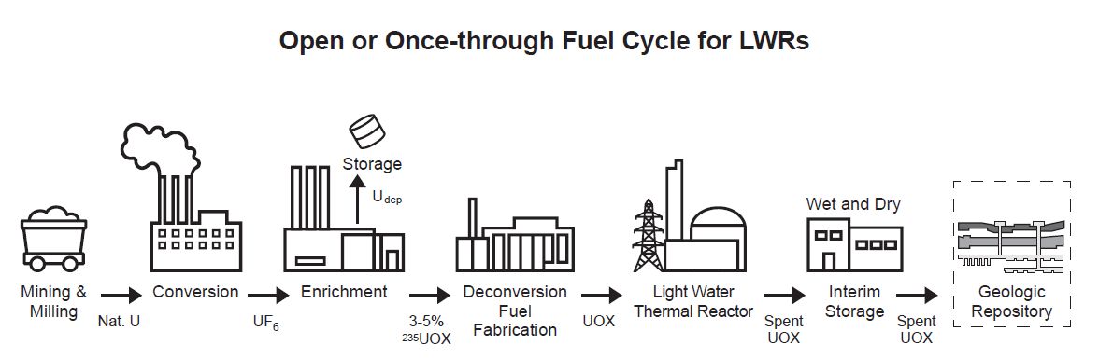
Where are we now?
Status of Fuel Cycle for Light Water Reactors (LWRs) in the United States
Once-through fuel cycle for LWRs with LEU-based fuel
Wet storage
Dry storage
no domestic capacity
Dry storage is default endpoint for managing spent nuclear fuel
partial domestic capacity

Slide 54
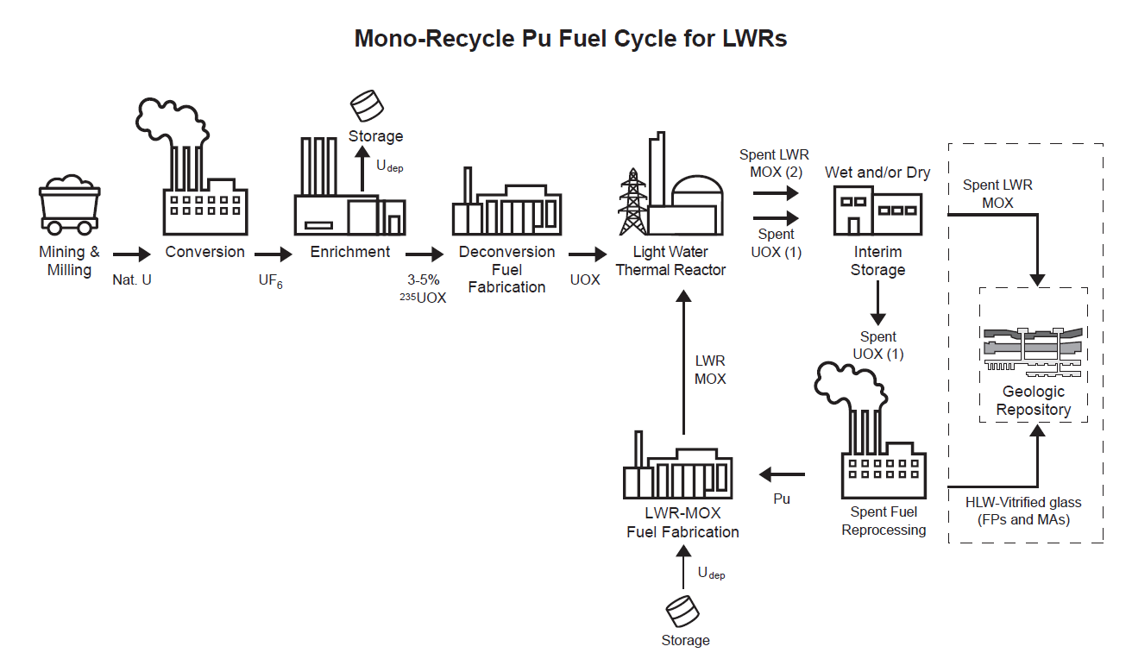
Where could we go?
Fuel cycle option with reprocessing for existing LWRs
From Finding 2:
Mono-recycling fuel cycle with existing LWRs as LWR-MOX (mixed oxide) fuel would add cost to power generation with no significant benefits, given the projected abundant supply of natural U and relatively low cost of U enrichment for the foreseeable future.
no domestic capacity
Spent LWR-MOX fuel: higher fissile inventory and minor actinides than spent UOX, giving rise to higher decay heat, potential for criticality, and radiation source term
partial domestic capacity

Slide 55
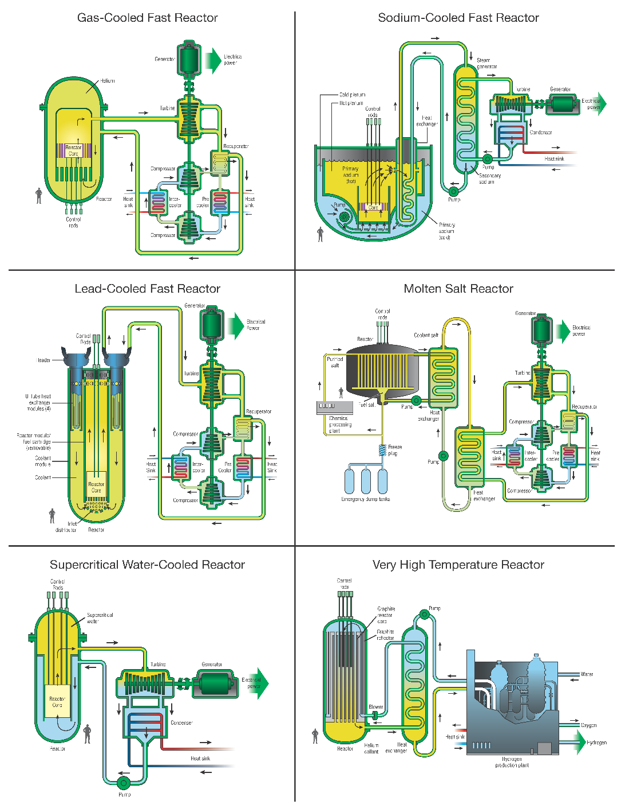
What advanced reactor designs did the committee consider?
Small Modular Light Water Reactor (LWR-SMR)
Liquid-metal-cooled Fast Reactor (LMFR)
  Sodium-cooled Fast Reactor (SFR)
  Lead-cooled Fast reactor (LFR)
High-Temperature Reactor (HTR)
  Gas-cooled High Temperature Reactor (HTGR)
  Fluoride salt-cooled High Temperature Reactor (FHR)
Gas-Cooled Fast Reactor (GFR)
Molten Salt Fueled Reactor (MSR) – MS fueled and cooled
  Fluoride based (F-MSR)
  Chloride-based (Cl-MSR)

Slide 56
What advanced reactor designs did the committee consider?
 | LWR-SMR | LMFR | HTR | GFR | F or Cl – MSR
Coolant | Light water | Liq. Na or Pb | Helium; FLiBe molten salt | Helium | NaF-BeF₂; ⁷LiF-BeF₂; Cl salt (³⁷Cl), MgCl₂/NaCl (³⁷Cl)
Fuel Type | U-oxide, Zr clad | U-metal alloy/Steel clad; UN (¹⁵N)/Steel clad | UCO TRISO pebble | UC/SiC clad | Liq. U or Th fluoride; liq. U or Pu chloride; Moltex static fuel pins
Enrichment | LEU | HALEU | HALEU | HALEU | LEU, DU, or HALEU
Spectrum | Thermal | Fast | Thermal | Fast | Thermal or Fast
Proposed FC | OTC | OTC* → CFC | OTC* | OTC* → CFC | OTC* → modified OTC → CFC
Waste | LWR spent U-oxide assemblies | Irrad. Na or Pb; U metal or UN spent fuel with FP & residual MA | Spent TRISO with FP and MA, dust, F salt; tritium | Spent UC/SiC clad fuel; recycle with residual MA and FP to waste | FP noble gas off-gas, F- or Cl-fuel salt with FP & residual MA, tritium, graphite
Example(s) | NuScale; GE-H; BWXT | Natrium-SFR; ARC-100; LeadCold Sealer 55; Westinghouse LFR | X-energy Xe-100; Framatome SC-HTGR; Kairos KP-X-FHR | General Atomics EM² | Terrestrial Energy IMSR-400; ThorCon; Flibe Energy; TerraPower MCFR; Moltex Stable Salt Wasteburner
BASELINE
OTC = Once-through cycle; * = increased burnup; = different from baseline fuel cycle

Slide 57
What we learned: Important Observations for Advanced Reactors
There is a wide range of advanced reactor designs – with different coolants (water, liquid metal, gas, molten salts), fuel types (²³⁵U, ²³⁹Pu, ²³³U(Th)), fuel forms (U metal, metal alloy, UN, UC, TRISO, liquid fuel salts), fuel enrichment (most require HALEU), and neutron spectrum initiating the fission reaction (thermal, fast).
Should these reactors be commercially deployed, the resulting spent fuel and associated waste streams will vary considerably from the current standard spent LWR LEU-oxide fuel assemblies.

Slide 58
The starting point for advanced reactors
From Finding 1. To enable commercial success of advanced reactors, no matter what fuel cycle option the U.S. chooses (once-through or closed fuel cycle), a long-term vision with significant and sustained financial commitment is required
From Finding 5. Small modular LWRs using LEU oxide fuels are the most mature reactor technology that could be licensed, constructed, and connected to the grid in the next decade.
Leverage existing LWR technology and fuel cycle infrastructure
Benefit from long-term government/industry financial support

Slide 59
Non-LWR advanced reactors & fuel cycle development –
From Finding 4. Challenges facing, especially non-light water-cooled advanced reactors, for commercial deployment by 2050:
little or no operating experience at engineering scale
lack of adequate capabilities to develop, test, and qualify advanced fuels and materials
unknowns related to regulatory processes and time required for licensing approval
From Recommendation B.
Congress and DOE should provide or assure access to materials testing and fuel qualification capabilities.
A coordinated plan between DOE-NE, DOE-SC, and domestic and international user communities should be developed and implemented to meet short- and long-term needs.

Slide 60
Support for advanced reactor & fuel cycle development
From Finding 3.
Government support to help bring advanced reactors to commercial deployment will take substantial financial and technical resources. Consistent and full funding of ARDP through completion will be key to helping DOE in its decision making process.
From Recommendation A.
A “few promising designs” that can meet NEICA goals and potentially be deployed by 2050 should go forward under cost-sharing arrangements between government and industry.
With limited budgets, deciding which designs to support will be difficult.
Selection and support should be:
  guided by data from ARDP and DOE R&D programs
  determined by clear, science-based criteria that encompass the entire fuel cycle
  based on reliable cost estimates for necessary manufacturing base and supply chain infrastructure.

Slide 61
What about the fuel cycle?
Advanced reactor developers are focusing on reactor designs and front-end fuel cycle components needed to support technology demonstration.
enrichment: 5% < HALEU < 20% ²³⁵U
and
fuel fabrication using HALEU

Slide 62
Front-end fuel cycle considerations – HALEU supply
From Finding 7.
There is no current domestic capacity to supply HALEU to meet the projected needs for U.S.-based advanced reactors.
Reliance on foreign sources of HALEU (e.g., Russia) could have serious energy and national security implications if advanced reactors using HALEU are adopted widely.
From Recommendation C. DOE should develop a plan and associated schedule to make clear to developers the timing and level of federal support available for domestic HALEU production.
DOE contingency plans may include:
delaying development & deployment of some advanced reactors requiring HALEU
releasing stockpiles of HEU for down blending until domestic HALEU available

Slide 63
What about the back-end of the fuel cycle?
Most advanced reactor developers are not focusing
on the back end of the fuel cycle.
They are opting initially for a once-through fuel cycle but leave open the possibility of closing the fuel cycle in the distant future.

Slide 64
Fuel Cycle Options for Advanced Reactors – Once-through with HALEU
Once-through fuel cycle for LWRs with LEU-based fuel
Wet storage
Dry storage
Once-through fuel cycle for advanced reactors with HALEU-based fuel
Wet storage
Dry storage
Advanced Reactor
5 - <20%
²³⁵UOx
HALEU-
based fuel
Spent fuel
Spent fuel
no domestic capacity
partial domestic capacity

Slide 65
Fuel cycle development for advanced reactors – the bottom line!
From Recommendation D.
Current U.S. policy of a once-through fuel cycle with direct disposal of commercial SNF in a geologic repository should continue.
DOE should develop and implement a phased, long-range R&D program on advanced separations and transmutations technologies so as not to preclude these options in the future.

Slide 66
What are the waste management and disposal options for advanced reactors?

Slide 67
Current Regulatory and Technical Structure for Spent Fuel Management Based on Large LWRs
The NWPA defines the governance structure and process for the eventual acceptance and disposal of SNF and HLW by DOE.
The vast majority of SNF from large light water reactors meeting the “Standard Fuel” definition under DOE’s Standard Contract (10CFR961, Appendix E).
Existing non-standard fuel represents only a small fraction of SNF inventory.
DOE’s Amended Standard Contract for New Reactors struck Appendix E provisions for Non-Standard Fuel.
Most advanced reactors produce non-standard spent fuel for which there is no current path for acceptance by DOE.

Slide 68
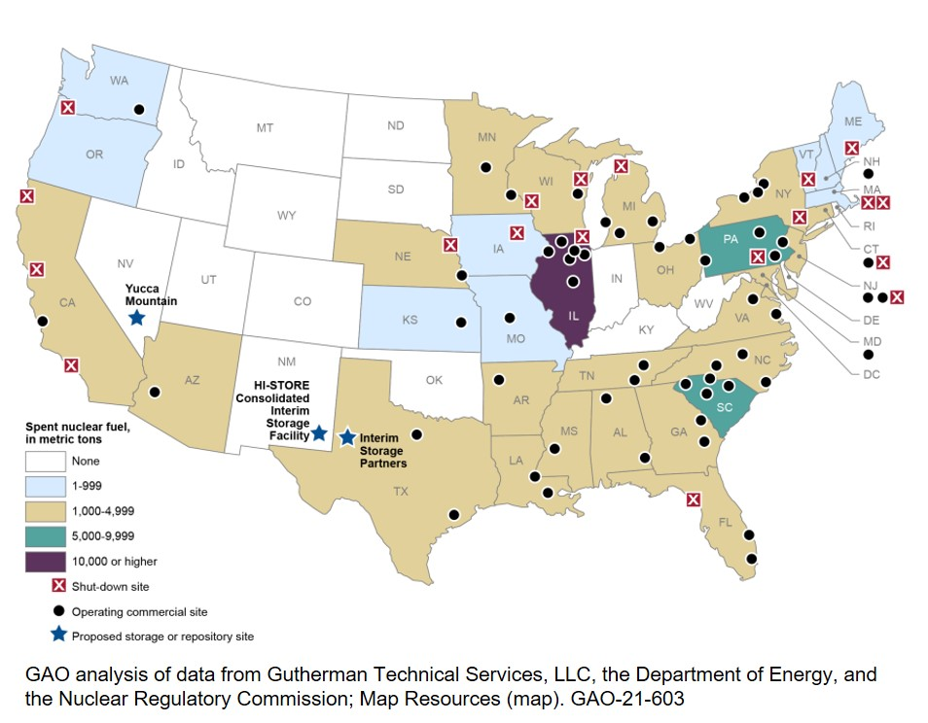
What is the status of spent nuclear fuel in the U.S.?
From Finding 11:
40 years since enactment of the Nuclear Waste Policy Act of 1982, there is no clear path forward for siting, licensing, and constructing a geologic repository to dispose highly radioactive waste, mainly commercial spent nuclear fuel.
From Finding 12:
Without a final geologic disposal strategy, expanding nuclear power with advanced reactors will add to the amount of SNF and associated waste requiring disposal and will increase the complexity of this challenge because new types of fuels and waste streams will need to be disposed of.
Stored commercial spent nuclear fuel (SNF) sites, showing ranges in tonnes of SNF for each state. Adapted from GAO-21-603.
Notes:
From Trish: remind Congress that unless they pass legislation amending the NWPA, DOE's hands are tied
Context for Finding 12: right now the US is about 17-18% nuclear and going down as we retire some of the current fleet. If advanced reactors are added to just replace lost generating capacity, wastes will not necessarily increase.

Slide 69
Tackling the nuclear waste challenge
From Recommendation G. Congress should establish a single-mission entity responsible for the management and disposal of nuclear wastes.
This entity should:
be responsible for cradle-to-grave management and disposal of nuclear wastes, with continuity of leadership and funding
be funded by users of nuclear-generated electricity, with funds collected in an escrow account and not subject to annual appropriations
initiate the process of site selection for a geologic repository using appropriate technical criteria and acceptable public engagement methods (e.g., consent-based siting)
Congress should make a decision on what to do with Yucca Mountain, which could include keeping it as a possible site for consideration, depending on the plans of the new entity.

Slide 70
Can advanced reactors “solve the waste problem”?
From Finding 12. The advanced reactor developers focus on the reactors themselves, with little or no attention to nuclear waste management or disposal because there is
no incentive for them to do so.
From Finding 14. Reducing the ~86,000 tonnes of legacy SNF using advanced reactors is not practicable to achieve in the near future.
From Recommendation J. The immediate-future focus of the U.S. nuclear waste management and disposal program should be to plan for geologic disposal of existing spent nuclear fuel.

Slide 71
Fuel cycle development for advanced reactors
Back-end fuel cycle considerations
From Finding 9. Reprocessing and recycling of spent nuclear fuel introduce additional safety and environmental considerations over the management of open cycle LWR oxide fuels.
Options for advanced reprocessing and recycling are at various stages of development and will be challenging to implement on an industrial scale.
Even a fully closed fuel cycle with recycle and transmutation operated over decades will still require a geologic repository for disposal of fission products.

Slide 72
What types of waste do advanced reactors generate?
From Finding 13: Proposed advanced reactor technologies will initially use a once-through fuel cycle, but with fuels of higher uranium enrichment and/or burnup, and new types of fuel materials and designs. Compared to uranium oxide spent fuel, these new fuel types may result in changes of:
the amounts (either in mass or volume), chemical compositions, and radionuclide inventories,
the thermal power of fuel assemblies, and
the durability of the spent fuel in a disposal environment.
From Finding 15: Most of the advanced reactor types proposed would generate waste streams for which there is little experience or mature technical ability to manage. All additional waste treatment options would entail additional costs not encountered in the management and disposal of spent light water reactor (LWR) fuel. Examples include:
Large volumes of spent TRISO fuel from high-temperature gas reactors
Radioactive dust from pebble bed reactors
Irradiated sodium waste and sodium-bonded spent fuel from sodium-cooled fast reactors
Radioactive off-gases and spent fuel salt waste from molten salt reactors
Large quantities of irradiated graphite waste from moderators or reflectors in several reactor designs

Slide 73
Disposing Wastes from Advanced Reactors
From Recommendation I.
DOE, NRC, and EPA should develop regulations and standards for a generic repository and new types of spent fuel and waste forms to support geologic disposal of fuel types from advanced reactors.
Advanced reactor developers need to anticipate the impact of new fuel types on their performance in a geologic repository.

Slide 74
Storage & Transportation of Advanced Reactor Waste
From Recommendation K.
DOE should require advanced reactor developers receiving its funding to develop fresh and spent fuel storage & transportation systems to mitigate disconnects in the back-end of the fuel cycle.
DOE should continue its collaboration with industry (e.g., via EPRI’s Extended Storage Collaboration Program) to identify and address long-term storage packaging issues.
From Recommendation L.
DOE should support the necessary criticality, thermal, and shielding assessments of storage & transportation systems to integrate HALEU into advanced fuel cycles.

Slide 75
What are the nonproliferation implications and security risks for advanced fuel cycles?

Slide 76
What features of advanced fuel cycles differ from the baseline LWR once-through cycle with UOX fuel?
The committee considered nonproliferation implications and security risks of the following:
  Once-through fast reactors using HALEU
  Pebble-bed reactors using HALEU
  “Once-through” molten salt-fueled reactors using LEU
  Nonproliferation and Security Implications of the Use of HALEU
  Proliferation and Security Risks of Fuel Cycles Using Reprocessing and Recycling

Slide 77
Nonproliferation Implications and Security Risks: HALEU
From Finding 19. Expanding the global use of HALEU would potentially exacerbate proliferation and security risks because of the potentially greater attractiveness of this material compared to LEU.
From Recommendation M.
NNSA and DOE-NE should assess proliferation and security risks associated with expanded global use of HALEU.
The U.S. government, with the IAEA, should foster international efforts to examine and address these risks.

Slide 78
Safeguards and Security for Advanced Fuel Cycles
From Finding 20. All advanced fuel cycles will require rigorous safeguards and security measures, with special attention paid to:
Material accountancy for molten salt and pebble bed technologies
Fuel cycles involving reprocessing and separation of fissile material that could be weapons-usable.
These should be considered as challenges, but not barriers.
From Recommendation N. The U.S. government should authorize IAEA access through the eligible facility list to advanced reactor systems for which IAEA does not currently have safeguards experience.
From Recommendation O. The NRC should initiate rulemaking to address security and material accounting for HALEU and other attractive nuclear materials in advanced fuel cycles.

Slide 79
Summary Conclusions

Slide 80
Conclusions
The vast array of advanced reactor and fuel cycle concepts, if realized, would significantly diversify reactor and fuel cycle technologies used in the U.S.
Tradeoffs are necessary when assessing potential merits and viabilities of different reactors and their associated fuel cycles. Not one advanced technology can concurrently provide for all the potential benefits relevant to the scope of this study.
The U.S. government and industry going forward will have to decide which features or attributes of advanced reactors and fuel cycles best align with the U.S. energy needs without increasing proliferation risks, having an adverse impact on the environment, or imposing an unacceptable economic burden on current and future generations.
Notes:
The U.S. government and industry going forward will have to decide which features or attributes of advanced reactors best align with the U.S. energy needs without increasing proliferation risks, having an adverse impact on the environment, or imposing an unacceptable economic burden on current and future generations.

Slide 81
Thank you!
Any questions?

Slide 82
Break
Return: 11:40 AM

Slide 83
Infrastructure
Dr. Kemal Pasamehmetoglu
NEAC Subcommittee updates and discussion

Slide 84
Overview of the scope and progress of the Infrastructure subcommittee
Committee had the mandate of understanding the infrastructure investment needed to support the expansion of <200 GW of capacity by 2050. The scope of this can be broad
  Workforce development
  Continuing innovation
  Demonstration of advanced concepts
  Large-scale commercialization
The committee also met with numerous DOE presenters to understand current challenges in the Infrastructure space:
  Alice Caponiti, Deputy Assistant Secretary (NE-5, Reactors)
  Patrick Edgerton, Director, Office of Budget and Planning, NE
  Julie Kozeracki and Christopher Vlahoplus, DOE Loan Programs Office
As a result, we have prepared a set of recommendations to maintain scope in a way that is useful for NE

Slide 85





















Summary of recommendations
Mission Need
HALEU prioritization
Reprocessing and recycling
Focused Deployment Strategy
User Facility Models
Demo projects (short-term)
Capability Metrics
Materials, Construction, Workforce (medium & long-term)
Advanced Reactors Input
Timescale strategies (medium & long-term)
Commercial deployment R&D
11

Slide 86
Detailed recommendations: General (1-2)
Mission Need:
Focused Deployment Strategy:
NE should develop an effective narrative around the need for and benefits of nuclear energy given the worldwide efforts to decarbonize.
The narrative should acknowledge the needs associated with combating climate change in the near term but also sustain those efforts beyond 2050 with continuous improvements
NE develop an infrastructure strategy that is focused on achieving established priorities, the most important of which is accelerating commercial deployment of existing reactor technology in the near term and advanced reactor technology in the long term.
The strategy should include a clear indication on the goals, timelines, and expected benefits.

Slide 87
Detailed recommendations: Short, medium and long-term (3-5)
Demo projects (short-term):
Materials, Construction, Workforce (medium & long-term)
Timescale strategies (medium & long-term)
Highest priority focus in the near term is moving forward expeditiously on getting more nuclear capability into commercial operation through demo projects utilizing existing technology. Longer term these issues tie to integration into industrial use cases, which may require new facilities for systems testing.
NE should focus on strategies (including project management tools) to shorten the timescales for nuclear projects and a new science-based paradigm for material qualification and licensing process.
The recent report from National Academy of Engineering and the DOE Liftoff report recommended a focus on materials development, construction technology R&D and workforce development.
Infrastructure is needed to support materials and construction R&D and certainly university training infrastructure to build workforce could be an area of emphasis.

Slide 88
Detailed recommendations: Supply chain for advanced reactors (6-7)
HALEU Prioritization:
Reprocessing and Recycling:
NE should prioritize implementation of the infrastructure necessary for commercialization of High Assay Low Enrichment Uranium (HALEU) advanced reactors
There needs to be a longer term focus, to focus on the commercialization of nuclear technologies, on solving this problem, and stimulating production in the absence of specific orders with a recognition that there will be demand for the product once larger scale production is a reality
Assuming nuclear energy production transitions to HALEU fuel, reprocessing and recycling will need to be seriously considered.
Reprocessing HALEU fuel should follow along with addressing the large-scale supply issue to ensure we address uranium utilization and supply reliability
Incorporating recycling into advanced reactor deployment would take 15-20 years; thus, the foundations must be established today

Slide 89
Detailed recommendations: Physical and intellectual infrastructure (8-9)
User Facility Models:
Capability Metrics:
Establish tight coordination between the university infrastructure and national laboratory physical infrastructure programs with adequate access models (user facility models) to an integrated set of capabilities.
It appears this is successfully being done by Nuclear Science User Facility, which can be expanded as the capabilities at the universities grow with additional investments
Develop a metric to measure how well the different pieces of the existing infrastructure is being used to support the national priorities and evaluate if there are some savings there by repurposing or shutting down facilities with little or no interest to free up funding for other priorities.
Determination of the most important capabilities that MUST be preserved to support the nuclear energy strategy with quantitative analysis of benefits would be very informative

Slide 90
Detailed recommendations: Advanced reactors and R&D (10-11)
Advanced Reactors Input:
11
Commercial deployment R&D:
NE should obtain clearer input from industry through a workshop between NE and the Working Groups, or some other form of face-to-face interaction that results in meaningful prioritization of the Working Group feedback
NE should facilitate a mechanism for receiving that clarified feedback given the Subcommittee’s impression that additional interaction with and information from the industry would be beneficial in accomplishing other of our recommendations
NE should establish R&D priorities specifically with respect to infrastructure with an emphasis on R&D that accelerates the bridge to commercial deployment. There should also be a definitive tie between the R&D programs to the ARDP and other demo programs
The area where NE has more direct control over investment strategies and priorities is on the R&D infrastructure

Slide 91
Potential follow on topics for the Subcommittee
Subcommittee could help to continue to develop priorities for funding
  This may require additional members with expertise outside the current NEAC members
Development of comprehensive R&D infrastructure – the subcommittee would benefit from a presentation if there is a strategic approach to this topic
Further exploration on the models needed for large-scale commercialization of advanced reactors:
  Can the existing mechanisms work or is a new paradigm necessary?
  Who owns them? What can NE do to make them actionable?
Work alongside the workforce subcommittee to identify the existing infrastructure that can support needs and identify gaps for new investments

Slide 92
Consent-Based Siting
Dr. J'Tia Hart
NEAC Subcommittee updates and discussion

Slide 93
Overview of the scope and progress of the Consent-based siting subcommittee
Committee had the goal of understanding the current status of the Nuclear Waste Management within NE
The group met with a few officials on the topic, including:
  Former Senator Jeff Bingham, who provided context on the Nuclear Waste Administration Act
  Lisa Frizzel, Nuclear Waste Management
As an outcome of these conversations, they want to applaud the efforts of the Office of Nuclear Energy regarding nuclear waste management, specifically:
  The 2021 request for information
  The 2023 funding opportunity announcement support by Congress in the Consolidated Appropriations Act of 2023

Slide 94




Summary of recommendations
Acknowledge that the Consent—Based Siting (CBS) process requires iteration:
DOE should move at the “speed of trust” solely determined by stakeholders and allocate sufficient time
Allocate Funding for Future Support:
DOE should allocate resources for continued continuity and stakeholder engagement as well as advocate for collaboration between consortia partners with expanded timelines, scope, funding, etc.
Advocate for Expanded Stakeholder Engagement:
DOE should advocate for expanded input with civil society organizations that represent marginalized communities. They should facilitate available and access to expertise
Advance Publication Timeline for Integrated Waste Management Strategy:
The DOE should expedite publication of an integrated waste management strategy with common community awareness as a foundation

Slide 95





Follow on topics and next steps
The subcommittee is currently considering and will issue a subsequent
report regarding:
  The creation of an independent organization to manage CBS
  Access to waste funding to support CBS
  Site governance options such as partnerships with local, state, and regional organizations
  Formation of an advisory panel comprised of social, local, and technical stakeholders such as those from previous successful projects
  Relevance of previous recommendations from studies and commissions on this topic

Slide 96
Lunch
Return: 1:45 pm

Slide 97
Workforce of the Future
Dr. Sonja Schmid
NEAC Subcommittee updates and discussion

Slide 98
Overview of the scope and progress of the Workforce subcommittee
The Workforce Committee had the mandate of understanding (a) the nature, size, and skillset of the nuclear workforce needed in the future to support a 2050 decarbonization goal, as well as (b) the gaps and problems associated with achieving this goal.
During multiple meetings over the last year, the committee heard from numerous presenters on challenges surrounding the future nuclear workforce, including:
  Ken Czerwinski, UNLV, PI of SUSTAIN
  Lori Brady, NEI
  Alice Caponiti, Deputy Assistant Secretary and her team
  Melinda Higgins, Director of STEM programs
As an outcome of our discussions, we have put together three preliminary recommendations based on a series of topics we discussed. These are intended as an update on work in progress; the Workforce Committee plans to continue its deliberations.

Slide 99






Preliminary Recommendations
Broaden funding targets:
Create new programs (and strengthen existing 4y-college and graduate programs) to improve diversity and the inclusion of e.g., community colleges, trade school programs, non-traditional students and career-changers. Support certificate programs, mentorship and Union apprenticeship programs by building and expanding networks with faculty, community and tribal colleges, and by actively encouraging curricular innovation.
Diversify the content:
Expand the content of training beyond the technical by committing a percentage of funding to social sciences and humanities training, and to a comprehensive perspective on nuclear energy. An open, critical, and nuanced discussion of the context of nuclear energy (environment, justice, labor etc.) is vital to support the growth of a workforce that is not only technically competent but also able to navigate difficult debates over a troubled history.
Share the results:
The UNLV SUSTAIN study, and industry gap analyses, should be advertised together with the availability of various grants and fellowships. Improve and revitalize community engagement through public-facing infrastructure (e.g. universities, national labs, and commercial entities) to establish nuclear facilities as trusted members of the community.

Slide 100
Follow on topics and next steps for the Workforce Subcommittee
Work alongside the infrastructure subcommittee to identify what existing and desirable infrastructure would best support the future nuclear workforce
Coordinate with the international subcommittee to assess how other countries succeed at training a nuclear workforce and what aspects are worth emulating
Interface with other units in DOE and elsewhere on training international leaders and decision-makers
Develop specific suggestions on how to expand the language and definition of appropriations to help broaden future workforce funding targets
Learn more about topics such as:
  The role of tribal colleges in contributing to the future workforce;
  Unconventional workforce challenges (temporary, transient, surge workforce), potentially through examples from other industries;
  Successful models to train workers to engage critically with their own industry, and how nuclear workforce curricula could emulate these.

Slide 101
Break
Return: 2:30 pm

Slide 102
International Engagement
The Hon. William D. Magwood, IV
NEAC Subcommittee updates and discussion

Slide 103
Overview of the scope and progress of the International subcommittee
Launched its work with the goal of understanding the driving objectives of the US government’s international nuclear energy activities.
Subcommittee met with a range of senior officials, including:
  Undersecretary of State for Arms Control and International Security
  DOE Assistant Secretary for International Affairs
  Deputy Administer for Defense Nuclear Nonproliferation at the National Nuclear Security
  Assistant Secretary of Commerce for Industry and Analysis
Through these conversations, found:
  Support for the domestic benefits of a strong nuclear industry and of U.S. climate goals
  Common understanding across the many agencies
  Appreciation for the bipartisan nature of these policies

Slide 104



Summary of initial observations
Concerns about in the U.S. government’s current framework:
Various agencies largely operate in their own lanes
No clear organizing mechanism or strategic focus
There are gaps in the policy framework
Example: U.S. is overmatched by the competition overseas:
Agencies haven’t developed a strategy to address this fact
Heroic effort in one case have dealt with the financing issue in one case, but this was complex and time-consuming
Lack of long-term view in developing relationships with potential partners:
Example: Whereas Russia and China engage with Africa countries early and establish significant training programs, the US typically engages quite late in the progress toward building plants

Slide 105




Primary Observations and Suggestions
Strategic vision: The USG requires a more comprehensive strategic framework in which NE and other elements can work and cooperate. The subcommittee suggests a policy-level interagency discussion
Financing of Overseas Projects: Financing is critical to U.S. nuclear competitiveness abroad. Ex-IM, U.S. IDFC and USTDA must have the capacity and latitude to compete and multinational institutions should be updated
Long-term investment in overseas relationships: The US should provide enhanced support to identify and develop potential customer nations
Export policies: As the global market for nuclear exports rapidly expands, framework agreements will be needed with more partner countries

Slide 106


Focus Areas for the subcommittee
Ensure a U.S. solution for fuel supply, particularly LEU and HALEU. This is a threshold issue for both the near term and the long term and is essential in building the confidence of potential partners. Further work is needed; suggest cooperation with Infrastructure subcommittee.
The Subcommittee plans to make Financing of Overseas Projects a key focus area for the coming months and will investigate the views of the involved organizations, both in the US Government and in international financial institutions. The Subcommittee will also maintain awareness of relevant legislation pending in Congress

Slide 107
Break
Return: 3:15 pm

Slide 108
Public Comment
3:15 pm – 3:35 pm

Slide 109
Closing Remarks
Assistant Secretary Dr. Katy Huff
The Honorable William D. Magwood, IV, Chair

