Slide 1
The Critical Materials Institute
An Energy Innovation Hub
DE‐AC02‐07CH11358
20 Corporations, 11 Universities, 4 National Laboratories
Led by the Ames Laboratory
2013 – 2019
Tom Lograsso (CMI Interim Director), Rod Eggert (Deputy Director)
U.S. DOE Advanced Manufacturing Office Virtual Program Review Meeting
June 2‐3, 2020
This presentation does not contain any proprietary, confidential, or otherwise restricted information.

Slide 2
Critical Materials Institute
Project Overview
Timeline
An Energy Innovation Hub
Supported by the US DOE, Advanced Manufacturing Office
One of five such Hubs supported by DOE
Commencement: June 1, 2013 (5‐years)
Program Renewal: July 1, 2018 (5‐years, nominal)
Funds appropriated for CMI Years 8, and 9
Program 70% complete
Budget
Barriers
To ensure robust critical materials supply chains through technological innovations
Better separation agents to improve production efficiency, minimize environmental impact
Improved manufacturing of rare‐earth metals and alloys
Better and production‐ready substitutes for critical material intensive technologies currently in use
More efficient recycling and reuse of critical materials from manufacturing wastes, and discarded products
Partners
 | FY18 | FY19 | FY20 | Total Planned Funding (FY21‐ FY23, end date)
DOE Funding | $25M | $25M | $25M | $25M
Project Cost Share | $0.8M | $1.1M | $0.8M | >$4M
National Labs: Ames (lead), Oak Ridge, Idaho National Lab, Lawrence Livermore
Universities: Arizona, Arizona State, Case Western, Colorado School of Mines, Florida Industrial and Phosphate Research Institute, Idaho State University, Iowa State, Purdue, Rutgers, California‐Davis, Wayne State
Corporations: All American Lithium, American Manganese, Arnold Magnetic Technologies, BorgWarner, Eck Industries, Electron Energy Corporation, First Solar, General Electric Company, Infinium, Marshallton Research Laboratories, Mercury Marine, OLI Systems, Retriev Technologies, Rio Tinto, Seegence Holdings, Spiers New Technologies, Solvay, TdVib, United Technologies Research Center, USA Rare Earths

Slide 3



CMI Objective
CMI mission is to accelerate the development of technological options that assure supply chains of materials essential to clean energy technologies – enabling innovation in US manufacturing and enhancing energy security.
Critical materials, such as rare earth elements, provide essential functional properties. They often have no easy substitutes, and if their supply chains are vulnerable they can constrain technology adoption, design choices, or manufacturing locations.
While needs for materials emerge on very short timescales, solutions typically take decades. We strive to make solutions available when they are needed.
3

Slide 4
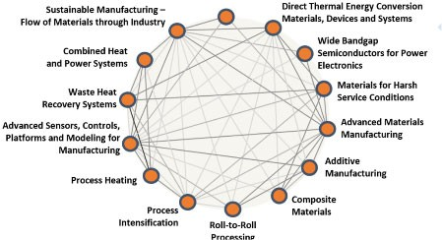
CMI Alignment with AMO Mission
AMO Mission: Catalyze research, development and adoption of energy-related advanced manufacturing technologies and practices to drive U.S. economic competitiveness and energy productivity.
Manufacturing: 25% of nation’s energy
Competitiveness: Requires energy security, resource availability, cost competitiveness, and full lifecycle energy and material management
µ Critical materials provide unique and essential properties for manufacturing and systems
CMI Mission: Accelerate the development of technological options that assure supply chains of materials essential to clean energy technologies – enabling innovation in US manufacturing and enhancing energy security.
CMI Hub Strategy:
Diversifying our supplies
Develop cost-effective alternatives
Driving recycle and reuse of critical material
14 RD&D Technology Areas (“TA”)
Critical Materials
AMO Critical Materials TA: “advance solutions that enable availability of materials essential to clean energy technologies by:”
Diversifying supply Developing substitutes Improving recycle and reuse

Slide 5
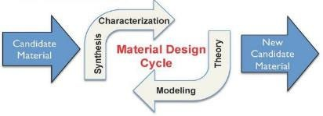

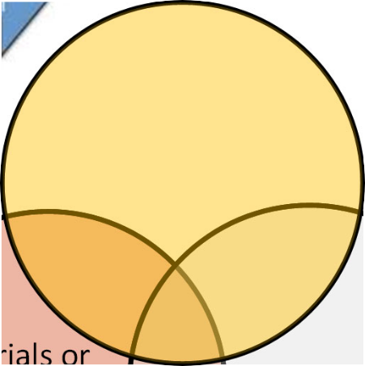
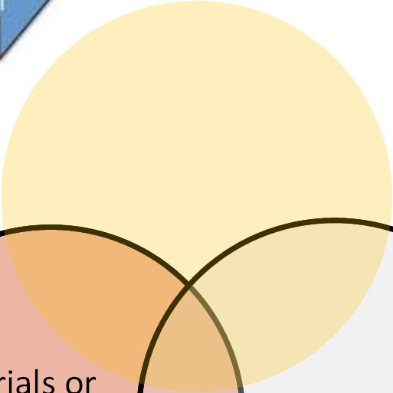





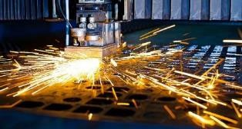
Technical Innovation
Materials or processes with the right properties
Mate processes that can be made or can
work
Research worth pursuing
rials or
Materials or processes that industry will adopt
Adoption Considerations Performance advantage CAPEX/OPEX
Supply Chain Technoeconomic Environmental Social acceptability

Slide 6
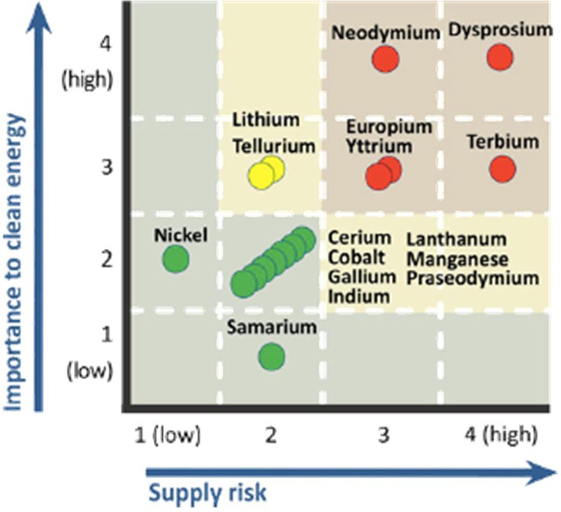
Technical Approach
CMI addresses materials that have been identified to be critical for U.S. manufacturing, in the 5‐15 year timeframe.
We identify specific barriers to technology deployment and remove them through early‐stage applied research.
Research teams include materials producers and users (OEMs), along with university and national lab researchers.
Speed and agility are key. We compete with alternative solutions, including technology substitution.

Slide 7
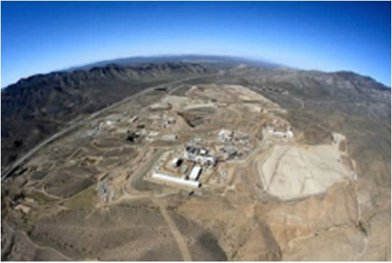
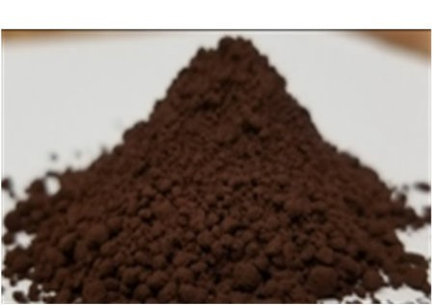
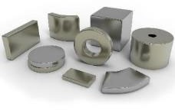
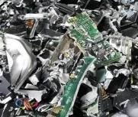
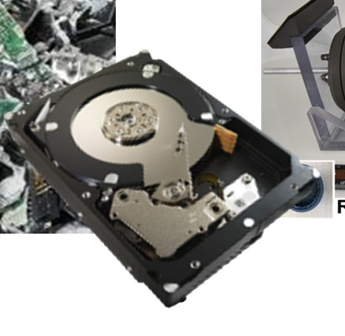
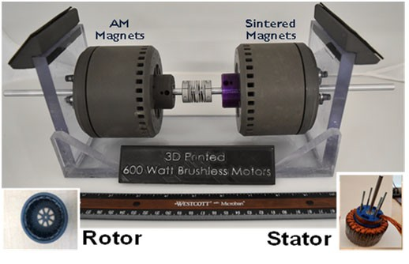
Technical Approach: Addressing Needs of the Supply Chain
Domestic concentrate exported to China
No domestic separation facility
Limited alloying infrastructure
More profitable methods & biz models
Low integration with US produced materials
Mining & Concentration
Extraction & Refining
Chemical & Metallurgical Processing
Refining & Alloying
Recycling
Fabrication
Part Manufacturing
Sub-Assembly Manufacturing
System Integration
Diversifying Supply
Efficient separations
Improve concentrations
Environmentally‐safe metal conversion
Developing Substitutes
New advanced materials
Enhanced processing
Driving Reuse and Recycling
Energy efficient and cost‐effective
Circular economy principles
Cross‐cutting Tools
Scientific and economic tools

Slide 8
Technical Approach: Supply Chain Needs & CMI Capabilities
Mining & Concentration
Extraction & Refining
Chemical &
Refining & Alloying
Recycling Fabrication
Part Manufacturing
Sub-Assembly Manufacturing
System Integration
Metallurgical Processing
DOE NATIONAL LABORATORIES
ORNL (separations, magnet material)
INL (integrated test bed)
INL (project road mapping)
LLNL (advanced materials & manufacturing)
Ames (materials discovery, recycling)
UNIVERSITIES
FI{RI (separations)
Iowa State Univ (materials discovery, recycling, fab)
Wayne State (robotics)
CSM (separation, alloying, recycling)
Economics & criticality assessments
UC Davis (material discovery)
Case Western (robotics
Rutgers & ASU (thermodynamics)
Arizona (life cycle analysis)
Purdue University (project road mapping, life cycle analsys, techno‐economic analysis)
CORPORATIONS
Seegence
American Manganese
Mercury Marine
Rio Tinto
TdVib
United Technologies
Marshallton
Solvay
Eck Industries
BorgWarner
OLI
Electron Energy Corporation
Spiers
All American Lithium
Arnold Magnetics
Retriev

Slide 9

Transition Beyond DOE Assistance
CMI Enduring Capability
Multi‐disciplinary team
257 research community
Spanning 30+ institutions
CMI Portfolio
Four focus areas
35 projects
Team & Affiliate program
34 team members
29 affiliate members
Options for supply‐chain focused consortia
Economic & supply chain analysis
Annual criticality review
Techno‐economic analyses
Project roadmapping
Specialist technical consultancy
Two strategic partnership programs
Natl Labs
Industry
Universities
Development Options
R&D Portfolio Mgt
Annual Criticality Review
Critical Material Supply Chain Expertise
Licensing & Consortia
Specialty Manufacturing

Slide 10
Transitions: Critical Materials Framework
CMI has established an enduring capability that couples:
research to diversify supply, develop substitutes, and drive reuse and recycling to accelerate the development and application of solutions to benefit U.S. manufacturing
with
early industrial input on issues and challenges, criticality assessments, roadmapping, techno‐economic analyses, lifecycle analyses, and supply chain analyses.

Slide 11
Management Approach
Operations
Jen Brockpahler (Ames)
Interim Director
Tom Lograsso (Ames)
Budget
Carol Bergman (Ames)
Education & Outreach
Rod Eggert (Mines)
Deputy
Rod Eggert (Mines)
Partnership Management
Stacey Joiner (Ames)
Diversifying Supply
Bruce Moyer (ORNL), Lead
Kevin Lyon (INL), Deputy
Developing Substitutes
Driving Reuse & Recycling
Crosscutting Research
David Parker (ORNL), Lead
Ikenna Nlebedim (Ames), Deputy
Carol Handwerker (Purdue), Lead
Dan Ginosar (INL), Deputy
Eric Schwegler (LLNL), Lead
Yoshiko Fujita (INL), Deputy
Expanded Sources
Magnets with Reduced RE Content
Energy Storage Systems
Enabling Science
Transformational Processing
Enabling & Optimizing Co‐Production
Environmental Sustainability
New Uses for Co‐Products
Supply Chain & Economic Analysis
Electric Machines
35 individual projects, each with quarterly progress measures, annual milestones & go/no‐go decisions
Permanent Magnets Energy Storage Electronics
Project ends on June 30, 2023

Slide 12
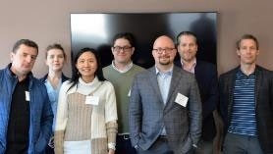
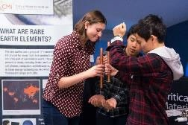
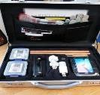

Management Approach
Project Management
Roadmaps ‐ Where do we start, where are we going, how do we relate to other CMI efforts? Where are the key decision points?
Techno‐Economic Analyses ‐ Required of all Tasks and Projects after they reach TRL 4
Annual Project Evaluations ‐ Two‐thirds of our projects have been changed in some way, over CMI duration
Education and Workforce Development
CMI Leadership Academy ‐ 18 month experience designed to develop leadership management skills for a group of emerging leaders within the CMI community
CMI Winter Meeting ‐ Annual postdoctoral/graduate student professional meeting at Colorado School of Mines
Educational Outreach ‐ Webinars, professional societies (e.g., SWE), undergraduates, high‐school students
Education Toolkits ‐ Resources for K‐12, teachers, university students and instructors

Slide 13
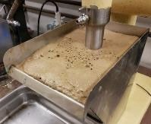
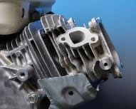
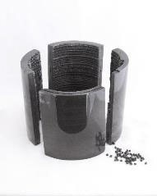
Permanent Magnets
Results and Accomplishments
Improved Beneficiation
RE oxide recoveries of up to 78% achieved with novel flotation collectors
Up to 30% more REs obtained from
bastnaesite ore
Efficient Leaching Eliminates Costly Crack Step Increased Separation Factor
Sm, Nd Metal Conversion & Ce Metal Reduction New Class of Al‐Ce‐X Alloys
Acid Free Recycling
Automated Hard Disk Drive Disassembly Biomaterials for Dissolution, Recovery, & Separation
Critical REE‐Free Gap Magnets
Additively Manufactured Bonded Magnets Magnet Maturation
Supported by Cross‐Cutting R&D:
Thermodynamic Characterization
Machine Learning Tools
Analysis of Chinese Policy Impacts on RE Production
Mining & Concentration
Extraction
Separation
Flotation cell
Conversion to Metals
Refining & Alloying
Recycling
Fabrication
AlCe Alloy Cast
Part Manufacturing
Sub-Assembly Manufacturing
System Integration
3D Printed Magnet

Slide 14

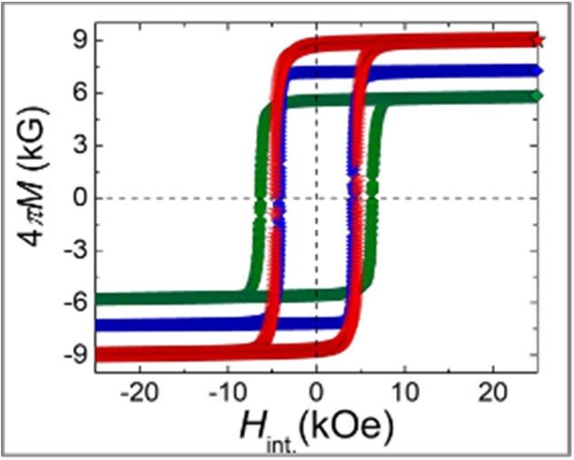
Industry Adoption
of CMI Technology
Results and Accomplishments
Extraction technology for recovery of rare earths from leachate has been licensed by CHC‐Rare Earths, Inc.
All American Lithium has requested to license two inventions (one patented, the other pending) on lithium extraction from salar brines.
CMI has developed promising technologies that isolates and fixes hazardous arsenic during cobalt recovery from skudderudite which is of interest to prospective partner First Cobalt.
Two Technology Commercialization Fund (DOE‐ Office of Technology Transitions) proposals are under evaluation for further development of CMI magnet discovery.
CMI Partner TdVib licensed “Acid‐free dissolution” technology and have applied for STTR funding to adapt it to its Terfenol‐D (Tb, Dy) process wastes.
Atacama salt flat
CeCuCo gap magnets

Slide 15
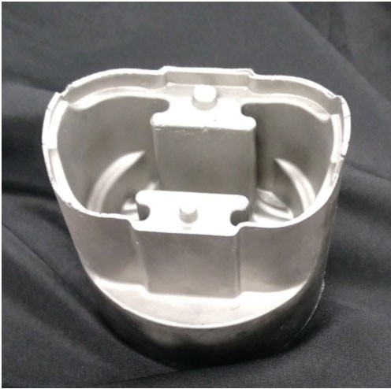
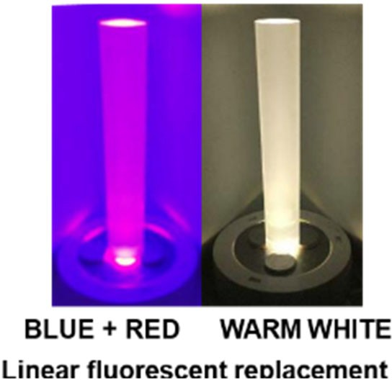
Measure of Success
CMI has already achieved or made significant progress towards several of AMO critical material targets.
Develop enhanced beneficiation, leaching, and extraction technologies to separate rare earth elements from phosphate processing streams. CMI technology licensed to CHC Rare earths
Demonstrate a new material or process employing cerium with the potential to increase use of this metal by 20% compared to 2011. Al‐Ce alloys are projected to meet this target.
Develop a new phosphor that requires one‐tenth critical rare earth elements compared to current fluorescent lamp phosphors. Red and green alternatives development
Develop a substitute permanent magnet that exhibits properties similar to current neodymium‐iron‐boron magnets but contains 50% less critical rare earth materials. Discovery of La‐substituted NdFeB replacing half the Nd is being developed.
Recover and recycle materials from end‐of‐life (EOL) products and manufacturing waste to increase domestic availability of critical materials for clean energy technologies by 20%. Acid‐free dissolution process for recovery of hard drive magnets.
Die-Cast Al-Ce piston

Slide 16


Measures of Success
335+
Referred Publications
140+
Invention Disclosures
260
CMI Participants
58
Patent Applications
16
Awarded Patents
6
Technology Licenses
4
R&D 100 Awards
26
Active Affiliates
35
Active Team Members

