Slide 1
DOE Nuclear Fuel Cycle DPA
Consortium
First Official Meeting
October 23, 2025

Slide 2
Opening remarks
Ted Garrish
Assistant Secretary for Nuclear Energy

Slide 3
The Voluntary Agreement
& Plans of Action
Sarah McPhee Charrez
Chief of Staff for Nuclear Fuel Cycle

Slide 4

The Voluntary Agreement
DOE DPA Consortium
Purpose & Legal Framework
Scope & Duration
Consortium Governance
Committees & Participation
Plans of Action
Rules, Modifications & Expenses
Recordkeeping & Confidentiality
Antitrust Defense, Oversight & Transparency
Application & Agreement
Draft Voluntary Agreement published in Regulations.gov on 10/22, will be published in the Federal Register for public comment in early November.

Slide 5
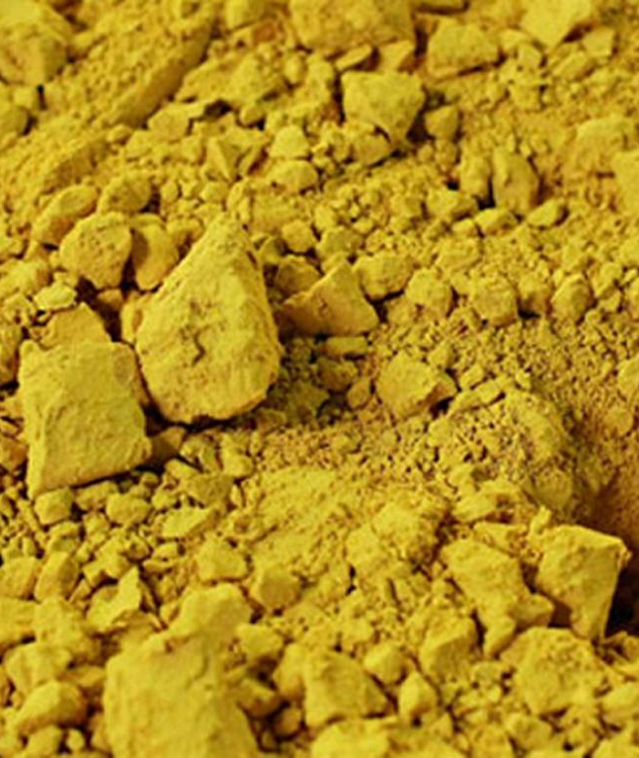
Purpose & Legal Framework
DOE DPA Consortium
Establishes DOE-led mechanism under DPA §708 to strengthen the U.S. nuclear fuel cycle.
Authorized by Defense Production Act, Atomic Energy Act, and Executive Order 14302.
Participants act under DOE supervision, with DOJ and FTC oversight.
Creates a legal safe harbor for approved collaboration addressing nuclear fuel cycle vulnerabilities.
Participation is voluntary.
All actions are limited to energy security and national defense purposes with DOE-approved scope.
Notes:
Explain that this agreement provides the structure for coordination across the nuclear fuel cycle, with guardrails to protect competitiveness and ensure national security. Reassure that oversight is continuous and multi-agency.

Slide 6
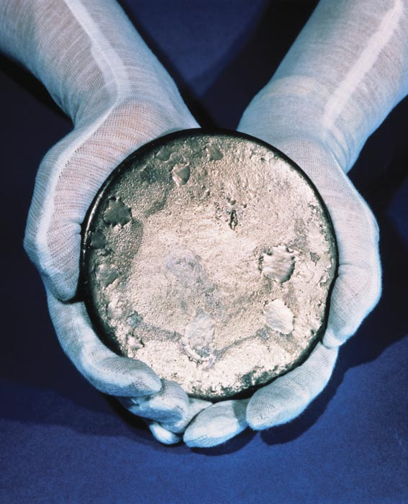
Scope & duration
DOE DPA Consortium
Covers the full nuclear fuel cycle, plus end users and (as a result of feedback) cross-cutting issues.
Supports DOE’s mission for domestic capability, security, and resilience.
Coordination, data sharing, and planning are central elements.
Agreement effective upon signature by Participant.
Remains active up to five years unless extended or terminated.
No actions may occur until DOE formally activates a Plan of Action (POA).
Notes:
Explain that this agreement provides the structure for coordination across the nuclear fuel cycle, with guardrails to protect competitiveness and ensure national security.
Emphasize the clarity of purpose—this is not a commercial coordination effort. Reassure that oversight is continuous and multi-agency.

Slide 7
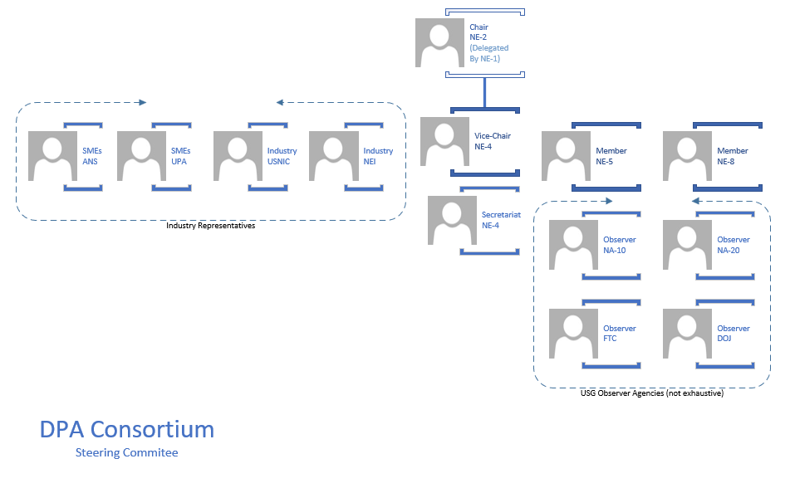
Governance Structure
DOE DPA Consortium
NE-1
Chairperson: Assistant Secretary for Nuclear Energy (leads, delegates tasks as needed).
Vice-Chairperson: DAS for Nuclear Fuel Cycle (supports and deputizes).
Steering Committee: DOE, DOJ, FTC, NNSA, industry reps guide priorities. Will meet at least twice annually.
Secretariat: Maintains records and coordinates logistics.
Notes:
Clarify that this governance ensures balance—industry insight under government direction, not the other way around.

Slide 8
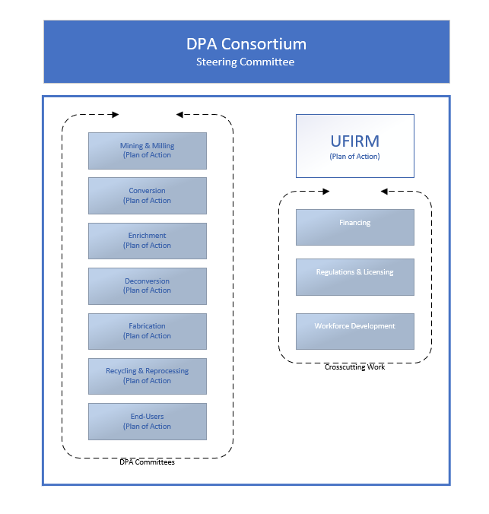
Committees & ufirm
DOE DPA Consortium
Committees address more near-term approaches and are organized by fuel cycle stage (e.g., Mining, Enrichment, Fabrication).
  Each Committee has a Plan of Action.
One DOE Committee Chair and two Industry Chairs as voted by the Committee, with six-month rotations to encourage action.
Participants must maintain 75% meeting attendance and submit deliverables.
  Non-participation may result in removal after written notice and appeal opportunity.
The Uranium Fuel Infrastructure Resilience Mechanism (UFIRM) will function like a Committee, but with no industry co-leads, to address cross-cutting issues such as financing, regulations, workforce development, etc., which tend to have more long-term approaches.
  UFIRM will have one Plan of Action.
Notes:
Reinforce fairness and transparency—everyone has a role, and participation standards protect the integrity of the process.

Slide 9
Plans of action
DOE DPA Consortium
Specific, DOE-approved frameworks for implementation.
Activation requires DOJ/FTC concurrence and Federal Register notice.
Actions outside the Plan of Action (POA) scope are not covered by antitrust protections.
Each POA will contain:
  Scope of Activities: Each Committee will identify at least one activity, addressing how each activity advances the goal of ensuring “that the nuclear fuel supply chain capacity, including milling, conversion, enrichment, deconversion, fabrication, recycling or reprocessing, is available to enable the continued reliable operation of the Nation’s existing, and future, nuclear reactors.”
  Roles & Responsibilities: All Participants must have a specific role and identified responsibilities based on a short “capability statement” that maps their contribution to the Committee’s goals.
  Timelines & Milestones: Corresponding with the Scope of Activities
  Resources Required: Each POA will identify the resources required to accomplish the identified work.
Notes:
Make this point clearly—antitrust protections only exist within DOE-approved and supervised activities.

Slide 10
Rules, modifications & expenses
Participants must comply with DPA §708 and 10 CFR Part 821.
DOE, DOJ, or FTC may modify or terminate agreements at any time.
Participants may propose modifications or amendments.
All expenses are the responsibility of Participants. Unless explicitly identified in a previous or future federal program of record, no USG funding should be assumed.
Notes:
Note that this keeps administrative flexibility with DOE while maintaining fairness and voluntary participation.

Slide 11
Record keeping & confidentiality
DOE DPA Consortium
DOE Secretariat maintains records per 10 CFR 821.
Participants retain relevant records for 5 years.
Trade secrets and financial data protected under FOIA exemptions.
Exemptions for privileged and confidential information.
Notes:
Emphasize DOE’s commitment to confidentiality and responsible data management under federal law.

Slide 12
Next steps
DOE DPA Consortium
The draft Voluntary Agreement was published in Regulations.gov yesterday evening, should be available online today for public comment.
Following DPA Day, DOE will publish the draft Voluntary Agreement in the Federal Register for public comment. This will likely be in early November.
Once comments are reconciled, the Agreement will be made available to Participants for signature.
In the interim, Participants will take back the results of the work we do today to discuss with their companies and counsel.
Once the Voluntary Agreement is signed, Committees may begin to meet to finalize Plans of Action and elect co-leads.
Then the work really begins.
Notes:
Emphasize DOE’s commitment to confidentiality and responsible data management under federal law.

Slide 13
Listening Session feedback
& backgrounders
Grant Mills
Grid Deployment Office

Slide 14
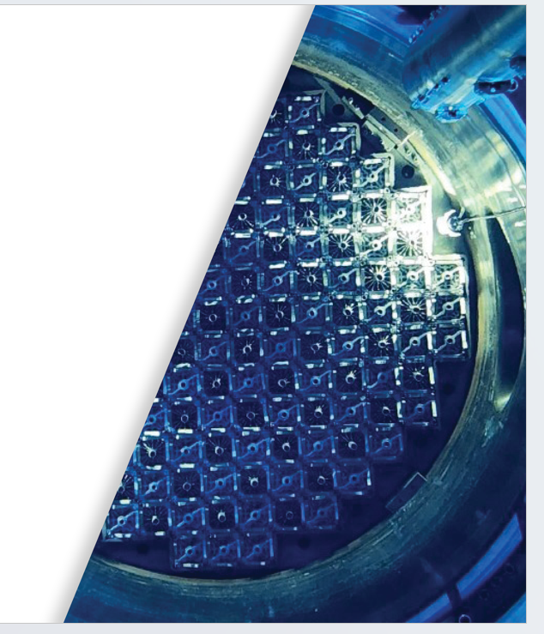
Listening Sessions
Mining & Milling September 10, 2025
Recycling & Reprocessing September 10, 2025
Enrichment September 11, 2025
Conversion September 11, 2025
Fabrication September 22, 2025
Deconversion September 23, 2025
End-Users (Reactors) September 24, 2025
End Users (Utilities) September 30, 2025
Chatham House Rules =
Input is anonymized and presented in this forum through the lens of our closed DPA Day breakout sessions following this meeting.

Slide 15
Workforce Development
What We Heard:
Labor Shortages
Loss of Knowledge/Skills
Ideas to Consider:
Possibility of a coordinated workforce pipeline
Coordination mechanism to help industry retain and transfer technical knowledge before retirements accelerate
Possibility for DPA Title III investment or procurement guarantees to stabilize employment in critical fuel cycle segments

Slide 16
Recycling & reprocessing
What We Heard:
Government Relationship
SNF Composition & Transportation
Nuclear Waste Fund Usage
Product Offtakers
Fuel Material Storage
Waste Disposal
Ideas to Consider:
Identifying an ideal model of public-private partnership to improve the economics of recycling LWR fuel
Coordination to determine best allocation of SNF for reprocessing
Coordination to estimate waste streams from each part of the process to best manage materials with existing facilities and infrastructure

Slide 17
Supply Chains
What We Heard:
Critical Materials
International Supply Chains
Russian Ban
Development Coordination
Ideas to Consider:
Identification of essential supply chain vulnerabilities for DPA support
Development of a DPA-supported mapping of international dependencies
Inter-sector structures for communicating development plans to ensure matched scaling

Slide 18
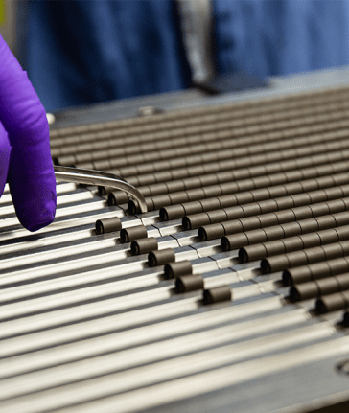
Increasing fuel cycle efficiencies
What We Heard:
Transportation and Packaging
Facility Co-location
Diverse Fuel Support
Ideas to Consider:
Utilization DPA mechanisms to coordinate facility planning and development
Identification of underutilized sites/facilities/infrastructure for fuel cycle development
Sharing information and techniques to standardize and improve transportation processes

Slide 19
Virtual HALEU Bank & Strategic Reserves
What We Heard:
Buyer of Last Resort
Strategic Reserves
Ideas to Consider:
Sharing data on inventories and needs to facilitate a DOE tracking system for material and service availabilities
Coordination for DPA-facilitated “banking” of EUP resources
Revisit a national uranium reserve

Slide 20
Forecasting demand growth
What We Heard:
Short-Term Roll-Ups
Long-Term Forecasts
Market Instability
Scrap Recovery
Ideas to Consider:
Development of a comprehension report on fuel cycle developments
Distribution of risks incurred by supporting new reactors and fuel forms across fuel cycle stakeholders
Reporting key metrics to DOE for accounting and forecasting

Slide 21
DPA Day
Overview & Goals
Florie Knauf
Acting Deputy Assistant Secretary for Nuclear Fuel Cycle

Slide 22
Goals for DPA Day
This Consortium is what we make of it.
Today’s Goal:
Identify initial action items and timelines that best meet the goal areas outlined in E.O.14302, “Reinvigorating the Nuclear Industrial Base. “ This Executive Order:
Creates a new opportunity for government and industry to work together differently and with urgency.
Emphasizes swift and decisive action required to jumpstart America's nuclear energy industrial base
Seeks to ensure our national and economic security by:
  Increasing fuel availability and production;
  Securing civil nuclear supply chains;
  Improving the efficiency with which advanced nuclear reactors are licensed; and,
  Preparing our workforce to establish America's energy dominance and accelerate our path towards a more secure and independent energy future.
These goals must guide our selection of Action Items and drive the Consortium Action Planning Process.

Slide 23
DPA Day Approach
We will be supported by a team of professional facilitators who have developed purposeful sessions and engagement strategies to help us identify potential Action Items in the areas of:
  Workforce Development,
  Recycling & Reprocessing,
  Supply Chains,
  Increasing Fuel Cycle Efficiencies,
  Virtual HALEU Bank & Strategic Reserves, and
  Forecasting Demand Growth.
As a group, we will also make recommendations on which Committee should review and select the Action Items and an initial timeline.
This session is the first step of the Consortium Action Planning Process.

Slide 24
DPA Day Approach, Continued
Please be prepared for a very fast pace.
There are 100+ participants both in-person and on-line and we will need to move quickly to accomplish our session objectives.
Our facilitators use the phrase “100 percent coverage, 80 percent complete” to describe this initial process – lots of ground to cover quickly knowing there is more to do.
We will all participate to accomplish the session objectives – identify Potential Action Items, recommend Consortium Committee action item assignment, and establish an initial timeline that best realizes the EO Goals.
DOE leadership and staff are focused on partnering with industry.
DOE staff will be active participants in the session and will provide both subject-matter expertise and manage topics that cannot be addressed in this session.

Slide 25
What we won’t do today…
This session is an initial step in what will be a long and challenging process. Due to constraints and considerations working a large and diverse group in person and online, we will work to achieve directional agreement and not consensus.
We must work together to avoid . . .
Exhaustively exploring and defending the merits of a Potential Actions. This session is one step in the Consortium process that is designed to identify the actions and timelines that we can agree upon to move forward.
Admiring the problem or providing past references to “the way we’ve always done it.” The EO provides a unique opportunity to work together differently and with urgency.
Dismissing a Potential Action at this point in the process. We all have different experiences, interests, and points of view. All Potential Actions will be validated through the Consortium process.

Slide 26
Bridging the gaps
In-person participants have been assigned based on selection priority and the need to balance the number of participants in each session.
We are using Zoom and the collaboration tool Mural to engage both online and in-person participants. On-line participation has constraints as well as benefits.
  Feedback from listening sessions will be included in the Mural whiteboards to avoid the need to cover old ground.
  Online participants will be able to choose their breakout rooms.
  Everyone logged into to Mural will be able to see all “rooms” at all times.
There will be a facilitator dedicated to online participants to address constraints and maximize participation.
Everyone’s input will be included and recorded.

Slide 27
This is a “new thing under the sun”
For decades, this industry has been waiting for its “moment.” That moment is NOW.
We may not have a defined picture of where we will end up, but we have the opportunity today to define, together, where we are going and how we want to get there.
DPA Consortiums are rare because they are not easy – but neither is what we all do everyday.
Every person in this room and participating online understands the importance of getting this right, not just to individual companies, but to our People, our Nation, and by extension, the world.
Today I challenge you to put aside old ways of thinking – and consider what is possible.
We aren’t going to solve all our problems today, far from it. But the work we do today is the all-important first step that puts us on the fast track to a nuclear future with abundant, firm energy.
We look forward to working with you all today!
Notes:
Emphasize DOE’s commitment to confidentiality and responsible data management under federal law.

Slide 28
Questions?
DPAConsortium@nuclear.energy.gov

