Slide 1

Demonstration of High-Temperature Calcium-Based Thermochemical Energy Storage System for Use with Concentrating Solar Power Facilities
Santosh Gangwal and Andrew Muto, Energy and Environment Division, Southern Research, Durham, North Carolina 27712

Slide 2
Project overview
Project name: Demonstration of High-Temperature Calcium-Based Thermochemical Storage System for Use with Concentrating Solar Power Facilities
DOE program names: ELEMENTS and APOLLO
DOE award number/ FOA number: DE-EE0006535 / DE-FOA-0000805 and DE-EE0007116/DE-FOA-0001186
Principle Investigators: Santosh Gangwal and Andrew Muto
Organization of Prime Awardee: Southern Research
Partners: Southern Company, EPRI, Clariant, and PCI
Award duration: ELEMENTS: May 2014 to July 2016; APOLLO: November 2015 to October 2018
Award amount: ELEMENTS: DOE share: $836,696, Cost-share: $209,175; APOLLO: DOE share: $2,000,000, Cost-share: $998,965

Slide 3
Problem Statement and Value Proposition
CSP facilities require an energy storage system to be economical
sCO2 power cycles operating at >650 C have potential to significantly increase the thermal efficiency of a CSP plant
However, currently available energy storage systems are costly and limited to about 500 C.
Southern Research (SR) is developing a low cost thermochemical energy storage (TCES) system for operation at high temperatures compatible with sCO2 power cycles

Slide 4
Types of Thermal Energy Storage
Sensible Heat
Energy stored in vibrational modes of molecules (sand, concrete, molten salts, etc.)
Latent Heat
Energy stored in media as it changes phase (ice/water, etc.)
Thermochemical Energy
Energy stored in chemical bonds of molecules (metal oxides, reversible oxidation, etc.)

Slide 5
TCES Advantages and Limitations
Advantages
Potential for very high volumetric energy densities
Wide and dynamic range of operating temperatures
Very high exergetic efficiencies, isothermal energy storage and delivery
Limitations
Difficulties maintaining durability of storage media over large number of charge/discharge cycles

Slide 6
Desirable Reaction System for TCES
Highly reversible
High heat of reaction
Reaction equilibrium occurs in relevant temperature range
Low cost, non-toxic storage media
Minimal required balance of plant
Southern Research is developing a high-temperature thermochemical storage process using a reaction which will exhibit all of these attributes

Slide 7
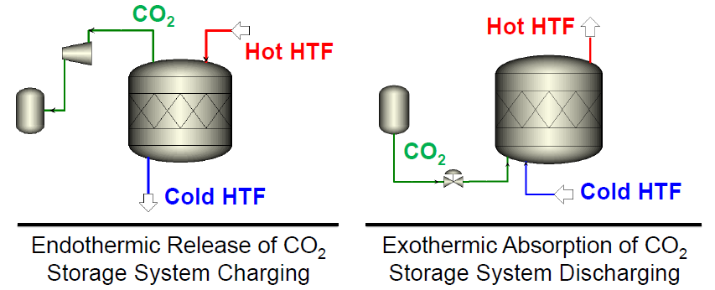
Southern Research TCES System
… the reversible carbonation of Calcium Oxide
CaO + CO₂ <-> CaCO₃ + 180 KJ

Slide 8
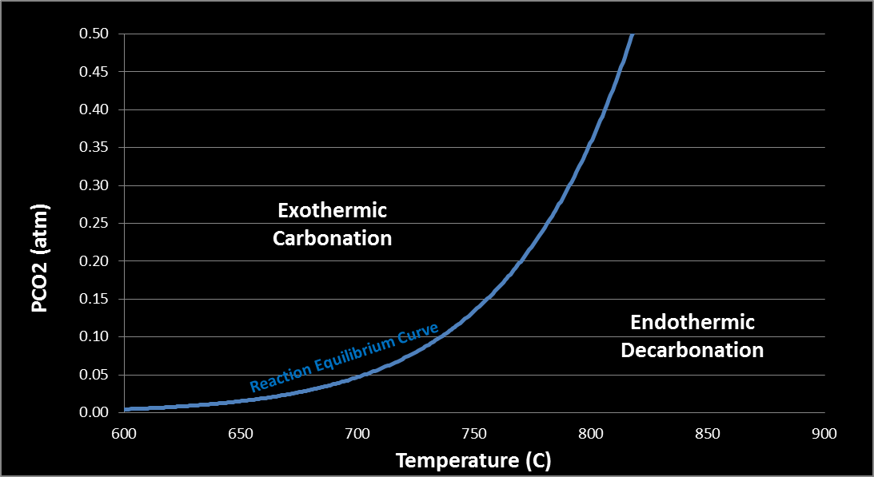
Southern Research TCES System (continued)
Reaction fully reversed by temperature and/or pressure swing
High heat of reaction
Reaction equilibrium occurs in relevant temperature range of 650-800ºC
Low cost, non-toxic, abundant storage media ~$50/ton
Capacity and durability are key challenges
Pressure
Swing

Slide 9
Baseline Sorbent Capacity and Durability
High-temperature storage systems in CSP applications must operate for 10,000 cycles (~30 yrs) !!

Slide 10
Objectives and Milestones
Optimize baseline CaO sorbent composition and demonstrate required high capacity and negligible degradation over >100s of accelerated cycles in TGA testing at sCO2 cycle-compatible temperatures (720-750 C)
Investigate and develop methods of in-situ capacity recovery if sorbent degrades due to accidental temperature increase
Design, build and test bench-scale heat exchanger reactor system (HxRx) to demonstrate required sorbent capacity and durability over >100s of accelerated cycles as well as real time (extended) cycles
In parallel, discuss HxRx designs with commercial Hx manufacturers and conduct techno-economic evaluation to optimize HxRx and balance of plant design (Target: Capital cost $15/kWh or less for a commercial plant)
Build and validate HxRx Multiphysics mathematical models using Comsol with TGA and bench-scale data to assist in scale up
Scale up sorbent manufacture to ton quantities with help from a manufacturer
Design, build and demonstrate a field scale system (0.5 to 1 MWh) to allow technology to advance to large pilot scale (Target: Exergy efficency>90 %)

Slide 11
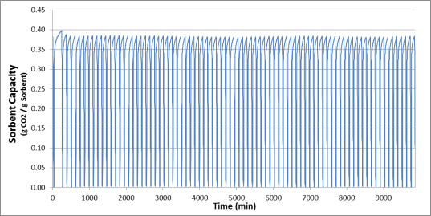
Several 100+ Cycle Capacity and Durability Tests Conducted on Optimized Sorbent Formulations
Required high sorbent durability and capacity was achieved by optimizing composition, and preparation and activation conditions
Near zero sorbent material degradation over 100 cycles!
Time

Slide 12
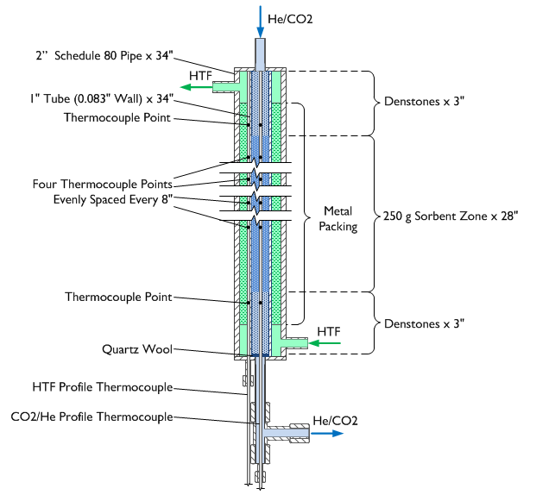
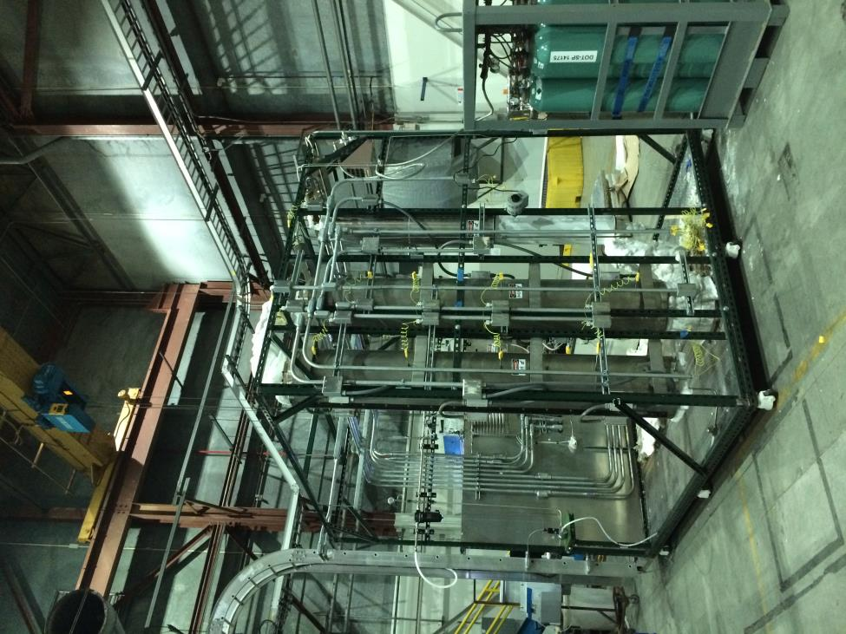
Bench-scale Reactor System Fabricated and Ready for Testing

Slide 13
Present Status of Sorbent Testing, Modeling and Scale-up
Bench-scale system has been built and fully commissioned using inert material in place of CaO sorbent
Methods have been investigated for recovery of sorbent activity after intentional degradation using high temperature exposure
Optimized sorbent has been scaled up to kg quantities and will be prepared for bench-scale testing. Multi-cycle durability testing will begin this month.
A 3D finite element model with coupled heat and mass transfer has been built for the bench-scale reactor. It is being validated with inert material in the place of the sorbent to isolate the effects of heat transfer boundary conditions from the reaction kinetics of the sorbent.
Scale up of sorbent manufacture to ton quantities is planned towards the end of this year

Slide 14
Present Status of HxRx Design and Techno-economic Analysis
A number of commercial Hx options including shell and tube, plate and fin, printed circuit Hx (PCHE) , microchannel, and hybrid PCHE were reviewed for compatibility with sorbent reaction conditions and sCO2 cycle
Based on this review, the choices have been narrowed down to 2 potential manufacturers.
Discussions are continuing under NDA with these candidate manufacturers to finalize the HxRx design for the Apollo project as well as for a commercial embodiment to allow final techno-economic analysis (TEA)
In parallel, a number of potential commercial embodiments of the storage system compatible with a sCO2 power cycle were conceived and evaluated. A preferred configuration was selected. Preliminary TEA of the system indicated potential to achieve capital cost target
Cost sensitivity analyses are being performed and a Technology Transfer Package is being prepared

Slide 15
Commercial Potential
Assumptions:
2GWh Storage / 100 MW_{e} Generating Capacity
Energy Storage Cost = $15/kwh_{th}
CSP facilities only (other thermal storage markets possible)
Timeframe | Installed Capacity (GW) | Potential CSP Energy Storage Capacity (GWh) | CSP Energy Storage Total Addressable Market
Current | 4 | 80 | $ 1,200,000,000
2020 | 147 | 2940 | $ 44,100,000,000
2050 | 1089 | 21780 | $ 326,700,000,000

Slide 16
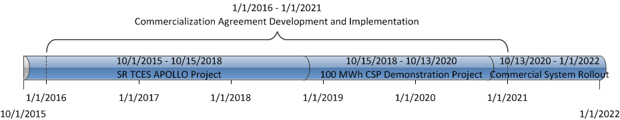
Commercialization Timeline
Southern Research Proprietary Information

