Slide 1

SunShot 2030 Goal: Half the Costs, More than Double the Solar

Slide 2


Speakers
Charlie Gay,
Director
Becca Jones-Albertus, Deputy Director (Acting)

Slide 3

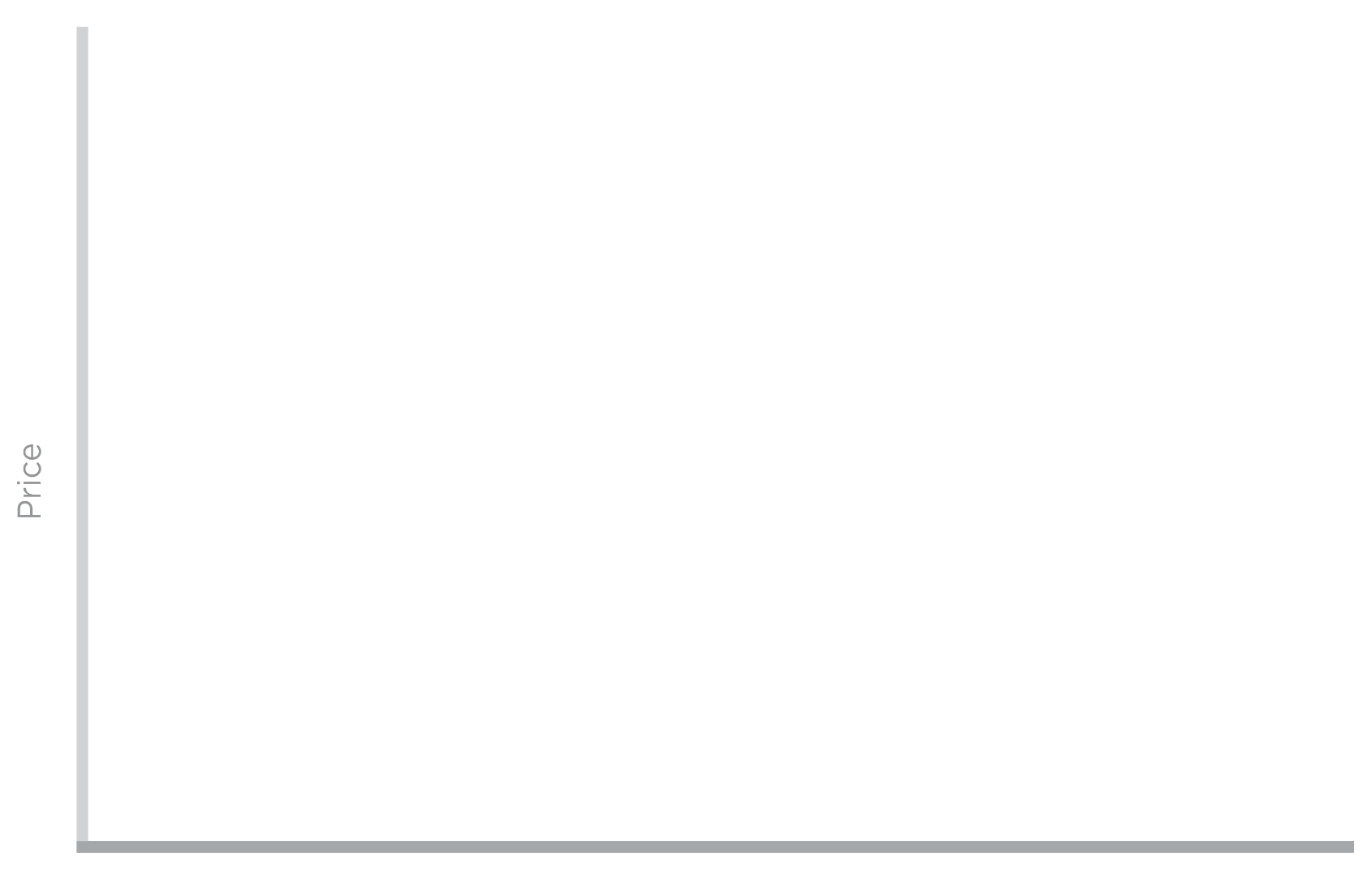




SunShot 2020
SunShot 2020 Goal:
6¢/kWh without subsidy (utility-scale)
Enabling PV to supply ~10% of U.S. electricity by 2030
Price
SunShot
Initiative
6¢/kWh
Coal
Nuclear
Gas
Solar
Notes:
The SunShot Initiative is a collaborative national effort to reduce the total cost of solar by 75% so it can be cost-competitive with other energy sources by 2020. DOE supports several programs that work toward this aggressive goal along the entire cost spectrum. Among these, the Incubator program is unique because it addresses all of the targeted reduction areas needed to achieve cost parity.

Slide 4
SunShot 2020 Goal in Reach — What's Next?
LCOE in cents/kWh (2016 $)*
SunShot Launch
2010
2016
SunShot
2020
* LCOE progress and targets for utility-scale PV are for average U.S. climate and without the ITC or state/local incentives. The 2016 number is for a system with one-axis tracking.
Notes:
DOE launched the SunShot Initiative in 2011 to make solar electricity cost-competitive with conventionally generated electricity by 2020. That meant reducing PV and CSP prices by approximately 75% – relative to 2010 prices – across the residential, commercial, and utility-scale sectors.
Tremendous progress has been made toward these cost reductions, with installed solar costs dropping by 50%-60% and cumulative U.S. solar deployment increasing more than tenfold. Although additional cost reductions of 40%–50% are required to achieve the 2020 goals, SETO sees clear pathways to meeting these goals on schedule. Many other observers of the solar industry share our confidence.
However, increasingly SETO and the solar industry have realized that beyond 2020 even more aggressive cost reductions are possible and—in conjunction with grid-integration strategies—that achieving these additional improvements would substantially increase the national benefits of solar energy.
As a result, the SunShot Initiative has set an even more ambitious goal for 2030: To reduce the average unsubsidized LCOE of utility-scale solar to 3 ¢/kWh, with commensurate reductions for commercial and residential rooftop PV costs between 2020 and 2030. This equates to an additional 50% LCOE reduction.
At 3 ¢/kWh, electricity from utility-scale solar would be among the least expensive options for new generation, and it would be below the variable cost of most U.S. fossil generators, even without any carbon constraints. Commercial and residential rooftop PV applications would also be highly competitive within their respective markets.

Slide 5
SunShot 2020 Goal in Reach — What's Next?
At 3¢/kWh solar would be among the lowest cost options for new generation— and below the variable costs of existing fuel plants.
LCOE in cents/kWh (2016 $)*
SunShot Launch
2010
2016
SunShot
2020
SunShot
2030
* LCOE progress and targets for utility-scale PV are for average U.S. climate and without the ITC or state/local incentives. The 2016 number is for a system with one-axis tracking.
Notes:
DOE launched the SunShot Initiative in 2011 to make solar electricity cost-competitive with conventionally generated electricity by 2020. That meant reducing PV and CSP prices by approximately 75% – relative to 2010 prices – across the residential, commercial, and utility-scale sectors.
Tremendous progress has been made toward these cost reductions, with installed solar costs dropping by 50%-60% and cumulative U.S. solar deployment increasing more than tenfold. Although additional cost reductions of 40%–50% are required to achieve the 2020 goals, SETO sees clear pathways to meeting these goals on schedule. Many other observers of the solar industry share our confidence.
However, increasingly SETO and the solar industry have realized that beyond 2020 even more aggressive cost reductions are possible and—in conjunction with grid-integration strategies—that achieving these additional improvements would substantially increase the national benefits of solar energy.
As a result, the SunShot Initiative has set an even more ambitious goal for 2030: To reduce the average unsubsidized LCOE of utility-scale solar to 3 ¢/kWh, with commensurate reductions for commercial and residential rooftop PV costs between 2020 and 2030. This equates to an additional 50% LCOE reduction.
At 3 ¢/kWh, electricity from utility-scale solar would be among the least expensive options for new generation, and it would be below the variable cost of most U.S. fossil generators, even without any carbon constraints. Commercial and residential rooftop PV applications would also be highly competitive within their respective markets.

Slide 6
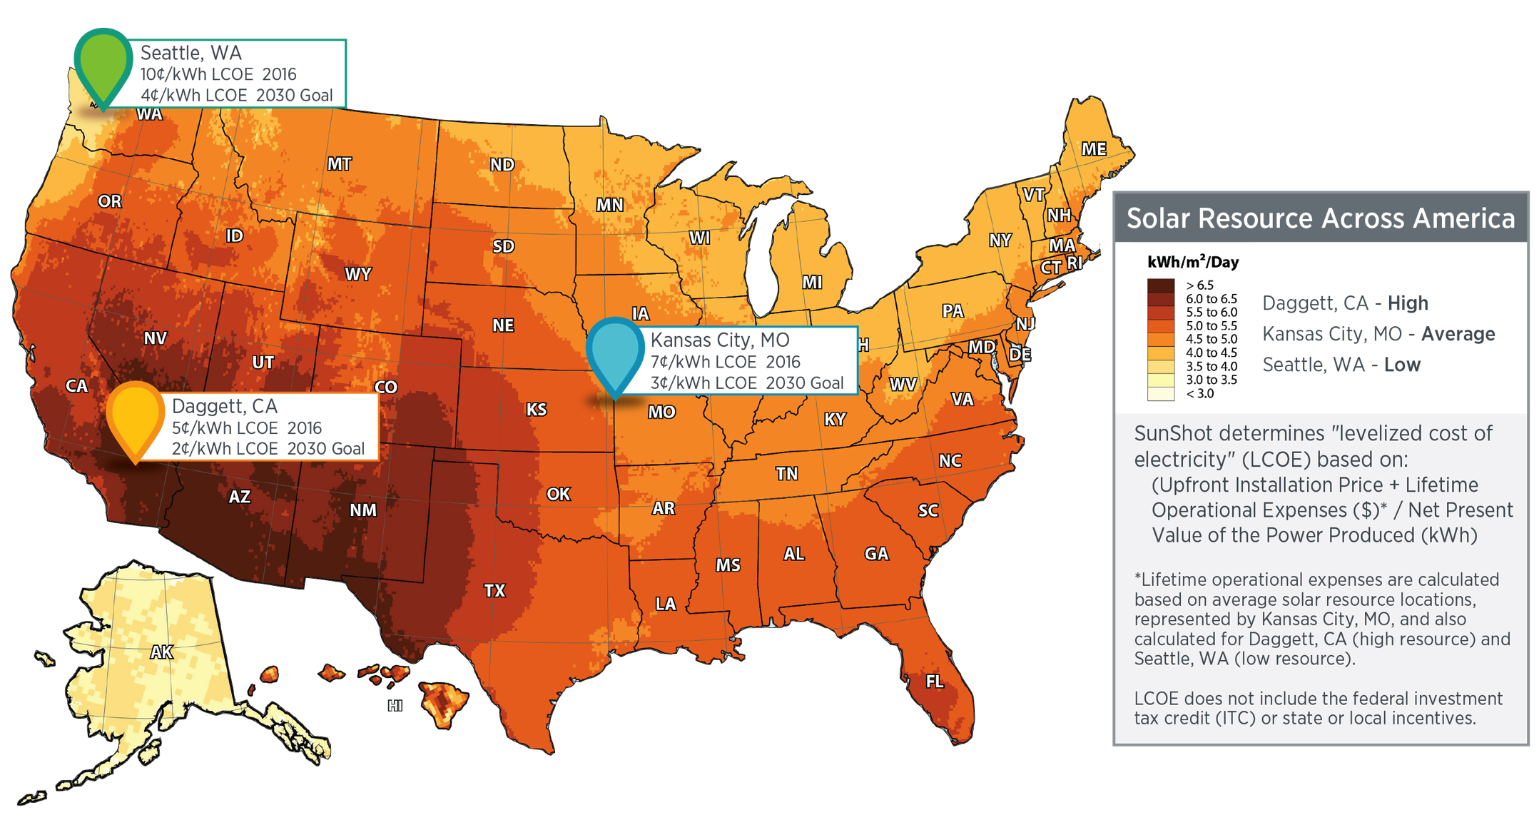
Average Solar Resource Calculation
The amount of power that is produced by a PV system depends upon the solar resource availability (in addition to other factors like temperature and snowfall), which is location dependent. The median solar resource for the United States is represented by Kansas City, MO, while the highest solar resource is represented by Daggett, CA, and the lowest solar resource is represented by Seattle, WA.

Slide 7
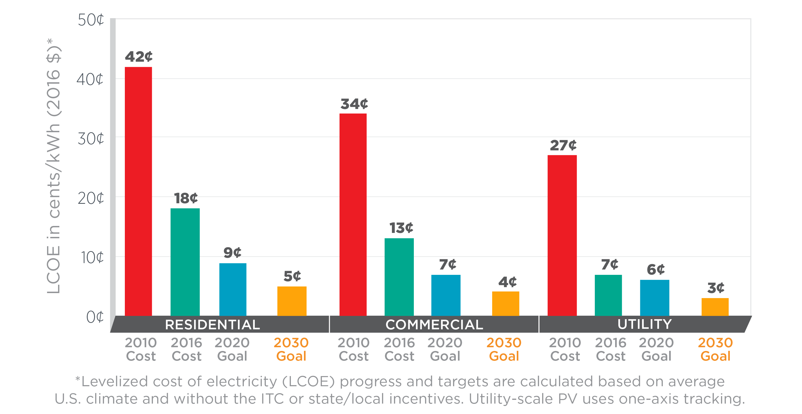
SunShot Progress and Goals
Notes:
3¢/kWh levelized cost of energy (LCOE) for utility-scale solar by 2030:
LCOE target is for photovoltaic systems installed in an area with average climate and without incentives
Enabling solar adoption also requires addressing associated market barriers and grid integration challenges
Corresponding reductions in LCOE for commercial and residential sectors (utility-scale is defined as ≥ 1 MW)
Note: Specific target for Concentrating Solar Power (CSP) with thermal energy storage still in development

Slide 8
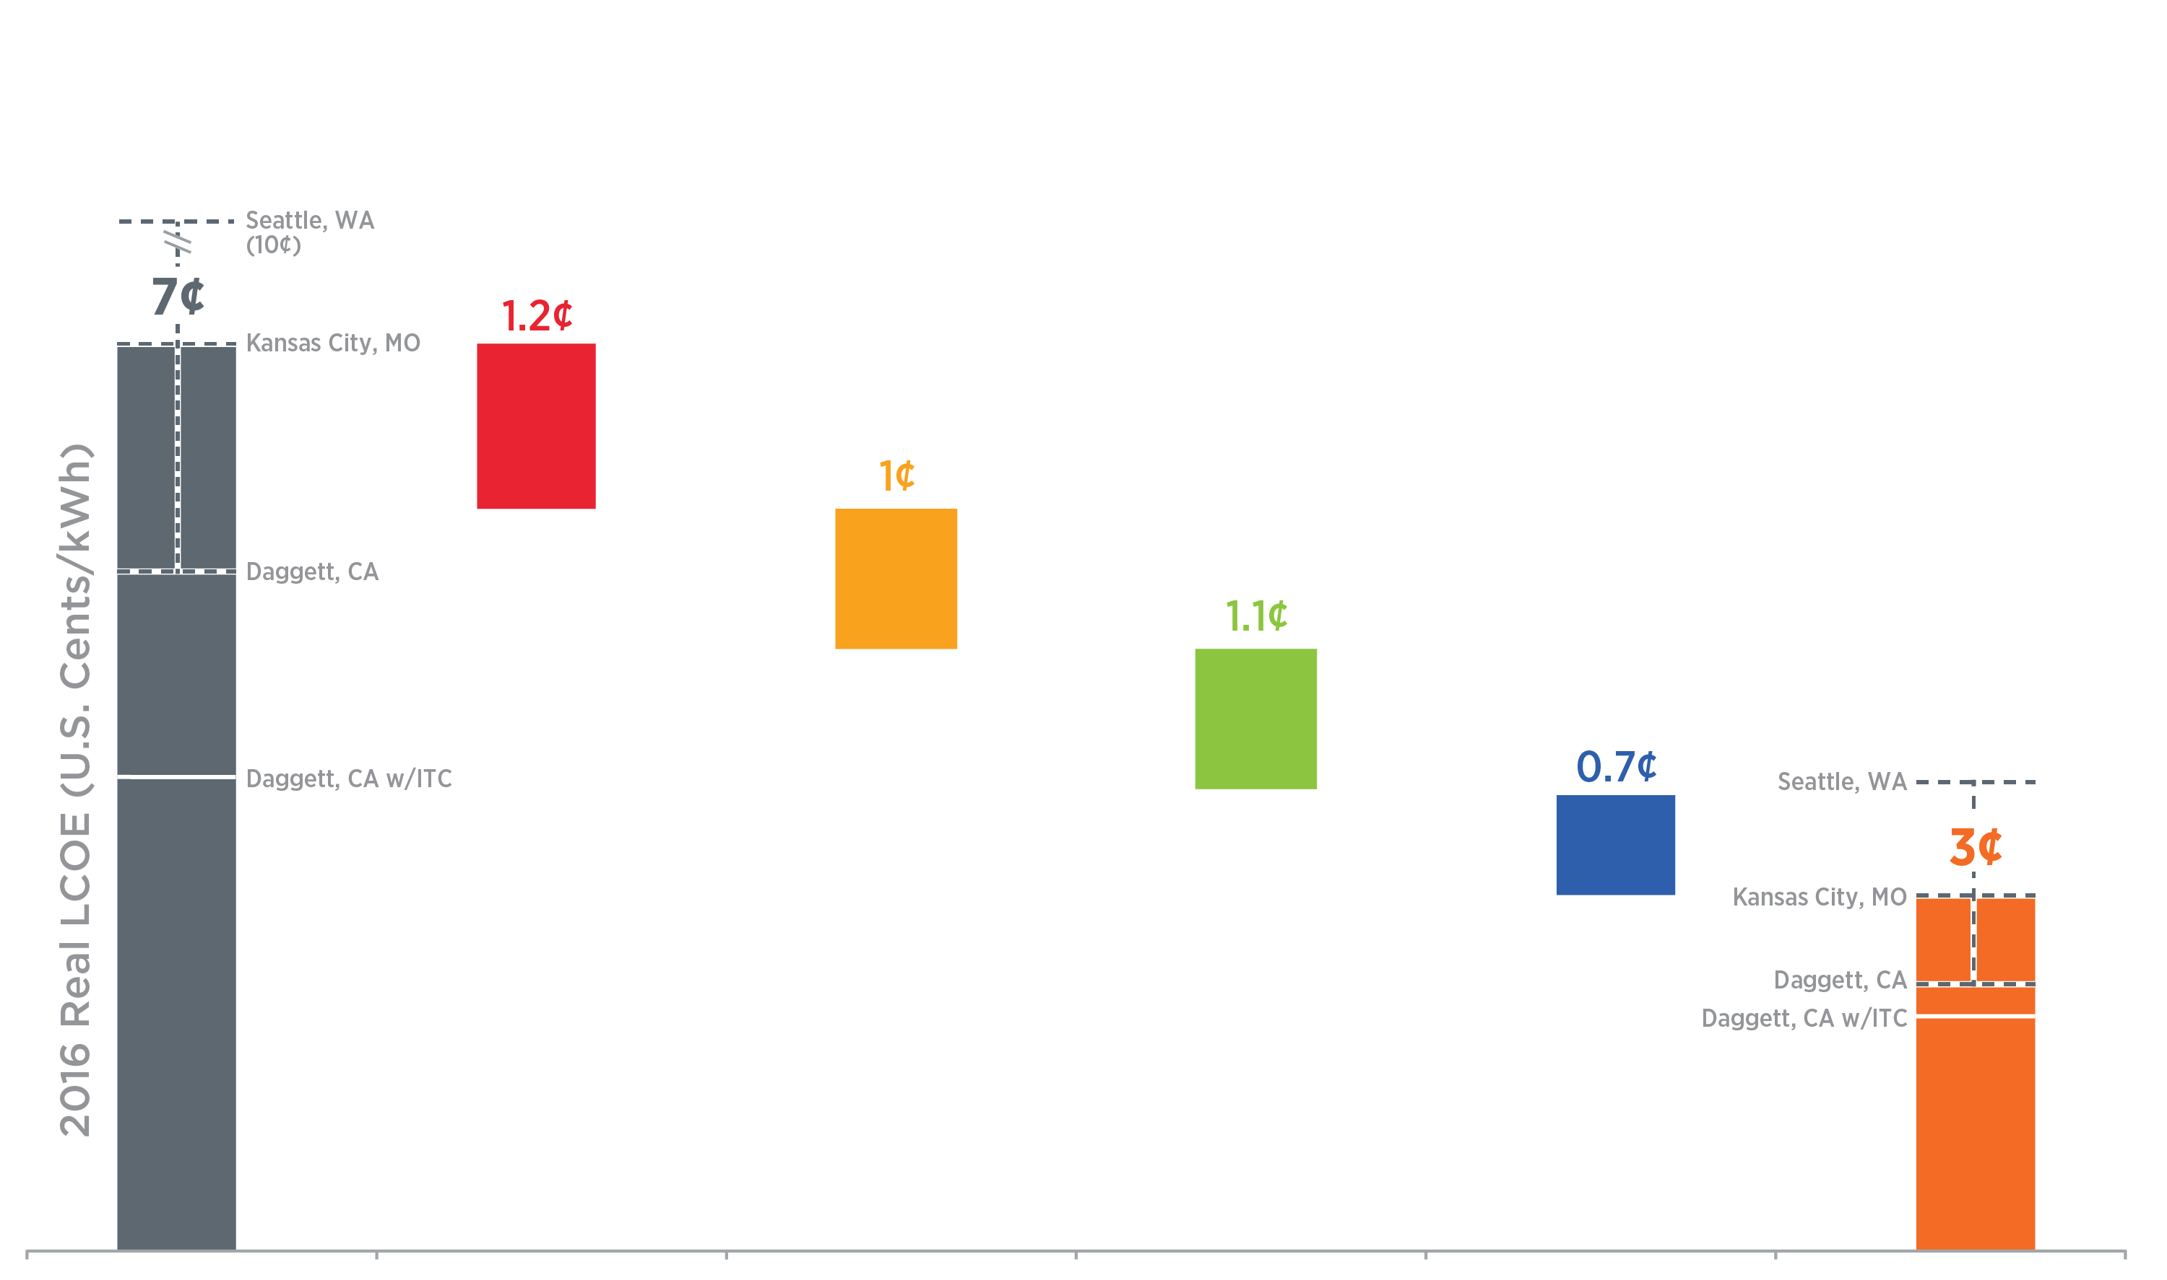
A Pathway To 3 Cents per kWh
Improve efficiency while decreasing cost
2016
Benchmark
Lower Sustainable Module Price:
$0.65 to $0.30/W
Lower Balance of System Hardware and Soft Costs
$0.85 to $0.55/W
Improve Lifetime:
30 to 50 years
and Lower Degradation Rate:
0.75% to 0.2% /year
Lower O&M:
$14 to
$4/kW-yr
SunShot 2030
Goal
100 MW_{(DC)} One-Axis Tracking Systems With 1,860 kWh_{(AC)}/kW_{(DC)} First-Year Performance.
Includes 5 Year MACRS. Cost of capital is 7% and inflation is 2.5%.
Notes:
Although these targets are aggressive, multiple pathways toward achieving them are possible. Here we show one potential route, which relies on significant improvements in module price and efficiency, system reliability, O&M costs, hardware and labor costs, and financing rates. However, the numerous interdependencies and tradeoffs among cost- and performance-improvement factors create numerous potential approaches—all of which require sustained, multifaceted innovation.

Slide 9
A Pathway To 3 Cents per kWh
Speed up installation and interconnection processes, reduce balance of system hardware costs
(and improve module efficiency)
2016
Benchmark
Lower Sustainable Module Price:
$0.65 to $0.30/W
Lower Balance of System Hardware and Soft Costs
$0.85 to $0.55/W
Improve Lifetime:
30 to 50 years
and Lower Degradation Rate:
0.75% to 0.2% /year
Lower O&M:
$14 to
$4/kW-yr
SunShot 2030
Goal
100 MW_{(DC)} One-Axis Tracking Systems With 1,860 kWh_{(AC)}/kW_{(DC)} First-Year Performance.
Includes 5 Year MACRS. Cost of capital is 7% and inflation is 2.5%.
Notes:
Although these targets are aggressive, multiple pathways toward achieving them are possible. Here we show one potential route, which relies on significant improvements in module price and efficiency, system reliability, O&M costs, hardware and labor costs, and financing rates. However, the numerous interdependencies and tradeoffs among cost- and performance-improvement factors create numerous potential approaches—all of which require sustained, multifaceted innovation.

Slide 10
A Pathway To 3 Cents per kWh
Improve upon today’s best-in-class reliability in low-cost modules
2016
Benchmark
Lower Sustainable Module Price:
$0.65 to $0.30/W
Lower Balance of System Hardware and Soft Costs
$0.85 to $0.55/W
Improve Lifetime:
30 to 50 years
and Lower Degradation Rate:
0.75% to 0.2% /year
Lower O&M:
$14 to
$4/kW-yr
SunShot 2030
Goal
100 MW_{(DC)} One-Axis Tracking Systems With 1,860 kWh_{(AC)}/kW_{(DC)} First-Year Performance.
Includes 5 Year MACRS. Cost of capital is 7% and inflation is 2.5%.
Notes:
Although these targets are aggressive, multiple pathways toward achieving them are possible. Here we show one potential route, which relies on significant improvements in module price and efficiency, system reliability, O&M costs, hardware and labor costs, and financing rates. However, the numerous interdependencies and tradeoffs among cost- and performance-improvement factors create numerous potential approaches—all of which require sustained, multifaceted innovation.

Slide 11
A Pathway To 3 Cents per kWh
Employ automation and data analytics
2016
Benchmark
Lower Sustainable Module Price:
$0.65 to $0.30/W
Lower Balance of System Hardware and Soft Costs
$0.85 to $0.55/W
Improve Lifetime:
30 to 50 years
and Lower Degradation Rate:
0.75% to 0.2% /year
Lower O&M:
$14 to
$4/kW-yr
SunShot 2030
Goal
100 MW_{(DC)} One-Axis Tracking Systems With 1,860 kWh_{(AC)}/kW_{(DC)} First-Year Performance.
Includes 5 Year MACRS. Cost of capital is 7% and inflation is 2.5%.
Notes:
Although these targets are aggressive, multiple pathways toward achieving them are possible. Here we show one potential route, which relies on significant improvements in module price and efficiency, system reliability, O&M costs, hardware and labor costs, and financing rates. However, the numerous interdependencies and tradeoffs among cost- and performance-improvement factors create numerous potential approaches—all of which require sustained, multifaceted innovation.

Slide 12

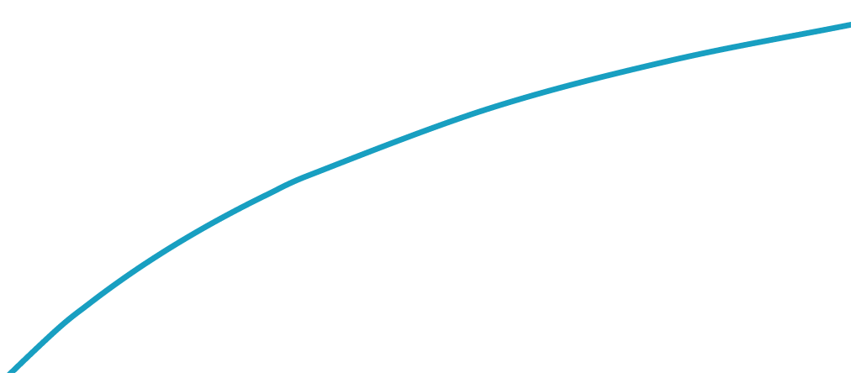

There are Many Technology Pathways
Cost and performance tradeoffs open up numerous possible pathways.
All pathways require sustained, multifaceted innovation.
All curves represent 3¢/kWh LCOE in average U.S. climate
2030 Example Scenario
Module Price ($/Wdc)
30 yr life
1%/yr degradation, 20 yr life
Total-Area Module Efficiency
Unless otherwise noted, all scenarios assume: 7% WACC, 2.5% inflation, $0.85/W system cost, $4/kW-yr O&M, 0.2%/yr degradation, 50 yr life, 21% capacity factor

Slide 13

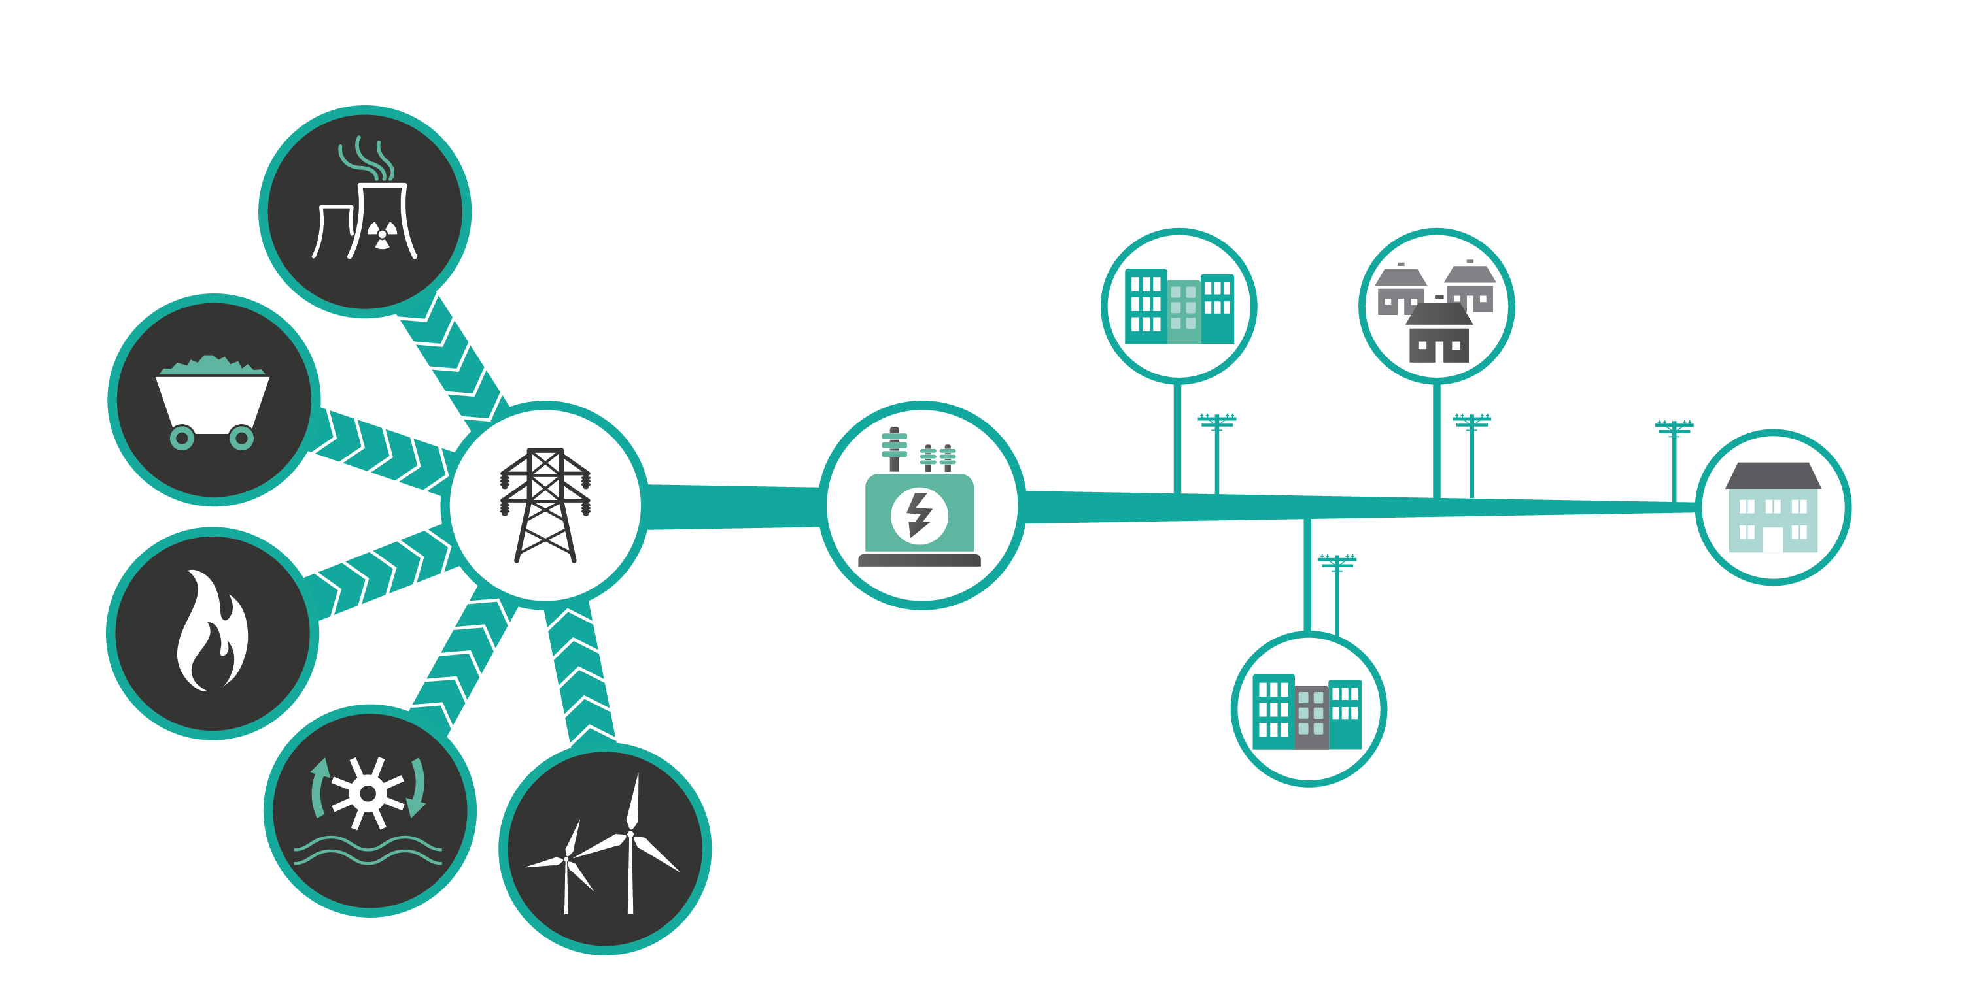




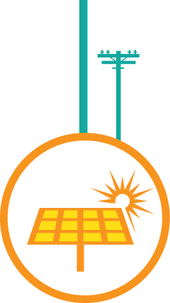






Grid Integration is also Critical
Part of DOE’s Grid Modernization Initiative

Slide 14
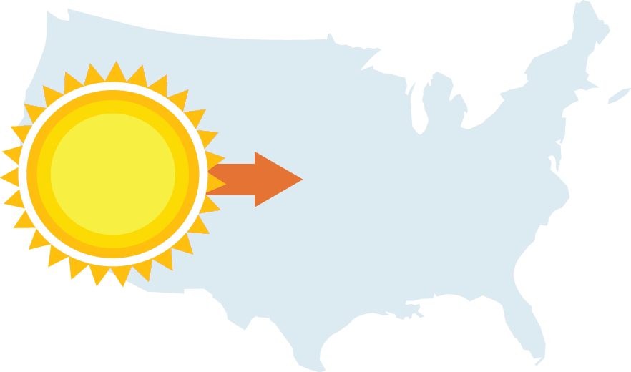





Capacity & Economic Impact
At the end of 2016 Q2…
Solar capacity has grown
26-fold
since President Obama took office.
MAJOR PROGRESS
Enough to power
31.6
GW
6,200,000
average American homes
Solar accounted for
60% of all new electrical generation capacity installed in 2016 Q1.
9,000
solar businesses in the U.S.
$16.3 billion:
Value of the U.S. solar market in 2015
53% ⬇
Solar systems costs are down
50% Since 2010
Source: SEIA.org/SMI
Notes:
Five years into the Energy Department’s decade-long SunShot Initiative, the solar industry is 70% of the way to achieving SunShot’s cost target of $0.06 per kilowatt-hour for utility-scale photovoltaic (PV) solar power.
Since SunShot’s inception, the average price per kWh of a utility-scale PV project has dropped from about $0.21 to $0.10. SunShot is well on its way to achieving its $0.06/kWh goal by 2020.
Today, as a result of DOE’s SunShot Initiative investments and the industry’s accelerated pace to meet the SunShot goal, solar generated electricity is now price competitive with traditional energy sources in 14 states across the U.S., including California, Hawaii, Texas, and Minnesota (with the Investment Tax Credit in place). Increased deployment of affordable and accessible of solar energy is growing quickly across the U.S. Note: all prices are quoted in 2010 dollars. See “Solar Data” section below for specifics.
• Solar is growing the U.S. economy. Solar grows our economy: In 2015, new U.S. PV installations were valued at $16.3 billion – three times greater than the $5.3 billion value of installations in 2010. A new solar project is installed every 100 seconds in America.

Slide 15
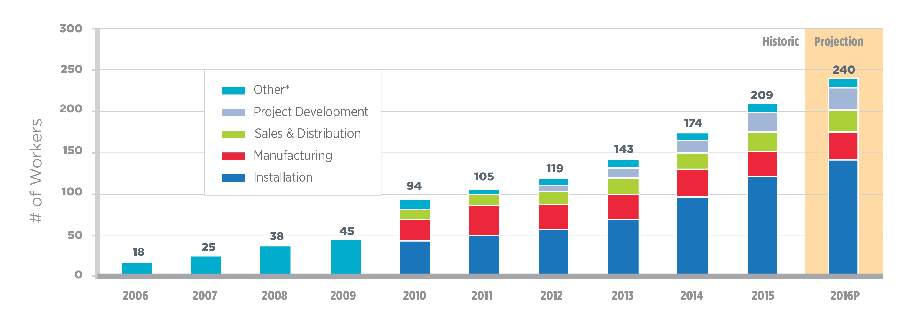




Breakdown of the U.S. Solar Workforce
14.7%
Increase projected
# of Workers (thousands)
Third straight year
20% +
Workforce growth
12X
National growth rate
Veterans make up
96 jobs are created every day in the solar industry
8% of the workforce
Source: The Solar Foundation, “The National Solar Jobs Census 2015.” January 2016.
Notes:
According to the Solar Foundation’s sixth annual National Solar Jobs Census 2015 report, the U.S. solar industry is creating high-skilled, well-paying jobs at a phenomenal rate, adding workers nearly 12 times faster than the overall economy.
There are nearly 209,000 solar workers in the United States, up from 174,000 in the previous year. This marks the third consecutive year in which employment growth was at least 20%. The solar workforce has grown an extraordinary 123% since 2010—adding more than 115,000 jobs.
As the solar workforce continues to display this strong growth trajectory, the Department of Energy is committed to address the needs of the growing workforce, ensuring that the next generation of solar workers has the training and skills needed to build a career in solar energy.

Slide 16
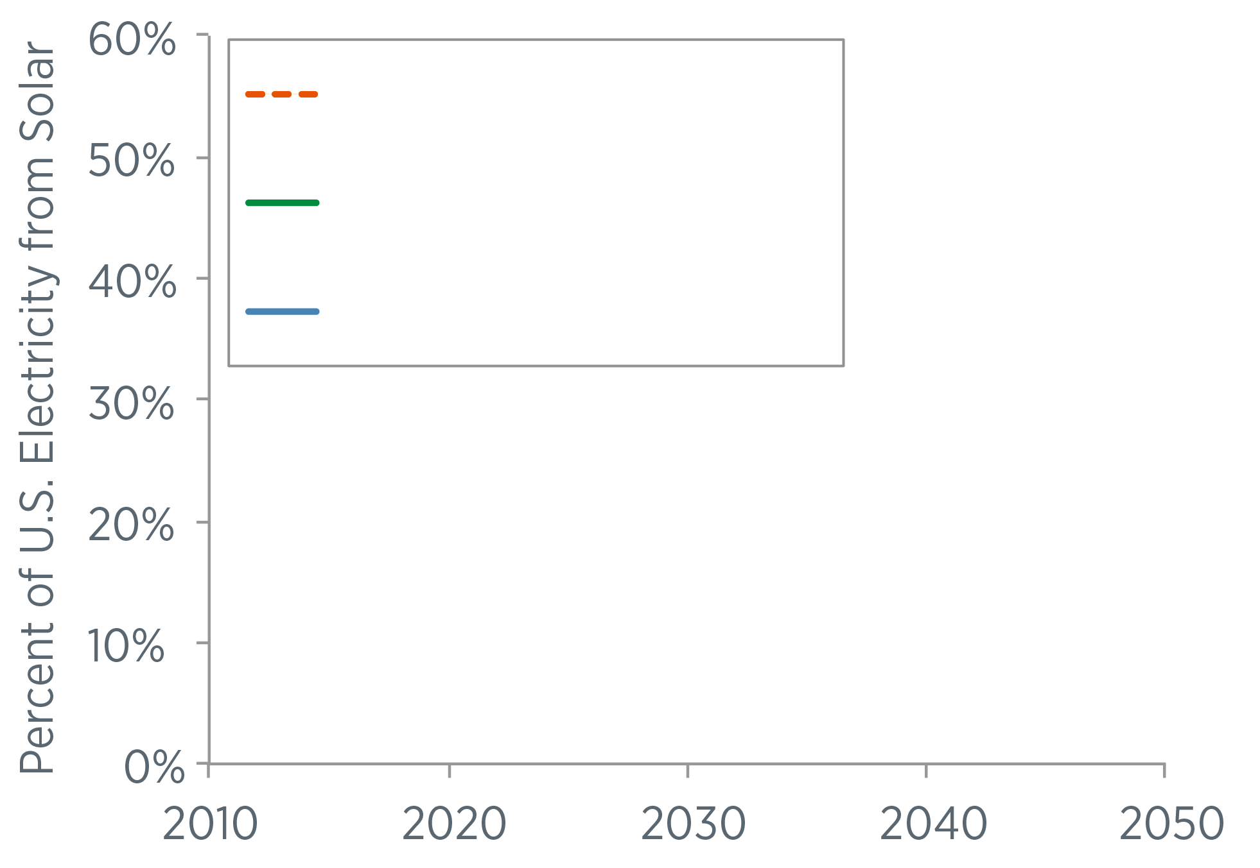
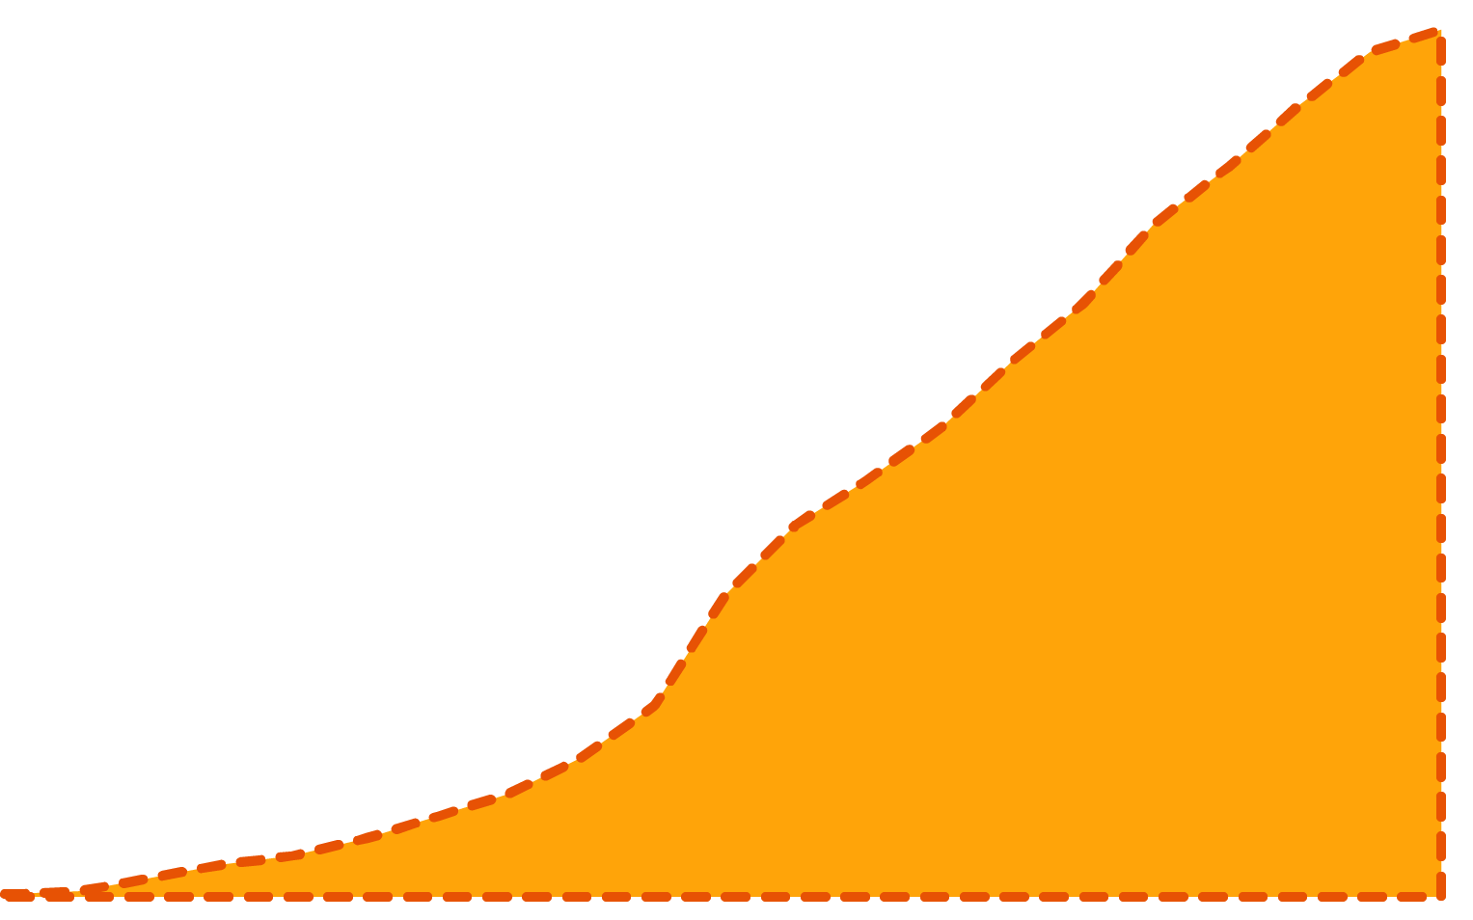


Half the Cost, More than Double the Solar
SunShot 2030 Goal + Low Cost Storage (3¢/kWh)
SunShot 2030 Goal (3¢/kWh)
SunShot 2020 Goal (6¢/kWh)

Slide 17

FOR MORE INFORMATION
For more information go to energy.gov/sunshot2030
Additional questions can be submitted to: solar@ee.doe.gov

Slide 18
SunShot Open Funding Opportunities
Funding Opportunity Announcement: Technology to Market 3 (Incubator 12, SolarMat 5) – Concept papers due December 12, 2016
Photovoltaics Research and Development 2: Modules and Systems (PVRD2) – Concept papers due December 14, 2016
Funding Opportunity Announcement: Solar Forecasting 2 – Concept papers due December 30, 2016
Funding Opportunity Announcement: Small Business Innovation Research and Small Business Technology Transfer (SBIR/STTR) - 2017 Phase 1, Release 2 – Applications due February 7, 2017
Prize Competition: Solar in Your Community Challenge – Applications due March 17, 2017
For more information go to energy.gov/sunshot

Slide 19
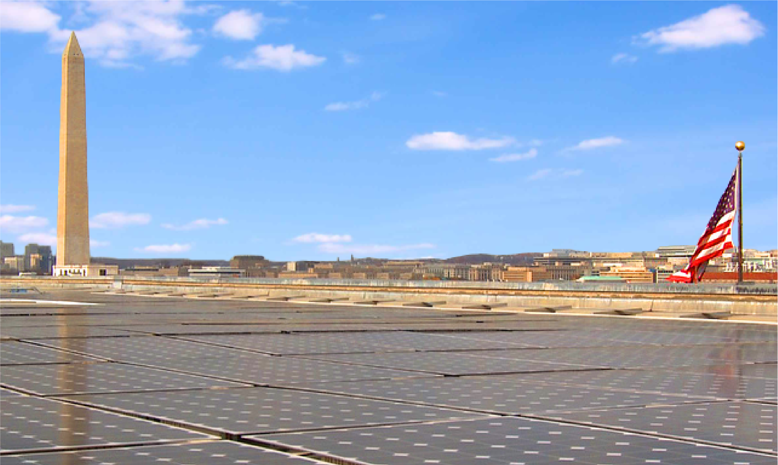
Science & Technology Policy Fellowships at SunShot
Play an integral role in establishing and implementing new initiatives in energy efficiency and renewable energy at DOE.
Drive innovations to make solar the most cost-effective source of electricity.
Design national R&D strategies for:
Concentrating Solar Power
Systems Integration
Photovoltaics
Technology to Market
Soft Costs
Fellowship Benefits:
One-year appointment, renewable for a second year
Competitive stipend
Mentorship from DOE officials
Travel allowance
Health insurance supplement
Relocation expenses
Applications are accepted on a rolling basis with two annual review dates: January 15 | June 15
For additional information or to apply:
VISIT: eere.energy.gov/education/stp_fellowships.html
EMAIL: STPfellowships@orise.orau.gov

Slide 20
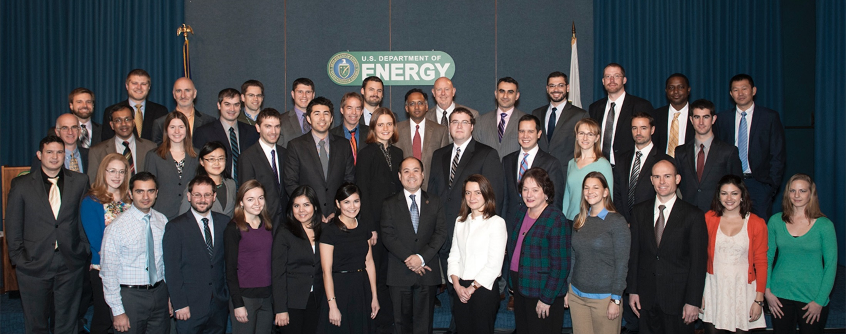





INTERESTED IN JOINING SUNSHOT?
Take on the SunShot grand challenge to make solar energy cost-competitive with traditional energy sources by 2020.
Join our team. Design national R&D strategies across:
PV
CSP
Systems Integration
Soft Costs
Tech to Market
Technical and support positions available. EMAIL ops.solar@ee.doe.gov for more information.

