Slide 1
R&D Consortia Model
Mike McKittrick, R&D Consortia Program Manager
Advanced Manufacturing Office
AMO Peer Review
June 2020 | Washington, DC
manufacturing.energy.gov

Slide 2
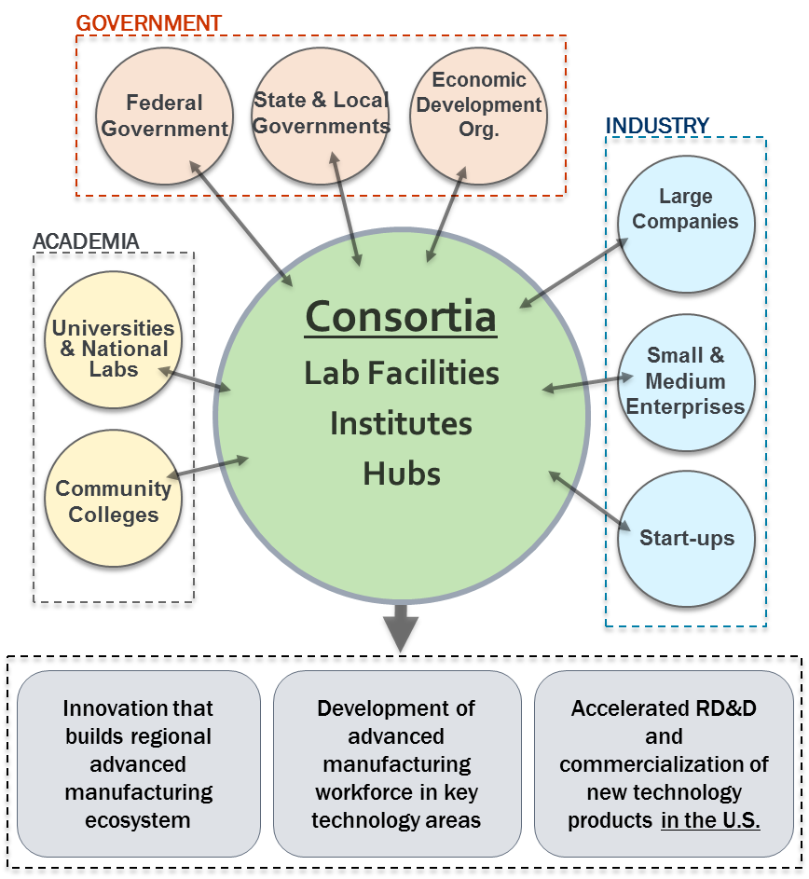
Why an R&D Consortia?
For key technology areas, a portfolio of standalone R&D projects is not sufficient to address the challenges:
  Need for a coordinated R&D effort across the supply chain or market sector to make an impact
  Education and Workforce Development
  Connecting the manufacturing ecosystem
Each R&D Consortia should have:
  Clear technology focus
  Technology Readiness Level suited to specific technology challenge
  Ability to address critical challenges
  A balanced portfolio of projects
  Active membership from industry, academia, and national labs
  Ability to leverage federal funding with non-federal cost share to catalyze a growing ecosystem

Slide 3
AMO R&D Consortia
R&D Consortia | Consortia Type | Technology Area | Lead Organization | AMO Funding/year
Manufacturing Demonstration Facility | Lab Facility | Additive Manufacturing | ORNL | $20M
Critical Materials Institute | Hub | Critical Materials | Ames | $25M
National Alliance for Water Innovation | Hub | Desalination/Water | LBNL | $20M
PowerAmerica | Institute | Wide-Band Gap Semiconductors | N.C. State | $14M
IACMI | Institute | Composites | CCS | $14M
RAPID | Institute | Process Intensification | AIChE | $14M
CESMII | Institute | Smart Manufacturing | UCLA | $14M
REMADE | Institute | Recycling/Reuse | SMIA | $14M
CyManII (selected) | Institute | Cybersecurity | UTSA | $14M
BOTTLE | Lab-led | Plastics | NREL | $5M

Slide 4
AMO R&D Consortia
How do they work?
Hubs vs. Institute vs. Lab-led
  Different models have different funding levels, cost-share, sustainability goals
DOE has an agreement with the lead organization
  Cooperative Agreement (academia, non-profits)
  Utilize the Lab AOP for Lab leads
Consortia Members
  Members sign agreements with the lead organization
  Agreements include IP, Non-disclosures, US Manufacturing Plan, governance
R&D projects
  Stakeholders are engaged to develop a technical roadmap and investment plans
  Projects are typically competed through project calls
  Organizations have to be members to participate in R&D
Management
  Each Institute has a Governing Board and technical committees
Co-investment
  Institutes: 50% cost-share, CyManII 20%
  Hubs: NAWI 20%, CMI 20% at for-profit companies
  MDF: Specific to type of project/CRADA
Peer Reviews
  AMO manages a separate peer review for each consortia
  Typically 1.5-2 days to review consortia management, operations and R&D portfolio
Sustainability
  Institutes are expected to be financially self-sufficient after DOE award

Slide 5
R&D Consortia: Examples of AMO Program Management
Substantial Involvement in Consortia Management, Operations and R&D
  Consortia Management
    Approval of key operational plans, key personnel, members, IP management plans, sustainability plans
    Regular meetings with Consortia Leadership
  Budgets and Statement of Project Objectives
    Negotiate SOPO and budgets for each budget period with Go/No-Go decision points
  R&D Portfolio
    Request for Proposals, Project Selection, Project Negotiations, Project SOPOs and budgets, Project Management
    Regular meetings with Consortia Technical Leadership and project teams
  Consortia Governance
    AMO sits on all Institute Governance Boards and appoints other Federal Representatives
  Quarterly Assessments
  Annual Consortia Peer Review
Award Monitoring
  Cooperative Agreement monitoring and modifications
  Coordinating with EERE contracting, legal, NEPA
  Invoice review/approval

Slide 6
AMO R&D Consortia Team
MDF
  Blake Marshall, Kenny Kort, Steve Shooter
CMI
  Helena Khazdozian
NAWI
  Melissa Klembara, Kenny Kort
PowerAmerica
  Al Hefner, Bill Prymak, Lexie Kim
IACMI
  Chad Schell, John Winkel, Lexie Kim, Ravi Deo
RAPID
  Kate Peretti, John Winkel, Lexie Kim, Melissa Klembara
CESMII
  Sudarsan Rachuri, Bill Prymak, Mahesh Mani, Kristen McDaniel, Steve Shooter
REMADE
  Chris Hovanec, Debbie Schultheis, Mahesh Mani, John Harrington
CyManII
  Chad Schell, Bill Prymak, Kristen McDaniel, Paul Syers
BOTTLE
  Melissa Klembara, Kate Peretti
Education and Workforce
  Nebiat Solomon, Steve Shooter
THANK YOU!

