Slide 1
Mechanisms for Fostering Innovation
Joe Cresko - Advanced Manufacturing Office, DOE
AMO Peer Review 2020
June 2, 2020

Slide 2

Fostering Innovative Technologies and Approaches
“Since the Industrial Revolution, the growth of economies throughout the world has been driven largely by the pursuit of scientific understanding, the application of engineering solutions, and continual technological innovation.”
AMO’s invests in innovation through:
R&D across manufacturing scales
Partnerships and Engagement with Manufacturers
Workforce Development

Slide 3
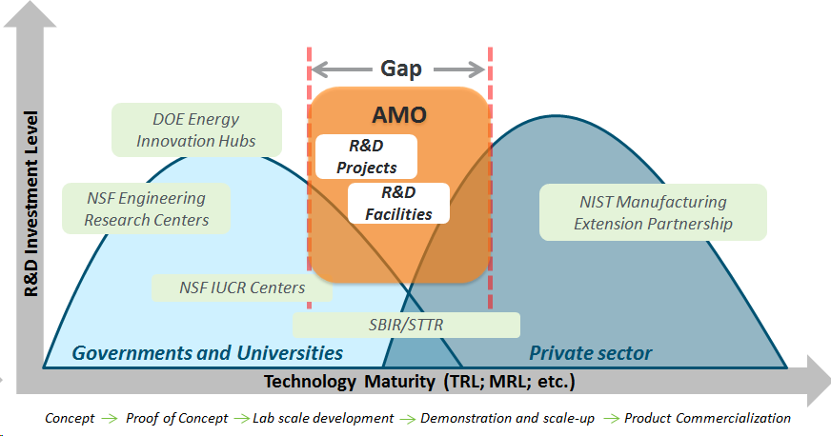
AMO Innovation Space
Importance of Innovation Ecosystems to Manufacturing
“AMO partners with manufacturers, their suppliers, and interested stakeholders to invest in advanced manufacturing technologies and practices that strengthen U.S. manufacturing competitiveness.”
AMO Multi-Year Program Plan
AMO Technical Assistance
AMO Research & Development
3

Slide 4
Investing in advanced manufacturing innovations - ROI
By catalyzing manufacturing innovations, AMO investments helps:
U.S. manufacturing competitiveness
Spur job creation.
Strengthen energy-relevant advanced manufacturing capabilities and accelerate technical progress throughout the manufacturing sector.
Improve the flexibility of energy systems, in part through innovations in energy conversion and storage solutions.
Bring together manufacturers, not-for-profit entities, research organizations, and institutions of higher education to identify challenges.
Bridge the gap from discovery to manufacturing and accelerate innovations into the market.

Slide 5
Innovation opportunities at all manufacturing scales
High
Technology Stage Timing
Theory Decades
Fundamental research Decades
Technology development 5–10 years
Proof of concept 1–2 years
Prototype 6 months
Alpha product 6–12 months
Qualification & manufacturing 12 months
Product extensions 2 years +
Deployment
Commercialized technologies – mature at large scale production
Demonstration
Mature at small
scale production
Mature at
pilot scale
Development
“Marginal” Improvements at Scale
Technology Maturity
Mature at bench scale
Applied
Research
Start large
scale production
Start small
scale production
Start pilot
scale
Next generation of production
Next Gen
Mfg. Scale
Basic
Research
Start bench scale
Next Generation Idea
Low
Manufacturing Scale
High
Materials & Process Research
Systems Development
Engineering & Mfg. Sciences
Validation & Certification

Slide 6
AMO Investments in Technology Innovation
R&D Projects: Targeted high-impact manufacturing technology, materials & process challenges.
Multi-Topic Funding Opportunity Announcements (FOAs), Lab Calls, SBIR/STTR
Consortia Model: Create innovative ecosystems.
Institutes, Hubs, Mfg. Demonstration Facility
National Laboratory Resources: Creative approaches to leverage assets across the national lab complex.
Lab-Embedded Entrepreneurship Program, Energy I-Corps, High Performance Computing for Manufacturing (HPC4Mfg) Program, Technologist in Residence (TIR) Program, Technology Commercialization Fund (TCF)

Slide 7
Approaches to Innovation in R&D Consortia
Advanced Manufacturing Innovation Institutes
Catalyze the development of new technologies, national infrastructure, educational competencies, production processes, and products via shared contributions from the public and private sectors and institutions of higher education.
Energy Innovation Hubs
Modeled after the strong scientific management characteristics of the Manhattan Project and AT&T Bell Laboratories.
Integrated research centers that combine basic and applied research with engineering to accelerate scientific discovery that addresses critical energy issues.
Collaborative manufacturing community that shares a common R&D infrastructure, providing affordable access to advanced physical and virtual tools for rapidly demonstrating new manufacturing technologies and optimizing critical processes.

Slide 8
Leveraging National Laboratory Resources to Accelerate Innovation
High Performance Computing for Manufacturing (HPC4Mfg) Program
Technologist in Residence (TIR) Program
Technology Commercialization Fund (TCF)
Enables collaborations between national labs and U.S. manufacturers to help de-risk future investments.
Focuses on applying modeling, simulation, and data analysis to industrial products/process to reduce time to market and production costs.
Streamlines engagement between national labs and private sector.
Program partners a senior national lab technologist with an industry professional to understand and tackle important problems and how lab resources can help.
Advances promising energy related, commercially potential technologies developed at national labs.
Strengthen partnerships between national labs and private sector companies able to deploy these technologies.
Trains innovators to develop entrepreneurial acumen and skills; introduces them to partners needed to facilitate commercial and investment opportunities.
Entrepreneurial scientists and engineers launching an energy-related business “spin-in” to National Lab.
Lab-Embedded Entrepreneurship Program

Slide 9



Innovating Across Technologies, Marketplace and Workforce
Lab-Embedded Entrepreneurship Programs
VC
Non-VC
M&A
Recruit the
best energy technology innovators
Leverage expert mentorship and world-class facilities at the national labs via a two-year fellowship + CRADA
Position
people and technology for market
Goal: Empower innovators to mature their ideas from concept to first product, test product and business viability, positioning them to align with the most suitable commercial path to bring their technology to scale.

Slide 10







Lab-Embedded Entrepreneurship Programs
Cyclotron Road @ Lawrence Berkeley
- Launched mid-2014
- Partnership with Activation Energy
- Currently working with 5th & 6th cohorts
Chain Reaction Innovations @ Argonne
- Launched mid-2016
- Partnership with Polsky/Purdue
- “Graduated” their first class of innovators spring 2019
Innovation Crossroads @ Oak Ridge
- Launched mid-2016
- Partnership with LaunchTN
- “Graduated” their first class of innovators spring 2019

Slide 11
Early successes from the Lab-Embedded Entrepreneurship Programs
Follow-on Funding: Since 2015 LEEP nodes have awarded more than $32 million to 89 fellows across over 65 projects, who have gone on to attract more than $120 million in additional funding to support their work through additional federal funding (SBIRs) and private funding from sources including philanthropy, angel investors, venture capital, and strategic investors.
National Recognition: Since 2016, a total of 10 innovators from the Programs have been named to Forbes’ “Thirty under 30” list in the energy category, including 3 innovators in 2018’s list.
Fulfilling an Unmet Need: To date, the Programs have provided top-tier innovators with a previously non-existent entrepreneurial platform from which to advance breakthrough energy and manufacturing technologies toward commercial impact.
Efficient Use of Funding/Avoided Costs: Interviews with innovators suggest ~$1M and 6-12 months of development cost/time can be avoided through participation in the Programs.
New Partnerships: Since being in operation, individual LEEP nodes have built relationships with and gained support for additional innovators from other DOE offices and USG Agencies.

Slide 12







Example of alignment with current priorities – Energy Conversion and Storage across the nodes
A novel radioisotope battery made from nuclear waste
2017 CRI Cohort
Potential markets include space power, military, remote energy storage
Graphene-enhanced electrodes
2018 CRI Cohort
Potential markets include Li-ion battery material and cell manufacturers
Portable thermophotovoltaic power generator
2018 CRI Cohort
Potential markets include U.S. military, emergency response, and drones
Organic materials for energy storage
2018 CRI Cohort
Potential markets include electrolyte and Li-ion cell manufacturers
Dielectric materials for high density capacitive energy storage
2019 CRI Cohort
Electrolytes to enable more powerful ultracapacitors
2018 Innovation Crossroads Cohort
Potential markets include mobile electronics and electric vehicles
Turning low-temperature waste heat into energy storage
2017 Innovation Crossroads Cohort
Potential markets include petrochemical and pulp & paper mfrs

Slide 13





Example of alignment with current priorities – Energy Conversion and Storage across the nodes
Advanced membranes for beyond Li-ion battery performance
2016 Cyclotron Road Cohort
Potential markets include mobile electronics and electric vehicles
Ultrasound & Machine Learning for Battery Inspection & Metrology
2016 Cyclotron Road Cohort
Potential markets include battery manufacturers and end users
Advanced Electrolyte for stable high-voltage Li-metal batteries
2016 Cyclotron Road Cohort
Potential markets include U.S. military, energy producers, and drones
CUBERG
A new class of ultra-low-cost flow battery
2018 Cyclotron Road Cohort
Potential markets include wind and solar energy producers
Low-cost thermal batteries for grid-scale energy storage
2018 Cyclotron Road Cohort
Potential markets include the U.S. military and energy providers

Slide 14
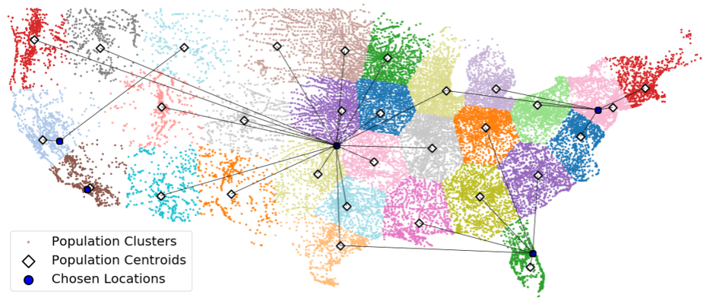
What are the future innovation needs for manufacturing?
Highly flexible and resilient manufacturing operations, systems and facilities.
Reverse, dynamic, adaptable supply chains.
Building new capabilities and rebuilding lost capabilities.
Data analytics, machine learning, artificial intelligence for robust cyber-physical systems.

