Slide 1
Advanced Manufacturing Office
Diana Bauer, Senior Technical Manager, Advanced Manufacturing Office
Advanced Manufacturing Office Peer Review
June 2, 2020

Slide 2
Framework to Shape AMO’s Portfolio
A holistic top-down and bottom-up systems approach to
shape the AMO portfolio with the highest potential for impact.
Identify & Address National Needs
Energy Storage
Critical
Materials
Plastics
Cyber
Water Security
Fundamental Systems Analyses (e.g. Lifecycle Analysis)
Integrative Approach
- - -
Materials & Processing
Electronics
Chemical Processes
Sensors &
Controls
- - -
Leverage Fundamental & Applied Science Foundation
Notes:
AMO’s broad portfolio allows the office to respond to national needs nimbly. The office brings fundamental and applied science foundations to bear through an integrative approach and uses fundamental systems methods to tackle new challenges. AMO’s goal is to strengthen manufacturing in the U.S. through both a top-down and bottom-up approach.
Work with other DOE offices to characterize and sketch out National Needs
Use fundamental systems methods to lay out the highest impact manufacturing challenges and opportunities in National Needs.
Target fundamental applied science and technology to address these challenges and opportunities.
Draw from fundamental systems methods to identify emerging national needs.
Build and strengthen fundamental systems methods.
Build and strengthen fundamental applied science foundation.

Slide 3

AMO Strategic Process
External Review
Strategic Analysis
(Past, Current,
& Future)
Spend Plan
Investment
Portfolio
Stakeholder
Input
Funding Opportunities
& Selections
National
Laboratory
Capabilities

Slide 4

Funding Opportunities and Investment Portfolio
      AMO’s funding opportunities and selected projects:
        Address national needs
        Fund congressionally directed efforts
        Support the manufacturing enterprise of the future
FUNDING OPPORTUNITIES
INVESTMENT PORTFOLIO
FOAs | PRIZES | LAB CALLS
R&D PROJECTS | CONSORTIA
AMO’s strategic framework guides development of new funding topics through:
  Strategic Analysis
  Stakeholder Workshops
  National Laboratory Listening Sessions
AMO actively manages a diverse portfolio, evaluating projects regularly for technical merit, energy impact, and progress against office goals through:
  Peer Review
  Introspective Portfolio Assessment
  Verification & Validation; Field Validation

Slide 5
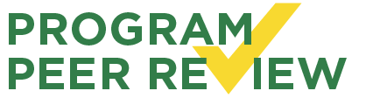
External Review: Annual Peer Review
OUTSIDE
PANEL
industry s academia s finance s nonprofit
National Academies s federal agencies
2019 PEER REVIEW FEEDBACK |  | AMO RESPONSE
Organize AMO’s technology areas into a higher-level framework |  | Developing a structured and systematic framework to help to shape, guide, and describe AMO’s work
Perform retrospective analyses to identify, communicate, and implement lessons learned |  | Scaling up Introspective Portfolio Assessment and Retrospective Analysis to examine selected projects’ impacts
Require every program to estimate energy and projected economic impacts |  | Requiring new project proposals to include estimates on energy impacts
Identify AMO’s biggest successes and best practices |  | Communicating success stories that will inform learning from the investment portfolio

Slide 6

Strategic Analysis
AMO has a robust and holistic independent approach that integrates analysis of past, current, and future investments with the office’s strategic success indicators, targets, and goals.
RETROSPECTIVE
ANALYSIS
Examine project impact
Incorporate technology
tracking back to 1990s
Draw on four decades
of data
PROSPECTIVE ANALYSIS
Envision what could be ahead
Evaluate possible future scenarios
Consider breakthroughs /
transformative moonshots
2010
2015
TODAY
2025
2030
2035
BEYOND
INTROSPECTIVE ANALYSIS
Assess and validate ongoing project direction
Establish continuity for next-generation investments
Consider how R&D topics interconnect and build on one another

Slide 7

Strategic Analysis: Technical White Papers
Draw on collaborative office knowledge for a topic area
Frame and refine ideas using a bottom-up / top-down approach
Clarify opportunity areas and uncover linkages
Lay out the current state of the field, the challenges
and barriers that exist, the opportunities for addressing
them, and a potential strategy for a path forward
for 2021 and beyond
Sample Topics
NATIONAL NEEDS
Critical minerals
Water security
Energy storage
FUNDAMENTAL SYSTEMS METHODS
Carbon capture
Electrification
Circular economy
FUNDAMENTAL AND APPLIED SCIENCE
Chemical processes
Additive manufacturing
Power electronics
Notes:
Icons made by <a href="https://www.flaticon.com/authors/freepik" title="Freepik">Freepik</a> from <a href="https://www.flaticon.com/" title="Flaticon"> www.flaticon.com</a>

Slide 8
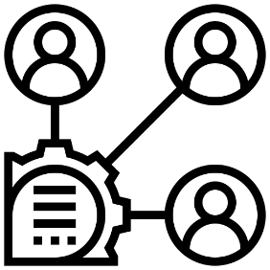


Stakeholder Input
Ongoing input from
INDUSTRY
& ACADEMIA
12+
IN-PERSON
& VIRTUAL
WORKSHOPS
ADDITIONAL
STAKEHOLDER
ENGAGEMENT
to understand current
and emerging challenges
and opportunities
to identify ongoing gaps, needs, and opportunities within the manufacturing sector
led by AMO in 2020 to expand
on technical white papers and build from AMO investments
TOPIC
EXAMPLES
  Materials for Harsh Service Conditions s Dynamic Catalyst Science
  Energy Storage s Carbon Capture s Additive Manufacturing
  Critical Materials s Chemical Manufacturing R&D s Circular Economy
  Water Security s Combined Heat and Power in the Flexible Manufacturing Enterprise

Slide 9
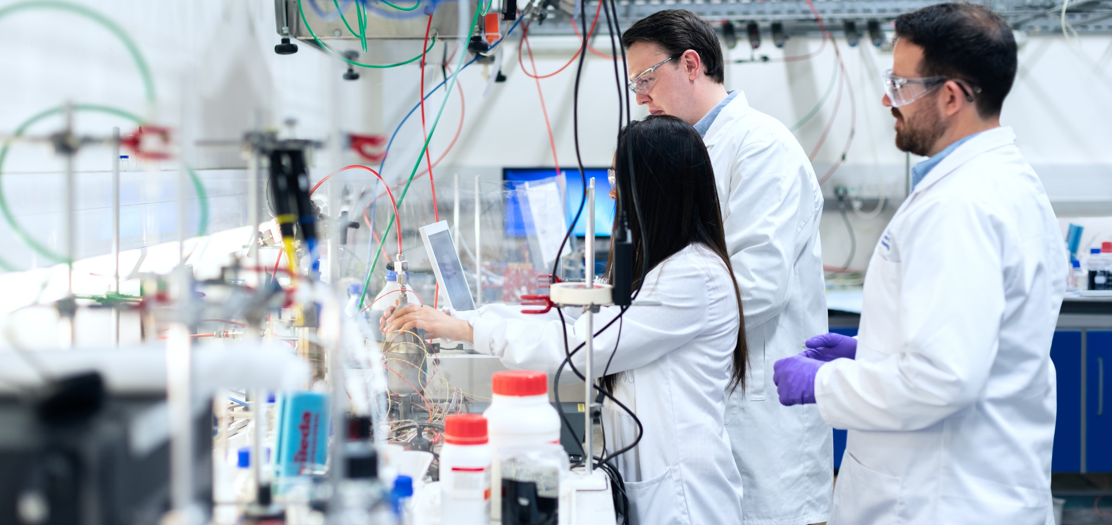

National Laboratory Listening Sessions
Forward-looking conversations to collaborate on new R&D opportunities
and investigate future manufacturing needs and trends
WHAT WE HEARD
The National Laboratory complex is well-positioned to
address national needs in manufacturing.
EX: CRITICAL MATERIALS | ENERGY STORAGE | CIRCULAR ECONOMY
Each National Laboratory brings unique domain
expertise to solve key U.S. manufacturing challenges.
National Laboratories offer specialized equipment,
expert staff, infrastructure, and platforms for industry collaboration.
Sessions underscored the need for advances in computation
and materials science to transform U.S. manufacturing.
KEY STRATEGIC
CAPABILITIES
High Performance Computing
  Machine Learning
  Manufacturing Demonstration
  Chemical Separations
  Testing and Validation
  (for materials, devices)
  Fundamental Systems Methods
AMO will harness the individual National Laboratories’ capabilities and the strength of the complex to inspire discovery and secure U.S. leadership in the future of manufacturing.

Slide 10
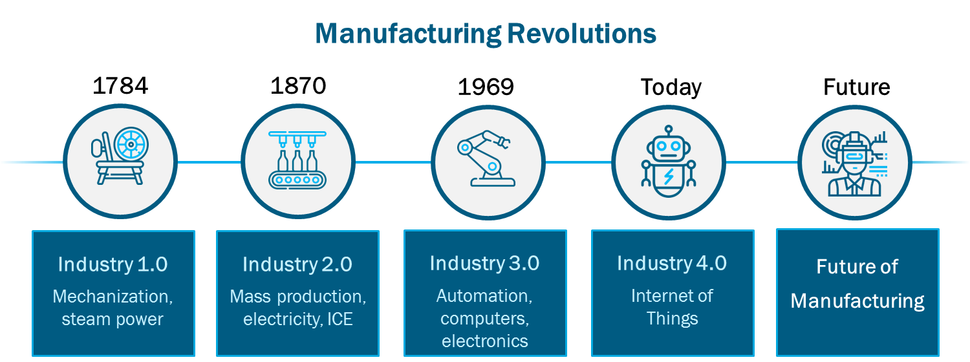
Future of Manufacturing
AMO ROLE
  Accelerate the development of new materials and processes through computational methods
  Capitalize on advanced sensors and controls for intelligent manufacturing
  Enable the circular economy to extend the life of raw materials
  Attract, develop, and grow tomorrow’s manufacturing workforce
  Convene stakeholders to develop and pursue an integrated vision
FEATURES
Data Driven
Artificial Intelligence-informed
Resilient
Distributed Manufacturing
Additive Manufacturing
Circular Economy

Slide 11
In Development: AMO Annual Report
AMO drives energy and material efficiency in manufacturing.
AMO’s technology investments build a stronger U.S. manufacturing sector.
AMO collaborates with a diverse
range of federal and state agencies, academic institutions, National Laboratories, and members
of industry.
AMO provides valuable technical assistance to U.S. manufacturers.
AMO’s support for the manufacturing industry enables a nimble response to national needs.
A holistic view of how AMO’s work influences and responds to national needs in manufacturing
Explain the structural and systematic framework
that shapes AMO’s work
KEY MESSAGES
Present energy and material impact analysis
AMO’S
ANNUAL
REPORT
APPROACH
Communicate successes and integrate learnings
Characterize future opportunities
Inform audiences on avenues for collaboration

Slide 12
Thank You
For additional information
and to subscribe for updates:
energy.gov/eere/amo/advanced-manufacturing-office

