Slide 1
Step 5: Project Operations & Maintenance (O&M)

Slide 2
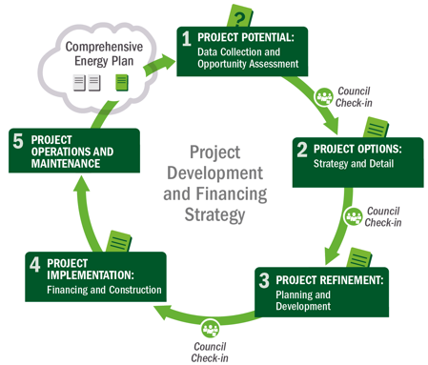
Project Development Process
5 Operations & Maintenance
5 Operations & Maintenance
1
Potential
2
Options
3
Refinement
4
Implementation
Notes:
Slide 2
Now lets turn to the long term care of the project: the operations and maintenance functions.
Overall, this step is the longest of them all because it spans the entire life of the project.

Slide 3
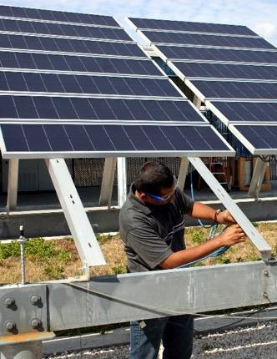
Step 5: Operations & Maintenance (O&M)
Purpose: Conduct or ensure ongoing O&M, including repair and replacement (R&R)*
O&M Costs:
Equipment maintenance and upkeep
Gearbox/inverter replacement
Insurance
Labor
Extended warranty agreements
If leasing, lessor often manages maintenance
If PPA, vendor typically manages maintenance
* Esp. if owner – role of highest O&M risk
Photo from Florida Solar Energy Center, NREL 14728
Notes:
Slide 3
Operations and maintenance, also called O&M, is the long term care of the renewable energy project to ensure maximum operating efficiency and availability.
Depending on the role selected by the Tribe, the renewable energy asset may be managed by a qualified 3rd party or the Tribe itself.
O&M costs for renewable power plants tends to be much less than fossil plants because there typically is no fuel cost (the exception is biomass). However, there are other maintenance costs to consider, including:
Equipment maintenance and upkeep (including using water to clean PV panels)
Gearbox replacement (Wind turbine); or inverter replacement for solar
Insurance
Labor and staffing
Extended warranty agreements
The developer partner will often have this in their proposal, if you have a partner.

Slide 4
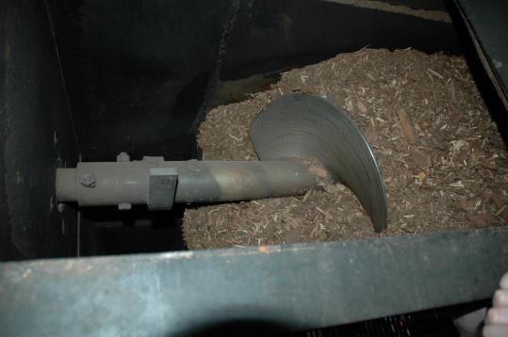
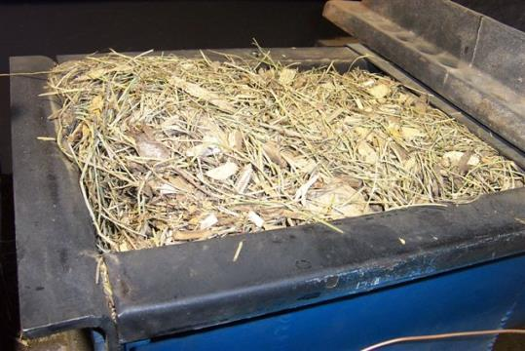
Step 5: Operations & Maintenance (O&M)
Purpose: Conduct or ensure ongoing O&M, including repair and replacement (R&R)*
O&M Costs:
Equipment maintenance and upkeep
Hardware replacement (augers, belts)
Insurance and contracts
Labor
Extended warranty agreements
If leasing, lessor often manages maintenance
If PPA, vendor typically manages maintenance
* Esp. if owner – role of highest O&M risk
Photos by Randy Hunsberger, NREL
Notes:
Slide 4
Operations and maintenance, also called O&M, is the long term care of the renewable energy project to ensure maximum operating efficiency and availability.
Depending on the role selected by the Tribe, the renewable energy asset may be managed by a qualified 3rd party or the Tribe itself.
O&M costs for renewable power plants tends to be much less than fossil plants because there typically is no fuel cost (the exception is biomass). However, there are other maintenance costs to consider, including:
Equipment maintenance and upkeep (including using water to clean PV panels)
Gearbox replacement (Wind turbine); or inverter replacement for solar
Insurance
Labor and staffing
Extended warranty agreements
The developer partner will often have this in their proposal, if you have a partner.

Slide 5
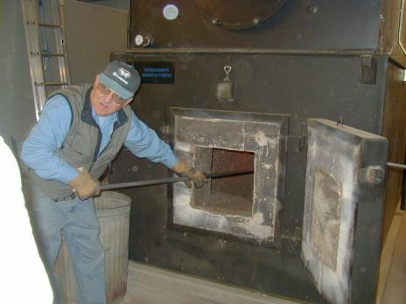
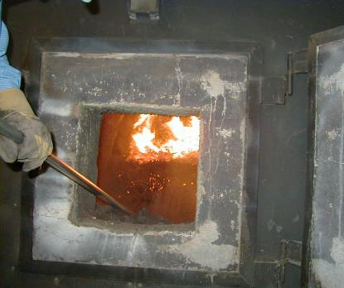
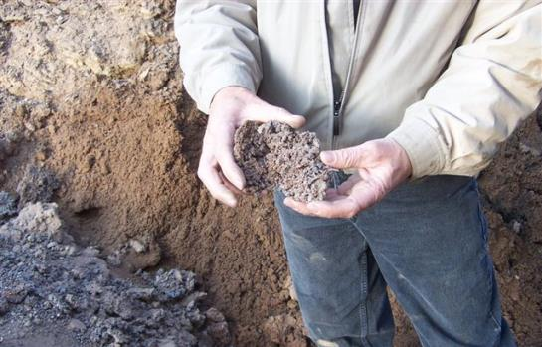
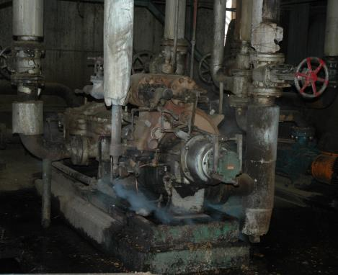
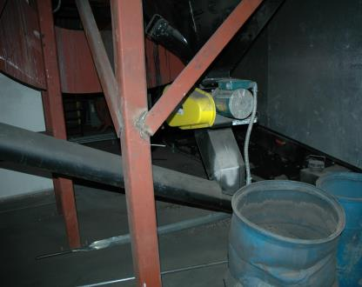
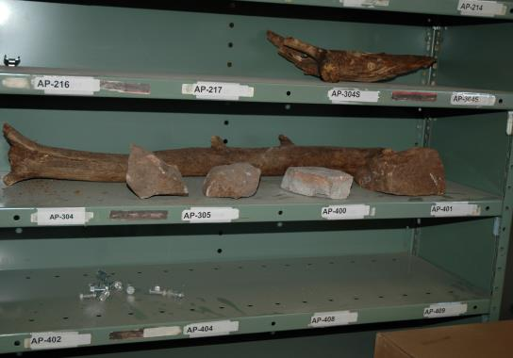
Step 5: Operations & Maintenance (O&M)
Photos by Randy Hunsberger, NREL
Notes:
Slide 5
Operations and maintenance, also called O&M, is the long term care of the renewable energy project to ensure maximum operating efficiency and availability.
Depending on the role selected by the Tribe, the renewable energy asset may be managed by a qualified 3rd party or the Tribe itself.
O&M costs for renewable power plants tends to be much less than fossil plants because there typically is no fuel cost (the exception is biomass). However, there are other maintenance costs to consider, including:
Equipment maintenance and upkeep (including using water to clean PV panels)
Gearbox replacement (Wind turbine); or inverter replacement for solar
Insurance
Labor and staffing
Extended warranty agreements
The developer partner will often have this in their proposal, if you have a partner.

Slide 6
Post-Procurement: Project O&M
O&M agreements
Warranties
Monitoring system
System performance
Production guarantees
Buyout options
Notes:
So, with this idea of a long term relationship in mind and given that a lot of people will come and go during the 30 year life of these projects, it is important to keep this list in mind.
Of course, depending on whether or not the Tribe has purchased a system directly or has entered into a PPA, the importance of the various items in the list varies.
As mentioned, O&M will be the responsibility of the PPA provider under a third party owned project, but it will be the Tribe’s responsibility (either directly or managing the O&M contract, if subbed out).
Monitoring the system’s performance is also critical regardless of the project ownership structure. Unfortunately, it is not unheard of for a system to be underperforming or not producing electricity at all for a month or two, without anyone realizing it.
If the RE system has a production guarantee, it is important to confirm that the system is exceeding this guarantee and if not, request the compensation based on the formula laid out in the contract.
And finally, if it is a third party owned system and there are various buy-out dates, as these dates approach, is anyone taking the time to evaluate whether or not the Tribe should buy the system, and if so, is financing being arranged to do so.
In general, given that the process of procuring a RE system can be so time consuming, we often reach the commissioning stage and feel like we’ve finished the race. When in reality, we are just getting started.

Slide 7
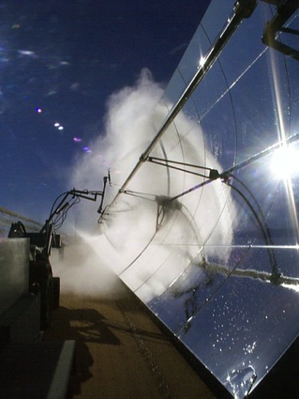
Step 5: O&M– Outputs
Ensure responsible party carries out O&M/R&R*
Measuring and tracking success
Correlation with business plan and strategic energy plan
Contract compliance
Reporting of generation
*Esp. if owner
Photo from Henry Price, NREL 14952
Notes:
Slide 7
Step 5 is like a marathon, where you need to pace yourself and do regular check-ins. Attention to detail can ensure the responsible party carries out their O&M responsibilities. Several times a year, it is important to measure and track success, manage revenue and ensure contract compliance. All of this can best be tracked by reporting and analyzing generation output.

Slide 8
Project Risk – Facility-Scale Post Step 5
 | Risks | Risk Assessment Post Step 5
Development | Loss/waste of development resources | Medium; now with more assurance of success ✓
Site | Improper orientation or project affected by shade | Low; some assumed by host ✓
 | Inadequate foundation or structural integrity | Low; developer assessed ✓
 | Site control for challenges for safety/security purposes | Low; some assumed by host ✓
Permitting | Tribe-adopted codes and permitting challenges | Low; permitting completed ✓
 | Utility interconnection challenges | None ✓
Finance | Capital constraints | None; project constructed/commissioned ✓
 | Incentive unavailability or insufficiency | Low to none/allocated to developer ✓
Construction/ Completion | Engineering, procurement, and construction difficulties | None; EPC complete ✓
 | Cost overruns | None; construction complete ✓
 | Schedule overruns | None; construction complete ✓
Operating | Output shortfall from expected | Being managed by appropriate party ✓
 | Technology O&M failure | Being managed by appropriate party ✓
Sources: Adapted from Holland & Hart, RE Project Development & Finance & Infocast, Advanced RE Project Finance & Analysis
NOTE: Underlining signifies that the risk assessment outcome changes during the step at hand.
Notes:
At this stage decisions have been made to allocate most risks away from the tribal entity…
Step through quickly…
In “step” 5, which is really a business/O&M cycle with certain R&R points (such as inverter replacement) the risk focus is, as we know, on operating risks, most commonly the risk of production shortfall (severity of risk depending on ownership arrangement), and the risk of project tech failure (resulting in the same outcome).
During commercial operation or operation, as the case may be, the focus is on ensuring that proper O&M, R&R, and monitoring to provide the information to support those activities, are key to mitigating those technological and production risks.
We don’t happen to mention on this slide, but also of importance is the mitigation of property and liability risks to the project or owner. As was mentioned two slides ago, properly insuring the PV system with appropriate limits and covered perils of property risk insurance and insuring against liability risks associated with ownership or hosting of a PV system are critical to appropriately allocating/managing these risks.

Slide 9
Project Risk – Community-Scale Post Step 5
 | Risks | Risk Assessment Post Step 5
Development | Poor or no renewable energy resource assessment Not identifying all possible costs Unrealistic estimation of all costs Incorrect estimation of long-term “community” energy use (energy efficiency first) Utility rules and ability to offset use with centralized production | Low; site picked ✓ Low; detailed model ✓ Low; detailed model ✓ Low; final projection ✓ None; executed ✓
Site | Structural (e.g. rooftop solar, wind loading, soil conditions) Installation safety (e.g., wind tower, hazard for adjacent sites) Site control for safety/security purposes | None; addressed ✓ None ; addressed ✓ Low; site secure ✓
Permitting | Tribe-adopted codes and permitting requirements Utility interconnection requirements | Low; complete ✓ None; complete ✓
Finance | Capital availability Incentive availability risk | None; finalized ✓ None; finalized ✓
Construction/ Completion | EPC difficulties Cost overruns Schedule | None; contracted ✓ None; construction complete ✓
Operating | Output shortfall from expected Technology O&M | Being managed by appropriate party ✓
Sources: Adapted from Holland & Hart, RE Project Development & Finance & Infocast, Advanced RE Project Finance & Analysis
*NOTE: Underlining signifies that the risk assessment outcome changes during the step at hand.
Notes:
Slide 9 - PAUSE
As you can see, in Step 5 - operation, since the project is operating the long term O&M is being managed by the appropriate party. If this is the Tribe, then the Tribe has more responsibilities to ensure long-term project performance.

Slide 10
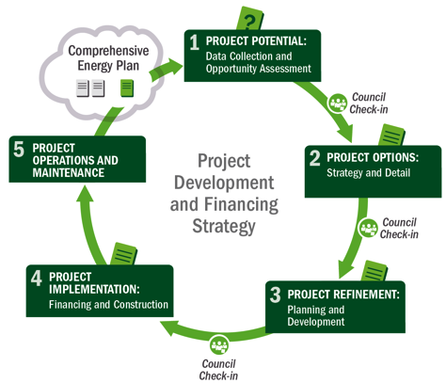
Not Quite Done!
Check back in with planning document – update as necessary
Identify next potential project from plan
Notes:
Slide 10
Now that the facility is operating and being maintained, you may think you are done, but you are not quite done!
The renewable energy project is now a part of your energy and financial portfolio. Integrating this project into your energy planning process is critical to making sure that what you learned from this project is carried into future projects.
From there, you can follow this same cycle as you approach additional potential projects that you’ve identified in your comprehensive energy plan.

Slide 11
Summary of Actions by Step
5 Operations & Maintenance
1
Potential
2
Options
3
Refinement
4
Implementation
Data Collection and Opportunity Assessment
Options and Strategies
Planning and Development
Financing and Construction
Step 1: Gather all relevant data in order to make first pass at potential project, understand Tribal role options
Step 2: Estimate value to Tribe, consider ownership approach, begin to identify off-takers, partners, vendors, begin planning permitting and site use
Step 3: Finalize economic assumptions and tribal roles, finalize permitting, interconnection, transmission and off-take agreements, and determine financial partnerships, ownership structure
Step 4: Finalize agreements (including vendor contracting); financial close and construction; project commissioning, begin operation
Celebrate!
Step 5: Maintenance plan implementation (conduct or ensure ongoing O&M, R&R)
Notes:
Slide 11
This has been a more detailed review of this project development framework, in the context of developing a commercial project where the power is sold to another entity (like a utility). It’s very important to remember that this process is iterative and involves increasing refinement of information in order to know if the project is going to achieve the Tribe’s goals.

Slide 12
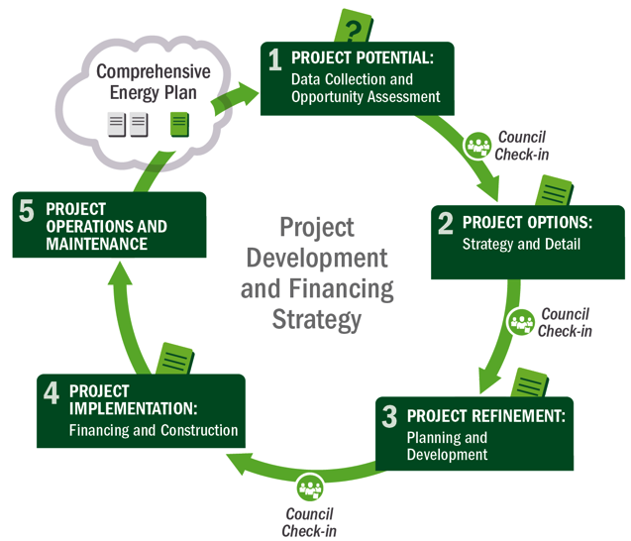
Wrap-Up: Project Development Process
Notes:
Slide 12
Overall, this 5 step process can help you consider the key tasks along the way, and the many check-ins needed to complete a renewable energy project. Project partners are needed at key steps – and they sometimes can be quite beneficial and save you time and money overall.

Slide 13
Big Group Exercise
Play Jeopardy! Win cash (bars) prize!

