Slide 1
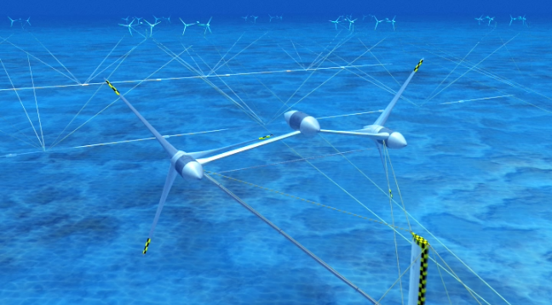




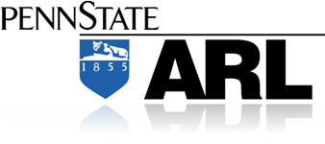
Water Power Peer Review
  Aquantis 2.5 MW Ocean-Current Generation Device- MHK
Alex Fleming: PI
Dehlsen Associates, LLC
E-Mail: afleming@ecomerittech.com
805.845.9100
September 26,11

Slide 2
Purpose, Objectives, & Integration
Principal Objective of the Aquantis Project
  Developing technology to harness the energy resource in the Gulf Stream
Primary Challenges
  Achieving an acceptable cost of energy
  Understanding the resource impact on system performance
  Designing a structure that withstands the large hydrodynamic loads
  Designing a moored platform with static and dynamic stability
  Designing a robust system with 20-year life
  Developing a cost-effective installation and maintenance strategy
  Determining effective computational and experimental tools
  Understanding potential environmental impacts

Slide 3
Technical Approach
Key Issues and Methodology
  Resource assessment
    Assess existing Gulf-Stream ADCP data
    Deploy instrumentation array to acquire better data
  Stability, mooring, and anchoring
    Use unsteady CFD and a rotorcraft code to develop hydrodynamic coefficients
    Revise a proven Navy coefficient-based simulation tool for to assess platform stability (static and dynamic)
    Use Orcina marine dynamic analysis software (OrcaFlex) for mooring
    Determine installation and maintenance strategies
  Cost-of-energy model
    Revise an existing model based on wind power
    Focus on capital and operational & maintenance (O&M) costs
    Base all system decisions on cost of energy

Slide 4
Plan, Schedule, & Budget
Schedule:
Initiation date: 10/01/10
Planned completion date: 8/31/13
Contract Award - Effective Date 09/01/2010 - date signed 09/15/2010 . Total Contract Cost - $4,005,625 (DOE Funded Costs - $2,400,000; Dehlsen Associates matching funded costs - $1,605,625) – period of performance 09/01/2010 through 08/31/2012 - Conditional award - upon successful completion of negotiations, the conditional status will be lifted.
Modification 001 – date signed 08/11/2011 – continued conditional status, added provision 25: NEPA requirements, and added attachments for IP provisions, Statement of Project Objectives, Reporting Requirements, and Budget Information
Modification 002 – date signed 09/14/2011 - removed conditional status, extended period of performance to 8/31/2013, changed method of payment to ASAP Reimbursement system
Milestones _Go/No-Go : Next Steps
Budget:
Siting Study for a Hydrokinetic Energy
Project Located Offshore Southeast Florida Completion Status
Summary of Tasks
Task 1. Dynamic Stability and Simulation 10%
Task 2. Fabrication and Instrumentation 0% - Beginning Nov. 15th’2011
Task 3 Experimental Validation: Tow Tank Test 0 % - Tow Tank Test begins March 15th ‘2012
Task 4. Documentation 2%
Budget History-MHK
FY2010 (10/01/10 - 09/30/11) |  | FY2011 (10/01/11 - 09/30/12) |  | FY2012 (10/01/12 - 09/30/13)
DOE | Cost-share | DOE | Cost-share | DOE | Cost-share
$243,000 | $0 | $1,200,000 | $800,000 | $957,000 | $805,625

Slide 5
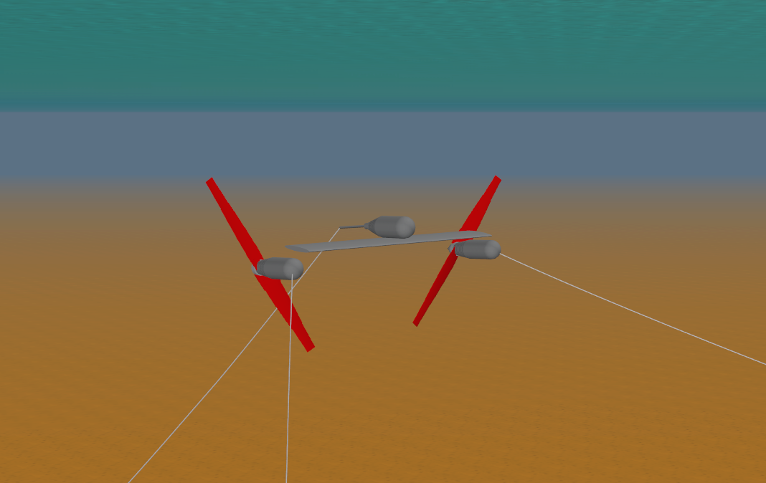
Accomplishments and Results
Stability, Mooring, and Anchoring
  Prepared Top Level Requirements defining system requirements with an emphasis on position control, ease of Aquantis Inspection, Maintenance and Repair (IM&R), cost reduction
  Mooring System Analysis using ORCAFLEX
    Iterative design resulted in preference for two forward semi-taut anchor legs, one rear vertical leg
  Developed IM&R methods and
  scenarios to all development of
  associated costs

Slide 6

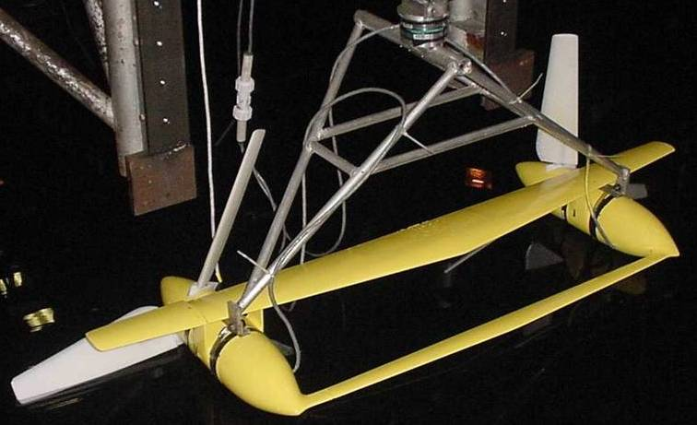
Accomplishments and Results
Stability, Mooring, and Anchoring
  Static pitch plane stability has been performed for
  platform configurations utilizing 2 rotors (2.5MW)
  and 4 rotors (3.2MW)
  Static pitch plane stability requires determination of a mooring point(s) in which the hydrostatic forces (in-water weight and buoyancy) of the various major components are balanced about the mooring point to producing zero platform pitch throughout the Gulf Stream current flow range (0 to 2.5 m/s)
  Develop target weights and buoyancy values for all major components and establish required locations for center of gravity and center of buoyancy that satisfy pitch plane stability criteria
  Investigated various platform net buoyancy-to-drag (rotor thrust) values to obtain mooring line lengths from the platform to ocean floor. Net buoyancy values in the range of 1,100 to 1,800 kN appear to be most practical in terms of providing viable platform structural and cost characteristics. This results in net buoyancy-to-drag ratios in the range of 0.20 to 0.33 at the design current of 1.6 m/s

Slide 7
Accomplishments and Results
Stability, Mooring, and Anchoring
  Investigated weight, buoyancy and mooring point location for the following platform configurations
    2-rotor platform with an airfoil-shaped wing structure above the nacelles and buoyancy pods located aft above the wing to provide static pitch plane stability
    2-rotor platform with a high net buoyancy wing structure above the nacelles
    4-rotor platform with a simple shaped wing structure located between and on the nacelle centerline
    4-rotor platform with a simple shaped wing structure above the nacelles
    4-rotor platform with a 3-legged buoyant truss structure with nacelles mounted between truss frame members
  Variants on the 4-rotor platform include:
    4-rotors mounted down-wind of the support structure (wing or truss)
    4-rotors mounted up-wind of the support structure
    2-rotors mounted down-wind and 2-rotors mounted up-wind

Slide 8
Challenges to Date
Challenge: designing the Aquantis system without full knowledge of the Gulf Stream resource—including extreme loads and knowledge of the seafloor properties
  Mitigation Approach: acquire new and better resource data
Challenge: designing the Aquantis system to maximize the rated power and to minimize the expense of the anchoring
  Mitigation Approach: vary the number of turbines, the diameter of the turbines, the number of anchors, and the number of mooring lines
  Mitigation Approach: acquire better knowledge of the seabed floor

Slide 9
Challenges to Date
Challenge: designing the Aquantis system to achieve the weight and buoyancy characteristics—with proper mooring line attachments and turbine locations—that allow for stability at all speeds
  Mitigation Approach: (1) Use the Navy coefficient-based simulation tool and Orcaflex to evaluate different concepts; and (2) develop a proper small-scale test to measure pitch and yawing moments as a function of angle of attack, and simulate a moored platform in a current

Slide 10
Challenges to Date
Challenge: determining the installation, operational, and maintenance costs for the Aquantis System
  Mitigation Approach:
  Consideration of IM&R capability early in design spiral
  Components selection to reduce maintenance requirements
  Evaluate buy vs lease options for vessels

Slide 11
Next Steps- Milestones
Design Milestone | Target Date | TRL | Status
1. CONCEPTUAL DESIGN | May 5-7, 2011 | 5 | Complete
2. FINALIZE CONFIGURATION | Sept. 15, 2011 | 5
3. PRELIMINARY DESIGN | TR1 - Oct. 18th, 2011 | 5
4. BUILD 1:20 SCALE MODEL | TR2 - Nov 15th, 2011 | 6
5. TOW TANK TEST OF MODEL | TR3 - Mar 15th, 2011 | 6
6. CRITICAL DESIGN REVIEW | TR4 - Oct. 15th, 2012 | 6
7. FULL SCALE DRIVE TRAIN | TR5 - Nov. 15th, 2012 | 6
8. AT SEA TEST OF MODEL | TR6 – Feb. 21st, 2013 | 6
9. BUILD FULL SCALE PROTO | TR7 - Mar. 15th , 2014 | 7
10. AT SEA TEST OF FULL SCALE PROTO | TR8 - June 21st, 2014 | 7

